Slide 1
Assessing and Quantifying Stressors
Workshop on resilience quantification in humans,
11th Resilience Symposium, Mainz
Matthias Zerban & Papoula Petri-Romão

Slide 2
Measuring stressors in your studies
Adapting existing measures, creating new items, recoding old variables

Slide 3
Designing new studies
Identifying new stressor items
In several studies we adapted measures to suit the population
  DynaMORE
    Pandemic-specific stressors
    Terrorism or war related items
  RESPOND
    Migrant workers
    Health care workers

Slide 4
Designing new studies
Steps to identify relevant stressor items
In RESPOND new items were identified through qualitative interviews
  Iterative process with researchers to narrow down most important items
  Motivation to reduce items to decrease burden on participant
In DynaMORE and other studies items were identified by researchers
  Through discussion and subject knowledge
  Literature on target population
Also consider existing measures (such as Life event list and MIMIS)

Slide 5
RESPOND population specific stressors
We would like to ask you about annoyances and hassles as may occur in daily life. The list below contains possible situations. Please only consider the last 14 days including today. Please read each item on the list and consider if it happened to you: ([0-3] ‘did not happen/almost never’ ‘sometimes ‘often’ to ‘(nearly) every day’)
Item | Question
EV_1 | Problems related to housing
EV_2 | Problems related to legal issues, for example related to tax, immigration or residence permits
EV_3 | Lack of access to services (for example: health services, etc.)
EV_4 | Discrimination or racism
EV_5 | Problems relating to language
EV_6 | Inability to see family or close ones
EV_7 | Inability to travel abroad
EV_8 | Being at increased risk of passing on a COVID-19 infection
Item | Question
EH_1 | Patients under your care have died due to COVID-19
EH_2 | People you know have been hospitalized due to COVID-19
EH_3 | Change in duties or unclear duties and protocols
EH_4 | Difficulty combining social life with work

Slide 6
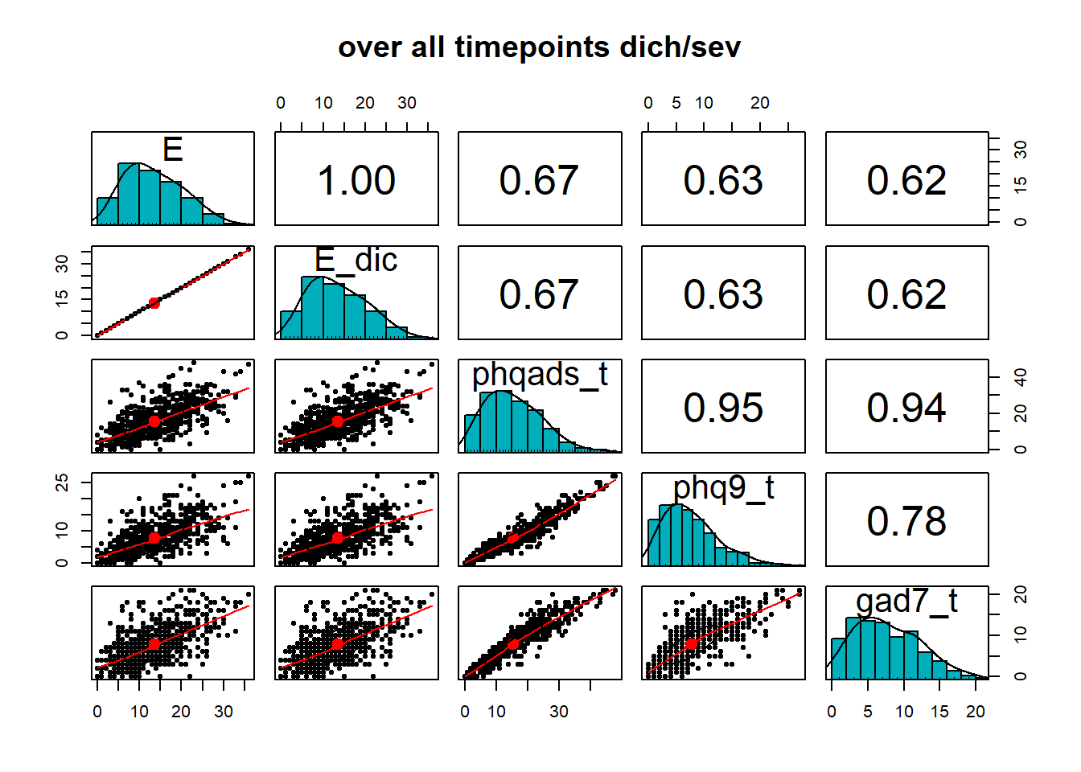
Designing new studies
Quality checks
Design of the study
  time between assessments and collection time period
  Burden on participants
Correlations
  Do stressors explain an adequate amount of variance in mental health?

Slide 7
Designing new studies
When should stressors be assessed?
Stressors should be included at all time points at which mental health problems are assessed. Ideally covering the same time period
  In the last week…
Ask over short time periods (to avoid recall bias)
  Past 7 days or two weeks

Slide 8
Using collected data
What if you already have collected data?
It is also possible to recode relevant items in existing datasets
Steps
  Review codebooks carefully
  Compare items to existing measures and subject literature
  Check if recoding is feasible (occurrence or appraisal?)
  Build scores
  Quality checks

Slide 9
Case Study: HEROES
Design: Prospective cohort study. Three waves: 2020, 2021, and 2022.
Participants: HCWs aged 18 years or more working in Spain.
  Wave 1 = 2,300 people; Wave 2 = 1,800 people; Wave 3 = 600 people. Participants with all assessment waves = 330.
Categorisation of stressors
  193 survey items
    Qualitative evaluation
    Comparison with existing stressor lists
      MIMIS
      Dynacore studies (covid stressors)
    17 dichotomous stress (yes/no)
      Summarised in sum score
Petri-Romão, Puhlmann, et al., in prep.
Notes:
HCWs from early pandemic hotspots were exposed to high occupational stress, especially during the first pandemic outbreak These stressors had immediate and long-lasting effects on the mental health of HCWs
And, consequently, on health systems themselves, which had to face unprecedented care demands.
REALLY BURDENED POPULATION
NO PRE PANDEMIC DATA (Baseline > first wave)
What does that mean for prediction? >> sill some context effect
IS THE SR SCORE REALLY RIDGID? WHAT ABOUT PROCESSES?

Slide 10
# | Item (original wording) | Supporting sources
1 | Have you been deployed. | Associated with poor mental health outcomes in Mediavilla et al. (2021), Moro et al. (2022)
2 | Working 6 or more days a week. | Similarity to item in stressor list in Veer et al., (2021)“Increased workload”
3 | Working an average of more than 12 hours per day. | Similarity to item in stressor list in Veer et al. (2021) “Increased workload” See also Moro et al. (2022)
4 | Having to take triage decisions. | Associated with poor mental health outcomes in Amador-Perilla et al. (2023), Chou et al. (2022), Mediavilla et al. (2021)
5 | Contact with COVID-19 patients (suspected or confirmed) | Similarity to item in stressor list in Veer et al. (2021) “Being at an increased risk for infection (e.g., at work).”
6 | Working in a COVID-19 unit. | Associated with poor mental health outcomes in Czepiel et al. (2024), Lai et al. (2020), Moro et al. (2022), Paniagua-Avila et al. (2022)
7 | Stigma or discrimination based on profession. | Associated with poor mental health outcomes in Kogan et al. (2023), Mediavilla et al. (2023), Moro et al. (2022), Zhang et al. (2023)
8 | Experience of conflict or aggression with family members of patients. | Similarity to item in stressor list in Veer et al. (2021) “Conflicts with strangers”
9 | Experience of violence due to being a HCW. | Similarity to item in stressor list in Veer et al. (2021) “Conflicts with strangers”

Slide 11
# | Item (original wording) | Supporting sources
10 | Lack of access to protective equipment. | Associated with poor mental health outcomes in Correia da Silva et al. (2022), Czepiel et al., (2022, 2024), Mediavilla et al. (2021), Paniagua-Avila et al. (2022), Umbetkulova et al. (2024).
11 | Death of close contact at work due to COVID-19. | Similarity to life events list used in previous studies (Chmitorz et al., 2020) “Death of a close person”
12 | Being worried about being infect with COVID-10. | Similarity to item in stressor list in Veer et al. (2021) “Being at an increased risk for infection (e.g., at work).” See also Czepiel et al. (2024), Moro et al. (2022), Paniagua-Avila et al. (2022)
13 | Being worried about infecting loved ones with COVID-10. | Similarity to item in stressor list in Veer et al. (2021) “A family member, friend, or loved one is at an increased risk of a serious course of the disease in case of an infection (they belong to the so-called 'at-risk group').”
14 | Testing positive for COVID-19. | Similarity to item in stressor list in Veer et al. (2021) “Having COVID-19 symptoms, or symptoms that could be related to COVID-19.”
15 | Loved one diagnosed with COVID-19. | Similarity to item in Mainz Inventory of Microstressors (Chmitorz et al., 2020).
16 | Death of loved one due to COVID-19. | Similarity to life events list used in previous studies (Chmitorz et al., 2020) “Death of a close person”
17 | Death of patient due to COVID-19. | Similarity to life events list used in previous studies (Chmitorz et al., 2020) “Death of a close person”

Slide 12
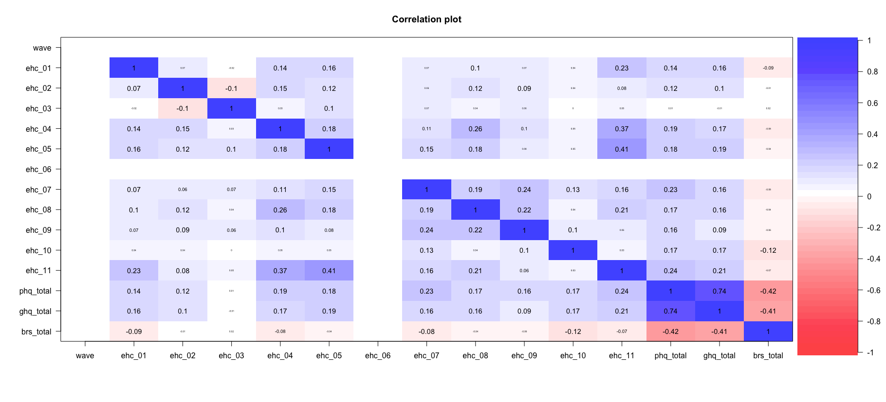
Item correlation with mental health
Healthcare related stressors
ehc_01 = "New functions",
ehc_02 = "Work more than 6 days",
ehc_03 = "Work more than 12h/day",
ehc_04 = "Triage decisions",
ehc_05 = "Frontline",
ehc_06 = "COVID-19 unit (waves 2 and 3)",
ehc_07 = "Stigma / discrimination",
ehc_08 = "Problems with patients' relatives",
ehc_09 = "Violence",
ehc_10 = "PPE shortages",
ehc_11 = "Patients passed away",

Slide 13
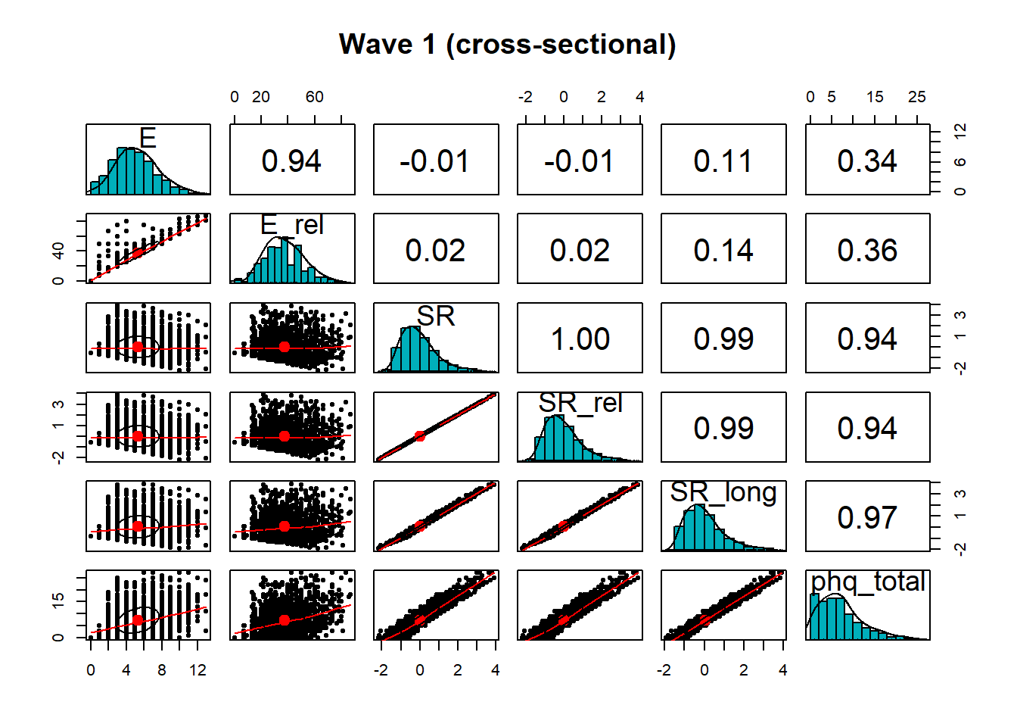
Case study 2: HEROES
Consider different sum scores
  Combined into a relative E score
    E at this time point/Possible E at this time point
    Overcoming different questionnaires at different time points
Quality checks
  Item and sum score correlation with you mental health measure
Petri-Romão, et al., in prep.

Slide 14
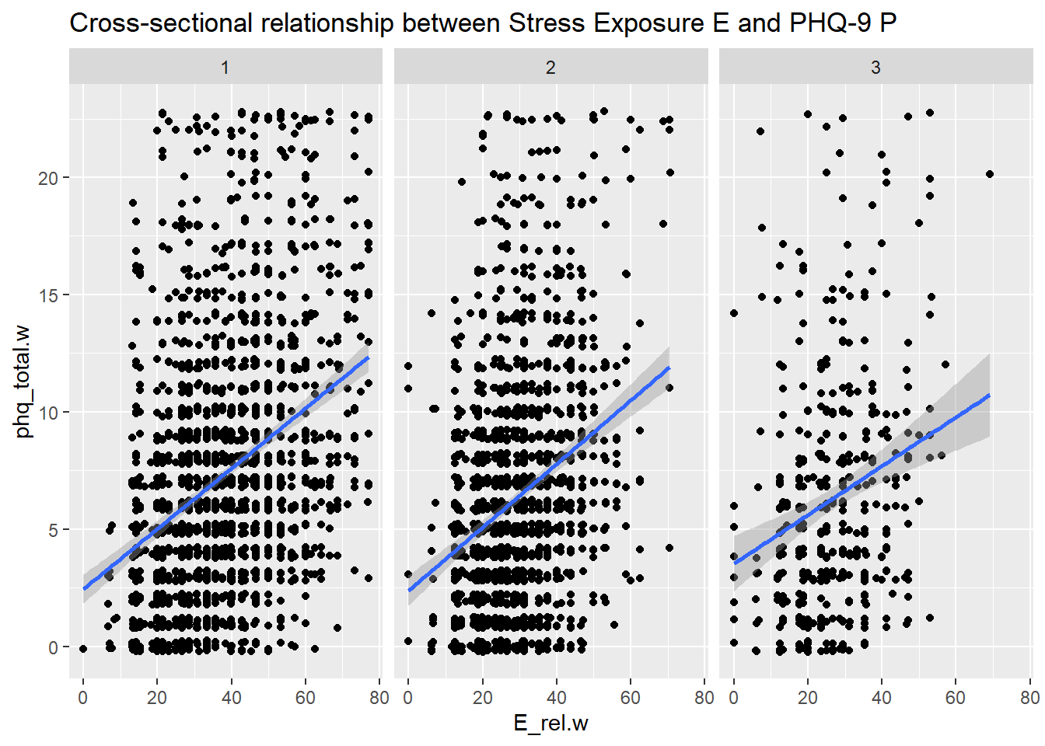
Case study 2: HEROES
You can then use the stressor exposure to build SR scores
Petri-Romão, et al., in prep.

Slide 15
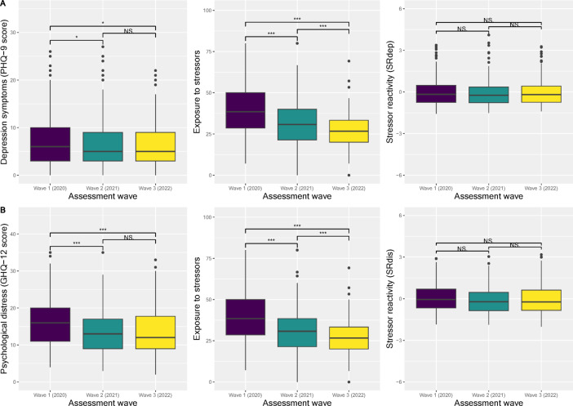
Petri-Romão et al 2025, Scientific Reports

Slide 16
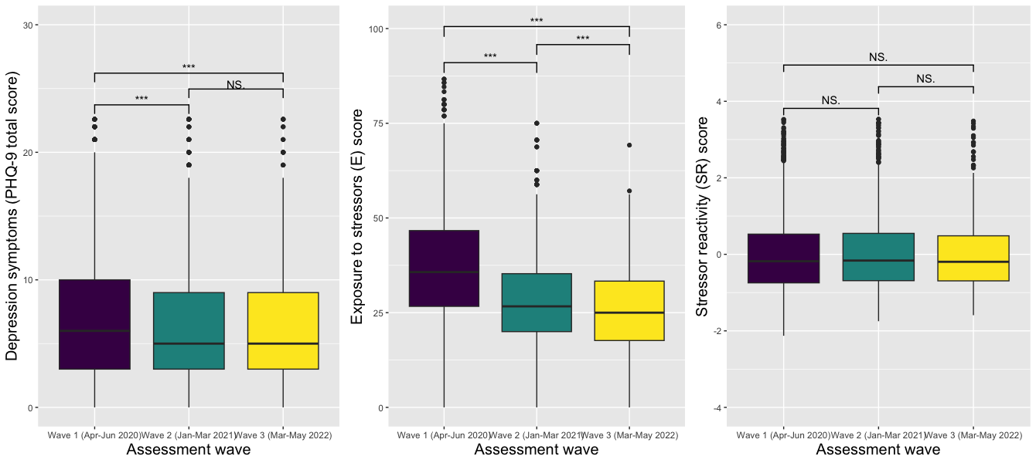
Stress and mental health across phases: HEROES
Mental health problems (P)
Stressor reactivity (SR)
Stressor exposure (E)
Petri-Romão et al.,2025, Scientific Reports
Notes:
HCWs from early pandemic hotspots were exposed to high occupational stress, especially during the first pandemic outbreak These stressors had immediate and long-lasting effects on the mental health of HCWs
And, consequently, on health systems themselves, which had to face unprecedented care demands.
REALLY BURDENED POPULATION
NO PRE PANDEMIC DATA (Baseline > first wave)
What does that mean for prediction? >> sill some context effect
IS THE SR SCORE REALLY RIDGID? WHAT ABOUT PROCESSES?

