Slide 1

Team Details
Team name:
Team leader name:
Problem Statement:
Team Details
Team name: Kali_innov
Team leader name: Kalithas G
Problem Statement: Track 2 — Prospect Assist AI: data-driven identification of eligible, repayment-capable, genuinely interested retail-loan prospects from transaction & behavioral insights (Personal · Home · Mortgage/LAP · Auto)

Slide 2
02 · IDEA
Brief about the idea
Retail lending today runs on declared income, bureau scores and static FOIR — so lead-to-loan conversion sits near 1%, and genuine borrowers with non-standard income are missed. Prospect Assist AI replaces declarations with evidence. A multi-agent pipeline mines consented transaction, UPI, GST, engagement and alt-data signals to answer three questions for every prospect — and hands relationship managers a prioritized queue where every lead carries its own affordability math and evidence bundle.
Can they repay?
Income inferred from cash-flow behavior; disposable surplus → safe EMI capacity → max loan, per segment (salaried · gig/self-employed · new-to-credit).
Do they need a loan now?
Life-event spend (rent, builder, dealer, medical), savings patterns and in-app engagement, amplified in real time with time-decay.
Will they convert?
~1% → >30% target lead-to-loan conversion
Calibrated conversion probability blends eligibility, intent and engagement recency — tiers leads from serious to not-ready.
Prospect Assist AI · IDBI Innovate 2026 · Track 2

Slide 3
03 · WHY US
Opportunities
How is it different?
How does it solve the problem?
USP of the solution
Inferred, behavior-derived income — not self-declared salary or one-size FOIR
Multi-agent orchestration with a reflection gate — contradictory signals are re-checked, never silently scored
Consent validated before any data is touched; scoring without a token is refused (HTTP 403)
Segment-native strategies instead of forcing gig workers and NTC customers through salaried logic
Separates window-shoppers from genuine borrowers using intent taxonomy + real-time engagement amplification
Quantifies repayment capacity: monthly surplus → safe EMI → max loan eligibility
Early-warning delinquency signal from current behavior feeds prudent structuring
Five lead tiers give RMs a ranked queue with a recommended action per lead
Every score ships with evidence: SHAP-style contributions + analyst narrative — underwriters see why, not just what
Data-source abstraction seam: mock sandbox → bank sandbox → production is a config swap, zero agent changes
Thin-file NTC coverage via electricity / fuel alt-data proxies with explicit confidence floors
Decision support by design — a human underwriter always makes the final call
Prospect Assist AI · IDBI Innovate 2026 · Track 2

Slide 4
04 · FEATURES
List of features offered by the solution
Behavior-derived income
Affordability waterfall
Three segment strategies: salary-credit medians, discounted gig/UPI + GST cross-check, alt-data proxies for NTC.
Income decomposed into obligations vs. surplus; safe EMI capacity and max-loan eligibility per lead.
Intent detection + decay
Delinquency early warning
Product-specific life-event signals, amplified by calculator use & session depth; decays 50% / 7d, 0 / 30d.
Forward-looking risk from card utilization trends, inquiry bursts and declining savings — not just bureau history.
5-tier lead prioritization
Explainable evidence bundle
Serious · Interested · Quality-watch · Manual-review · Not-ready, each with a recommended RM action.
SHAP-style feature contributions + plain-language analyst narrative for every scored lead.
Consent-gated pipeline
Reflection & guardrails
Scoped, expiring consent tokens enforced before any data fetch; violations are structurally impossible.
Contradiction gate, NTC confidence floor (never “serious” below 0.6), bounded retries, thin-file promotion rules.
Prospect Assist AI · IDBI Innovate 2026 · Track 2

Slide 5
05 · FLOW
Process flow — score one prospect
1 · Consent gate
Scoped, expiring token validated before any data access — else HTTP 403
2 · Data fetch
Transactions, UPI, bureau, GST, engagement, alt-data via connector
3 · Transaction intelligence
Categorization, life-event detection, behavioral features
4 · Segment inference
Salaried · gig / self-employed · new-to-credit
7 · Reflection gate
Contradiction check · NTC confidence floor · retry ≤ 3 · thin-file promotion
6 · Scoring ensemble
Eligibility with hard floors + calibrated conversion propensity
5 · Parallel agents
Capability (income & surplus) · Intent · Delinquency risk
8 · Tier + evidence
Composite score → 5 tiers; SHAP-style contributions + narrative
9 · Publish
Lead saved; served via API to the RM / underwriting dashboard
Batch mode: cohort scoring via POST /prospects/batch-score → 700-persona eval harness reuses this exact path.
Prospect Assist AI · IDBI Innovate 2026 · Track 2

Slide 6
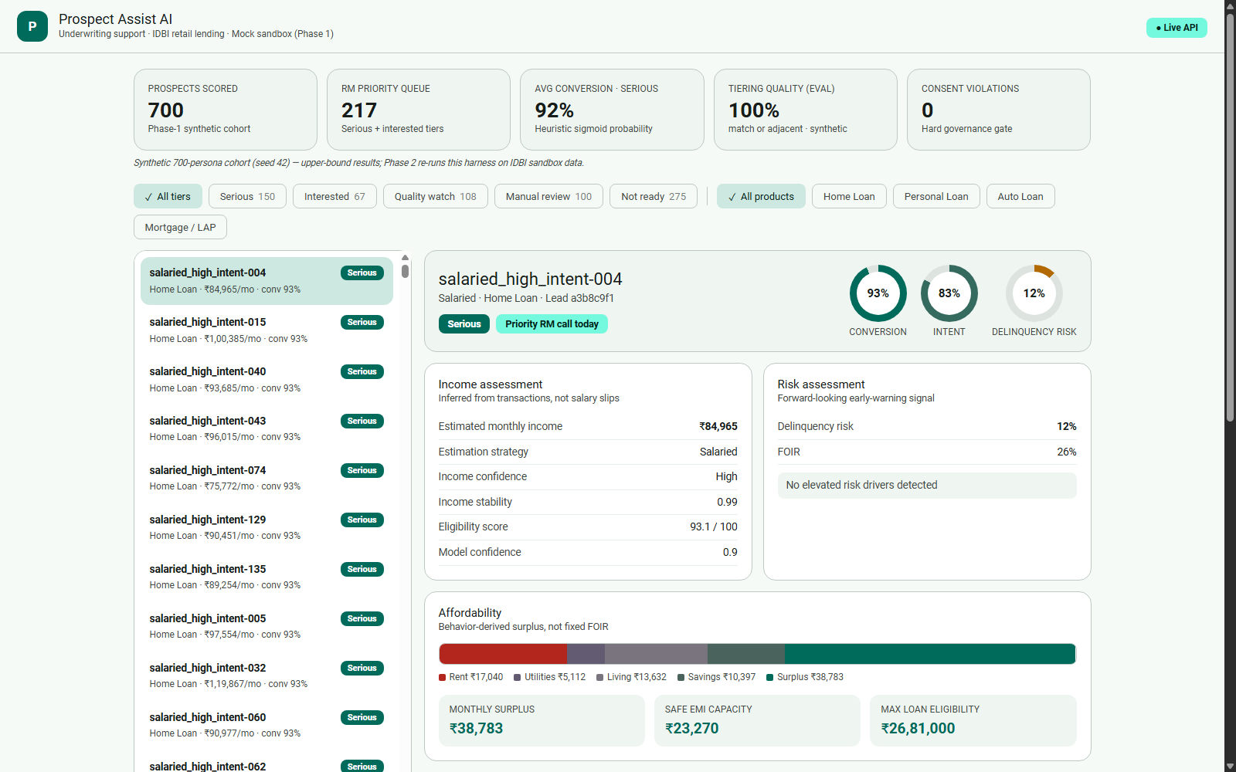
06 · UI
Wireframes / mock diagrams — implemented UI
Not a wireframe — the implemented Material Design 3 console: KPI strip, tier/product filters, ranked lead queue, and per-lead income, risk and affordability panels.

Slide 7
07 · ARCHITECTURE
Architecture of the proposed solution
Data sources
Phase 1: mock sandbox (700 personas) · Phase 2: IDBI sandbox APIs · Phase 3: AA, GST, bureau, production feeds
Data-source abstraction
BankDataConnector interface — phases swap by config, agents never change
Agent layer
Transaction parser · Capability · Intent · Delinquency · Eligibility ensemble · Conversion · Evidence compiler
RM dashboard
React + Material Design 3 console; evidence-first lead review
Public API (FastAPI)
score · leads · batch-score · feedback; 403 consent / 422 thin-file / 503 outage — stable across phases
Orchestrator
Plan → Execute → Reflect → Evaluate; contradiction & confidence gates, bounded retries
Consent service — scoped tokens with 24h TTL, validated at the orchestrator boundary before any connector call.
Persistence — in-memory store behind fixed interfaces (Phase 1); PostgreSQL 16 + Redis land in Phase 2 with no agent changes.
Prospect Assist AI · IDBI Innovate 2026 · Track 2

Slide 8
08 · STACK
Technologies used in the solution
Prototype (built & running)
Scale-up (Phase 2 / 3)
Python 3.14 · FastAPI + Pydantic v2 — typed public API contract
Deterministic rule-weighted ensembles with heuristic sigmoid squashing (honest labeling; learned calibration in Phase 2) — fully explainable Phase-1 scoring
React 18 + Vite + Recharts — Material Design 3 underwriting console
pytest — BDD scenarios written before implementation + API contract + governance/signal tests (25 tests)
Synthetic data generator — 700 personas, 6 archetypes, fixed seed 42, held-out ground-truth labels
XGBoost / CatBoost eligibility & intent models — drop in behind the same agent interfaces once labeled sandbox data exists
FinBERT for ambiguous transaction narrations (rule engine covers the rest)
PostgreSQL 16 + Redis behind the existing store interfaces
AWS deployment (containerized FastAPI, managed RDS, queue-based batch scoring)
Account Aggregator, GST and bureau integrations via the same connector seam
Prospect Assist AI · IDBI Innovate 2026 · Track 2

Slide 9
09 · COST
Estimated implementation cost
Pilot scenario — 100K customers, 12 months of transaction data (AWS, indicative)
Component | Monthly cost (INR) | Notes
Compute (EC2 / serverless) | ₹15,000 | Spot instances, auto-scaling
Storage (S3 data lake) | ₹2,100 | 1 TB transaction data
ETL (Glue / Spark) | ₹6,700 | Daily batch jobs
ML training (SageMaker) | ₹10,000 | Weekly retraining, spot pricing
ML inference (batch transform) | ₹12,500 | Nightly scoring, no real-time endpoints
Cache (ElastiCache) | ₹3,300 | Real-time intent signals
Database (RDS / Aurora) | ₹5,000 | Episodic + document store
Vector + graph DB | ₹6,700 | Qdrant + Neo4j on EC2
Monitoring (CloudWatch) | ₹2,100 | Observability stack
Total monthly | ~₹50,900 | Well within pilot budget
Unit economics
Metric | Value
Cost / lead scored | ₹0.51 (10× cheaper)
Cost / conversion | ₹170 (3× cheaper)
Cost / loan disbursed | ₹1,700 (3–5× cheaper)
Revenue / lead (2% margin) | ₹4,100 (3.4× higher)
ROI | 2.4× (10× improvement)
One-time setup: ~₹41,700 for data migration & initial model training.
Figures are indicative planning estimates; the data-source seam keeps re-platforming cost near zero between phases.
Prospect Assist AI · IDBI Innovate 2026 · Track 2

Slide 10
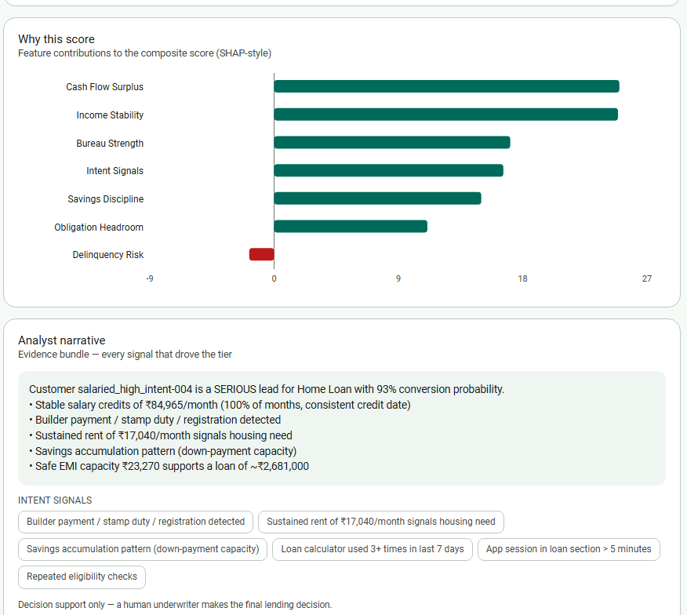
10 · PROTOTYPE
Snapshots of the prototype
Explainability panel — SHAP-style contributions and analyst narrative for every lead
Lead queue + KPI strip — 700 scored prospects, filterable by tier and product
Prospect Assist AI · IDBI Innovate 2026 · Track 2

Slide 11
11 · BENCHMARK
Prototype performance — 700-persona eval
Evaluation gate | Target | Achieved
Income estimation accuracy (per segment, ±15%) | ≥ 80% | 96 / 86 / 85%
Lead tiering quality (match or adjacent) | ≥ 85% | 100% · exact 84.6%
Simulated conversion on contacted tiers | > 30% | 65.4%
NTC hard-rule violations (“serious” below confidence floor) | 0 | 0
Segment strategy selection | 100% | 100%
Consent-gate violations | 0 | 0
25 / 25 tests pass — BDD scenarios (written first) + API contract + governance & signal tests
Ground truth is drawn independently of the scoring formulas (cash income, GST underreporting, proxy noise) — sub-100% numbers are honest by design. Phase 2 re-runs the same harness on IDBI sandbox data.
Prospect Assist AI · IDBI Innovate 2026 · Track 2

Slide 12
12 · ROADMAP
Additional details & future development
Phase 1 — done
Phase 2 — bank sandbox
Phase 3 — production
Full multi-agent pipeline on the synthetic sandbox
Consent, reflection and confidence guardrails in place
Eval harness + BDD suite green; working RM console
Swap in IDBI sandbox connector (config change only)
Train XGBoost / CatBoost + FinBERT on labeled data
PostgreSQL + Redis; re-run the identical eval harness
RM feedback loop via the existing feedback endpoint
Account Aggregator, GST, bureau & property/vehicle integrations
Champion/challenger models, drift monitoring, audit trail
Real-time intent amplification from live app events
Portfolio-level early-warning dashboards for underwriting
Prospect Assist AI · IDBI Innovate 2026 · Track 2

Slide 13
Links
GitHub public repository
github.com/KalithasG/prospect-assist-ai
Demo video (3 minutes)
____________________________
Final product link
prospect-assist-ai-brsg.onrender.com
Thank you — Prospect Assist AI · IDBI Innovate 2026 · Track 2

