Slide 1

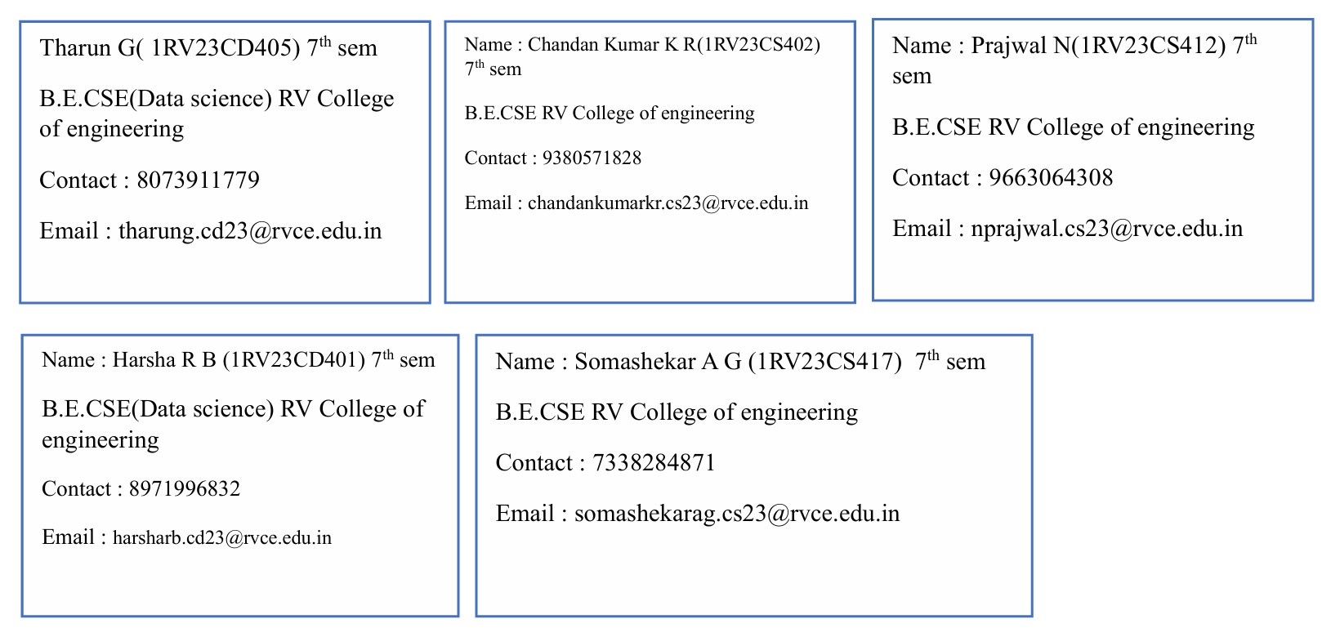
WEBPOISE INTERNSHIP PROJECT
PROJECT REPORT
Title : Event Affordability and Target Audience Segmentation

Slide 2
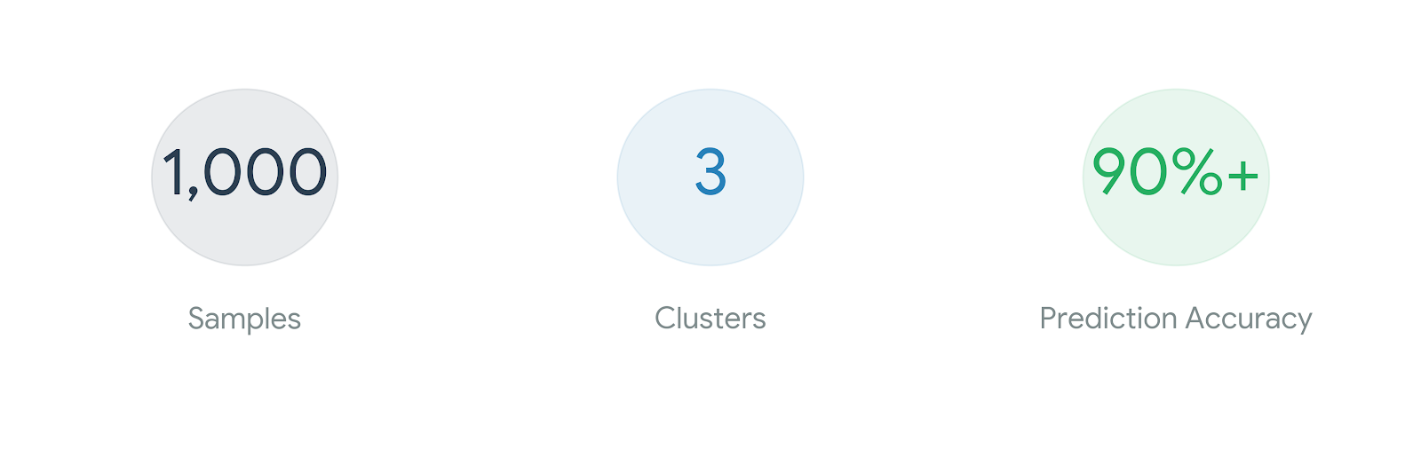
Executive Summary & Goal
Objective: To analyze how ticket prices and personal income affect event attendance.
Methodology: Used a synthetic dataset of 1,000 samples to model real-world demographic and economic behaviors.
Key Outcome: Identified distinct customer segments using K-Means clustering and developed predictive models for attendance.

Slide 3
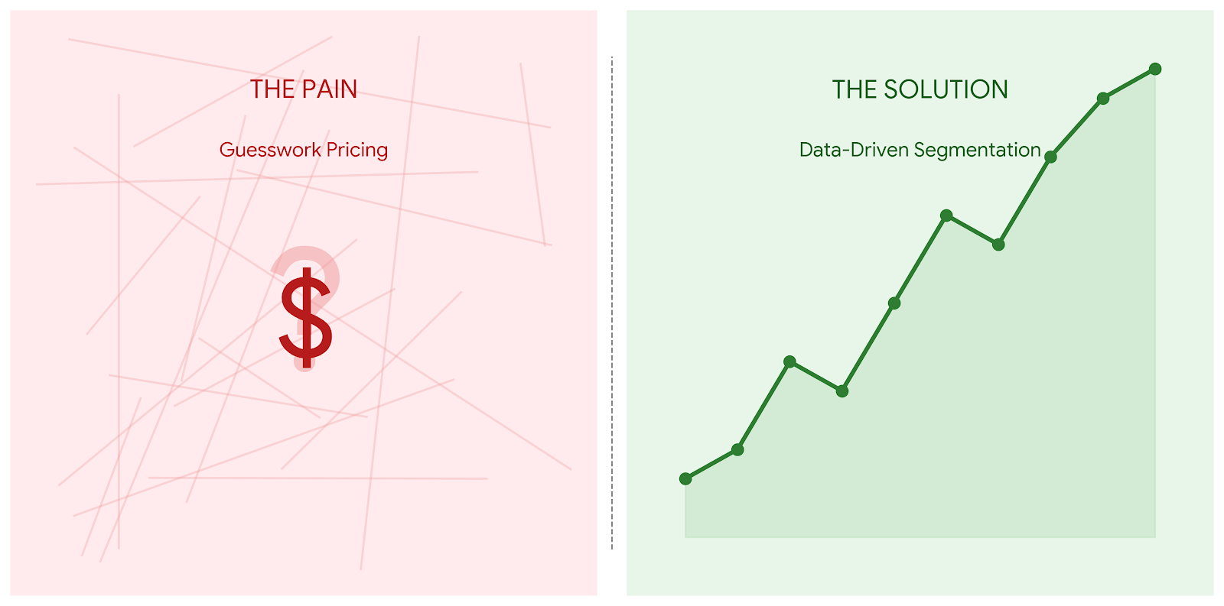
Problem Statement
The Challenge: Understanding the "Affordability Ratio" (Income vs. Ticket Price) and its impact on consumer decision-making.
Business Goal: How can we better target different age groups and genders for specific event types (Concerts, Sports, Festivals, etc.)?

Slide 4
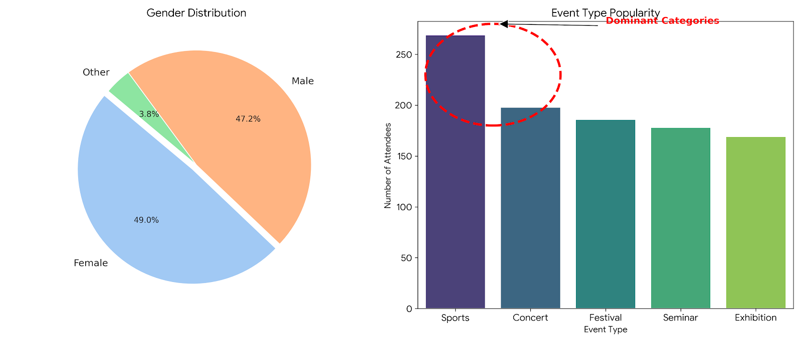
Data Overview & Exploration
Dataset Composition: 1,000 unique records including Age, Gender, Income, Event Type, and Ticket Price.
Demographic Breakdown:
Gender: Near equal split (Female: 494, Male: 465).
Event Popularity: Sports (26.5%) and Concerts (22.2%) lead in popularity.
Financials: Average income is ~$44.8k, with ticket prices averaging ~$108.

Slide 5
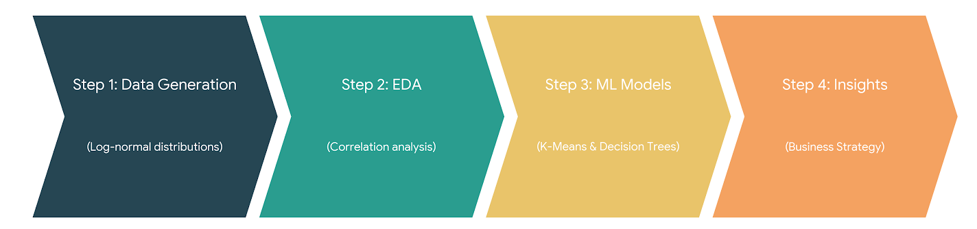
Methodology – The Data Science Process
Step-by-Step Approach:
Data Generation: Simulating realistic distributions (Log-normal for income).
Exploratory Data Analysis (EDA): Identifying correlations between age and event preference.
Preprocessing: Feature scaling (StandardScaler) and label encoding.
Machine Learning: Clustering for segmentation and Classification for attendance prediction.

Slide 6
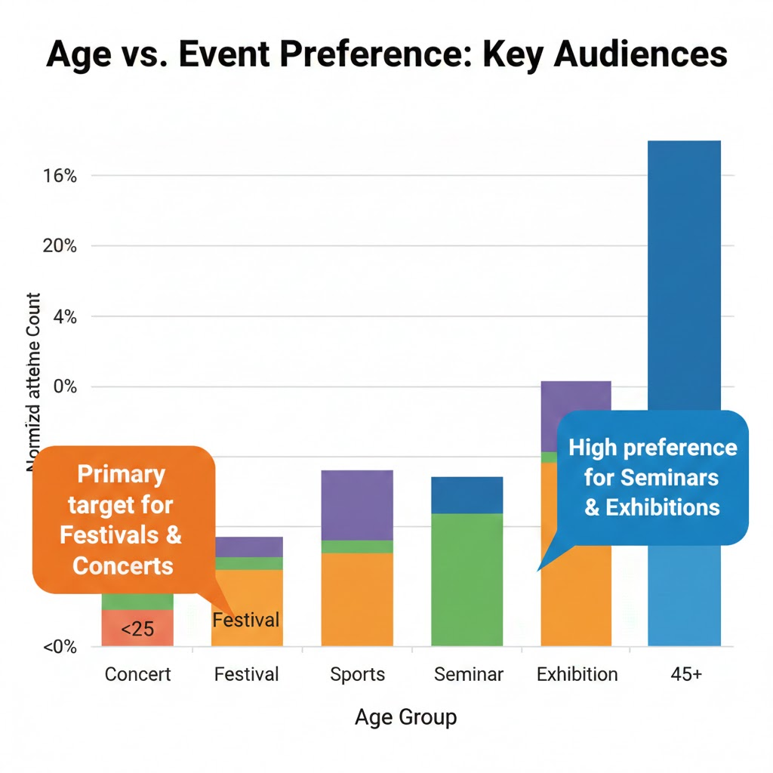
Key Insight – Age vs. Event Preference
Finding:Younger Audience (<30): High preference for Concerts and Festivals.
Older Audience (>45): Pivot toward Seminars and Exhibitions.
Business Action: Allocate marketing budget to social media for "Concert" ads and professional networks (LinkedIn) for "Seminars."

Slide 7
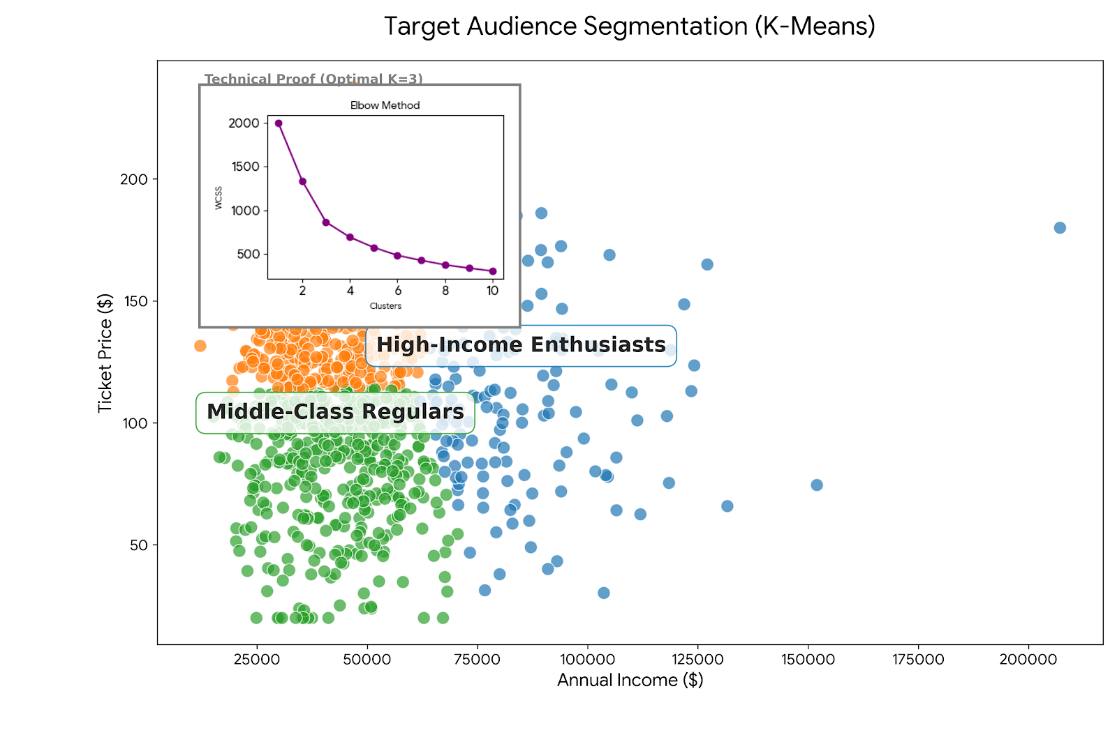
Audience Segmentation (Clustering)
The Model: K-Means Clustering.
Defined Clusters: (Include your cluster plot here).
High-Value Attendees: High income, high attendance, premium price tolerance.
Budget-Conscious: Lower income, highly sensitive to ticket price fluctuations.
Strategic Use: Create "Early Bird“ pricing for budget clusters to secure early volume.

Slide 8
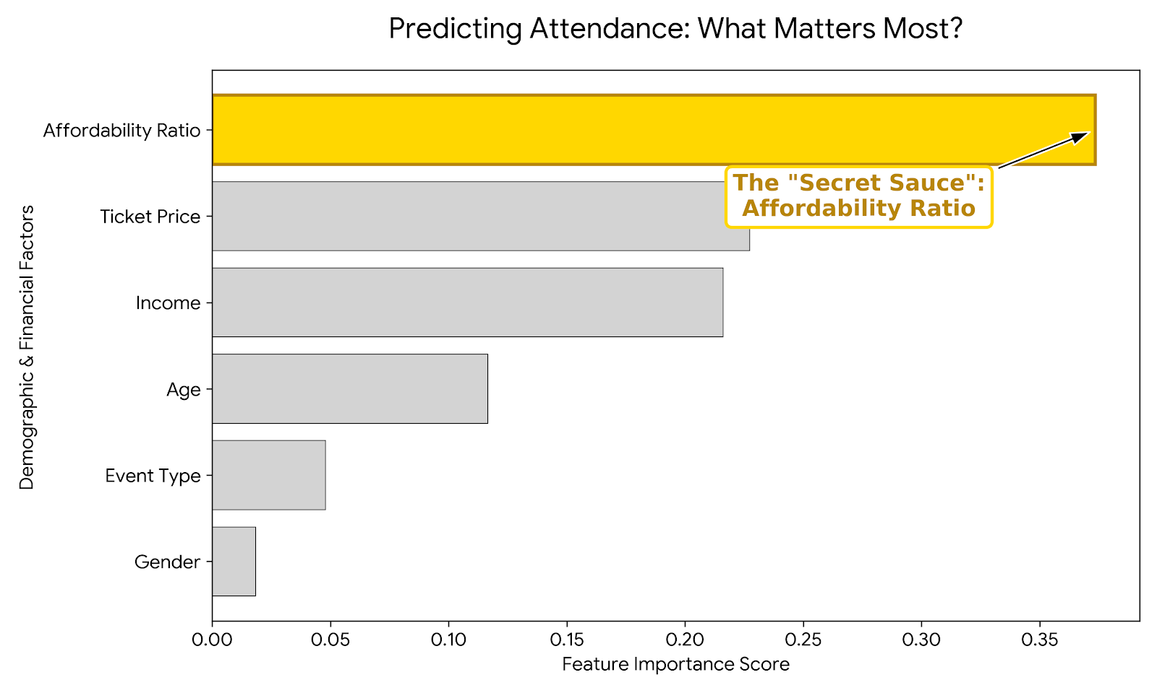
Predictive Modeling (Attendance)
Models Used: Logistic Regression and Decision Tree Classifier.
Performance: Achieved high accuracy in predicting whether a user will attend based on their financial profile.
Metric Highlight: Feature importance shows "Affordability Ratio" is the strongest predictor of conversion.

Slide 9
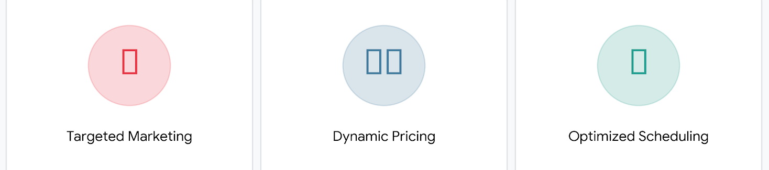
Recommendations
Tiered Pricing: Implement income-based tiers or regional pricing to optimize the affordability ratio.
Targeted Scheduling: Schedule Seminars during standard business hours (targeting the 45+ demographic) and Concerts for weekends (targeting the <30 demographic).
Dynamic Discounts: Use the predictive model to offer targeted discounts to those on the "attendance fence."

Slide 10
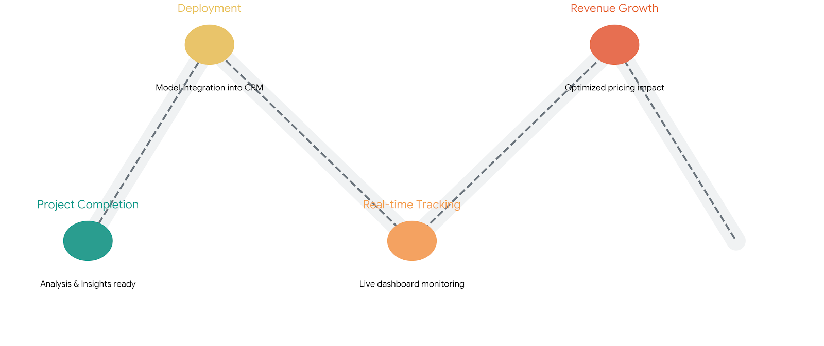
Conclusion & Next Steps
Impact: Moving from "one-size-fits-all" pricing to targeted, data-backed audience engagement.
Future Scope: Integrate real-time social media sentiment or geographic location data for more precise models.

