Slide 1
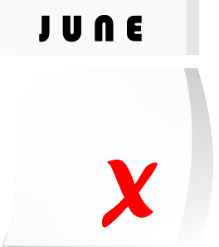
Deminder
An app that reminds you of your deadlines
Thomas Malina – Tillmann Nünninghof – Natalie Busam – Lea Wegner

Slide 2
Table of contents
Understand business need
Technical Ability
Quality
Thomas Malina – Tillmann Nünninghof – Natalie Busam – Lea Wegner

Slide 3
Understand business need
Thomas Malina – Tillmann Nünninghof – Natalie Busam – Lea Wegner

Slide 4
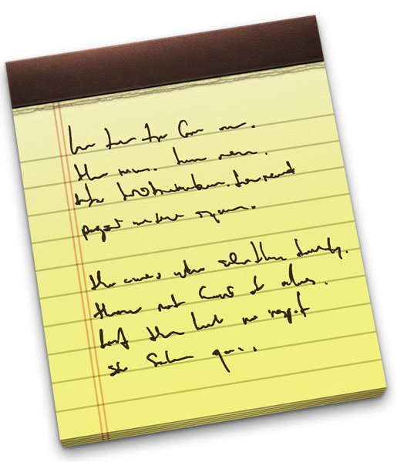
Vision
Many deadlines to keep track off
Exams, dates, papers you need to finish and e-mails you have to write
Focus on important things
Show an overview of your deadlines
The ability to create, manage and delete deadlines and subtasks
Subtask with check option
Possibility to set deadlines as recurring
Don‘t forget any important upcoming dates
Organize and track your progress
Thomas Malina – Tillmann Nünninghof – Natalie Busam – Lea Wegner

Slide 5
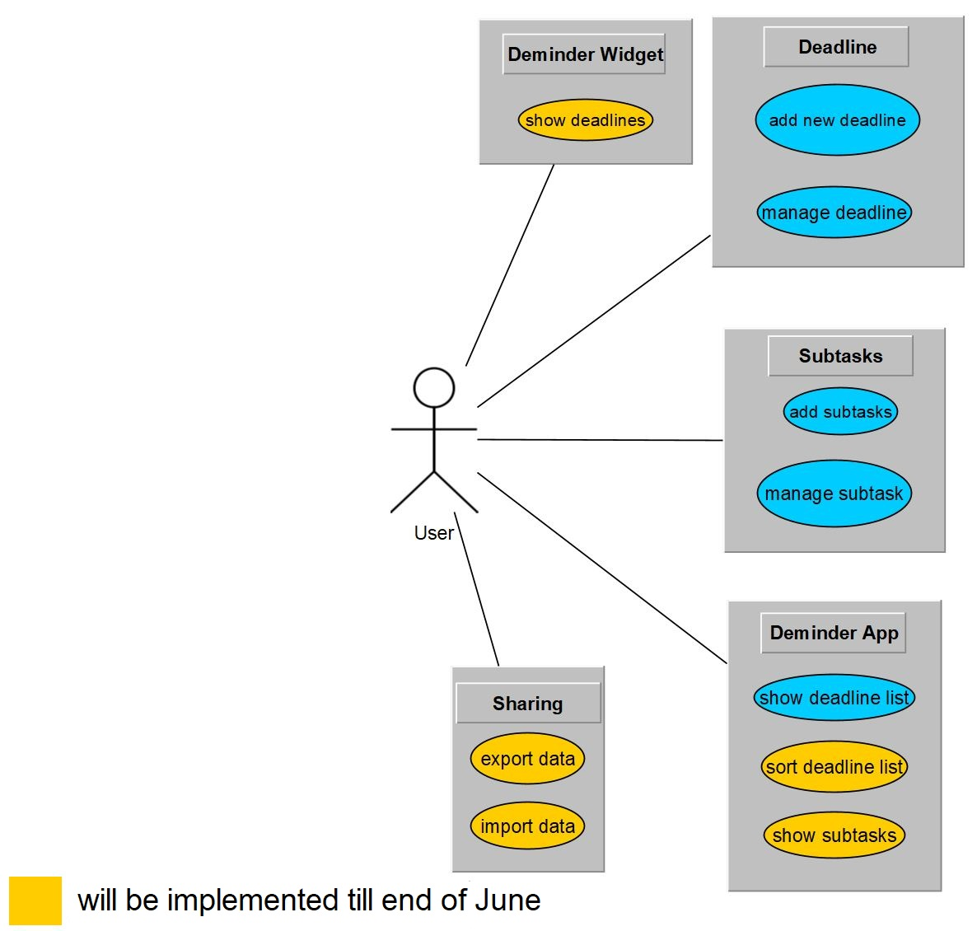
Use cases
Thomas Malina – Tillmann Nünninghof – Natalie Busam – Lea Wegner

Slide 6
Software Requirements Specification
Scope:
remind the user of upcoming deadlines such as exams
overview to show all your deadlines
Functionality:
Create, edit, show, delete deadline
Add, show and delete subtasks, mark subtasks as finished
Thomas Malina – Tillmann Nünninghof – Natalie Busam – Lea Wegner

Slide 7
Non-functionals
Reliability
Data is never lost or corrupted, acurate time, app always active
Performance
Fast loading, asynchronus saving, low response time
Supportability
Conventions, clear programm structure supporting modularity, clean code and commits
Design constraints
Java, Android Studio, Git, YouTrack, Wordpress
Thomas Malina – Tillmann Nünninghof – Natalie Busam – Lea Wegner

Slide 8

Project Methodology
Tool
YouTrack
PM method
Scrum
What is Scrum?
breaks large processes down into small pieces in order to streamline efficiency
Time-tracking
Advantages
Very agile
Thomas Malina – Tillmann Nünninghof – Natalie Busam – Lea Wegner

Slide 9
Iterative Process
Small Scrum tasks to complete a objective set for our sprint
Each task is complete on its own and contributes towards the sprint goal
Thomas Malina – Tillmann Nünninghof – Natalie Busam – Lea Wegner

Slide 10
Project Management
access our task list in our IDE, Android Studio
track the time one of our team members is working on a specific task
Contributing to our git repository via Android Studio directly
Thomas Malina – Tillmann Nünninghof – Natalie Busam – Lea Wegner

Slide 11
RUP and long-term planning
Usage of RUP for clear roles of each member and structure
Burndown to keep track of our progress
Thomas Malina – Tillmann Nünninghof – Natalie Busam – Lea Wegner

Slide 12
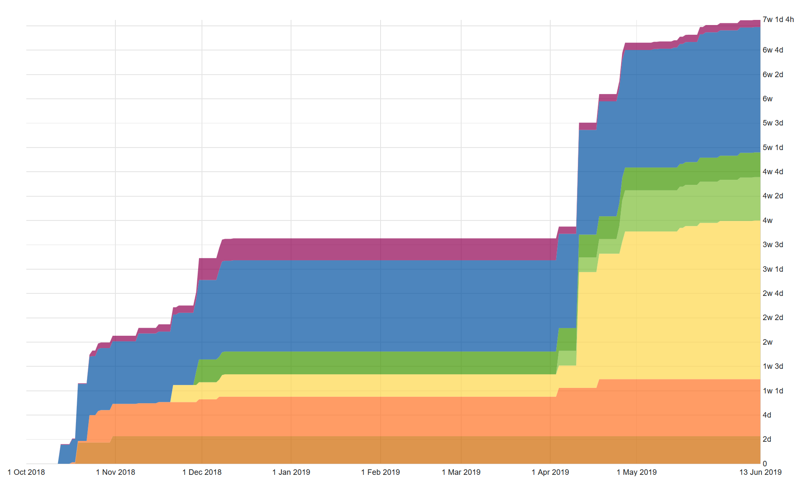
Cumulative Chart

Slide 13
Cost Estimation
Use Case | FP's | Estimated Time | Time spent
Import Data | 11,76 | 50 | 1d 6h
Export Data | 11,76 | 50 | 6h
Sort deadline list | 10,9 | 45 | 1d 3h
Show subtasks | 5,88 | 20 | 1d 8h

Slide 14
Technical ability
Thomas Malina – Tillmann Nünninghof – Natalie Busam – Lea Wegner

Slide 15
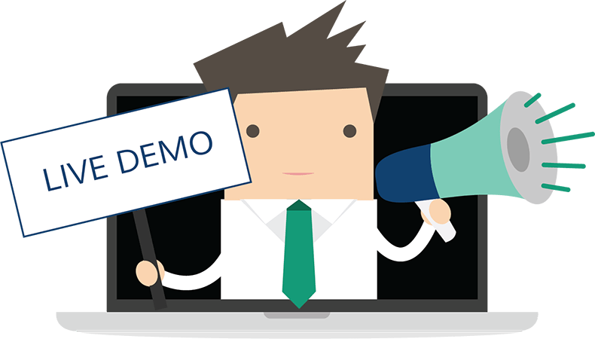
Thomas Malina – Tillmann Nünninghof – Natalie Busam – Lea Wegner

Slide 16
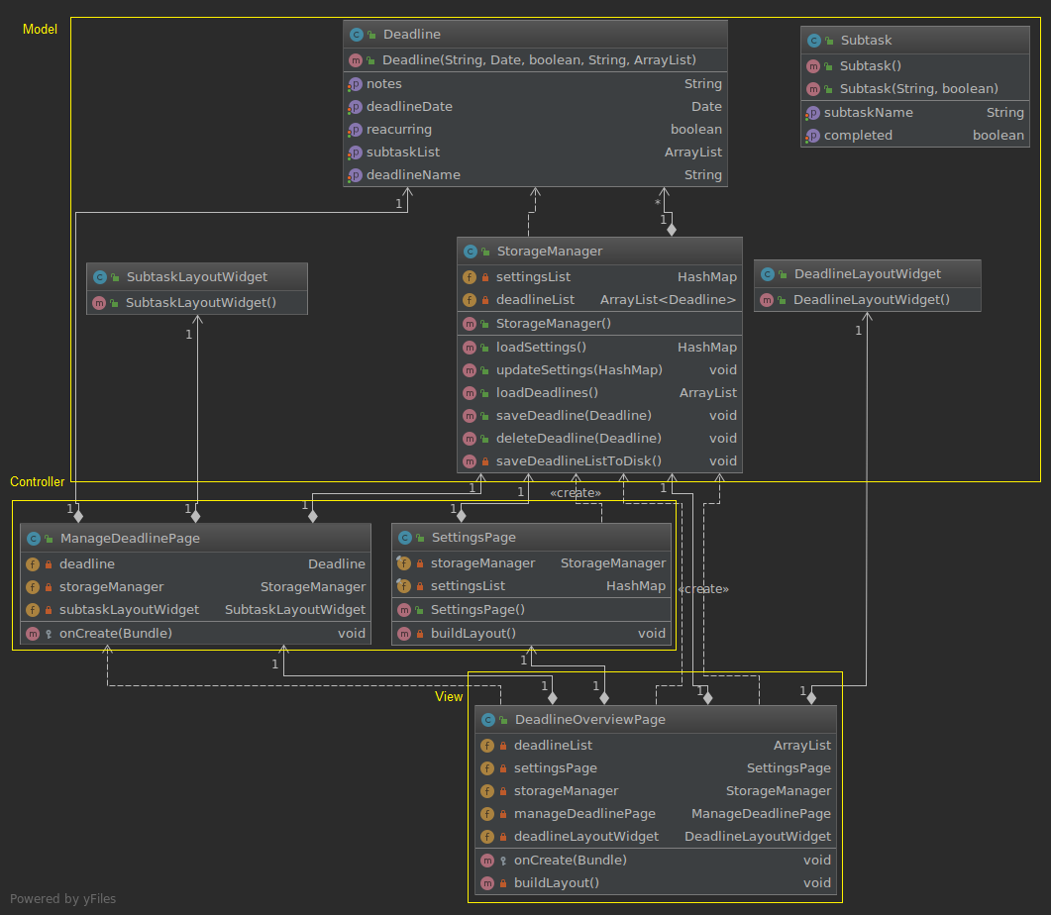
Class diagram
Thomas Malina – Tillmann Nünninghof – Natalie Busam – Lea Wegner

Slide 17
Quality
Thomas Malina – Tillmann Nünninghof – Natalie Busam – Lea Wegner

Slide 18
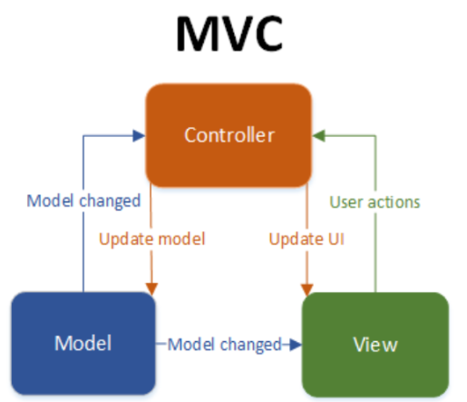
Architecture
No server, only a client side which uses MVC
Written in Java for android
Model View Controller
Goal: seperate view from logic
Controller takes care of handling actions by the user
Models contain the data that is displayed in the views
Data Storage
Deadlines stored on the phone drive
Thomas Malina – Tillmann Nünninghof – Natalie Busam – Lea Wegner

Slide 19

Automation
Automatic time tracking
Automatic tests
Automatic deployment
Thomas Malina – Tillmann Nünninghof – Natalie Busam – Lea Wegner

Slide 20
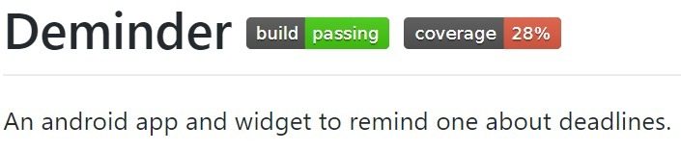
Continuous Integration
Travis CI as automated build service
Every commit to the master branch triggers a build
Travis CI runs all tests and statistics
If build fails, commiter gets
Badges:
Thomas Malina – Tillmann Nünninghof – Natalie Busam – Lea Wegner

Slide 21
Risk Management
Name | Occurence | Impact | Factor
The speciality of the app is not clear | 80% | 8 | 6,4
Inadequate estimation of required resources | 50% | 7 | 3,5
High level of technical complexity | 60% | 5 | 3
Ineffective communications | 50% | 6 | 3
Thomas Malina – Tillmann Nünninghof – Natalie Busam – Lea Wegner

Slide 22
Risk Management
Name | Occurence | Impact | Factor
Unknown technologies are difficult to handle | 90% | 3 | 2,7
User does not understand the usage of the app | 20% | 8 | 1,6
Loss of team members | 10% | 10 | 1
Changing requirements | 10% | 8 | 0,8
Thomas Malina – Tillmann Nünninghof – Natalie Busam – Lea Wegner

Slide 23

Testing
Feature test with Espresso Framework
Thomas Malina – Tillmann Nünninghof – Natalie Busam – Lea Wegner

Slide 24
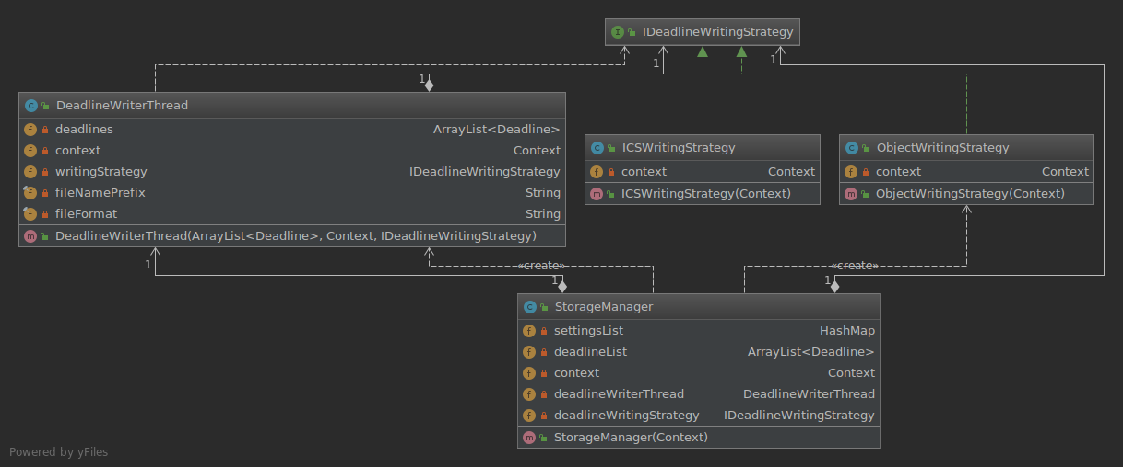
Patterns
Thomas Malina – Tillmann Nünninghof – Natalie Busam – Lea Wegner

Slide 25
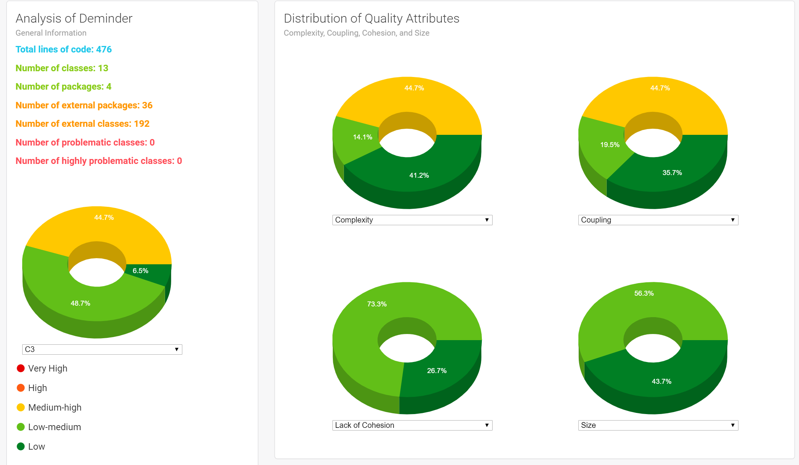
Metrics
Complexity
Coupling
Thomas Malina – Tillmann Nünninghof – Natalie Busam – Lea Wegner

Slide 26
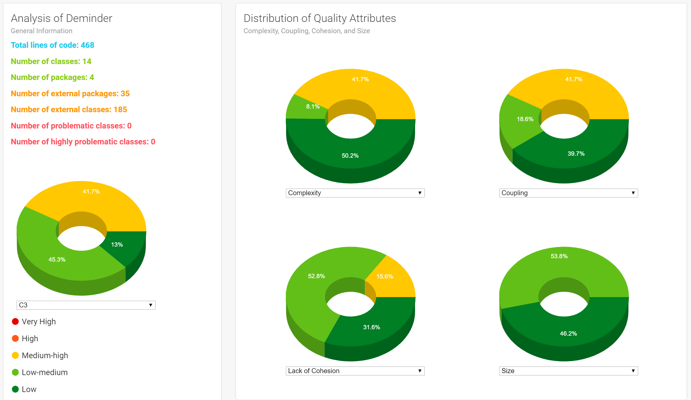
Metrics
Thomas Malina – Tillmann Nünninghof – Natalie Busam – Lea Wegner

Slide 27
Thank you for your attention!
Thomas Malina – Tillmann Nünninghof – Natalie Busam – Lea Wegner

