Slide 1
vim – vi IMproved
ePortfolio Software Engineering
Thomas Malina – 08.11.2018

Slide 2

Table of contents
History
First view
Modes
Basic movement
Hands on!

Slide 3
History
1976 – vi by Bill Joy
  Editor for BSD
1991 – vi IMitation by Bram Moolenar
  Originally vi-clone for Amiga-mashines
1992 - Port to Unix & MS-DOS (vi IMproved)
  Many improvements over the years
Notes:
BSD: Variation of Unix

Slide 4
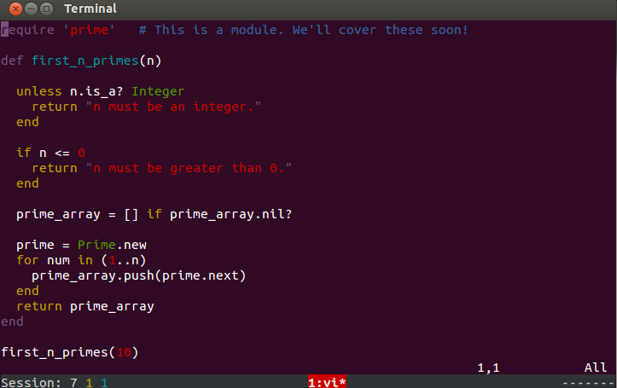
First view

Slide 5
Modes
Normal mode
  Navigation
  Manipulation of text
  Press „ESC“
Insert mode
  Write text
  Press e.g. „i“ in Normal Mode

Slide 6
Modes
Command mode
  Execute commands
  e.g. open file, save and close current file
  Press „:“ in Normal mode
Visual mode
  Select text
  Press e.g. „v“ in Normal mode
Ex- and select-mode
  Not covered here, advanced features

Slide 7
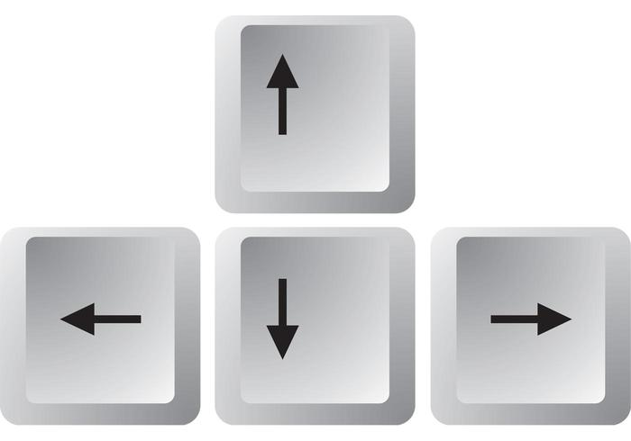
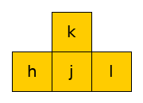
Basic movement
→

Slide 8
And now….
...let‘s vim!

