Slide 1
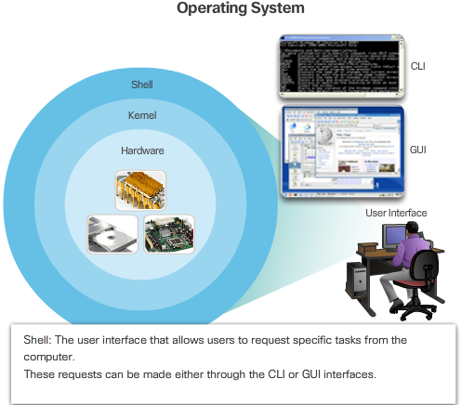

Notes:
2.1.1.1 Operating Systems

Slide 2
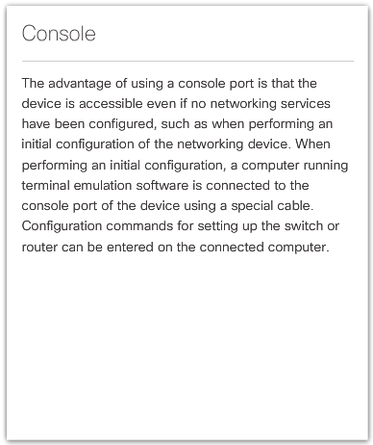
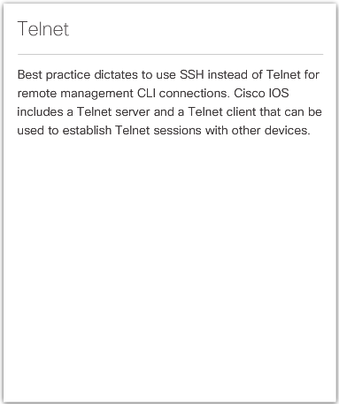
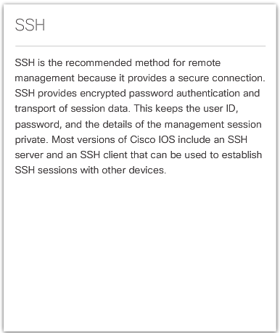
Notes:
2.1.2.1 Access Methods

Slide 3
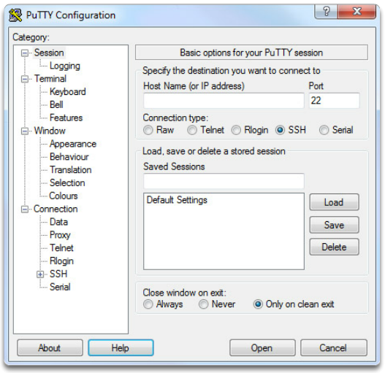
PuTTY
Notes:
2.1.2.2 Terminal Emulation Programs

Slide 4
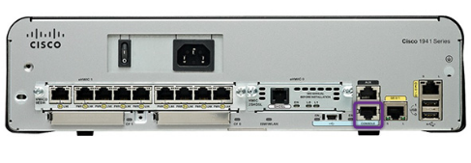
A console connection must be established before initial configuration of a Cisco device.
After being consoled in, the network technician will have to navigate through various command modes of the IOS CLI.
The Cisco IOS modes use a hierarchical structure and are quite similar for both switches and routers.
Notes:
2.1.3.1 Cisco IOS Modes of Operation

Slide 5
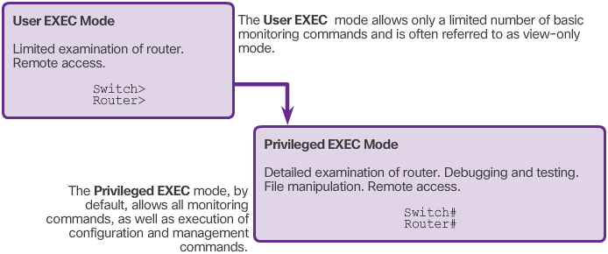
Notes:
2.1.3.2 Primary Command Modes

Slide 6
Global Configuration Mode
To configure the device must enter this mode with configure terminal command
Example: Switch(config)#
CLI configuration changes are made that affect the operation of the device as a whole
From this mode, the user can enter different sub-configuration modes
Two common sub-configuration modes include:
Line Configuration Mode - Used to configure console, SSH, Telnet, or AUX access. Example: Switch(config-line)#
Interface Configuration Mode - Used to configure a switch port or router network interface. Example: Switch(config-if)#
Notes:
2.1.3.3 Configuration Command Modes

Slide 7
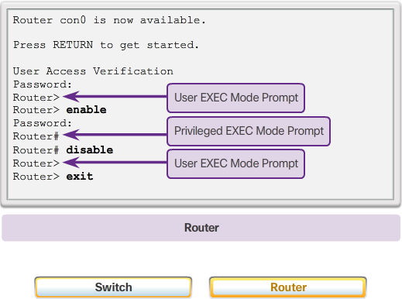
Notes:
2.1.3.4 Navigate Between IOS Modes

Slide 8
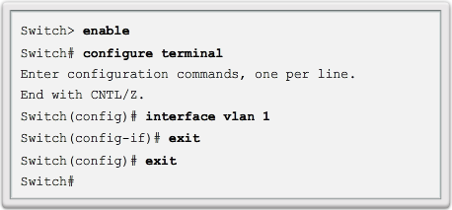
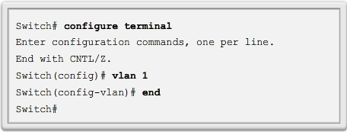
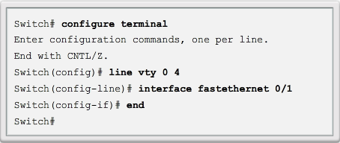
Exit
End or Ctrl+Z
Notes:
2.1.3.4 Navigate Between IOS Modes

Slide 9
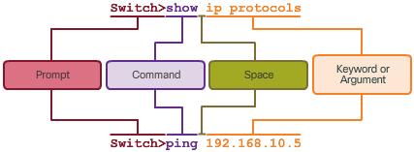
Notes:
2.1.4.1 Basic IOS Command Structure

Slide 10
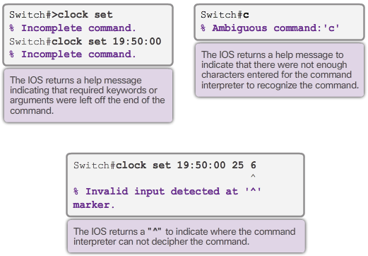
Notes:
2.1.4.3 IOS Help Features

Slide 11

Notes:
2.2.1.2 Configure Hostnames

Slide 12
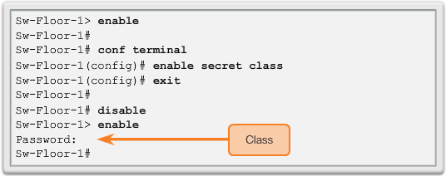
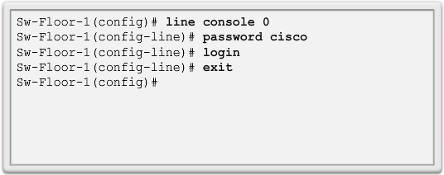
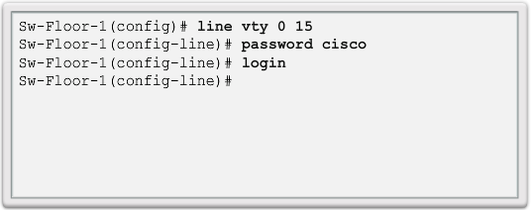
Privileged EXEC Password Example
User EXEC Password Example
VTY Line Password Example
Notes:
2.2.2.2 Configure Passwords

Slide 13
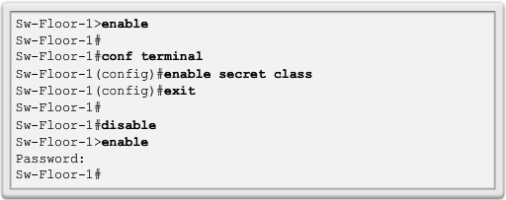
Use the enable secret command, not the older enable password command.
The enable secret command provides greater security because the password is encrypted.
Notes:
2.2.2.2 Configure Passwords

Slide 14
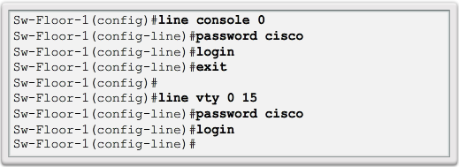
Console port must be secured.
  Reduces the chance of unauthorized personnel physically plugging a cable into the device and gaining device access.
VTY lines allow access to a Cisco device via Telnet.
  The number of VTY lines supported varies with the type of device and the IOS version.
Notes:
2.2.2.2 Configure Passwords

Slide 15
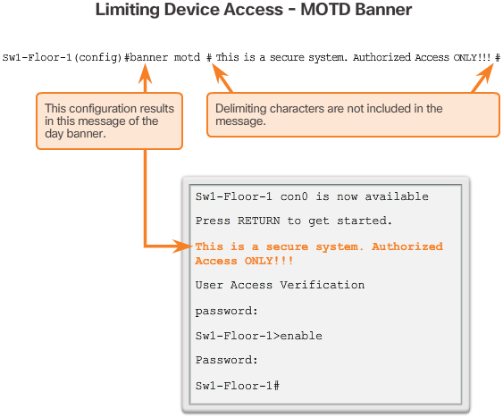
These are an important part of the legal process in the event that someone is prosecuted for breaking into a device.
Wording that implies that a login is "welcome" or "invited" is not appropriate.
Often used for legal notification because it is displayed to all connected terminals.
Notes:
2.2.2.4 Banner Messages
2.2.2.5 Syntax Checker - Limiting Access to a Switch

Slide 16
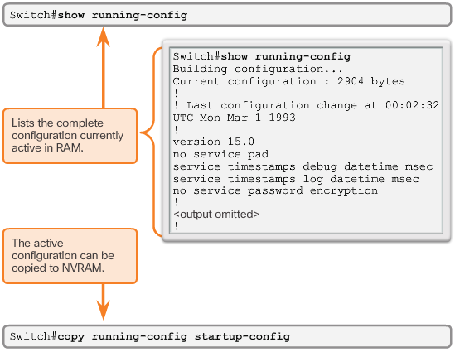
Startup configuration –File stored in NVRAM that contains all of the commands that will be used upon startup or reboot. NVRAM does not lose its contents when the device is powered off.
Running configuration –
File stored in RAM that reflects the current configuration, modifying affects the operation of a Cisco device immediately. RAM loses all of its content when the device is powered off or restarted.
Notes:
2.2.3.1 Save the Running Configuration File

Slide 17
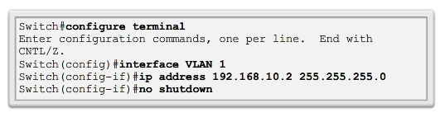
Video Available
IP address - Together with subnet mask, uniquely identifies end device on internetwork
Subnet mask - Determines which part of a larger network is used by an IP address
interface VLAN 1 - Interface configuration mode
ip address 192.168.10.2 255.255.255.0 - Configures the IP address and subnet mask for the switch
no shutdown - Administratively enables the interface
Switch still needs to have physical ports configured and VTY lines to enable remote management
Notes:
2.3.2.3 Switch Virtual Interface Configuration
2.3.2.4 Syntax Checker – Configuring a Switch Virtual Interface
2.3.2.5 Packet Tracer – Implementing Basic Connectivity

Slide 18
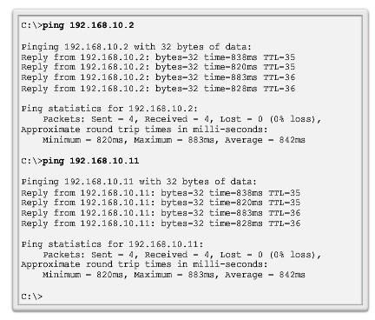
Notes:
2.3.3.2 End-to-End Connectivity Test
2.3.3.3 Lab – Building a Simple Network
2.3.3.4 Lab – Configuring a Switch Management Address

