Slide 1
NAT Characteristics
IPv4 Private Address Space
IPv4 address space is not big enough to uniquely address all the devices that must be connected to the Internet.
Network private addresses are described in RFC 1918 and are to designed to be used within an organization or site only.
Private addresses are not routed by Internet routers while public addresses are.
Private addresses can alleviate IPv4 scarcity, but because they aren’t routed by Internet devices, they first need to be translated.
NAT is process used to perform such translation.
Notes:
11.1.1.1 IPv4 Private Address Space

Slide 2
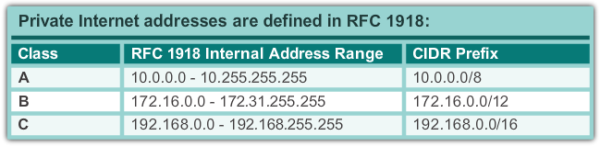
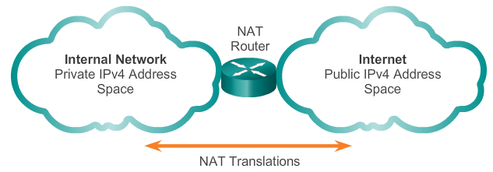
NAT Characteristics
IPv4 Private Address Space
Notes:
11.1.1.1 IPv4 Private Address Space

Slide 3
NAT Characteristics
What is NAT?
NAT is a process used to translate network addresses.
NAT’s primary use is to conserve public IPv4 addresses.
NAT is usually implemented at border network devices, such as firewalls or routers.
NAT allows the networks to use private addresses internally, only translating to public addresses when needed.
Devices within the organization can be assigned private addresses and operate with locally unique addresses.
When traffic must be sent or received to or from other organizations or the Internet, the border router translates the addresses to a public and globally unique address.
Notes:
11.1.1.2 What is NAT?

Slide 4
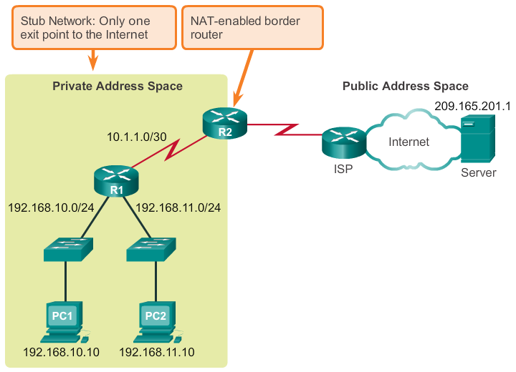
NAT Characteristics
What is NAT? (cont.)
Notes:
11.1.1.2 What is NAT? (cont.)

Slide 5
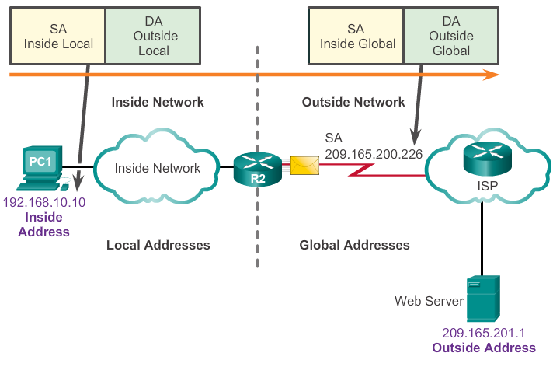
NAT Characteristics
NAT Terminology
Inside network is the set of devices using private addresses
Outside network refers to all other networks
NAT includes four types of addresses:
  Inside local address
  Inside global address
  Outside local address
  Outside global address
Notes:
11.1.1.3 NAT Terminology

Slide 6
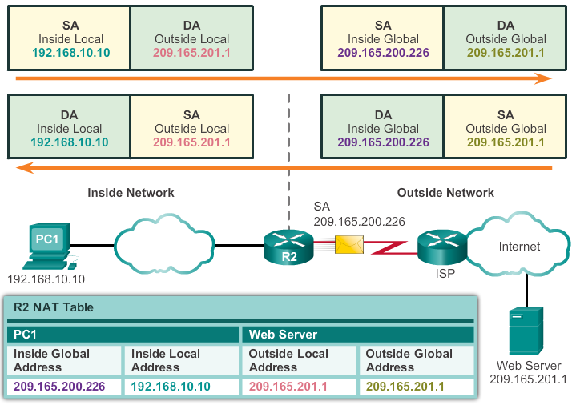
NAT Characteristics
NAT Terminology (cont.)
Notes:
11.1.1.4 NAT Terminology (cont.)

Slide 7
Types of NAT
Static NAT
Static NAT uses a one-to-one mapping of local and global addresses.
These mappings are configured by the network administrator and remain constant.
Static NAT is particularly useful when servers hosted in the inside network must be accessible from the outside network.
A network administrator can SSH to a server in the inside network by pointing the SSH client to the proper inside global address.
Notes:
11.1.2.1 Static NAT

Slide 8
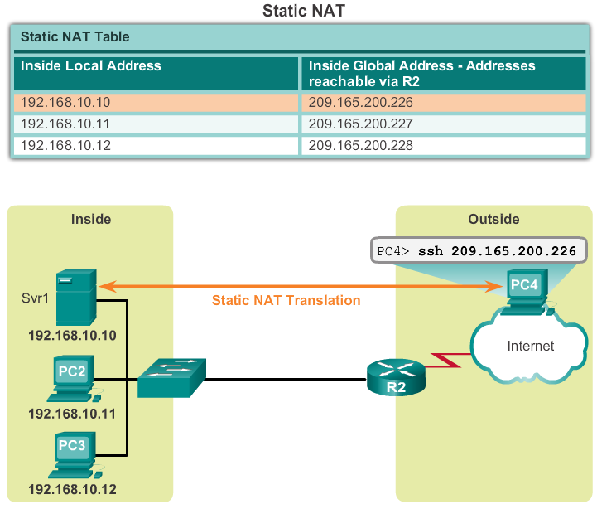
Types of NAT
Static NAT (cont.)
Notes:
11.1.2.1 Static NAT (cont.)

Slide 9
Types of NAT
Dynamic NAT
Dynamic NAT uses a pool of public addresses and assigns them on a first-come, first-served basis.
When an inside device requests access to an outside network, dynamic NAT assigns an available public IPv4 address from the pool.
Dynamic NAT requires that enough public addresses are available to satisfy the total number of simultaneous user sessions.
Notes:
11.1.2.2 Dynamic NAT

Slide 10
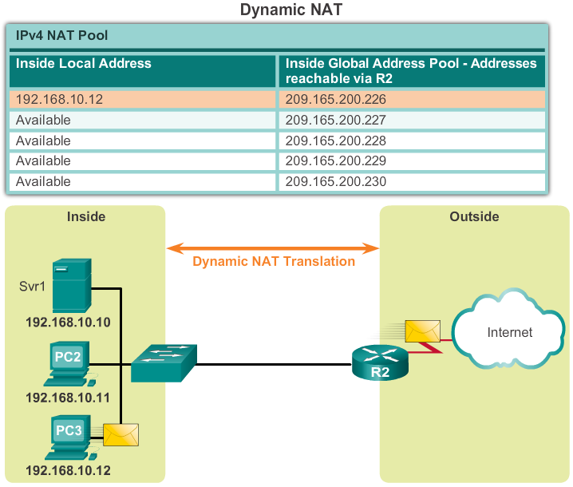
Types of NAT
Dynamic NAT (cont.)
Notes:
11.1.2.2 Dynamic NAT (cont.)

Slide 11
Types of NAT
Port Address Translation
Port Address Translation (PAT) maps multiple private IPv4 addresses to a single public IPv4 address or a few addresses.
PAT uses the pair source port and source IP address to keep track of what traffic belongs to what internal client.
PAT is also known as NAT overload.
By also using the port number, PAT forwards the response packets to the correct internal device.
The PAT process also validates that the incoming packets were requested, thus adding a degree of security to the session.
Notes:
11.1.2.3 Port Address Translation NAT

Slide 12
Types of NAT
Comparing NAT and PAT
NAT translates IPv4 addresses on a 1:1 basis between private IPv4 addresses and public IPv4 addresses.
PAT modifies both the address and the port number.
NAT forwards incoming packets to their inside destination by referring to the incoming source IPv4 address provided by the host on the public network.
With PAT, there is generally only one or a very few publicly exposed IPv4 addresses.
PAT is able to translate protocols that do not use port numbers, such as ICMP; each one of these protocols is supported differently by PAT.
Notes:
11.1.2.5 Comparing NAT and PAT

Slide 13
Benefits of NAT
Benefits of NAT
Conserves the legally registered addressing scheme
Increases the flexibility of connections to the public network
Provides consistency for internal network addressing schemes
Provides network security
Notes:
11.1.3.1 Benefits of NAT

Slide 14
Benefits of NAT
Disadvantages of NAT
Performance is degraded
End-to-end functionality is degraded
End-to-end IP traceability is lost
Tunneling is more complicated
Initiating TCP connections can be disrupted
Notes:
11.1.3.2 Disadvantages of NAT

Slide 15
Configuring Static NAT
Configuring Static NAT
There are two basic tasks to perform when configuring static NAT translations:
Create the mapping between the inside local and outside local addresses.
Define which interfaces belong to the inside network and which belong to the outside network.
Notes:
11.2.1.1 Configuring Static NAT

Slide 16
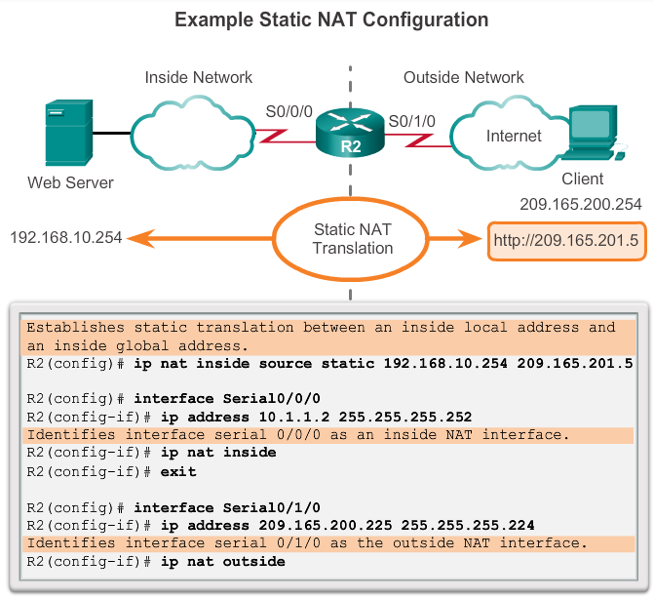
Configuring Static NAT
Configuring Static NAT
Notes:
11.2.1.1 Configuring Static NAT

Slide 17
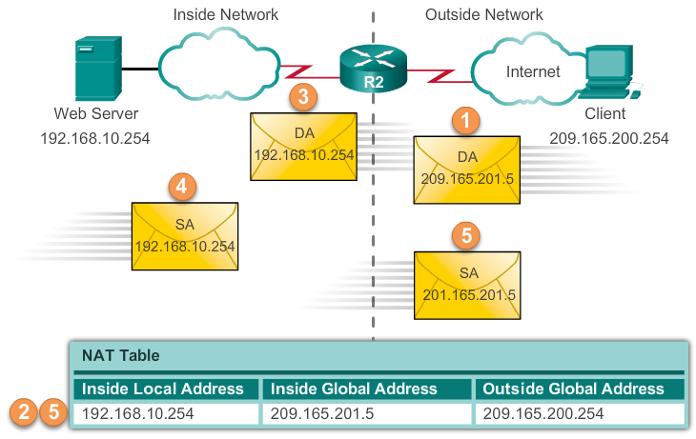
Configuring Static NAT
Analyzing Static NAT
Notes:
11.2.1.2 Analyzing Static NAT

Slide 18
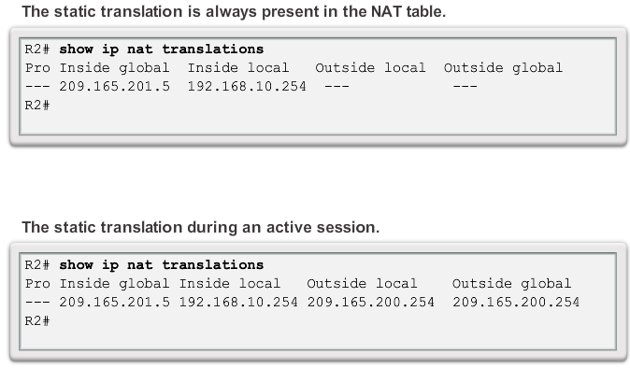
Configuring Static NAT
Verifying Static NAT
Notes:
11.2.1.2 Verifying Static NAT

Slide 19
Configuring Dynamic NAT
Dynamic NAT Operation
The pool of public IPv4 addresses (inside global address pool) is available to any device on the inside network on a first-come, first-served basis.
With dynamic NAT, a single inside address is translated to a single outside address.
The pool must be large enough to accommodate all inside devices.
A device is unable to communicate to any external networks if no addresses are available in the pool.
Notes:
11.2.2.1 Dynamic NAT Operation

Slide 20
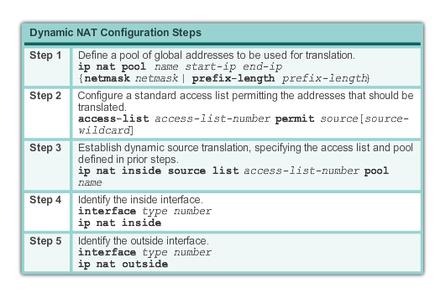
Configuring Dynamic NAT
Configuring Dynamic NAT
Notes:
11.2.2.2 Configuring Dynamic NAT

Slide 21
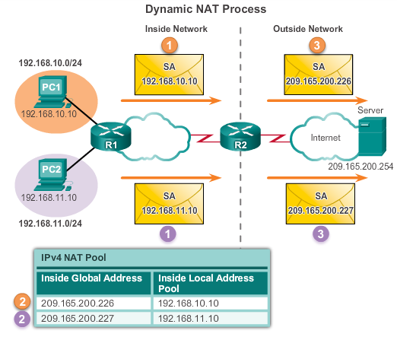
Configuring Dynamic NAT
Analyzing Dynamic NAT
Notes:
11.2.2.3 Analyzing Dynamic NAT

Slide 22
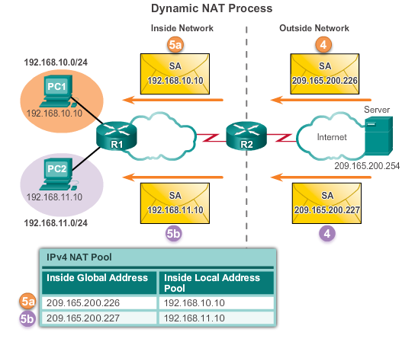
Configuring Dynamic NAT
Analyzing Dynamic NAT
Notes:
11.2.2.3 Analyzing Dynamic NAT

Slide 23
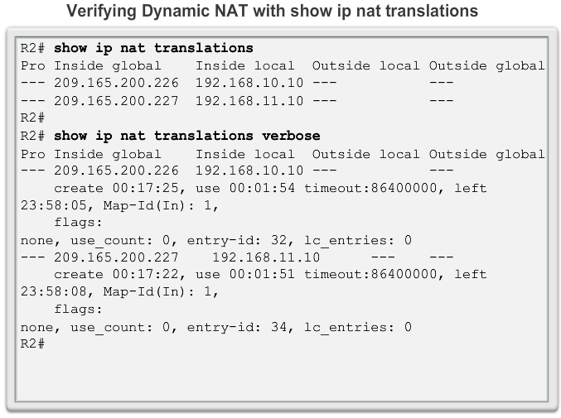
Configuring Dynamic NAT
Verifying Dynamic NAT
Notes:
11.2.2.4 Verifying Dynamic NAT

Slide 24
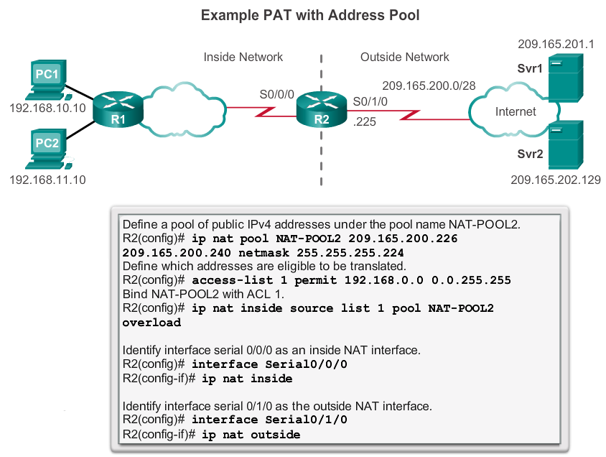
Configuring PAT
Configuring PAT: Address Pool
Notes:
11.2.3.1 Configuring PAT: Address Pool

Slide 25
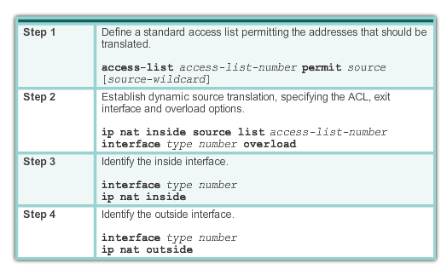
Configuring PAT
Configuring PAT: Single Address
Notes:
11.2.3.2 Configuring PAT: Single Address

Slide 26
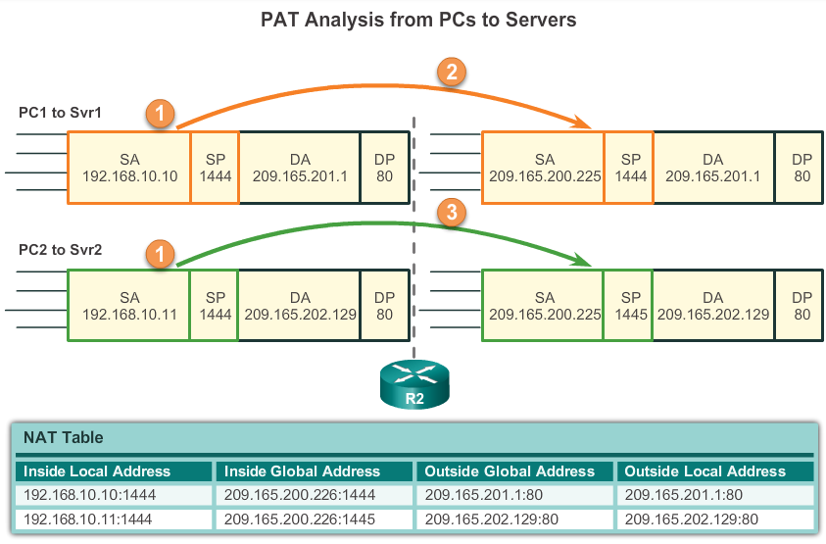
Configuring PAT
Analyzing PAT
Notes:
11.2.3.3 Analyzing PAT

Slide 27
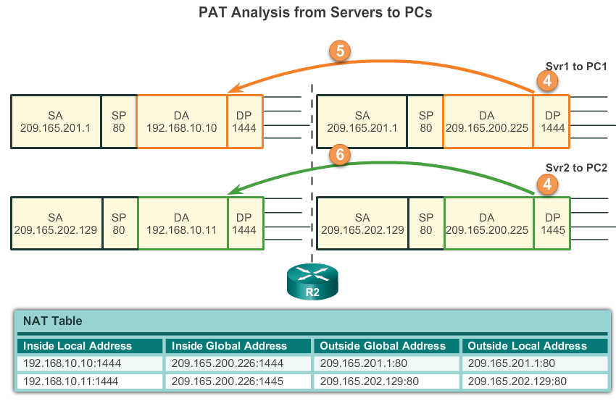
Configuring PAT
Analyzing PAT
Notes:
11.2.3.3 Analyzing PAT

Slide 28
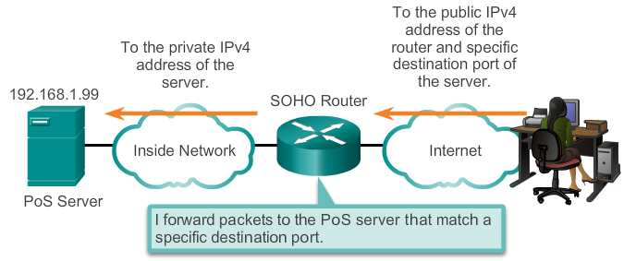
Port Forwarding
Port Forwarding
Port forwarding is the act of forwarding a network port from one network node to another.
A packet sent to the public IP address and port of a router can be forwarded to a private IP address and port in inside network.
Port forwarding is helpful in situations where servers have private addresses, not reachable from the outside networks.
Notes:
11.2.4.1 Port Forwarding

Slide 29
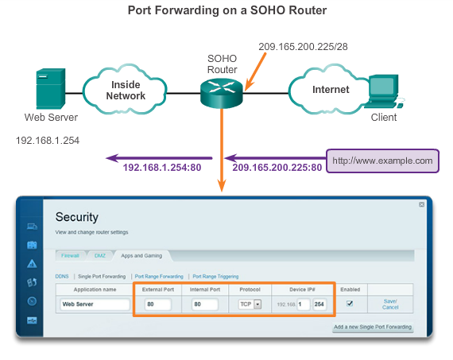
Port Forwarding
SOHO Example
Notes:
11.2.4.2 SOHO Example

Slide 30
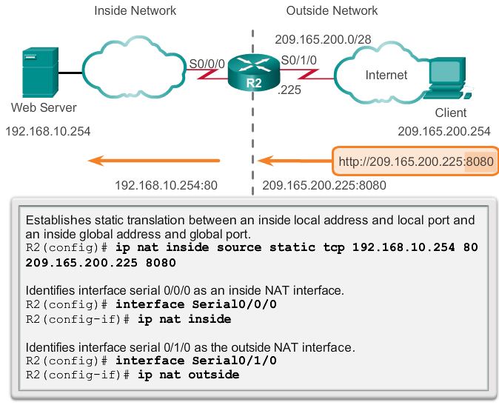
Port Forwarding
Configuring Port Forwarding with IOS
In IOS, Port forwarding is essentially a static NAT translation with a specified TCP or UDP port number.
Notes:
11.2.4.3 Configuring Port Forwarding with IOS

