Slide 1
Overview of VLANs
VLAN Definitions
A VLAN is a logical partition of a Layer 2 network.
Multiple partitions can be created, allowing for multiple VLANs to co-exist.
Each VLAN is a broadcast domain, usually with its own IP network.
VLANs are mutually isolated and packets can only pass between them via a router.
The partitioning of the Layer 2 network takes place inside a Layer 2 device, usually via a switch.
The hosts grouped within a VLAN are unaware of the VLAN’s existence.
Notes:
3.1.1.1 VLAN Definitions

Slide 2
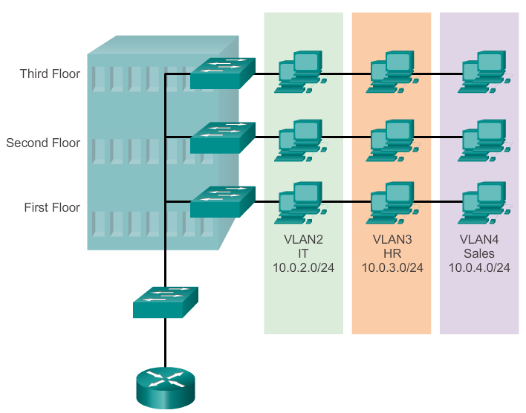
Overview of VLANs
VLAN Definitions (cont.)
Notes:
3.1.1.1 VLAN Definitions

Slide 3
Overview of VLANs
Benefits of VLANs
Security
Cost reduction
Better performance
Shrink broadcast domains
Improved IT staff efficiency
Simpler project and application management
Notes:
3.1.1.2 Benefits of VLANs

Slide 4
Overview of VLANs
Types of VLANs
Data VLAN
Default VLAN
Native VLAN
Management VLAN
Notes:
3.1.1.3 Types of VLANs

Slide 5
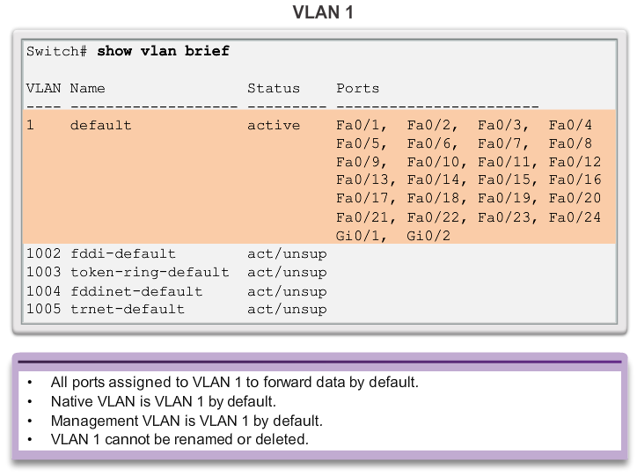
Overview of VLANs
Types of VLANs (cont.)
Notes:
3.1.1.3 Types of VLANs

Slide 6
Overview of VLANs
Voice VLANs
VoIP traffic is time-sensitive and requires:
  Assured bandwidth to ensure voice quality.
  Transmission priority over other types of network traffic.
  Ability to be routed around congested areas on the network.
  Delay of less than 150 ms across the network.
The voice VLAN feature enables access ports to carry IP voice traffic from an IP phone.
The switch can connect to a Cisco 7960 IP phone and carry IP voice traffic.
The sound quality of an IP phone call can deteriorate if the data is unevenly sent; the switch supports quality of service (QoS).
Notes:
3.1.1.4 Voice VLANs

Slide 7
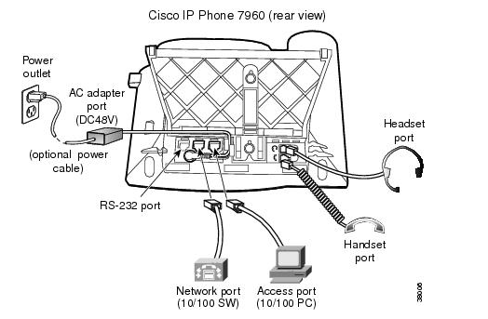
Overview of VLANs
Voice VLANs (cont.)
The Cisco 7960 IP phone has two RJ-45 ports that each support connections to external devices.
  Network Port (10/100 SW) - Use this port to connect the phone to the network. The phone can also obtain inline power from the Cisco Catalyst switch over this connection.
  Access Port (10/100 PC) - Use this port to connect a network device, such as a computer, to the phone.
Notes:
3.1.1.4 Voice VLANs

Slide 8
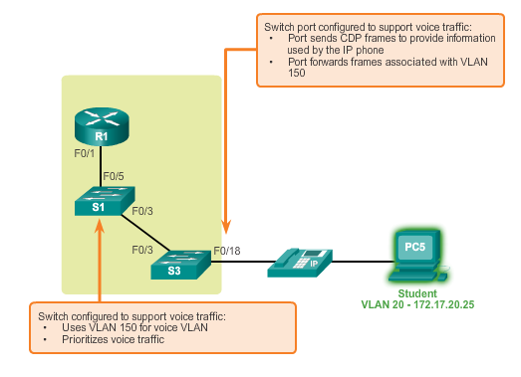
Overview of VLANs
Voice VLANs (cont.)
Notes:
3.1.1.4 Voice VLANs

Slide 9
VLANs in a Multi-Switched Environment
VLAN Trunks
A VLAN trunk carries more than one VLAN.
A VLAN trunk is usually established between switches so same-VLAN devices can communicate, even if physically connected to different switches.
A VLAN trunk is not associated to any VLANs; neither is the trunk ports used to establish the trunk link.
Cisco IOS supports IEEE802.1q, a popular VLAN trunk protocol.
Notes:
3.1.2.1 VLAN Trunks

Slide 10
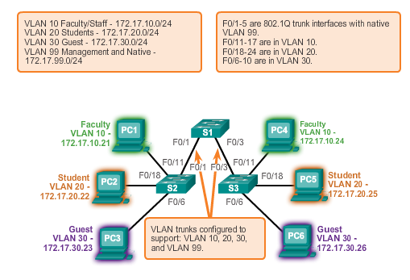
VLANs in a Multi-Switched Environment
VLAN Trunks (cont.)
Notes:
3.1.2.1 VLAN Trunks

Slide 11
VLANs in a Multi-Switched Environment
Controlling Broadcast Domains with VLANs
VLANs can be used to limit the reach of broadcast frames.
A VLAN is a broadcast domain of its own.
A broadcast frame sent by a device in a specific VLAN is forwarded within that VLAN only.
VLANs help control the reach of broadcast frames and their impact in the network.
Unicast and multicast frames are forwarded within the originating VLAN.
Notes:
3.1.2.2 Controlling Broadcast Domains with VLANs

Slide 12
VLANs in a Multi-Switched Environment
Tagging Ethernet Frames for VLAN Identification
Frame tagging is the process of adding a VLAN identification header to the frame.
It is used to properly transmit multiple VLAN frames through a trunk link.
Switches tag frames to identify the VLAN to that they belong. Different tagging protocols exist; IEEE 802.1Q is a vey popular example.
The protocol defines the structure of the tagging header added to the frame.
Switches add VLAN tags to the frames before placing them into trunk links and remove the tags before forwarding frames through nontrunk ports.
When properly tagged, the frames can transverse any number of switches via trunk links and still be forwarded within the correct VLAN at the destination.
Notes:
3.1.2.3 Tagging Ethernet Frames for VLAN Identification

Slide 13
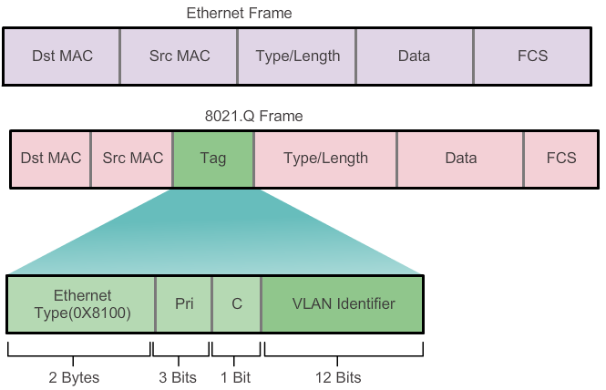
VLANs in a Multi-Switched Environment
Tagging Ethernet Frames for VLAN Identification
Notes:
3.1.2.3 Tagging Ethernet Frames for VLAN Identification

Slide 14
VLANs in a Multi-Switched Environment
Native VLANs and 802.1Q Tagging
Frames that belong to the native VLAN are not tagged.
Frames received untagged remain untagged and are placed in the native VLAN when forwarded.
If there are no ports associated to the native VLAN and no other trunk links, an untagged frame is dropped.
In Cisco switches, the native VLAN is VLAN 1, by default.
Notes:
3.1.2.4 Native VLANs and 802.1Q Tagging

Slide 15
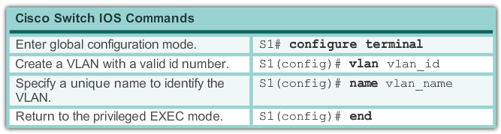
VLAN Assignment
Creating a VLAN
Notes:
3.2.1.2 Creating a VLAN

Slide 16
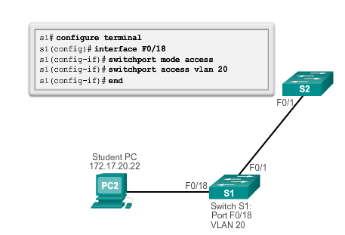
VLAN Assignment
Assigning Ports to VLANs (cont.)
Notes:
3.2.1.3 Assigning Ports To VLANs

Slide 17
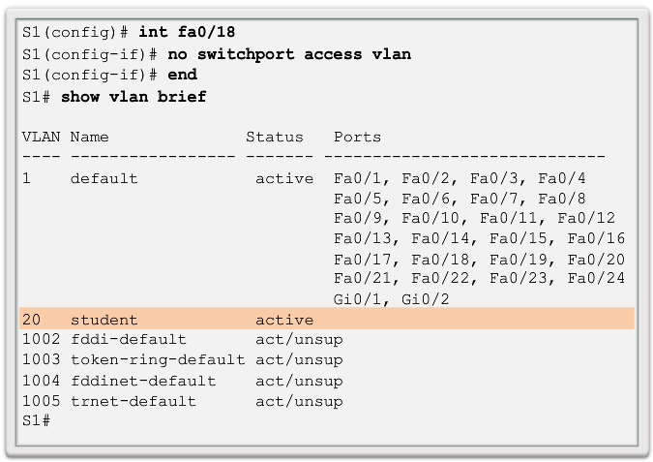
VLAN Assignment
Changing VLAN Port Membership
Notes:
3.2.1.4 Changing VLAN Port Membership

Slide 18
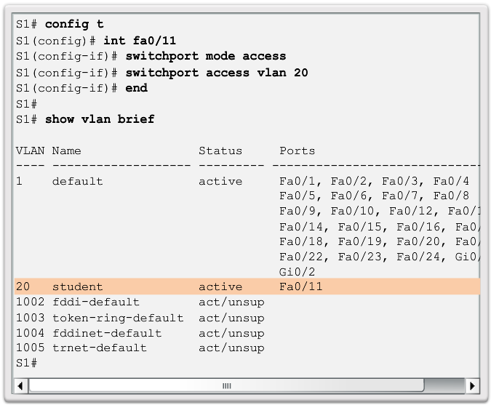
VLAN Assignment
Changing VLAN Port Membership (cont.)
Notes:
3.2.1.4 Changing VLAN Port Membership

Slide 19
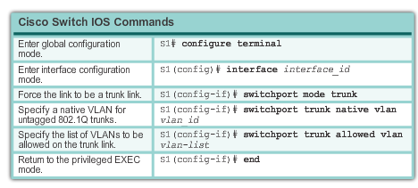
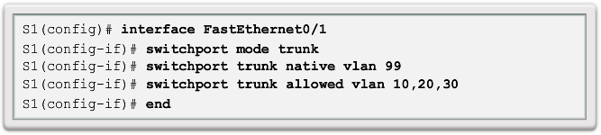
VLAN Assignment
Configuring IEEE 802.1q Trunk Links
Notes:
3.2.2.1 Configuring IEEE 802.1q Trunk Links

Slide 20
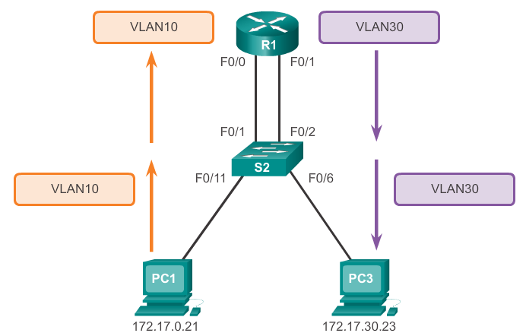
Inter-VLAN Routing Operation
What is Inter-VLAN routing?
Layer 2 switches cannot forward traffic between VLANs without the assistance of a router.
Inter-VLAN routing is a process for forwarding network traffic from one VLAN to another, using a router.
Notes:
5.1.1.1 What is Inter-VLAN routing?

Slide 21
Inter-VLAN Routing Operation
Legacy Inter-VLAN Routing
In the past:
Actual routers were used to route between VLANs.
Each VLAN was connected to a different physical router interface.
Packets would arrive on the router through one through interface, be routed and leave through another.
Because the router interfaces were connected to VLANs and had IP addresses from that specific VLAN, routing between VLANs was achieved.
Large networks with large number of VLANs required many router interfaces.
Notes:
5.1.1.2 Legacy Inter-VLAN Routing

Slide 22
Inter-VLAN Routing Operation
Router-on-a-Stick Inter-VLAN Routing
The router-on-a-stick approach uses a different path to route between VLANs.
One of the router’s physical interfaces is configured as a 802.1Q trunk port so it can understand VLAN tags.
Logical subinterfaces are created; one subinterface per VLAN.
Each subinterface is configured with an IP address from the VLAN it represents.
VLAN members (hosts) are configured to use the subinterface address as a default gateway.
Only one of the router’s physical interface is used.
Notes:
5.1.1.3 Router-on-a-Stick Inter-VLAN Routing

Slide 23
Configure Router-on-a-Stick
Preparation
An alternative to legacy inter-VLAN routing is to use VLAN trunking and subinterfaces.
VLAN trunking allows a single physical router interface to route traffic for multiple VLANs.
The physical interface of the router must be connected to a trunk link on the adjacent switch.
On the router, subinterfaces are created for each unique VLAN.
Each subinterface is assigned an IP address specific to its subnet or VLAN and is also configured to tag frames for that VLAN.
Notes:
6.1.3.1 Configure Router-On-A-Stick: Preparation

Slide 24
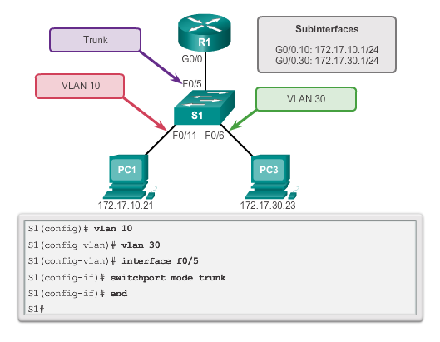
Configure Router-on-a-Stick
Switch Configuration
Notes:
6.1.3.2 Configure Router-on-a-Stick: Switch Configuration

Slide 25
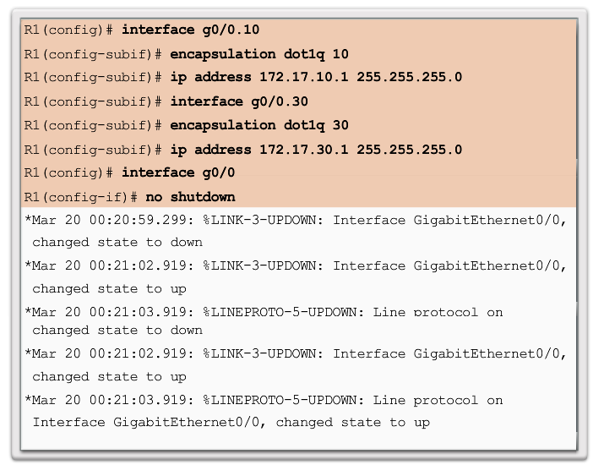
Configure Router-on-a-Stick
Router Subinterface Configuration
Notes:
6.1.3.3 Configure Router-on-a-Stick: Router Subinterface Configuration

