Slide 1

Notes:
3.2.3.1 Open Standards

Slide 2
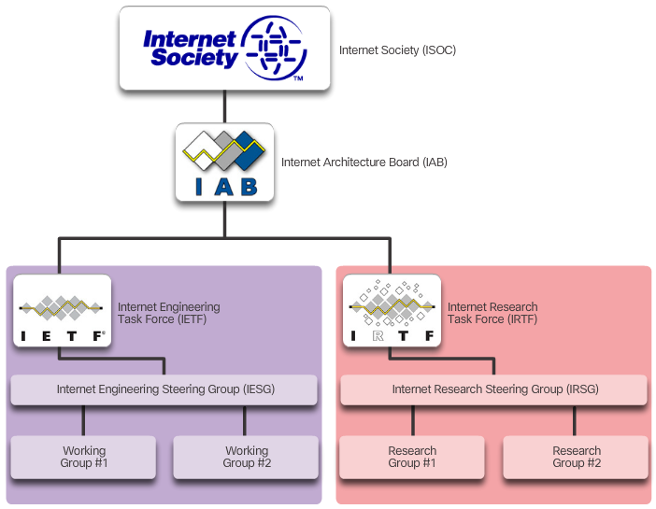
ISOC, IAB, IETF, and IRTF
Notes:
3.2.3.2 Internet Standards

Slide 3
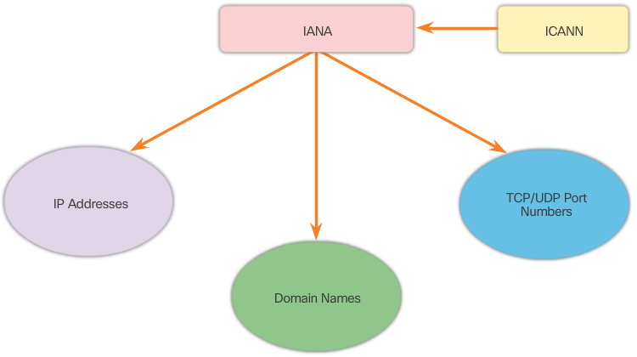
IANA and ICANN
Notes:
3.2.3.2 Internet Standards (Cont.)

Slide 4

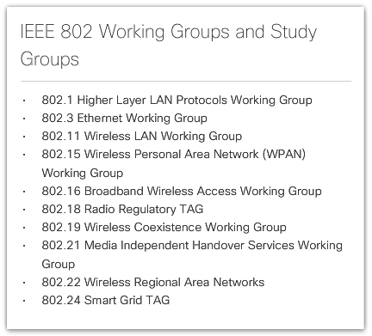
Institute of Electrical and Electronics Engineers (IEEE)
Notes:
3.2.3.3 Electronics and Communications Standard Organizations

Slide 5

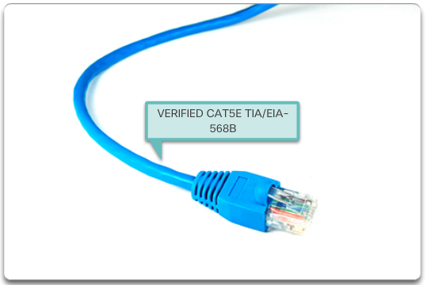
EIA/TIA Standards
Notes:
3.2.3.3 Electronics and Communications Standard Organizations (Cont.)
3.2.3.4 Lab- Researching Networking Standards

Slide 6
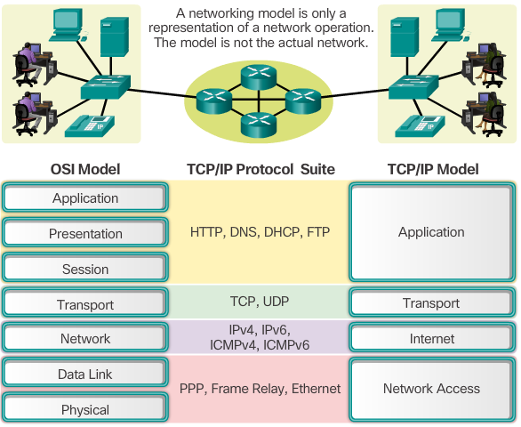
Notes:
3.2.4.1 The Benefits of Using a Layered Model

Slide 7
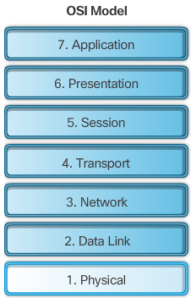
Notes:
3.2.4.2 The OSI Reference Model

Slide 8
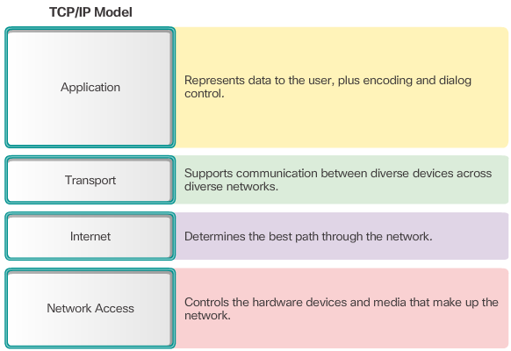
Notes:
3.2.4.3 The TCP/IP Protocol Model

Slide 9

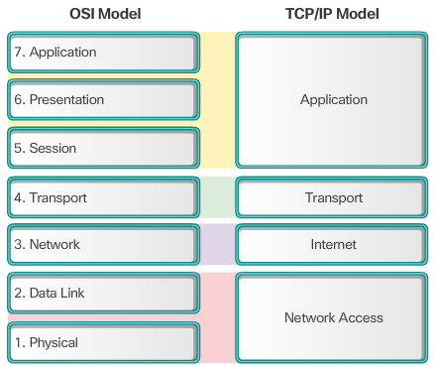
Notes:
3.2.4.4 OSI Model and TCP/IP Model Comparison
3.2.4.5 Activity – Identify Layers and Functions
3.2.4.6 Packet Tracer – Investigating the TCP/IP and OSI Models in Action

Slide 10
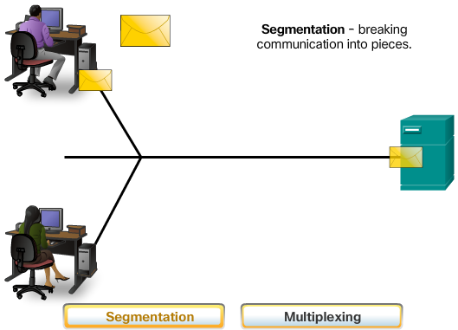
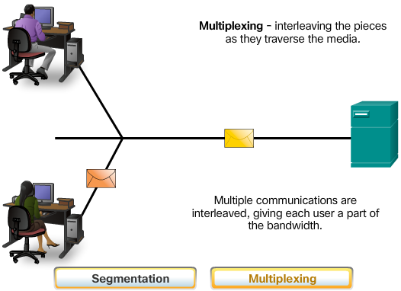
Communicating the Message
Notes:
3.3.1.1 Message Segmentation

Slide 11
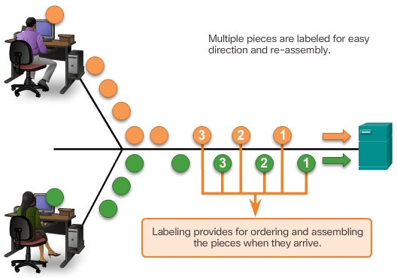
Communicating the Message
Notes:
3.3.1.1 Message Segmentation (Cont.)

Slide 12
Segmenting Messages:
Allows many different conversations to be interleaved
Increases the efficiency of network communications
Adds complexity
Notes:
3.3.1.1 Communicating the Message

Slide 13
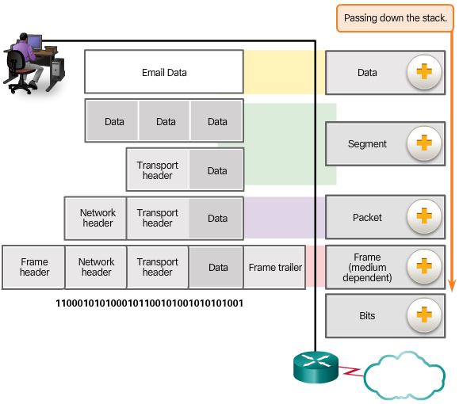
Encapsulation
Data
Segment
Packet
Frame
Bits
Notes:
3.3.1.2 Protocol Data Units

Slide 14
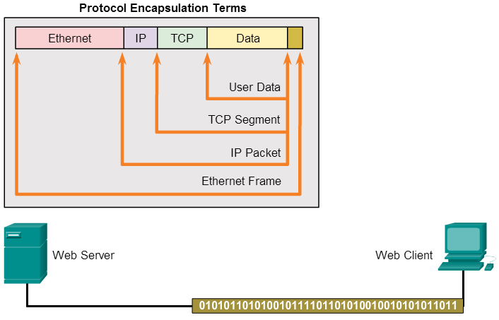
Notes:
3.3.1.3 Encapsulation Example

Slide 15
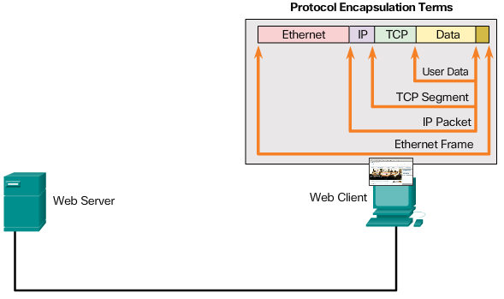
Notes:
3.3.1.4 De-Encapsulation
3.3.1.5 Activity – Identify the PDU Layer

Slide 16
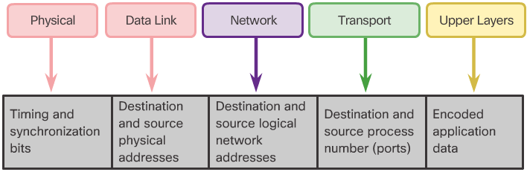
Network Addresses and Data Link Addresses
Notes:
3.3.2.1 Network Addresses

Slide 17
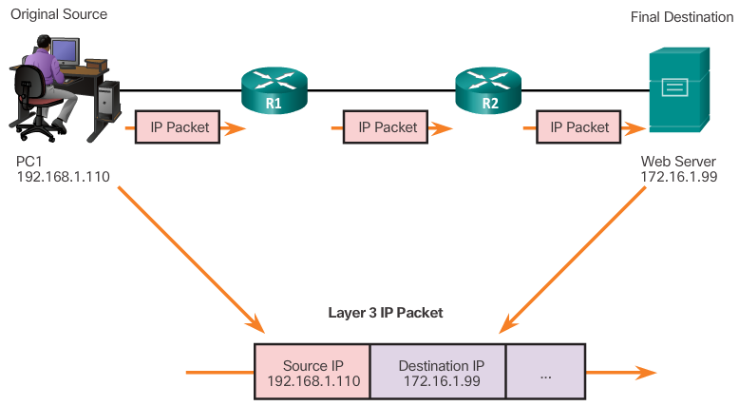
Layer 3 Network Addresses
Notes:
3.3.2.1 Network Addresses (Cont.)

Slide 18
Network Address
Source IP address
Destination IP address
Responsible for delivering the IP packet from the original source to the final destination, either on the same network or to a remote network.
Data Link Address
Source data link address
Destination data link address
Responsible for delivering the data link frame from one network interface card (NIC) to another NIC on the same network
Notes:
3.3.2.2 Data Link Addresses

Slide 19
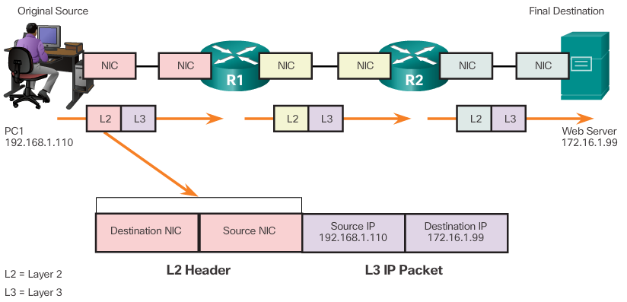
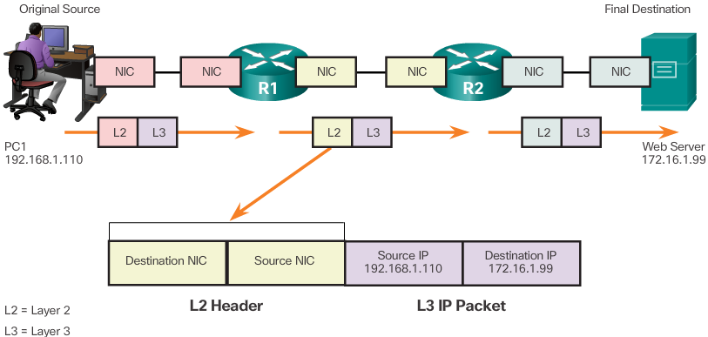
Layer 2 Data Link Addresses
Notes:
3.3.2.2 Data Link Address (Cont.)

Slide 20
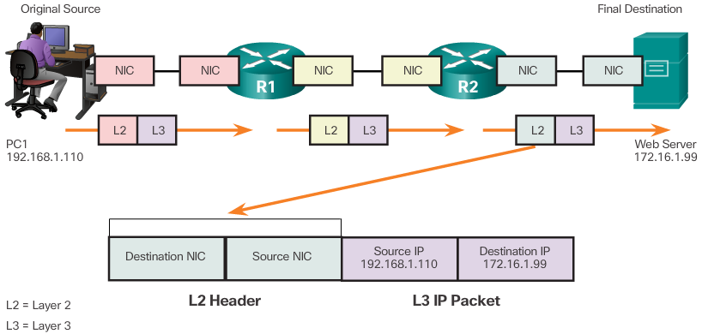
Layer 2 Data Link Addresses
Notes:
3.3.2.2 Data Link Address (Cont.)

Slide 21
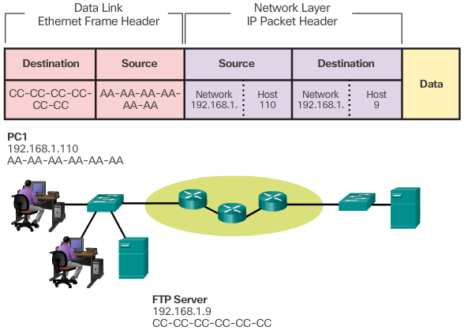
Notes:
3.3.2.3 Devices on the Same Network

Slide 22
Role of the Network Layer Addresses
    Network portion of the IP Address – The left-most part of the address that indicates which network the IP address is a member.
    Host portion – The remaining part of the address that identifies a specific device on the network.
Source IP address – The IP address of the sending device
Destination IP address – The IP address of the receiving device
Role of the Data Link Layer Addresses
    Source MAC address – This is the data link address, or the Ethernet MAC address, of the sending device.
    Destination MAC address – When the receiving device is on the same network as the sending device, this is the data link address of the receiving device.
Notes:
3.3.2.3 Devices on the Same Network (cont.)

Slide 23
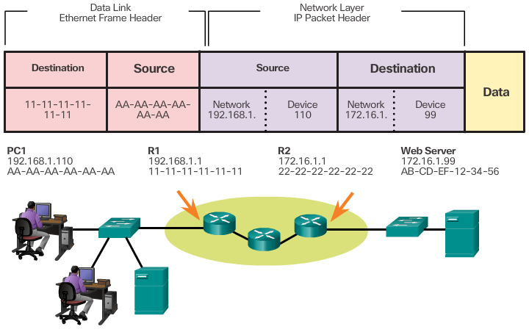
Notes:
3.3.2.4 Devices on a Remote Network

Slide 24
Role of the Network Layer Addresses
The source and destination IP addresses will represent hosts on different networks indicated by the different network portions of the source and destination addresses.
Role of the Data Link Layer Addresses
Destination MAC address - When the receiving device is on a different network from the sending device, the sending device uses the Ethernet MAC address of the default gateway or router.
Notes:
3.3.2.4 Devices on a Remote Network (cont.)

Slide 25
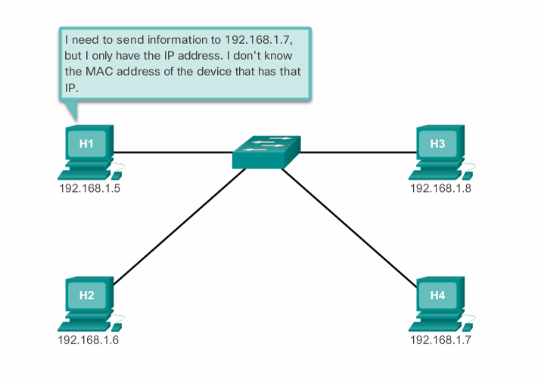
Notes:
5.3.2.1 Introduction to ARP

Slide 26
ARP Table
Used to find the MAC address that is mapped to the destination IPv4 address.
If the destination IPv4 address is on the same network as the source IPv4, the device will search the ARP table for the destination IPv4 address.
If the destination IPv4 address is on a different network, the device will search for the IPv4 address of the default gateway.
If the device locates the IPv4 address, its corresponding MAC address is used as the destination MAC address in the frame.
If no entry is found, then an ARP request is sent.
Notes:
5.3.2.2 ARP Functions

Slide 27
Sent when a device needs a MAC address associated with an IPv4 address, and it does not have an entry in its ARP table.
The ARP request message includes:
    Target IPv4 address – This is the IPv4 address that requires a corresponding MAC address.
    Target MAC address – This is the unknown MAC address and will be empty in the ARP request message.
The ARP request is encapsulated in an Ethernet frame using the following header information:
    Destination MAC address – This is a broadcast address requiring all Ethernet NICs on the LAN to accept and process the ARP request.
    Source MAC address – This is the sender’s MAC address.
    Type – ARP messages have a type field of 0x806.
Notes:
5.3.2.3 Video Demonstration - ARP Request

Slide 28
The device with the target IPv4 address in the ARP request will respond with an ARP reply. The ARP reply message includes:
    Sender’s IPv4 address – This is the IPv4 address of the sender, the device whose MAC address was requested.
    Sender’s MAC address – This is the MAC address of the sender, the MAC address needed by the sender of the ARP request.
The ARP reply is encapsulated in an Ethernet frame using the following header information:
    Destination MAC address – This is the MAC address of the sender.
    Source MAC address – This is the sender of the ARP reply’s MAC address.
    Type – ARP messages have a type field of 0x806.
Notes:
5.3.2.4 Video Demonstration - ARP Reply

Slide 29
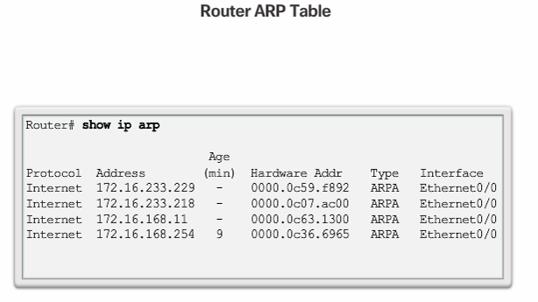
Notes:
5.3.2.7 ARP Tables on Networking Devices

Slide 30
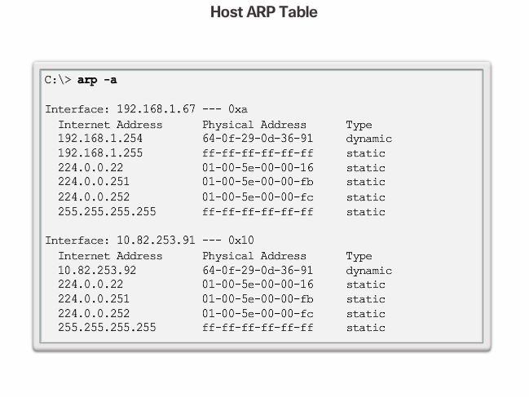
Notes:
5.3.2.7 (Cont.) ARP Tables on Networking Devices
5.3.2.8 Packet Tracer - Examine the ARP Table

