Slide 1
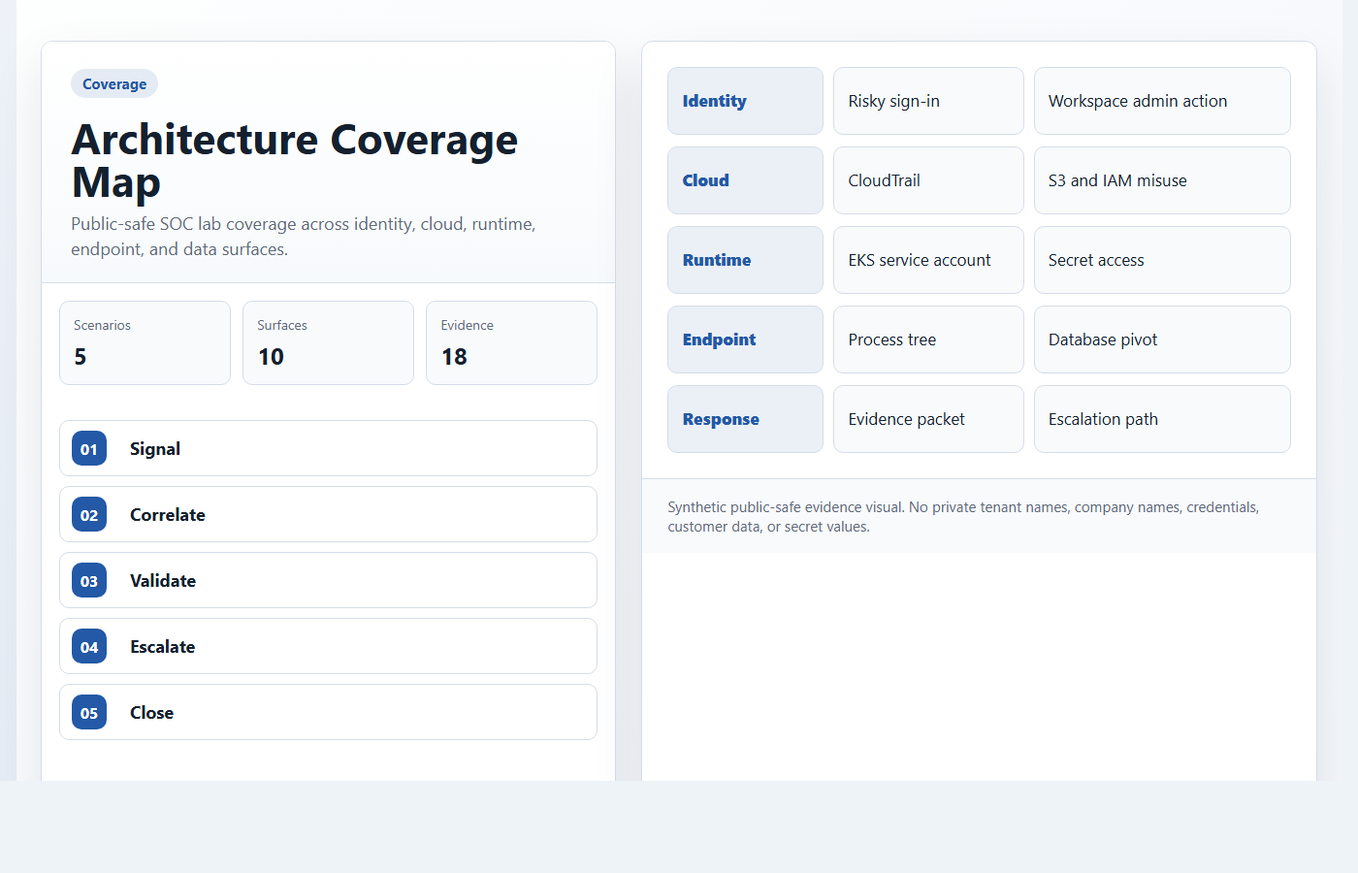
PUBLIC-SAFE SOC LAB
CloudSec SOC Detection Lab
A complete detection-engineering package with dashboard, synthetic datasets, replay harness, evidence visuals, flowcharts, and validation notes.
Architecture coverage map
Five scenarios, one evidence-led story
Public-safe lab package: synthetic datasets, sanitized evidence visuals, and no private tenant details.

Slide 2
ARCHITECTURE
02 / 10
The Lab Moves From Scenario Data To Analyst Action
The working model is intentionally layered: scenario rows, controlled replay, log visibility, monitor logic, evidence, and response.
ARCHITECTURE
Scenario
->
Replay
->
Logs
->
Monitor
->
Triage
Signal generation
Detection validation
Analyst output
Synthetic scenario rows model identity,
cloud, runtime, endpoint, and
data-access behavior without private
data.
Lambda replay sends controlled events
to Datadog-style logs using
source:test-harness and synthetic:true.
The dashboard maps proof, query pivots,
response decisions, and validation order into
one technical path.
Public-safe lab package: synthetic datasets, sanitized evidence visuals, and no private tenant details.

Slide 3
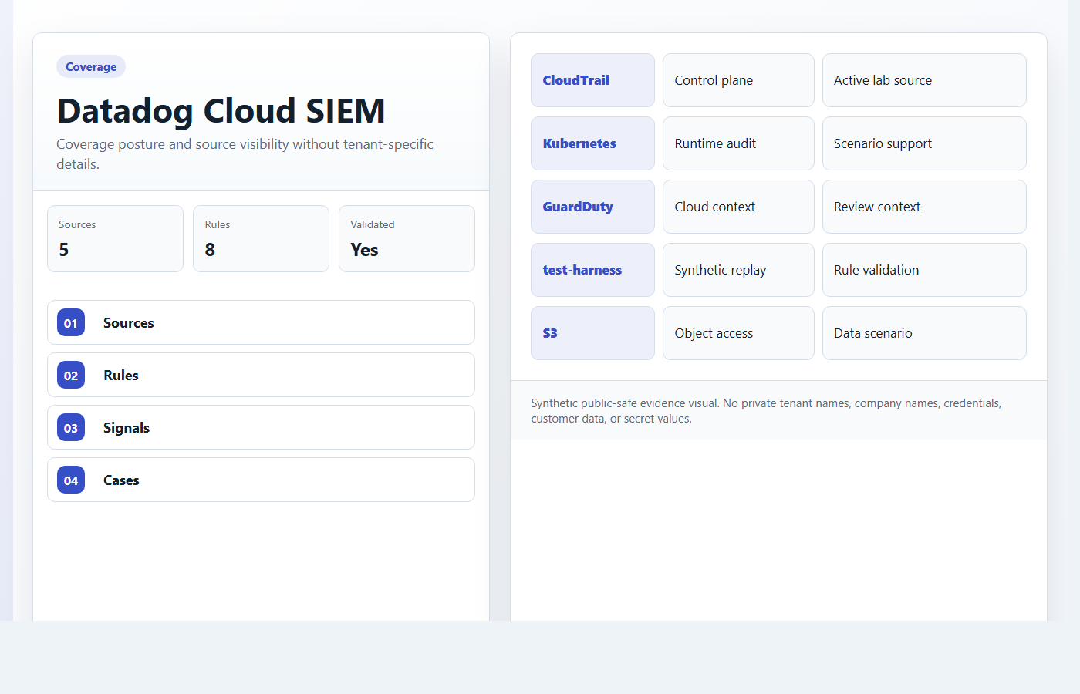
COVERAGE
03 / 10
Five Scenarios Cover The Core SOC Review Surface
Every scenario has a trigger, correlation path, proof anchor, query pivot, and response posture.
COVERAGE
5/5
18
6
Scenario coverage
Evidence visuals
Synthetic datasets
Identity, cloud, runtime, endpoint, and data access
Repo-owned public-safe assets
Alerts, identity, cloud, endpoint, assets, timeline
Public-safe lab package: synthetic datasets, sanitized evidence visuals, and no private tenant details.

Slide 4
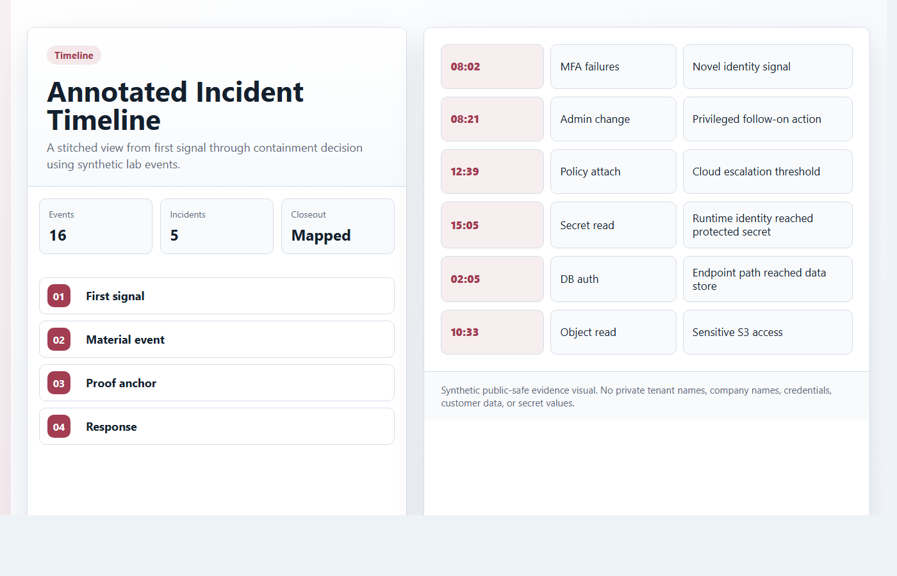
EVIDENCE MODEL
04 / 10
Proof Is Public-Safe And Still Mapped To Operator Decisions
Generated evidence panels replace environment-specific captures while the investigation logic remains intact.
EVIDENCE MODEL
Alert
->
Evidence
->
Query
->
Blast radius
->
Action
Proof anchor
Query pivot
Response packet
Each scenario has a visual artifact
that explains why the alert deserves
attention.
The query appendix shows how an analyst
would narrow the case from event
context to response action.
Checklist, timeline, and escalation
outline make the handoff defensible
without private prep notes.
Public-safe lab package: synthetic datasets, sanitized evidence visuals, and no private tenant details.

Slide 5
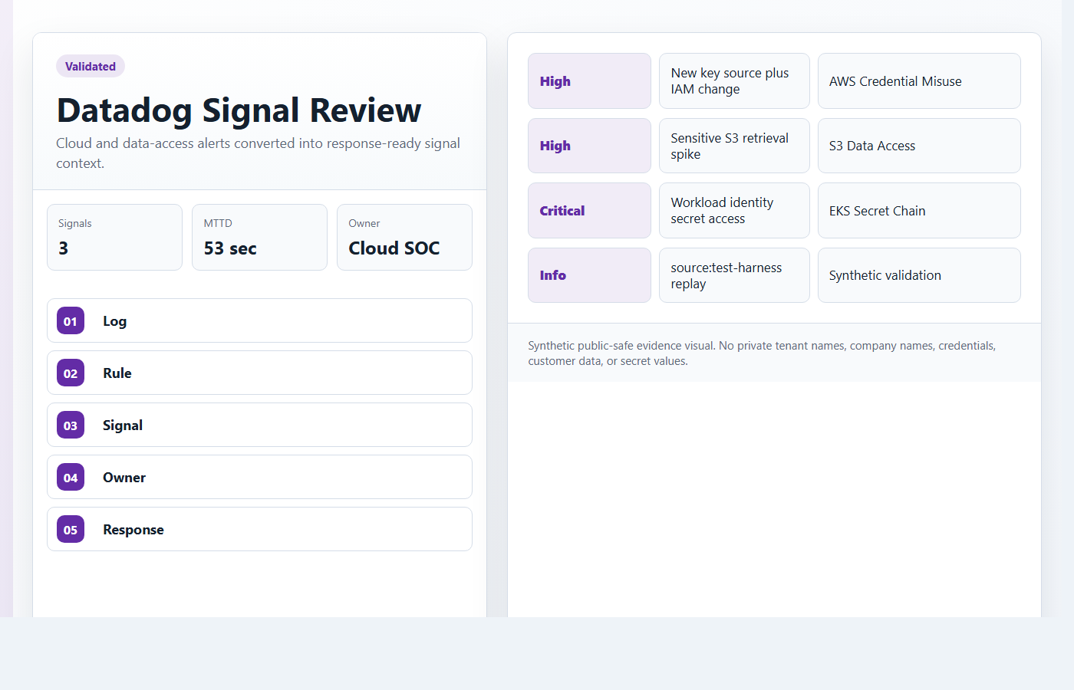
DETECTION ENGINEERING
05 / 10
Each Scenario Follows The Same Analyst Pattern
A consistent trigger-to-response structure makes the case flow easy to audit and easy to defend.
DETECTION ENGINEERING
Trigger
->
Correlate
->
Materiality
->
Response
Trigger
Correlate
Respond
Start from a concrete security signal:
identity anomaly, API change, secret
read, process chain, or object access.
Connect the first signal to material
follow-on behavior before escalating.
Choose containment, validation,
rotation, or escalation based on asset
and data impact.
Public-safe lab package: synthetic datasets, sanitized evidence visuals, and no private tenant details.

Slide 6
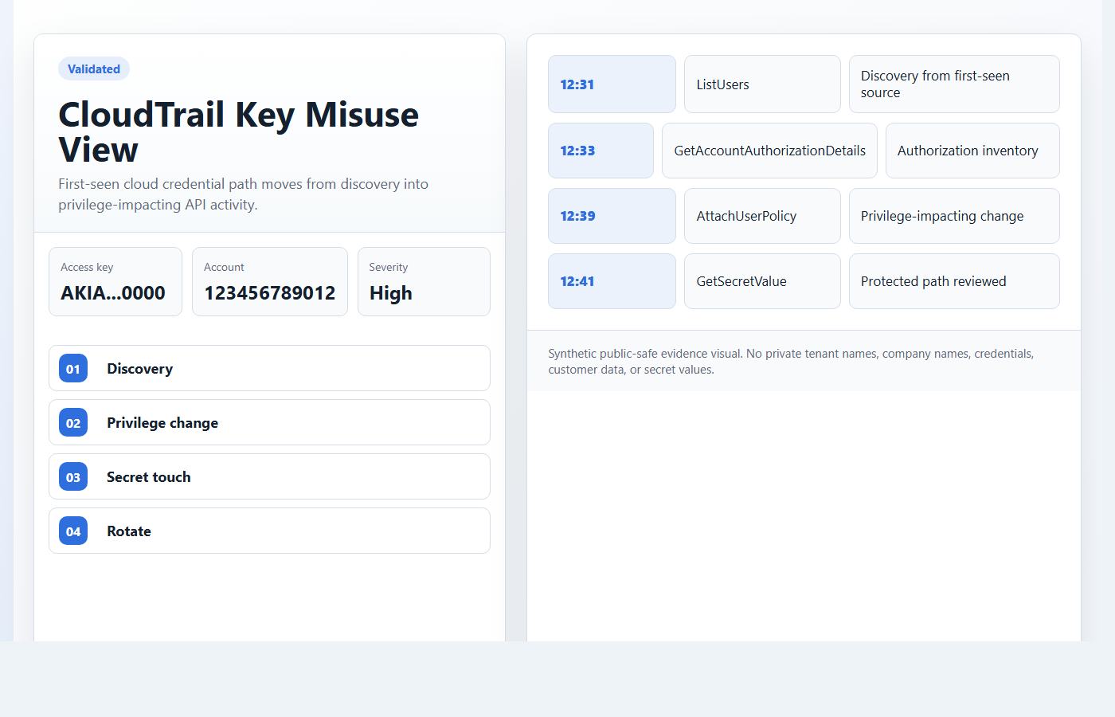
CLOUD SCENARIOS
06 / 10
AWS Credential Misuse And S3 Access Show Cloud Materiality
Discovery becomes an incident when privilege, secrets, or sensitive objects enter the path.
CLOUD SCENARIOS
IAM
S3
53s
Privilege path
Data path
Detection target
First-seen credential plus policy-impacting API activity
Novel principal with sensitive object access
Fast signal review after high-confidence activity
Public-safe lab package: synthetic datasets, sanitized evidence visuals, and no private tenant details.

Slide 7
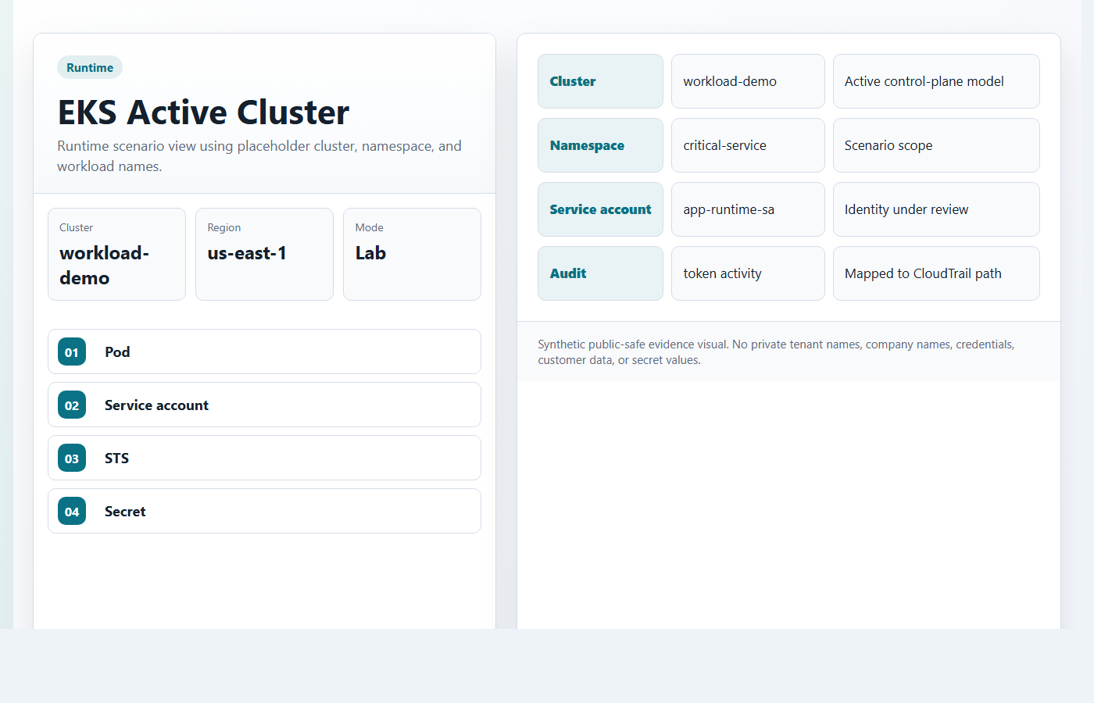
RUNTIME SCENARIO
07 / 10
EKS Secret Access Chain Turns Runtime Noise Into Impact
The important jump is from workload identity behavior into STS, secret retrieval, and KMS usage.
RUNTIME SCENARIO
Pod
->
Service account
->
STS
->
Secret
->
Rotate
Workload identity
Secret touch
Response bias
Unexpected service-account activity
creates the first runtime signal.
GetSecretValue or KMS decrypt makes the
case material.
Contain namespace or identity, preserve
workload evidence, and rotate touched
secrets.
Public-safe lab package: synthetic datasets, sanitized evidence visuals, and no private tenant details.

Slide 8
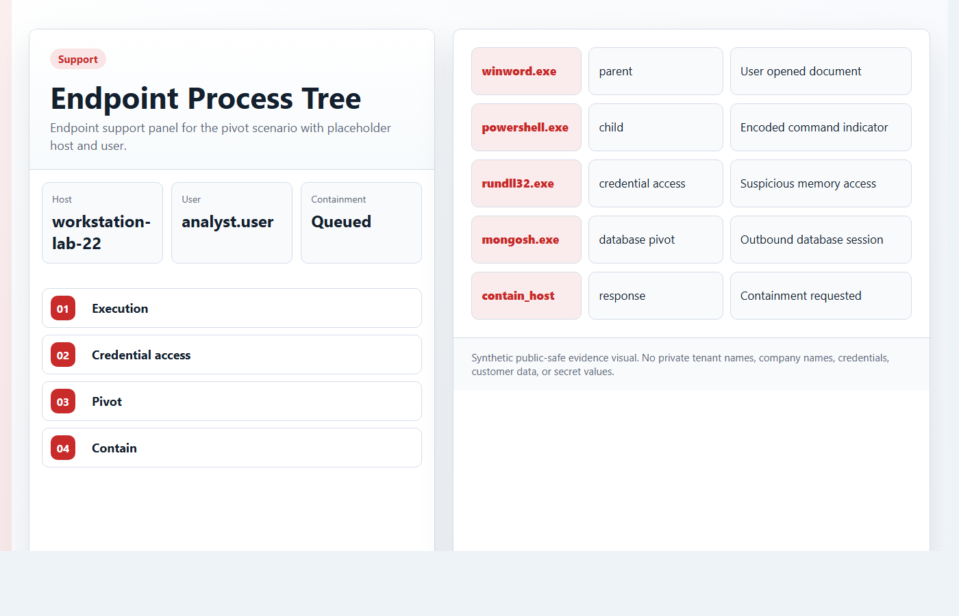
ENDPOINT TO DATA
08 / 10
Endpoint-To-MongoDB Pivot Connects Host Evidence To Data Risk
Process lineage becomes higher priority when it lines up with database authentication and collection access.
ENDPOINT TO DATA
Execution
->
Credential access
->
DB auth
->
Collection
->
Contain
Host signal
Database touch
Containment
Suspicious process lineage gives the
first endpoint proof.
MongoDB authentication and collection
access make the case data-facing.
Preserve process lineage, contain the
host, and scope database reads.
Public-safe lab package: synthetic datasets, sanitized evidence visuals, and no private tenant details.

Slide 9
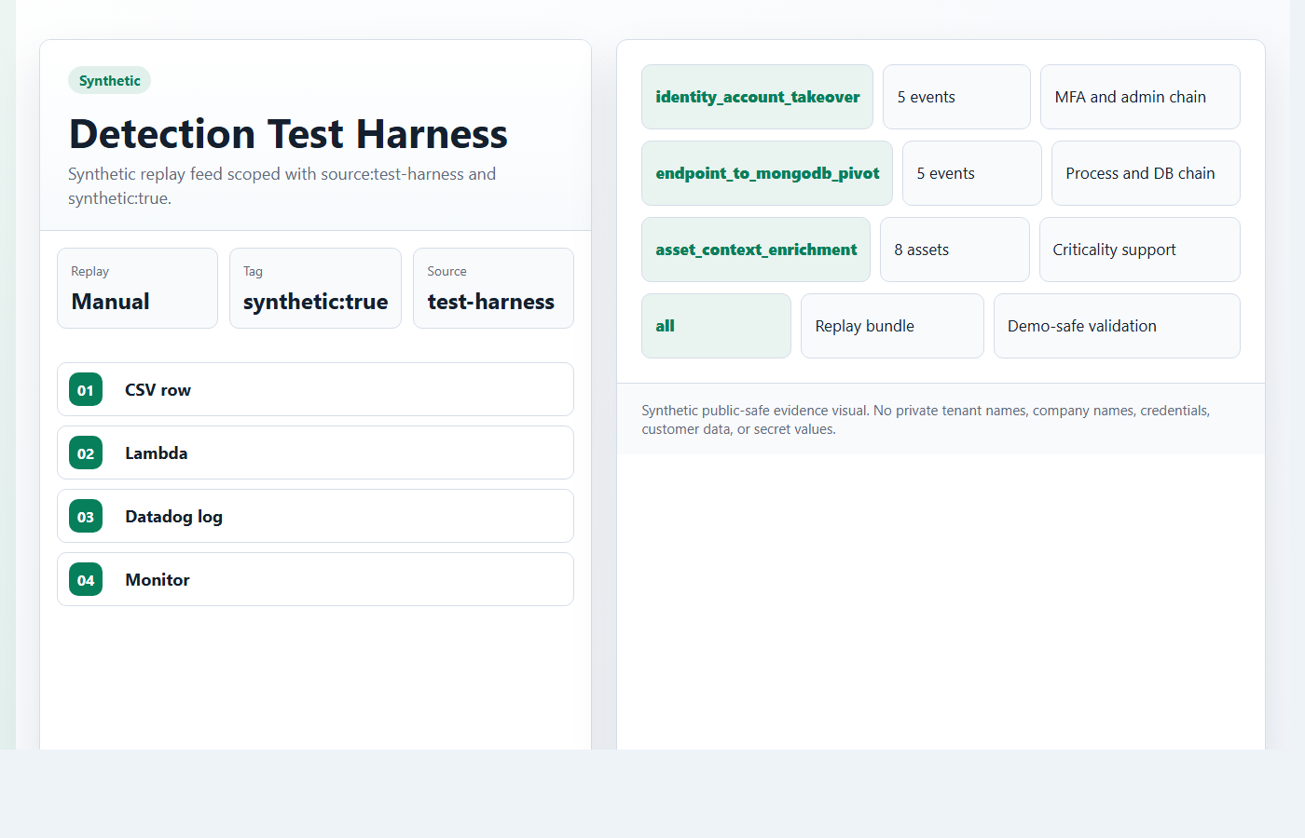
HARNESS AND DASHBOARD
09 / 10
Validation Is Repeatable Because Replay Is Controlled
The harness creates consistent validation data, while the dashboard keeps the evidence map grounded.
HARNESS AND DASHBOARD
source:test-harness
synthetic:true
5 stages
Replay scope
Integrity tag
Dashboard flow
Synthetic feed is visible and filterable
Validation data is not confused with tenant telemetry
Scope, status, evidence, engineering, closeout
Public-safe lab package: synthetic datasets, sanitized evidence visuals, and no private tenant details.

Slide 10
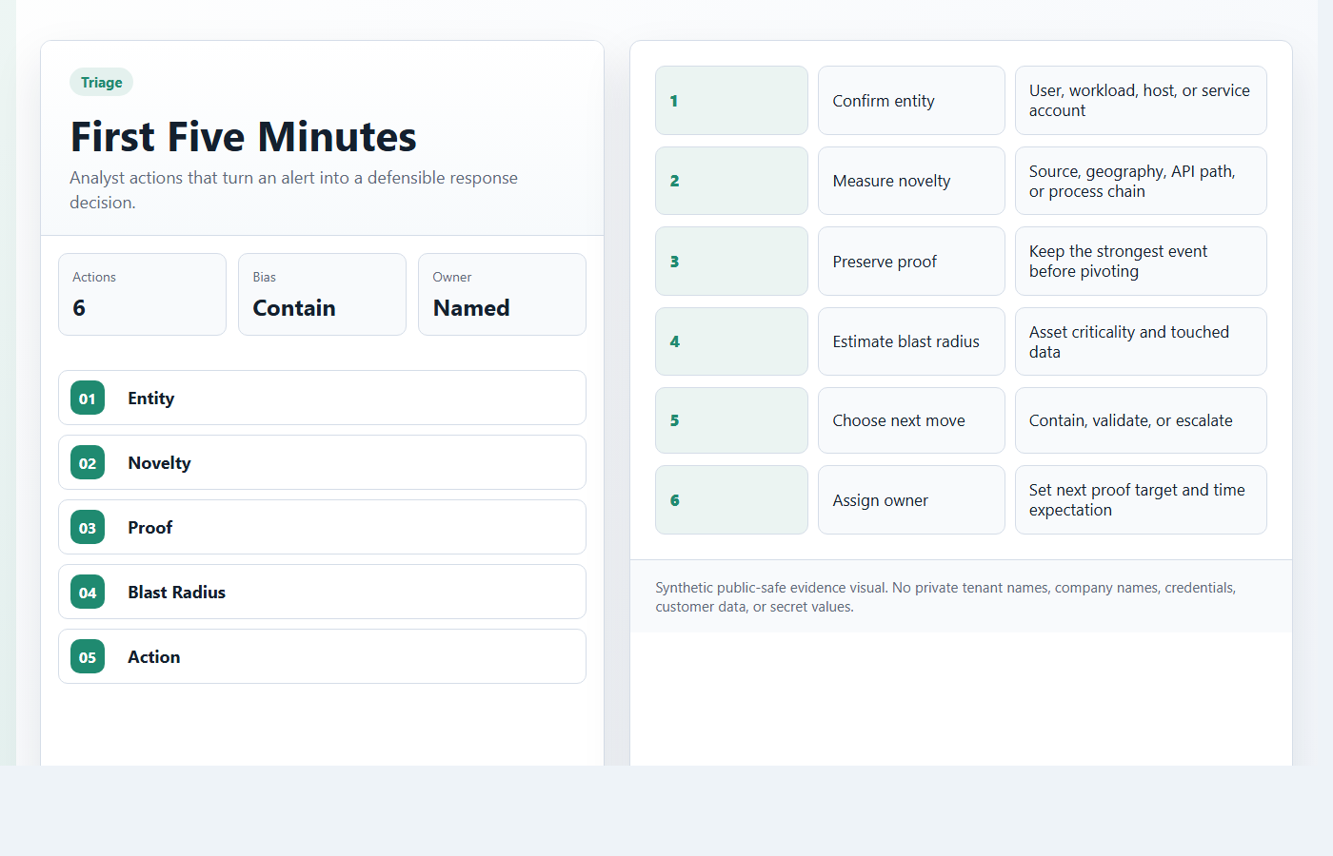
READINESS
10 / 10
The Public Package Is Complete And Defensible
The dashboard, flowcharts, evidence, harness, and scenario notes can be inspected together.
READINESS
Dashboard
->
Evidence
->
Scenarios
->
Harness
->
Closeout
Complete package
Public-safe
Validation-ready
Dashboard, datasets, harness, evidence
assets, flowcharts, query appendix, and
deck are aligned.
No company names or tenant identifiers,
no credentials or secret values,
and no environment-specific captures.
The lab has clear truth rules,
fallback visuals, and repeatable
validation order.
Public-safe lab package: synthetic datasets, sanitized evidence visuals, and no private tenant details.

