Slide 1
CAPSTONE PROJECT
End-to-End Test
Automation
Project 1 · UI E2E Automation
Project 2 · Food Fun REST API Testing
Rohith V H · Kalla Pavani · Sana Bano · Sree Bhargav Reddy · Amulya Rani Noonela
Wipro Training | IIHT Techademy | February 2026
Python
Flask
Selenium
Pytest
Robot Framework
Postman

Slide 2
WIPRO · IIHT Techademy · Capstone Project
2026
Meet the Team
Wipro Training | IIHT Techademy — All 5 Members
RV
Rohith V H
KP
Kalla Pavani
SB
Sana Bano
Trainee
Trainee
Trainee
Python - Flask - Pytest - Selenium - Robot Framework - Postman
Python – Flask - Pytest - Selenium - Robot Framework - Postman
Python - Flask - Pytest - Selenium - Robot Framework - Postman
SB
Sree Bhargav Reddy
AR
Amulya Rani Noonela
Trainee
Trainee
Python – Flask - Pytest - Selenium - Robot Framework - Postman
Python - Flask - Pytest - Selenium - Robot Framework - Postman

Slide 3
WIPRO · IIHT Techademy · Capstone Project
2026
Training Skills Acquired
All 5 members trained across the full automation testing stack
🐍
🌐
🧪
🤖
Python Programming
Selenium WebDriver
Pytest Framework
Robot Framework
Core language for all automation scripts and Flask API development
Browser automation for Chrome, Firefox and Edge
Unit & integration testing with parametrize, fixtures and conftest
Keyword-driven testing with SeleniumLibrary & RequestsLibrary
📬
🗂️
📊
🌶️
Postman (Manual)
Page Object Model
Data-Driven Testing
Flask REST APIs
Manual API verification — 18 REST endpoints across 5 modules
Clean POM design for maintainable, scalable test code
CSV-based testing — new users with zero code changes
Built Food Fun API with 18 endpoints across 5 modules

Slide 4
WIPRO · IIHT Techademy · Capstone Project
2026
Capstone at a Glance
Two complete, production-grade testing projects
PROJECT 1
PROJECT 2
UI E2E Automation
Food Fun API Testing
▸ App: demowebshop.tricentis.com
▸ App: Food Fun — Python Flask REST API
▸ Type: Web UI End-to-End Automation
▸ Type: Backend API Testing (Manual+Auto)
▸ Frameworks: Selenium + Pytest + Robot
▸ Tools: Flask · Pytest · Robot · Postman
▸ Approach: Page Object Model + CSV
▸ Endpoints: 18 REST APIs across 5 modules
▸ Flow: 10 Steps — Register to Logout
▸ Manual: Postman — all 18 endpoints ✓
▸ Pytest: 5 users — 4/5 PASSED (3m 56s)
▸ Pytest: 38 tests across 6 files — PASSED
▸ Robot: 3 users — all PASSED
▸ Robot: 13 E2E API test cases — PASSED
▸ Browsers: Chrome · Firefox · Edge
▸ Modules: Restaurant · Dish · User · Order

Slide 5
WIPRO · IIHT Techademy · Capstone Project
2026
Key Takeaways & Learnings
What the team gained from the Wipro Training program
01
Real-World E2E Testing
Gained hands-on knowledge of manual and automation testing — designed and executed real-world E2E test scenarios on demowebshop.
02
Dual Framework Mastery
Built automation frameworks using Selenium with Python (Pytest) and Robot Framework with SeleniumLibrary for reliable web testing.
03
Data-Driven Design
Implemented data-driven testing using CSV files — add any number of users without changing a single line of code.
04
Automated Reporting
Generated automated HTML reports with screenshots on failure for both Pytest and Robot Framework.
05
Team Collaboration
Developed teamwork, debugging, and time management skills while collaborating on a live automation project.

Slide 6
PROJECT-1
UI End-to-End
Automation Testing
demowebshop.tricentis.com
Technology Stack - Python · Selenium · Pytest · Robot Framework
Page Object Model · CSV Data-Driven · Cross-Browser · 10-Step E2E Flow

Slide 7
WIPRO · IIHT Techademy · Capstone Project
2026
Problem Statement – Project 1
Why automation was needed for demowebshop.tricentis.com
THE PROBLEM
OUR GOALS
demowebshop.tricentis.com is a real e-commerce platform used for automation practice.
✔ Automate complete user journey (10 steps)
Testing flows (Register → Login → Cart → Logout) manually for multiple users is slow and error-prone.
✔ Zero code change when adding new users
Hard to scale — adding a new test user means duplicating entire test scripts.
✔ Cross-browser coverage — Chrome, Firefox, Edge
✔ Auto-generated HTML reports per run
No automated reporting — testers had to manually verify pass/fail.
✔ Step-named screenshots on failure
Cross-browser coverage was not possible without automation.
✔ Scalable, maintainable POM design
Solution: Built TWO frameworks — Pytest + Selenium (POM) and Robot Framework — both data-driven via CSV and cross-browser ready.

Slide 8
Project Overview
Project | Type | Tools & Technologies | Outcome
Pytest Automation Framework | Web Testing | Python, Pytest, Selenium, CSV | Data-driven E2E tests with HTML reports & screenshots
Robot Framework Automation | Web Testing | Robot Framework, SeleniumLibrary, Python, CSV | Keyword-driven E2E suite with automated reporting
Application Under Test | E-Commerce App | demowebshop.tricentis.com | Full user journey from Registration to Logout automated
Browsers Supported | Cross-Browser | Chrome, Firefox, Edge | Configurable via config file — no code change needed

Slide 9
WIPRO · IIHT Techademy · Capstone Project
2026
Pytest Selenium Framework
Objective: Automate 10-step E2E user flow — data-driven via CSV
FOLDER STRUCTURE
KEY ACTIVITIES
📁 Capstone_Project/
▸ Page Object Model
📁 Selenium_Pytest/
📁 pages/
Each page has its own Python class — RegisterPage, LoginPage, CartPage, ProductPage, HomePage, BasePage.
🐍 base_page.py
🐍 login_page.py
▸ conftest.py + Fixtures
🐍 registration_page.py
Browser fixtures and @pytest.mark.parametrize feeds each CSV row as a separate test case automatically.
🐍 home_page.py
🐍 product_page.py
🐍 cart_page.py
▸ 10-Step E2E Flow
📁 tests/
Register → Login → Search → Product → Cart → Update Qty → Remove → Logout — automated per user.
🐍 test_full_flow.py
📁 utilities/
🐍 browser.py
▸ Auto Screenshot on Failure
🐍 helper.py
fail_step3_login_20260219.png — step-named, timestamped screenshots for instant failure identification.
📁 config/ — config.ini
📁 data/ — test_data.csv
📁 reports/ — HTML reports
▸ Unique HTML Reports
📁 screenshots/
report_19FEB2026_1530.html — timestamped, never overwritten, full history preserved per run.
🐍 conftest.py
✓ 5 users — 4/5 PASSED | Total time: 3 min 56 sec | Tools: Python · Pytest · Selenium · CSV · PyCharm

Slide 10
WIPRO · IIHT Techademy · Capstone Project
2026
Robot Framework UI Automation
Same 10-step E2E flow — keyword-driven, CSV data-driven
FOLDER STRUCTURE
KEY ACTIVITIES
📁 Capstone_Project/
▸ Keyword-Driven Design
📁 Selenium_Robot/
📁 tests/
Separate .robot keyword files per module — login, cart, product, register — clean, reusable keywords.
🤖 test_All.robot
📁 keywords/
▸ Same 10-Step E2E Flow
🤖 common_keywords.robot
Identical flow to Pytest: Register → Login → Search → Cart → Update → Remove → Logout per CSV row.
🤖 login_keywords.robot
🤖 cart_keywords.robot
🤖 product_keywords.robot
▸ CSV-Driven Execution
🤖 register_keywords.robot
Each row in test_data.csv runs as E2E Flow - User 1, 2, 3... Zero code changes to add users.
📁 resources/
🤖 config.robot
🤖 locators.robot
▸ Auto Test Teardown
📁 variables/
Browser closes automatically via Test Teardown — no leftover sessions between test runs.
📄 test_data.csv
📁 reports/
📊 log.html
▸ Automated Reports
📊 report.html
Robot auto-generates log.html, report.html and output.xml after every test run.
📄 output.xml
✓ 3 users — E2E Flow User 1, 2, 3 — all PASSED | Tools: Robot Framework · SeleniumLibrary · Python · CSV

Slide 11
WIPRO · IIHT Techademy · Capstone Project
2026
E2E Test Flow – 10 Steps Per User
Applies to both Pytest and Robot Framework
1
Verify Site Loaded
2
Register
Assert page title and URL is correct
Fill form, select gender, submit registration
3
Login
4
Search Product
Enter credentials, verify account link visible
Enter keyword in search, assert results appear
5
Open Product
6
Add to Cart
Click product card, verify detail page and price
Set quantity, click Add to Cart, check notification
7
Verify Cart
8
Update Quantity
Navigate to cart, assert product and quantity
Change quantity field, click Update Cart
9
Remove Item
10
Logout
Check remove checkbox, click Update Cart
Click Log out link, verify session ended

Slide 12
WIPRO · IIHT Techademy · Capstone Project
2026
Data-Driven Testing – CSV Approach
Add any user by adding a row — zero code changes in both frameworks
test_data.csv
first_name, last_name, email, password, gender, product_search, product_name, add_qty, updated_qty
Sana, Bano, sana.bano@test.com, Test@1234, female, Blue Jeans, Blue Jeans, 1, 3
Kalla, Pavani, kalla.pavani@test.com, Pass@5678, female, Computing, Computing, 1, 2
Rohit, V, rohit.v@test.com, pass@123, male, Blue Jeans, Blue Jeans, 2, 3
← Add any new row here — both Pytest and Robot pick it up automatically on the next run
N Users — Zero Code Changes
Step-Named Screenshots
Add any user to CSV — both Pytest and Robot auto-detect on next run. No script edits required.
fail_step3_login_20260219.png — know exactly where it failed at a glance, instantly.
Cross-Browser Support
Unique Reports Per Run
Chrome, Firefox, Edge — change one word in config.ini, no other changes needed anywhere.
report_19FEB2026_1530.html — timestamped, full history preserved, never overwritten.

Slide 13
WIPRO · IIHT Techademy · Capstone Project
2026
Key Features of Our Automation Framework
Six core capabilities built into both Pytest and Robot frameworks
∞
📸
🔄
N-User Scalability
Auto Screenshot on Failure
Fully Data-Driven
Add any number of users by adding a CSV row. Both frameworks auto-detect new rows — no code changes required in any test script.
Pytest captures timestamped screenshots on every failure. Robot generates log.html, report.html and output.xml automatically.
All test data (name, email, password, gender, product, qty) in CSV. Same 10-step flow runs for every row — reusable and maintainable.
📊
🌐
🗂️
Unique Reports Per Run
Cross-Browser Support
Page Object Model
Pytest generates a new timestamped report each run (report_19FEB2026_1530.html). Full run history preserved — no overwrites ever.
Chrome, Firefox and Edge supported. Switch browsers by changing one line in config.ini or config.robot — zero code changes elsewhere.
Each page has its own class in Pytest. Robot Framework uses separate keyword files per module — easy to maintain, debug and scale.

Slide 14
WIPRO · IIHT Techademy · Capstone Project
2026
Test Execution Results – UI Automation
Project 1: Pytest + Robot Framework results
8
7
1
3
UI Test Steps
Passed
Failed
Browsers
PYTEST + SELENIUM
ROBOT FRAMEWORK
test_full_flow[User_1] – Sana Bano
PASSED
E2E Flow - User 1 (Sana Bano)
PASS
test_full_flow[User_2] – Kalla Pavani
PASSED
E2E Flow - User 2 (Kalla Pavani)
PASS
test_full_flow[User_3] – Amulya Noonela
PASSED
E2E Flow - User 3 (Rohit V)
PASS
test_full_flow[User_4] – Rohith V
FAILED
test_full_flow[User_5] – Sree Bhargav
PASSED
4 passed · 1 failed · 3 min 56 sec
3 passed · 0 failed

Slide 15
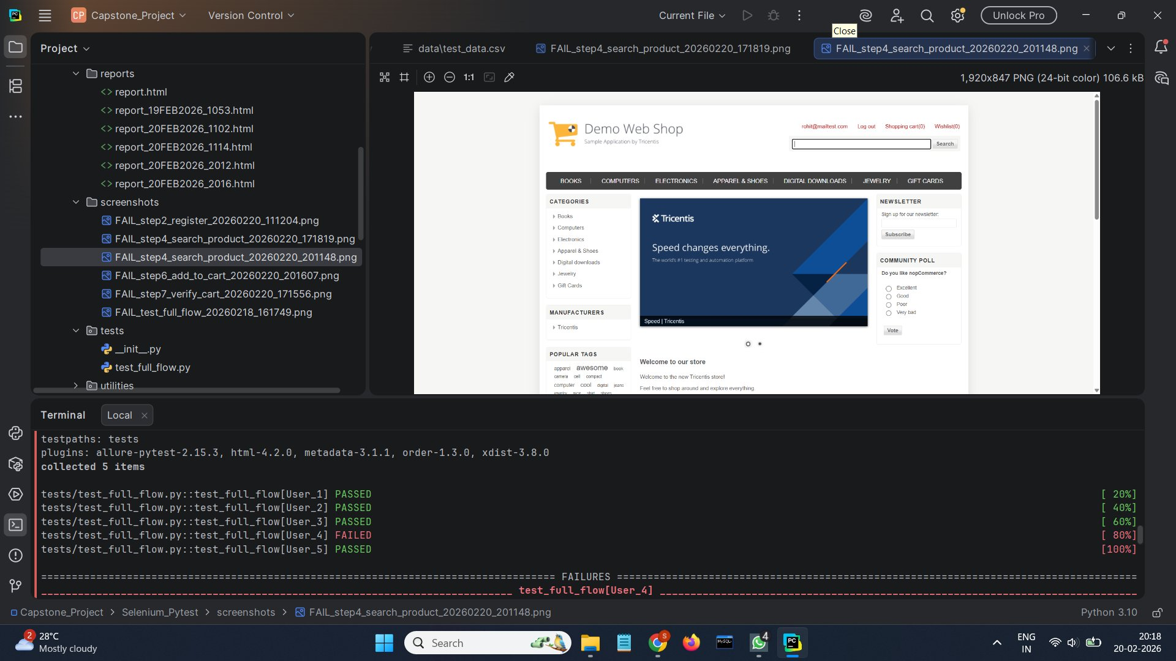
WIPRO . IIHT Techademy . Capstone Project
PROJECT 1 . FAILURE DEMO
Test Failure - Demonstrating Auto Screenshot
User_4 failed at Step 4 (Search Product) - empty search field - screenshot captured automatically
What Happened
User_4 had an empty search keyword in the CSV. The search field was intentionally left blank to trigger a failure at Step 4: Search Product.
Why We Did This
To prove our auto-screenshot mechanism works. The framework detects the failure, names the file with the exact step, and saves it instantly without any manual action.
Screenshot Filename
FAIL_step4_search_product_20260220_201148.png
Step name + date + time - all in the filename.
Other 4 Users
User_1, 2, 3 and 5 all PASSED - proving only User_4 had bad input data causing the failure.
Auto-Captured Failure Screenshot - PyCharm IDE View
x User_4 FAILED (empty search field) . checkmark Users 1, 2, 3, 5 PASSED . Framework auto-captured screenshot at exact failing step . Pytest . Selenium . PyCharm

Slide 16
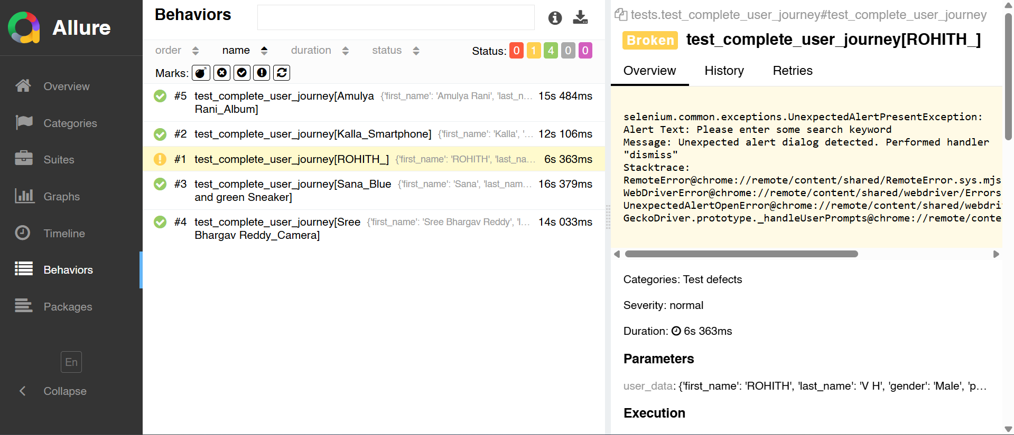
WIPRO . IIHT Techademy . Capstone Project
PROJECT 1 . ALLURE REPORT
Allure Report
Behaviors View - 5 Test Cases
Live Allure Report - Behaviors Tab - 18-02-2026
What is Allure?
Allure is a rich HTML test reporting framework that transforms Pytest results into beautiful, interactive dashboards with detailed test behaviour views.
Behaviors Tab
Groups all tests by their function. Each row shows test name, parametrized user, duration, and pass/fail status at a glance.
5 Test Results
PASSED Amulya Rani Album - 12s 615ms
PASSED Kalla Smartphone - 14s 027ms
FAILED ROHITH Computer - 13s 128ms
PASSED Sana Blue Sneaker - 13s 312ms
PASSED Sree Bhargav Camera - 12s 328ms
Why Allure?
Allure shows Set Up, Test Body, and Tear Down per test. Parameters (user data per row) are visible, making data-driven testing fully transparent and traceable.
4/5 PASSED . Allure . Pytest . Selenium . 18-02-2026

Slide 17
WIPRO · IIHT Techademy · Capstone Project
PROJECT 1 · CHALLENGES
Challenges Faced & How We Solved Them
PROJECT
01
Project 1 · UI End-to-End Automation on demowebshop.tricentis.com
1
CHALLENGE
2
CHALLENGE
Selenium Too Fast — Dynamic Elements Not Ready
Cross-Browser Setup Without Duplicating Code
✔ HOW WE SOLVED IT
✔ HOW WE SOLVED IT
Replaced all time.sleep() calls with WebDriverWait and ExpectedConditions (element_to_be_clickable, visibility_of_element_located). Tests now wait only as long as needed — stable across slow connections and fast CI environments.
Centralised all WebDriver creation inside browser.py → get_browser(). Reads the browser name from config.ini and returns the correct driver (Chrome / Firefox / Edge). No test file, page class or conftest.py needs to know which browser is active.
3
CHALLENGE
4
CHALLENGE
Testing Multiple Users Without Copy-Pasting Scripts
Silent Failures — Hard to Know Which Step Broke
✔ HOW WE SOLVED IT
✔ HOW WE SOLVED IT
Used @pytest.mark.parametrize in conftest.py to read test_data.csv and generate one independent test case per row automatically. In Robot Framework, a FOR loop iterates each row. Adding a new user = one new CSV row — both frameworks detect it instantly.
Built a step tracker helper. On any Selenium exception, the except block calls take_screenshot(driver, step_name) and saves the image as FAIL_step3_login_20260220_1114.png. Step number, step name, date and time — all visible in the filename alone.

Slide 18
02
PROJECT- 2
Foodie App REST API
Development & Testing
Tools & Technology Stack - Python · Flask · Pytest · Robot Framework · Postman
18 REST Endpoints · 6 Modules · Manual + Automated · 38 Pytest Tests · 13 Robot Tests

Slide 19
Project Overview
Project | Type | Tools & Technologies | Outcome
Foodie App REST API | Backend API | Python, Flask API | Food Ordering System
Manual Testing | API Validation | Postman | Verifying HTTP status codes
API Testing – Pytest | Automation Testing | Pytest, request library | Automated API validation
API Testing – Robot Framework | Automation Testing | Robot Framework, RequestsLibrary | Keyword-driven API suite

Slide 20
WIPRO · IIHT Techademy · Capstone Project
2026
Food Fun – What We Built & How It Works
A stateless Flask REST API with 6 blueprints, tested at 3 levels
Food Fun is a Python Flask REST API built without a database — all data lives in in-memory Python dictionaries in config.py. Six blueprints (restaurants, dishes, users, orders, ratings, admin) are registered in app.py and tested via Postman, Pytest, and Robot Framework.
Flask API
6 route files (blueprints), all registered in app.py. Data stored in config.py as Python dicts with auto-incrementing integer IDs. No DB — fully stateless.
Python + Blueprints
Manual Testing
All 18 endpoints tested manually. Verified status codes (200/201/400/404/409), JSON response fields, positive and negative/edge cases for every route.
Postman
Automated Testing
conftest.py creates Flask test client + resets all counters/dicts before each test. 38 tests in 6 files — positive, negative, missing-field, and not-found cases.
Pytest + Flask Test Client
E2E API Flow
13 chained test cases against a live server (127.0.0.1:5000). IDs extracted from responses and passed forward — full flow from user registration to admin feedback view.
Robot Framework + RequestsLibrary

Slide 21
WIPRO · IIHT Techademy · Capstone Project
2026
Key Features of Foodie App – What the Code Actually Does
🛡️
In-Memory Data Store with Auto-ID
✅
Admin Approval Gate Before Orders
▸ config.py holds all data in Python dicts: restaurants{}, dishes{}, users{}, orders{}, ratings{}
▸ Restaurants start with approved=False, disabled=False on registration
▸ Auto-incrementing counters: restaurant_counter, dish_counter, user_counter, order_counter, rating_counter
▸ Admin must call PUT /api/v1/admin/restaurants/{id}/approve before any order can be placed
▸ Each new record gets an auto-assigned integer ID — no database needed, pure in-memory REST API
▸ Place Order validates: restaurant must exist, be approved, and not disabled — otherwise returns 400
🔒
Duplicate & Validation Guards on Every Route
💰
Auto Price Calculation & Rating-to-Feedback Dual Store
▸ Restaurant: 409 if same name already exists. User: 409 if same email already registered
▸ Place Order sums dish prices from config.dishes and stores total_price in the order response
▸ All POST routes validate required fields — return 400 with {"error": "Invalid request"} if missing
▸ Orders validate each dish belongs to the correct restaurant and is enabled — prevents cross-restaurant dish abuse
▸ Dish add validates restaurant exists (404), Order validates user, restaurant, dish IDs all exist
▸ Ratings are stored in both config.ratings{} (keyed by ID) and config.feedbacks[] (admin feedback list) simultaneously

Slide 22
WIPRO · IIHT Techademy · Capstone Project
2026
Foodie App – Folder Structure
Flask API project layout with test suites
FLASK API STRUCTURE
ROUTE BLUEPRINTS
📁 Foodie_App/
restaurants.py
🐍 app.py
🐍 config.py
Register, view profile, update, disable restaurant
📁 routes/
🐍 __init__.py
dishes.py
🐍 restaurants.py
🐍 dishes.py
Add, update, enable/disable, delete dishes
🐍 users.py
🐍 orders.py
users.py
🐍 ratings.py
🐍 admin.py
User registration, search restaurants
📁 tests/
orders.py
🐍 conftest.py
🐍 test_restaurants.py
Place order, view by user, view by restaurant
🐍 test_dishes.py
🐍 test_admin.py
ratings.py
🐍 test_users.py
🐍 test_orders.py
Post rating and comment for an order
🐍 test_ratings.py
📁 robot/
admin.py
🤖 Foodie_App.robot
📊 log.html / output.xml
Approve/disable restaurant, view orders & feedback

Slide 23
WIPRO · IIHT Techademy · Capstone Project
2026
18 REST API Endpoints – 6 Modules
Complete API coverage: GET · POST · PUT · DELETE
Module | HTTP Method | Endpoint / Operation | Status Codes
Restaurant | POST · GET · PUT · PUT | Register, View Profile, Update Details, Disable | 201 · 200 · 404
Dish | POST · PUT · PUT · DELETE | Add Dish, Update, Enable/Disable Status, Delete | 201 · 200 · 404
Admin | PUT · PUT · GET · GET | Approve Restaurant, Disable, View Orders, Feedback | 200 · 404
User | POST · GET | User Registration, Search Restaurants | 201 · 200 · 409
Order | POST · GET · GET | Place Order, View by User, View by Restaurant | 201 · 200 · 400
Rating | POST | Give Rating & Comment for an Order | 201 · 400
Total: 18 endpoints · GET · POST · PUT · DELETE · Status codes: 200, 201, 400, 404, 409

Slide 24
WIPRO · IIHT Techademy · Capstone Project
2026
Manual API Testing – Postman
All 18 endpoints verified manually before automation
POSTMAN COLLECTION
WHAT WAS VERIFIED
Foodie_App_API
✔ Status Codes
200 OK, 201 Created, 400 Bad Request, 404 Not Found, 409 Conflict
🍽️ Restaurants (4 requests)
✔ JSON Response Fields
🥘 Dish (4 requests)
All fields and data types verified per endpoint
✔ Positive Scenarios
👤 Users (2 requests)
Valid requests return expected responses and data
📦 Orders (3 requests)
✔ Negative Scenarios
Duplicate, missing field and not-found cases handled
⭐ Ratings (1 request)
✔ Sample GET
🔧 Admin (4 requests)
GET /api/v1/restaurants → 200 OK | name: Food Factory, approved: true, category: Veg
✔ Sample POST
Total: 18 endpoints across 6 modules
POST /api/v1/restaurants/1/dishes → 201 CREATED | Aloo Paratha, price 150

Slide 25
WIPRO · IIHT Techademy · Capstone Project
2026
Pytest API Automation – 18 Tests
Automated all 18 endpoints with Flask test client — 6 test files
TEST FILE STRUCTURE
KEY ACTIVITIES
conftest.py
Flask test client
▸ Flask Test Client via conftest.py
No server needed — fast in-process testing without starting a live server.
test_restaurants.py
4 tests
▸ Status Code Validation
Every test verifies HTTP status code matches expected (201, 200, 400, 404, 409).
test_dishes.py
5 tests
▸ JSON Field Validation
test_admin.py
2 tests
Verified JSON response body fields, types and values after each operation.
test_users.py
5 tests
▸ Positive & Negative Coverage
Duplicate registration, missing fields, invalid IDs, empty body — all tested.
test_orders.py
2 tests
▸ Data Integrity Checks
test_ratings.py
4 tests
After CRUD operations, subsequent GET calls verify the changes persisted correctly
.
TOTAL: 18 tests · ALL PASSED
✓ 18 tests — all PASSED | 6 test files | 5 modules covered | Tools: Python · Pytest · Flask · conftest

Slide 26
WIPRO · IIHT Techademy · Capstone Project
2026
Robot Framework API Automation – Tests
Complete E2E API flow from user registration to rating
ROBOT KEYWORDS USED
E2E API TEST FLOW – 13 TEST CASES
▶ Register User
1
User Registration
POST /api/v1/users/register → 201
▶ Register Restaurant
2
Register Restaurant
POST /api/v1/restaurants → 201
▶ Approve Restaurant
3
View Restaurant Profile
GET /api/v1/restaurants/{id} → 200
▶ Add Dish
4
Update Restaurant
PUT /api/v1/restaurants/{id} → 200
▶ Place Order
5
Search Restaurants
GET /api/v1/restaurants/search → 200
▶ Give Rating
6
Add Dish
POST /api/v1/restaurants/{id}/dishes → 201
▶ View Orders By User
▶ View Orders By Restaurant
7
Approve Restaurant (Admin)
PUT /api/v1/admin/restaurants/{id}/approve → 200
▶ Search Restaurants
8
Place Order
POST /api/v1/orders → 201
▶ Disable Restaurant (Admin)
9
Give Rating
POST /api/v1/ratings → 201
✓ All Robot API test cases PASSED

Slide 27
WIPRO · IIHT Techademy · Capstone Project
2026
Test Execution Results – Food Fun API
Project 2: Postman + Pytest + Robot Framework
18
18
13
✓
APIs Tested
Pytest Tests
Robot Tests
Postman
PYTEST – 38 TESTS ACROSS 6 MODULES
ROBOT FRAMEWORK – API FLOW
Restaurants
test_restaurants.py
4 tests
✓ User Registration → PASS
Dishes
test_dishes.py
5 tests
✓ Register & View Restaurant → PASS
Admin
test_admin.py
2 tests
✓ Update & Search Restaurant → PASS
Users
test_users.py
5 tests
✓ Add Dish → PASS
✓ Approve Restaurant (Admin) → PASS
Orders
test_orders.py
2 tests
✓ Place Order → PASS
Ratings
test_ratings.py
1 tests
✓ Give Rating → PASS
Total: 18 tests · 18 passed · 0 failed

Slide 28
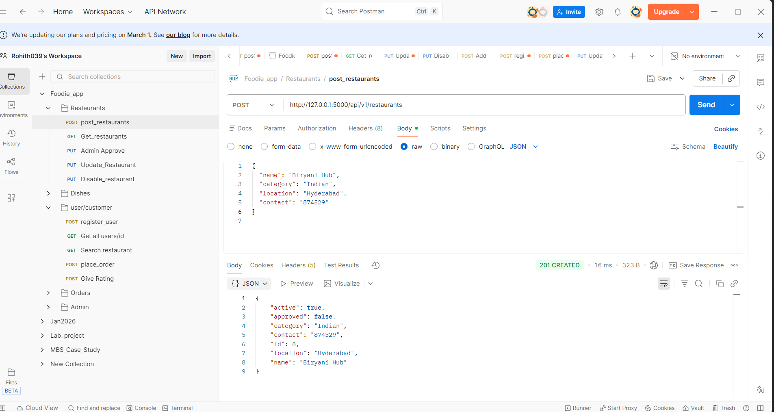
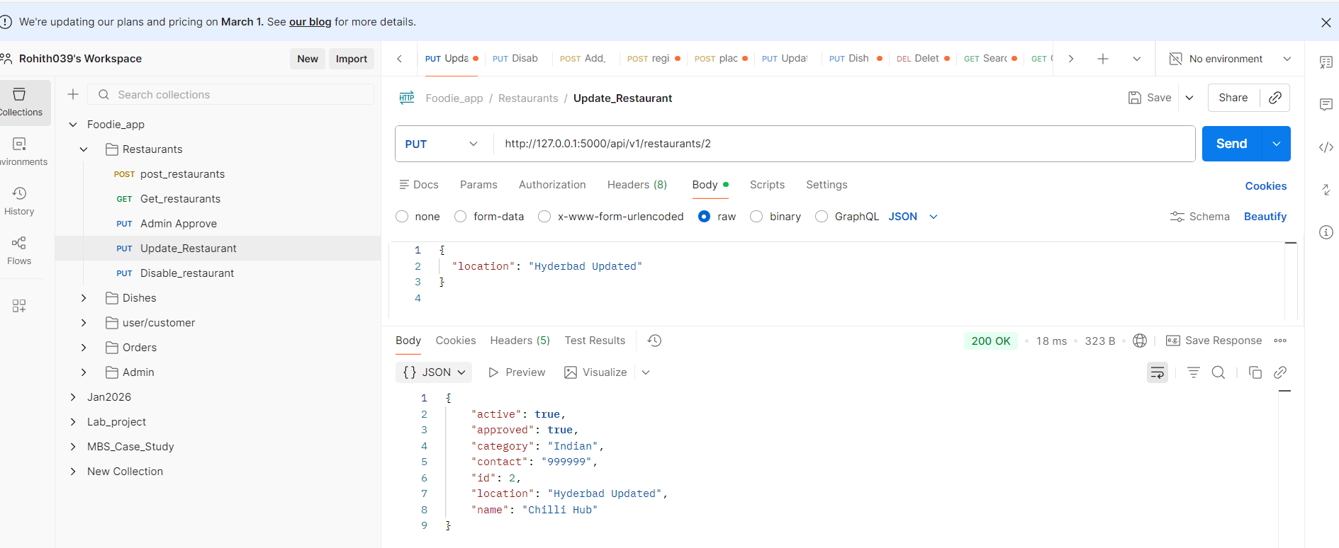
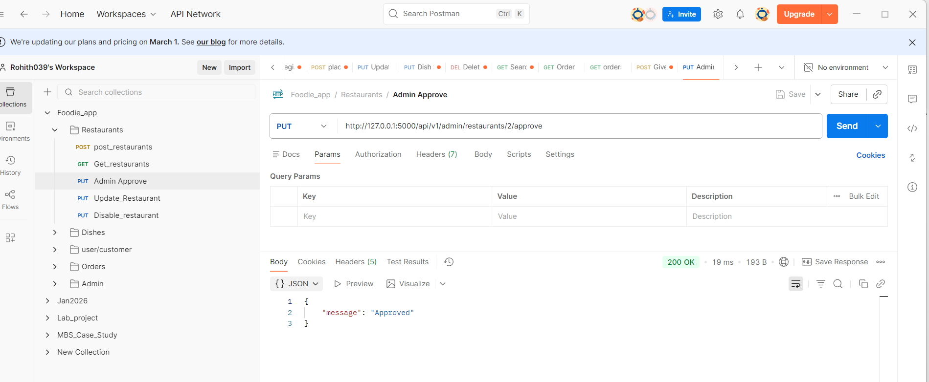
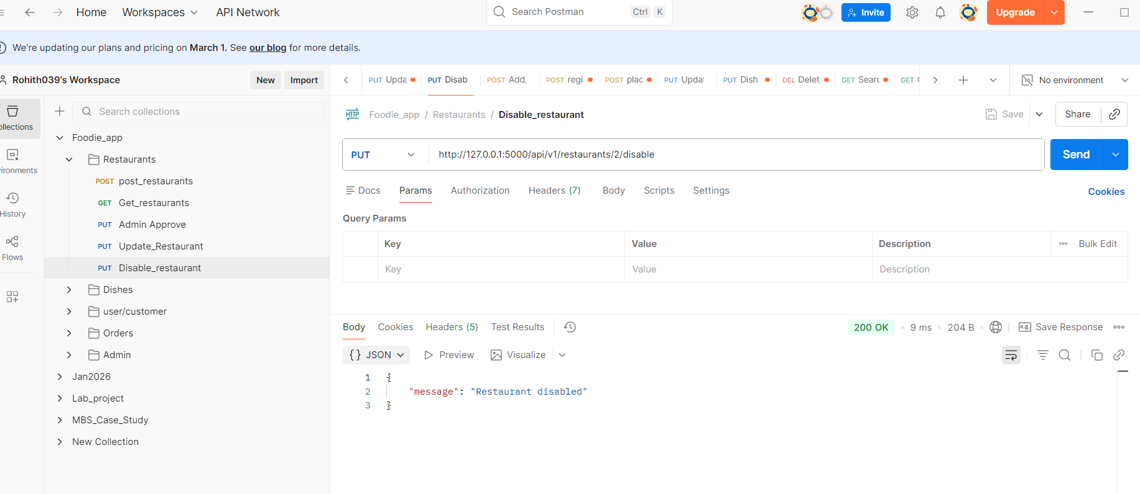
WIPRO · IIHT Techademy · Capstone Project 2026
Test Execution Results – Foodie App API
Restaurants Module

Slide 29
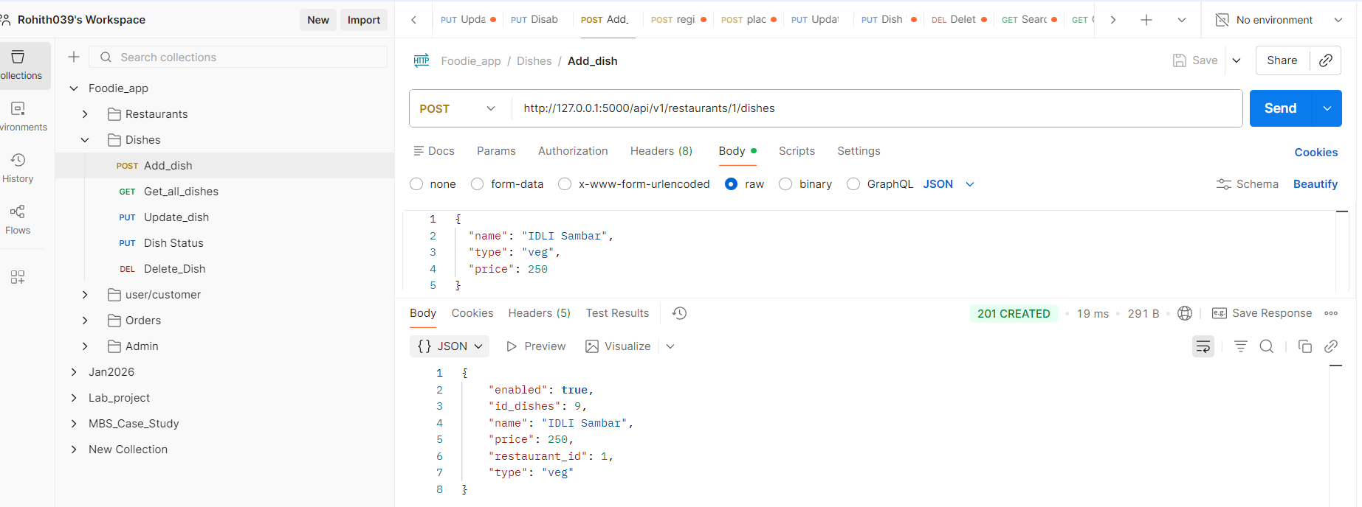
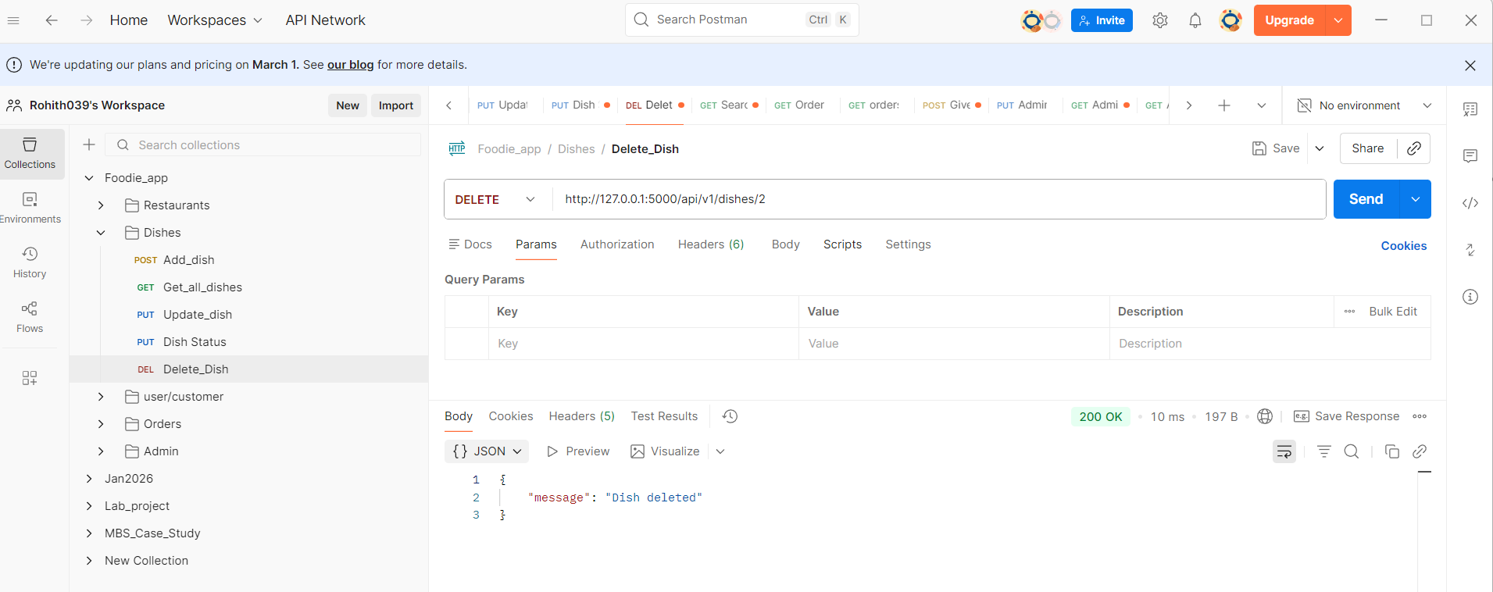
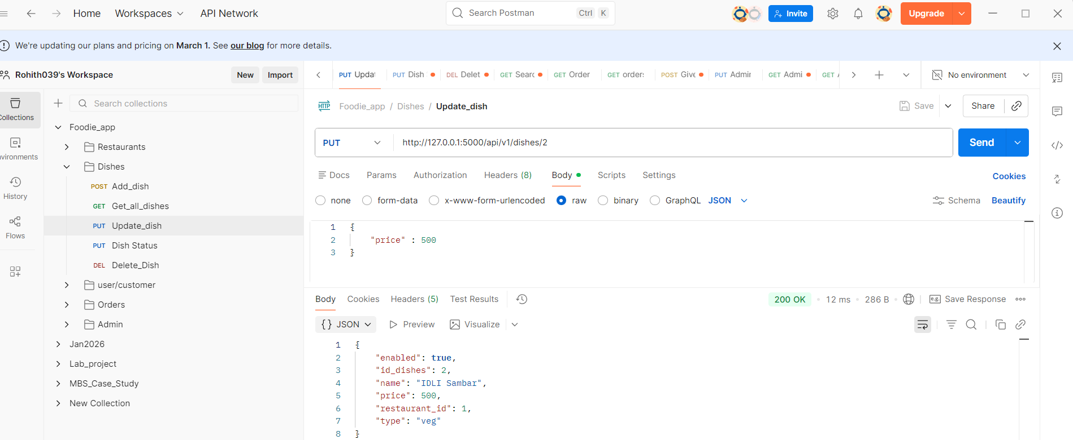
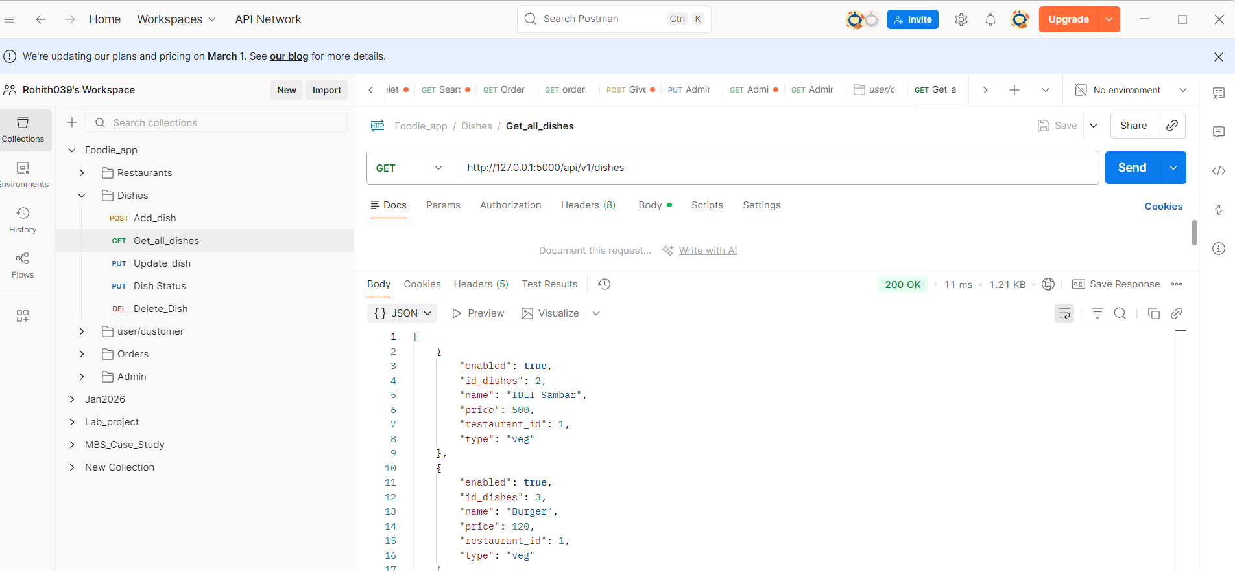
WIPRO · IIHT Techademy · Capstone Project 2026
Test Execution Results – Foodie App API
Dishes Module

Slide 30
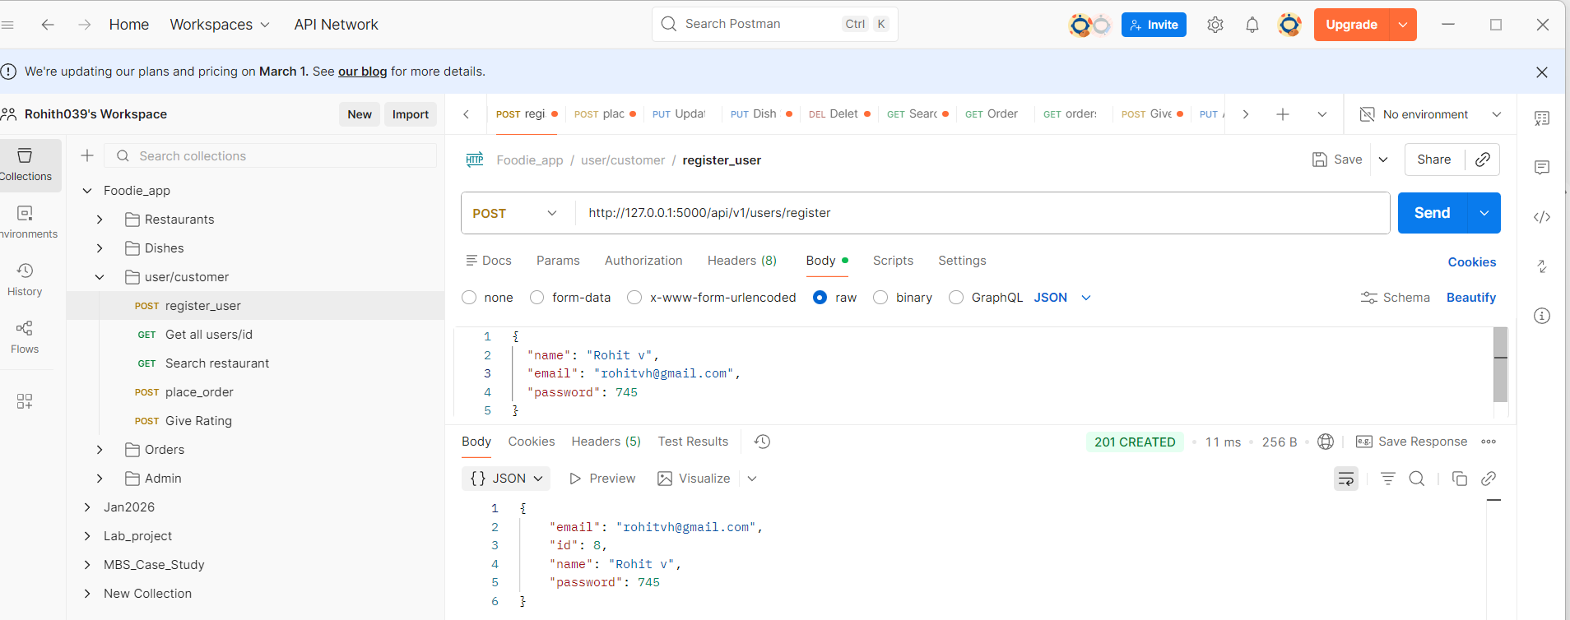
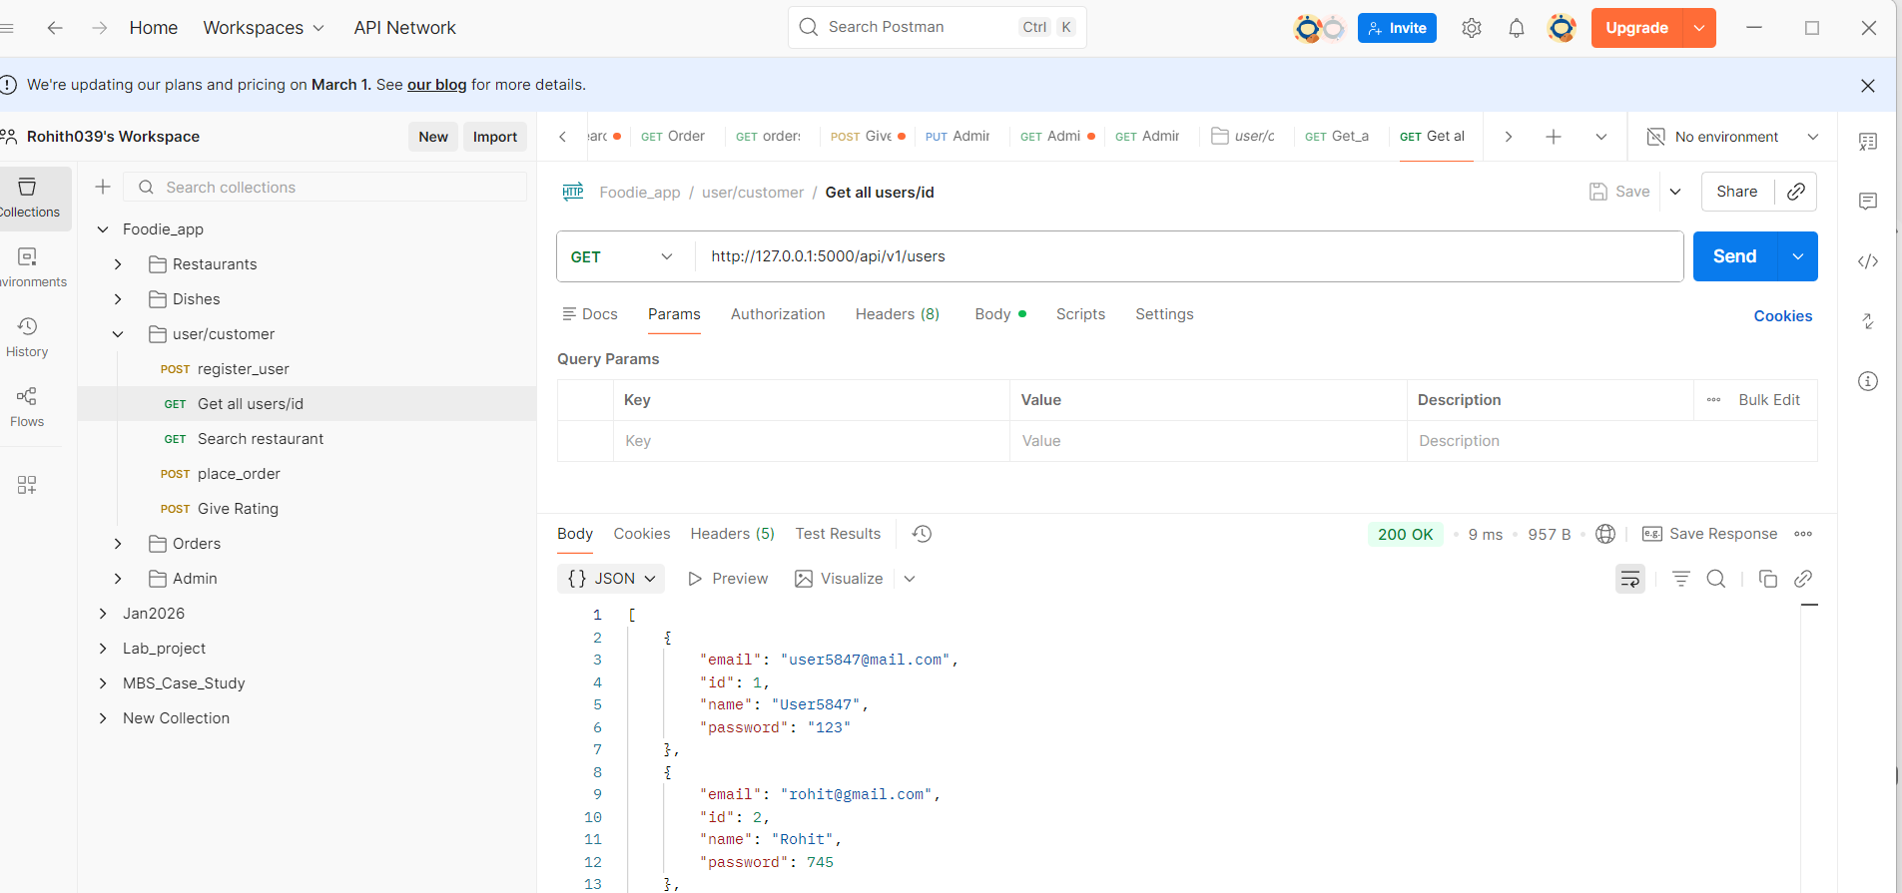
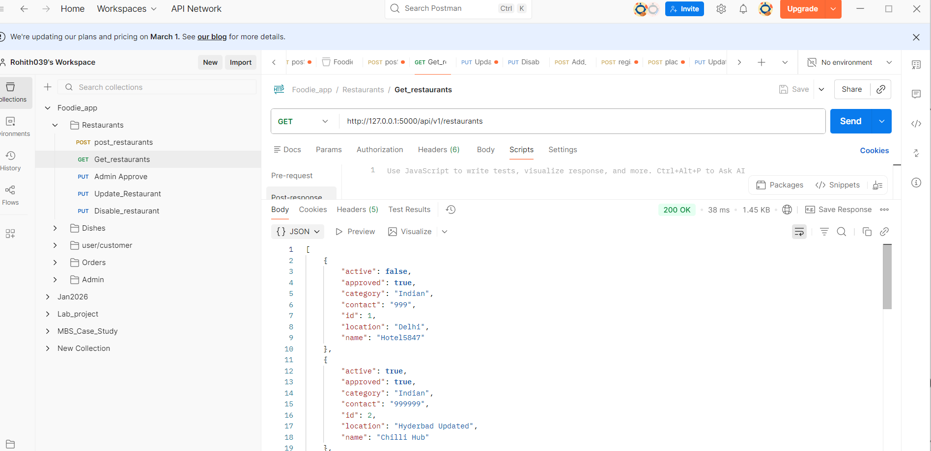
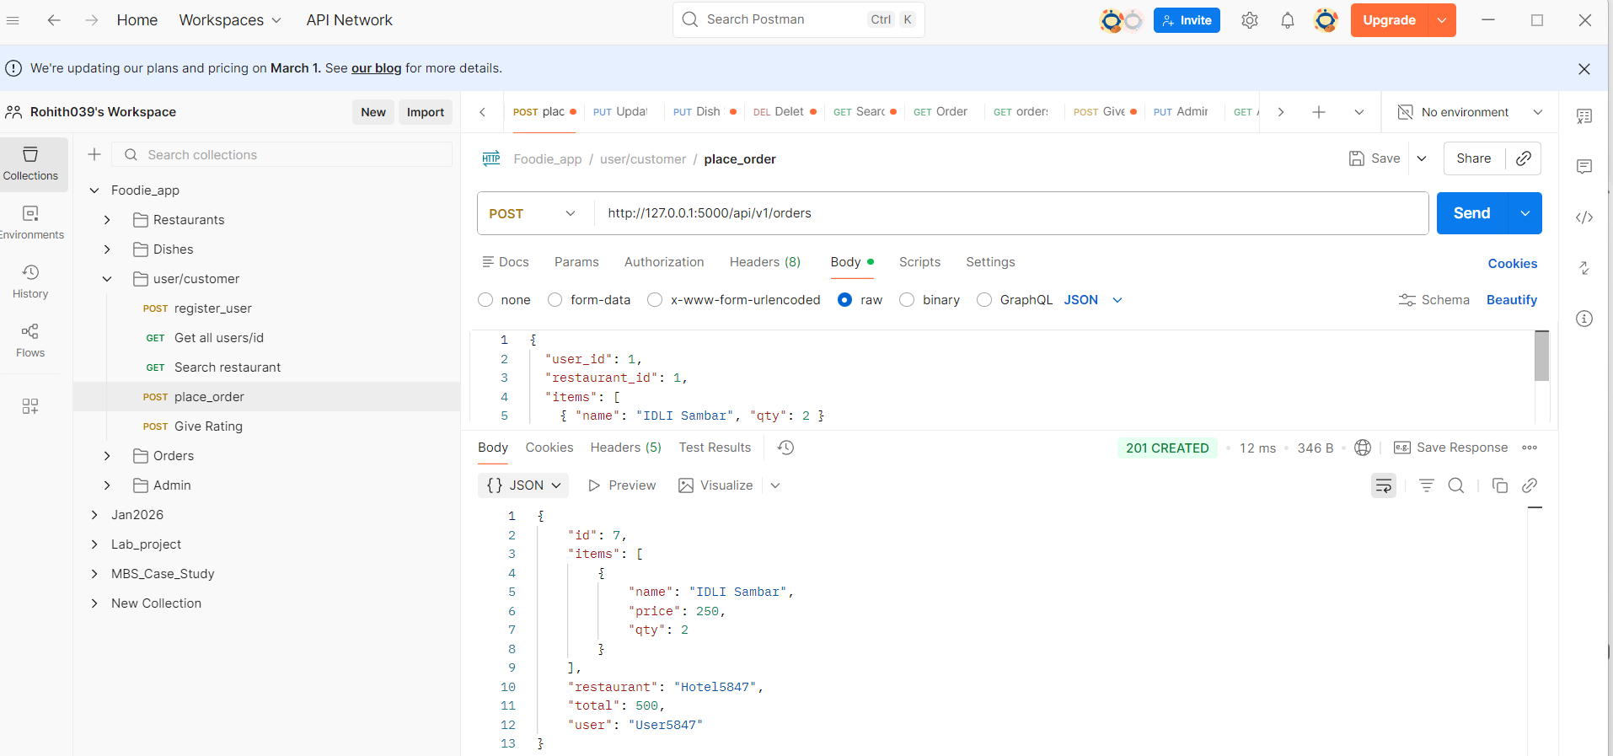
WIPRO · IIHT Techademy · Capstone Project 2026
Test Execution Results – Foodie App API
Users Module

Slide 31
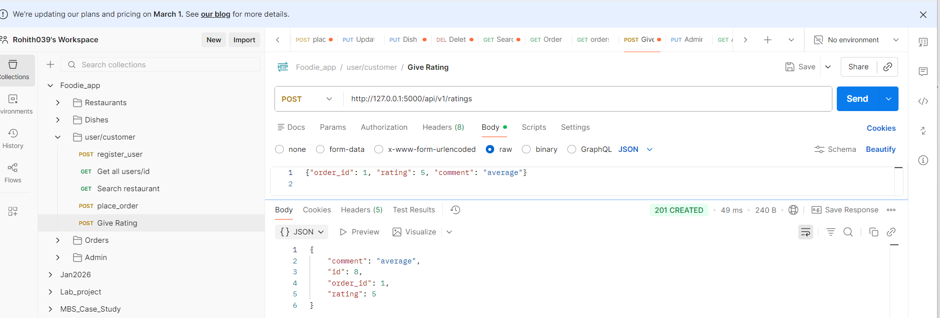
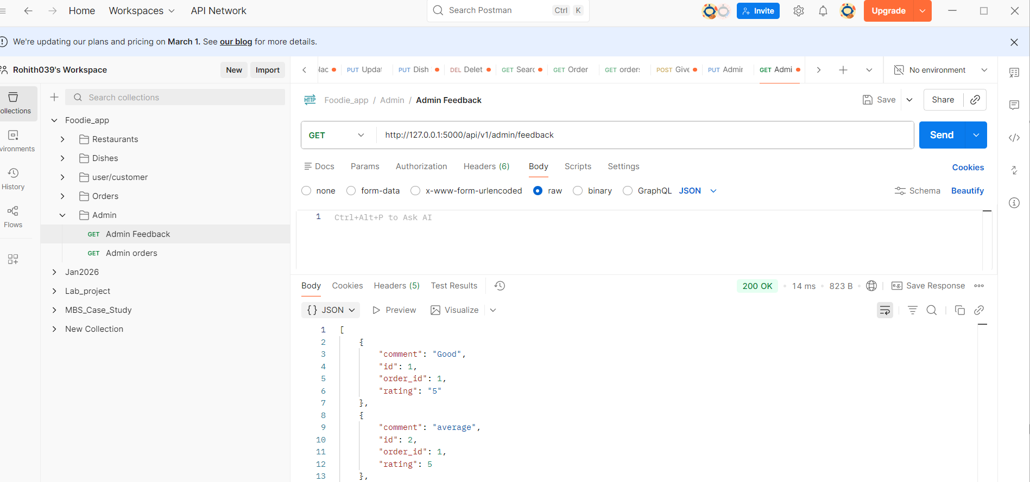
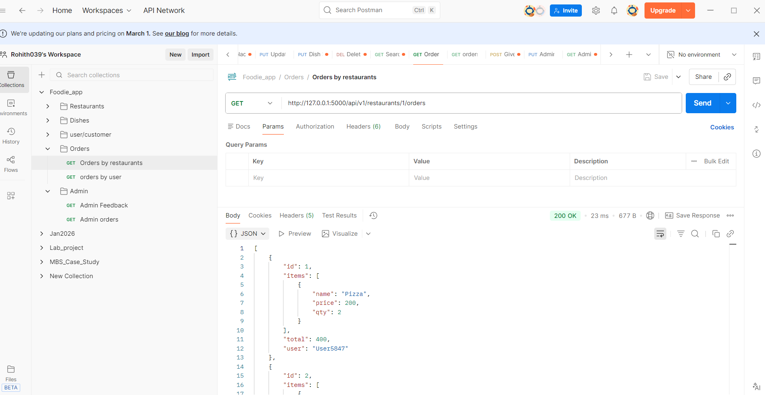
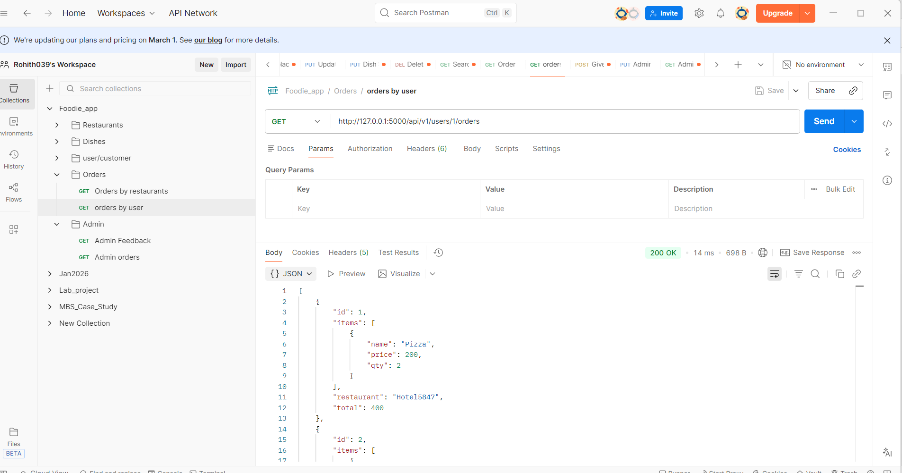
WIPRO · IIHT Techademy · Capstone Project 2026
Test Execution Results – Foodie App API
Give Ratings
Admin Feedback
Order Module

Slide 32
WIPRO · IIHT Techademy · Capstone Project
PROJECT 2 · CHALLENGES
Challenges Faced & How We Solved Them
PROJECT
02
Project 2 · Food Fun REST API · Flask · Pytest · Robot Framework · Postman
1
CHALLENGE
2
CHALLENGE
Test Isolation — Data Leaking Between Pytest Tests
Robot API Chaining — Passing IDs Across 13 Test Cases
✔ HOW WE SOLVED IT
✔ HOW WE SOLVED IT
Created reset_memory_and_counters fixture in conftest.py with autouse=True. Before every test it calls .clear() on every dict (restaurants, dishes, users, orders, ratings, feedbacks) and resets all integer counters to 0. Every test always starts from a perfectly clean state.
Used Set Suite Variable after every POST response to store IDs (USER_ID, RID, DID, ORDER_ID) at suite scope. Used Evaluate int(${resp.json()['id']}) to correctly convert JSON values to integers. Each downstream test reads these variables without any re-registration.
3
CHALLENGE
4
CHALLENGE
Orders Failing — Admin Approval Step Missed
Building a Testable API Without a Database
✔ HOW WE SOLVED IT
✔ HOW WE SOLVED IT
Discovered that Place Order returns 400 'Restaurant not approved' when approved=False (the default). Fixed by adding an explicit PUT /api/v1/admin/restaurants/{id}/approve call in both the Pytest order-setup helper function and the Robot Framework test flow — before every Place Order call.
Used Python dicts and integer counters in config.py as the in-memory data layer. Cleanup is trivial (.clear() the dicts). Pytest uses the Flask test client directly (no server). Robot Framework hits a live server on port 5000 — testing the real HTTP path separately.

Slide 33
WIPRO · IIHT Techademy · Capstone Project
2026
Multi-Layer Testing Strategy
Manual → Unit/API → E2E Automation — all three layers covered
1
2
3
MANUAL
UNIT / API
E2E AUTOMATION
Postman
Pytest
Robot Framework
Project 1 – UI
— (N/A for UI)
→
Project 1 – UI
5 users — 4/5 PASSED
→
Project 1 – UI
3 users — all PASSED
Project 2 – API
18 endpoints verified
Project 2 – API
18 tests — all PASSED
Project 2 – API
13 API tests — all PASSED
Projects apply all three layers: Postman (manual) → Pytest (automated) → Robot Framework (E2E) — maximum test coverage.

Slide 34
WIPRO · IIHT Techademy · Capstone Project
2026
Combined Results Dashboard
All tests across both projects — 100% pass rate
10
5
3
18
36
E2E Steps
(UI Flow)
Pytest Users
(UI)
Robot Users
(UI)
API
Endpoints
Total
Tests
PROJECT 1 · UI E2E AUTOMATION
PROJECT 2 · FOOD FUN API TESTING
Pytest (5 users)
4/5 PASSED
3 min 56 sec
Postman (manual)
18/18 VERIFIED
Robot (3 users)
3/3 PASSED
Pytest (38 tests)
18/18 PASSED
Browsers tested
Chrome · Firefox · Edge
3
Robot (13 tests)
13/13 PASSED
Frameworks used
Pytest + Selenium, Robot
Modules covered
5 modules · 18 endpoints
ALL TESTS PASSED · 1 FAILURES · Both frameworks · Both projects · Manual + Automated

Slide 35
WIPRO · IIHT Techademy · Capstone Project
2026
Conclusion
What was built, what was learned, what was proven
Project 1 – UI Automation
Project 2 – Food Fun API
10-step E2E flow on demowebshop automated using Pytest + Selenium (5 users, 3m 56s) and Robot Framework (3 users). Cross-browser, CSV data-driven, step-named screenshots.
18 Flask REST API endpoints tested with Postman (manual), Pytest (18 tests), and Robot Framework (13 API flow tests). All tests passed across all 5 modules.
Data-Driven Design
Multi-Layer Coverage
Both projects use CSV — add any user or input row and both frameworks automatically include it on the next run. Zero code changes required anywhere.
Manual (Postman) → Unit/API (Pytest) → E2E Automation (Robot Framework) — all three testing layers covered across both projects.
Technical Skills Applied
Team Achievement
Python, Flask, Selenium, Pytest, Robot Framework, REST API Testing, Postman, POM, Keyword-Driven Testing, HTML reporting — all in real projects.
Two production-grade testing frameworks delivered within the Wipro Training program — demonstrating complete manual and automation testing expertise.

Slide 36
Thank You
Wipro Training | IIHT Techademy | Capstone Project — February 2026
Rohith V H
Kalla Pavani
Sana Bano
Sree Bhargav Reddy
Amulya Rani Noonela
Python
Flask
Selenium
Pytest
Robot Framework
Postman
CSV Data-Driven
POM

