Slide 1
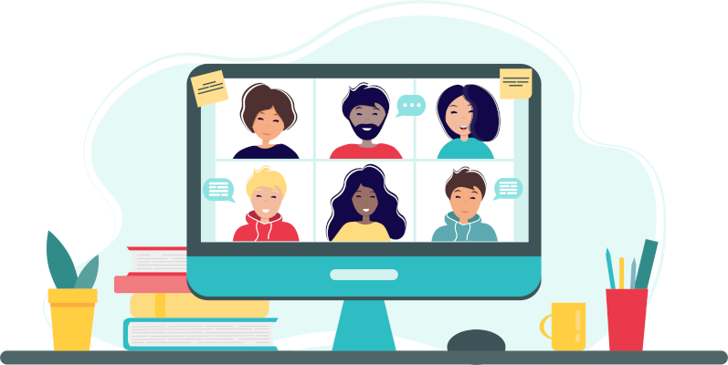
Microsoft Engage 21

Slide 2
About Me
Hey, this is Kalla Rukmini, currently enrolled as 2nd year Undergraduate in Computer Science & Engineering Department at Indian Institute of Technology BHU, Varanasi.
I am very passionate about Software Technologies and an enthusiastic learner of Web Development and Deep Learning. I mostly code in C++ and Python and sometimes Javascript. I like building websites and collaborate with other people to work.
Beside programming I am interested in sports and music.

Slide 3
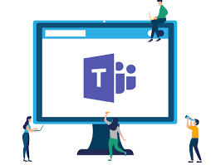
What is this project about?!
A fully functional video conferencing web application where 2 or more people can confer, chat, call and collaborate with each other(basically a clone of MS Teams) .

Slide 4
Tech Stack
This main components of Web application are created using
WebRTC Technology for real-time peer-to-peer audio and video communication and Node.js.
Express library to serve static files for UI.
Socket.io library to establish connection between two devices and data exchange with WebSockets.

Slide 5
Features developed
No Sign ups required and user can create room or enter a room with a room code!
Chat
Video Conferencing
Collaborative Whiteboard

Slide 6
Let’s dive into the demo
(deployed on Heroku)

Slide 7
How I adapted Agile methodologies during my project.
I’ve thoroughly gone through the theme description and got complete picture of what I am supposed to develop.
I listed the prerequisites to build this application.
I divided the work in 4 weeks.
I made daily goals and worked on learning and completion of the tasks.

Slide 8
Work breakdown
Week 1
Week 2
Week 3
Week 4
I’ve gone through various technologies like WebRTC, WebSockets and designed UI of the application
Video chat implementation by coding UI using HTML,CSS,JS creating server and several instances and room
Handling all the connections and implementing the features like whiteboard and worked on the surprise feature.
Deploying and improving the UI

Slide 9
Further improvements I would like to work on :
Screen Sharing functionality should be added
Make application much more interactive by adding sounds and notifications
Deploying the application on a large scale user base

Slide 10
Finally I would like to thank my mentors at Microsoft for providing me the guidance and support throughout the Mentorship Programme!

