Slide 1
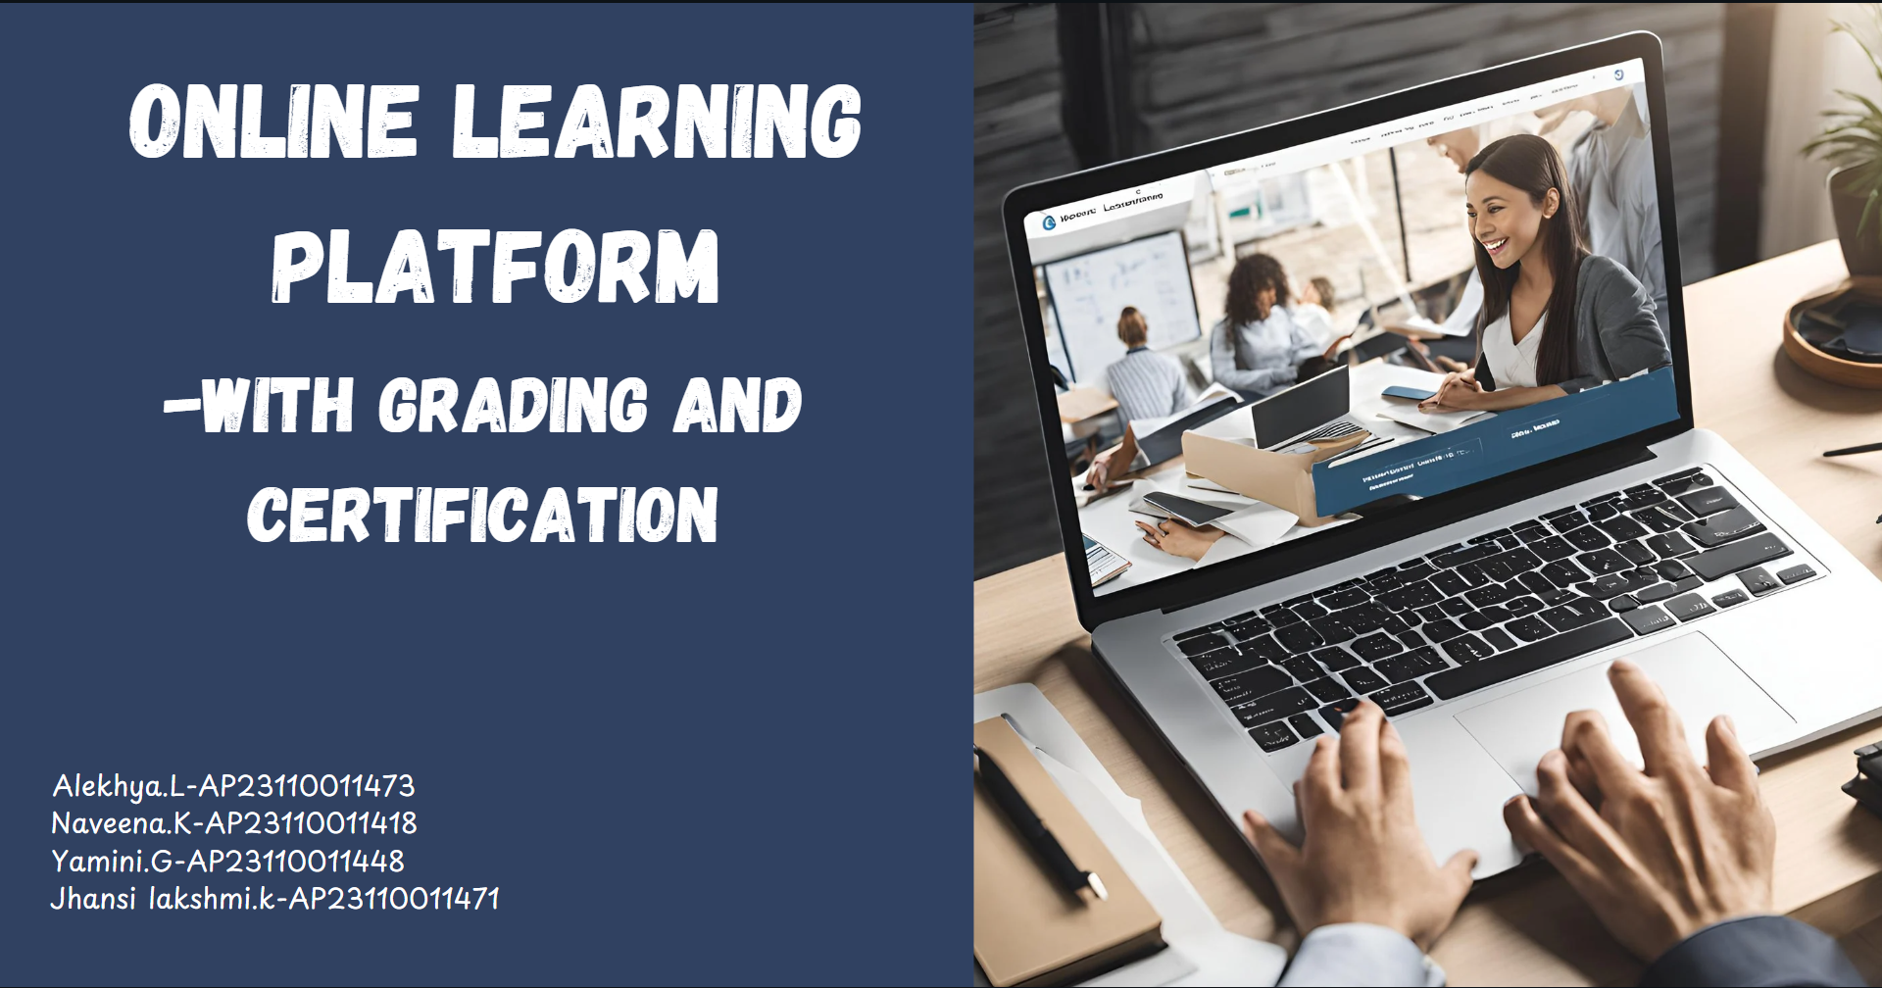

Slide 2

Introduction
The purpose of the project :
To create a structured online learning platform where students can
Learn effectively by selecting from a variety of courses such as C,C++, Python, HTML and Data Structures.
Assess their skills through quizzes with two difficulty levels (Basic and Harder).
Track progress and earn certificates as a validation of their learning and performance.

Slide 3


WORKFLOW
STEP-BY-STEP PROCESS:
Registration: Collect name, college, email.
Course Selection: C, C++, Python, HTML, DAA.
Quizzes:
Basic Quiz: Score >60% to proceed.
Harder Quiz: Pass to earn a certificate.
Certification: Confirms achievement.

Slide 4

IMPLEMENTATION
KEY CONCEPTS:
Classes:
Student: Manages user data.
Course: Handles course information.
Quiz: Implements quiz logic and scoring.
Certificate: Generates success messages.

Slide 5
CONCLUSION:
The platform effectively combines education and technology, enabling structured learning and assessment.
Demonstrates the power of C++ in creating efficient, modular, and user-friendly applications.
FUTURE ENHANCEMENTS:
Introduce a graphical user interface (GUI) for improved usability.
Implement a database to store user progress and results.
Add multilingual support to cater to a global audience.
Incorporate real-time feedback and performance analytics.

Slide 6
THANK YOU……

