Slide 1
Fruit ‘n’ Local
Keenan Allcott
2022-06-07

Slide 2

Goal Of Fruits’n’Local
The purpose is providing an app to inform our users what fruits are currently in season!
To do so we provide info on a fruits:
Season
Region of origin
Largest producer

Slide 3
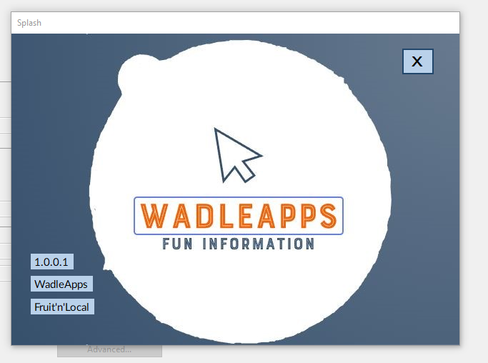
Lets Get into the App!
Splash Screen
Note Version number
Company Name
Product Name

Slide 4
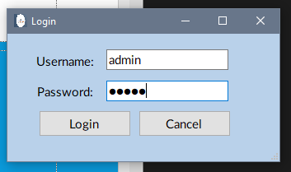
Login Screen
There Are two login paths after the login screen
One for user level privileges
One for admin level privileges
First we shall show off the admin login.
Mr. Murry your login will be an admin account.

Slide 5
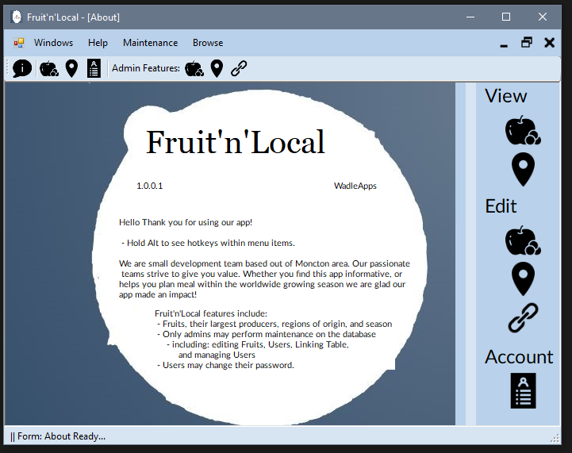
Admin Landing page
Opens to the midi form with the about page loaded in.
For admins the maintenance menu strips, tool strip, and about page icon are available

Slide 6
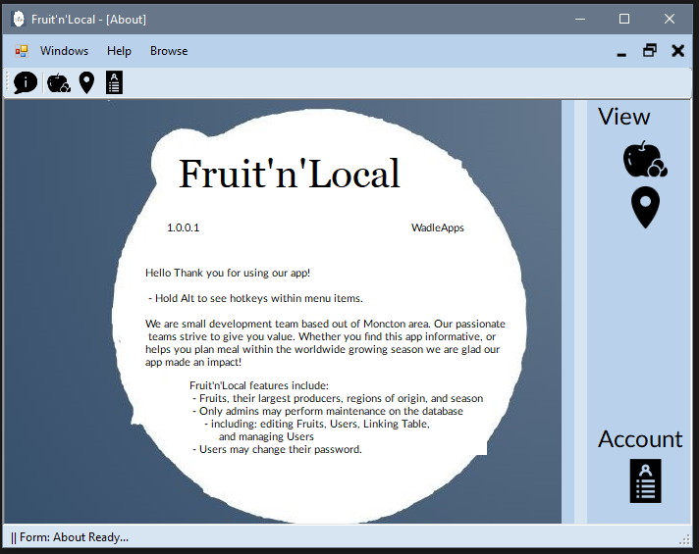
User landing page
Note Maintenance is hidden

Slide 7
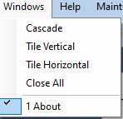
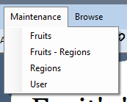


Admin Menu Strip
Allows the user to access any feature within the app.

Slide 8
Admin Toolstrip
From left to right:
About page
Browse Fruits
Browse Region
Account setting (admin)
Edit Fruits
Edit Regions
Edit Fruits_Regions

Slide 9



Status Strip Bar
Same for all users
Form Change / Load
Browse Form:
First Record Click:
Last Record Click:
On Save/Create: - On click
- On Complete
- After small delay
On Add

Slide 10
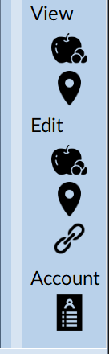
About page menu bar
Allows user to quick access items like the toolbar
From top to bottom:
Browse fruits
Browse Location
Edit Fruits
Edit Regions
Edit Fruits_Regions
Account Setting (admin)

Slide 11
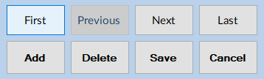
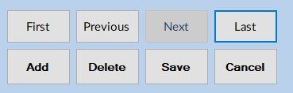
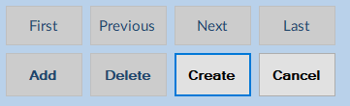
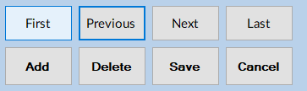
Navigation Button Management
Navigation buttons will disable:
When on first record
When on last record
When on add
- Note changed “Create”
- Return to normal

Slide 12
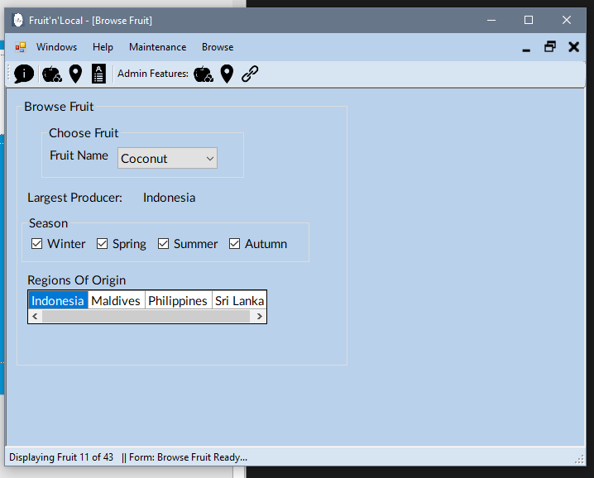
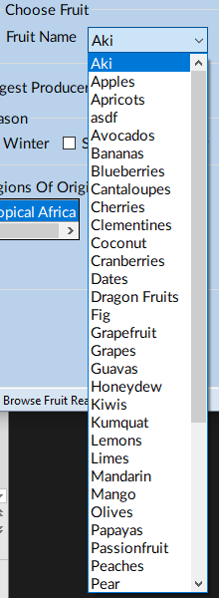

Browse Fruits
Allows user to browse all fruits:
Same for users and Admin
The data grid is rotated and skimmed to show only relevant data.
Fruit Drop down: (left)
No Region:

Slide 13
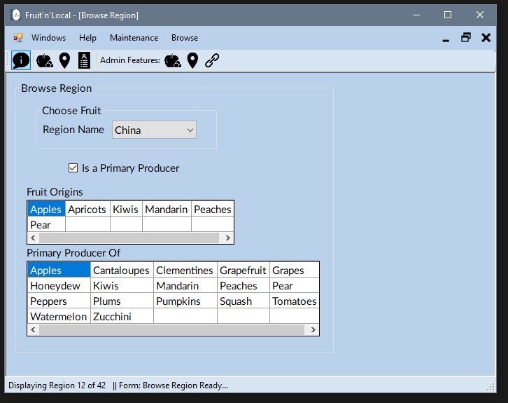

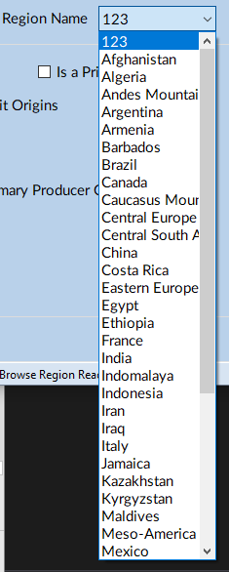

Browse Region
Allows users to browse regions
Note rotated data grid view will begin a new row on the 5th column
No Origin:
No Producer
Region Dropdown:

Slide 14
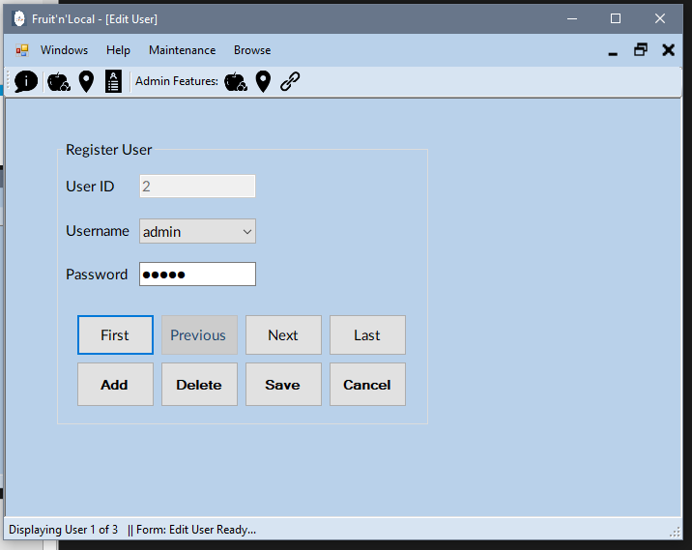
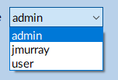
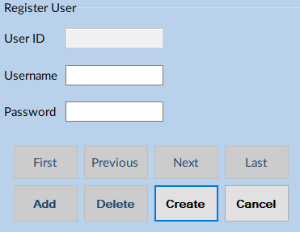
Account Settings (Admin only)
Allows admin to create new users, and change user passwords.
User Dropdown:
On Add Click:
Cancel will revert previously selected record if available

Slide 15
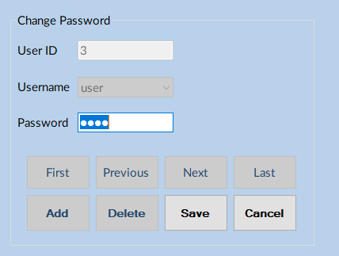
Account Settings (User)
User’s only option is to change their password

Slide 16
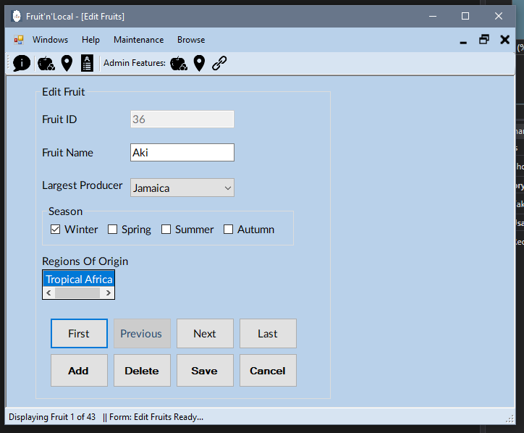
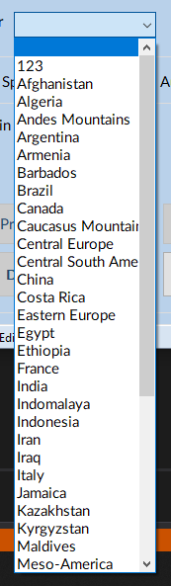
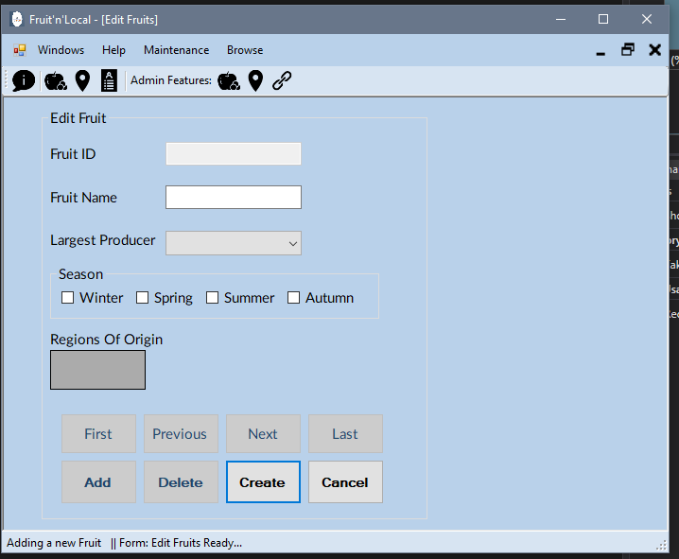
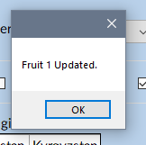
Edit Fruits (admin Only)
Allows Admin to edit fruits
- Largest producer dropdown: (left)
On Add:
On Save

Slide 17



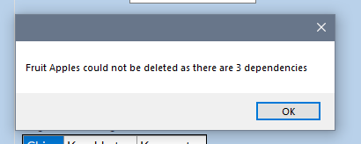
Edit Fruits Validation (admin Only)
When records are required:
Fruit:
Producer:
Season:
Cannot delete with Dependencies:

Slide 18
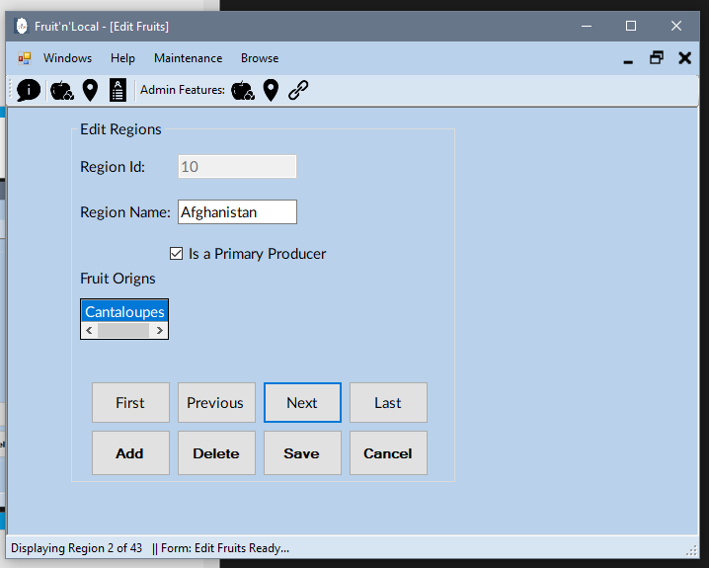

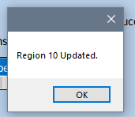

Edit Regions (Admin Only)
Allows admins to edit Regions
Is A Primary producer cannot be clicked, it to indicator if there is a dependency in fruits table
No origin:
On Save:
On Validation

Slide 19
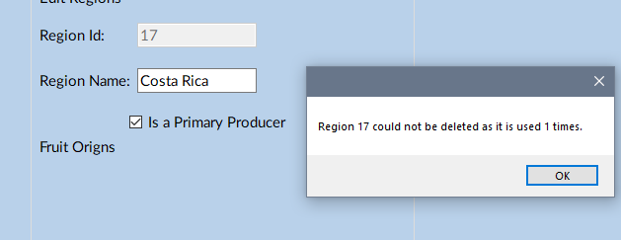
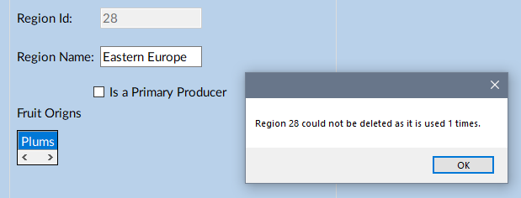
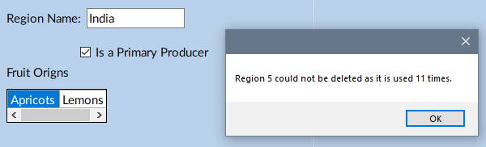
Edit Regions Dependency (admin Only)
On Dependency: No origin, but is primary producer
On Dependency : No origin
On dependency: Both

Slide 20
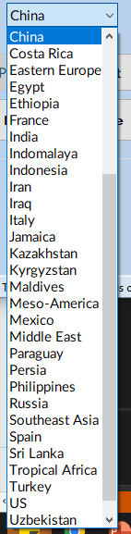
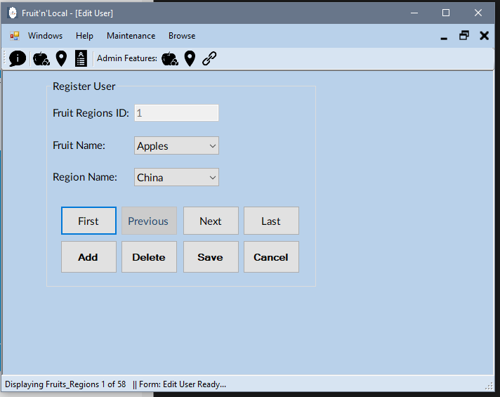
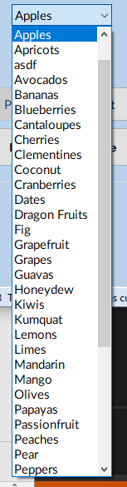
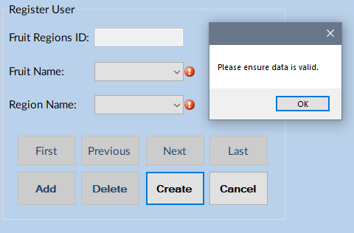
Edit Fruits_Regions (admin Only)
Allows admin to edit linking table between Fruits & Regions
Fruit Dropdown:
Region Dropdown (left):
On failed add (below):

Slide 21
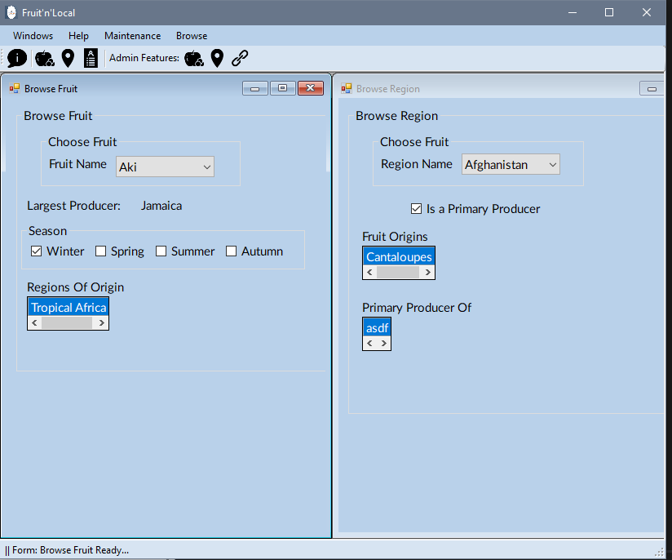
Window Tiling
The intended us is to compare two forms, as when a form is clicked it will maximize.

Slide 22

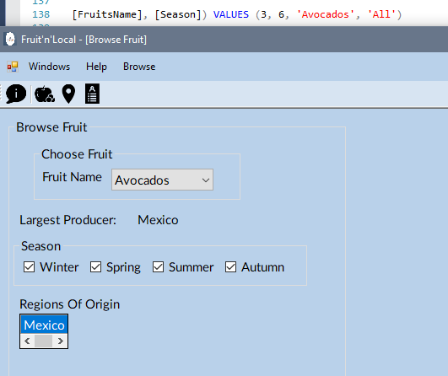
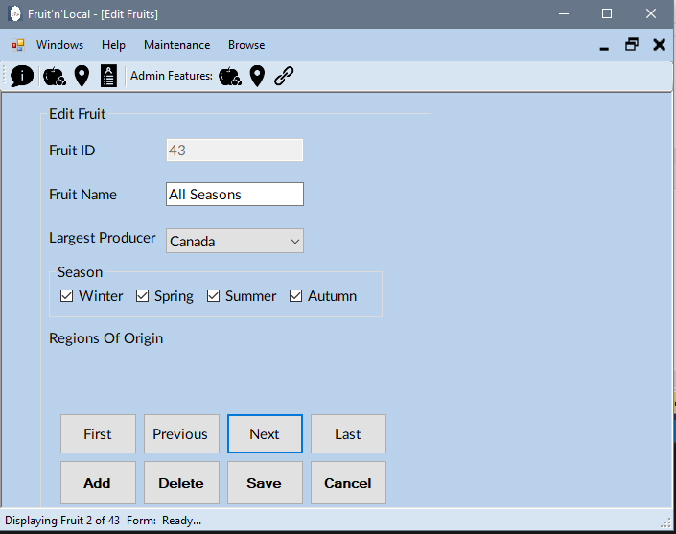
Business Rule
All in the data base is treated as All seasons selected
Only Admin can access maintenance forms:

