Slide 1
Book4
File created on: 4/12/19 7:09:13 PM PDT

Slide 2
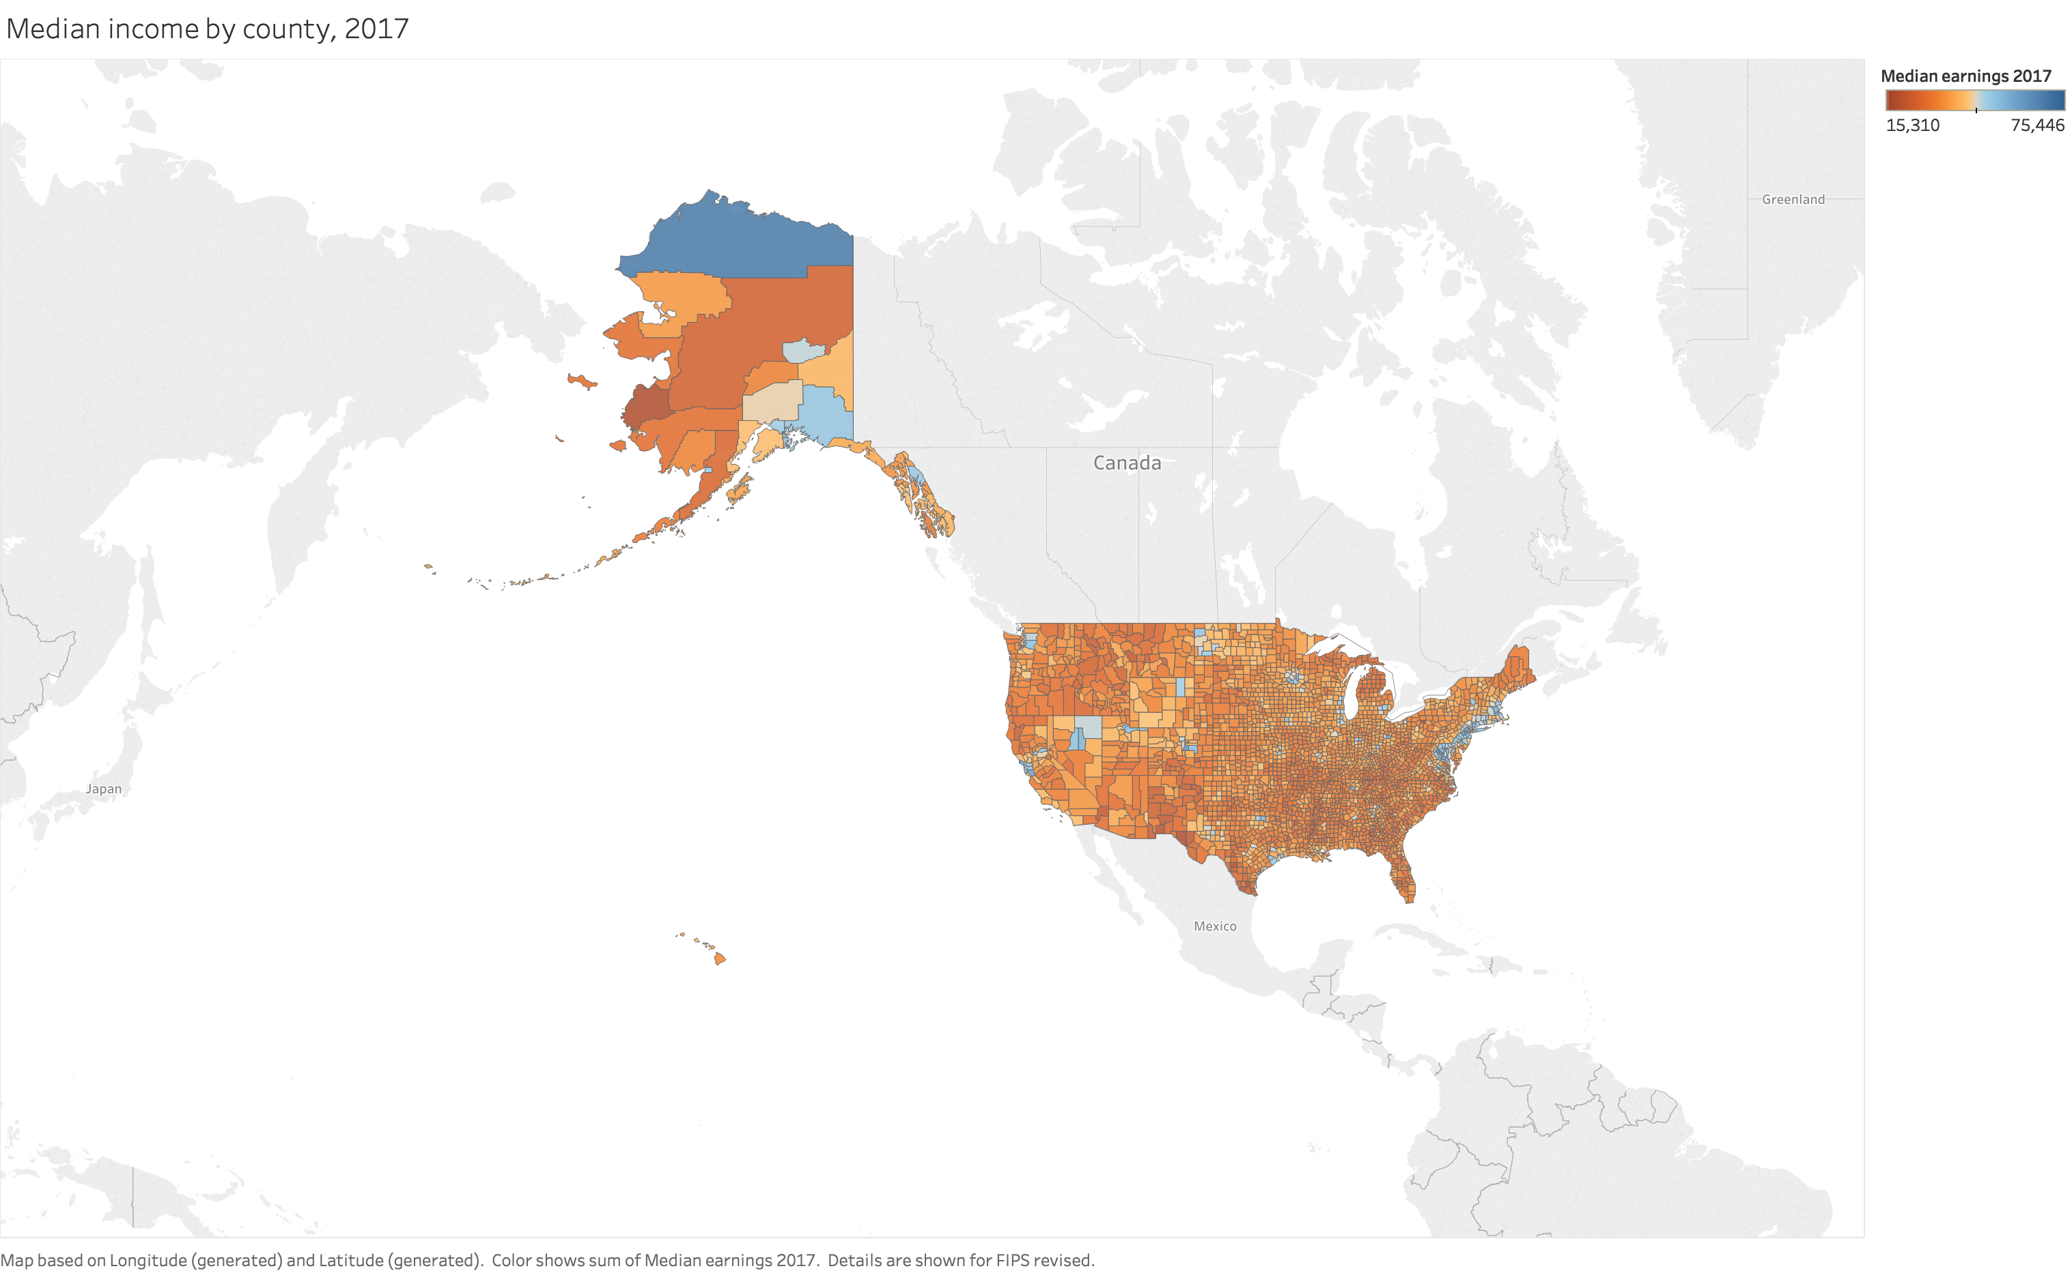

Slide 3
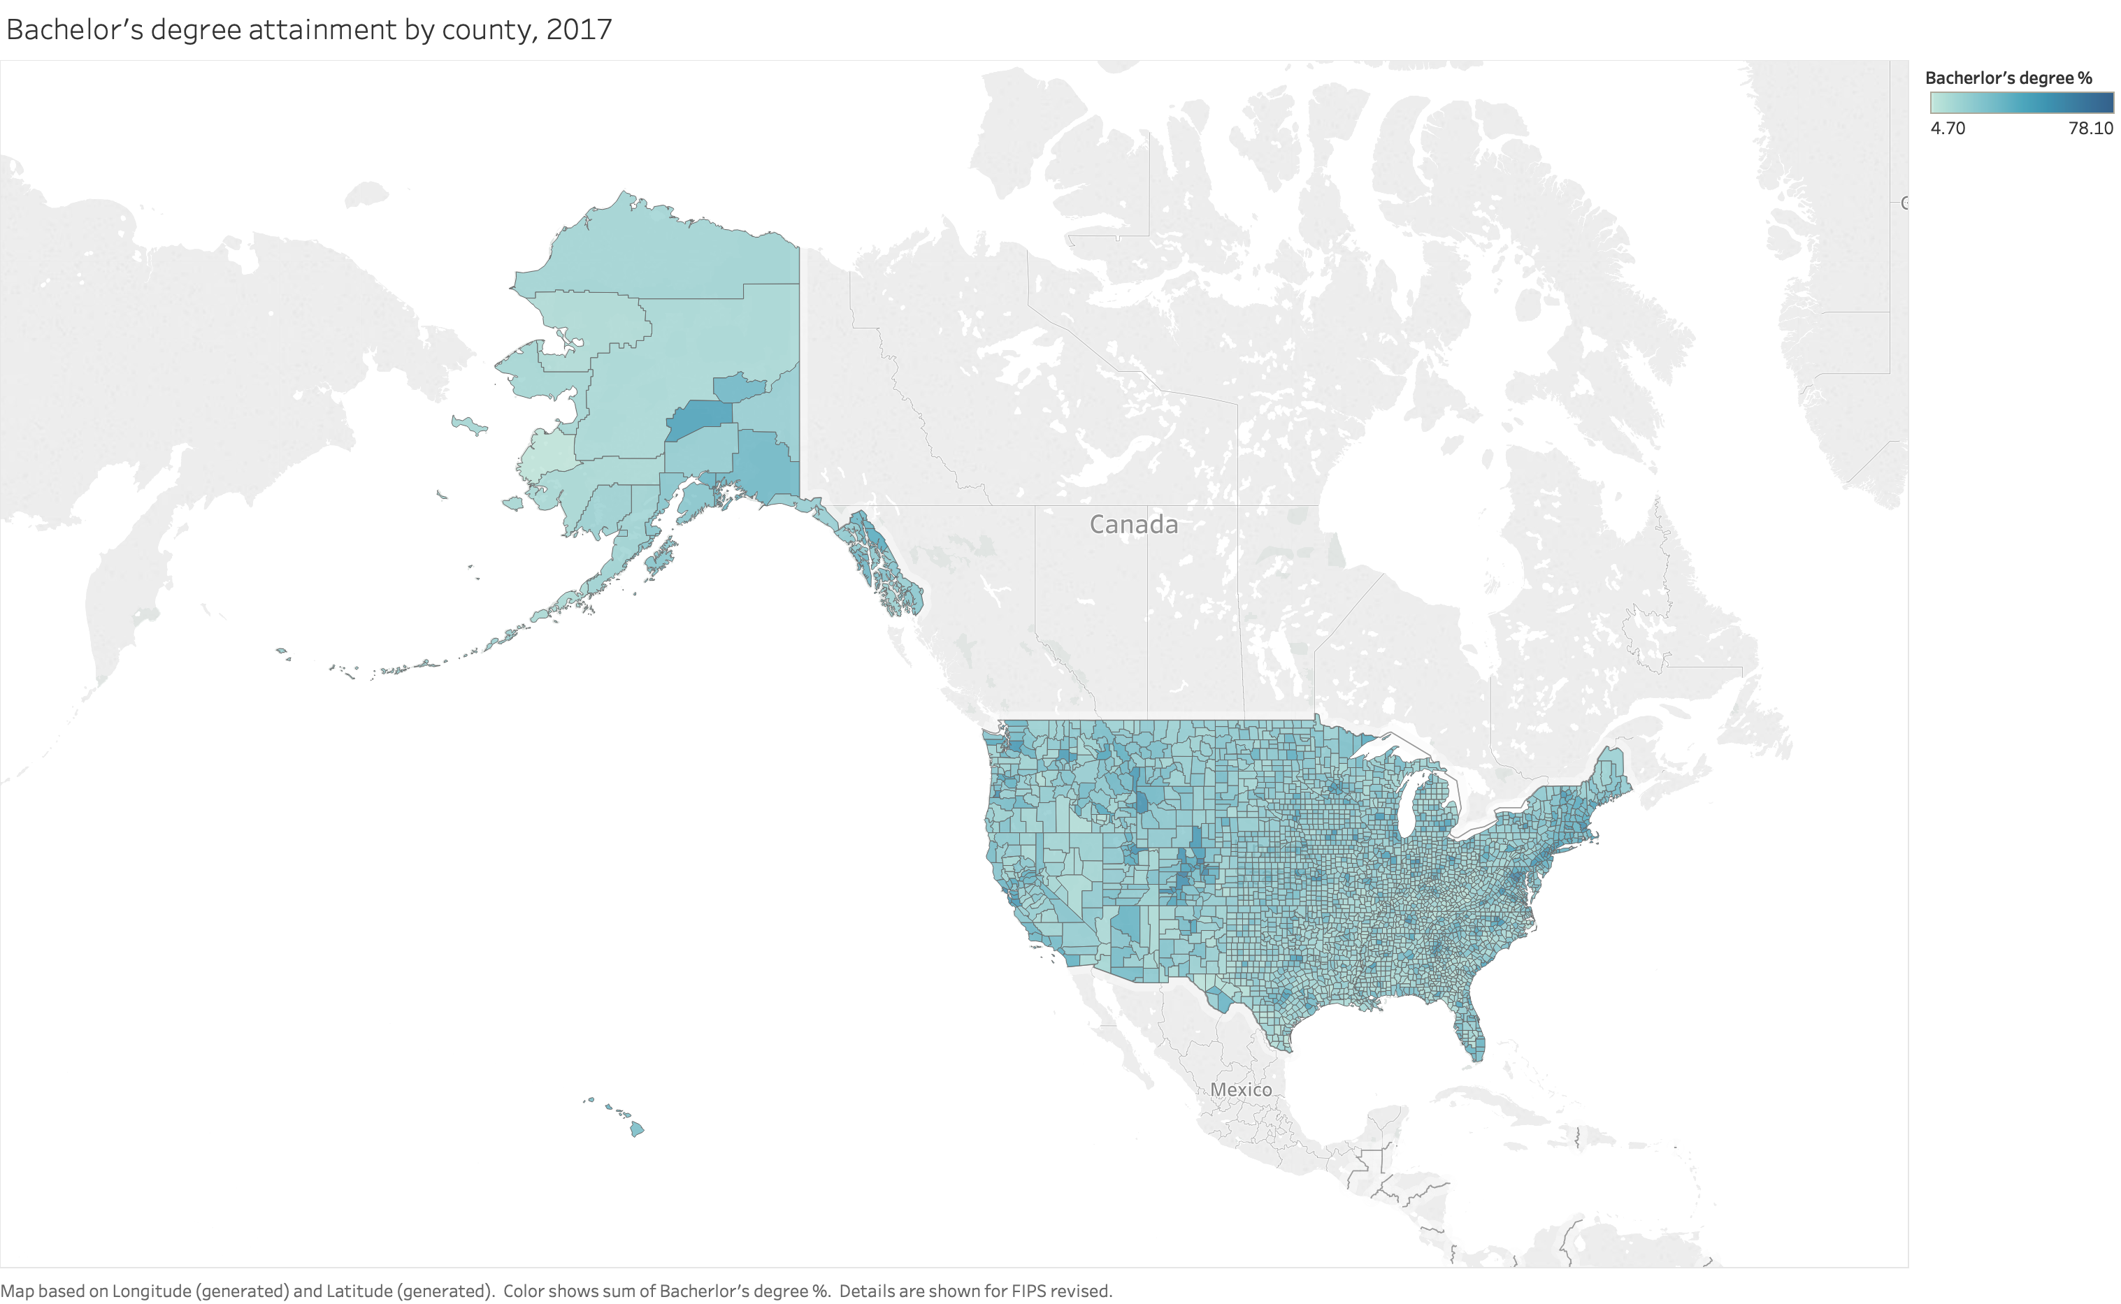

Slide 4
