Slide 1
GKV - Team 9
PROGRAMMING LANGUAGE
Gowtham G Nayak
Kallol Chatterjee
Vimarsh Deo

Slide 2
Features
Arithmetic Operators & Primitive Data Types i.e. integer and boolean
Parameterized Functions & Support for local, non-local variables
Assignment Statement
Decision Making Statement (if...then...else)
Iterative Execution Statement (while)
Support for a data type… stack
Recursion Implementation
Low Level Intermediate Language (aka igkv files)
Block Structured

Slide 3
Tools Used
ANTLR4 Tool: Another Tool For Language Recognition
Powerful Parser generator
Used to write formal language description called a grammar
Generates a parser for that language that can automatically build parse trees
Generates tree walkers that you can use to visit the nodes of those trees
Used listener class for the generation of intermediate code
JAVA: Runtime Environment

Slide 4
Sample Program
integer a;
integer b;
integer c;
a = 10;
b = 20;
c = a + b;
print c;
DECLINT A
DECLINT B
DECLINT C
PUSH 10
SET A
PUSH 20
SET B
PUSH A
PUSH B
ADD
SET C
PRINT C
High Level Code Intermediate Code Output
30

Slide 5
High Level Language (Overview)
Assignment Operator : =
Print Operator : show
Function Call : call function_name with parameters
Function Definition : function function_name uses parameters returns datatype
Decision Making : if...then...else
Loop Statement : while
Datatype : integer, boolean, stack
Relational Operators : and , or
Stack Operators : push, pop
Comparison Operators : equalTo, lessThan, greaterThan, lessThanOrEqualTo, greaterThanOrEqualTo,
notEqualTo

Slide 6
Intermediate Code Generation

Slide 7
Grammar & Parse Tree
function
: FK_FUNCTION IDENTIFIER (FK_USES idList)? FK_RETURNS DATATYPE
O_BRACE
sequenceOfStatements
C_BRACE
;
Sample Grammar

Slide 8
High Level Language - Function
function add uses integer a, integer b returns integer {
integer c;
c = a + b;
return c;
}

Slide 9
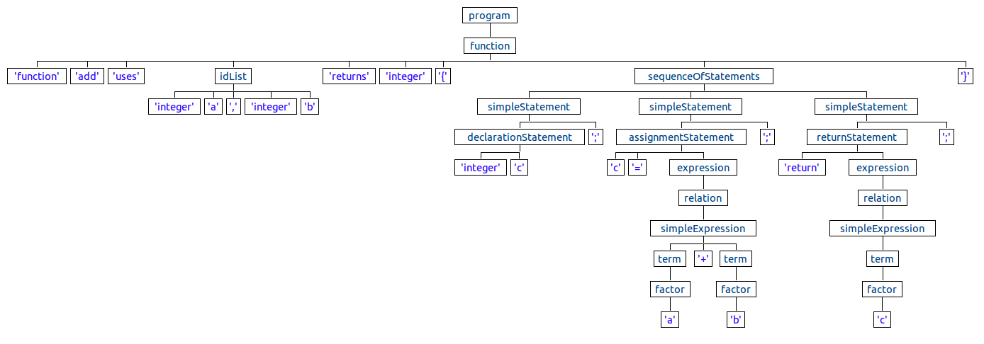
Intermediate Code (Overview)

Slide 10
GKVWalker Class
@Override
public void enterDeclarationStatement(GKVParser.DeclarationStatementContext ctx) {
String datatype = this.typeMap.get(ctx.DATATYPE().getText());
int variableCount = ctx.IDENTIFIER().size();
for (int i = 0 ; i < variableCount; i++) {
stringBuilder.append(datatype + WHITESPACE);
stringBuilder.append(ctx.IDENTIFIER(i).getText().toUpperCase() + NEWLINE);
}
}

Slide 11
Intermediate Code
FUNCSTART ADD INTEGER
SCOPESTART
DECLINT A
DECLINT B
DECLINT C
PUSH A
PUSH B
ADD
SET C
PUSH C
RET C
SCOPEEND
FUNCEND
INTERMEDIATE CODE EXAMPLE

Slide 12
Runtime Development(Overview)
Developed in JAVA and takes .igkv files i.e. intermediate files as input
Line by line parsing of words from the beginning of the file
Global and Local Scopes handled using MAP and STACK
Produces output on the console

Slide 13
Challenges Faced
Getting a hang of Tools like ANTLR4
Understanding requirements and building grammar accordingly
Implementing Listener Class for generating Intermediate Code
Developing runtime environment which is in sync with intermediate code producing desirable output

Slide 14
THANK YOU…!

