Slide 1



AI-Powered Customer Relationship Management
AI Lead Qualification & Scoring
Capture, Classify, Enrich, Qualify
AiLA CRM
Sales Pipeline Management
Project Overview
Sales Pipeline & Deal Management
One Platform to Manage Leads, Automate Work, and Grow Sales.
AI Email Content Generation
Email Campaign Management

Slide 2


Overview
AILA CRM is an AI-powered Customer Relationship Management platform designed to help businesses manage leads, contacts, sales activities, email communications, and marketing campaigns from one centralized system.
The platform combines traditional CRM capabilities with AI-powered tools to simplify daily operations, reduce manual work, improve customer engagement, and increase sales productivity.
10
Key Modules
87
Features
4
Milestones

Slide 3






Key Modules
01
02
03
04
05
User & Workspace Management
Contact & Company Management
AI Business Card & Lead Capture
Sales Pipeline & Deal Management
Inbox & Messaging
06
07
08
09
10
Email Campaign Management
AI CRM Assistant
Tasks & Workflow Automation
Dashboard & Reporting
System Administration & Security

Slide 4






Business Benefits
Centralized Management
Manage leads, contacts, sales, and email communications in one platform.
Effective Email Marketing
Run targeted email campaigns and monitor engagement.
Improved Productivity
Reduce repetitive administrative tasks through AI and automation.
Sales Visibility
Track opportunities, team activities, and sales performance through dashboards.
Better Lead Management
Capture, organize, qualify, and follow up with potential customers efficiently.
Scalable Architecture
Support multiple businesses with secure, separate workspaces.
Streamlined Communication
Manage multiple email inboxes and customer conversations within the CRM.

Slide 5

Project Objective
Capture & connect more leads instantly
Automate routine work
To develop a modern, user-friendly, scalable AI-powered CRM that helps businesses capture more leads, automate routine work, manage customer relationships, and improve sales performance, without relying on multiple disconnected tools.
Manage customer relationships
Improve sales performance

Slide 6
User & Workspace Management
Multi-Tenant CRM
Role-Based Access Control
01
Company / Workspace Management
User & Team Management
Module
6 features
User Login & Authentication
User Profile & Account Settings

Slide 7
Contact & Company Management
Contact Management
Advanced Filtering & Segmentation
Company Management
Custom Fields & Tags
02
Lead Management
Contact Lists Management
Excel / CSV Contact Import & Export
Contact Activity Timeline
Module
11 features
Duplicate Contact Detection & Merging
Contact Notes & Attachments
Contact & Company Search
Voice memo

Slide 8
AI Business Card & Lead Capture
AI Business Card Scanning (OCR)
Duplicate Detection & Merging
Bulk Business Card Import excel/csv/pdf
AI Lead Classification, Qualification & Scoring. Custom Classification rules.
03
Automatic Contact Information Extraction
Lead Source Tracking
Module
8 features
AI Contact & Company Enrichment
(EX:Linkedin, Email, Phone, Whatsapp)
QR Code Lead Capture

Slide 9
Sales Pipeline & Deal Management
Sales Pipeline Management
Sales Activities & Follow-ups
Customizable Deal Stages
Reminders
04
Deal & Opportunity Management
Sales Team Assignment
Module
Lead Status Management
Deal Activity History
9 features
Deal Value & Expected Closing Date

Slide 10
Email Inbox Management
Email Account Integration (Gmail, Outlook, IMAP/SMTP)
CRM Contact Email History
Multiple Inbox Management
Campaign Reply Tracking
05
Two-Way Email Synchronization
Email Search & Filtering
Module
Send, Receive, Reply & Forward Emails
Inbox Connection Settings
10 features
Email Conversation Threads
WhatsApp Business Integration

Slide 11
Email Campaign Management
Email Campaign Creation & Management
Test Email & Preview
Contact Lists & Audience Segmentation
Campaign Analytics
Email Template Management
Email Open & Click Tracking
06
AI Email Content Generation
Bounce & Delivery Tracking
Module
Email Personalization
Unsubscribe Management
13 features
Bulk Email Sending
Campaign History & Reporting
Email Campaign Scheduling

Slide 12
AI CRM Assistant
AI Email Drafting
AI Sales Activity Summarization
AI Follow-up Suggestions
Natural Language CRM Search
07
AI Lead & Company Information Enrichment
AI Reporting & Insights
Module
7 features
AI Contact Summarization

Slide 13
Tasks & Workflow Automation
Task Creation & Assignment
Lead Assignment Rules
Follow-up Reminders
Task Status Tracking
08
Activity Scheduling
Notifications & Alerts
Module
7 features
Basic Workflow Automation

Slide 14
Dashboard & Reporting
CRM Overview Dashboard
Email Campaign Performance Dashboard
Lead & Contact Analytics
Sales Team Activity Reports
09
Sales Pipeline Dashboard
Lead Source Analytics
Module
8 features
Deal & Revenue Reporting
Report Export (CSV / Excel)

Slide 15
System Administration & Security
Tenant Data Isolation
Activity & Audit Logs
Email Configuration Management
Data Import & Export
10
Data Backup & Recovery
System Settings
Module
8 features

Slide 16






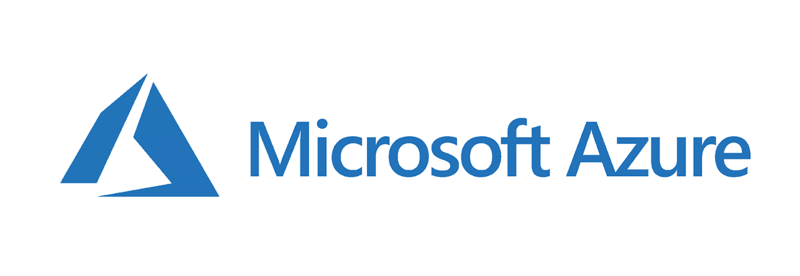
Technology

Slide 17
Estimates
Estimate 1
Estimate 2
Infrastructure 1 :
Azure Cloud - VM
Infrastructure 2:
Azure Cloud - Cluster
$1,224/year
$7,968.84/year
Development:
Compatible for basic cloud infrastructure
Development:
High end AI CRM
$10,000
$12,000
Timeline:
Timeline:
4 months
5 Months

Slide 18
Milestones
20%
30%
25%
25%
1
Milestone
2
Milestone
3
Milestone
4
Milestone
Project initiation & requirements confirmation
Core CRM development completion
AI features & integrations completion
Final testing, deployment & acceptance
Total 100%

Slide 19



Support & Team
Team:
Software Architect & Senior Developer
Support:
Kallol Roy
$20/per hour
QA & Tester (Module Based)
- Tazim

Slide 20
AILA CRM
One Platform to Manage Leads, Automate Work, and Grow Sales.

