Slide 1
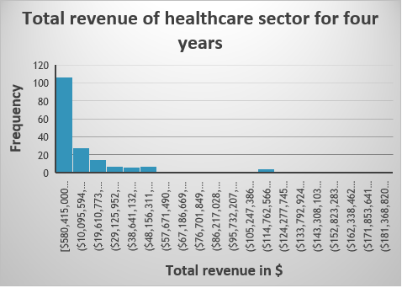
Are the revenues of the Health care Sector bigger or smaller than the energy sector?
This histogram indicates the total revenue of the healthcare sector for all companies in four years.
It highlights the positively skewed distribution, meaning the average is higher than the median. The highest frequency for the total revenue (over 100) is in the range of $580,415,000 to $10,095,594,000.
By considering the graph and the summary statistics, we could see the maximum and minimum revenues in the healthcare sector have a large difference. The range number is between $580,415,000 to $190,884,000,000 which are the minimum and maximum values for total revenue. Observing the statistics summary, the mean and median values for health care sector are $23,463,223,026 and $8,563,050,000, respectively. The standard deviation of total revenue for this sector is $37,710,947,029.

Slide 2
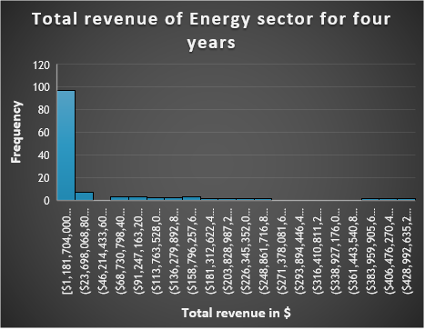
Are the revenues of the Health care Sector bigger or smaller than the energy sector?
This histogram indicates the total revenue of the energy sector for all companies in four years.
It highlights the positively skewed distribution, meaning the average is higher than the median. The highest frequency for the total revenue (less than 100) is in the range of $1,181,704,000 to $23,698,06800.
By considering the graph and the summary statistics, we could see the maximum and minimum revenues in the energy sector have a large difference more than the healthcare sector. The range number is between $1,181,704,000 to $451,509,000,000 which are the minimum and maximum values for total revenue. Observing the statistics summary, the mean and median values for health care sector are $38,984,796,516 and $11,777,257,500, respectively. The standard deviation of total revenue for this sector is $79,864,818,250.

Slide 3
Are the revenues of the Health care Sector bigger or smaller than the energy sector?
The standard deviation of total revenue for the energy sector ($79,864,818,250) is higher than the standard deviation of total revenue for the healthcare sector ($37,710,947,029). It shows that there is a higher variability of total revenues in the energy sector compared to the healthcare sector.
The range value for the energy sector’s total revenue is $450,327,296,000 which is higher than the range of total revenue for the healthcare sector $190,303,585,000. It highlights that the energy sector has more significant variability in the total revenues they receive because their range is more spread out.
In addition, both histograms of the two sectors indicate a positively skewed distribution which means both sectors’ average is higher than the median. Comparing the two sectors, the mean and the median values for the energy sector are higher than the healthcare sector.
Based on these results we could conclude that the revenues for the energy sector are bigger than the healthcare sector.

