Slide 1
AJAX/XML
Week 9 Session1

Slide 2
Contents of This session
Ajax
XmlHttpRequest object
Request
Response
Event

Slide 3
What is Ajax?
AJAX = Asynchronous JavaScript and XML.
AJAX is not a new programming language, but a new way to use existing standards.
AJAX allows web pages to be updated asynchronously by exchanging small amounts of data with the server behind the scenes.
This means that it is possible to update parts of a web page, without reloading the whole page

Slide 4
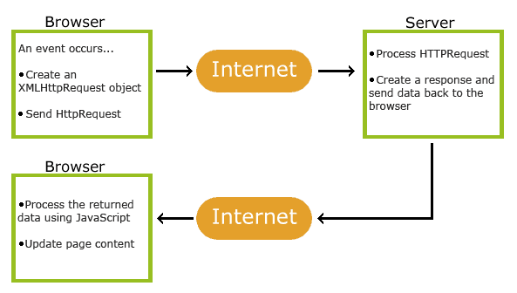
How Ajax works?
Image from w3schools.com

Slide 5
How Ajax works?
AJAX is based on internet standards, and uses a combination of:
XMLHttpRequest object (to exchange data asynchronously with a server)
JavaScript/DOM
CSS
XML/HTML

Slide 6
Ajax - The XMLHttpRequest Object
The XMLHttpRequest object is used to exchange data with a server behind the scenes
To create XMLHttpRequest object
var xmlhttp;
if (window.XMLHttpRequest)
{// code for IE7+, Firefox, Chrome, Opera, Safari
xmlhttp=new XMLHttpRequest();
}
else
{// code for IE6, IE5
xmlhttp=new ActiveXObject("Microsoft.XMLHTTP");
}

Slide 7
Ajax – The Request
To send a request to a server, we use the open() and send() methods of the XMLHttpRequest object:
Get method
xmlhttp.open("GET","ajax_info.txt",true);
xmlhttp.send();

Slide 8
Ajax – The Request
Post method
xmlhttp.open("POST","ajax_test.asp",true);
xmlhttp.setRequestHeader("Content-type","application/x-www-form-urlencoded");
xmlhttp.send("fname=Henry&lname=Ford");

Slide 9
Ajax – The Response
To get the response from a server, use the responseText or responseXML property of the XMLHttpRequest object.
responseText get the response data as a string
responseXML get the response data as XML data
Example
document.getElementById("myDiv").innerHTML
=xmlhttp.responseText;

Slide 10
Ajax – The onreadystatechange Event
When a request to a server is sent, we want to perform some actions based on the response.
The onreadystatechange event is triggered every time the readyState changes.
The readyState property holds the status of the XMLHttpRequest.

Slide 11
Ajax – The onreadystatechange Event
When a request to a server is sent, we want to perform some actions based on the response.
The onreadystatechange event is triggered every time the readyState changes.
The readyState property holds the status of the XMLHttpRequest.

Slide 12
Ajax – The onreadystatechange Event
Property | Description
onreadystatechange | Stores a function to be called automatically each time the readyState property changes
readyState | Holds the status of the XMLHttpRequest. Changes from 0 to 4: 0: request not initialized 1: server connection established 2: request received 3: processing request 4: request finished and response is ready
status | 200: "OK" 404: Page not found

Slide 13
Ajax – The onreadystatechange Event
xmlhttp.onreadystatechange=function()
{
if (xmlhttp.readyState==4 && xmlhttp.status==200)
{
document.getElementById("myDiv").innerHTML
=xmlhttp.responseText;
}
}

Slide 14
Ajax – The onreadystatechange Event
When a request to a server is sent, we want to perform some actions based on the response.
The onreadystatechange event is triggered every time the readyState changes.
The readyState property holds the status of the XMLHttpRequest.

Slide 15
Ajax – Demo
This example demonstrates how a web page can communicate with a web server via AJAX and some type of server side scripts.
http://www.w3schools.com/ajax/ajax_php.asp

Slide 16
Exercise
Ajax Navigation Links Exercise

Slide 17
End of The Session 1
Week 9

