Slide 1
AJAX/XML
Week 9 Session2

Slide 2
Contents of This session
Ajax
Jquery Ajax
XML

Slide 3
jQuery AJAX
The $.get() method requests data from the server with an HTTP GET request
Syntax:
$.get(URL,callback);
The required URL parameter specifies the URL you wish to request.
The optional callback parameter is the name of a function to be executed if the request succeeds

Slide 4
jQuery AJAX
Example
$("button").click(function(){
$.get("demo_test.asp", function(data, status){ alert("Data: " + data + "\nStatus: " + status);
}); });

Slide 5
jQuery AJAX
The $.post() method requests data from the server using an HTTP POST request.
Syntax:
$.post(URL,data,callback);
The required URL parameter specifies the URL you wish to request.
The optional data parameter specifies some data to send along with the request.
The optional callback parameter is the name of a function to be executed if the request succeeds.

Slide 6
jQuery AJAX
Example
$("button").click(function(){ $.post("demo_test_post.asp", { name: "Donald Duck", city: "Duckburg" }, function(data, status){ alert("Data: " + data + "\nStatus: " + status); }); });

Slide 7
XML
XML stands for EXtensible Markup Language.
XML was designed to store and transport data.
XML was designed to be both human- and machine-readable.

Slide 8
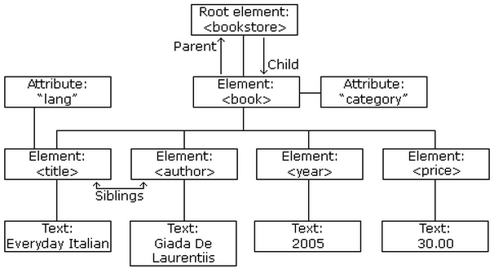
XML Tree structure

Slide 9
XML Syntax
All XML Elements Must Have a Closing Tag
XML Tags are Case Sensitive
XML Elements Must be Properly Nested
XML Documents Must Have a Root Element
XML Attribute Values Must be Quoted

Slide 10
XML Syntax
Example of the correct syntax
<bookstore>
<book category="CHILDREN">
<title>Harry Potter</title>
<author>J K. Rowling</author>
<year>2005</year>
<price>29.99</price>
</book>
</bookstore>

Slide 11
XML DOM
Wih the DOM, you can access every node in an XML document
These are some typical DOM properties:
x.nodeName - the name of x
x.nodeValue - the value of x
x.parentNode - the parent node of x
x.childNodes - the child nodes of x
x.attributes - the attributes nodes of x

Slide 12
XML DOM
These are some typical DOM method:
x.getElementsByTagName(name) - get all elements with a specified tag name
x.appendChild(node) - insert a child node to x
x.removeChild(node) - remove a child node from x

Slide 13
XML DOM
var xmlDoc=loadXMLDoc("books.xml");
var x=xmlDoc.getElementsByTagName("title");
for (i=0;i<x.length;i++)
{
document.write(x[i].childNodes[0].nodeValue);
document.write("<br>");
}

Slide 14
Exercise
Ajax Exercise

Slide 15
End of The Session 2
Week 9

