Slide 1
JSON JavaScript Object Notation
Week 11 Session1

Slide 2
Contents of This session
JSON
What is JSON?
JSON vs XML
Syntax

Slide 3


What is JSON? What JSON is Not?
No
No
Notes:
First lets see what Json is not ?
It is not a markup language.
It dose not require JavaScript to use it, so it’s not dependant on java script.

Slide 4
What JSON is?
Notes:
It is texts that is used to import and export data between platforms.
Another example of Data Interchange Format that we have introduced before is XML.

Slide 5
What is JSON?
JSON stands for JavaScript Object Notation
JSON is a syntax for storing and exchanging data.
JSON is an easier-to-use alternative to XML.
JSON is programing language independent *
JSON is "self-describing" and easy to understand

Slide 6
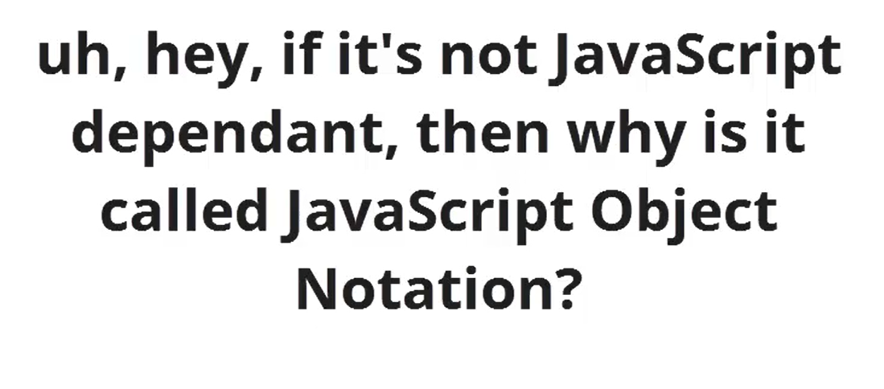
What is JSON?
Notes:
You might wonder……
It is called JavaScript Object Notation because it is based on the object letteral notation of JavaScript.

Slide 7
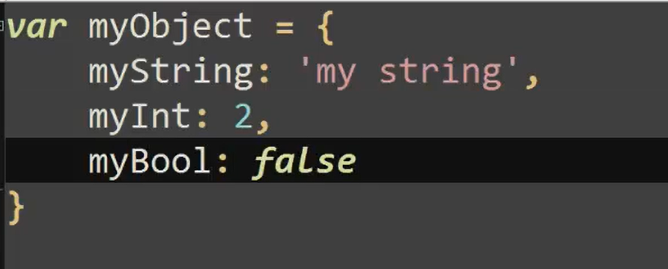

Slide 8
JSON
{"employees":[
{"firstName":"John", "lastName":"Doe"},
{"firstName":"Anna", "lastName":"Smith"},
{"firstName":"Peter", "lastName":"Jones"}
]}

Slide 9
JSON vs XML
XML
Json
<employees>
<employee>
<firstName>John</firstName> <lastName>Doe</lastName>
</employee>
<employee>
<firstName>Anna</firstName> <lastName>Smith</lastName>
</employee>
<employee>
<firstName>Peter</firstName> <lastName>Jones</lastName>
</employee>
</employees>
{"employees":[
{"firstName":"John", "lastName":"Doe"},
{"firstName":"Anna", "lastName":"Smith"},
{"firstName":"Peter", "lastName":"Jones"}
]}

Slide 10
JSON vs XML
Much Like XML Because
Both JSON and XML are "self describing" (human readable)
Both JSON and XML are hierarchical
Both JSON and XML can be parsed and used by lots of programming languages
Both JSON and XML can be fetched with an XMLHttpRequest
Much Unlike XML Because
JSON doesn't use end tag
JSON is shorter
JSON is quicker to read and write
JSON can use arrays
The biggest difference is:
Notes:
Hi ra ki cal

Slide 11
Why JSON?
For AJAX applications, JSON is faster and easier than XML:
Using XML
Fetch an XML document
Use the XML DOM to loop through the document
Extract values and store in variables
Using JSON
Fetch a JSON string
JSON.Parse the JSON string

Slide 12
JSOM Example
JSON Data
“firstName”:“John”
JSON Object
{“firstName” :”John”, ”lastName”: “Doe”}
Notes:
This is name /value pair…..
The only thing we missing to make it an object is curly brackets.
We can have more than one name/value pair inside the brackets to do so we need to separate them by a camma.
What if we need to have more than one object. We can create array.

Slide 13
JSOM Example
JSON Array
“employees”:[
{“firstName”: “John”, “lastName”: “Doe”},
{“firstName” : “Anna”, “lastName”: “Smith”},
{“firstName”: “Peter”, “lastName”: “Jones”}
]

Slide 14
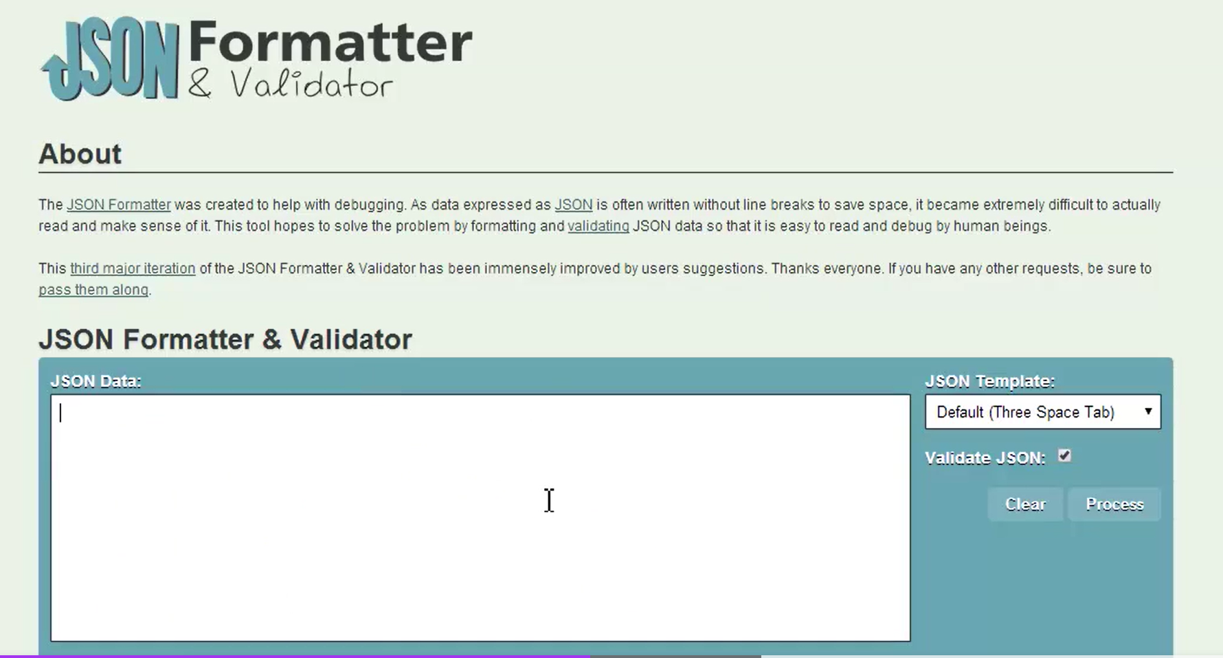
JSON Formatter
Notes:
https://jsonlint.com/

Slide 15
How JSON works?
The JSON format is syntactically identical to the code for creating JavaScript objects
Instead of using a parser (like XML does), a JavaScript program can use standard JavaScript functions to convert JSON data into native JavaScript objects
Notes:
So what does that mean

Slide 16
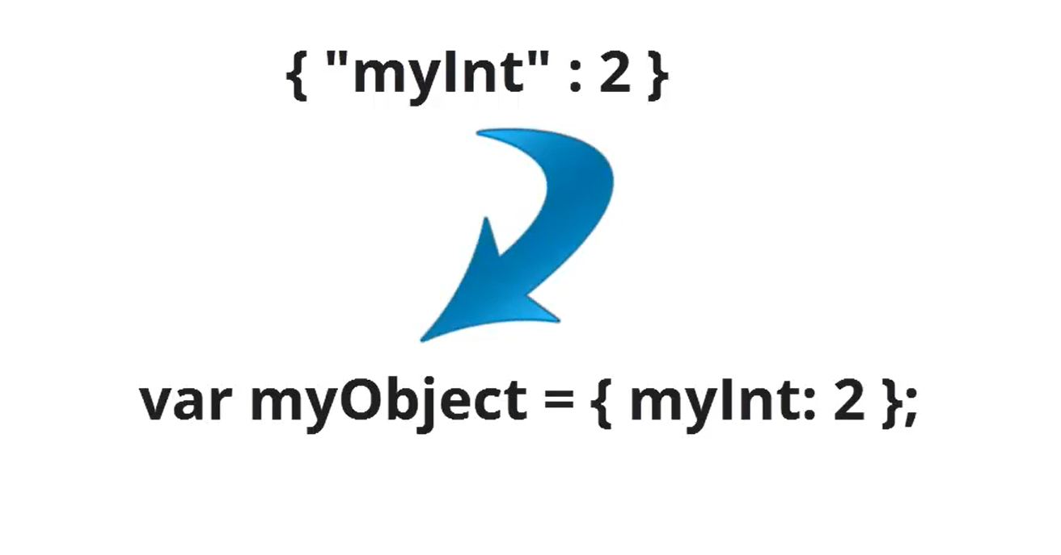
Notes:
Because Json is based on JavaScript notational object it can be converted directly into a JavaScript object.
Let see another example.

Slide 17
How JSON works?
A JavaScript string containing JSON syntax:
var text = '{ "employees" : [' +
'{ "firstName":"John" , "lastName":"Doe" },' +
'{ "firstName":"Anna" , "lastName":"Smith" },' +
'{ "firstName":"Peter" , "lastName":"Jones" } ]}';
The JavaScript function JSON.parse(text) can be used to convert a JSON text into a JavaScript object:
var obj = JSON.parse(text);

Slide 18
How JSON works?
Use the new JavaScript object in your page:
<p id="demo"></p>
<script>
document.getElementById("demo").innerHTML =
obj.employees[1].firstName + " " + obj.employees[1].lastName;
</script>

Slide 19
JSON and XMLhttpRequest
A common use of JSON is to read data from a web server, and display the data in a web page.
easy steps, how to read JSON data, using XMLHttp
Create an array of objects in a web server
Write a function to display the array
Read the JSON string with an XMLHttpRequest
The example reads JSON data from a web server running PHP and MySQL

Slide 20
Exercise
JSON exercise

Slide 21
Exercise
<script>
var xmlhttp = new XMLHttpRequest();
var url = "https://gist.githubusercontent.com/DilaBee/33b869bcba3c52240612725453660cb2/raw/d5a2fab1110af399efdfb75b62f7e5a8bd0c3f13/example.json";

Slide 22
Exercise
xmlhttp.onreadystatechange = function() {
if (this.readyState == 4 && this.status == 200) {
var myArr = JSON.parse(this.responseText);
myFunction(myArr);
}
};
xmlhttp.open("GET", url, true);
xmlhttp.send();

Slide 23
Exercise
function myFunction(arr) {
var out = "<ul>";
var i;
for(i = 0; i < arr.length; i++) {
out += '<li>' + arr[i].name +' '+arr[i].lastName+'</li>'; }
out += "</ul>"
document.getElementById("id01").innerHTML = out;
}
</script>
</body>
</html>

Slide 24
End of The Session 1
Week 11

