Slide 1
jQuery
Week 8 Session1

Slide 2
Contents of This session
Jquery
How to use
Syntax
Selector
Event
Effect

Slide 3
What is jQuery
Query is a JavaScript Library.
jQuery greatly simplifies JavaScript programming.
jQuery is easy to learn

Slide 4
What is jQuery
The jQuery library contains the following features:
HTML/DOM manipulation
CSS manipulation
HTML event methods
Effects and animations
AJAX
Utilities

Slide 5
Get Started to use jQuery
There are several ways to start using jQuery on your web site. You can:
Download the jQuery library from jQuery.com
<script src="jquery-1.11.3.min.js"></script>
Include jQuery from a CDN, like Google
<script src="https://ajax.googleapis.com/ajax/libs/jquery/1.11.3/jquery.min.js"></script>

Slide 6
jQuery Syntax
The jQuery syntax is tailor made for selecting HTML elements and performing some action on the element(s).
Basic syntax is:
$(selector).action()
A $ sign to define/access jQuery
A (selector) to "query (or find)" HTML elements
(‘#id’, ‘.class’ or ‘tagname’)
A jQuery action() to be performed on the element(s)

Slide 7
jQuery Syntax
It is good practice to wait for the document to be fully loaded and ready
This also allows you to have your JavaScript code in the head section or external js file
$(document).ready(function(){ // jQuery methods go here... });

Slide 8
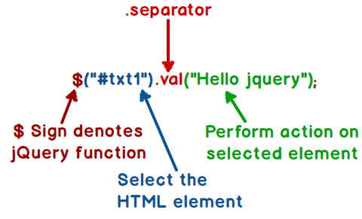
jQuery Selectors
jQuery selectors allow you to select and manipulate HTML element(s)
element Selector
$("p")
#id Selector
$("#test")
.class Selector
$(".test")
More example of selector
http://www.w3schools.com/jquery/jquery_selectors.asp
https://www.codeproject.com/Articles/778374/JQUERY-JSON-Angular-and-Less-Interview-questions#Sowilljqueryreplacejavascript

Slide 9
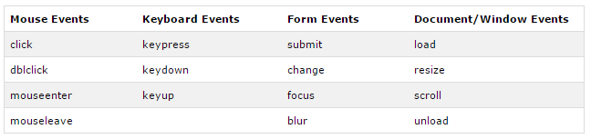
jQuery Event
These are common events in browsers
The table shows common events in browsers

Slide 10
jQuery Event
Method | Description
click() | The function is executed when the user clicks on the HTML element
dblclick() | The function is executed when the user double-clicks on the HTML element
mouseenter() | The function is executed when the mouse pointer enters the HTML element
mouseleave() | The function is executed when the mouse pointer leaves the HTML element
hover() | The hover() method takes two functions and is a combination of the mouseenter() and mouseleave() methods
$(document).ready() | allows us to execute a function when the document is fully loaded
More jQuery Event
http://www.w3schools.com/jquery/jquery_ref_events.asp

Slide 11
jQuery Event
Example
$("p").click(function(){ // action goes here!! });
$("p").click(function(){
$(this).hide(); });
When P elements are clicked, they will be hidden.

Slide 12
jQuery Effects - Hide and Show
Hide effect
$(selector).hide(speed,callback);
Show effect $(selector).show(speed,callback);
Toggle effect
$(selector).toggle(speed,callback);
The optional speed parameter specifies the speed of the hiding/showing( "slow", "fast", or milliseconds)
The optional callback parameter is a function to be executed after the hide() or show() method completes

Slide 13
jQuery Effects - Fade In and Out
Fade In effect
$(selector).fadeIn(speed,callback);
Fade out effect $(selector).fadeOut(speed,callback);
Fade Toggle effect
$(selector).fadeToggle(speed,callback);
Fade To effect
$(selector).fadeTo(speed,opacity,callback);

Slide 14
Exercise
jQuery Image Hovering

Slide 15
End of The Session 1
Week 8

