Slide 1

Michael Franssen
Joris Geurts
ALE2
Automata in professional practice

Slide 2
week overview
NDFA
regular expression
powerset construction for DFA
PDA
parallel automata

Slide 3
week 1: Finite State Automata
finite number of states (set S)
a starting state (s∈S)
several final states (F⊆S)
alphabet Σ of labels
labeled transitions between states
(transition relation δ: (SxΣ)↪S)

Slide 4
finite automata (II)
c
X
state
a
C
X
start state
b
X
final state
A
B
x
labeled transition

Slide 5
operational model
an automaton is a machine that generates strings
  every path from start state to final state produces a string being the concatenation of the labels of the transitions
    path ACCB produces string acb
    path ACB produces string ab
    string acbb cannot be produced
or: automaton accepts a given string
language L(A):
set of all strings that can be produced
by automaton A
c
a
C
b
A
B

Slide 6
deterministic automata (DFA)
exactly 1 transition for each state and each symbol of the alphabet
therefor it's simpel to check if string s belongs to L(A)
other finite automata: non deterministic finite automata (NDFA)
both types are equally powerful:
  a DFA is een special case of an NDFA
  for each NDFA you can construct a DFA that produces the same language
  (but this DFA has (theoretically) exponentially more states compared to the NDFA)

Slide 7
ε ('epsilon') transitions
an NDFA may have transition with label ε (the empty string)
if an automaton is in state X and X can go to Y via an ε transition, and Y goes to Z via label a, then X goes to Z via a as well
c
A goes via a to C
A goes via b to B
cccb ∈ L (P)
b ∈ L (P)
automaton P
a
C
b
A
ε
B

Slide 8
week 2: regular expressions
You can use RE's to generate words:
ε is a RE
each letter a from alphabet Σ is a RE
if x and y are REs, then x.y (concatenation), x|y (choice) en x* (repetition) are RE's as well.
sometimes we skip the . for concatenation
the language of a RE:
      L(ε) = ∅
      L(a) = { a }
      L(x.y) = { ab | a∈L(x) and b∈L(y) }
      L(x*) = { a₁a₂a₃…a_{n} | a_{i}∈L(x) for 1 ≤ i ≤ n and 0 ≤ n}
      L(x|y) = { a | a∈L(x) or a∈L(y) }

Slide 9
regular expressions
examples:
L(a.b*|c*) = { a, ab, abb, abbb, abbbb, …
ε, c, cc, ccc, cccc, … }
(note: ε is the empty string!)
Construct a NDFA from a RE: use "Thompson's construction"

Slide 10


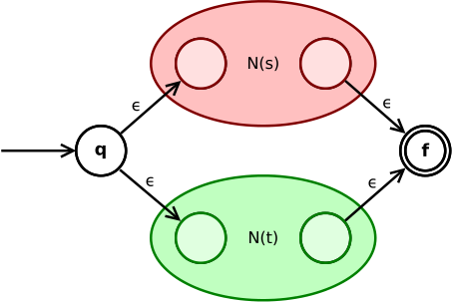
Thompson's construction (I)
convert ε and a
convert s|t
https://en.wikipedia.org/wiki/Thompson's_construction

Slide 11
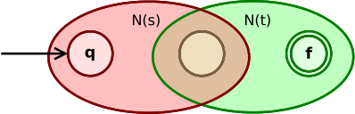
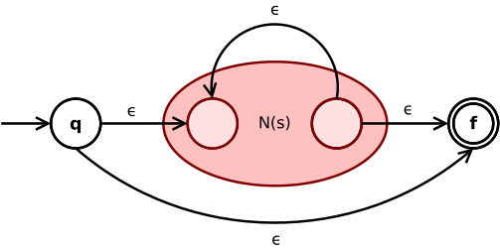
Thompson's construction (II)
convert s∙t (concatenation)
convert Kleene star s*

Slide 12
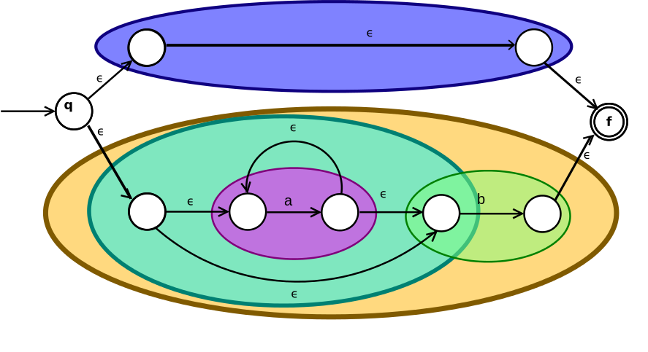
Thompson's construction (III)
example: (ε|a*b)

Slide 13
week 3: powerset construction
see Math2 - week 6

Slide 14
week 4: Push Down Automaton
contains a stack (with separate stack alphabet)
in a state transition, element can be pushed onto and/or popped from the stack
starts with empty stack
a state transition can only be done when its stack symbol can indeed be popped from the stack
ends when a final state is reached and when stack is empty

Slide 15
example
a[ε/t]
c[ε/ε]
b[t/ε]
a[ε/t]
b[t/ε]
A
C
B
this automaton accepts all strings like a^{n}c^{m}b^{n}, with n>0 and m≥0. So: ab, acb, aacccccbb; but not: aab, aaacbbbb
because: after n times reading an a, the stack contains n times a t. Now you can read as many c's as you want. When reading the first b, the automaton is in state B, but it can only finish when all t’s are removed from the stack (so after reading n times b)

Slide 16
week 5: parallel automata (I)
an automaton can be regarded as a machine who takes actions
the generated string is the trace of action that this machine has done
or: the given string represent the actions that this machine needs to execute
in this way, we can observe the behaviour of a system with two (or more) parallel automata
the state of this system is the combination of the states of the separate automata

Slide 17
parallel automata (II)
suppose automaton A with alphabet Σ_{A}, states S_{A}, start state s_{A}, final states F_{A} and transition function δ_{A}
and automaton B with Σ_{B}, S_{B}, s_{B}, F_{B} and δ_{B}
automaton AxB models the behaviour of the parallel operating automata A and B
AxB is defined by alphabet Σ_{A}xΣ_{B} and states S_{A}xS_{B}.
AxB starts in (s_{A},s_{B}). The final states are those (s_{a},s_{b}) with s_{a} ∈ F_{A} and s_{b} ∈ F_{B}.
transition function δ_{AxB} describes the parallel behaviour

Slide 18
parallel automata (III)
AxB can make a transition from (s_{a1},s_{b1}) with input (x,ε) to (s_{a2},s_{b1}) if δ_{A}(s_{a1},x)=s_{a2}.
AxB can make a transition from (s_{a1},s_{b1}) with input (ε,y) to (s_{a1},s_{b2}) if δ_{B}(s_{b1},y)=s_{b2}.
with those rules we have interleaving parallellisme: in fact the automaton does only one step every time
real parallellism can be obtained by adding this rule:
AxB can make a transition from (s_{a1},s_{b1}) with input (x,y) to (s_{a2},s_{b2}) if δ_{A}(s_{a1},x)=s_{a2} and δ_{B}(s_{b1},y)=s_{b2}.

Slide 19
parallel automata (IV)
running two independent automata in parallel is not interesting
therefor we add symbols R and T to both alphabets ∑_{A} and ∑_{B} for communication
transitions for symbols R and T are only done when:
  AxB makes a transition from (s_{a1},s_{b1}) with input (R,R) to (s_{a2},s_{b2}) when δ_{A}(s_{a1},R)=s_{a2} and δ_{B}(s_{b1},R)=s_{b2}.
  AxB makes a transition from (s_{a1},s_{b1}) with input (T,T) to (s_{a2},s_{b2}) when δ_{A}(s_{a1},T)=s_{a2} and δ_{B}(s_{b1},T)=s_{b2}.
so: communication steps are only done when both automata are at the synchronization point at the same time

