Slide 1
Satisfiability
Davis-Putnan algorithm

Slide 2
Satisfiability
assign values (True or False) to proposition variables A, B, C, D, E such that proposition (¬A ∨ B ∨ ¬C) ∧ (E) ∧ (¬A ∨ C ∨ D) is True

Slide 3
notation
(¬A ∨ B ∨ ¬C) ∧ E ∧ (¬A ∨ C ∨ D)
[ aBc, E, aCD ]

Slide 4
emptiness
empty CNF: satisfiable
empty clause: unsatisfiable

Slide 5
resolution
if a CNF contains clauses (A ˅ p) and (B ˅ ¬p) then they can be replaced by (A ˅ B)

Slide 6
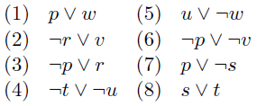
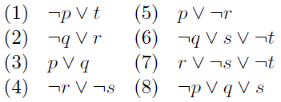
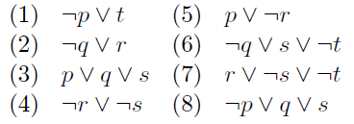
exercises
(p ˅ q) ∧ (¬r ˅ s) ∧ (¬q ˅ r) ∧ (¬r ˅ ¬s) ∧ (¬p ˅ r)
(p ˅ q) ∧ (¬r ˅ s) ∧ (¬q ˅ r) ∧ (q ˅ ¬s) ∧ (¬p ˅ r)

Slide 7
RemoveUseless
a clause with X and ¬X is always true: clause can be removed
example:
[BCEFc,BEFbc,BEFbce,BEFce,ce,CEFbce,CEFc,CEFce,EFbc,EFce,f ]
becomes:
[ ce,EFbc,f ]

Slide 8
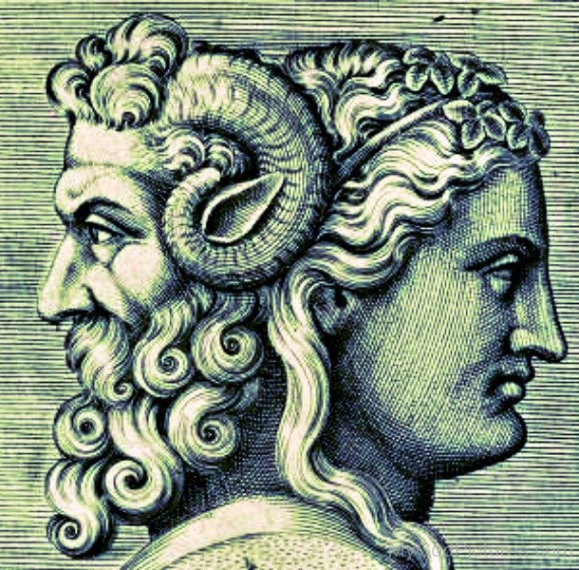
NonJanus
when a CNF only contains X (and no ¬X), then X can be set to True (throughout the CNF)
similar to only ¬X (and no X)
https://en.wikipedia.org/wiki/Janus

Slide 9
algorithm
cnf only contains 'K' .. 'Z'
('A' .. 'J' already resoluted)
DavisPutnan(cnf):
pick next variable v
cnf = RemoveUseless(cnf)
cnf = SolveNonJanus(cnf,v)
if v is not the last variable:
DavisPutnan(resolution(cnf,v))
cnf = substituteSolution(cnf)
either:
janus: unsat
non-janus: solution for v found
else: choose any solution for v
suppose it is variable 'K'
this cnf only contains 'L' .. 'Z'
solution for 'L' .. 'Z' available
cnf only contains 'K'
solution for 'K' .. 'Z' available

Slide 10
[ Abd,acd,Cbd,Cd ]
remove-useless: [ Abd,acd,Cbd,Cd ]
solve-non-janus on A: [ Abd,acd,Cbd,Cd ]
resolution on A: [ bcd,Cbd,Cd ]
remove-useless: [ bcd,Cbd,Cd ]
solve-non-janus on B: B=false, [ Cd ]
resolution on B: [Cd ]
remove-useless: [Cd ]
solve-non-janus on C: C=true, [ -- ]
resolution on C: [ -- ]
remove-useless: [ -- ]
solve-non-janus on D: [ -- ]
resolution on D: [ -- ]
(no recursive call any more)
choose D=true
substitute-solution: [ -- ]
substitute-solution: [ -- ]
substitute-solution: [ a ]
solve-non-janus: A=false

Slide 11
[ CDc,CDE,CDEa,D,Ef,F ]
remove-useless: [ CDE,CDEa,D,Ef,F ]
solve-non-janus on A: A=false, [ CDE,D,Ef,F ]
resolution on A: [ CDE,D,Ef,F ]
remove-useless: [ CDE,D,Ef,F ]
solve-non-janus on C: C=true, [ D,Ef,F ]
resolution on C: [ D,Ef,F ]
remove-useless: [ D,Ef,F ]
solve-non-janus on D: D=true, [ Ef,F ]
resolution on D: [Ef,F ]
remove-useless: [Ef,F ]
solve-non-janus on E: E=true, [ F ]
resolution on E: [ F ]
remove-useless: [ F ]
solve-non-janus on F: F=true, [ -- ]
(no recursive call any more)
substitute-solution: [ -- ]
substitute-solution: [ -- ]
substitute-solution: [ -- ]
substitute-solution: [ -- ]

Slide 12
[ A,AC,acd,AD,af,AFa,AFf,CD,Fa,Ff ]
remove-useless: [ A,AC,acd,AD,af,CD,Fa ]
solve-non-janus on A: [ A,AC,acd,AD,af,CD,Fa ]
resolution on A: [ Ccd,cd,CD,Cf,CF,Dcd,Df,DF,f,F ]
remove-useless: [ cd,CD,Cf,CF,Df,DF,f,F ]
solve-non-janus on C: [ cd,CD,Cf,CF,Df,DF,f,F ]
resolution on C: [ Dd,df,Df,DF,f,F,Fd ]
remove-useless: [ df,Df,DF,f,F,Fd ]
solve-non-janus on D: [ df,Df,DF,f,F,Fd ]
resolution on D: [ f,F,Ff ]
remove-useless: [ f,F ]
solve-non-janus on F: [ f,F ]
(no recursive call any more)
has-janus: UNSAT

Slide 13
Tseitin transformation (I)
=(A,=(B,=(~(C),=(D,=(E,A)))))
[Abcd,aAbcD,aAbCd,aAbCD,aABcd,aABcD,aABCd,aABCD,aAbcdE,aAbcDe,aAbCde,aAbCDE,aABcde,aABcDE,aABCdE,aABCDe,aAbce,aAbcE,aAbCe,aAbCE,aABce,aABcE,aABCe,aABCE,aAbceE,aAbCeE,aABceE,aABCeE,aAbdD,aABdD,aAbdDe,aAbdDE,aABdDe,aABdDE,aAbdDeE,aABdDeE,aAbde,aAbdE,aAbDe,aAbDE,aABde,aABdE,aABDe,aABDE,aAbdeE,aAbDeE,aABdeE,aABDeE,aAcCd,aAcCD,aAcCdD,aAcCdDe,aAcCdDE,aAcCdDeE,aAcCde,aAcCdE,aAcCDe,aAcCDE,aAcCdeE,aAcCDeE,aAcCe,aAcCE,aAcCeE,aAcdD,aACdD,aAcdDe,aAcdDE,aACdDe,aACdDE,aAcdDeE,aACdDeE,aAcde,aAcdE,aAcDe,aAcDE,aACde,aACdE,aACDe,aACDE,aAcdeE,aAcDeE,aACdeE,aACDeE,AbB,aBcC,AbcC,abcdD,aBCdD,AbCdD,ABcdD,abcde,abcDE,abCdE,abCDe,aBcdE,aBcDe,aBCde,aBCDE,Abcde,AbcDE,AbCdE,AbCDe,ABcdE,ABcDe,ABCde,ABCDE,abcdeE,abCDeE,aBcDeE,aBCdeE,AbcDeE,AbCdeE,ABcdeE,ABCDeE,abceE,aBCeE,AbCeE,ABceE,aBdDe,aBdDE,AbdDe,AbdDE,aBdDeE,AbdDeE,aBdeE,aBDeE,AbdeE,AbDeE,AcCdD,AcCdDe,AcCdDE,AcCdDeE,AcCde,AcCdE,AcCDe,AcCDE,AcCdeE,AcCDeE,AcCeE,AcdDe,AcdDE,ACdDe,ACdDE,AcdDeE,ACdDeE,AcdeE,AcDeE,ACdeE,ACDeE ]

Slide 14

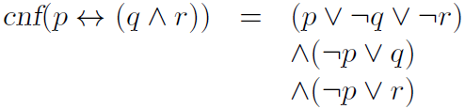
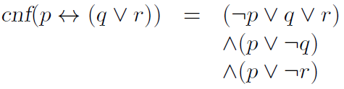
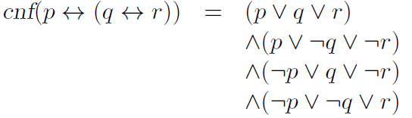
Tseitin transformation (II)
(¬A∧B)⇔((C⇒D)˅E)
((J ∧B)⇔((C⇒D)˅E)) ∧ (J⇔¬A)
(K ⇔ ((C⇒D)˅E)) ∧ (J⇔¬A)∧(K ⇔ J∧B)
(K ⇔(L ˅E)) ∧ (J⇔¬A)∧(K ⇔ J∧B) ∧ (L ⇔ (C⇒D))
(K ⇔ M ) ∧ (J⇔¬A)∧(K ⇔ J∧B) ∧ (L ⇔ (C⇒D)) ∧ (M ⇔ L˅E)
(N ) ∧ (J⇔¬A)∧(K ⇔ J∧B) ∧ (L ⇔ (C⇒D)) ∧ (M⇔L˅E) ∧ (N⇔(K⇔M))

