Slide 1
Fire Fighter
By Alexander Popov and Kaloyan Stoykov

Slide 2
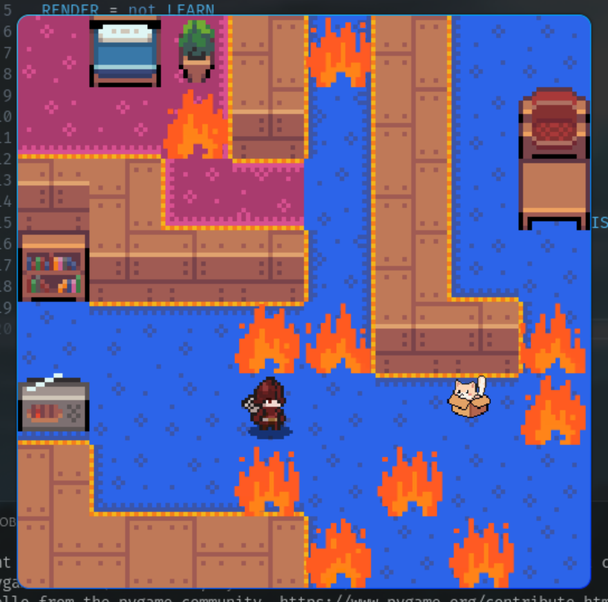
The game
Goal
Obstacles
Actions

Slide 3
Classic MDP
Identify requirements in terms of theory and also pygame constraints
Transition Models
Rewards
Actions, States
Markovian Process

Slide 4
Interesting points
Difficulty with “random” spreading fire
Right actions
Introducing “stochastic” actions
Reformat environment code

Slide 5
Takeaways for MDP
“Know all” environment – cannot be expected for fire hazards in real life
Interesting to build, hard to get right
Parameters play a big role

Slide 6

Rewards
    -100 >= Negative
Illegal action = -10
Time = -3
Death = -100
Positive <= 100
Distance = 0.2
Extinguish fire = 10

Slide 7
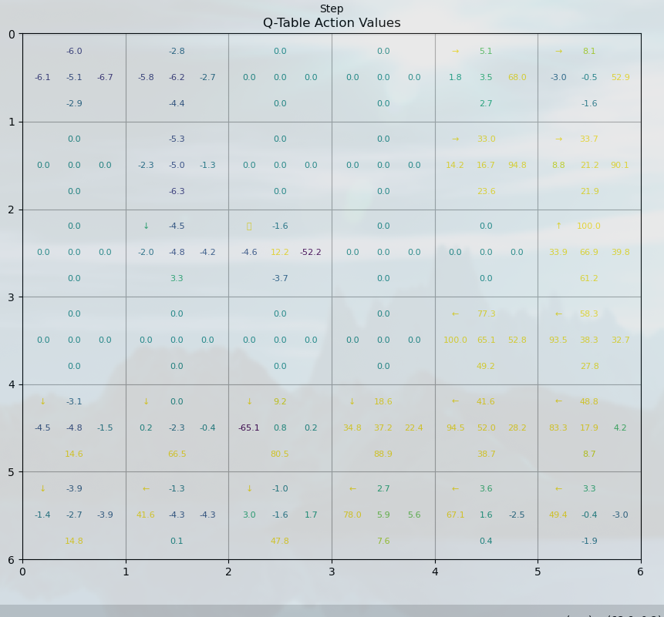
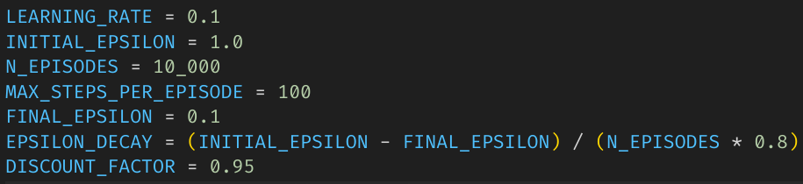
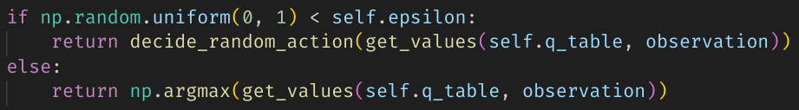
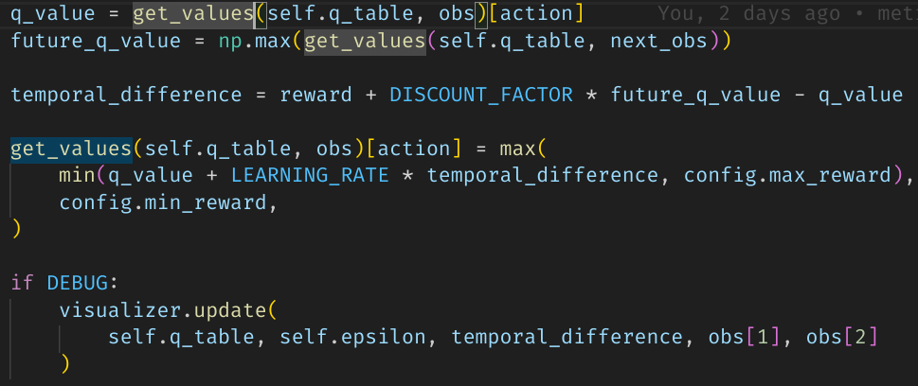
Q-Learning
States - 6x6x2x6x6x5

Slide 8
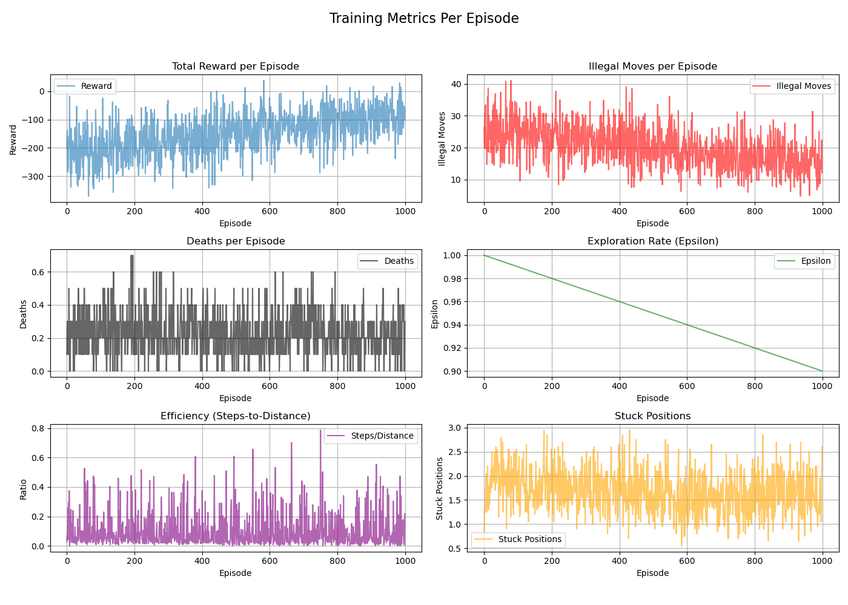
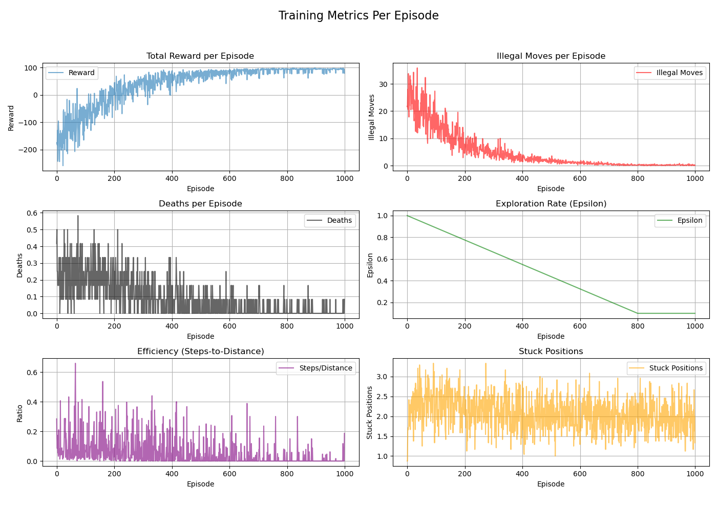
Q-Learning metrics

Slide 9
MDP
No actual “learning”
Make the process markovian:
  Agent depends only on current state and action taken via transition model P(s0 | s, a)
Static environment → predefined static fire is initialized and policy is computed

Slide 10
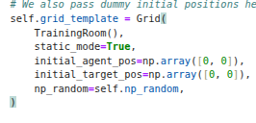
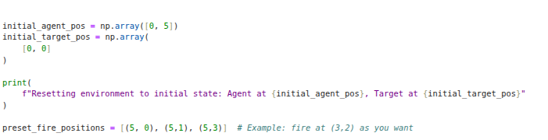
The environment at hand

Slide 11

Gameplay

Slide 12
Thank you for your attention!

