Slide 1
Fire Fighter
By Alexander Popov and Kaloyan Stoykov

Slide 2
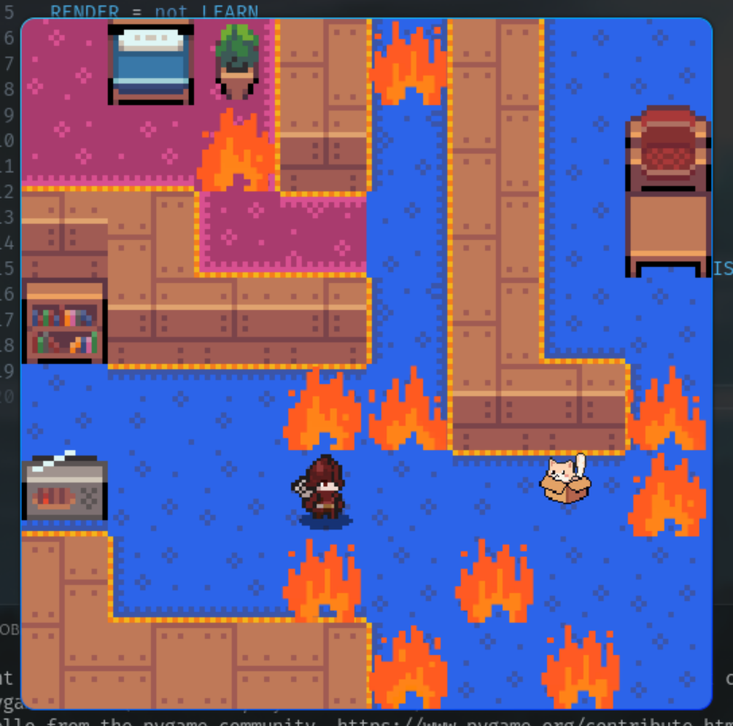
The game
Goal
Obstacles
Actions

Slide 3

Rewards
    -100 >= Negative
Illegal action = -10
Time = -3
Death = -100
Positive <= 100
Distance = 0.2
Extinguish fire = 10

Slide 4
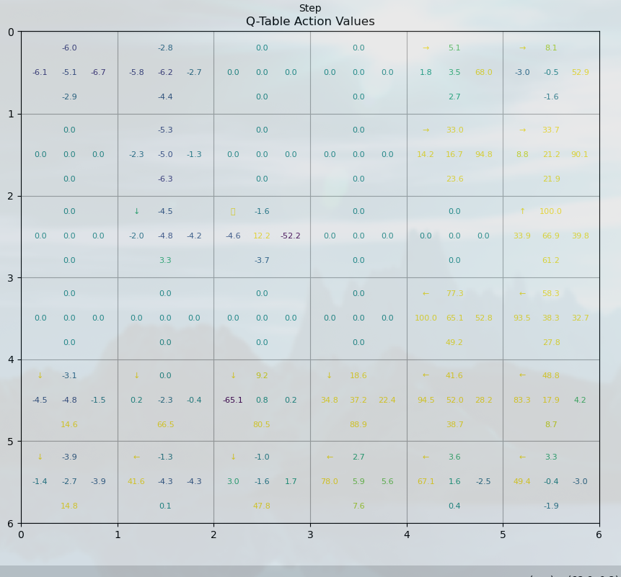
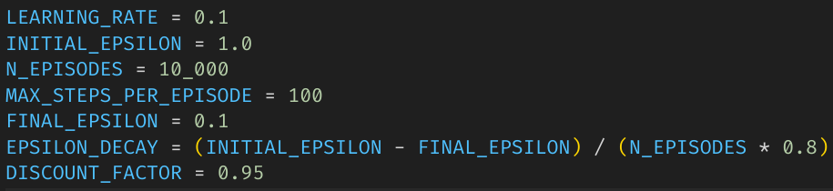
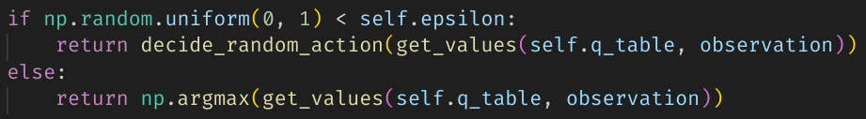
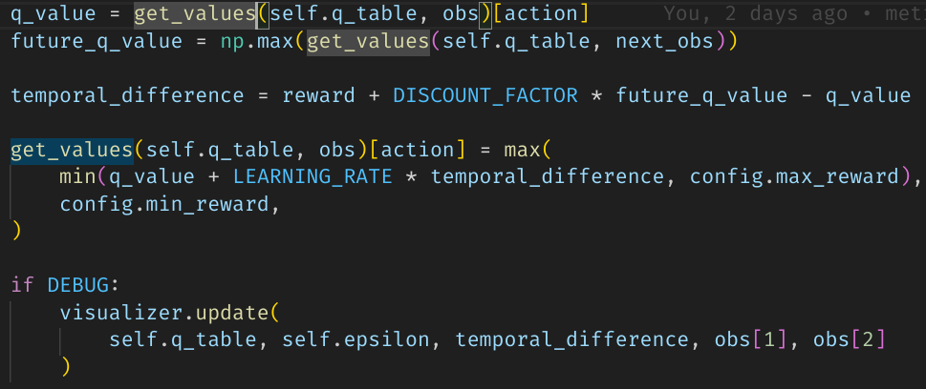
Q-Learning
States - 6x6x2x6x6x5

Slide 5
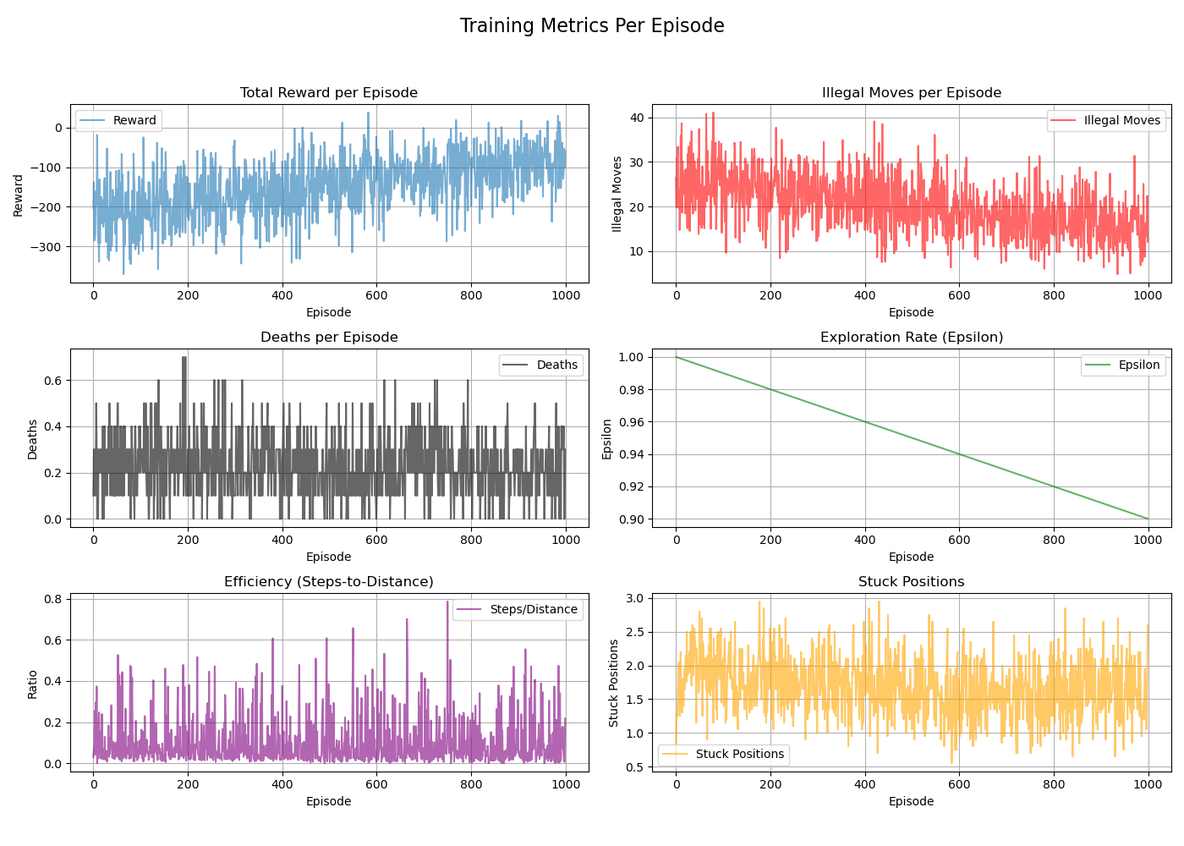
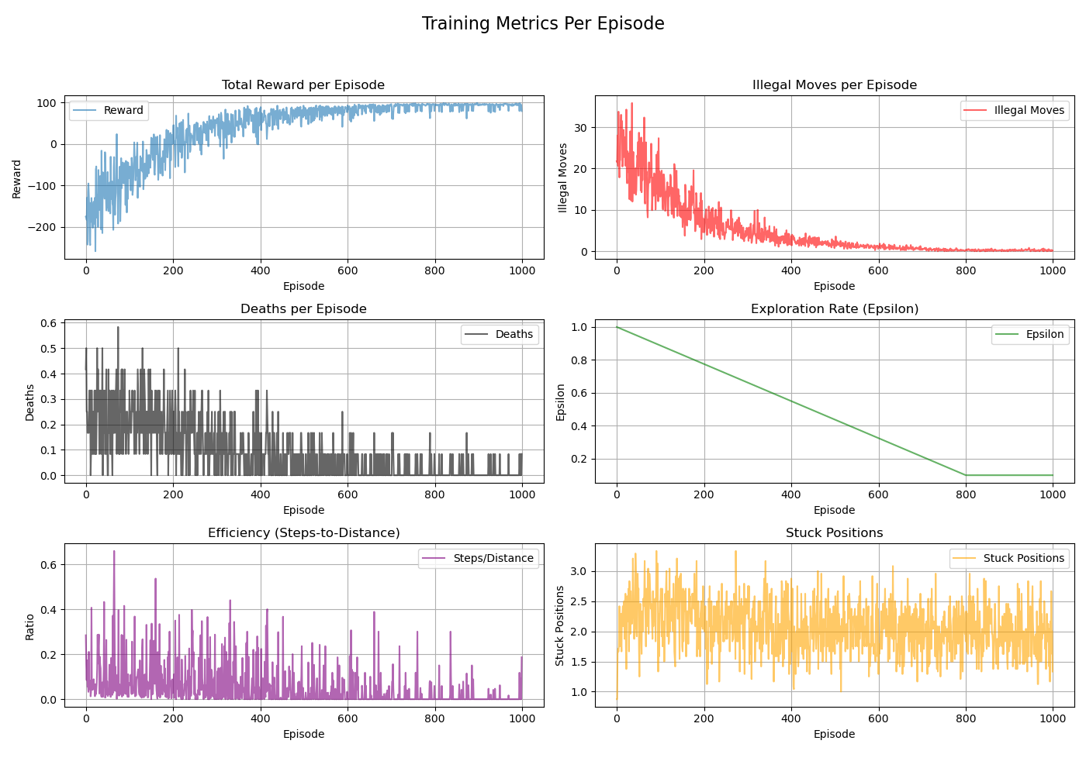
Q-Learning metrics
Unnecessary putting out fire
Max steps per ep

Slide 6
MDP

Slide 7

Gameplay
https://firefighter-game-deth-on-81184.web.app/

Slide 8
Thank you for your attention!

