Slide 1
Scrum Sprint Planning, 04.05.2017
Henriette Selter
Dana Vladimirova
Mohamed Achref Chiha
Vanya Vucheva
Kaloyan Todorov
House Tyrell

Slide 2
Agenda
  Project Overview
  (Customer) Software Requirements
  Sprint Review
  Actual Sprint Planning

Slide 3
Project Overview

Slide 4
Lab Topics
  Team Based Software Building
  Story Driven Application Testing
  Using Cutting Edge Tech Stack
  Agile Development

Slide 5
Lab Goals
  Simplifying Testing Process
  Learning Teamwork with Scrum
  Learning Technologies
  Learning to work with a Client

Slide 6
(Customer) Software Requirements

Slide 7
General Project Guidelines
  Angular or React for Frontend
  Dockerize Microservices
  Sprint Boot for Backend
  Other Technologies as needed

Slide 8
Requirements Frontend
  CSV Data Im-/Export
  Data Management on Page
    Manipulation
    Creation/Deletion
  Interfacing Backend Functionalities

Slide 9
Requirements Backend
  Storing and Retrieving Data from DB
  Working with Test Stories
    Execution and Resultparsing
    Efficient Storing
  Search and Analyze Everything Test Related
  Generating Test Data

Slide 10
Sprint Review
Requirements Engineering First Sprint

Slide 11
Initializing Project
  25.04.2017
  Learning about our Project
  Finding our House (Team)
  27.04.2017
  Meeting Customer
  Learning about Customer Requirements
  01.05.2017
  Feature Engineering
  Dividing Responsibilities
  Next Sprint Planning

Slide 12
Sprint Planning

Slide 13
General Guideline
  Always write Documentation
  Dockerize your Microservices
  Split your Tasks => Jot down as User Stories

Slide 14
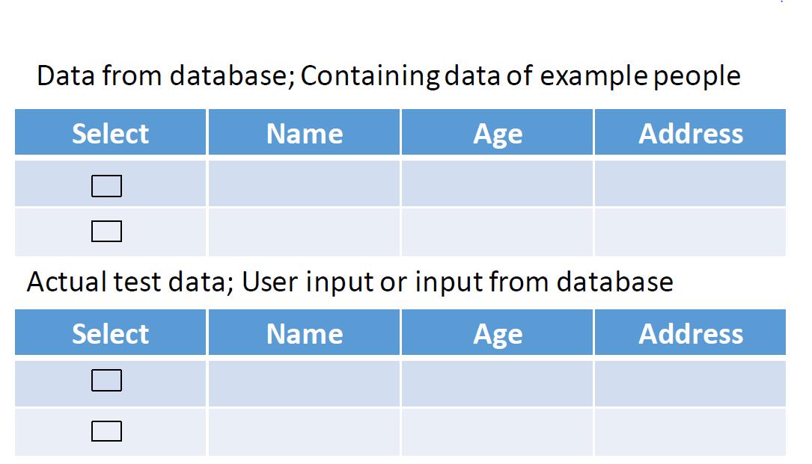
Frontend (Achref, Dana)
    ToDo
    Technologies
  AngularJS
  Bootstrap (CSS)
  Basic Mockup
    Footer, Navbar
    Clear Text API Requests
2. Displaying API Replies in a nice Fashion

Slide 15
REST API (Nils)
    ToDo
  Defining Basic Endpoints
  Writing YAML Documentation
    Technologies
  Flask or Spring Boot (API)
  Swagger (Documentation)
  Dataflow Im/Export
Frontend
CSV File
API Handler
JSON
Backend

Slide 16
Backend Data Manipulation (Kaloyan)
    ToDo
    Technologies
  Spring Boot
  Creating Project Structure Eclipse
  Implementing Im/Export
    Creating first Datamodel
  Interfacing with API Handler

Slide 17
Backend Data Management (Henriette, Vanya)
    ToDo
    Technologies
  MongoDB (DB)
  Spring Boot (Interface)
  Creating DB Schema for
    Test Data
    Test Stories
  Create first DB Interface
    Implementation
    Documentation

Slide 18
Deliverable House Tyrell (18.05.2017)
Frontend
Import
Export
Basic Display
API Handler
Import Endpoint
Export Endpoint
Swagger Documentation
CSV File
JSON
Database
Schema Test Data
Scheme Test Story
Backend DB
DB Interfacing
Backend Manipulation
Import Functionality
Export Functionality
API Interfacing
?
?

