Slide 1
Introduction
Proposed approach
Conclusion
References
Emojify:
Emotion Detector
Emojify
Emotion Detector
Machine Learning (IE 406)
(Group-1)
Instructor - Prof. M V Joshi
Kalp Pandya - 202001466
Jay Grover - 202001467
Dhirubhai Ambani Institute of Information and Communication Technology (DA-IICT), Gandhinagar, Gujarat
Email spam classification
Emojify: Emotion Detector

Slide 2
Introduction Proposed approach
Dataset
Results
Conclusion
References
Kaggle’s FER-2013
7 different classes of facial expressions
Gray scale images
Size - 48x48 pixels
Face centered image
Training size - 28,709
Testing size - 7,178
[1] Kaggle fer-2013 Dataset
Email spam classification
Emojify: Emotion Detector

Slide 3
Introduction Proposed approach
Result
Conclusion
Reference
Basic Steps
Input
Open CV
Output
Model
Emojify: Emotion Detector
Email spam classification

Slide 4
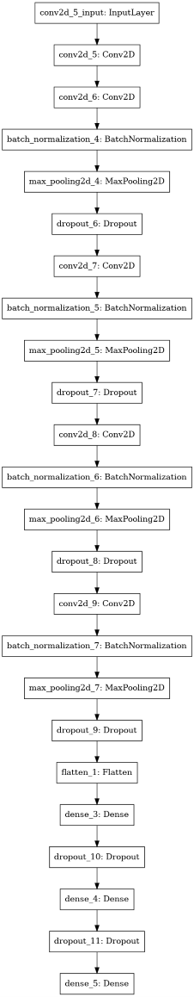
Introduction Proposed approach
CNN Model
Conclusion
References
Results
[2] E. Pranav, S. Kamal, C. Satheesh Chandran and M. H. Supriya, "Facial Emotion Recognition Using Deep Convolutional Neural Network," 2020 6th International Conference on Advanced Computing and Communication Systems (ICACCS), 2020, pp. 317-320, doi: 10.1109/ICACCS48705.2020.9074302.
Email spam classification
Emojify: Emotion Detector

Slide 5
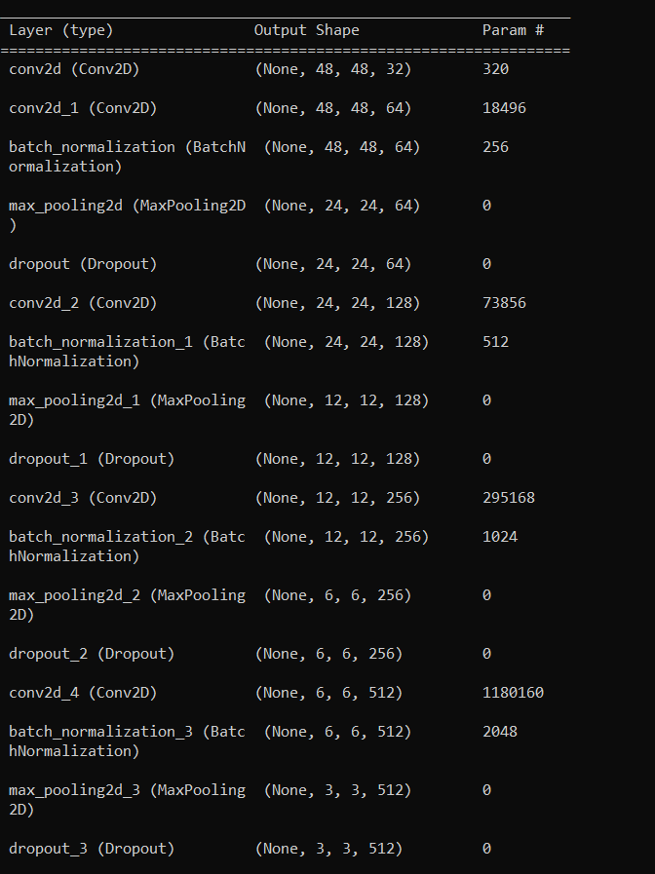
Introduction Proposed approach
CNN Model
Conclusion
References
Results
Email spam classification
Emojify: Emotion Detector

Slide 6
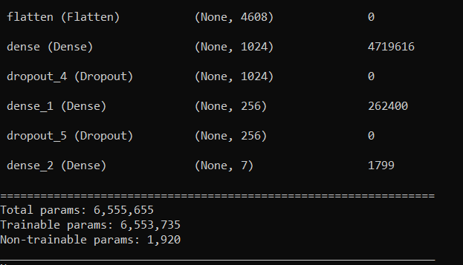
Introduction Proposed approach
Dense Network
Conclusion
References
Results
Email spam classification
Emojify: Emotion Detector

Slide 7
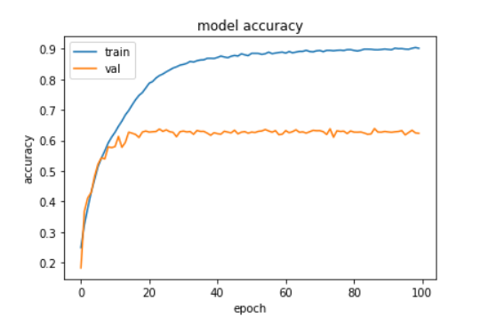
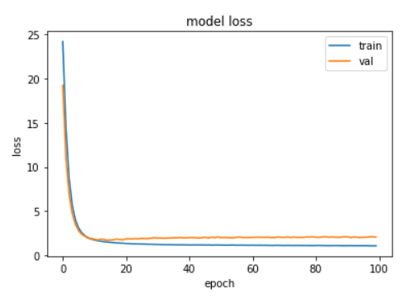
Introduction
Proposed approach
Results
Conclusion
References
Results of Overfit_Model
Training Loss: 1.09
Training Accuracy: 0.90
Validation Loss: 2.07
Validation Accuracy: 0.62
Simultaneous Inpainting and Susolution
Email spam classification
Emojify: Emotion Detector ‹#›/15

Slide 8
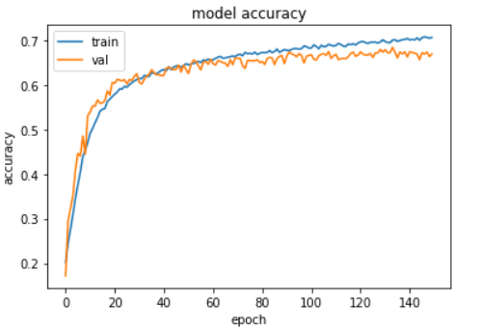
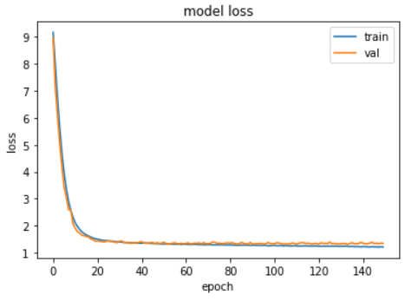
Introduction
Proposed approach
Results
Conclusion
References
Results of Final_Model
Training Loss: 1.29
Training Accuracy: 0.69
Validation Loss: 1.36
Validation Accuracy: 0.67
Simultaneous Inpainting and Susolution
Email spam classification
Emojify: Emotion Detector 8/15

Slide 9
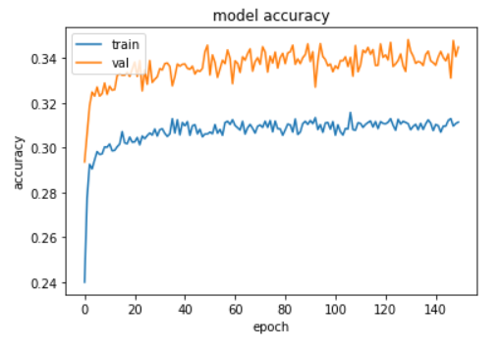
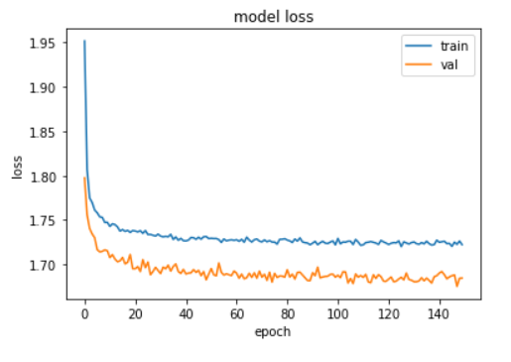
Introduction
Proposed approach
Results
Conclusion
References
Results of Logistic Classification
Training Loss: 1.72
Training Accuracy: 0.31
Validation Loss: 1.68
Validation Accuracy: 0.34
Simultaneous Inpainting and Susolution
Email spam classification
Emojify: Emotion Detector 9/15

Slide 10
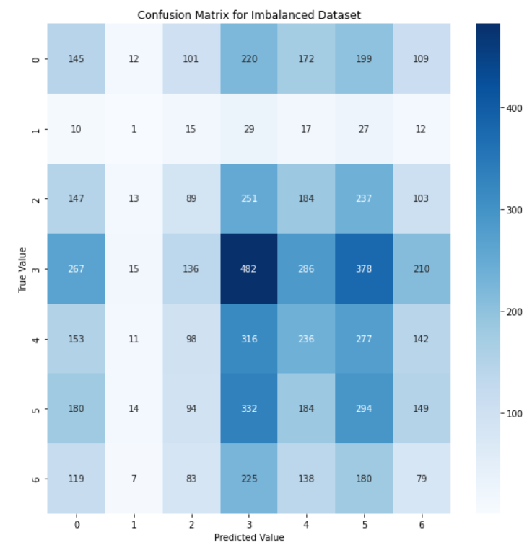
Introduction
Proposed approach
Results
Conclusion
References
Final Confusion Matrix
We can see that we are most confident in class happy.
Simultaneous Inpainting and Susolution
Email spam classification
Emojify: Emotion Detector 10/15

Slide 11
Introduction
Proposed approach
Results
Conclusion
References
Open CV
Steps:
We first break video into frames.
Then, we need to detect boundary boxes using CascadeClassifier.MultiScale()
Finally, we create rectangular boxes around faces in the image and display the emotion detected using model output file.
Simultaneous Inpainting and Sr-resolution
Email spam classification
Emojify: Emotion Detector 11/15

Slide 12

Introduction
Proposed approach
Results
Conclusion
References
Practical Implementation
Implemented on video from https://www.pexels.com/videos/
Simultaneous Inpainting and Sr-resolution
Emojify: Emotion Detector

Slide 13
Introduction
Proposed approach
Results
Conclusion
References
Future Scope
As in this dataset the size of input is small, so initial number of features are not sufficient to detect emotion properly. We can try to implement this model after making images of high resolution.
As sir suggested to some different group to add hierarchical approach to increase accuracy, so that can be tried also.
Simultaneous Inpainting and Sr-resolution
Emojify: Emotion Detector

Slide 14
Introduction
Proposed approach
Result
Conclusion
References
References
[1] Kaggle fer-2013 Dataset
[2] E. Pranav, S. Kamal, C. Satheesh Chandran and M. H. Supriya, "Facial Emotion Recognition Using Deep Convolutional Neural Network," 2020 6th International Conference on Advanced Computing and Communication Systems (ICACCS), 2020, pp. 317-320, doi: 10.1109/ICACCS48705.2020.9074302.
[3] S. Pandey, S. Handoo and Yogesh, "Facial Emotion Recognition using Deep Learning," 2022 International Mobile and Embedded Technology Conference (MECON), 2022, pp. 248-252, doi: 10.1109/MECON53876.2022.9752189.
[4] Demonstration on video
Simultaneous Inpainting and Super-relution
22/22
Emojify: Emotion Detector

Slide 15
Thank you !
Simultaneous Inpainting and Super-relution
22/22
Emojify: Emotion Detector

