Slide 1
ELDER HEALTH & CARE MONITORING SYSTEM
Project Progress Presentation
SEMESTER PROJECT
presented by : Yash Desai, Kalp Patel, Harsh Hirpara

Slide 2
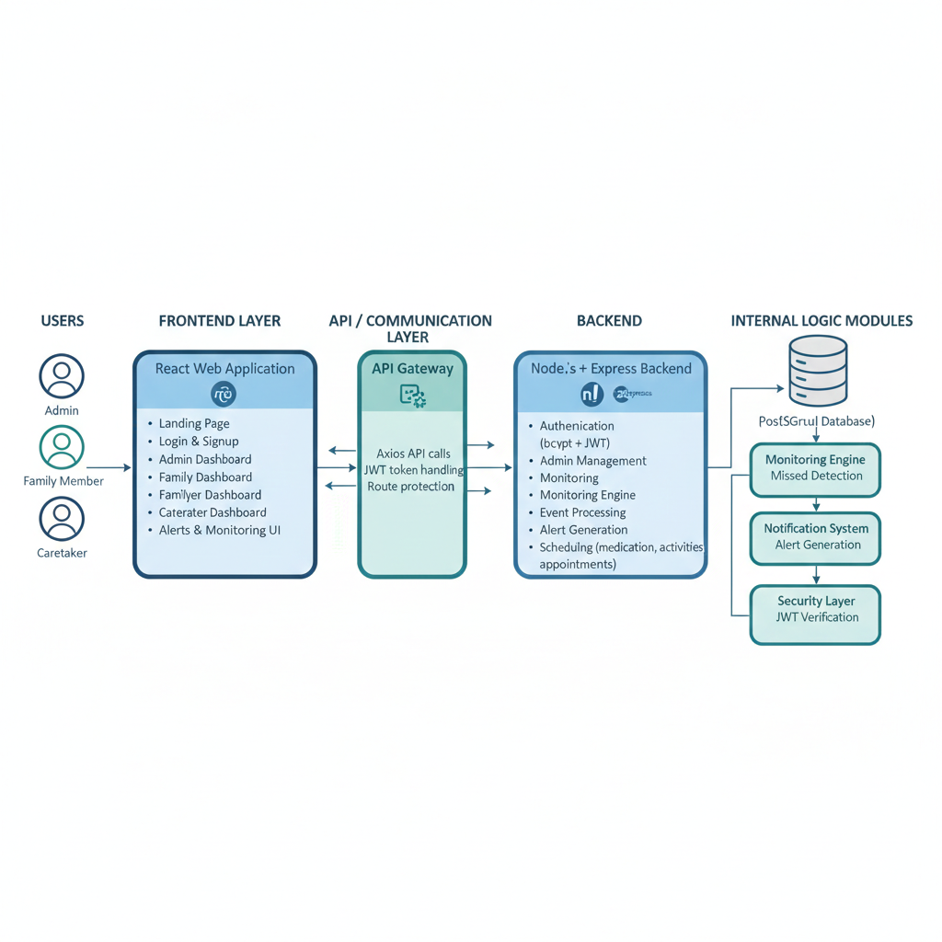
PROJECT
OVERVIEW
Role-based Elder Monitoring Platform
Appointment & activity scheduling
Real-time monitoring dashboards
Medication tracking and alerts

Slide 3
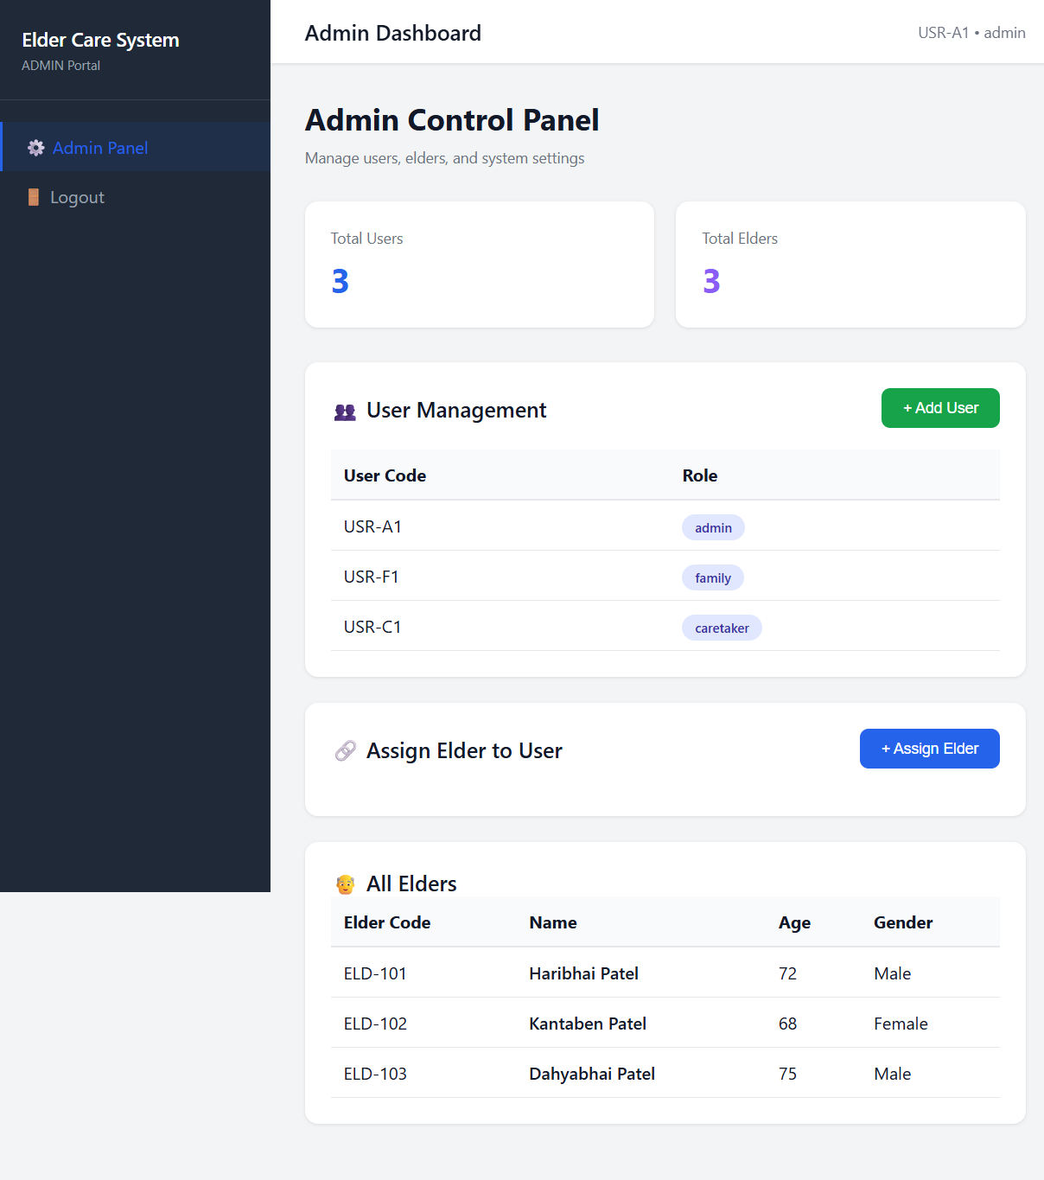
WORK COMPLETED
SO FAR
• PostgreSQL Database Design
• Backend APIs (Node.js + Express)
• Authentication System (Hashing)
• Admin Portal, Family Member Portal and Caretaker Portal(basic management)

Slide 4
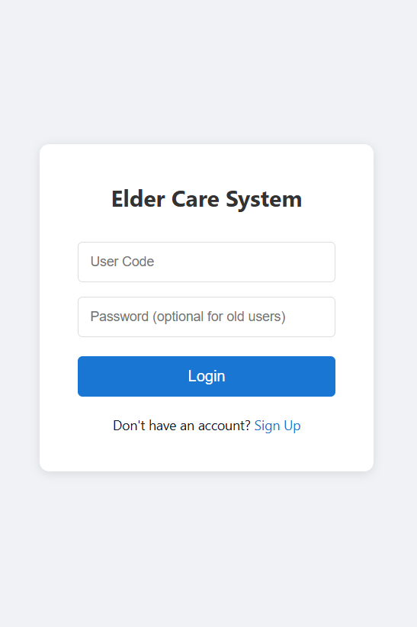
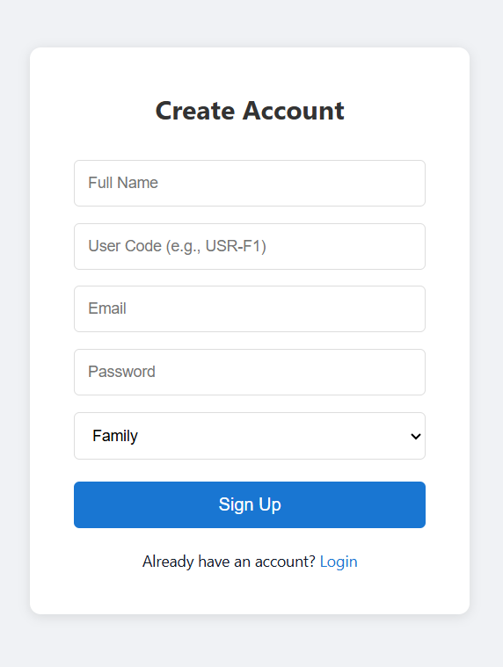
Frontend
PROGRESS
• Basic React dashboard structure
• Elder activity timeline
• Alerts system integration
• Medication module working

Slide 5
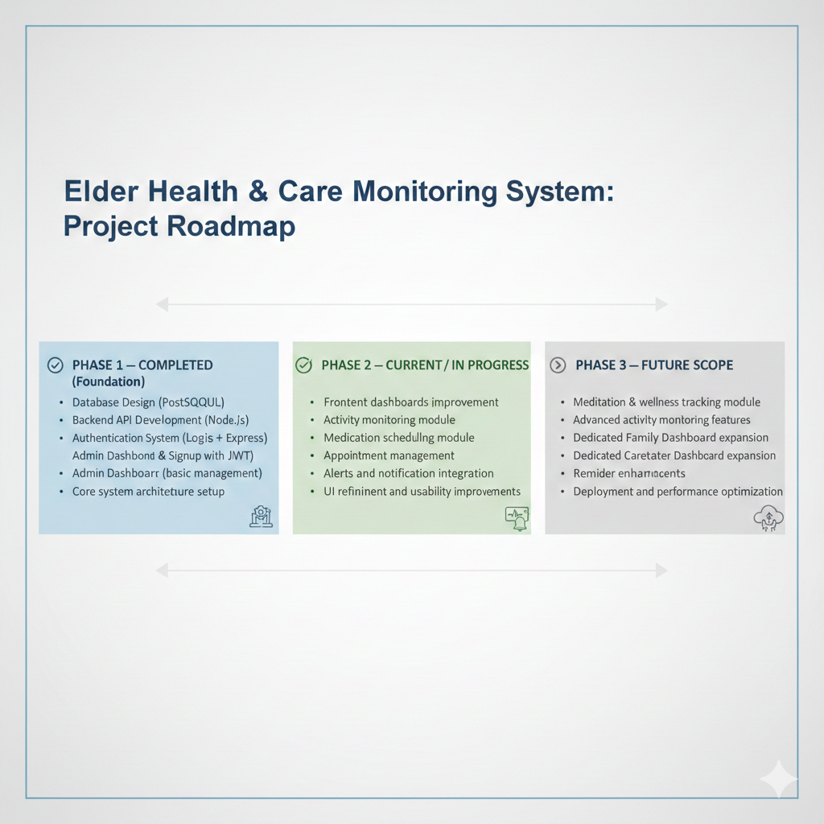
FUTURE SCOPE
ROADMAP
• Meditation & wellness tracking module
• Advanced activity monitoring features
• Appointment enhancement & reminders
• Full Family Dashboard implementation
• Full Caretaker Dashboard implementation
• UI improvements & analytics

Slide 6
THANK YOU

