Slide 1

Department of Computer Science and Engineering
Graphic Era (Deemed to be University)
Dehradun, Uttarakhand
July-2023
BACHELOR OF TECHNOLOGY
IN
COMPUTER SCIENCE & ENGINEERING
Submitted by:
Student Name University Roll No.
Kalp sah 2017334

Slide 2
HANDWRITTEN DIGIT RECOGNITION (using ML)
mentor name
mr Ashwini kumar

Slide 3
INTRODUCTION
Scientist believe the most intelligent device is human brain.
There is no device that can beat the efficiency of Human brain. These inefficiencies in computer lead to evolution of “Artificial Neural Network”
They differ from conventional system in sense that rather than being programmed these system learn pattern.

Slide 4
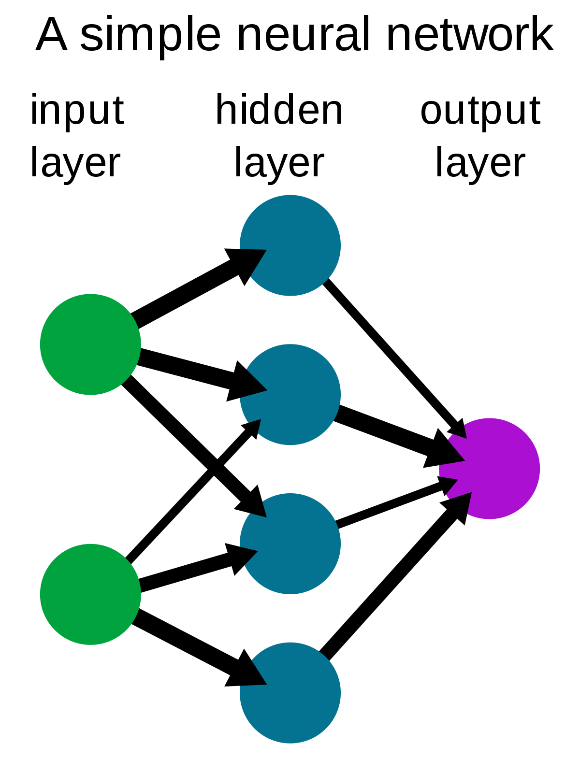
What are Neural Networks?
A neural network is a method in artificial intelligence that teaches computers to process data in a way that is inspired by the human brain. It is a type of machine learning process, called deep learning, that uses interconnected nodes or neurons in a layered structure that resembles the human brain

Slide 5

Training Dataset
Training of network is done by dataset name MNIST (Modified National Institute of Standards and Technology).
MNIST dataset has training set of 60000 handwritten digits in form of images, and a test set of 10000 images.
All images in dataset are of 28 X 28 pixels.
Larger datasets help in training model such that it can learn from variety of examples thus making a more generalized model.

Slide 6
Convulational Neural Network
Convolutional neural networks are distinguished from other neural networks by their superior performance with image, speech, or audio signal inputs.
They have three main types of layers, which are Convolutional layer, Pooling layer , Fully-connected (FC) layer.
With each layer, the CNN increases in its complexity, identifying greater portions of the image.
As the image data progresses through the layers of the CNN, it starts to recognize larger elements or shapes of the object until it finally identifies the intended object.

Slide 7
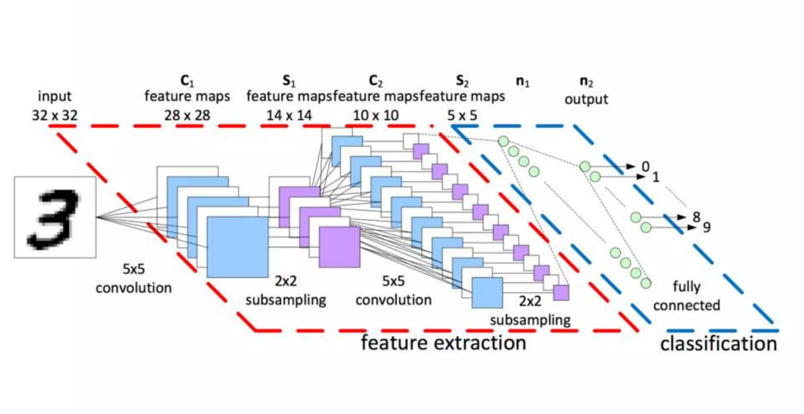
Architecture of CNN

Slide 8
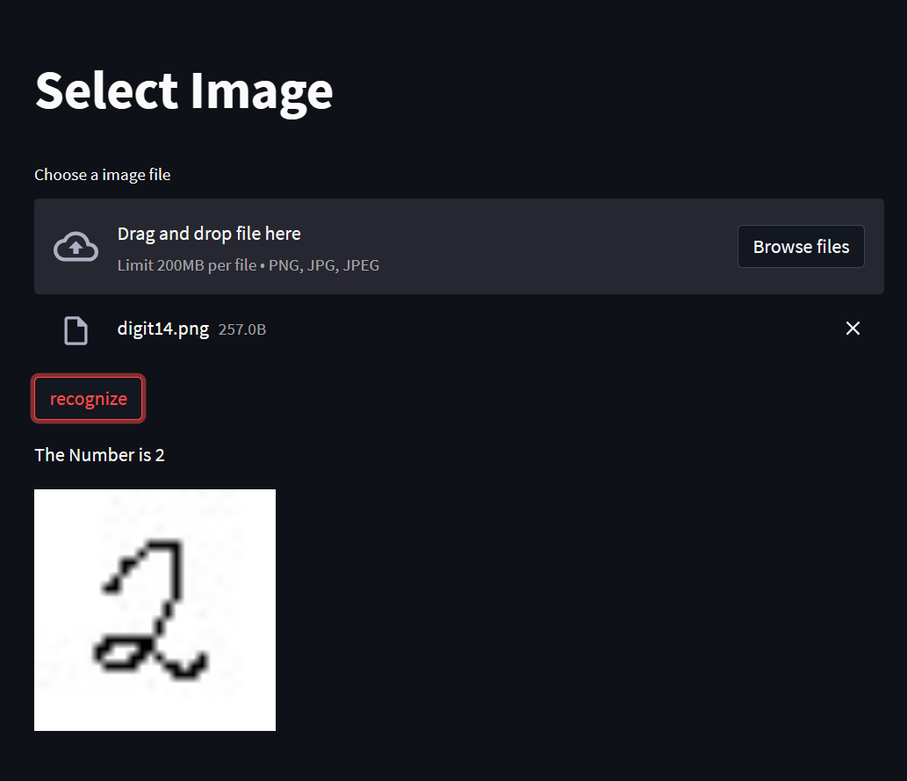
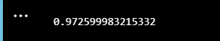
Result
Before the input is fed into the model for processing, analyze and get the output, the model needs to be trained first. In the program, the epochs have to be set to 3. By setting this, the model will be trained for 3 times. It can be changed to how many times you want the model to be trained depending on the error rate of the prediction.
The accuracy of model is 97.2599983215332%

Slide 9
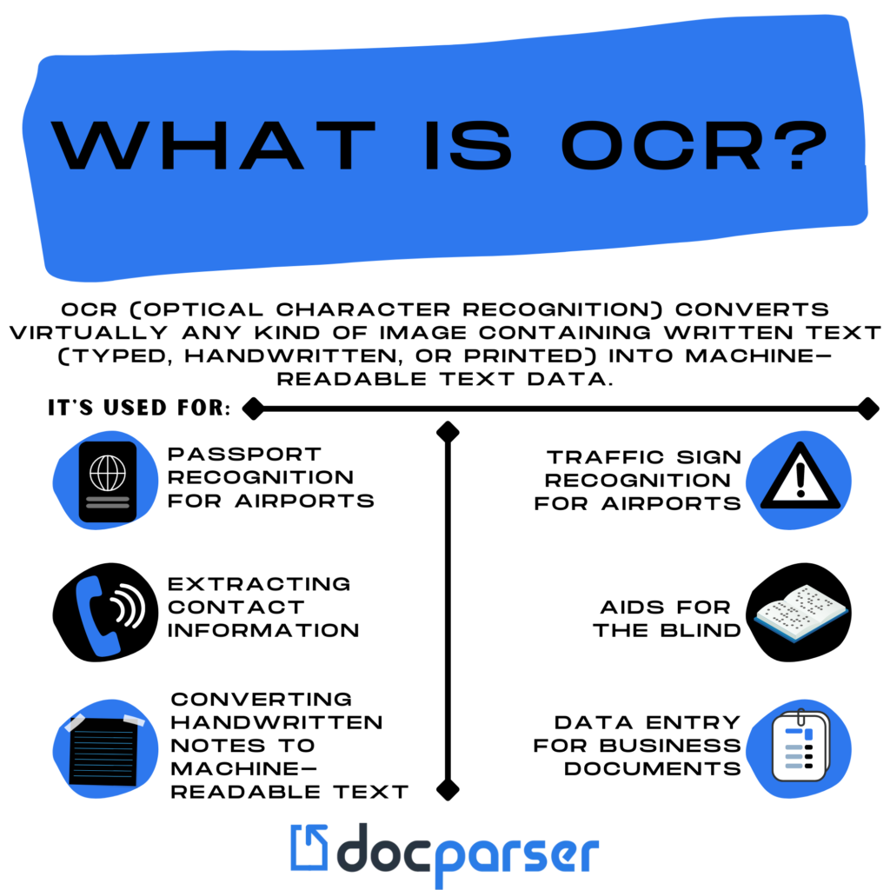
Future Work
The current model works only on digit recognition so the NLP it can perform is limited to numeric characters.
However with enough learning and inspiration from this project , I am motivated to create a better OCR which can identify and read Alphabets and Numeric characters along with some special characters.

Slide 10
THANK YOU

