Slide 1
Confidence-Aware
Medical Diagnostic System
Fine-tuning Llama-3.2-3B on DDXPlus for safety-stratified clinical triage
Kalpan Shah · Northeastern University
Cotiviti Intern Assessment

Slide 2
The Clinical NLP Landscape
80% of healthcare data is unstructured. The question is always: can we make machines read it as well as clinicians do?
1990s – 2000s
2010s
2020s – Present
Rule-Based NLP
Neural NLP
Foundation Models
▸ cTAKES, MedLEE
▸ BioBERT, ClinicalBERT
▸ Llama 3, GPT-4, Med-PaLM 2
▸ Hand-written grammars
▸ Learned from data
▸ Fine-tuning via LoRA / PEFT
▸ Medical ontology-driven
▸ NER and relation extraction
▸ Near-physician reasoning
▸ Brittle to variation
▸ Domain-adapted transformers
▸ Agentic + multimodal
This project: fine-tuned Llama-3.2-3B (foundation model era) on 1.3M clinical cases — and evaluated the result rigorously.

Slide 3



Problem Statement & Dataset
Can a fine-tuned LLM safely triage patients — diagnosing when it should, referring when it shouldn't?
LLMs Hallucinate
DDXPlus Dataset
Base models produce confident wrong answers. In a clinical context that's not just an accuracy problem — it's a liability.
NeurIPS 2022 · aai530-group6/ddxplus
1.3M+
Synthetic patient cases
Dark Clinical Data
49
Disease pathologies
Structured claims capture what was billed. Clinical notes capture what actually happened. Most pipelines only see the former.
50,000
Test cases evaluated
Safety Can't Live in the Prompt
Telling a model to refer uncertain cases in its system prompt is only as reliable as the model's ability to follow instructions.
12
Symptoms decoded per case

Slide 4
System Architecture
Two separate jobs. The model diagnoses. The code enforces safety. Neither trusts the other to do the other's job.
Llama-3.2-3B
(fine-tuned)
DDXPlus
Dataset
Symptom
Decoder
Decision
Layer
Top-3 predictions
+ confidence
1.3M+ cases
49 diseases
Evidence codes
→ readable text
Severe?
Conf < 2/N?
Diagnosis + Confidence
Refer to Specialist
Both rules pass → show result
Severe OR below confidence threshold
The model's only job is prediction. Safety is guaranteed by the code — not by asking the model nicely.

Slide 5
Four-Phase Experimental Design
Each phase isolates one variable so we can measure what actually moves the needle.
Raw Baseline
41.8%
Phase 1a
Model: Untrained Llama-3.2-3B · Safety: None
n=1,000
Baseline + Prompt Safety
35.4%
Phase 1b
Model: Untrained Llama-3.2-3B · Safety: Rules in system prompt
n=1,000
Fine-Tuned + Prompt Safety
49.8%
Phase 2
Model: LoRA fine-tuned Llama · Safety: Rules in system prompt
n=1000
Fine-Tuned + Code Safety
69.1%
Phase 3
Model: LoRA fine-tuned Llama · Safety: Deterministic code layer
n=50,000

Slide 6
Fine-Tuning with LoRA
Adapting a 3-billion-parameter model to a clinical task — without a data center.
How LoRA Works
Our Training Setup
▸ Instead of retraining all parameters, LoRA injects small trainable matrices (A and B) into each attention layer of the frozen base model
Base model
Llama-3.2-3B-Instruct (Meta)
▸ Only ~0.1–1% of parameters are ever updated — the rest stay exactly as Meta released them
Fine-tuning
LoRA / PEFT — HuggingFace
Dataset
DDXPlus train split (1.3M cases)
▸ The rank r controls how expressive the adaptation is. Higher rank = more capacity, more compute
Framework
PyTorch + Transformers
▸ The result is a small LoRA adapter file that can be merged into the base model or swapped at runtime
Test set
50,000 held-out DDXPlus cases
▸ Practical outcome: you can fine-tune Llama-3.2-3B on a single GPU in a few hours, not weeks
Metric
Strict Pass@1 (safety-weighted)

Slide 7
The Decision Layer
Two rules that run after every model response. The model has no say in whether they trigger.
Rule 1 — Severe Disease
Rule 2 — Dynamic Threshold (2/N)
22 life-threatening conditions always trigger specialist referral — regardless of confidence:
Confidence must be ≥ 2× random chance to proceed.
The bar scales with case complexity — not fixed.
NSTEMI / STEMI · Pulmonary embolism
Anaphylaxis · Tuberculosis · Ebola
4 options → Threshold 50.0%
Pulmonary neoplasm · Guillain-Barré · SLE
8 options → Threshold 25.0%
Spontaneous pneumothorax · Myocarditis +10
13 options → Threshold 15.4%
33 options → Threshold 6.1%
What happened across 50,000 test cases
20,195
2,710
17,061
100%
Severe cases referred
40.4% of all cases
Low-conf referred
5.4% of all cases
Directly diagnosed
34.1% of all cases
Precision on diagnosed
cases

Slide 8
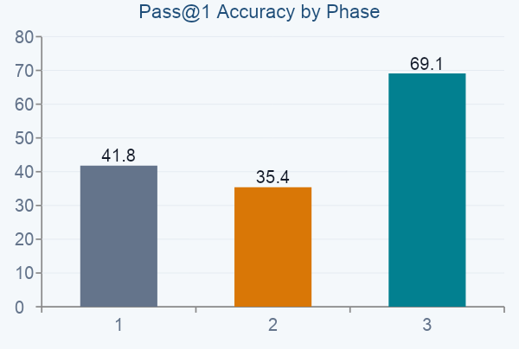
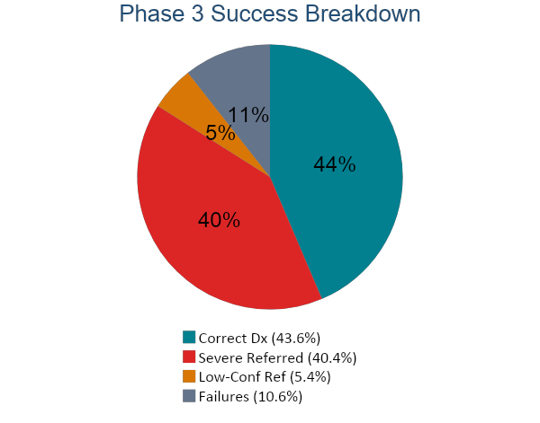
Results
69.1% Pass@1 across 50,000 cases — and 100% precision when the system chose to diagnose directly.
69.1%
100%
+27.3pp
50K
Pass@1 accuracy
Precision — direct dx
vs. Phase 1a baseline
test cases evaluated

