Slide 1
Employee expenditure and savings analysis
STUDENT NAME: KALPANA K
REGISTER NO: DEPARTMENT: COLLEGE :
312204578,83ED006E8FC8F3AB22F46C6AE4EF0238
COMMERCE
K. C. S. KASI NADAR COLLEGE OF ARTS AND SCIENCEB3

Slide 2
PROJECT TITLE
Employee expenditure and savings Analysis

Slide 3
AGENDA
1.Problem Statement 2.Project Overview 3.End Users
4.Our Solution and Proposition 5.Dataset Description 6.Modelling Approach 7.Results and Discussion 8.Conclusion
3/21/2024 Annual Review

Slide 4
PROBLEM STATEMENT
Formulating a problem statement for analyzing employee expenditure and savings typically involves identifying the specific issues or challenges to be addressed.
Data Accuracy Issues The accuracy of employee expenditure and savings data is in consistent, leading to unreliable financial insights and potentially flawed decision-making.

Slide 5
PROJECT OVERVIEW
The results will be used to inform financial planning and
offer recommendations for improving financial well-being
This project aims to analyze employee expenditure and savings data to optimize financial management and benefits.
Deliverables include detailed reports and dashboards with actionable insights for improving financial wellness and
compensation strategies.

Slide 6

WHO ARE THE END USERS?
1. Human Resources (HR) Departments
2. Finance Departments
3. Management and Executives
4. Employees Themselves
5. External Auditors and Compliance Officers

Slide 7
OUR SOLUTION AND ITS VALUE PROPOSITION
Enhanced Financial Insights
Informed Decision-Making
Personalized Employee Support
Optimized Budgeting
Compliance and Transparency
Data-Driven Strategy

Slide 8
Dataset Description
The data overview for employee expenditure and savings analysis includes payroll data, expense reports, savings contributions, and benefit utilization.
Name Of The employee
Gender
Age
Salary
Expenditure
Savings

Slide 9
MODELLING
Creating Dashboard
Creating Table
Data Cleaning
Creating Pivot Chart
Inserting Pivot Chart in Dashboard
Inserting formulas in dash board to make interaction
Creating interactive dashboard by putting all together el
9

Slide 10
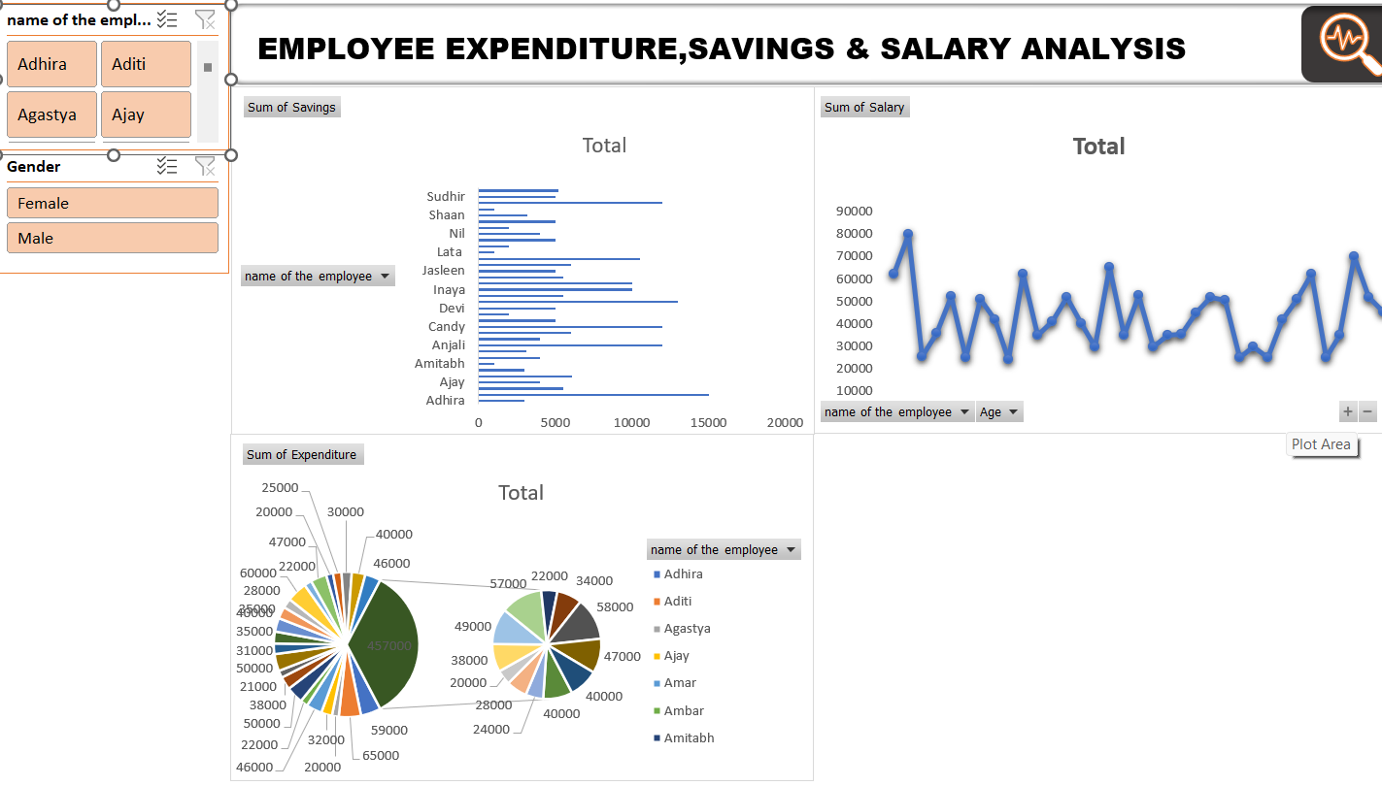
RESULTS
(click to open file)
10

Slide 11
CONCLUSION
Employee expenditure and savings analysis is crucial for understanding financial behaviors and needs within an organization. By leveraging detailed data on payroll, expenses, and savings, organizations can make informed decisions about compensation, benefits, and financial wellness programs. This analysis enables better budget management, enhances employee support through personalized financial insights, and ensures compliance with financial regulations. It also helps in identifying trends and opportunities for improving employee satisfaction and retention.
Ultimately, a robust expenditure and savings analysis not only optimizes organizational financial strategies but also empowers employees to manage their finances more effectively.

