Slide 1


RAJEEV INSTITUTE OF TECHNOLOGY, HASSAN
DEPARTMENT OF COMPUTER SCIENCE AND ENGINEERING
CG MINI PROJECT ON
“Congestion Control”

Slide 2
CONTENTS
ABSTRACT
INTRODUCTION
METHODOLOGY
ARCHITECTURE
SOFTWARE & HARDWARE REQUIREMENT
ADVANTAGES AND DISADVANTAGES
SNAPSHOTS
CONCLUSION
REFERANCE

Slide 3
ABSTRACT
Main aim of this Mini Project is to illustrate the concepts and usage of Congestion Control in OpenGL. In data network and queuing theory, network congestion occurs when a link or node is carrying so much data that its quality of service deteriorates When more packets were sent than could be handled by intermediate routers, the intermediate routers discarded many packets, expecting the end points of the network to retransmit the information. When this packet loss occurred, the end points sent extra packets that repeated the information lost, doubling the data rate sent, exactly the opposite of what should be done during congestion. This pushed the entire network into a 'congestion collapse' where most packets were lost and the resultant throughput was negligible. We have used input devices like mouse and key board to interact with program

Slide 4
INTRODUCTION
Main aim of this Mini Project is to illustrate the concepts and usage of Congestion Control in OpenGL.
In data network and queuing theory, network congestion occurs when a link or node is carrying so much data that its quality of service deteriorates
When more packets were sent than could be handled by intermediate routers, the intermediate routers discarded many packets, expecting the end points of the network to retransmit the information.
When this packet loss occurred, the end points sent extra packets that repeated the information lost, doubling the data rate sent, exactly the opposite of what should be done during congestion.
This pushed the entire network into a 'congestion collapse' where most packets were lost and the resultant throughput was negligible.
We have used input devices like mouse and key board to interact with program

Slide 5
METHODOLOGY
Requirement Analysis and Planning
Data Collection
Software and tools selection
Designing the Development
Integration
Testing and validation
Documentation and presentation
Deployment

Slide 6
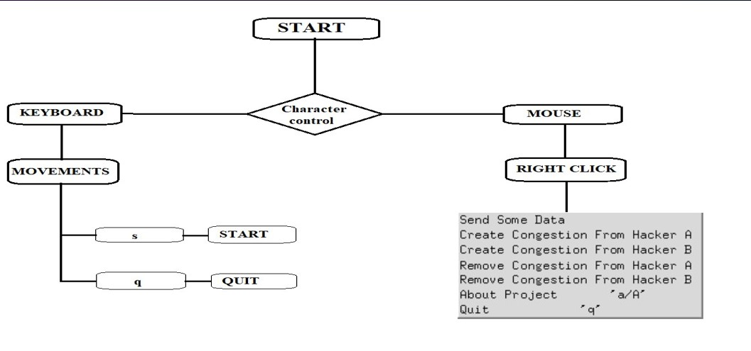
ARCHITECTURE

Slide 7
SOFTWARE & HARDWARE REQUIREMENT
Software :
Hardware :
Operating System : Windows
GLUT libraries, GLUT utility toolkit must be available
Language : C++
Processor : Pentium or higher
Ram : 2 GB or more
A standard keyboard and Microsoft compatible mouse
A VGA monitor

Slide 8
ADVANTAGES AND DISADVANTAGES
ADVANTAGES:
Smooth Rendering and Playback
Improved Quality of Service (QoS)
Efficient Bandwidth Utilization
Scalability
Cost-effectiveness
Enhanced User Experience
Reduced Latency
DISADVANTAGES:
Algorithmic Complexity
Potential Delays
Overhead and Complexity
Impact on Real-Time Applications
Adaptability to Network Dynamics

Slide 9
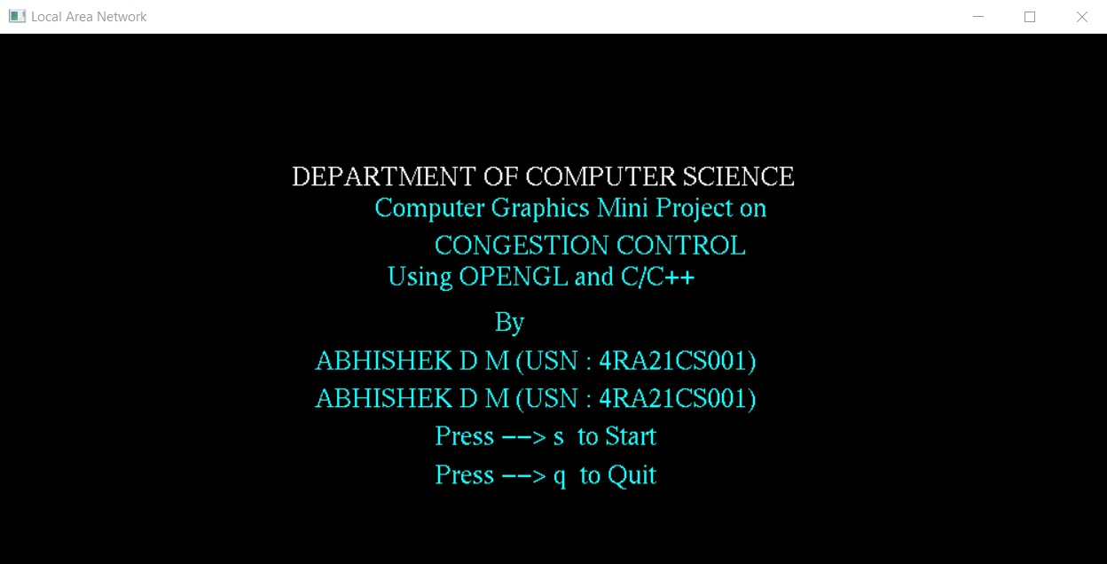
SNAPSHOTS

Slide 10
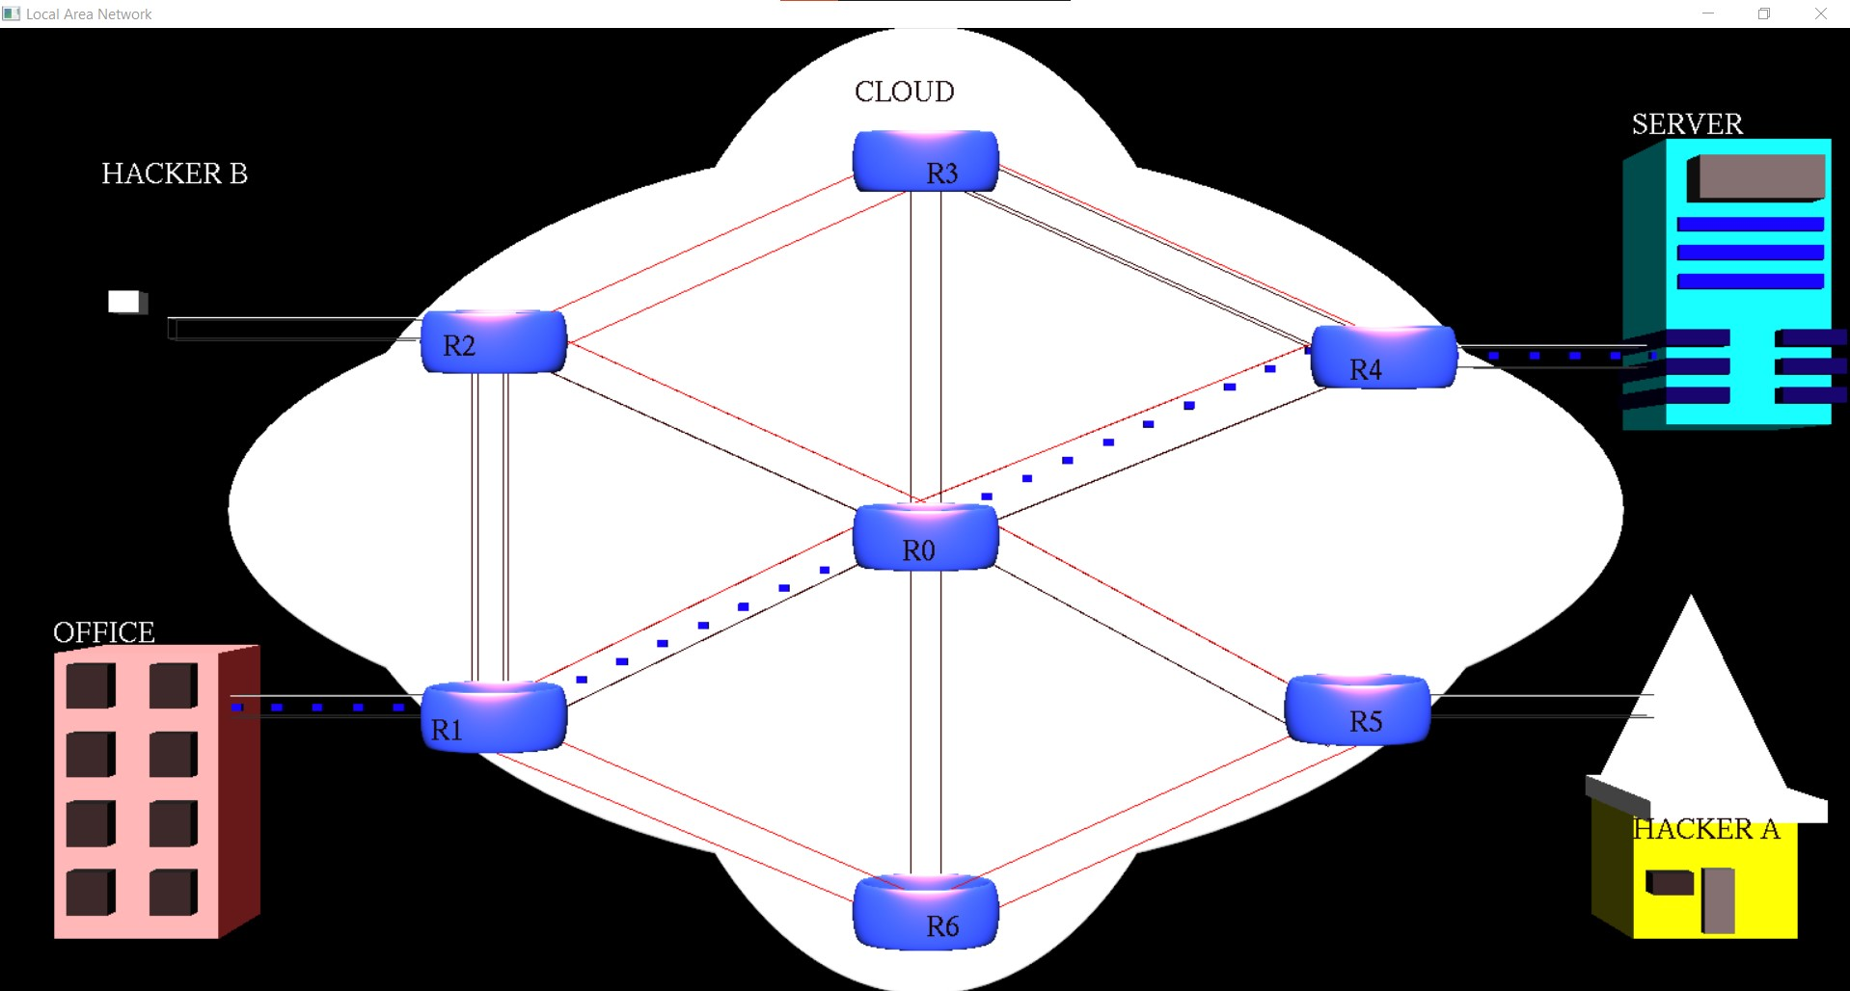

Slide 11
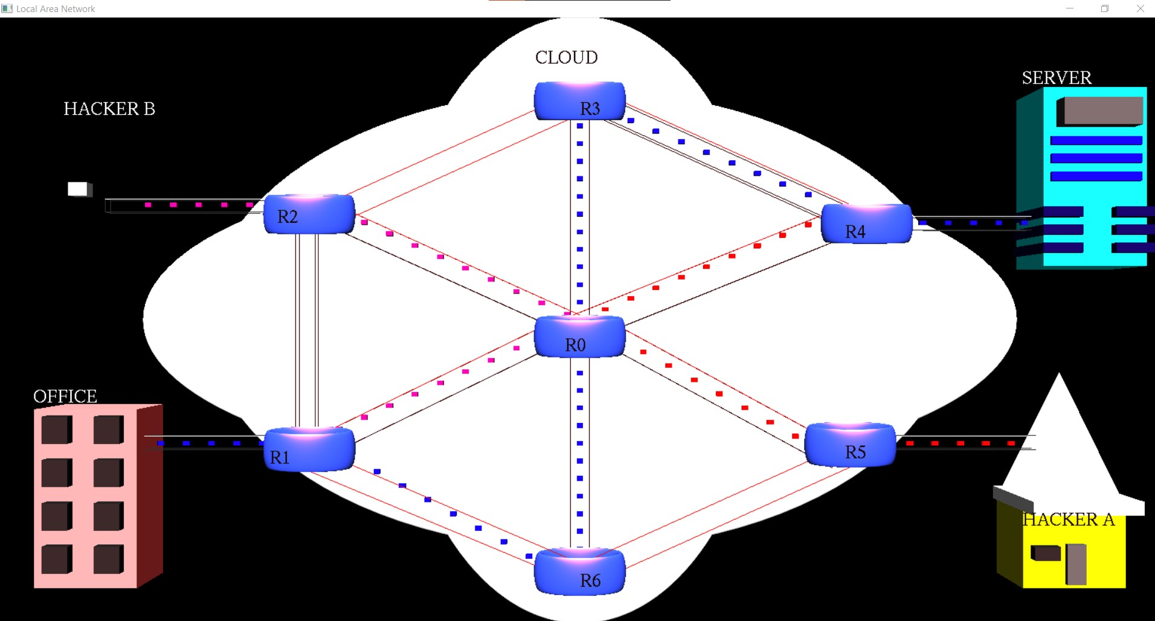

Slide 12
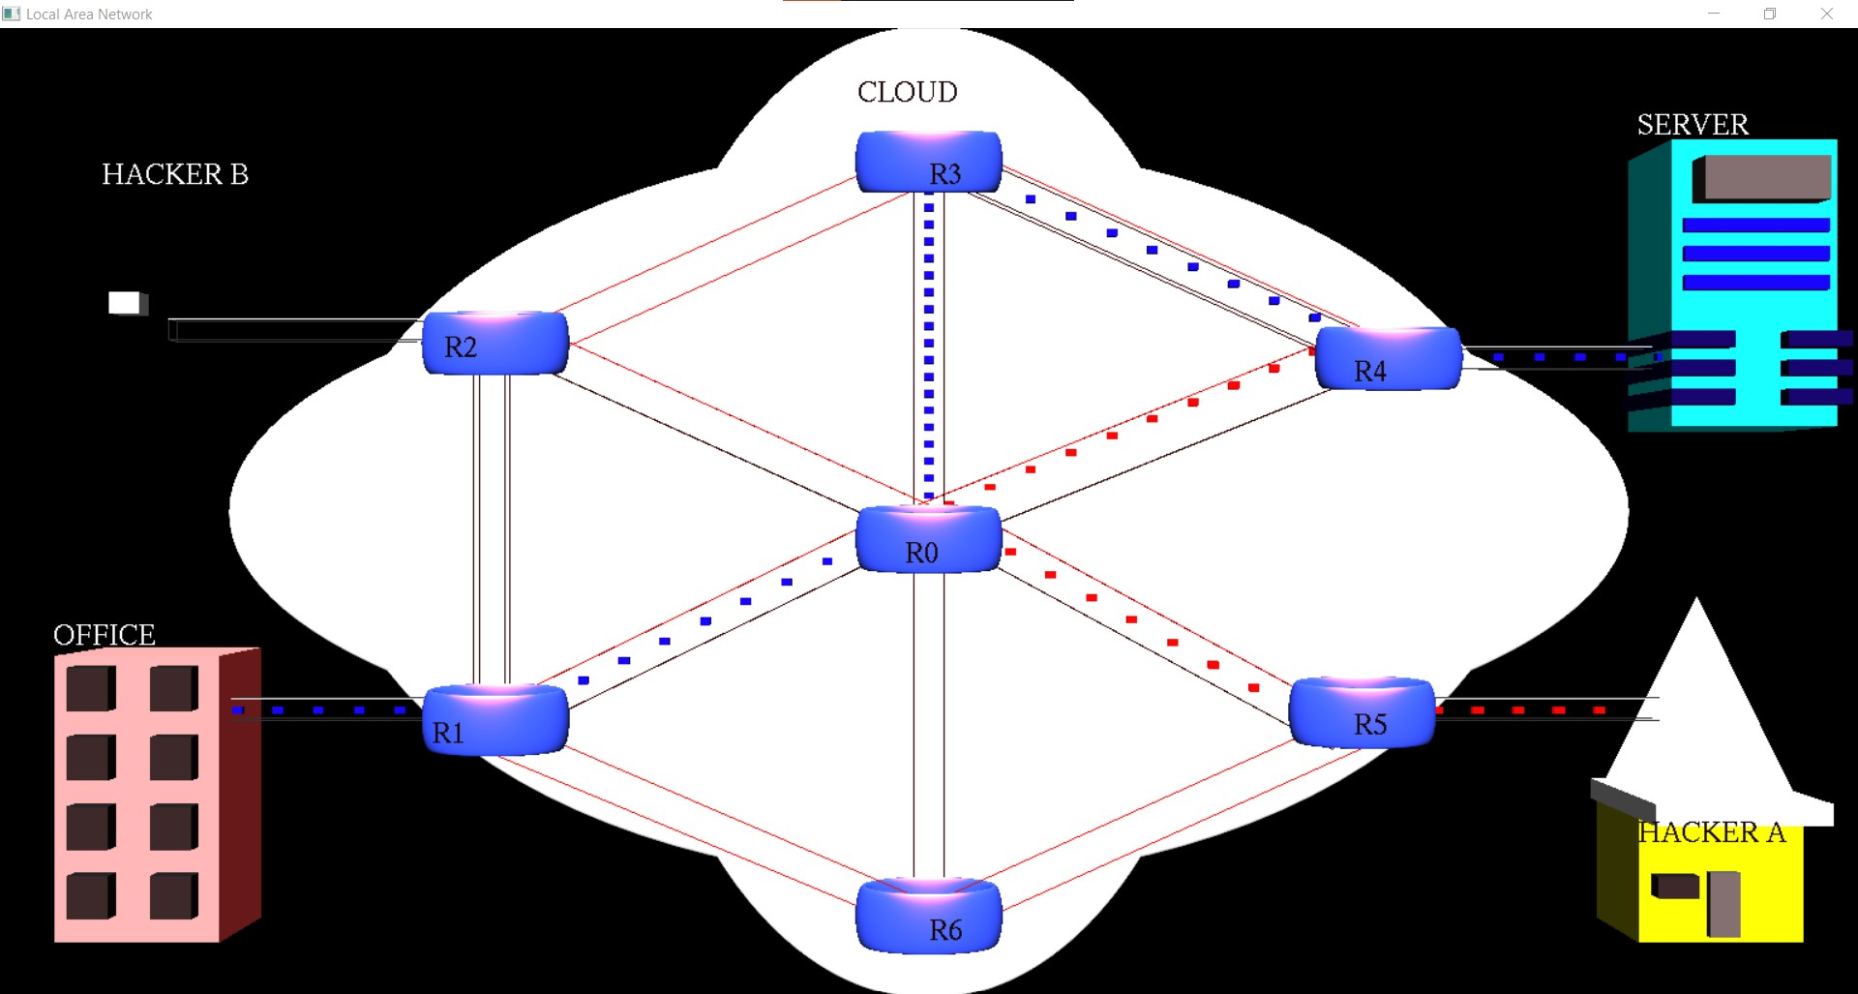

Slide 13
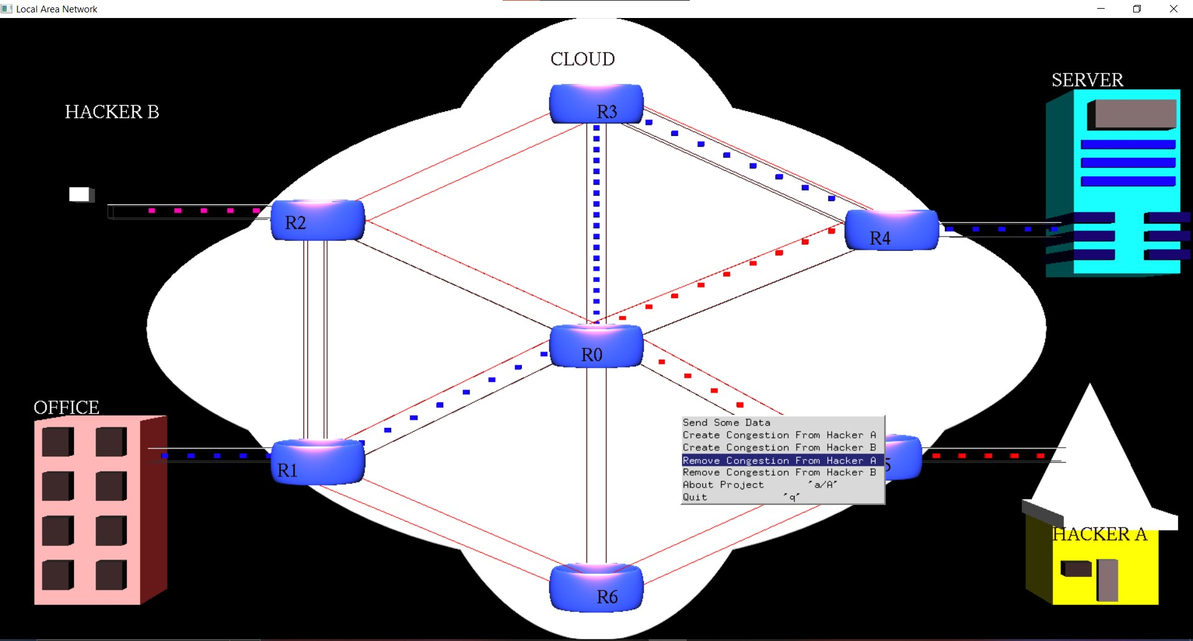

Slide 14
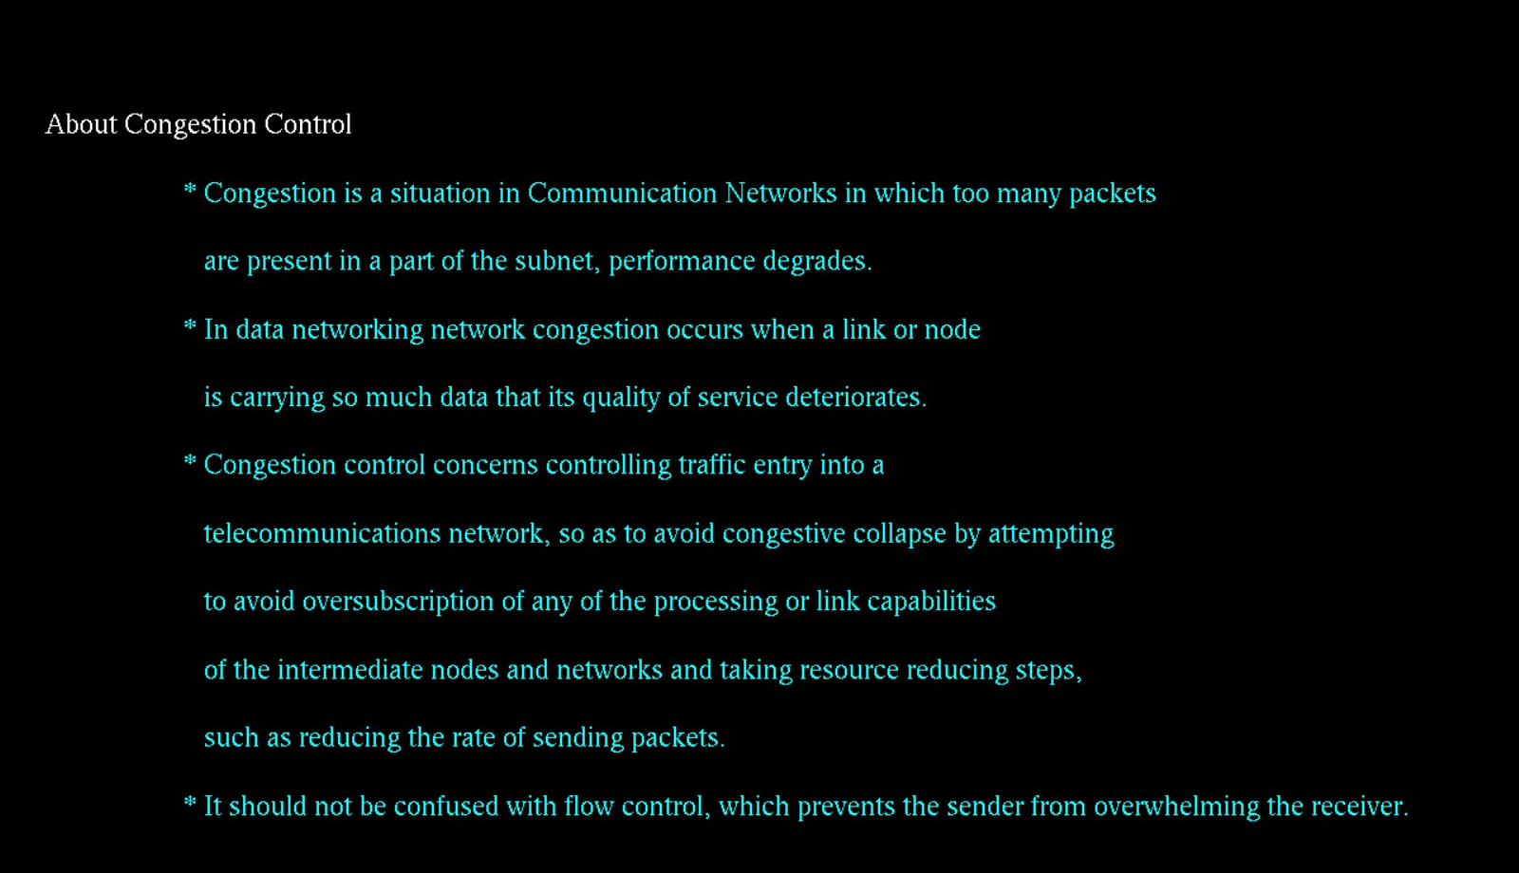

Slide 15
CONCLUSION
In conclusion, congestion control in computer graphics is a crucial aspect of network management that aims to optimize data transmission, enhance user experience, and ensure efficient utilization of network resources. By effectively managing data flow and mitigating congestion, this technology supports smoother rendering, reduced latency, and improved quality of service in graphics-intensive applications.
However, the implementation of congestion control comes with challenges, such as increased complexity, potential delays, and the need for adaptive algorithms to handle dynamic network conditions. Balancing these considerations is essential to achieve optimal performance while maintaining responsiveness in real-time applications.
Ultimately, the benefits of congestion control—such as smoother playback, reduced latency, and enhanced scalability—outweigh its drawbacks when carefully implemented and tailored to specific application requirements. As technology evolves, ongoing advancements in congestion control algorithms and network infrastructure will continue to play a critical role in advancing the field of computer graphics and improving the overall user experience.

Slide 16
REFERENCES
Interactive computer graphics A top-down approach with OpenGL –
Edward Angel , 5th Edition , Addition – Wesley 2008.
Computer Graphics using OpenGL – F.S HILL Jr , 2nd edition , Pearson Education 2001.
1. Edward angel –” Interactive computer graphics A top-down approach with OpenGL – Edward Angel , 5th Edition , Addition – Wesley 2008.”
2.”computer graphics”-Donald hearn M Pauline Baker.

Slide 17
THANK YOU

