Slide 1

SREENIDHI INSTITUTE OF SCIENCE AND TECHNOLOGY (An Autonomous Institution Approved by UGC) Yamnampet, Ghatkesar, R.R. District -501 301 Department of COMPUTER SCIENCE and ENGINEERING
A Group Project Design seminar on PORT SCANNER
by
Ch. Kalpana(19311A05J4)
V. Naga Rushikesh(19311A05K7)
M. Srikanth(19311A05P2)
Project Guide Project Coordinator Head of the Department
P Durga Prasad P Durga Prasad Dr Aruna Varanasi
Asst Professor Asst Professor Professor & HOD
CSE CSE CSE

Slide 2
CONTENTS
ABSTRACT
INTRODUCTION
SYSTEM DESIGN
EXISTING SYSTEM
PROPOSED SYSTEM
HARDWARE REQUIREMENTS
SOFTWARE REQUIREMENTS
USE CASE DIAGRAM
CLASS DIAGRAM
ACTIVITY DIAGRAM
IMPLEMENTATION
CODE
OUTPUT
CONCLUSION
REFERENCES

Slide 3
ABSTRACT
Port scanning may be defined as a surveillance technique, which is used in order to locate the open ports available on a particular host. Penetration tester or a hacker can use this technique. We can configure the port scanner according to our requirements to get maximum information from the target system. It brute forces by sending synchronized packets through every port in the given range. Instead of making a 3way hand shake with the target IP address it simply sends a reset packet after every successful 2way hand shake. After the scan it completely provides the information about the open, closed and filtered ports on the target IP address. A port number is a 16-bit unsigned integer, thus ranging from 0 to 65535. We use multithreading to implement an efficient Port Scanner.

Slide 4
Introduction
Port scanning is the act of determining which ports on a network are open. Ports on a computer are where information is sent and or received. Port scanning a network or server can tell a user the ports that are open and receiving information and can also give the user information such as the presence of things like firewalls that are in place. A port scan sends a carefully prepared packet to each destination port number.
Open port: The remote host sends a response to accept the connection.
Closed port: The remote host sends a response indicating the connection is denied.
Filtered port: There is no reply from the remote host.
Vanilla
Sweep Scan
SYN Scan

Slide 5
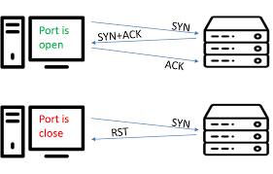
SYSTEM DESIGN

Slide 6
Existing System
The Existing system of Port Scanning follows brute force approach i.e, it sends synchronized packets through each port in a given range.
Brute force approach takes more time to implement the program.

Slide 7
Proposed System
The proposed application creates threads which attempt to connect to the supplied ip address and using the range of port numbers supplied.
In this approach the effects of connection timeouts is minimized and the application can process a range of port.

Slide 8
Hardware Requirements
Minimum requirements:
2 gb RAM
Intel IX processor or equivalent
4 gb space
Compatible requirements
8gb RAM
6th gen intel IX processor or equivalent
10 gb free space

Slide 9
Software Requirements
Python2.5 or above
open Source language that is python and is used. We can also use in Linux operating system.
Socket module in python programming

Slide 10
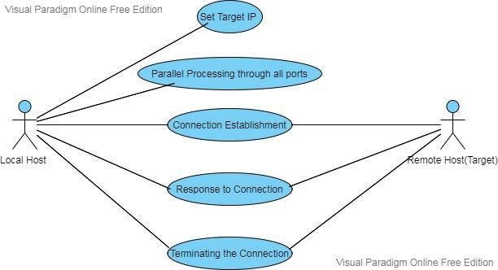
USECASE DIAGRAM

Slide 11
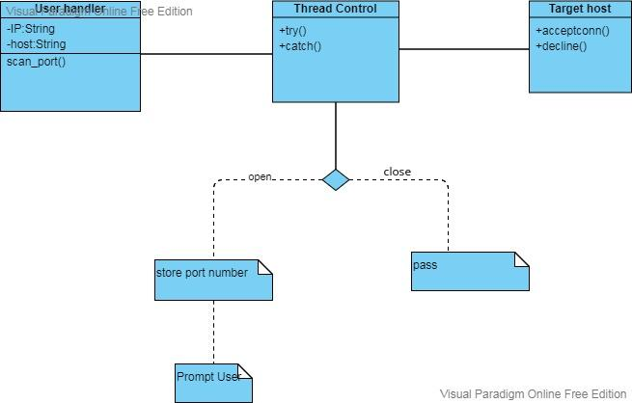
CLASS DIAGRAM

Slide 12
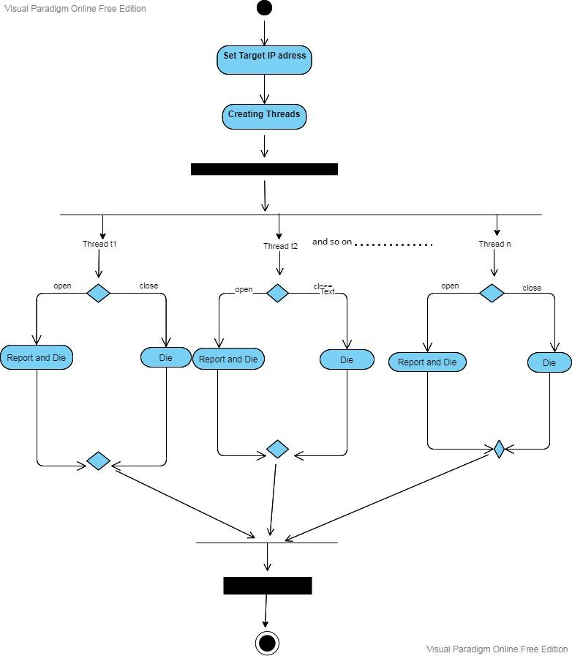
ACTIVITY DIAGRAM

Slide 13
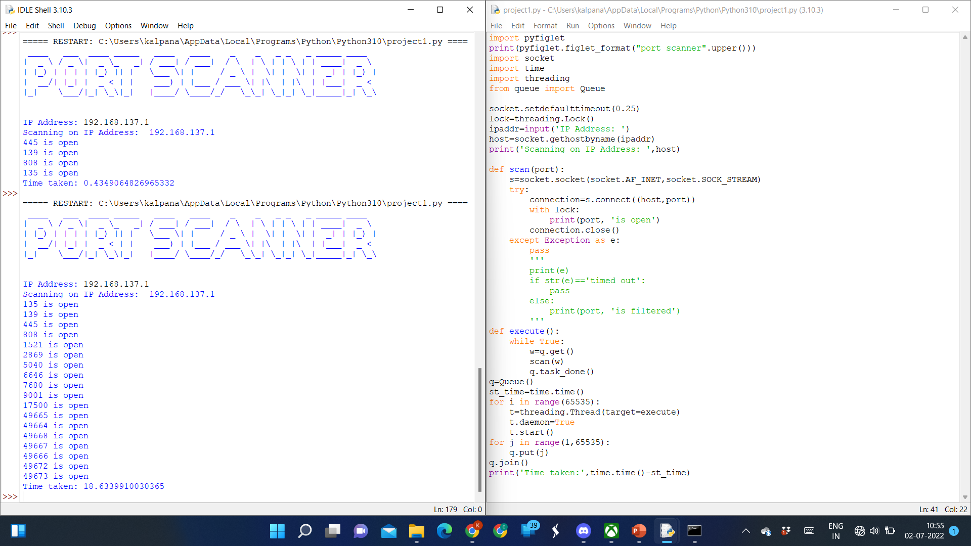
IMPLEMENTATION

Slide 14
OUTPUT

Slide 15
CONCLUSION
The technological benefits of PORT SCANNER are monitor and enhance the performance of the system and provide security to the system. Using port scanner we can scan multiple ports simultaneously by using the concept called multithreading, by this time will be saved. Mainly port scanners are used in firewalls to find the open ports, so that the firewall can protect our system from threats which attack through these open ports. We can scan our own system without any help of a web server and we don’t require any additional software to use this

Slide 16
References
https://resources.infosecin
https://codemint.net/computer-science/design-and-implementation-of-a-port-scanner/index.htmlstitute.com/topic/port-scanners/
https://resources.infosecinstitute.com/topics/penetration-testing/

Slide 17
Thank You

