Slide 1
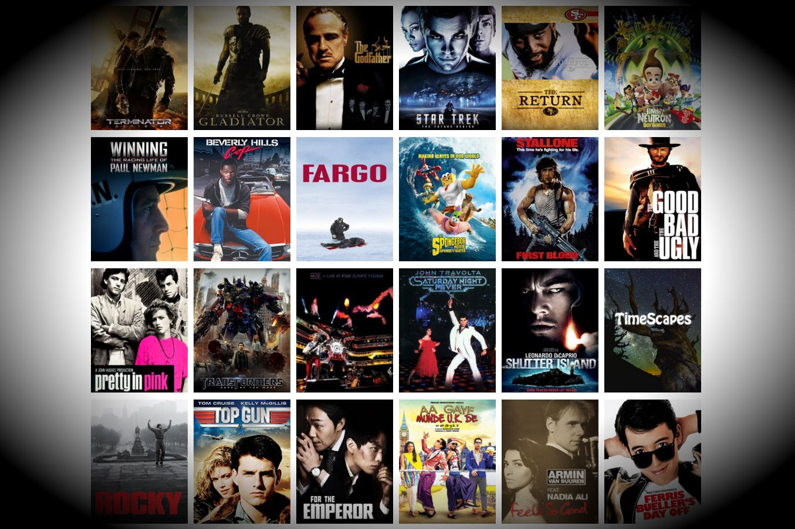
EDA on Movie Data

Slide 2
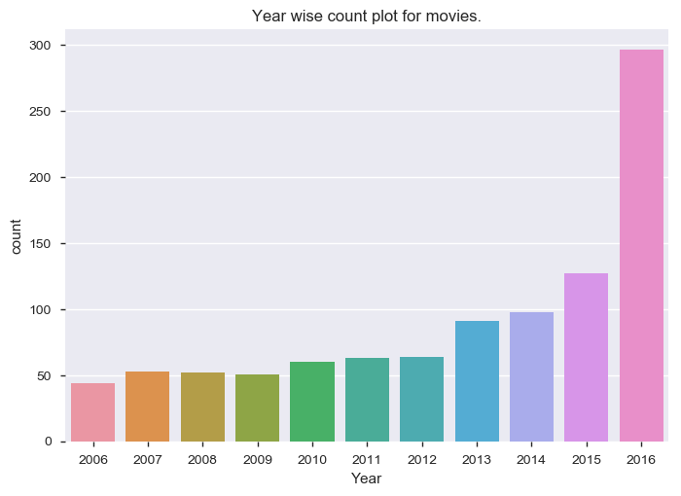
Which year has largest number of movie release?
Year 2016 has maximum number of movies released

Slide 3
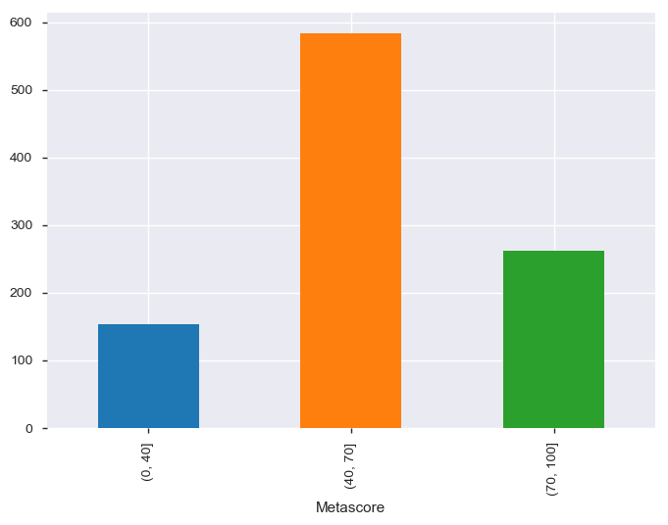
Which Metascore rating is likely to be given by Critics ?
It is clearly visible that Critics are more likely to give Metascore rating from 40-70

Slide 4
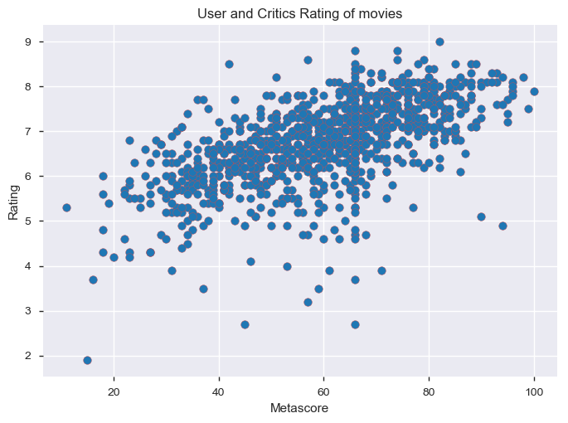
Do user rating pattern matches with critics rating for movies ?
It is observed that there is high concentration of points that can be interpreted as straight line.
It indicates that user rating trend follows critics rating trend.

Slide 5
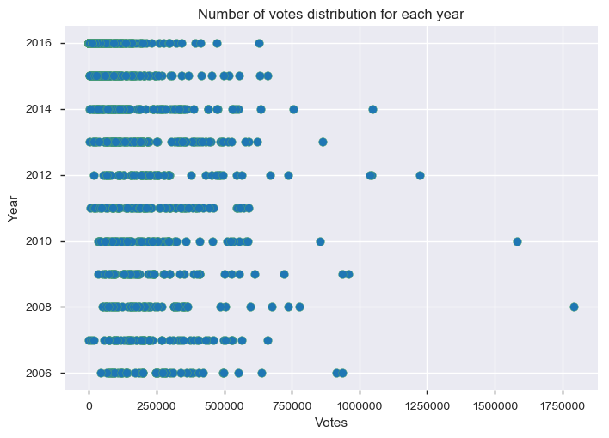
Which movie has the highest number of votes and in which year?
It is clearly visible that in 2008 , viewers voted exceptionally high for a movie.
Movie name is The Dark Knight.

Slide 6
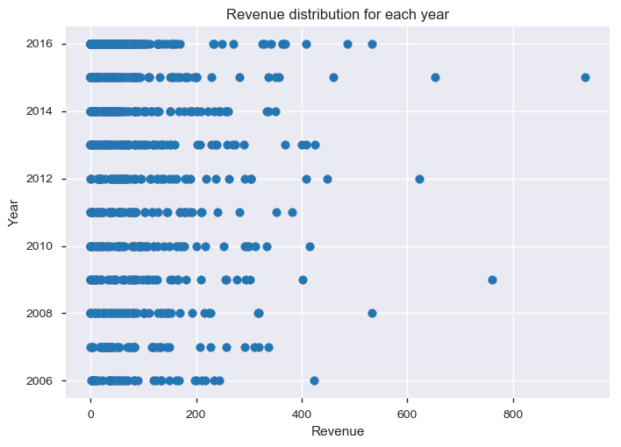
Which movie has the highest revenue and in which year?
It is clearly visible that revenue is highest in 2015. Movie name is 'Star Wars: Episode VII - The Force Awakens'.

Slide 7
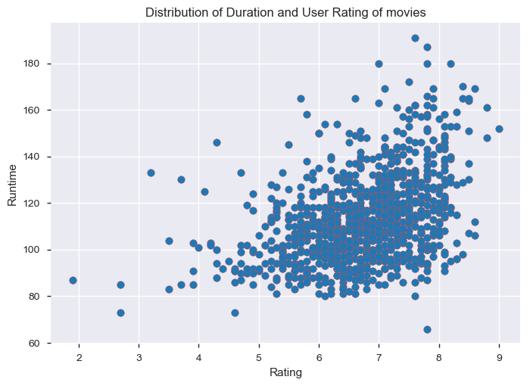
What is the effect of duration of the movie on rating?
It is clearly visible that viewers likes to watch movie that has duration ranges from 80 to 130 minutes.
Graph is concentrated more during this duration and rating is also good comparatively.

Slide 8
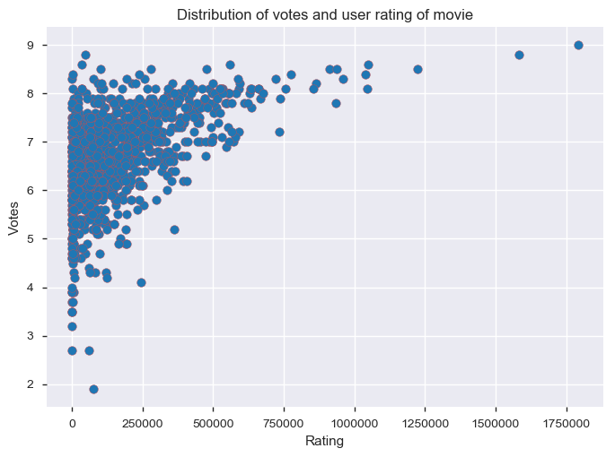
What is the relationship between votes and user rating?
It is easily observed that viewers are going to vote for the movie that they like.

Slide 9
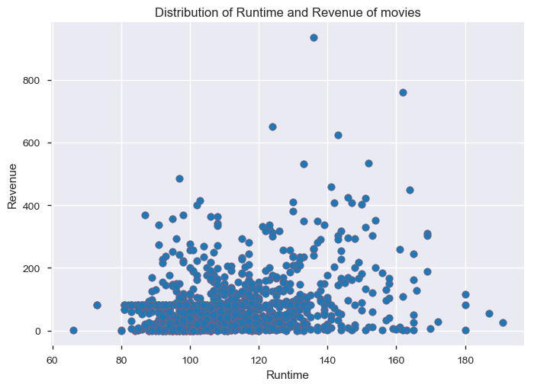
What should be the duration of movie to generate more revenue?
To get maximum revenue, movie duration should be between 80 to 130 minutes. It can be seen from graph that movies with long duration tend to generate less revenue.

Slide 10
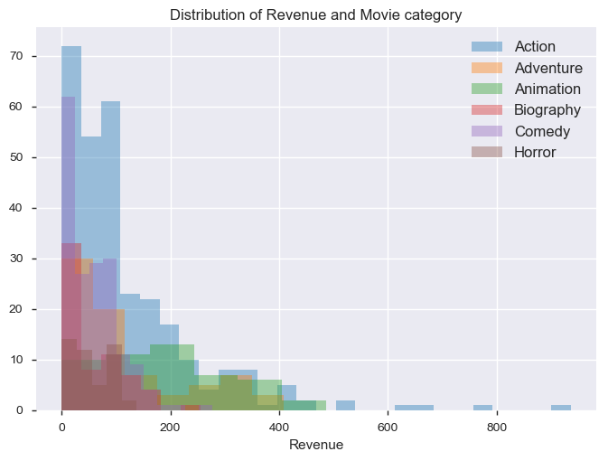
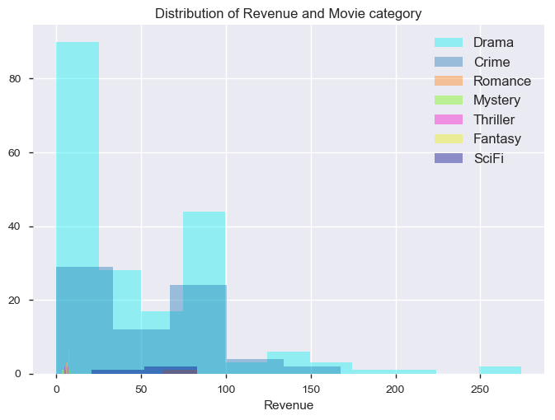
Which type of movie, generates more revenue?¶
Using above superimposed graphs using distplots also states same that
Action, Comedy and Drama generated more revenue.

Slide 11
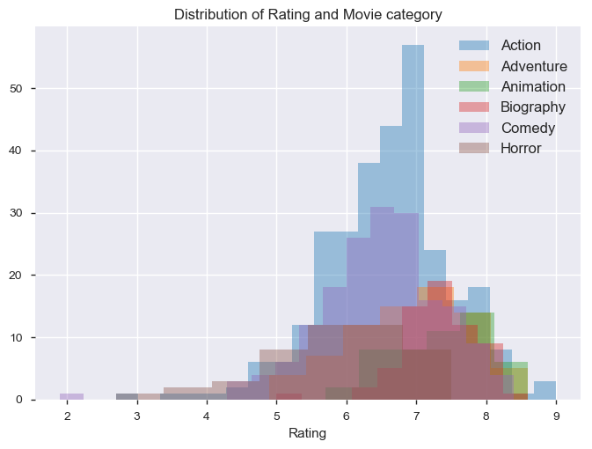
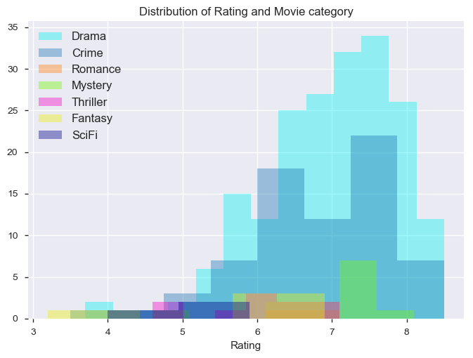
Which type of movie, viewers like more?¶
From above superimposed graph , it can be seen clearly that maximum number of movies related to Action, Comedy and Drama that user rates positively.

Slide 12
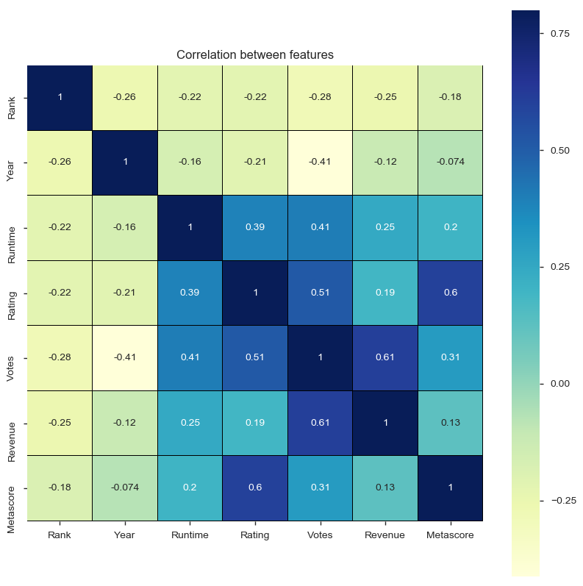
Which features have highest correlation?
It is clearly seen that highest correlation is between votes and revenue i.e. 0.61 that clearly states that
if we want more revenue to generate then user must like the movie and critics rating does not
have much impact on revenue i.e. 0.13.

