Slide 1
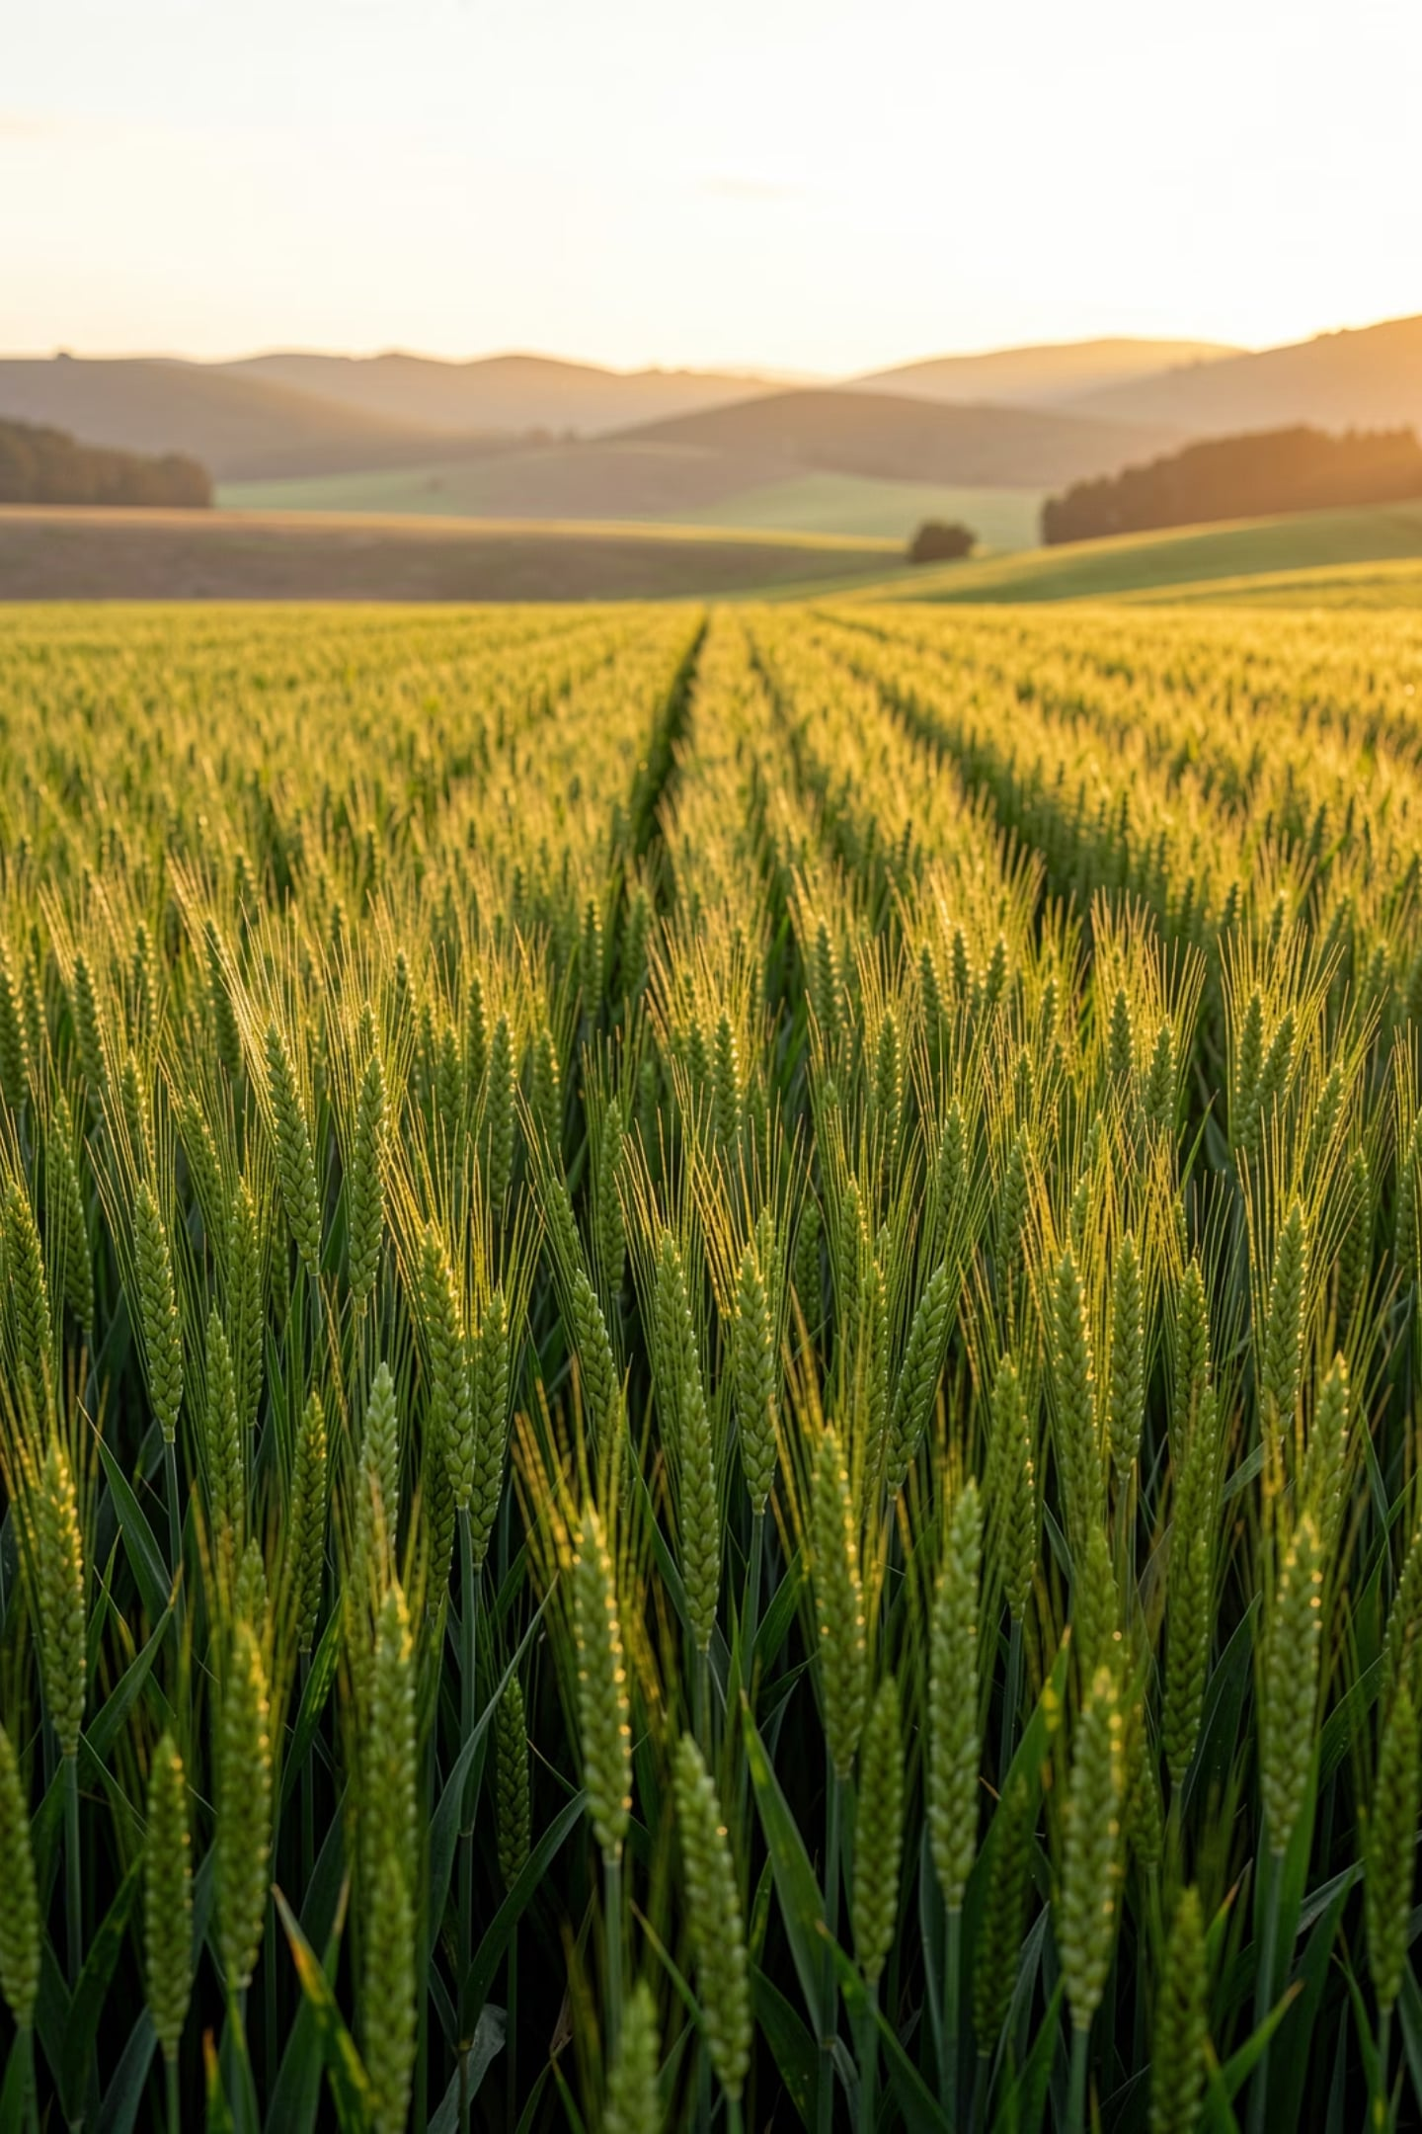
TFI SUMMER INTERNSHIP
Crop Yield Prediction Using Machine Learning
Kalpana Rajagiri | Roll No: 24JR1A05F8
A beginner-friendly project exploring how data-driven models can help farmers estimate harvest outcomes before planting season begins.

Slide 2
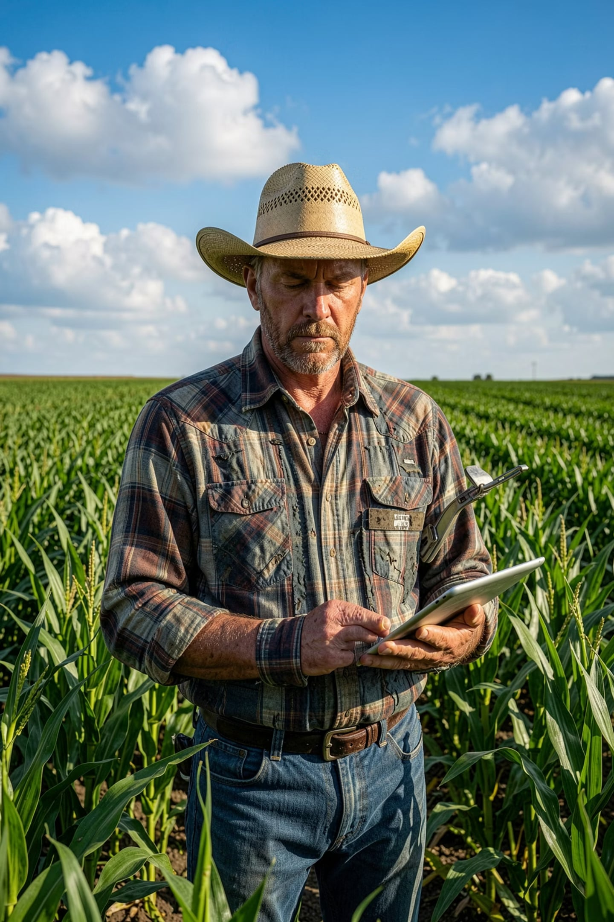

Introduction
Agriculture remains a cornerstone of the economy, supporting livelihoods and food security across the country.
Accurately predicting crop yield helps farmers plan resources, manage risk, and make informed decisions well before harvest.
Economic Backbone
Agriculture sustains millions of livelihoods
Smarter Planning
Yield forecasts guide planting decisions
ML-Powered
Models learn from historical farm data

Slide 3

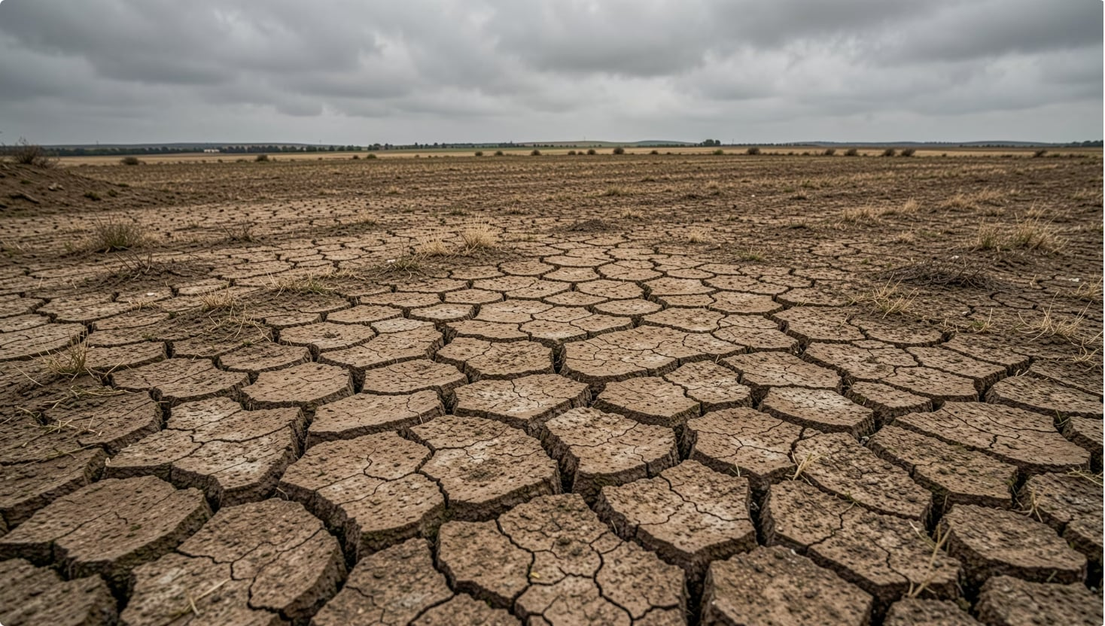

Problem Statement
Farmers today face a critical challenge: predicting how much their fields will produce in a given season.
Manual Estimation
Yield is often guessed from past experience, leading to inaccurate forecasts.
Unpredictable Conditions
Rainfall, temperature, and pest pressure vary widely each season.
No Data Analysis
Without structured data, making reliable, evidence-based decisions is nearly impossible.

Slide 4









Dataset & Inputs
The model learns from eight key agricultural variables to predict crop yield.
Crop
Season
Type of crop grown (e.g., rice, wheat, maize)
Growing season such as Kharif or Rabi
State
Area
Geographic region of cultivation
Total land area under cultivation
Annual Rainfall
Fertilizer
Total yearly precipitation in mm
Quantity of fertilizer applied
Pesticide
Temperature
Amount of pesticide used
Average temperature during growth
Output: Predicted Crop Yield — the estimated production quantity the model returns after analyzing all inputs.

Slide 5

Methodology
From raw data to an interactive web app — the project follows a clear, step-by-step pipeline.
Each stage builds on the previous one: data is cleaned and encoded, split into training and testing sets, then fed into a Random Forest Regressor that learns patterns and generates predictions. Finally, a Streamlit app lets users interact with the model in real time.

Slide 6

Results
Model Success
The Random Forest model successfully predicts crop yield from the input variables.
Interactive App
Users enter farming details like crop type, rainfall, and temperature into the Streamlit interface.
Instant Output
The predicted yield is displayed immediately, making the tool practical for quick decision-making.

Slide 7
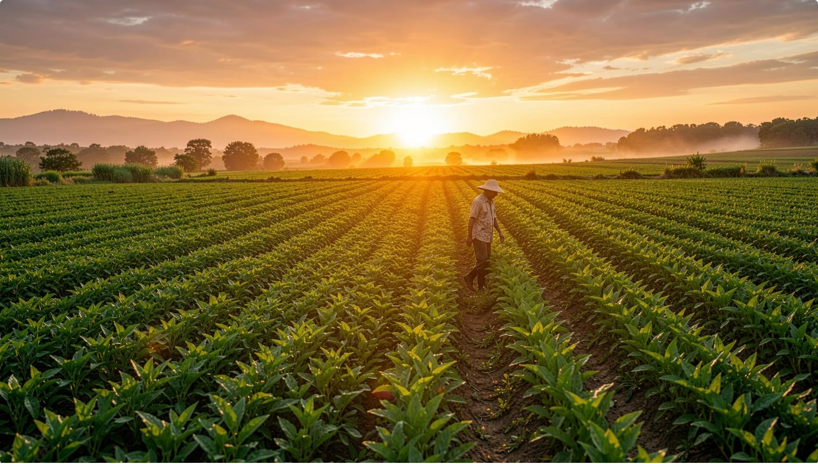
Conclusion
ML for Agriculture
Machine learning offers a reliable way to estimate crop yield from historical and environmental data.
Random Forest Performance
The model captures complex, non-linear relationships between inputs and yield, producing strong predictions.
Farmer Empowerment
By turning data into insight, the project helps farmers plan resources and reduce uncertainty.
Future Scope
Adding soil type and live weather data could further improve prediction accuracy and real-world usefulness.

Slide 8

Thank You
Questions & Answers
Kalpana Rajagiri | Roll No: 24JR1A05F8 | TFI Summer Internship

