Slide 1
RESEARCH VIVA PRESENTATION
Intelligent Recruitment Automation System
for Job Description Creation, Application Shortlisting,
and Skill Gap Identification
Presented by: Kalpani D. Kapuge · Student ID 28870
Programme: BSc (Hons) in Software Engineering
Faculty: Faculty of Computing, NSBM Green University
Date: September 2026
A layered, AI-assisted, human-governed web platform spanning Candidate, Employer and Administrator recruitment workflows.

Slide 2
ROADMAP
What This Talk Covers
Eight sections, aligned to the thesis structure
01
Problem & Motivation
Why recruitment automation still falls short
05
System Design & Architecture
Requirements, layers, and data model
02
Aim, Question & Objectives
What this research set out to do
06
Core AI Contribution
Explainable multi-signal scoring pipeline
03
Literature Review
The gap: integrated vs. single-purpose AI tools
07
Evaluation & Results
98.5% classifier accuracy, tested & traced
04
Methodology
Pragmatism, mixed methods, DSRM
08
Conclusion & Future Work
What was achieved, what comes next
IRAS — Intelligent Recruitment Automation System · Research Viva
02 / 19

Slide 3
01 · PROBLEM & MOTIVATION
Recruitment Is Still Manual, Slow and Opaque
▪ Application posting, resume screening, ranking, interview coordination and feedback are still largely manual or keyword-based
– Keyword matching misses meaning — a resume with “Node.js” won’t match a posting for “server-side JavaScript,” though they mean the same thing
▪ Poorly written job descriptions attract the wrong candidates and discourage the right ones
▪ Rejected candidates rarely receive feedback — a “black box” that limits their ability to improve
▪ AI adoption in recruiting is accelerating: Generative-AI use among recruiters rose from 27% to 37% in a single year
– But unmanaged AI can introduce racial and gender bias into resume screening — automation alone is not the goal
IRAS — Intelligent Recruitment Automation System · Research Viva
03 / 19

Slide 4
01 · PROBLEM & MOTIVATION
The Research Gap
No single, intelligent system currently supports the full recruitment lifecycle end to end.
Existing tools solve ONE piece:
• Job post creation assistance
• CV / resume screening & parsing
• Applicant ranking & shortlisting
• Skill-gap identification
IRAS unifies them into one platform:
• Automated candidate–job matching
• CV generation & interview coordination
• Feedback provision & notifications
• Knowledge-base & chatbot support
→ This is the specific gap Intelligent Recruitment Automation System (IRAS) is built to fill.
IRAS — Intelligent Recruitment Automation System · Research Viva
04 / 19

Slide 5
02 · AIM, QUESTION & OBJECTIVES
Research Question & Aim
MAIN RESEARCH QUESTION
How can an Intelligent Recruitment Automation System with AI help in job-description development, application selection, candidate ranking, skill-gap identification, automated job–candidate matching, CV writing, interview scheduling, feedback, and transparency — for both employer and candidate?
RESEARCH AIM
Design and develop IRAS by integrating AI and NLP with structured scoring techniques to improve the efficiency, consistency and transparency of recruitment — automating job descriptions, shortlisting, skill-gap analysis, matching, CV generation, interview scheduling, feedback, monitoring, and chatbot assistance.
IRAS — Intelligent Recruitment Automation System · Research Viva
05 / 19

Slide 6
02 · AIM, QUESTION & OBJECTIVES
Research Objectives
1
To Identify
Key challenges in traditional and AI-supported recruitment: screening, skill-gap ID, ranking, feedback, CV creation, interview scheduling, chatbot support
2
To Analyze
The current landscape of recruitment automation: resume screening, semantic matching, LLM-based JD generation, feedback, scheduling and chatbot-based processes
3
To Design / Implement / Develop
A web-based, three-role (Candidate / Employer / Admin) system with AI-assisted matching, skill-gap analysis, CV generation, scheduling, feedback and chatbot support
4
To Evaluate
Ranking accuracy, resume-parsing accuracy, skill-gap identification, CV-generation correctness, usability, transparency and user satisfaction
IRAS — Intelligent Recruitment Automation System · Research Viva
06 / 19

Slide 7
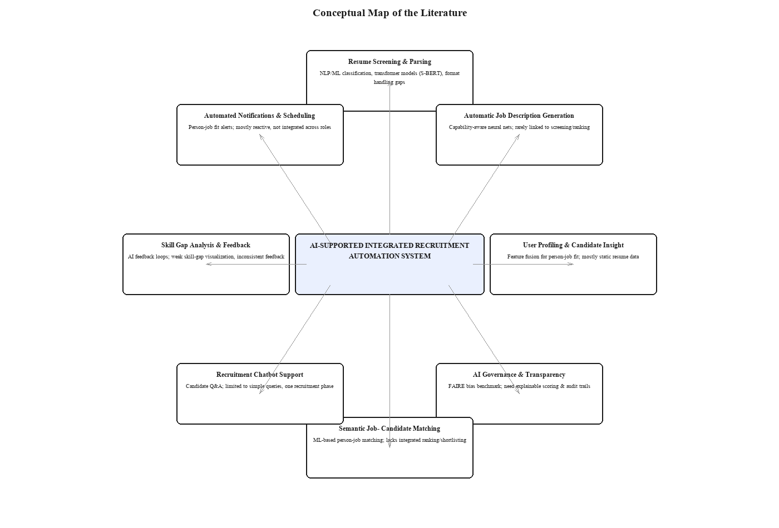
03 · LITERATURE REVIEW
Twenty-Eight Sources, One Consistent Gap
▪ 28 sources reviewed, 2016 – 2026, majority from the last 5 years
▪ Resume screening & ranking (NLP / BERT / S-BERT): reduces effort, but explanation & feedback stay weak
▪ AI job-description generation: rarely linked back to screening or ranking
▪ Skill-fit, feedback & chatbot studies: each solves one recruitment stage in isolation
▪ AI-fairness research (FAIRE benchmark): confirms bias risk in unmanaged AI screening
No study offers one unified, role-based, explainable recruitment platform — the gap IRAS fills.
IRAS — Intelligent Recruitment Automation System · Research Viva
07 / 19

Slide 8
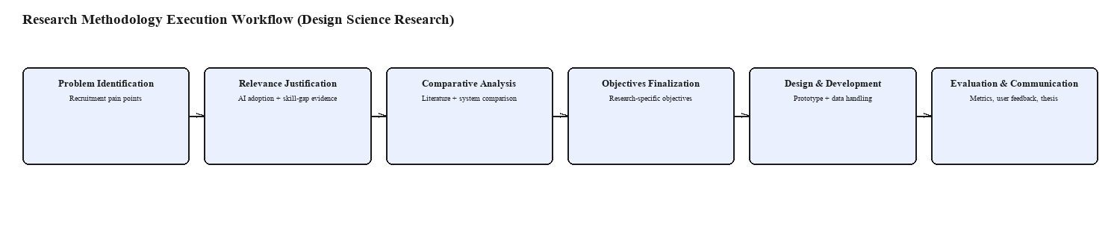
04 · METHODOLOGY
Design Science Research, Guided by Pragmatism
▪ Paradigm: Pragmatism — a practical problem, a working software artifact
▪ Approach: Mixed methods — qualitative (literature, UX) + quantitative (ranking accuracy, ML metrics)
▪ Strategy: Design Science Research Methodology (DSRM) — problem → design → demonstration → evaluation
▪ Project management: Scrum, sprint-based, incremental across Candidate / Employer / Admin modules
IRAS — Intelligent Recruitment Automation System · Research Viva
08 / 19

Slide 9
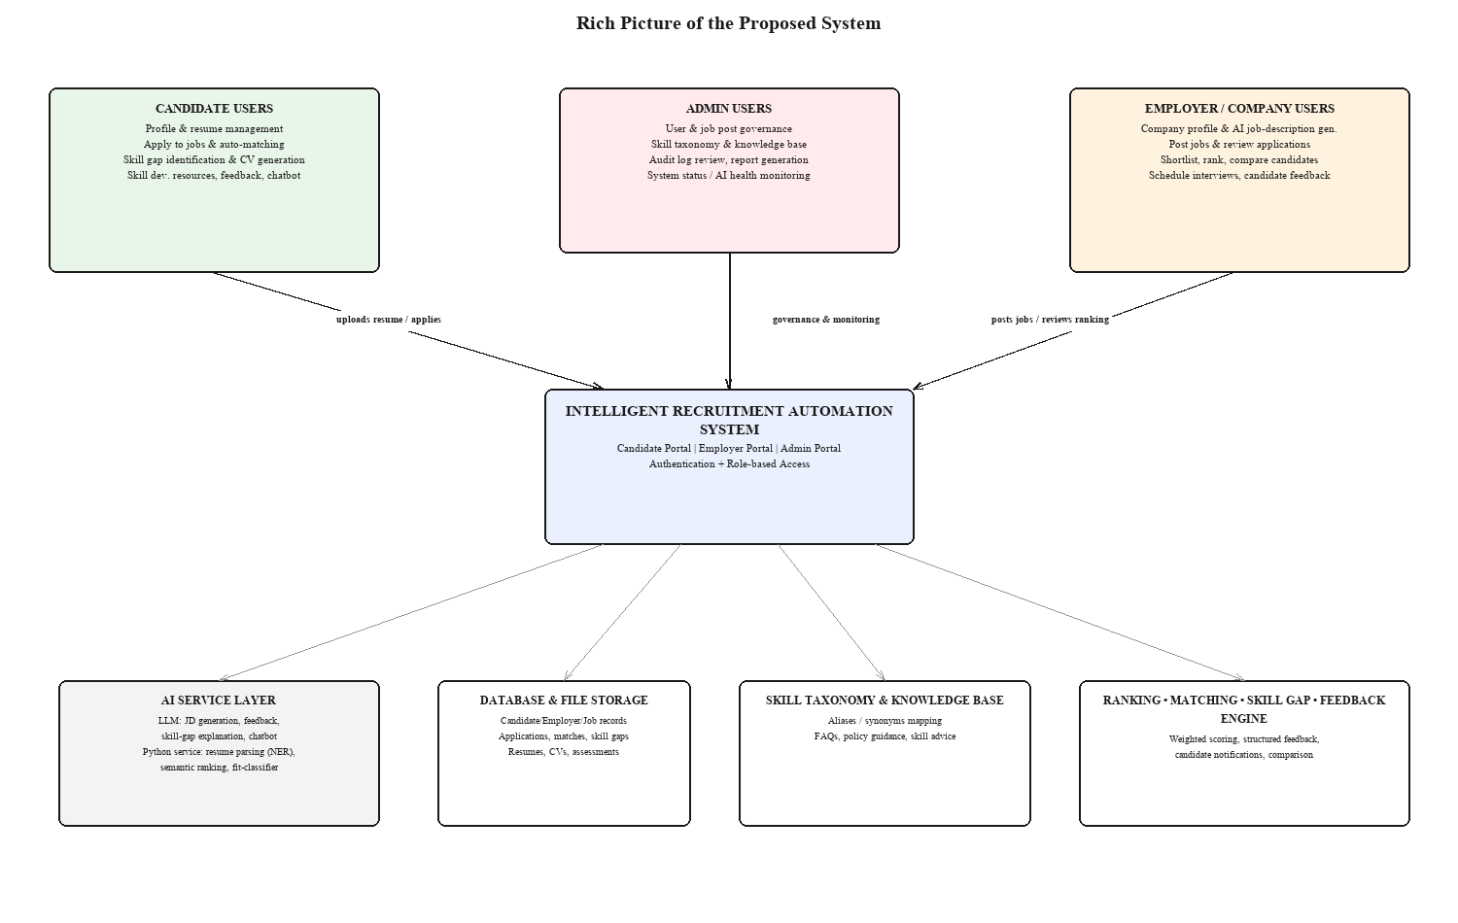
05 · SYSTEM DESIGN & ARCHITECTURE
Proposed Solution — Three Roles, One Platform
IRAS — Intelligent Recruitment Automation System · Research Viva
09 / 19

Slide 10
05 · SYSTEM DESIGN & ARCHITECTURE
System Requirements at a Glance
4
Stakeholders Candidate · Employer Admin · AI Service
26
Use Cases 11 Candidate · 7 Employer 8 Administrator
36
Domain Entities across 8 module swimlanes
21 + 10
Functional + Non-Functional Requirements
▪ Requirements traced back to a specific research objective AND a fact-gathering activity — not guesswork
▪ Use-case diagram models explicit UML «include» / «extend» dependencies (e.g. Post Job always includes Generate JD)
▪ Full lifecycle state machines defined for Application (Applied → … → Hired/Rejected/Withdrawn) and SkillPlanEvidence
▪ Enhanced ER diagram models weak entities and a disjoint, partial ISA specialization of User
IRAS — Intelligent Recruitment Automation System · Research Viva
10 / 19

Slide 11
05 · SYSTEM DESIGN & ARCHITECTURE
A Layered Architecture, With One Deliberate Service Boundary
Presentation
React + TypeScript (Vite) — Candidate, Employer and Admin portals
API
ASP.NET Core controllers · JWT bearer auth · Swagger / OpenAPI
Application
Business services — matching, skill-gap, assessments, chat, CV generation
Domain
Persistent entities — User, Job, Application, SkillGap, Interview, …
Infrastructure
EF Core + SQL Server (relational data) · Supabase (file/object storage only) · AI-service HTTP client
External Python FastAPI AI microservice — resume parsing, semantic ranking, fit-classifier — isolated so it can scale, fail and redeploy independently of the core API.
IRAS — Intelligent Recruitment Automation System · Research Viva
11 / 19

Slide 12
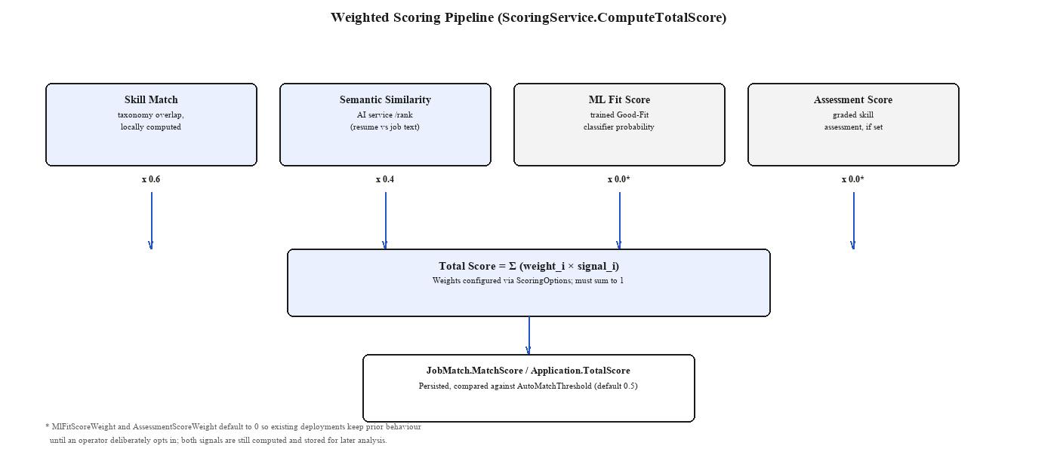
06 · CORE AI CONTRIBUTION
Explainable, Multi-Signal Candidate Scoring
▪ Total Score = weighted sum of Skill Match, Semantic Similarity, ML Fit Score and Assessment Score — weights are configurable, not hard-coded
▪ Every score is persisted and shown to candidate AND employer as a breakdown, never a single opaque number
▪ If the AI service is unreachable, the system degrades to skill-match-only scoring rather than failing the request
IRAS — Intelligent Recruitment Automation System · Research Viva
12 / 19

Slide 13
06 · CORE AI CONTRIBUTION
AI-Assisted, Not AI-Automated
AI-Assisted Job Descriptions
Generated from minimal input, but always returned as an editable draft — employer must approve before it publishes
Skill-Gap Explanation & Plan
Plain-language AI explanation of the gap, plus a personalized, sequenced improvement plan
Confidence-Gated Evidence Review
High-confidence AI decisions auto-apply; low-confidence submissions escalate to an Administrator
Role-Aware Chatbot
Scoped strictly to the authenticated user’s own data and recruitment topics; out-of-scope questions are deflected
Every AI-influenced decision is written to an immutable audit log — explainability by design, not an afterthought.
IRAS — Intelligent Recruitment Automation System · Research Viva
13 / 19

Slide 14
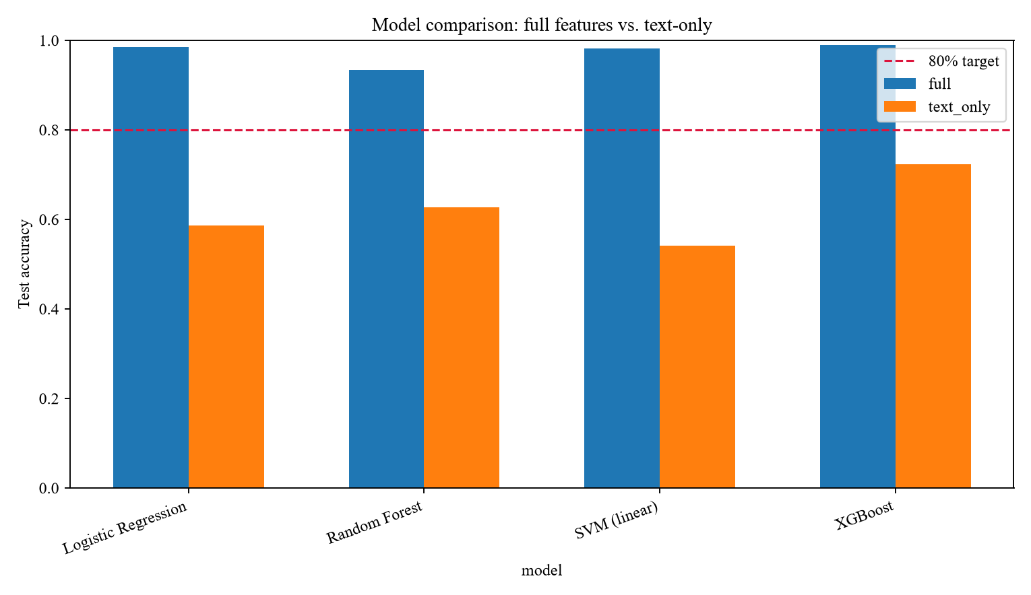
07 · EVALUATION & RESULTS
Structured Features Beat Free Text, Decisively
98.5%
Deployed model (Logistic Regression) — full-feature test accuracy
58.7%
Same model, text-only features — no skill / semantic signal
+25 to +44 pts
Accuracy gained by every algorithm once skill-overlap +
semantic-similarity features are added
IRAS — Intelligent Recruitment Automation System · Research Viva
14 / 19

Slide 15
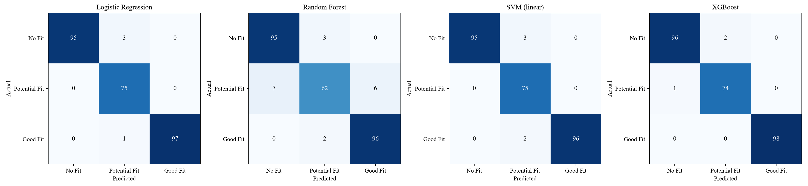
07 · EVALUATION & RESULTS
Why Logistic Regression, Not the Top-Scoring XGBoost
▪ XGBoost reached the highest test accuracy (98.9%) — 0.4 points above Logistic Regression (98.5%)
▪ But the XGBoost model, trained on Linux, failed to deserialize on the Windows deployment target — a real integration-testing finding, not a hypothetical risk
▪ Logistic Regression, Random Forest and Linear SVM store plain Python/NumPy parameters — no cross-platform risk
▪ Decision: deployment reliability outweighed a 0.4-point accuracy gain → Logistic Regression shipped to production
IRAS — Intelligent Recruitment Automation System · Research Viva
15 / 19

Slide 16
07 · EVALUATION & RESULTS
Testing Strategy — Design-Time Traceability + a Real Finding
▪ 10 sample test cases (7 functional + 3 non-functional) each traced from requirement → exact implementation unit
▪ Running the existing xUnit suite did not just pass or fail silently — it surfaced a genuine compile-time defect
– A hand-written test fake had drifted out of sync with an extended service interface (CS0535)
– The statically-typed backend caught this before a single test could run against a stale fake and report a misleading “green” build
▪ Usability testing and load testing require a live, user-facing deployment — scoped honestly as near-term future work, not claimed as done
IRAS — Intelligent Recruitment Automation System · Research Viva
16 / 19

Slide 17
08 · CONCLUSION & FUTURE WORK
Objectives Achieved — Triangulated, Not Assumed
To Identify
Accomplished
Confirmed against 28 literature sources + the problem background
To Analyze
Accomplished
Every requirement traced to a specific literature-identified gap
To Design / Implement / Develop
Accomplished
21 functional requirements realized across Candidate / Employer / Admin
To Evaluate
Partially — quantitative done
98.5% classifier accuracy proven; usability & CV-gen human evaluation is future work
IRAS — Intelligent Recruitment Automation System · Research Viva
17 / 19

Slide 18
08 · CONCLUSION & FUTURE WORK
Where This Goes Next
▪ Live usability & CV-generation evaluation with real candidates and employers
▪ Load/performance testing under realistic concurrent traffic
▪ Enable the ML Fit Score and Assessment Score weights in a controlled production rollout
▪ Investigate ONNX export so a higher-scoring model isn’t excluded purely on deployment grounds
▪ Extend the skill taxonomy to a second domain (e.g. healthcare credentialing) to test generalization
▪ Package the scoring + evidence-review engine as a white-label module for existing ATS vendors
CONCLUSION
IRAS demonstrates a complete, auditable, AI-assisted recruitment lifecycle — not another single-purpose screening tool — with every consequential AI decision kept explainable and reviewable by a human.
IRAS — Intelligent Recruitment Automation System · Research Viva
18 / 19

Slide 19
Thank You
Questions & Discussion
Kalpani D. Kapuge · 28870 · BSc (Hons) Software Engineering · NSBM Green University

