Slide 1
OSmosis
[VIT logo]
A course-grounded tutor for Operating Systems: retrieval-augmented explanations, exact numerical solvers and diagnosis of student reasoning
[Course code] - [Course name]
[Student name] | [Registration number]
Faculty: [Faculty name]
[School / Department], Vellore Institute of Technology | [Academic year]
Notes:
OSmosis is a tutor for our Operating Systems course. It answers questions from the course's own textbook, teacher slides and lab notes, computes numerical answers exactly in code, and shows students where their own working goes wrong.
Before presenting: replace every bracketed placeholder (course code and name, student name, registration number, faculty, school, academic year) and insert the VIT logo in the dashed box.

Slide 2
Introduction and objectives
The problem
Objectives and status
Static material shows results, not reasoning: a worked example gives the final schedule, not why each decision was taken.
Numerical problems are error-prone: one missed preemption changes every later value, and final answers cannot show where it went wrong.
Generic AI answers are not tied to the course: different conventions, no citations, unreliable arithmetic.
1
Course-grounded answers with RAG
Achieved
2
Citations, figures and slide images
Achieved
3
Exact solvers for four problem families
Achieved + tested
4
Step-level diagnosis of student working
Achieved + tested
5
Interactive algorithm execution (OS Lab)
Achieved + tested
6
Misconception tracking, targeted practice
Rules not validated
Goal: explanations grounded in the course material, exact answers to numerical problems, and feedback on the step where a student's reasoning fails.
7
Quiz, viva and adaptive difficulty
LLM output not evaluated
8
Retrieval evaluation and automated tests
Achieved
Notes:
Students need three things the usual resources do not give together: explanations in their own course's terms, exact solutions to numerical problems, and feedback on where their own reasoning failed.
Eight objectives. Six are achieved and tested. Two are implemented but not fully validated: the misconception rules are unit-tested but were not validated with students, and the quality of LLM-written quiz questions and answers was not evaluated quantitatively, because no API key was available in the test environment.

Slide 3
Methodology: two paths, one interface
Streamlit interface
Chat · Solver · Check my working · OS Lab · Quiz · Map
Numerical problem detector
RAG path: explanations
Deterministic path: exact numbers
Intent + query
follow-ups carry the previous question
Exact solvers
scheduling · Banker's · paging · disk
BM25
keywords
BGE embeddings
ChromaDB
Knowledge base
2,222 passages · 928 images
textbook · teacher slides · lab notes
Debugger + OS Lab
compare working · replay decisions
Weighted rank fusion
k = 60, teacher ×1.05, back matter ×0.5
Learning map
evidence rules · recommendations
Top 6 passages + figures
tagged [S1]-[S6]
LLM: gpt-oss-120b (Groq)
grounded, cited answer; explains, never computes
Progress file
quiz statistics + evidence (JSON)
Dashed: the solver's exact result is passed to the LLM as fixed text to explain. Without an API key, every feature except written answers still works.
Stack Python 3.12 · Streamlit 1.65 · rank_bm25 · BAAI/bge-base-en-v1.5 (sentence-transformers) · ChromaDB 1.5.9 · gpt-oss-120b via Groq (OpenAI-compatible API) · PyMuPDF · python-pptx
Notes:
Every question goes through one detector. If it states a numerical problem, the matching solver computes the exact answer, on the right. In parallel, retrieval on the left selects the six most relevant course passages: BM25 for exact terms, BGE embeddings for paraphrases, combined with weighted reciprocal rank fusion.
The LLM receives the passages and, for numericals, the solver's result as fixed text. It explains and cites; it never computes. The same solver traces drive the debugger, OS Lab and the learning map. Without an API key, every feature except written answers keeps working.

Slide 4
R&D: tuning retrieval and constraining the LLM
Retrieval experiments
78 labelled questions; 19 held out. A grid of 147 fusion settings was scored on the other 59; the best MRR that did not lower Hit@3 or Hit@6 was selected.
Prompt engineering
Answer only from the numbered SOURCES, cite every factual sentence [S#], say when the sources do not cover it. Invalid citation tags are stripped in code; quiz JSON is validated.
Implementation
Solvers record every decision; the debugger, OS Lab and learning map read those states. 71 automated tests in 7 suites, all passing.
71.8% → 76.9%
84.2% → 94.7%
0.830 → 0.858
Hit@1, all 78 questions
Hit@1, 19 held-out questions
MRR, all 78 questions
Hit@6 is unchanged at 98.7%. Per-topic changes are not statistically significant: the smallest topics have only 3 and 5 questions.
Notes:
The retrieval audit found that the original teacher boost let unrelated slides outrank passages both rankers placed first, and that end-of-chapter material sometimes ranked first. We scored 147 fusion settings on 59 questions and kept 19 aside. The selected configuration raised first-rank accuracy from 71.8 to 76.9 percent, and on the held-out questions from 84.2 to 94.7 percent, without lowering top-3 or top-6.
Prompts restrict the LLM to the numbered sources and require citations; this is enforced in code by stripping invalid tags. Numbers always come from the solvers. Limits: the question set is small and labelled by the developer, and LLM answer quality was not measured.

Slide 5
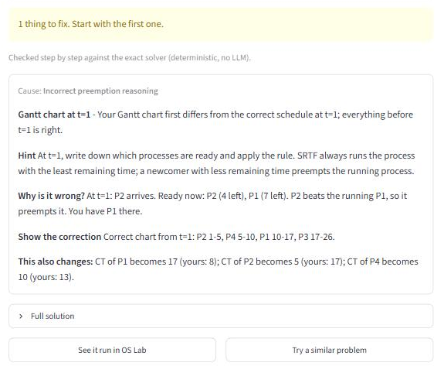
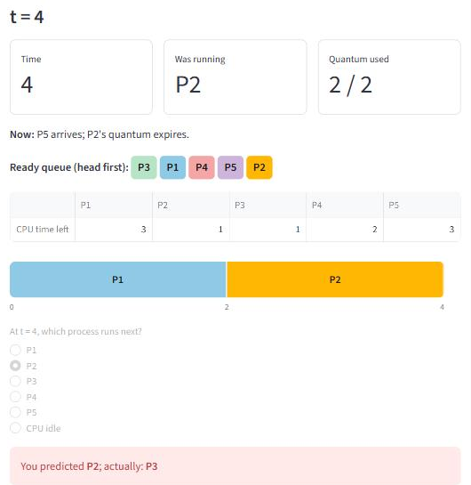
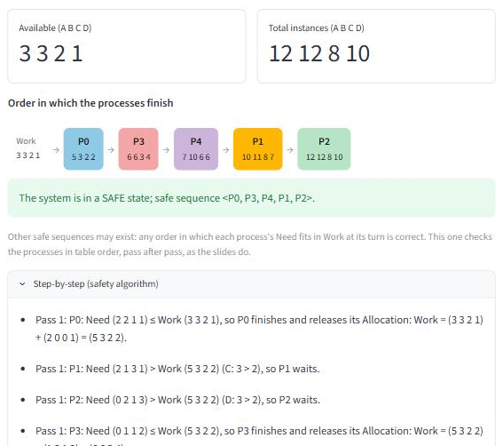
Features in use, and how they were checked
Check my working: a missed SRTF preemption found at t = 1, with cause, hint and correction
OS Lab: Round Robin at t = 4; the student predicted P2, the scheduler runs P3
Numerical solver: Banker's algorithm safe sequence with Work after each step
71 / 71
20
6 pages
Not yet
automated tests pass (7 suites), no API key needed
worked examples from the slides and textbook, solved in code in the chat
exercised in the browser: chat, solvers, debugger, lab, map, quiz
evaluated: LLM-written answers and questions; no student study
Notes:
These are screenshots of the running application, taken without an LLM key. On the left, the Reasoning Debugger compares a student's SRTF chart with the solver's and finds the first wrong decision, at t = 1, with its cause; the hint never gives the answer away. In the middle, OS Lab replays the teacher's Round Robin example: the student predicted P2, but the course rule queues the newly arrived process first, so P3 runs. On the right, the Banker's solver shows the safe sequence with Work after each step.
Evaluation: 71 automated tests across seven suites all pass, the solvers reproduce the 20 worked examples, and every page was exercised in a browser. What is not yet evaluated: the quality of LLM-written answers and questions, and any study with students.

Slide 6
Conclusion and future work
What OSmosis shows
Future work
Grounded explanation and exact computation are kept apart: the LLM explains from cited course passages, code produces every number.
The same recorded solver states let the system diagnose a student's first wrong step and replay the real algorithm.
Measured: Hit@1 71.8% → 76.9% (held-out 84.2% → 94.7%) with Hit@6 at 98.7%; 71 automated tests pass.
1
Reranking stage
A cross-encoder over the fused candidates, to fix the adjacent-section errors that remain.
2
Validation with students
A usability study, and checking the misconception rules against real outcomes.
3
Evaluating LLM output
Measure answer and question quality, and make the progress file safe for concurrent sessions.
Not validated in this project: the quality of LLM-written content, and learning outcomes with students.
Notes:
The central design choice is separating grounded explanation from exact computation. It uses the LLM where it is strong and keeps every Gantt chart, safe sequence and fault count correct by construction. It also makes diagnosis possible: the same recorded states locate a student's first wrong step.
Three next steps: a reranker for the remaining retrieval errors, validation with students, and a quantitative evaluation of LLM output, together with making the progress file safe when several browser sessions are open.

Slide 7
References
[1]
A. Silberschatz, P. B. Galvin, and G. Gagne, Operating System Concepts, 10th ed. Hoboken, NJ, USA: Wiley, 2018.
[2]
P. Lewis et al., "Retrieval-augmented generation for knowledge-intensive NLP tasks," in Advances in Neural Information Processing Systems 33 (NeurIPS 2020), 2020, pp. 9459-9474.
[3]
S. Robertson and H. Zaragoza, "The probabilistic relevance framework: BM25 and beyond," Foundations and Trends in Information Retrieval, vol. 3, no. 4, pp. 333-389, 2009, doi: 10.1561/1500000019.
[5]
S. Xiao, Z. Liu, P. Zhang, N. Muennighoff, D. Lian, and J.-Y. Nie, "C-Pack: Packed resources for general Chinese embeddings," arXiv:2309.07597, 2023.
[9]
G. V. Cormack, C. L. A. Clarke, and S. Büttcher, "Reciprocal rank fusion outperforms Condorcet and individual rank learning methods," in Proc. 32nd Int. ACM SIGIR Conf. Research and Development in Information Retrieval, 2009, pp. 758-759, doi: 10.1145/1571941.1572114.
[10]
OpenAI, "gpt-oss-120b & gpt-oss-20b model card," arXiv:2508.10925, 2025.
Numbers follow the project report's reference list (16 entries), which also cites the libraries, model documentation and course material used.
Notes:
These are the main sources behind the design: the course textbook, retrieval-augmented generation, BM25, the BGE embedding model, reciprocal rank fusion and the gpt-oss model. The numbers match the full reference list in the project report.

