Slide 1
HTML

Slide 2
What is HTML?
HTML is a markup language for describing web documents (web pages).
HTML stands for Hyper Text Markup Language
A markup language is a set of markup tags
HTML documents are described by HTML tags
Each HTML tag describes different document content

Slide 3
HTML is Hypertext Markup Language. | DHTML is Dynamic Hypertext Markup Language.
HTML stands for only static pages. | DHTML is Dynamic HTML means HTML+JavaScript.
It is referred as a static HTML and static in nature. | It is referred as a dynamic HTML and dynamic in nature.
A plain page without any styles and Scripts called as HTML. | A page with HTML, CSS, DOM and Scripts called as DHTML.
HTML sites will be slow upon client-side technologies. | DHTML sites will be fast enough upon client-side technologies.

Slide 4
Structure of HTML Documents
<!DOCTYPE html> <html> <head> <title>Page Title</title> </head> <body> <h1>My First Heading</h1> <p>My first paragraph.</p> </body> </html>

Slide 5
HTML ELEMENTS
An HTML element is defined by a starting tag. If the element contains other content, it ends with a closing tag, where the element name is preceded by a forward slash as shown below with few tags:

Slide 6
Start Tag | Content | End Tag
<p> | Content of paragraph | </p>
<h1> | Content of Heading Tag | </h1>
<div> | Content of Div tag | </div>
<br/>
So here <p>....</p> is an HTML element, <h1>...</h1> is another HTML element. There are some HTML elements which don't need to be closed, such as <img.../>, <hr /> and <br /> elements. These are known as void elements.
HTML documents consists of a tree of these elements and they specify how HTML documents should be built, and what kind of content should be placed in what part of an HTML document

Slide 7
Types of Elements
Heading
Paragraph
Line Break
Horizontal rule
Comments
<!-- This is Comment tag-->

Slide 8
Linking in HTML
Linking Element
1) The Link Element
2) The Anchor element

Slide 9
Link Element
The HTML <link> tag is used for defining a link to an external document. It is placed in the <head> section of the document.
<!DOCTYPE html>
<html>
<head>
<title>HTML link Tag</title>
<link rel="stylesheet" href="stylenew.css">
</head>
<body>
<div id="contentinfo"> <p>Welcome to our website. We provide tutorials on various subjects.</p>
</div>
</body>
</html>

Slide 10
Link Attribute
Rel
Target
Sizes
type

Slide 11
Anchor Element
The <a> tag defines a hyperlink, which is used to link from one page to another.
The most important attribute of the <a> element is the href attribute, which indicates the link's destination.
By default, links will appear as follows in all browsers:
An unvisited link is underlined and blue
A visited link is underlined and purple
An active link is underlined and red

Slide 12
Attribute of Anchor Elements
href
name
target
<a href="http://www.w3schools.com">Visit W3Schools.com!</a>

Slide 13
Image Map
The <map> tag is used to define a client-side image-map. An image-map is an image with clickable areas.
The required name attribute of the <map> element is associated with the <img>'s usemap attribute and creates a relationship between the image and the map.
The <map> element contains a number of <area> elements, that defines the clickable areas in the image map.

Slide 14
<img src="planets.gif" width="145" height="126" alt="Planets" usemap="#planetmap"> <map name="planetmap"> <area shape="rect" coords="0,0,82,126" href="sun.htm" alt="Sun"> <area shape="circle" coords="90,58,3" href="mercur.htm" alt="Mercury"> <area shape="circle" coords="124,58,8" href="venus.htm" alt="Venus"> </map>

Slide 15
Meta Information
Metadata is data (information) about data.
The <meta> tag provides metadata about the HTML document. Metadata will not be displayed on the page, but will be machine parsable.
Meta elements are typically used to specify page description, keywords, author of the document, last modified, and other metadata.
The metadata can be used by browsers (how to display content or reload page), search engines (keywords), or other web services.

Slide 16
<head> <meta charset="UTF-8"> <meta name="description" content="Free Web tutorials"> <meta name="keywords" content="HTML,CSS,XML,JavaScript"> <meta name="author" content="Hege Refsnes"> </head>

Slide 17
Image Preliminaries
<img src=“path of image”/>
Attribute
alt
align
height
width

Slide 18
Layout
A webpage layout is very important to give better look to your website. It takes considerable time to design a website's layout with great look and feel.
Now- a-days, all modern websites are using CSS and JavaScript based framework to come up with responsive and dynamic websites but you can create a good layout using simple HTML tables or division tags in combination with other formatting tags. This chapter will give you few examples on how to create a simple but working layout for your webpage using pure HTML and its attributes.

Slide 19
Layout using table
The simplest and most popular way of creating layouts is using HTML <table> tag. These tables are arranged in columns and rows, so you can utilize these rows and columns in whatever way you like.

Slide 20
For example,
the following HTML layout example is achieved using a table with 3 rows and 2 columns but the header and footer column spans both columns using the colspan attribute:

Slide 21
<!DOCTYPE html>
<html>
<head>
<title>HTML Layout using Tables</title>
</head>
<body>
<table width="100%" border="0">
<tr>
<td colspan="2" bgcolor="#b5dcb3">
<h1>This is Web Page Main title</h1>
</td>
</tr>
<tr valign="top">
<td bgcolor="#aaa" width="50">
<b>Main Menu</b><br />
HTML<br />
PHP<br />
PERL...

Slide 22
</td>
<td bgcolor="#eee" width="100" height="200">
Technical and Managerial Tutorials
</td>
</tr>
<tr>
<td colspan="2" bgcolor="#b5dcb3">
<center>
Copyright © 2007 Tutorialspoint.com
</center>
</td>
</tr>
</table>
</body>
</html>

Slide 23
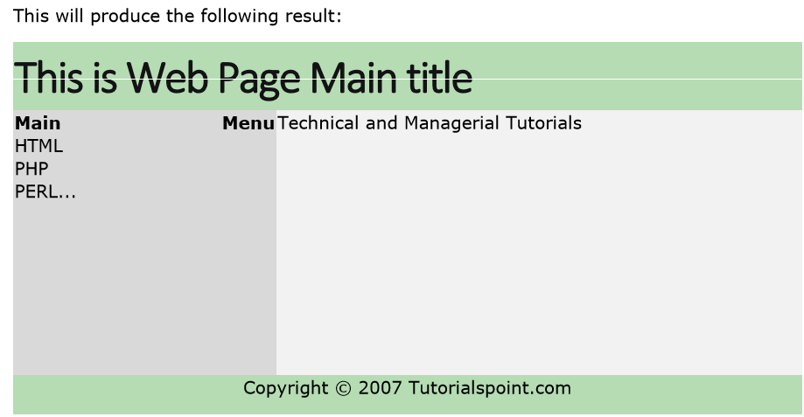

Slide 24
Multiple Columns Layout - Using Tables
You can design your webpage to put your web content in multiple pages. You can keep your content in middle column and you can use left column to use menu and right column can be used to put advertisement or some other stuff. This layout will be very similar to what we have at our website tutorialspoint.com.

Slide 25
<!DOCTYPE html>
<html>
<head>
<title>Three Column HTML Layout</title>
</head>
<body>
<table width="100%" border="0">
<tr valign="top">
<td bgcolor="#aaa" width="20%">
<b>Main Menu</b><br />
HTML<br />
PHP<br />
PERL...
</td>
<td bgcolor="#b5dcb3" height="200" width="60%">
Technical and Managerial Tutorials
</td>
<td bgcolor="#aaa" width="20%">
<b>Right Menu</b><br />
HTML<br />
PHP<br />
PERL...
</td>
</tr>
<table>
</body>
</html>

Slide 26
HTML Layouts - Using DIV, SPAN
The <div> element is a block level element used for grouping HTML elements. While the <div> tag is a block-level element, the HTML <span> element is used for grouping elements at an inline level.
Although we can achieve pretty nice layouts with HTML tables, but tables weren't really designed as a layout tool. Tables are more suited to presenting tabular data.

Slide 27
Note: This example makes use of Cascading Style Sheet (CSS), so before understanding this example you need to have a better understanding on how CSS works.

Slide 28
Example Here we will try to achieve same result using <div> tag along with CSS, whatever you have achieved using <table> tag in previous example.

Slide 29
<!DOCTYPE html>
<html>
<head>
<title>HTML Layouts using DIV, SPAN</title>
</head>
<body>
<div style="width:100%">
<div style="background-color:#sdftre; width:100%; border:2px solid black;">
<h2>This is Web Page Main title</h2>
</div>
<div style="background-color:#aaa; height:200px;width:100px;float:left;">
<div><b>Main Menu</b></div>
HTML<br />
PHP<br />
PERL...
</div>
<div style="background-color:#eee; height:200px;width:350px;float:left;">
<p>Technical and Managerial Tutorials</p>
</div>
<div style="background-color:#aaa; height:200px;width:100px;float:right;">
<div><b>Right Menu</b></div>
HTML<br />
PHP<br />
PERL...
</div>
<div style="background-color:#b5dcb3;clear:both">
<center>
Copyright © 2007 Tutorialspoint.com
</center>
</div>
</div>
</body>
</html>

Slide 30
HTML_Background
By default, your webpage background is white in color. You may not like it, but no worries. HTML provides you following two good ways to decorate your webpage background.
• Html Background with Colors •
Html Background with Images

Slide 31
Html Background with Colors
The bgcolor attribute is used to control the background of an HTML element, specifically page body and table backgrounds. Following is the syntax to use bgcolor attribute with any HTML tag.
<tagname bgcolor="color_value"...>

Slide 32
<!-- Format 1 - Use color name -->
<table bgcolor="lime" >
<!-- Format 2 - Use hex value -->
<table bgcolor="#f1f1f1" >
<!-- Format 3 - Use color value in RGB terms -->
<table bgcolor="rgb(0,0,120)" >

Slide 33
<!DOCTYPE html>
<html>
<head>
<title>HTML Background Colors</title>
</head>
<body>
<!-- Format 1 - Use color name -->
<table bgcolor="yellow" width="100%">
<tr>
<td>
This background is yellow
</td></tr>
</table>

Slide 34
<table bgcolor="#6666FF" width="100%">
<tr><td>
This background is sky blue
</td></tr>
</table>

Slide 35
<table bgcolor="rgb(255,0,255)" width="100%">
<tr><td>
This background is green
</td></tr>
</table>
</body>
</html>

Slide 36
Html Background with Images
The background attribute can also be used to control the background of an HTML element, specifically page body and table backgrounds. You can specify an image to set background of your HTML page or table. Following is the syntax to use background attribute with any HTML tag.

Slide 37
<tagname background="Image URL"...>

Slide 38
<!DOCTYPE html>
<html>
<head>
<title>HTML Background Images</title>
</head>
<body>
<!-- Set table background -->
<table background="/images/html.gif" width="100%" height="100">
<tr><td>
This background is filled up with HTML image.
</td></tr>
</table>
</body>
</html>

Slide 39
Colors and Text
Colors are very important to give a good look and feel to your website. You can specify colors on page level using <body> tag or you can set colors for individual tags using bgcolor attribute.
The <body> tag has following attributes which can be used to set different colors:
• bgcolor - sets a color for the background of the page.
• text - sets a color for the body text.
• alink - sets a color for active links or selected links.
• link - sets a color for linked text.
• vlink - sets a color for visited links - that is, for linked text that you have already clicked on.

Slide 40
HTML Color Coding Methods
There are following three different methods to set colors in your web page:
• Color names - You can specify color names directly like green, blue or red.
• Hex codes - A six-digit code representing the amount of red, green, and blue that makes up the color.
• Color decimal or percentage values - This value is specified using the rgb() property.

Slide 41
HTML Colors - Color Names
You can specify direct a color name to set text or background color. W3C has listed 16 basic color names that will validate with an HTML validator but there are over 200 different color names supported by major browsers.

Slide 42
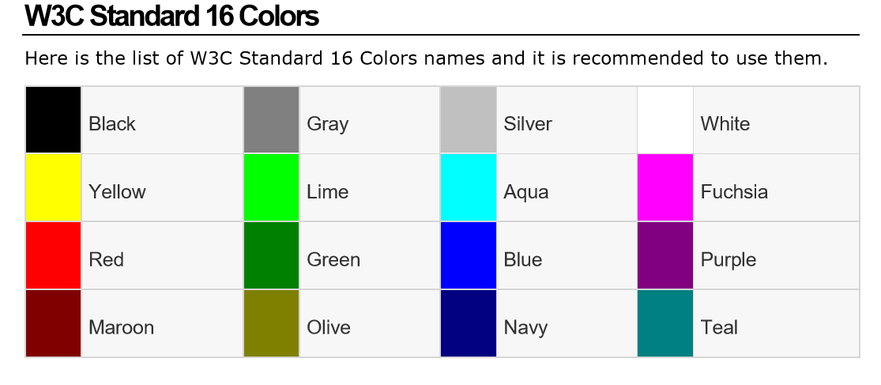

Slide 43
<!DOCTYPE html>
<html>
<head>
<title>HTML Colors by Name</title>
</head>
<body text="blue" bgcolor="green">
<p>Use different color names for for body and table and see the result.</p>
<table bgcolor="black">
<tr>
<td>
<font color="white">This text will appear white on black background.</font>
</td>
</tr>
</table>
</body>
</html>

Slide 44
HTML Colors - Hex Codes
A hexadecimal is a 6 digit representation of a color. The first two digits(RR) represent a red value, the next two are a green value(GG), and the last are the blue value(BB).
A hexadecimal value can be taken from any graphics software like Adobe Photoshop, Paintshop Pro or MS Paint.

Slide 45
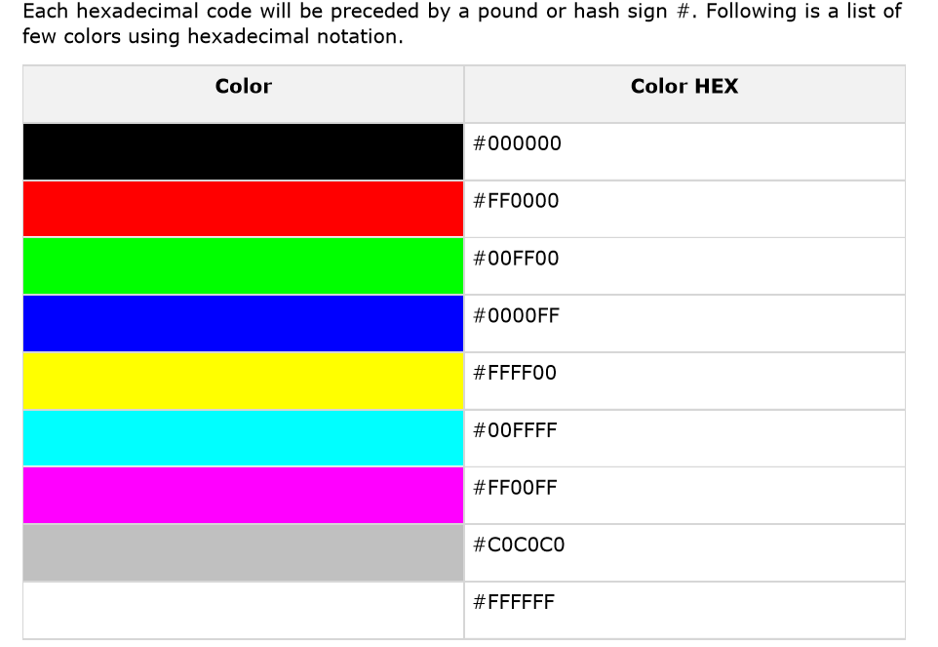

Slide 46
HTML Colors - RGB Values
This color value is specified using the rgb( ) property. This property takes three values, one each for red, green, and blue. The value can be an integer between 0 and 255 or a percentage.

Slide 47
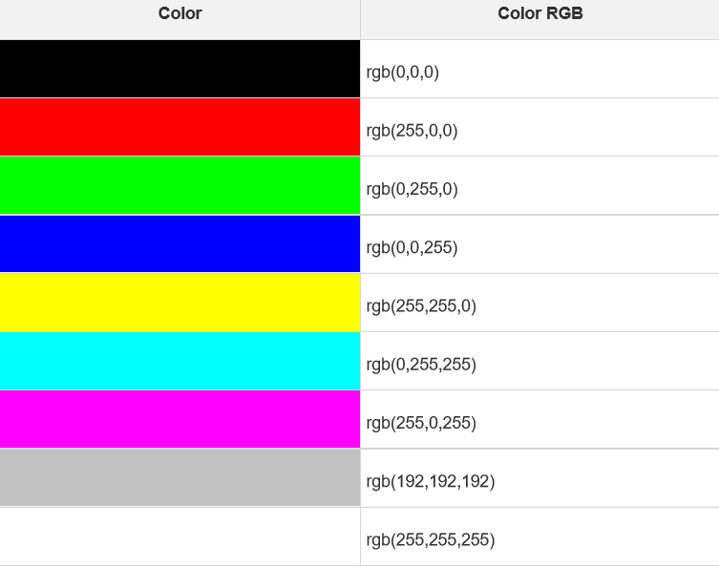

Slide 48
Font
Fonts play a very important role in making a website more user friendly and increasing content readability. Font face and color depends entirely on the computer and browser that is being used to view your page but you can use HTML <font> tag to add style, size, and color to the text on your website. You can use a <basefont> tag to set all of your text to the same size, face, and color.

Slide 49
The font tag is having three attributes called size, color, and face to customize your fonts. To change any of the font attributes at any time within your webpage, simply use the <font> tag. The text that follows will remain changed until you close with the </font> tag. You can change one or all of the font attributes within one <font> tag.

Slide 50
Set Font Size
You can set content font size using size attribute. The range of accepted values is from 1(smallest) to 7(largest). The default size of a font is 3.

Slide 51
<!DOCTYPE html>
<html>
<head>
<title>Setting Font Size</title>
</head>
<body>
<font size="1">Font size="1"</font><br />
<font size="2">Font size="2"</font><br />
<font size="3">Font size="3"</font><br />
<font size="4">Font size="4"</font><br />
<font size="5">Font size="5"</font><br />
<font size="6">Font size="6"</font><br />
<font size="7">Font size="7"</font>
</body>
</html>

Slide 52
Setting Font Face
You can set font face using face attribute but be aware that if the user viewing the page doesn't have the font installed, they will not be able to see it. Instead user will see the default font face applicable to the user's computer.

Slide 53
<!DOCTYPE html>
<html>
<head>
<title>Font Face</title>
</head>
<body>
<font face="Times New Roman" size="5">Times New Roman</font><br />
<font face="Verdana" size="5">Verdana</font><br />
<font face="Comic sans MS" size="5">Comic Sans MS</font><br />
<font face="WildWest" size="5">WildWest</font><br />
<font face="Bedrock" size="5">Bedrock</font><br />
</body>
</html>

Slide 54
Setting Font Color
You can set any font color you like using color attribute. You can specify the color that you want by either the color name or hexadecimal code for that color.

Slide 55
<!DOCTYPE html>
<html>
<head>
<title>Setting Font Color</title>
</head>
<body>
<font color="#FF00FF">This text is in pink</font><br />
<font color="red">This text is red</font>
</body>
</html>

Slide 56
The <basefont> Element:
The <basefont> element is supposed to set a default font size, color, and typeface for any parts of the document that are not otherwise contained within a <font> tag. You can use the <font> elements to override the <basefont> settings.
The <basefont> tag also takes color, size and face attributes and it will support relative font setting by giving size a value of +1 for a size larger or -2 for two sizes smaller.

Slide 57
<!DOCTYPE html>
<html>
<head>
<title>Setting Basefont Color</title>
</head>
<body>
<basefont face="arial, verdana, sans-serif" size="2" color="#ff0000"> <p>This is the page's default font.</p>

Slide 58
<h2>Example of the &lt;basefont&gt; Element</h2>
<p><font size="+2" color="darkgray">
This is darkgray text with two sizes larger
</font></p>
<p><font face="courier" size="-1" color="#000000">
It is a courier font, a size smaller and black in color.
</font></p>
</body>
</html>

Slide 59
HTML – TABLES
The HTML tables allow web authors to arrange data like text, images, links, other tables, etc. into rows and columns of cells.
The HTML tables are created using the <table> tag in which the <tr> tag is used to create table rows and <td> tag is used to create data cells.

Slide 60
<!DOCTYPE html>
<html>
<head>
<title>HTML Tables</title>
</head>
<body>
<table border="1">
<tr>
<td>Row 1, Column 1</td>
<td>Row 1, Column 2</td>
</tr>
<tr>
<td>Row 2, Column 1</td>
<td>Row 2, Column 2</td>
</tr>
</table>
</body>
</html>

Slide 61
Here, the border is an attribute of <table> tag and it is used to put a border across all the cells. If you do not need a border, then you can use border="0".
Table Heading
Table heading can be defined using <th> tag. This tag will be put to replace <td> tag, which is used to represent actual data cell. Normally you will put your top row as table heading as shown below, otherwise you can use <th> element in any row.

Slide 62
Cellpadding and Cellspacing Attributes
There are two attributes called cellpadding and cellspacing which you will use to adjust the white space in your table cells. The cellspacing attribute defines the width of the border, while cellpadding represents the distance between cell borders and the content within a cell

Slide 63
<!DOCTYPE html>
<html>
<head>
<title>HTML Table Cellpadding</title>
</head>
<body>
<table border="1" cellpadding="5" cellspacing="5">
<tr>
<th>Name</th>
<th>Salary</th>
</tr>
<tr>
<td>Ramesh Raman</td>
<td>5000</td>
</tr>
<tr>
<td>Shabbir Hussein</td>
<td>7000</td>
</tr>
</table>
</body>
</html>

Slide 64
Colspan and Rowspan Attributes
You will use colspan attribute if you want to merge two or more columns into a single column. Similar way you will use rowspan if you want to merge two or more rows.

Slide 65
<!DOCTYPE html>
<html>
<head>
<title>HTML Table Colspan/Rowspan</title>
</head>
<body>
<table border="1">
<tr>
<th>Column 1</th>
<th>Column 2</th>
<th>Column 3</th>
</tr>
<tr><td rowspan="2">Row 1 Cell 1</td><td>Row 1 Cell 2</td><td>Row 1 Cell 3</td></tr>
<tr><td>Row 2 Cell 2</td><td>Row 2 Cell 3</td></tr>
<tr><td colspan="3">Row 3 Cell 1</td></tr>
</table>
</body>
</html>

Slide 66
Tables Backgrounds
You can set table background using one of the following two ways:
• bgcolor attribute - You can set background color for whole table or just for one cell.
• background attribute - You can set background image for whole table or just for one cell.

Slide 67
</head>
<body>
<table border="1" bordercolor="green" background="/images/test.png">
<tr>
<th>Column 1</th>
<th>Column 2</th>
<th>Column 3</th>
</tr>
<tr><td rowspan="2">Row 1 Cell 1</td><td>Row 1 Cell 2</td><td>Row 1 Cell 3</td></tr>
<tr><td>Row 2 Cell 2</td><td>Row 2 Cell 3</td></tr>
<tr><td colspan="3">Row 3 Cell 1</td></tr>
</table>
</body>
</html>

Slide 68
Table Height and Width
You can set a table width and height using width and height attributes. You can specify table width or height in terms of pixels or in terms of percentage of available screen area.

Slide 69
<!DOCTYPE html>
<html>
<head>
<title>HTML Table Width/Height</title>
</head>
<body>
<table border="1" width="400" height="150">

Slide 70
Table Caption
The caption tag will serve as a title or explanation for the table and it shows up at the top of the table. This tag is deprecated in newer version of HTML/XHTML
<table border="1" width="100%">
<caption>This is the caption</caption>

Slide 71
Table Header, Body, and Footer
Tables can be divided into three portions: a header, a body, and a foot. The head and foot are rather similar to headers and footers in a word-processed document that remain the same for every page, while the body is the main content holder of the table.
The three elements for separating the head, body, and foot of a table are:
• <thead> - to create a separate table header. • <tbody> - to indicate the main body of the table. • <tfoot> - to create a separate table footer.
A table may contain several <tbody> elements to indicate different pages or groups of data. But it is notable that <thead> and <tfoot> tags should appear before <tbody>

Slide 72
<!DOCTYPE html>
<html>
<head>
<title>HTML Table</title>
</head>
<body>
<table border="1" width="100%">
<thead>
<tr>
<td colspan="4">This is the head of the table</td>
</tr>
</thead>
<tfoot>
<tr>
<td colspan="4">This is the foot of the table</td>

Slide 73
</tr>
</tfoot>
<tbody>
<tr>
<td>Cell 1</td>
<td>Cell 2</td>
<td>Cell 3</td>
<td>Cell 4</td>
</tr>
</tbody>
</table>
</body>
</html>

Slide 74
Nested Tables
You can use one table inside another table. Not only tables you can use almost all the tags inside table data tag <td>.

Slide 75
<!DOCTYPE html>
<html>
<head>
<title>HTML Table</title>
</head>
<body>
<table border="1" width="100%">
<tr>
<td>
<table border="1" width="100%">

Slide 76
<tr>
<th>Name</th>
<th>Salary</th>
</tr>
<tr>
<td>Ramesh Raman</td>
<td>5000</td>
</tr>
<tr>
<td>Shabbir Hussein</td>
<td>7000</td>
</tr>
</table>
</td>
</tr>
</table>
</body>
</html>

Slide 77
Frames
HTML frames are used to divide your browser window into multiple sections where each section can load a separate HTML document. A collection of frames in the browser window is known as a frameset. The window is divided into frames in a similar way the tables are organized: into rows and columns.

Slide 78
Disadvantages of Frames
There are few drawbacks with using frames, so it's never recommended to use frames in your webpages:
• Some smaller devices cannot cope with frames often because their screen is not big enough to be divided up.
• Sometimes your page will be displayed differently on different computers due to different screen resolution.
• The browser's back button might not work as the user hopes.
• There are still few browsers that do not support frame technology.

Slide 79
Creating Frames
To use frames on a page we use <frameset> tag instead of <body> tag. The <frameset> tag defines, how to divide the window into frames. The rows attribute of <frameset> tag defines horizontal frames and cols attribute defines vertical frames. Each frame is indicated by <frame> tag and it defines which HTML document shall open into the frame.

Slide 80
<!DOCTYPE html>
<html>
<head>
<title>HTML Frames</title>
</head>
<frameset rows="10%,80%,10%">
<frame name="top" src="/html/top_frame.htm" />
<frame name="main" src="/html/main_frame.htm" />
<frame name="bottom"src="/html/bottom_frame.htm" />
</frameset>
<body>

Slide 81
<!DOCTYPE html>
<html>
<head>
<title>HTML Frames</title>
</head>
<frameset cols="25%,50%,25%">
<frame name="left" src="/html/top_frame.htm" />
<frame name="center" src="/html/main_frame.htm" />
<frame name="right" src="/html/bottom_frame.htm" />
<noframes>
<body>
Your browser does not support frames.
</body>
</noframes>
</frameset>
</html>

Slide 82
The <frameset> Tag Attributes
cols
Specifies how many columns are contained in the frameset and the size of each column. You can specify the width of each column in one of the four ways:
Absolute values in pixels. For example, to create three vertical frames, use cols="100, 500,100".
A percentage of the browser window. For example, to create three vertical frames, use cols="10%, 80%,10%".
Using a wildcard symbol. For example, to create three vertical frames, use cols="10%, *,10%". In this case wildcard takes remainder of the window.

Slide 83
rows
This attribute works just like the cols attribute and takes the same values, but it is used to specify the rows in the frameset. For example, to create two horizontal frames, use rows="10%, 90%". You can specify the height of each row in the same way as explained above for columns.

Slide 84
border
This attribute specifies the width of the border of each frame in pixels. For example, border="5". A value of zero means no border.

Slide 85
frameborder
This attribute specifies whether a three-dimensional border should be displayed between frames. This attribute takes value either 1 (yes) or 0 (no). For example frameborder="0" specifies no border.

Slide 86
framespacing
This attribute specifies the amount of space between frames in a frameset. This can take any integer value. For example framespacing="10" means there should be 10 pixels spacing between each frames.

Slide 87
The <frame> Tag Attributes
src
This attribute is used to give the file name that should be loaded in the frame. Its value can be any URL. For example, src="/html/top_frame.htm" will load an HTML file available in html directory.

Slide 88
name
This attribute allows you to give a name to a frame. It is used to indicate which frame a document should be loaded into. This is especially important when you want to create links in one frame that load pages into an another frame, in which case the second frame needs a name to identify itself as the target of the link.

Slide 89
Frameborder
This attribute specifies whether or not the borders of that frame are shown; it overrides the value given in the frameborder attribute on the <frameset> tag if one is given, and this can take values either 1 (yes) or 0 (no).

Slide 90
marginwidth
This attribute allows you to specify the width of the space between the left and right of the frame's borders and the frame's content. The value is given in pixels. For example marginwidth="10".

Slide 91
Marginheight
This attribute allows you to specify the height of the space between the top and bottom of the frame's borders and its contents. The value is given in pixels. For example marginheight="10".

Slide 92
noresize
By default, you can resize any frame by clicking and dragging on the borders of a frame. The noresize attribute prevents a user from being able to resize the frame. For example noresize="noresize".

Slide 93
scrolling
This attribute controls the appearance of the scrollbars that appear on the frame. This takes values either "yes", "no" or "auto". For example scrolling="no" means it should not have scroll bars.

Slide 94
HTML <layer> Tag
The HTML <layer> tag is used to position and animate (through scripting) elements in a page. A layer can be thought of as a separate document that resides on top of the main one, all existing within one window.
This tag has support in Netscape 4 and higher versions of it.

Slide 95
Example
This example creates three overlapping layers. The back one is red, the middle one is blue, and the front one is green.

Slide 96
<!DOCTYPE html>
<html>
<head>
<title>HTML layer Tag</title>
</head>
<body>
<layer id="layer1" top="250" left="50" width="200"
height="200" bgcolor="red">
<p>layer 1</p>
</layer>
Continue…..

Slide 97
<layer id="layer2" top="350" left="150" width="200"
height="200" bgcolor="blue">
<p>layer 2</p>
</layer>
<layer id="layer3" top="450" left="250" width="200"
height="200" bgcolor="green">
<p>layer 3</p>
</layer>
</body>
</html>

Slide 98
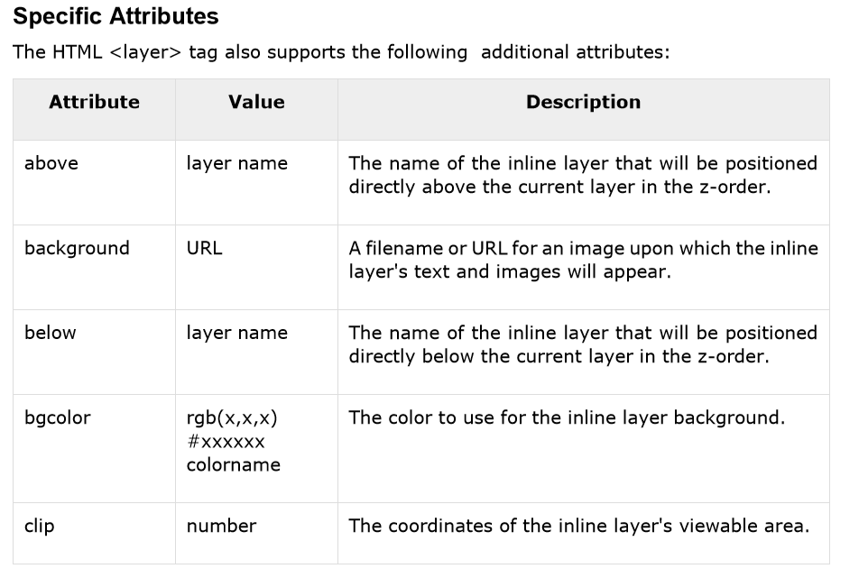
The HTML <layer> tag also supports the following additional attributes:

Slide 99
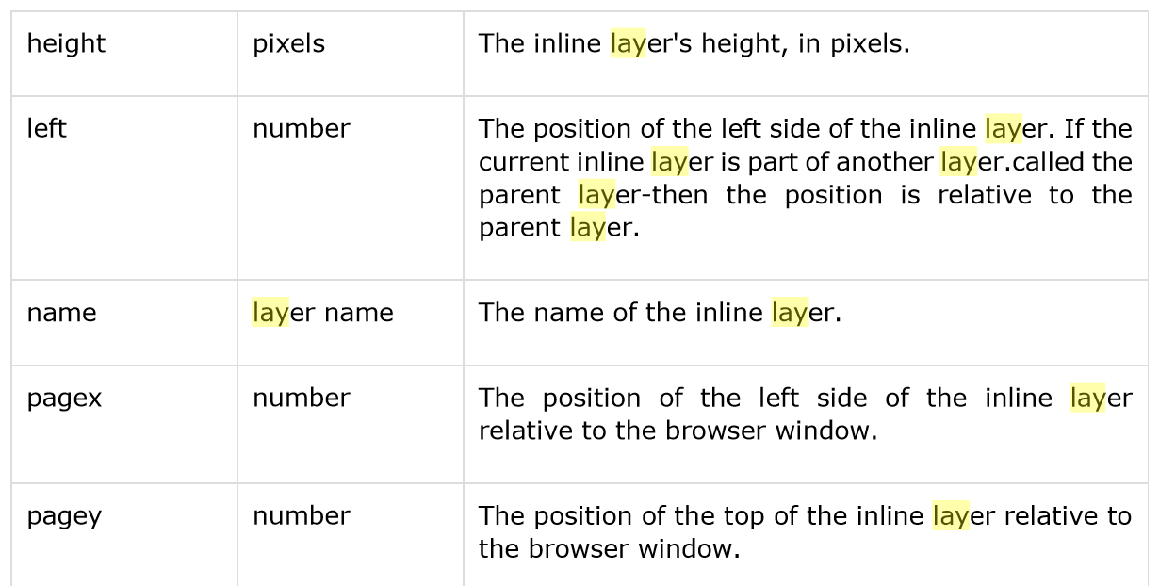

Slide 100
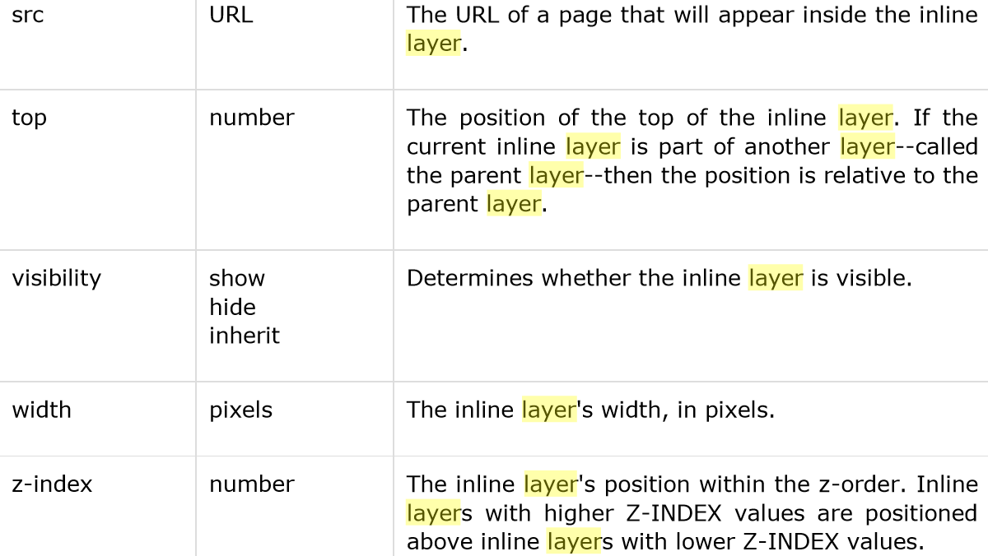

Slide 101
Audio & video Support with Web Page
HTML5 features, include native audio and video support without the need for Flash.
The HTML5 <audio> and <video> tags make it simple to add media to a website. You need to set src attribute to identify the media source and include a controls attribute so the user can play and pause the media.

Slide 102
Embedding Video
<video src="foo.mp4" width="300" height="200" controls> Your browser does not support the <video> element. </video>
The current HTML5 draft specification does not specify which video formats browsers should support in the video tag. But most commonly used video formats are −
Ogg − Ogg files with Thedora video codec and Vorbis audio codec.
mpeg4 − MPEG4 files with H.264 video codec and AAC audio codec.

Slide 103
You can use <source> tag to specify media along with media type and many other attributes. A video element allows multiple source elements and browser will use the first recognized format −

Slide 104
<!DOCTYPE HTML>
<html>
<body>
<video width="300" height="200" controls autoplay>
<source src="/html5/foo.ogg" type="video/ogg" /> <source src="/html5/foo.mp4" type="video/mp4" /> Your browser does not support the video element. </video>
</body>
</html>

Slide 105
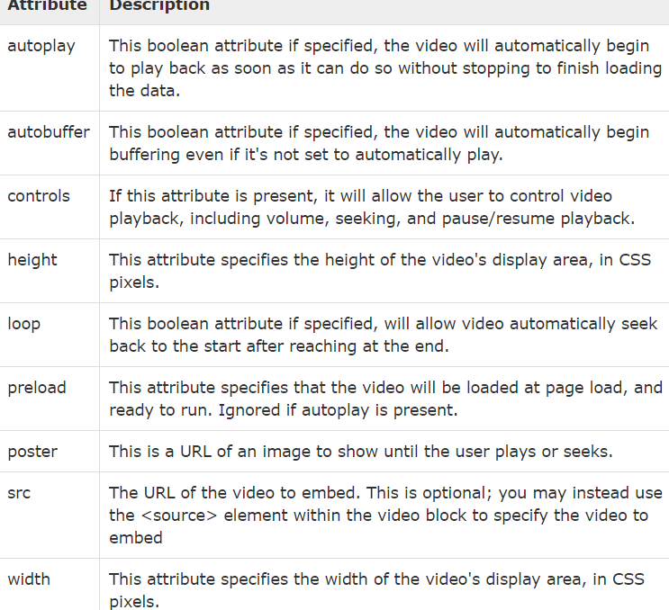
Video Attribute Specification

Slide 106
Embedding Audio
HTML5 supports <audio> tag which is used to embed sound content in an HTML or XHTML document as follows.
<audio src="foo.wav" controls autoplay>
Your browser does not support the <audio> element. </audio>

Slide 107
The current HTML5 draft specification does not specify which audio formats browsers should support in the audio tag. But most commonly used audio formats are ogg, mp3 and wav.

Slide 108
You can use <source> tag to specify media along with media type and many other attributes. An audio element allows multiple source elements and browser will use the first recognized format −

Slide 109
<!DOCTYPE HTML>
<html>
<body>
<audio controls autoplay>
<source src="/html5/audio.ogg" type="audio/ogg" />
<source src="/html5/audio.wav" type="audio/wav" />
Your browser does not support the audio element.
</audio>
</body>
</html>

Slide 110
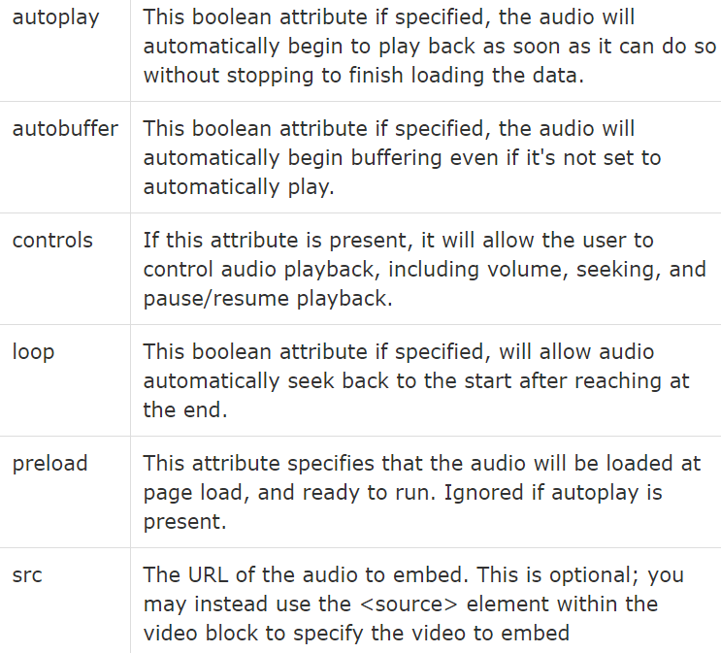
Audio Attribute Specification

Slide 111
HTML – FORMS
HTML Forms are required, when you want to collect some data from the site visitor. For example, during user registration you would like to collect information such as name, email address, credit card, etc.
A form will take input from the site visitor and then will post it to a back-end application such as CGI, ASP Script or PHP script etc. The back-end application will perform required processing on the passed data based on defined business logic inside the application.
There are various form elements available like text fields, textarea fields, drop-down menus, radio buttons, checkboxes, etc.
The HTML <form> tag is used to create an HTML form and it has following syntax:
<form action="Script URL" method="GET|POST">
form elements like input, textarea etc.
</form>

Slide 112
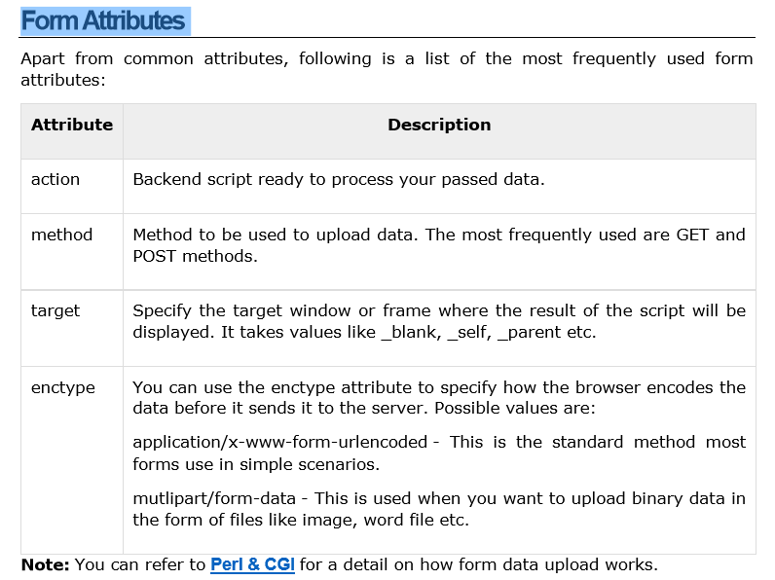
Form Attributes

Slide 113
HTML Form Controls
Text Input Controls
• Checkboxes Controls
• Radio Box Controls
• Select Box Controls
• File Select boxes •
Hidden Controls
• Clickable Buttons
• Submit and Reset Button

Slide 114
Text Input Controls
There are three types of text input used on forms:
Single-line text input controls - This control is used for items that require only one line of user input, such as search boxes or names. They are created using HTML <input> tag.
• Password input controls - This is also a single-line text input but it masks the character as soon as a user enters it. They are also created using HTMl <input> tag.
• Multi-line text input controls - This is used when the user is required to give details that may be longer than a single sentence. Multi-line input controls are created using HTML <textarea> tag.

Slide 115
Single-line text input controls
This control is used for items that require only one line of user input, such as search boxes or names. They are created using HTML <input> tag.
First name:
<input type="text" name="first_name" />

Slide 116
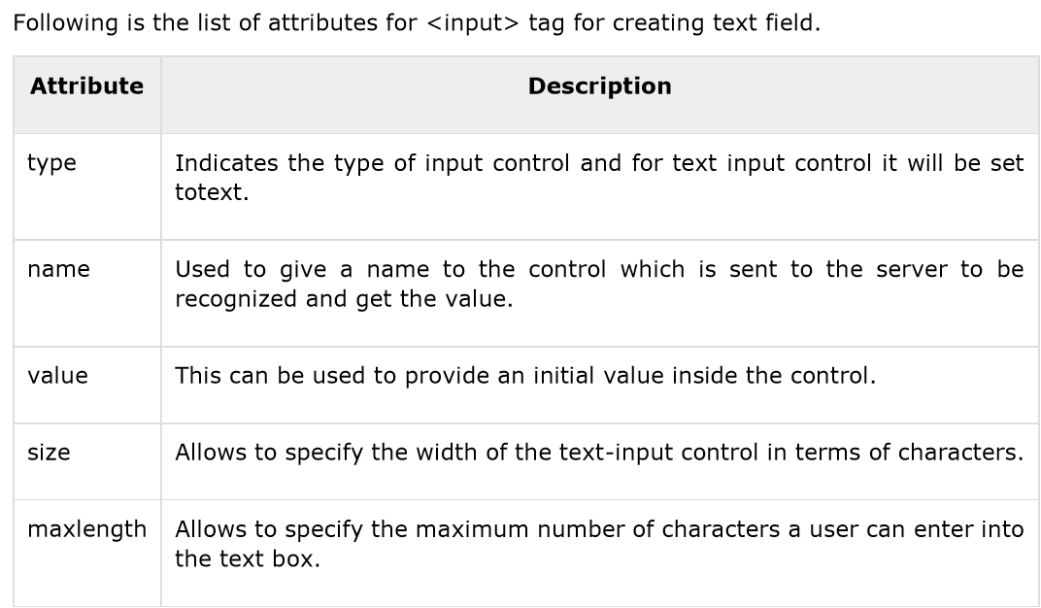
Attributes

Slide 117
Password Input controls
This is also a single-line text input but it masks the character as soon as a user enters it. They are also created using HTML <input> tag but type attribute is set to password.
<form >
User ID : <input type="text" name="user_id" />
<br>
Password: <input type="password" name="password" />
</form>

Slide 118
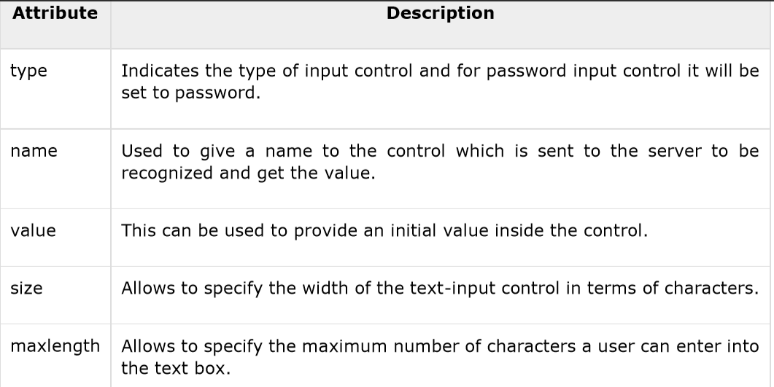
Attributes

Slide 119
Multiple-Line Text Input Controls
This is used when the user is required to give details that may be longer than a single sentence. Multi-line input controls are created using HTML <textarea> tag.
<form>
Description: <br />
<textarea rows="5" cols="50" name="description">
Enter description here...
</textarea>
</form>

Slide 120
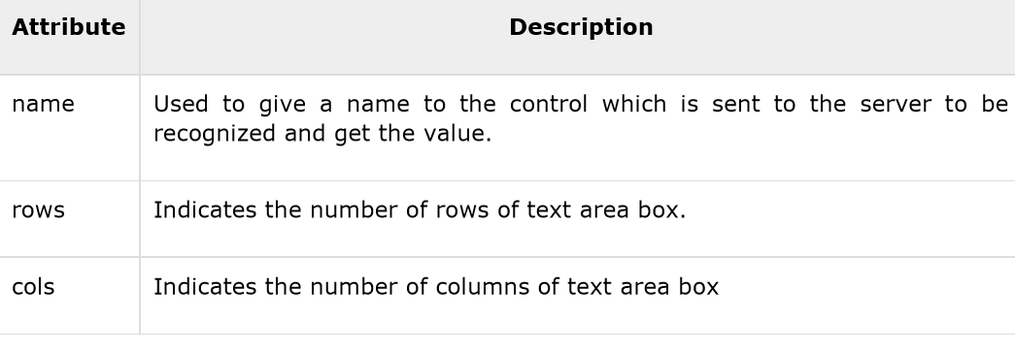
Attributes
Following is the list of attributes for <textarea> tag.

Slide 121
Checkbox Control
Checkboxes are used when more than one option is required to be selected. They are also created using HTML <input> tag but type attribute is set to checkbox.
<form>
<input type="checkbox" name="maths" value="on"> Maths
<input type="checkbox" name="physics" value="on"> Physics
</form>

Slide 122
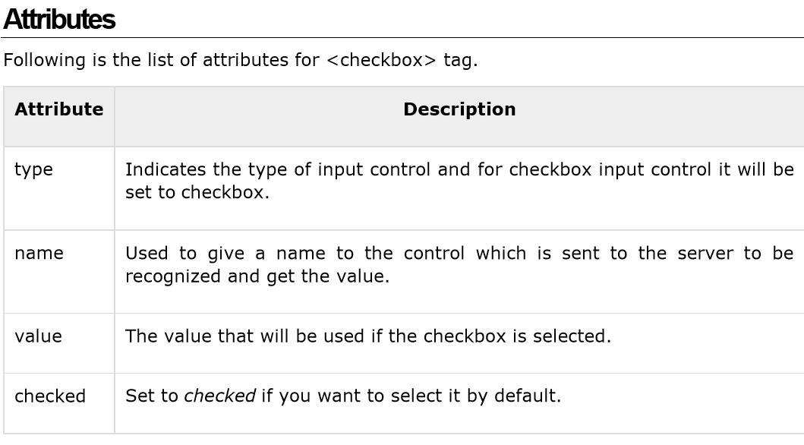

Slide 123
Radio Button Control
Radio buttons are used when out of many options, just one option is required to be selected. They are also created using HTML <input> tag but type attribute is set to radio.
<form>
<input type="radio" name="subject" value="maths"> Maths
<input type="radio" name="subject" value="physics"> Physics
</form>

Slide 124
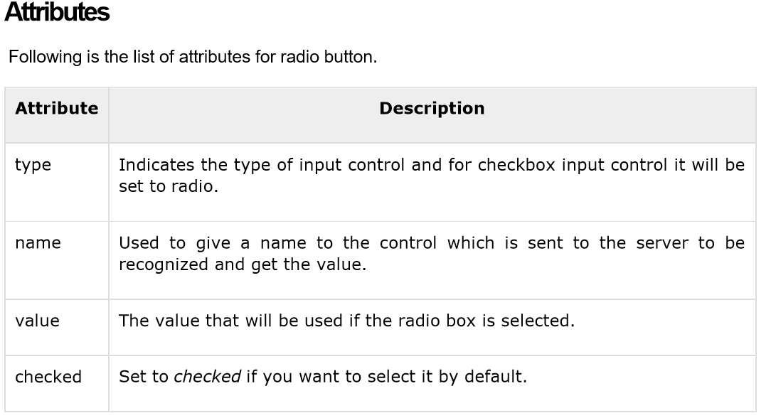

Slide 125
Select Box Control
A select box, also called drop down box which provides option to list down various options in the form of drop down list, from where a user can select one or more options.

Slide 126
<form>
<select name="dropdown">
<option value="Maths" selected>Maths</option>
<option value="Physics">Physics</option>
</select>
</form>

Slide 127
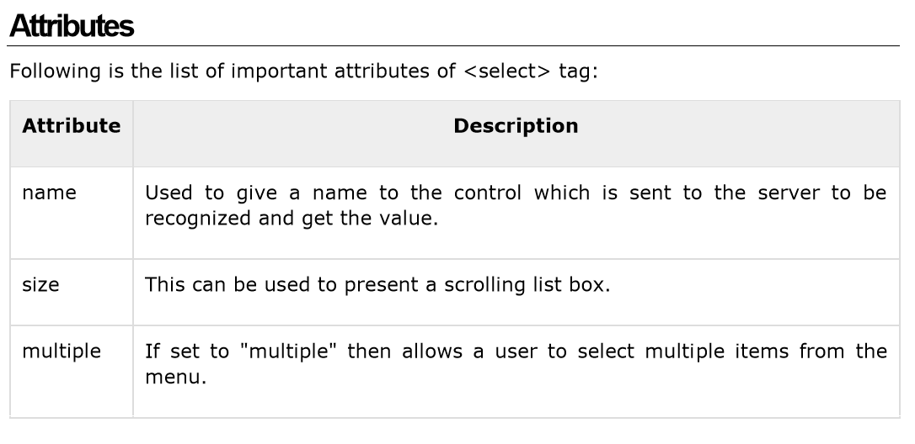

Slide 128
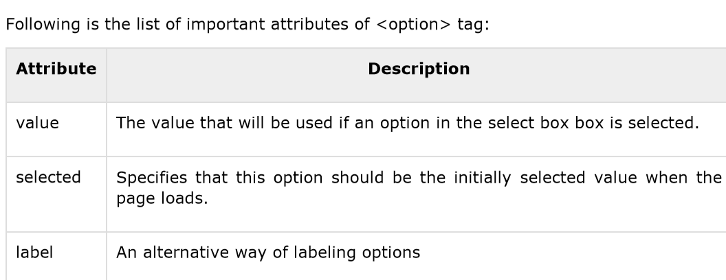

Slide 129
File Upload Box
If you want to allow a user to upload a file to your web site, you will need to use a file upload box, also known as a file select box. This is also created using the <input> element but type attribute is set to file.

Slide 130
<!DOCTYPE html>
<html>
<head>
<title>File Upload Box</title>
</head>
<body>
<form>
<input type="file" name="fileupload" accept="image/*" />
</form>
</body>
</html>

Slide 131
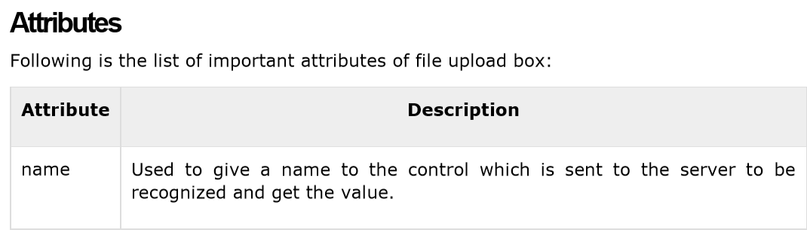
Accept Specifies the types of files that the server accepts

Slide 132
Button Controls
There are various ways in HTML to create clickable buttons. You can also create a clickable button using <input> tag by setting its type attribute to button. The type attribute can take the following values:

Slide 133
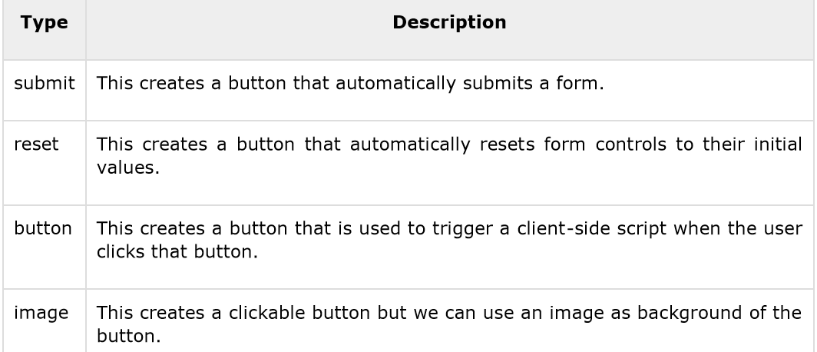

Slide 134
<form>
<input type="submit" name="submit" value="Submit" />
<input type="reset" name="reset" value="Reset" />
<input type="button" name="ok" value="OK" />
<input type="image" name="imagebutton" src="/html/images/logo.png" />
</form>

Slide 135
Hidden Form Controls
Hidden form controls are used to hide data inside the page which later on can be pushed to the server. This control hides inside the code and does not appear on the actual page. For example, following hidden form is being used to keep current page number. When a user will click next page then the value of hidden control will be sent to the web server and there it will decide which page will be displayed next based on the passed current page.

Slide 136
<!DOCTYPE html>
<html>
<head>
<title>File Upload Box</title>
</head>
<body>
<form>
<p>This is page 10</p>
<input type="hidden" name="pagename" value="10" />
<input type="submit" name="submit" value="Submit" />
<input type="reset" name="reset" value="Reset" />
</form>
</body>
</html>

Slide 137
CSS
Cascading Style Sheets (CSS) describe how documents are presented on screens, in print, or perhaps how they are pronounced. W3C has actively promoted the use of style sheets on the Web since the consortium was founded in 1994.
Cascading Style Sheets (CSS) provide easy and effective alternatives to specify various attributes for the HTML tags. Using CSS, you can specify a number of style properties for a given HTML element. Each property has a name and a value, separated by a colon (:). Each property declaration is separated by a semi-colon (;).

Slide 138
Example First let's consider an example of HTML document which makes use of <font> tag and associated attributes to specify text color and font size:
<html>
<head>
<title>HTML CSS</title>
</head>
<body>
<p><font color="green" size="5">Hello, World!</font></p>
</body>
</html>

Slide 139
We can re-write above example with the help of Style Sheet as follows:
<!DOCTYPE html>
<html>
<head>
<title>HTML CSS</title>
</head>
<body>
<p style="color:green;font-size:24px;">Hello, World!</p>
</body>
</html>

Slide 140
You can use CSS in three ways in your HTML document:
External Style Sheet: Define style sheet rules in a separate .css file and then include that file in your HTML document using HTML <link> tag.
Internal Style Sheet: Define style sheet rules in header section of the HTML document using <style> tag.
Inline Style Sheet: Define style sheet rules directly along-with the HTML elements using style attribute.

Slide 141
External Style Sheet
If you need to use your style sheet to various pages, then its always recommended to define a common style sheet in a separate file. A cascading style sheet file will have extension as .css and it will be included in HTML files using <link> tag.
Example
Consider we define a style sheet file style.css which has following rules:

Slide 142
Style.css
.red
{
color: red;
}
.thick
{
font-size:20px;
}
.green
{
color:green;
}

Slide 143
Here we defined three CSS rules which will be applicable to three different classes defined for the HTML tags. I suggest you should not bother about how these rules are being defined because you will learn them while studying CSS. Now let's make use of the above external CSS file in our following HTML document:

Slide 144
<!DOCTYPE html>
<htm<!DOCTYPE html>
<html>
<head>
<title>HTML External CSS</title>
<link rel="stylesheet" type="text/css" href="/html/style.css">
</head>
<body>
<p class="red">This is red</p> l>
<head>
<title>HTML External CSS</title>
<link rel="stylesheet" type="text/css" href="/html/style.css">
</head>
<body>
<p class="red">This is red</p>
continuee…..

Slide 145
<p class="thick">This is thick</p>
<p class="green">This is green</p>
<p class="thick green">This is thick and green</p>
</body>
</html>

Slide 146
Internal Style Sheet
If you want to apply Style Sheet rules to a single document only, then you can include those rules in header section of the HTML document using <style> tag.
Example Let's re-write above example once again, but here we will write style sheet rules in the same HTML document using <style> tag:

Slide 147
<!DOCTYPE html>
<html>
<head>
<title>HTML Internal CSS</title>
<style type="text/css">
.red{
color: red;
}
.thick{
font-size:20px;
}
.green{

Slide 148
color: green;
}
</style>
</head>
<body>
<p class="red">This is red</p>
<p class="thick">This is thick</p>
<p class="green">This is green</p>
<p class="thick green">This is thick and green</p>
</body>
</html>

Slide 149
Inline Style Sheet
You can apply style sheet rules directly to any HTML element using style attribute of the relevant tag. This should be done only when you are interested to make a particular change in any HTML element only.
Rules defined inline with the element overrides the rules defined in an external CSS file as well as the rules defined in <style> element.

Slide 150
Example Let's re-write above example once again, but here we will write style sheet rules along with the HTML elements using style attribute of those elements.

Slide 151
<!DOCTYPE html>
<html>
<head>
<title>HTML Inline CSS</title>
</head>
<body>
<p style="color:red;">This is red</p>
<p style="font-size:20px;">This is thick</p>
<p style="color:green;">This is green</p>
<p style="color:green;font-size:20px;">This is thick and green</p>
</body>
</html>

Slide 152
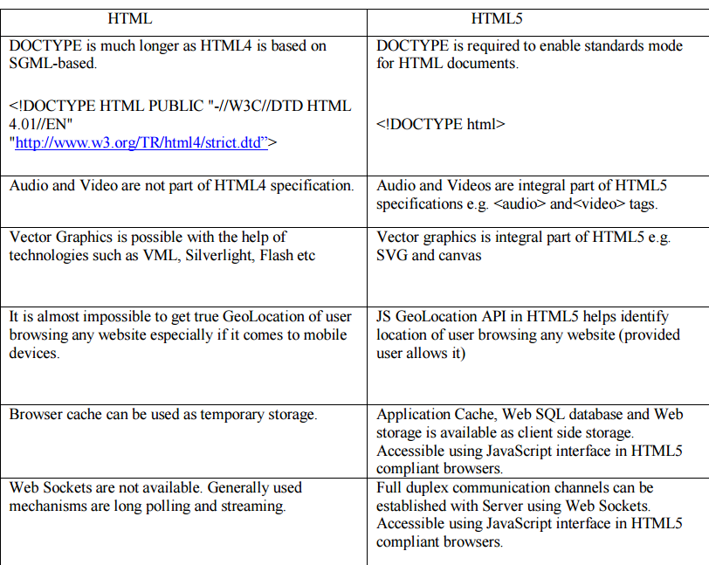

Slide 153
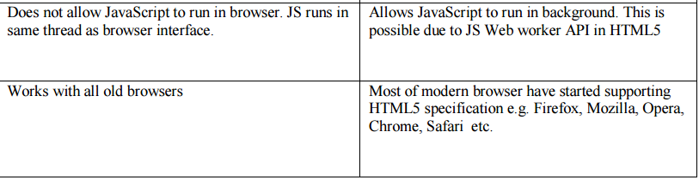

Slide 154
Applying Style
body { background-color: powderblue; } h1 { color: blue; } p { color: red; }

Slide 155
CSS Fonts
The CSS color property defines the text color to be used.
The CSS font-family property defines the font to be used.
The CSS font-size property defines the text size to be used.

Slide 156
<!DOCTYPE html> <html> <head> <style> h1 { color: blue; font-family: verdana; font-size: 300%; } p { color: red; font-family: courier; font-size: 160%; } </style> </head> <body> <h1>This is a heading</h1> <p>This is a paragraph.</p> </body> </html>

Slide 157
CSS Border
The CSS border property defines a border around an HTML element:
p { border: 1px solid powderblue; }

Slide 158
CSS Padding
The CSS padding property defines a padding (space) between the text and the border:
p { border: 1px solid powderblue; padding: 30px; }

Slide 159
CSS Margin
The CSS margin property defines a margin (space) outside the border:
p { border: 1px solid powderblue; margin: 50px; }

Slide 160
The id Attribute
To define a specific style for one special element, add an id attribute to the element:
<p id="p01">I am different</p>
then define a style for the element with the specific id:
#p01 { color: blue; }

Slide 161
The class Attribute
To define a style for a special type of elements, add a class attribute to the element:
<p class="error">I am different</p>
then define a style for the elements with the specific class:
p.error { color: red; }

Slide 162
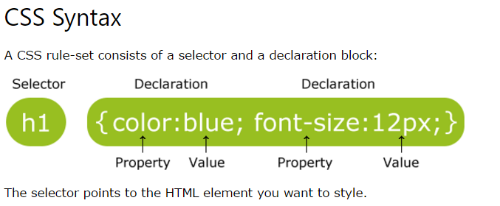
CSS Selectors
In CSS, selectors are patterns used to select the element(s) you want to style.

Slide 163
The element Selector
The element Selector
The element selector selects elements based on the element name.
You can select all <p> elements on a page like this (in this case, all <p> elements will be center-aligned, with a red text color):
p { text-align: center; color: red; }

Slide 164
The id Selector
The id selector uses the id attribute of an HTML element to select a specific element.
The id of an element should be unique within a page, so the id selector is used to select one unique element!
To select an element with a specific id, write a hash (#) character, followed by the id of the element.
The style rule below will be applied to the HTML element with id="para1":

Slide 165
#para1 { text-align: center; color: red; }

Slide 166
class Selector
The class Selector
The class selector selects elements with a specific class attribute.
To select elements with a specific class, write a period (.) character, followed by the name of the class.
In the example below, all HTML elements with class="center" will be red and center-aligned:

Slide 167
.center { text-align: center; color: red; }

Slide 168
You can also specify that only specific HTML elements should be affected by a class.
In the example below, only <p> elements with class="center" will be center-aligned:
p.center { text-align: center; color: red; }

Slide 169
HTML elements can also refer to more than one class.
In the example below, the <p> element will be styled according to class="center" and to class="large":
<p class="center large">This paragraph refers to two classes.</p>

Slide 170
Grouping Selectors
If you have elements with the same style definitions, like this:
h1 { text-align: center; color: red; } h2 { text-align: center; color: red; } p { text-align: center; color: red; }

Slide 171
It will be better to group the selectors, to minimize the code.
To group selectors, separate each selector with a comma.
In the example below we have grouped the selectors from the code above:
h1, h2, p { text-align: center; color: red; }

Slide 172
CSS Comments
p { color: red; /* This is a single-line comment */ text-align: center; }

Slide 173
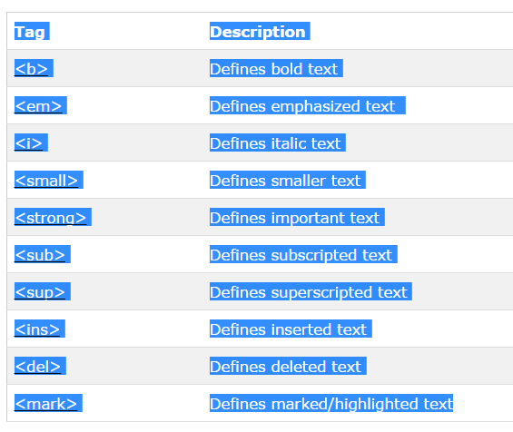
HTML Text Formatting Elements

Slide 174
CSS Layout - The position Property
The position property specifies the type of positioning method used for an element (static, relative, fixed or absolute).
The position Property
The position property specifies the type of positioning method used for an element.

Slide 175
There are four different position values:
static
relative
fixed
Absolute
Elements are then positioned using the top, bottom, left, and right properties. However, these properties will not work unless property is set first. They also work differently depending on the position value.

Slide 176
position: static;
HTML elements are positioned static by default.
Static positioned elements are not affected by the top, bottom, left, and right properties.
An element with position: static; is not positioned in any special way; it is always positioned according to the normal flow of the page:

Slide 177
This <div> element has position: static;
Here is the CSS that is used:
Example
div.static { position: static; border: 3px solid #73AD21; }

Slide 178
position: relative;
An element with position: relative; is positioned relative to its normal position.
Setting the top, right, bottom, and left properties of a relatively-positioned element will cause it to be adjusted away from its normal position. Other content will not be adjusted to fit into any gap left by the element.

Slide 179
This <div> element has position: relative;
Here is the CSS that is used:
div.relative { position: relative; left: 30px; border: 3px solid #73AD21; }

Slide 180
position: fixed;
An element with position: fixed; is positioned relative to the viewport, which means it always stays in the same place even if the page is scrolled. The top, right, bottom, and left properties are used to position the element.
A fixed element does not leave a gap in the page where it would normally have been located.
Notice the fixed element in the lower-right corner of the page. Here is the CSS that is used:

Slide 181
div.fixed { position: fixed; bottom: 0; right: 0; width: 300px; border: 3px solid #73AD21; }

Slide 182
position: absolute;
An element with position: absolute; is positioned relative to the nearest positioned ancestor (instead of positioned relative to the viewport, like fixed).
However; if an absolute positioned element has no positioned ancestors, it uses the document body, and moves along with page scrolling.

Slide 183
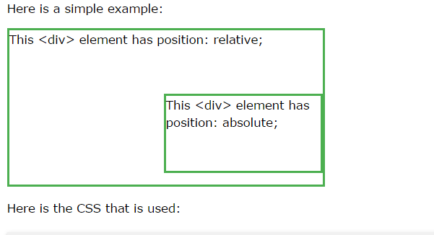

Slide 184
div.relative { position: relative; width: 400px; height: 200px; border: 3px solid #73AD21; } div.absolute { position: absolute; top: 80px; right: 0; width: 200px; height: 100px; border: 3px solid #73AD21; }

