Slide 1
IIM MUMBAI · CAPSTONE PROJECT · GROUP 6
End-to-End Algorithmic
Trading System
with Backtesting & Risk Control
“Can a rule-based trading strategy generate consistent
returns after accounting for risk?”
Faculty Advisor: Prof. Rakesh Verma AlgoLab — a backtesting workbench for NSE equities

Slide 2
CONTENTS
What we'll walk through — start to finish
No prior knowledge is assumed. We begin with the absolute basics and build up, one idea at a time.
01
02
03
The basics & the problem
The key ideas
The four strategies
What a share is, what we're really asking, and why it's hard
Strategies, backtesting, and the app we built to test them
Each trading rule, in plain words, and why we chose it
04
05
06
Risk, costs & scoring
The app in action
Findings & close
How we limit losses, count real costs, and grade results
Running tests, comparing rules, and understanding each trade
What we found, what we learned, and our honest answer
AlgoLab · End-to-End Algorithmic Trading System · IIM Mumbai Capstone · Group 6
02

Slide 3
01 · THE BASICS
First, the absolute basics
▸ A share is a tiny piece of ownership in a company. If a company were a giant pizza, one share would be a single slice — own it, and you own that slice of the business.
▸ Shares are bought and sold all day on a stock exchange. In India, the largest one is the NSE (National Stock Exchange). “Trading” simply means buying and selling these shares.
▸ A share’s price moves all the time because it reflects what thousands of buyers and sellers think the company is worth right now. More buyers push the price up; more sellers push it down.
▸ A trader tries to buy a share when its price is low and sell it later when the price is higher, keeping the difference as profit. If the price falls instead, that difference becomes a loss.
THE WHOLE GAME IN ONE LINE
Buy low, sell higher — and do it often enough, and safely enough, that the small profits stack up into a real, reliable gain over time.
The catch
Nobody knows the future. So the real question is not “what will go up?” but “is there a sensible, repeatable way to decide when to buy and sell that comes out ahead over many trades?”
AlgoLab · End-to-End Algorithmic Trading System · IIM Mumbai Capstone · Group 6
03

Slide 4
01 · THE BASICS
What does “rule-based” or “algorithmic” trading mean?
IN PLAIN ENGLISH
Algorithmic trading means deciding when to buy and sell using a fixed set of rules written as a computer program — instead of relying on gut feeling, tips, or emotion.
▸ A human trader is emotional — they panic and sell when prices fall, and turn greedy when prices rise. A program follows the very same rule every single time, with no fear and no hope.
▸ Because the rules are written as code, we can replay them over many years of real past prices and measure, exactly, how well they would have done.
▸ A rule can be as simple as: “buy when the price has been climbing steadily, and sell when it starts to slip.” Clear, mechanical, and repeatable by anyone.
▸ This project builds four such rule-sets and, most importantly, checks whether they truly make money once real-world costs and risks are taken into account.
A SIMPLE ANALOGY
It’s like a cooking recipe: anyone — or any computer — who follows the exact same steps gets the exact same dish. No improvising, no mood swings, no “I had a feeling about this one.”
AlgoLab · End-to-End Algorithmic Trading System · IIM Mumbai Capstone · Group 6
04

Slide 5
01 · THE BASICS
Our problem statement & the one question we answer
THE QUESTION THIS PROJECT SETS OUT TO ANSWER
▸ In plain words: if we trade strictly by rules, will we reliably end up with more money than we started — without taking dangerous gambles to get there?
▸ “Consistent” is the key word. Anyone can get lucky once. We want results that hold up across hundreds of trades, many different stocks, and good and bad markets alike.
▸ “After accounting for risk” means we refuse to celebrate a big profit if it was earned by nearly wiping out the account along the way.
“Can a rule-based trading strategy generate consistent returns after accounting for risk?”
Why this question is genuinely hard
▸ Markets are noisy: a rule can look brilliant on one stock or one year, then fail badly on the next.
▸ Costs bite: brokerage and taxes quietly eat away an edge that looked great “on paper”.
▸ Risk is not the same as return: a high profit earned through stomach-churning crashes is not something anyone could actually live with.
▸ Backtests can deceive: small mistakes can make a losing idea look like a winner — so honest testing is most of the real work.
AlgoLab · End-to-End Algorithmic Trading System · IIM Mumbai Capstone · Group 6
05

Slide 6
02 · THE KEY IDEAS
Two ideas you need: a “strategy” and a “backtest”
① A strategy = the rulebook
② A backtest = a test-drive through history
A strategy is the exact, written set of conditions that decide when to buy and when to sell — with no exceptions and no guessing. If the condition is true, it acts; if not, it waits. That is the whole of it.
A backtest takes a strategy and replays it across years of real past prices, pretending we were trading back then. It lets us see exactly how the rules would have performed — without risking a single rupee.
THE ANALOGY THAT MAKES IT CLICK
⚠ A backtest can fool you
A backtest is a flight simulator for trading. Pilots rehearse emergencies safely on the ground before ever flying a real plane. We test trading rules safely on past data before risking real money.
If you accidentally let the rules “peek” at future prices, or forget to subtract trading costs, a losing idea can look like a winner. Avoiding these traps is the hard part.
Our project, in one sentence: we wrote four strategies, backtested each one honestly on real Indian stocks, and measured whether any of them truly comes out ahead.
AlgoLab · End-to-End Algorithmic Trading System · IIM Mumbai Capstone · Group 6
06

Slide 7
02 · THE KEY IDEAS
Our solution — AlgoLab, in plain words
WHAT ALGOLAB IS
AlgoLab is the desktop app we built. You pick an Indian stock, choose a strategy, and AlgoLab shows you exactly how that strategy would have performed on that stock in the past — with realistic costs already deducted.
WHAT YOU DO — FOUR SIMPLE STEPS
1
2
3
4
→
→
→
Pick a stock
Choose a strategy
Click “Run”
Read the results
Log in securely and choose any NSE company — say Reliance or HDFC Bank.
Select one of the four trading rules and the time period to test.
AlgoLab replays history day by day and trades strictly by the rules.
See the profit or loss, a chart of every trade, and clear risk scores.
Important — this is a learning & research tool only: AlgoLab never places a real order. There is deliberately no “buy” button wired to anyone’s money. It exists to study and explain strategies safely.
AlgoLab · End-to-End Algorithmic Trading System · IIM Mumbai Capstone · Group 6
07

Slide 8
02 · THE KEY IDEAS
How a backtest actually runs, step by step
Here is everything that happens between your click and the result — explained without jargon.
Get the real data
AlgoLab securely logs in to Upstox (a stockbroker) and downloads the genuine past price history of the stock you picked — real numbers, not made-up ones.
1
Move through time, one day at a time
Starting from the first day, the program looks only at prices up to “today” in the replay — never tomorrow’s — so it can never cheat by peeking ahead.
2
Check the rules each day
Every day it asks: “do my buy or sell conditions hold right now?” It buys, sells, or simply waits — only ever acting when a rule says so.
3
Trade realistically
When it buys or sells, it pays the real brokerage and taxes, and it limits how much money it puts at risk on each single trade.
4
Keep score
It records every trade and tracks the account’s value day by day, then hands you a full report: profit, a trade chart, and risk scores.
5
AlgoLab · End-to-End Algorithmic Trading System · IIM Mumbai Capstone · Group 6
08

Slide 9
03 · THE FOUR STRATEGIES
Before we begin: what is an “indicator”?
IN PLAIN ENGLISH
An indicator is a number worked out from past prices that summarises what the price has been doing. It turns a messy, jagged price chart into one clean, easy-to-read signal.
▸ Example: the “average price over the last 50 days” smooths out daily jitter, so you can clearly see the underlying trend instead of the noise.
▸ Each of our four strategies watches one or two such indicators and follows a simple rule like “buy when this indicator does X, sell when it does Y”.
▸ You don’t need any maths to follow along — each upcoming slide shows a picture of when the rule buys (green) and sells (red).
One fair fight
All four strategies share the exact same safety system and cost calculator inside AlgoLab. So when we compare them, any difference in results comes from the trading idea alone — a clean, like-for-like test.
How to read the next four slides: each one gives you the idea in one line, a picture of its buy/sell signals, the rule in plain words, and why we included it.
AlgoLab · End-to-End Algorithmic Trading System · IIM Mumbai Capstone · Group 6
09

Slide 10
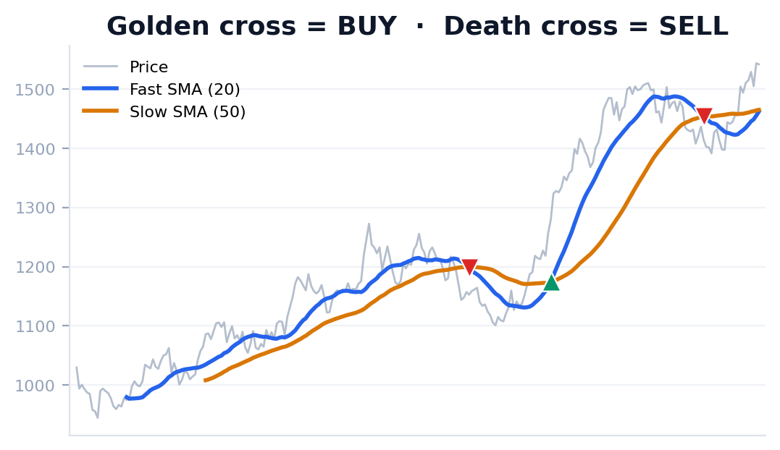
03 · STRATEGY 1 OF 4
SMA Crossover
TREND-FOLLOWING · IT RIDES THE TREND
THE IDEA IN PLAIN WORDS
This rule follows the trend. It assumes that once a price starts moving up, it tends to keep going up for a while — so it climbs aboard and rides the move. It watches a fast (20-day) and a slow (50-day) average price.
When it buys and sells
BUY the fast 20-day average rises above the slow 50-day average — a sign the trend has turned upward (traders call this a “golden cross”).
SELL the fast average drops back below the slow one (a “death cross”), suggesting the up-move is over.
Default settings: fast = 20 days, slow = 50 days
Illustrative picture on example data — green = buy, red = sell
Why we included it
It is the simplest, most famous trend-following rule, which makes it the perfect baseline to measure everything else against. It is easy to explain to anyone, and it directly tests our core question: does simply following the trend pay off after costs?
AlgoLab · End-to-End Algorithmic Trading System · IIM Mumbai Capstone · Group 6
10

Slide 11
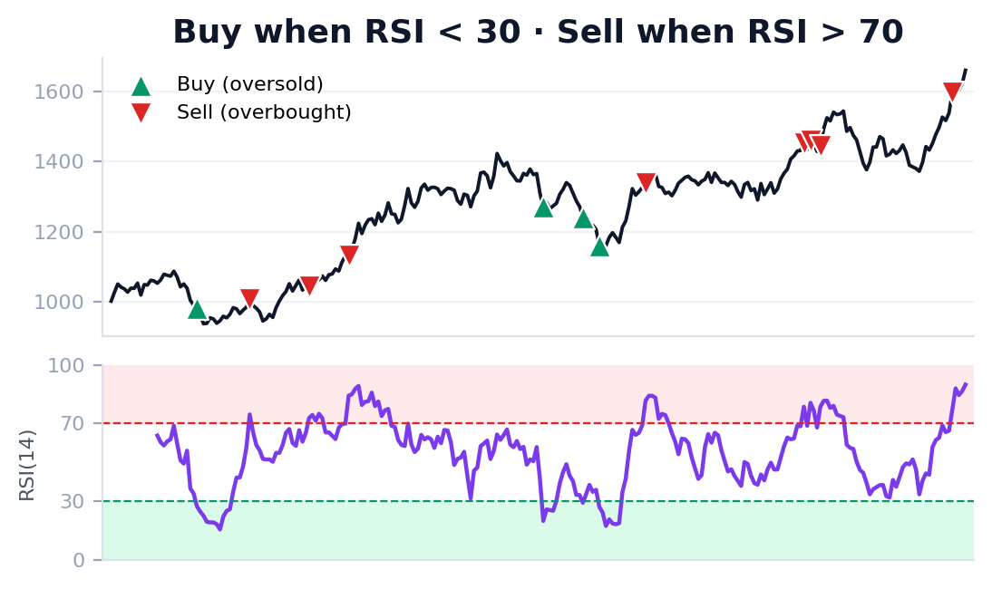
03 · STRATEGY 2 OF 4
RSI Mean Reversion
MEAN REVERSION · IT BETS ON A BOUNCE-BACK
THE IDEA IN PLAIN WORDS
This rule does the opposite of trend-following. It assumes that when a price has fallen too far, too fast, it tends to bounce back — so it buys the dip. It uses the RSI, a 0–100 score of how hard a stock has recently been bought or sold.
When it buys and sells
BUY the RSI falls below 30 (“oversold”) — the stock has been sold off hard and may be due for a rebound.
SELL the RSI climbs above 70 (“overbought”) — the bounce has played out, so it takes the gain.
Default settings: RSI length = 14, oversold = 30, overbought = 70
Illustrative picture on example data — green = buy, red = sell
Why we included it
We deliberately wanted a strategy that bets the opposite way to the trend-followers, to see which view the data supports. It also tends to win often with small gains — a very different pattern that stress-tests our question from another angle.
AlgoLab · End-to-End Algorithmic Trading System · IIM Mumbai Capstone · Group 6
11

Slide 12
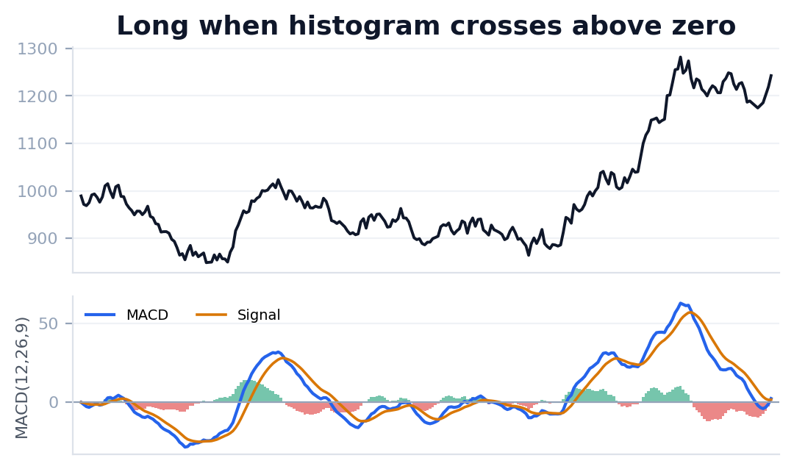
03 · STRATEGY 3 OF 4
MACD Trend
MOMENTUM · TREND-FOLLOWING WITH A FILTER
THE IDEA IN PLAIN WORDS
Like SMA, this follows momentum — but adds an extra confirmation step designed to avoid being fooled by brief, false moves. MACD tracks the gap between a fast and a slow average; when that gap widens upward, momentum is building.
When it buys and sells
BUY the MACD “histogram” crosses above zero — short-term momentum has just overtaken the longer-term trend, often the start of an up-move.
SELL the histogram crosses back below zero, meaning that momentum has faded away.
Default settings: fast = 12, slow = 26, signal = 9
Illustrative picture on example data — green = buy, red = sell
Why we included it
It is a more refined cousin of the simple moving-average cross and is widely used by professional traders. Including it lets us test whether that extra layer of confirmation actually produces steadier results than the basic version.
AlgoLab · End-to-End Algorithmic Trading System · IIM Mumbai Capstone · Group 6
12

Slide 13
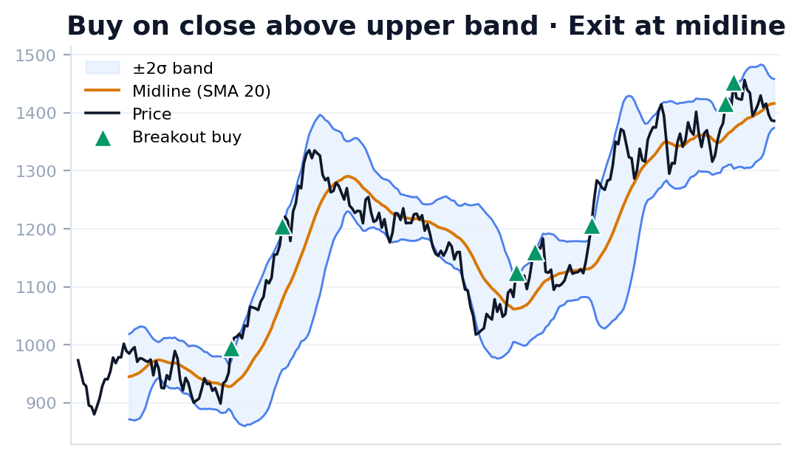
03 · STRATEGY 4 OF 4
Bollinger Breakout
VOLATILITY · IT RIDES A BREAKOUT
THE IDEA IN PLAIN WORDS
This rule reacts to volatility — how wildly a price is swinging. It draws a “normal range” around the price and bets that when the price escapes that range, a strong new move has begun. The bands sit above and below the 20-day average.
When it buys and sells
BUY the price closes above the upper band — it has broken out of its normal range, often the start of a powerful run.
SELL the price falls back to the middle line (the average), signalling the breakout has fizzled out.
Default settings: length = 20 days, width = 2 standard deviations
Illustrative picture on example data — green = buy, red = sell
Why we included it
It completes our set with a volatility-based idea. Tellingly, it looks at the same extreme as RSI but bets the opposite way: RSI says “it’s stretched, it’ll snap back”, while Bollinger says “it’s broken out, it’ll keep going”. We let the data settle the argument.
AlgoLab · End-to-End Algorithmic Trading System · IIM Mumbai Capstone · Group 6
13

Slide 14
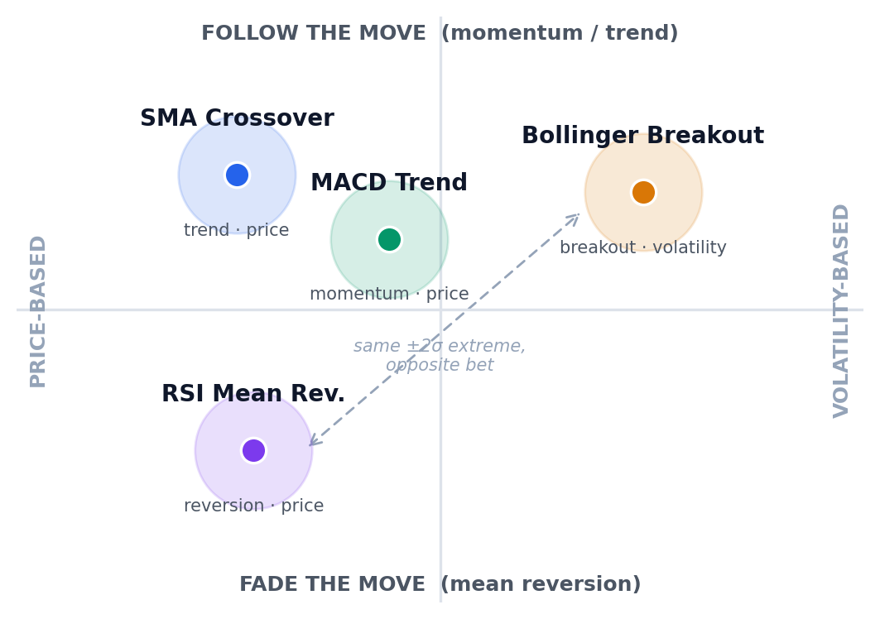
03 · THE FOUR STRATEGIES
Why these four? Deliberate variety, not a gamble
▸ Together they cover the four main families of trading ideas: following a trend (SMA), confirming momentum (MACD), betting on a bounce-back (RSI), and riding a volatility breakout (Bollinger).
▸ They don’t just differ — two of them openly disagree. At the same price extreme, RSI bets the move reverses while Bollinger bets it continues. Rather than guess who is right, we let the backtest decide.
▸ They also trade very differently — some often, some rarely; some with many small wins, some with a few big ones — which is exactly the variety we need to test our question honestly.
In short: we chose breadth over betting — four different lenses on “what works”, not four versions of one idea.
AlgoLab · End-to-End Algorithmic Trading System · IIM Mumbai Capstone · Group 6
14

Slide 15
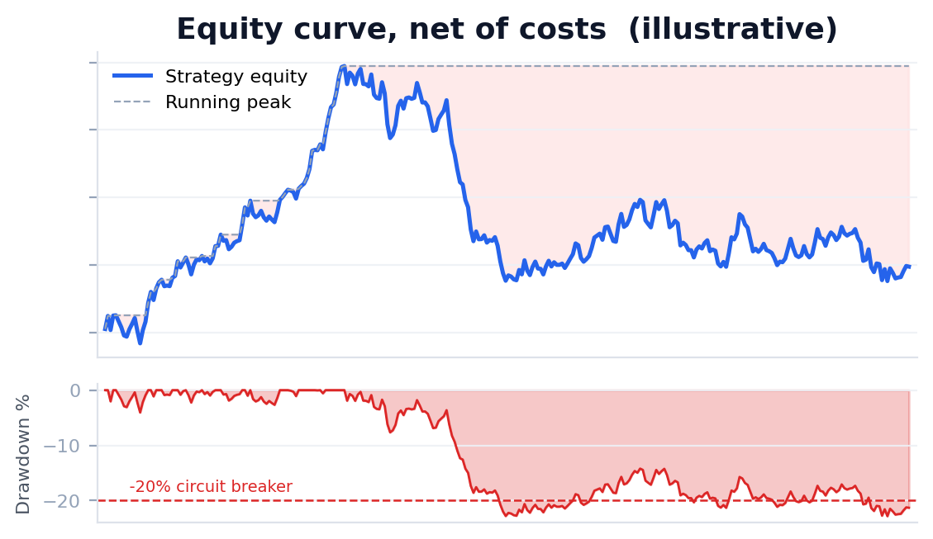
04 · RISK, COSTS & SCORING
Managing risk — how we stop losses getting out of hand
THE GOLDEN PRINCIPLE
Not losing badly matters more than winning big. Three safety rules are built into every strategy so that a few bad trades can never wipe out the account.
1 · How much to buy (position sizing)
Before each trade we risk only a small, fixed slice of the account — about 1%. If a stock swings more wildly, the app automatically buys fewer shares, so the rupees at risk stay roughly the same every time.
2 · When to bail out (stop-loss & take-profit)
The moment we buy, two automatic exits are set: a stop-loss that sells if the price drops 2% (cutting losses early), and a take-profit that sells if it rises 4% (locking in gains). We aim to win twice what we risk.
3 · The emergency brake (drawdown circuit-breaker)
Reading the picture: the top line is the account’s value over time; the shaded dips below show drawdowns (falls from a peak). The dashed line is the –20% level where trading would stop.
The app tracks how far the account has fallen from its highest-ever value. If that fall reaches 20%, it halts all trading at once — like a fuse that blows to protect the wiring before real damage is done.
AlgoLab · End-to-End Algorithmic Trading System · IIM Mumbai Capstone · Group 6
15

Slide 16
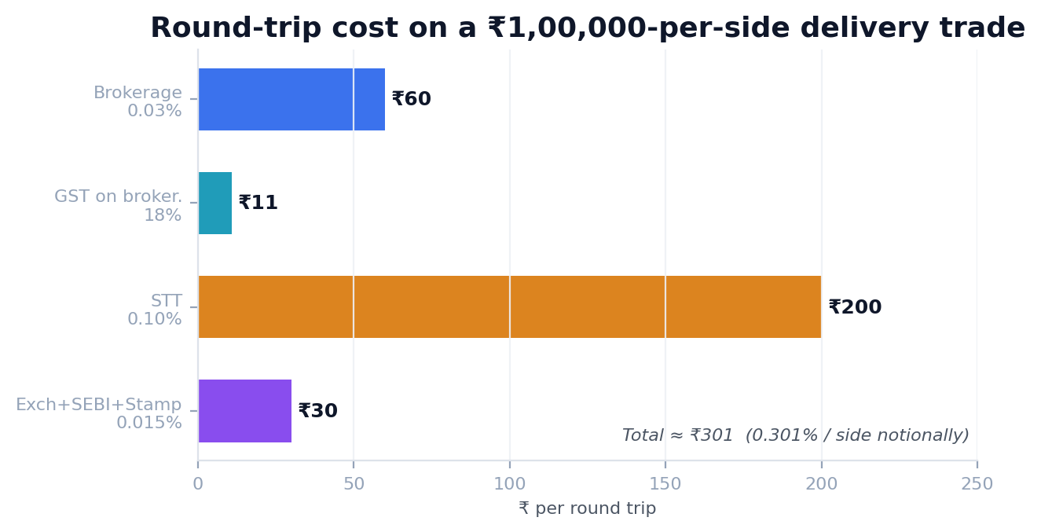
04 · RISK, COSTS & SCORING
The hidden enemy: trading costs & taxes
WHY THIS SLIDE MATTERS
Every time you buy or sell a share in India, you pay small fees and taxes. Each one looks tiny — but a strategy that trades often pays them again and again, and together they quietly eat into profits.
Brokerage
the fee your broker charges to handle the buy or sell.
STT (Securities Transaction Tax)
a government tax on the value of each trade.
Exchange + SEBI + stamp duty
small charges from the exchange and the market regulator.
GST
tax of 18% applied on top of the brokerage fee.
What AlgoLab does: it subtracts every one of these from each trade — so the profit you see is the profit you would truly keep. A strategy that only wins before costs is not really a winner.
AlgoLab · End-to-End Algorithmic Trading System · IIM Mumbai Capstone · Group 6
16

Slide 17
04 · RISK, COSTS & SCORING
How do we know if a strategy is good?
THE SCORECARD IDEA
A big profit on its own does not make a strategy good. We grade each one on several measures — the way a school report card looks at more than a single subject.
Beat buy-and-hold?
Sharpe / Sortino ratio
Maximum drawdown
Did the strategy do better than simply buying the stock and holding it the whole time? If not, all the trading added nothing.
Reward for the stress endured: how much profit you earned for each unit of nerve-wracking ups and downs. Higher is better.
The worst fall from a peak the account suffered. It answers: “could you have stomached this without giving up?”
Win rate
Profit factor
Net profit / return
Out of all trades, what fraction made money. A low rate can still be fine if the wins are far bigger than the losses.
Total winnings divided by total losses. Above 1 means it made money overall; the higher the number, the stronger the edge.
The bottom line — money made or lost after every cost — shown in rupees and as a percentage of what you started with.
Our definition of success: beat buy-and-hold, with a bearable worst-case fall and more winnings than losses — all after costs.
AlgoLab · End-to-End Algorithmic Trading System · IIM Mumbai Capstone · Group 6
17

Slide 18
05 · THE APP IN ACTION
Using AlgoLab — test one rule, or race several
Connect
Backtest
Compare
About
▸ Backtest tab: run a single strategy and instantly see the headline scores as plain tiles, each with a hover-over note explaining it in everyday language.
▸ The chart marks every buy and sell on the real price, so you can see at a glance where the strategy acted — and whether it made sense.
▸ Compare tab: race several strategies on the same stock at once. The best and worst are tinted green and red, and all the scores sit side by side in one table.
▸ Because they all use identical costs and safety rules, it is a genuinely fair fight — the winner wins on the strength of the idea alone.
₹ · ·
₹ · ·
₹ · ·
₹ · ·
₹ · ·
₹ · ·
Net P&L
Return %
Sharpe
Max DD
Win rate
Costs paid
the price, with a green marker on every buy and a red one on every sell
Entry Exit Qty P&L (₹) Return % Duration
a complete list of every trade the strategy made — exportable to a spreadsheet
AlgoLab · End-to-End Algorithmic Trading System · IIM Mumbai Capstone · Group 6
18

Slide 19
05 · THE APP IN ACTION
No black box — every trade explained in plain English
Most trading tools just tell you what to do, never why. AlgoLab does the opposite — click any trade and it explains itself.
BUY • RSI Mean Reversion
▸ It speaks each strategy’s own language: RSI quotes its score, SMA quotes its averages, Bollinger quotes the band prices — always the real numbers from that exact day.
▸ It is written for non-experts: anyone comfortable with shares but new to the jargon can follow why each trade happened.
▸ It shows the cost of that trade right next to its profit, so nothing is hidden.
▸ The result is trust through transparency — you can always see, and explain to others, exactly why a decision was made.
Date
13 Aug 2024
Price
₹ 1,184.20
Quantity
84 shares
Costs paid
₹ 248.60
Net profit
+ ₹ 6,930.00
Why buy here?
The RSI had dropped to 27.4, below the oversold line of 30. The stock had been sold off hard for several days; this rule bets that sellers run out of steam and the price snaps back — so it bought.
AlgoLab · End-to-End Algorithmic Trading System · IIM Mumbai Capstone · Group 6
19

Slide 20
06 · FINDINGS
What our tests revealed
HOW TO READ THIS
Exact numbers depend on which stock, time period and settings you choose when you run a test. So instead of one headline figure, here are the steady, repeatable patterns we saw again and again.
Costs are decisive
Each rule has a personality
A strategy that traded very often saw a healthy-looking profit shrink sharply once brokerage and taxes were applied. Over-trading quietly kills returns.
The bounce-back rule (RSI) won often with small gains; the trend rules (SMA, MACD) won less often but rode bigger moves. This is the classic textbook trade-off, seen for real.
There was no universal winner
Risk control earned its keep
Which rule came out on top depended on the stock and the market. Trend rules shone in steady up-markets; the bounce-back rule did better in choppy, sideways ones.
The stop-loss and the 20% emergency brake clearly cut the worst losses, improving the risk-adjusted scores even on tests where the raw profit dipped.
The honest headline: after real costs, simply buying and holding the stock was a tough benchmark to beat — a sobering, useful answer to our central question.
AlgoLab · End-to-End Algorithmic Trading System · IIM Mumbai Capstone · Group 6
20

Slide 21
06 · FINDINGS
What we learned, and where it falls short
What we learned
Honest limitations
▸ A backtest can lie to you. Letting rules peek at the future, over-tuning, or ignoring costs all flatter the results — honest testing is the real deliverable.
▸ Net beats gross. An edge only counts after brokerage and taxes; modelling India’s real costs changed our conclusions.
▸ Risk control is not optional. Sizing trades and a kill-switch are what make a return usable in real life, not just on paper.
▸ Simple is strong. Rules we could fully explain were easier to trust, debug and reason about than clever, opaque complexity.
▸ We assume perfect, instant fills — in reality the price you get can differ slightly from the price you saw.
▸ It tests one stock at a time and only buys (never “sells short”), so it isn’t a full portfolio.
▸ We used sensible default settings rather than heavily optimising them, to avoid fooling ourselves.
▸ It focuses on daily prices, so fast intraday moves and overnight gaps aren’t modelled.
▸ It is for research and learning only — by design, it does not trade real money.
AlgoLab · End-to-End Algorithmic Trading System · IIM Mumbai Capstone · Group 6
21

Slide 22
06 · FINDINGS
Conclusion — our honest answer
“Can a rule-based strategy generate consistent returns after accounting for risk?”
Our answer: sometimes — but only when costs and risk are taken seriously.
A simple, transparent rule can show a real, measurable edge on the right stock in the right market — yet no single strategy won everywhere, and after India’s trading costs, even matching “buy and hold” proved genuinely hard. The lasting value of this project is the honest, end-to-end system we built to find that out.
✓
Built a real, end-to-end trading system
✓
Made costs & risk first-class citizens
✓
Measured the edge honestly, not hopefully

Slide 23
GROUP 6
The team & acknowledgements
GROUP 6 — MEMBERS
RV
Srivathsa
Jitasha Shastri
S
JS
Neeraj Mahajan
Kalpesh Dangare
NM
KD
Hema D
Hardik Parchani
Prof. Rakesh Verma
HD
HP
Faculty Advisor
Sidharth Dhanuka
Nihar Nitin Bhosale
For the guidance, the rigour, and pushing us to question every assumption — thank you, Sir.
SD
NN
Gurpreet Singh Saluja
Riya Rajesh Saraiya
GS
RR
AlgoLab · End-to-End Algorithmic Trading System · IIM Mumbai Capstone · Group 6
23

Slide 24
Thank you
Questions & discussion welcome
AlgoLab — End-to-End Algorithmic Trading System with Backtesting & Risk Control
IIM Mumbai · Capstone Project · Group 6 · Advisor: Prof. Rakesh Verma

