Slide 1
CPSC 8810: Motion Planning Final Project
Project Title: Nonholonomic Motion Planning for a Car in 2D Environment using RRT*
By- Kalpit Madhusudan Vadnerkar Vasanth Seethapathi

Slide 2
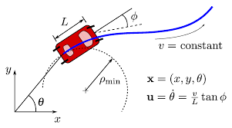
Problem and Approach
RRT* algorithm incrementally builds a tree of random configurations in the search space, similar to RRT, and attempts to rewire the tree iteratively by adding new connections between nodes resulting in a low-cost path optimized tree structure.
Develop an efficient RRT* algorithm to plan collision-free motion for a nonholonomic Dubins car through 2D obstacles, while considering its motion constraints.

Slide 3
Operating Parameters
Car: Non Holonomic dubins Car, this contains the information of initial and final positions, as well as its motion constraints.
max_steps: Maximum number of steps the algorithm will take before terminating. It has an influence on the execution time and computational resources required for planning.
pick_target: Frequency at which the algorithm will select a new target node to expand the tree towards the goal. A higher value will result in more frequent expansions on contrary to a lower value which will result in fewer expansions.
check_dubins: This parameter checks for the direct dubins paths when adding new edges to the tree. Also, it expands the dubins analytic solution that connects to the final position if the solution is valid and collision free. This also sets a frequency to check for connecting to the final position.
search_radius: Maximum distance the algorithm will search for nodes to connect while expanding the tree. A larger value will result in wider search area.

Slide 4
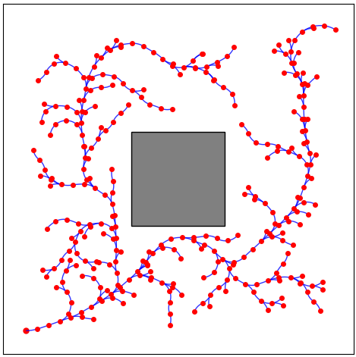
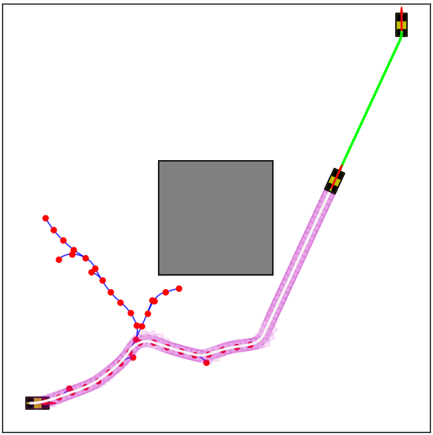
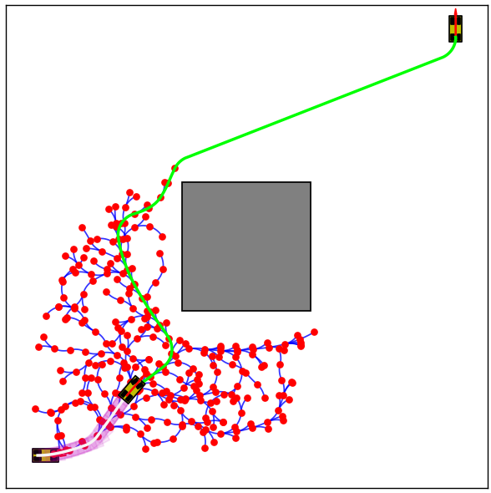



RRT and RRT* comparison
RRT exploration
RRT
RRT*

Slide 5
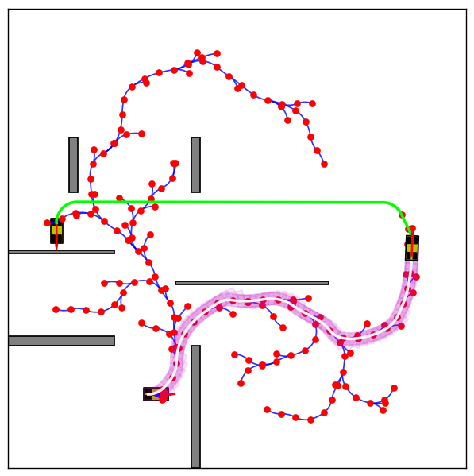
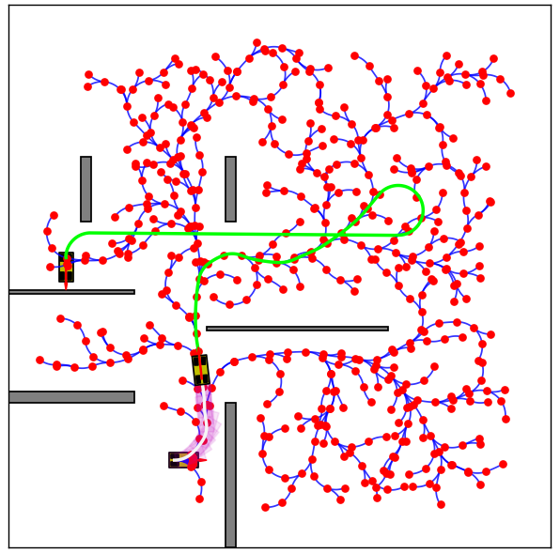
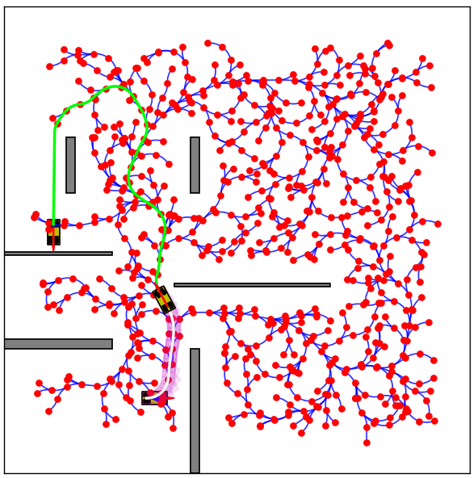



2D map exploration based on Iterations on RRT* -
Parameters: max_steps=50, pick_target=10, check_dubins=1, search_radius=1.0

Slide 6
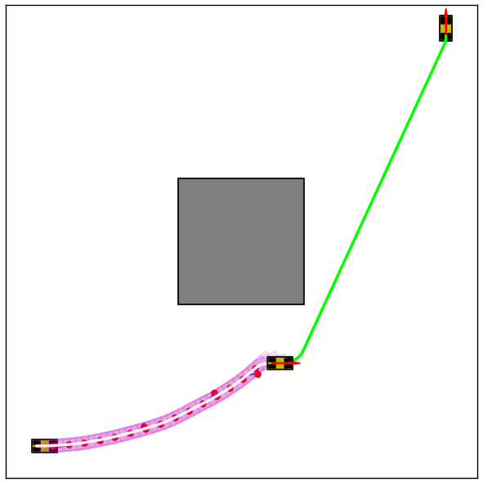
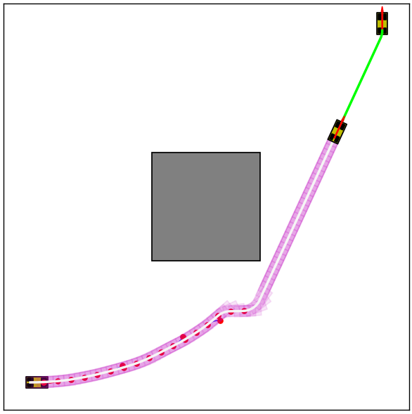


Algorithm Comparison -
Random Seeds are set to the same value for better results for comparison.
RRT
RRT*
Note: Based on sampling points, the trajectory is expected to vary from one simulation run to another

Slide 7
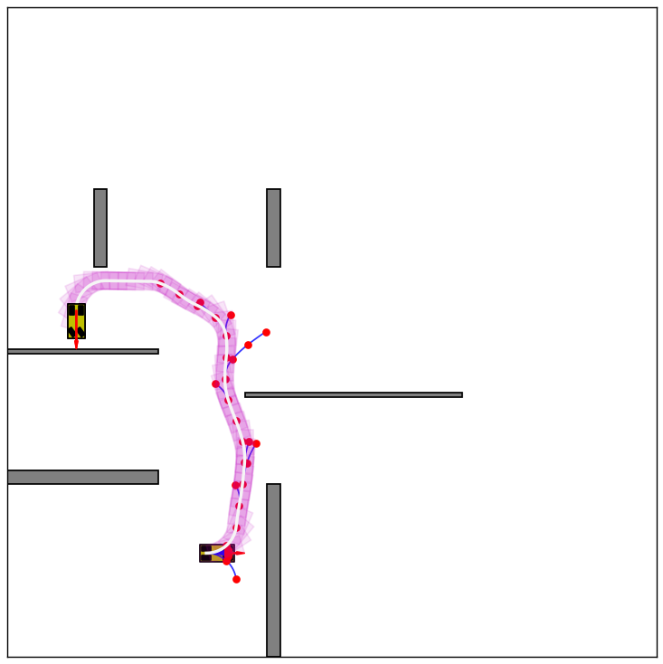
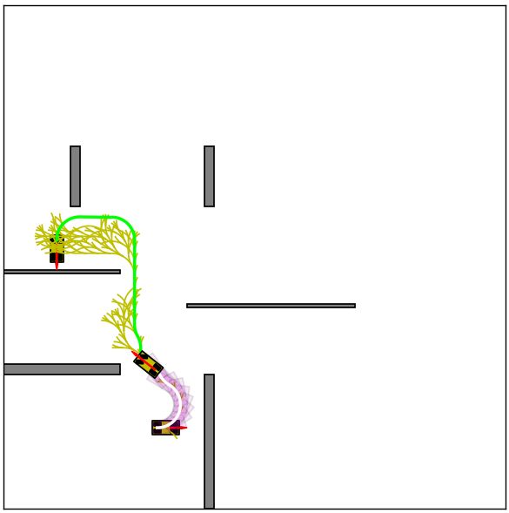
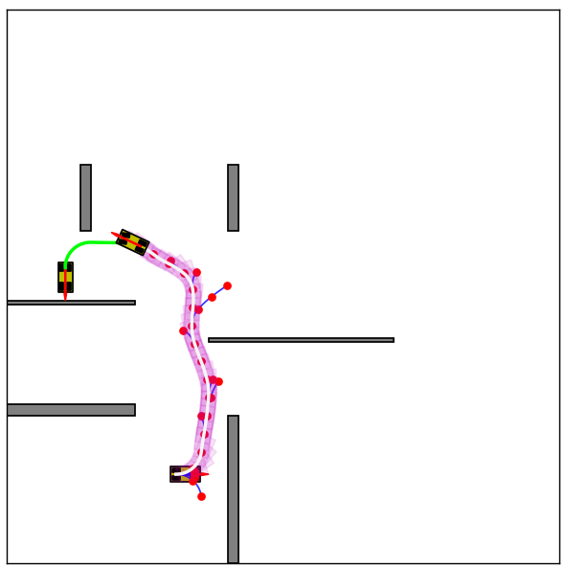



Algorithm Comparison -
RRT
Hybrid A*
RRT*
Note: Based on sampling points, the trajectory is expected to vary from one simulation run to another

Slide 8
Algorithm Comparison (higher iteration)-
RRT
Hybrid A*
RRT*
Note: Based on sampling points, the trajectory is expected to vary from one simulation run to another

Slide 9
Benefits -
Related to A*
Comapred to RRT

Slide 10
Drawbacks -
Although RRT* can find a feasible solution with a certain probability, it may not always find the optimal solution and its quality may vary based on the problem and environment.
RRT* may not be suitable for problems that involve multiple agents or goals that require coordination, as it is designed for motion planning problems with a single start and goal configuration.
Choosing optimal values for parameters such as step size, sampling density, and exploration radius can be challenging and require significant experimentation due to RRT*'s sensitivity to parameter choices.
The drawback of using graph-search techniques for trajectory generation is the resolution lost due to discretization of state space and/or control space. The only boundary states that can be reached are those that already exist in the network.

Slide 11
Path Smoothing Methods -

Slide 12
Success rate : depends on the

