Slide 1

A Probabilistic Framework for Safe and Reliable Autonomous Vehicles as Digital-Twins
Ph.D. Proposal – Computer Engineering
Kalpit Vadnerkar
Committee Members:
Dr. Richard Brooks, Committee Chair
Dr. Pierluigi Pisu, Co-Chair
Dr. Kuang-Ching Wang
Dr. Linke Guo
October 2026
Notes:
Good morning. This is the October update on the dissertation: a probabilistic framework for safe and reliable autonomous vehicles, using the digital twin, our learned predictor, as the core.
Since the last meeting, the focus has narrowed to one concrete risk, sensor faults that corrupt the vehicle's own state estimate, and to one question: can we keep the vehicle working safely under such a fault instead of only detecting it or stopping.
I'll briefly recap the earlier approach and the literature, then the story as it stands, and then spend most of the time on two things that were confusing last time: what exactly goes into the model and where each input comes from, and how the safety envelope gets moved. I'll finish with the offline correction result, the closed-loop plan, and four questions where I need your call.

Slide 2
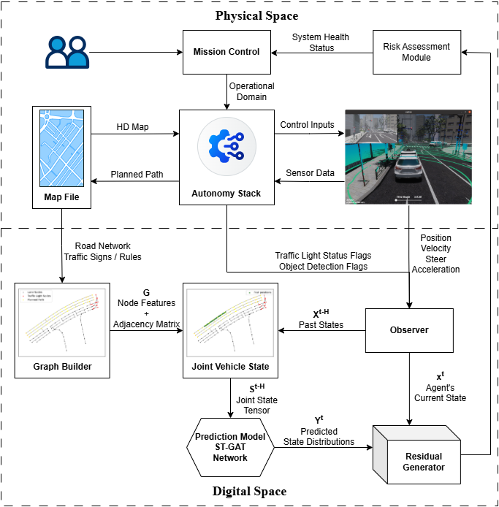
Old Approach: System Architecture
Goal:
Close the control loop from Digital-Twin residuals to MPC safety constraints to handle unmodeled risks in real-time.
Key Concept:
Risk is not just about detecting obstacles, but quantifying the trustworthiness of our system's perception and prediction. When the Digital Twin (DT) diverges from reality (high residual), our trust decreases, and we must "back off" by tightening safety constraints.
Notes:
This is where the project started, for context. The original architecture closed the loop from the digital twin's residuals to MPC safety constraints: when the twin's prediction diverges from what the vehicle actually does, trust goes down, and the controller backs off by tightening its constraints.
The key idea from then still holds: risk isn't only about detecting obstacles, it's about how far we can trust the stack's own perception and state. What changed is how we use that trust signal. Instead of a single residual that tightens constraints, we now break it into when, how much and which way, turn that into a consequence on the map, and use the same estimate to correct the state.

Slide 3
The Loop Strategy
Observe: Real vehicle state (X) vs Digital Twin prediction (Y).
Quantify: Compute Residuals using KL-Div or CUSUM.
Assess: Estimate CVaR (tail risk) from the sliding window of residuals.
Act: Map CVaR to a constraint margin f(CVaR).
Control: Update MPC bounds.

Slide 4
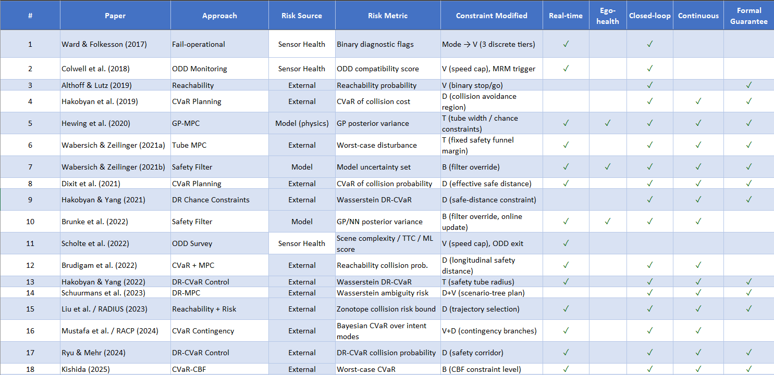
Literature Review
Notes:
This is the literature table from the proposal, kept as background. The columns show, for each line of work, the source of risk it considers, the risk metric, what constraint it modifies, and whether it runs in real time, uses ego health, closes the loop, is continuous and has formal guarantees.
The pattern I want to point out: work that monitors sensor or system health mostly stops at a binary flag or a degraded mode, and work that plans against risk mostly assumes its own state and predictions are correct. Very little takes a calibrated measure of the vehicle's own state error and carries it through to a consequence and a response. That's the gap this work sits in.

Slide 5
Since last meeting: the story in one slide
Risk: sensor faults that corrupt the vehicle's own state estimate (IMU faults so far).
Two failure modes today:
→ Silent: the stack never notices. In our data Autoware's estimate stayed in lane while the real car left the road (4 departures).
→ Detected: the default response is to stop (MRC). Safe, but the vehicle stops for faults that would not have mattered.
Our approach, reading only what the stack already publishes:
1. Learn how the stack's estimates normally agree with the vehicle's own reports (consistency), nominal data only.
2. Calibrated disagreement → WHEN the state is off, HOW MUCH, WHICH WAY (a pose-error estimate).
3. Layer 2: move the predicted futures by that error, check them against the map → P(violation).
4. Same estimate → a correction: correct and continue; stop only when it cannot be corrected.
Status: 1–3 done; 4 tested offline against AWSIM ground truth; closed loop is next.
Notes:
Before we get into details, here's the story as it stands now, because it shifted since the last meeting.
The risk we look at is sensor faults, specifically faults that corrupt the vehicle's own state estimate. They cause two different failures. First, silent ones: in our AWSIM IMU fault data, Autoware's own pose estimate stayed in the lane while the real vehicle left the road, four times. The stack never knew. Second, when a fault is detected, the default is to stop the vehicle. That's safe, but it costs availability, and most of the faults we inject turn out to be harmless.
Our approach reads only what the stack already publishes. The model learns, on nominal data, how the stack's own estimates normally agree with the vehicle's own reports. Calibrated disagreement tells us WHEN the state is off, HOW MUCH, and WHICH WAY. Layer 2 turns that into a probability of leaving the road or hitting something, on the real map. And the same estimate gives us a correction, so the response can be correct-and-continue instead of stop.
What's shown today is detection, sizing, consequence, and the correction offline, against ground truth. Keeping the vehicle running with the correction in the loop is the next experiment.

Slide 6
Three-layer architecture
Two bodies of work exist today and don't talk to each other:
UQ / anomaly detection: raises a flag, treats uncertainty as an alarm to threshold, not a quantity to reason further about
Risk-aware planning: computes collision risk and plans against it, but ASSUMES its own prediction models are correct
A digital twin's own predictive uncertainty, once properly calibrated and validated against real faults, is the substrate for translating "how off-nominal is this vehicle behaving" into "what physical consequence does that imply", without needing a catalog of known fault types to work.
Layer 1: Detect
Calibrated anomaly signal (WHEN) + consistency heads (HOW MUCH, WHICH WAY). No fault data needed to build.
STATUS: DONE (ego_v6)
Layer 2: Consequence
Futures of the forecast, moved by the estimated pose error, checked against the road and objects: P(violation).
STATUS: BUILT, OFFLINE
Layer 3: Response
Correct the pose with the same estimate; slow down or stop only if it cannot be corrected.
STATUS: CORRECTION TESTED OPEN-LOOP
Notes:
This is the three-layer architecture, with updated status.
The motivation on top is the same: uncertainty and anomaly detection usually stops at raising a flag, and risk-aware planning usually assumes its own prediction models are right. We want the digital twin's calibrated uncertainty to translate "how off-nominal is the vehicle" into "what physical consequence does that imply", without a catalogue of known faults.
Layer 1, detect: a calibrated anomaly signal for WHEN, plus the consistency heads for HOW MUCH and WHICH WAY. Built from nominal data only. That's done, with the ego_v6 model.
Layer 2, consequence: futures from the forecast, moved by the estimated pose error, checked against the road and objects, giving P(violation). Built and evaluated offline.
Layer 3, response: correct the pose with the same estimate, and slow down or stop only if it can't be corrected. The correction is tested open loop; closing the loop is the next experiment.
--- Earlier background notes ---
If asked "why not just do detection with a threshold, why does Layer 2
need reachability specifically" — because a raw anomaly magnitude can't
distinguish "the model is surprised on an empty road" (irrelevant) from
"the model is equally surprised near a pedestrian crossing" (potentially
severe) — that distinction is exactly what a physical consequence model
adds, and it's why Layer 2, not a bigger Layer 1, is the actual thesis
payload.

Slide 7
THE DIGITAL TWIN: ST-GAT ARCHITECTURE
Encoder: GCN graph encoder (HD-map lanelets) fused with a Transformer temporal encoder + LSTM over a 3-second (30-step, 10 Hz) window.
Inputs (ego_v6): ego motion, the stack's own uncertainty and localization health, 5 consistency gaps, traffic light, objects, map graph, route ahead. Full table with sources on the next slide.
Outputs: 3 s forecast of
→ behaviour: position, velocity, steering, acceleration, traffic-light channels (WHEN something is off)
→ consistency: the 5 gaps (HOW MUCH and WHICH WAY the state is off)
Uncertainty: plain point predictor, wrapped in post-hoc conformal calibration (leave-one-trial-out, per horizon step).
Trained on nominal driving only. No fault data is used to build it.
Notes:
This is the digital twin itself, the ST-GAT.
The encoder is a graph network over the HD-map lanelets, fused with a Transformer temporal encoder and an LSTM, over a 3-second window at 10 hertz. It forecasts the next 3 seconds.
Inputs, in short: ego motion, the stack's own uncertainty and localization health, five consistency gaps, the traffic light, objects, the map graph, and the route ahead. The next three slides go through every input, where it comes from, and what it would be on a real car.
Outputs are two kinds of heads. Behaviour heads forecast position, velocity, steering, acceleration and the traffic-light channels; their residuals tell us WHEN something is off. Consistency heads forecast the five gaps; their residuals tell us HOW MUCH and WHICH WAY the state is off.
The network is a plain point predictor. Uncertainty comes from post-hoc conformal calibration, leave-one-trial-out and per horizon step, not from the network reporting its own confidence. And it's trained on nominal driving only: no fault data is used to build it.
--- Earlier background notes ---
Three additional calibration fixes worth mentioning if asked about model quality:
(1) position was scaled relative to each window's own bounding box, which is invisible to the model and made a trivial constant-velocity baseline outperform the trained model by 30x — fixed by switching to a fixed-scale relative-displacement representation.
(2) beta-NLL reweighting (Seitzer et al., ICLR 2022) fixed the standard Gaussian NLL's pathology of down-weighting gradients by 1/variance, which was preventing the model from learning to widen its variance appropriately at longer horizons.
(3) a variance floor bug (VAR_FLOOR=1e-4) was pinning position's predicted uncertainty at exactly 1.0m regardless of input, once the representation fix shrank real error below that floor — lowered to 1e-8 and stress-tested against synthetic near-zero-residual data before retraining.
Current calibration status (z-score std, want 1.0): position 0.885 (mildly underconfident, and drifts to 1.177 at longer horizons), velocity 1.174, steering 1.101, traffic_light_state 1.332 (the most overconfident remaining, worth watching once conformal calibration is layered on top — that layer should catch and correct this by construction, per docs/research_notes/model_improvement_notes_2026.md, but it's confirmed empirically not just assumed).
Known, deliberately deferred limitations (see docs/research_notes/model_improvement_notes_2026.md, not hidden): route/goal information reaches the model via path_node graph flags but gets diluted by uniform mean-pooling over ~150 graph nodes; VAR_FLOOR is one global constant, not per-feature; object encoder is mean-pool-only, not attention-weighted. None of these are blocking — logged as the honest punch list for later.
UPDATED 2026-08-20: the z-score numbers above are from the Student-t/NLL path, which is now PAUSED (see slide 10 for the full before/after). Don't present them as the current calibration status — the current, trusted calibration status is slide 10's conformal reliability diagram. Why the pivot: an independent architecture review made the case that the recurring miscalibration pathology (scale drifting below the true validation-residual spread over training, on top of the dof-collapse issue) is a general, documented failure mode (Wong-Toi et al., UAI 2023) of jointly training a network to predict a value AND self-report its own confidence in one objective — not fixable by one more regularizer. Conformal calibration on a plain point predictor sidesteps the whole pathology: no jointly-optimized variance head, no distribution-family assumption. If asked whether the Student-t work was wasted: no — the two architecture bugs it surfaced (gradient contention, dof-collapse) are real fixes kept in the model regardless, and epistemic disagreement between independently-trained point predictors (also built during this arc) is a live, useful robustness check (slide 11). "Paused" is accurate, not "abandoned" — docs/research_notes/nll_calibration_arc_and_conformal_pivot_2026-08-20.md §5 has the concrete next step if it's ever resumed, so don't re-diagnose from scratch.

Slide 8
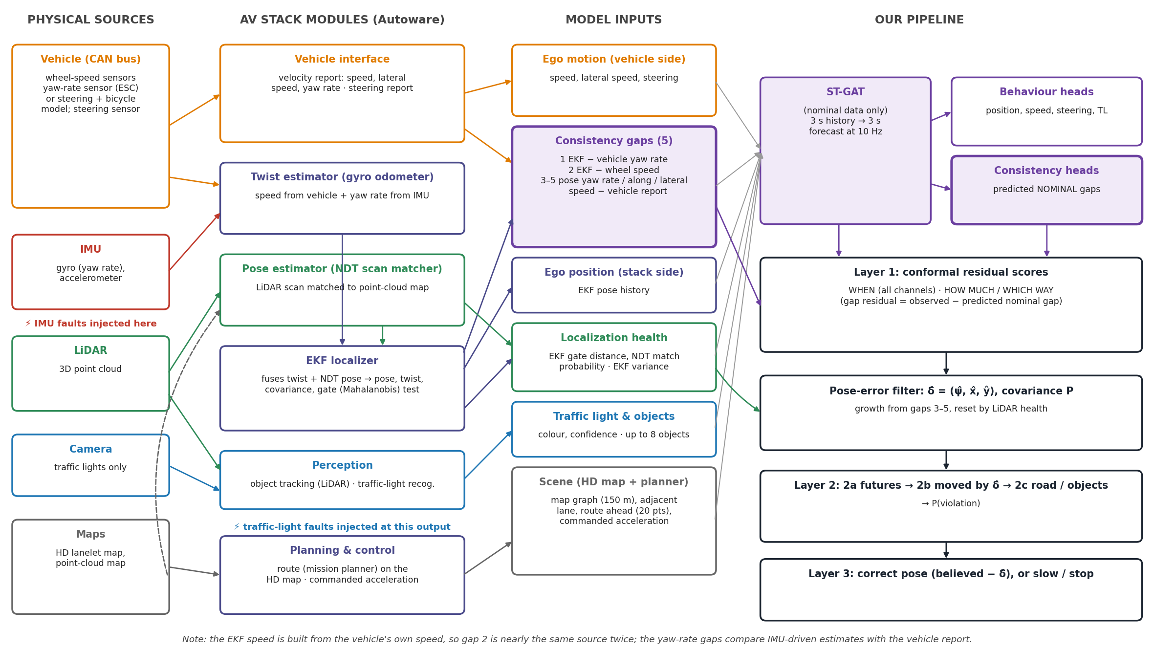
Where every input comes from
Notes:
This diagram answers the question of where each input actually comes from. Read it left to right.
On the far left are the physical sources. The vehicle itself, through its CAN bus: wheel-speed sensors, a yaw-rate sensor in the stability control unit, or the steering angle combined with a bicycle model, and the steering sensor. Then the IMU, the LiDAR, the camera, which in this Autoware setup is used only for traffic lights, and the maps: the HD lanelet map and the point-cloud map that LiDAR is matched against.
The second column is the Autoware modules those sources go through. The vehicle interface turns CAN messages into a velocity report and a steering report. The twist estimator, which Autoware calls the gyro odometer, takes the speed from the vehicle and the yaw rate from the IMU. The pose estimator, the NDT scan matcher, matches each LiDAR scan to the point-cloud map. The EKF fuses that twist with the NDT pose and outputs the pose the rest of the stack drives on, its covariance, and a gate test that rejects NDT poses that disagree too much with its prediction. Perception gives objects from LiDAR and the traffic-light state from the camera. Planning gives the route and control gives the commanded acceleration.
The third column is our model's input groups, coloured by where they come from. The important one is the purple box: the consistency gaps take one side from the EKF and the other from the vehicle interface. The localization-health inputs come from the EKF's gate test and the NDT match probability.
The fourth column is our pipeline: the ST-GAT with its behaviour and consistency heads, Layer 1, the pose-error filter, Layer 2 and Layer 3.
Two things to point out. The lightning marks show where we inject faults: IMU faults on the IMU output, before the twist estimator, and traffic-light faults on the recognition output. And the note at the bottom: the EKF's speed is built from the vehicle's own wheel speed, so gap 2 compares nearly the same source twice. The informative gaps are the yaw-rate ones and the pose-based ones.

Slide 9
Model inputs: what, where from, what it means
Group | Input (dims) | Source (ROS topic) | What it signifies
Ego motion | position x, y (2) | /localization/kinematic_state (EKF pose) | Where the stack BELIEVES the car has been; corrupted by localization faults
 | velocity: along, across (2) | /vehicle/status/velocity_status | How the vehicle itself reports it moved; independent of localization
 | steering (1) | /vehicle/status/steering_status | Measured steering angle
 | acceleration (1) | /control/command/control_cmd | What the controller asked for
Self-reported confidence | EKF position variance x, y (2) | /localization/pose_with_covariance | How sure the stack SAYS it is about its position
Consistency (new) | 5 gaps (also predicted) | kinematic_state vs velocity_status | Do the stack's estimates agree with the vehicle's reports? (next slide)
Localization health (new) | EKF gate Mahalanobis; LiDAR-map match probability (2) | /diagnostics (ekf_localizer, ndt_scan_matcher) | Is the absolute reference (LiDAR matched to the HD map) working right now? Input only
Traffic light | colour, confidence, map-vs-perception mismatch (3) | traffic_signals_faulted + HD map | What perception reports, and whether the map expects a light it did not report
Objects | up to 8 × (rel. x, y, speed, class) | /perception/.../tracking/objects | Who is around
Scene | adjacent lane exists (1) | Lanelet2 routing graph | Room to deviate
 | map graph: ≤1024 nodes × (x, y, TL node, on route, lane dir.) | Lanelet2 HD map, 150 m radius | Road geometry around the car
 | route ahead: 20 points, 3 m apart | /planning/mission_planning/route | Where the car intends to go
History: 3 s at 10 Hz in the ego frame. Outputs: 3 s forecast of motion, traffic-light channels and the 5 gaps.
Notes:
This is the full list of what goes into the model, because this was the confusing part last time.
Every row is a 3-second history at 10 hertz, in the vehicle's own frame, except the map and route, which are a snapshot around the current position.
The thing to notice is the source column. Some inputs come through localization: position, the EKF's own uncertainty, its health diagnostics. Others come straight from the vehicle: velocity, steering, the commanded acceleration. Others from perception: traffic light and objects. And the map and route are fixed facts. A localization fault corrupts the first group but not the second. That separation is exactly what the consistency channels on the next slide exploit.
The highlighted rows are new since the earlier models: the consistency gaps and the localization health. Note that localization health is an input only: we don't predict it, we use it to decide when the LiDAR map match can be trusted as an absolute reference.

Slide 10
One velocity report, and where it comes from
A real message (nominal bag)
VelocityReport
header.stamp: 4318.422 s
header.frame_id: base_link
longitudinal_velocity: 4.613 m/s
lateral_velocity: −0.038 m/s
heading_rate: 0.0488 rad/s (2.8°/s)
SteeringReport
steering_tire_angle: −0.0337 rad
IMU (for comparison)
angular_velocity.z: −0.205 rad/s
(gyro; reported noise σ = 0.03 rad/s)
Field | In AWSIM | On a real vehicle
longitudinal velocity | simulated body's true velocity (exact) | wheel-speed sensors (ABS encoders) × tire radius, via CAN → vehicle interface
lateral velocity | true (exact) | usually not measured; reported as 0
heading rate | true angular velocity (exact) | stability-control (ESC) yaw-rate sensor, or v·tan(steering angle)/wheelbase
steering angle | simulated steering | steering-angle sensor in the column / power steering unit
Consequence for this work: in simulation the vehicle side is a clean reference. On a real car it has noise, bias and wheel slip, and the ESC yaw-rate sensor is itself a gyro (independent hardware from the localization IMU).
To do: re-test the filter with realistic odometry noise and bias added offline.
Notes:
You asked what a data point of the vehicle velocity report looks like. This is a real message from one of our nominal bags.
It has a header, with a time stamp and the frame, base_link, which is the vehicle's own body frame. Then three numbers: longitudinal velocity, 4.6 metres per second; lateral velocity, minus 0.04; and heading rate, 0.049 radians per second, which is about 2.8 degrees per second, so the car was turning gently. The steering report next to it is a single number, the tire angle in radians.
The table on the right is the important part for a real system. In AWSIM all three velocity fields are copied straight from the simulated car body's true velocity: I checked the AWSIM source, it publishes the rigid body's local velocity and angular velocity. So in simulation they're exact.
On a real car, the vehicle interface would fill them from the CAN bus. Longitudinal velocity comes from the wheel-speed sensors, the same Hall-effect encoders the ABS uses, converted with the tire radius. Lateral velocity is usually not measured at all and is reported as zero. Heading rate comes either from the stability-control yaw-rate sensor, which is a separate automotive gyro, or it's computed from the steering angle and the wheel speed with a bicycle model: speed times the tangent of the steering angle, divided by the wheelbase.
What this means for us: our consistency signal compares the localization stack against a clean reference in simulation. On a real car that reference has noise, bias, and wheel slip. That's the weakness I want to test offline, by adding realistic odometry noise and bias to the vehicle side and rerunning the filter.

Slide 11
Every input on a real vehicle
Model input | Real sensor(s) | Stack module that produces it
ego position | IMU + wheels + LiDAR (+ GNSS) | localization EKF (pose)
speed, lateral speed, yaw rate | wheel encoders; ESC yaw sensor or steering | vehicle interface (CAN)
steering angle | steering-angle sensor | vehicle interface
commanded acceleration | none (software) | controller
EKF position variance | none (software) | EKF covariance
gaps 1–2: EKF yaw rate / speed | IMU gyro + wheel speed | twist estimator → EKF
gaps 3–5: pose yaw rate / along / lateral | IMU + wheels + LiDAR | EKF pose, differenced (0.5 s / 1 s)
EKF gate distance | LiDAR (vs EKF prediction) | EKF outlier gate (Mahalanobis)
LiDAR-map match probability | LiDAR + point-cloud map | NDT scan matcher
traffic light colour, confidence | camera | traffic-light recognition
objects (≤ 8) | LiDAR (often + camera, radar) | perception tracker
map graph, adjacent lane | HD map (surveyed offline) | map loader / routing graph
route ahead | none (software) | mission planner
Notes:
This table translates every input from ROS topics into hardware and software modules, for a real vehicle.
Reading down. The ego position is the localization EKF's output, which on a real car fuses the IMU, the wheel odometry, LiDAR matching, and often GNSS. Speed, lateral speed and yaw rate come from the vehicle interface reading the CAN bus, as on the previous slide. Steering from the steering-angle sensor. The commanded acceleration isn't a sensor at all, it's what our own controller asked for.
The EKF's variance is the filter's own covariance, its self-reported confidence. Gaps 1 and 2 use the twist the EKF receives, which is the IMU gyro and the wheel speed combined by the twist estimator. Gaps 3 to 5 use the EKF's pose, differenced over half a second for yaw and one second for position, so they include every LiDAR correction.
The two health inputs: the EKF gate distance is how far the latest LiDAR pose is from what the EKF predicted, a Mahalanobis distance; the NDT match probability is the scan matcher's own score of how well the scan fits the map.
Traffic light from the camera through the recognition module; objects from LiDAR through the tracker; on many real vehicles that would also include camera and radar. The map graph and adjacent-lane flag come from the HD map, which is surveyed offline. And the route from the mission planner.
The point: nothing here is a new sensor. Everything is already published inside a standard AV stack.

Slide 12
Consistency: the stack checked against itself
# | Gap (stack − vehicle) | Stack side | Vehicle side | Reveals
1 | EKF yaw rate − vehicle yaw rate | IMU gyro, via twist estimator → EKF | vehicle report | IMU gyro faults, directly
2 | EKF speed − wheel speed | wheel speed, via twist estimator → EKF | vehicle report | little: same source twice (sanity check)
3 | pose yaw rate − vehicle yaw rate | EKF pose, differenced over 0.5 s (incl. LiDAR corrections) | vehicle report | growth rate of HEADING error
4 | pose along-track speed − wheel speed | EKF pose, differenced over 1 s | vehicle report | growth rate of ALONG-TRACK error
5 | pose lateral speed − vehicle lateral speed | EKF pose, differenced over 1 s | vehicle report (≈ 0) | growth rate of LATERAL error
What the consistency head does
The gaps are not zero in normal driving (turn lag, acceleration, jitter). The head predicts the NOMINAL gap for this scene, 3 s ahead.
residual = observed gap − predicted nominal gap
Calibrated (conformal) → is it abnormal? (WHEN) and its signed size in rad/s or m/s (HOW MUCH, WHICH WAY).
A gap is a RATE of error, not the error
IMU bias 0.02 rad/s → residual 0.02 rad/s, small at every instant.
Integrated over 10 s → 11° heading error.
At 11 m/s, 11° of heading error adds ≈ 2 m/s of sideways drift.
→ the filter integrates the residuals, with a reset when LiDAR is healthy.
Notes:
These are the five consistency channels. Each one compares two measurements of the same physical quantity: one that goes through localization, and one straight from the vehicle.
Channel 1 compares the EKF's yaw rate, which comes from the IMU gyro through the twist estimator, with the vehicle's reported yaw rate. It sees an IMU gyro fault directly. Channel 2 compares the EKF's speed with the wheel speed. I need to be honest here: in Autoware the EKF's speed is built from that same wheel speed, so channel 2 is nearly the same source twice. It's a sanity check, and as you'll see on the next slide, it never fires on our faults.
Channels 3 to 5 are what changed in ego_v6. They difference the final pose that Autoware actually drives on, so they include every LiDAR correction, and compare its yaw rate, along-track speed and lateral speed with the vehicle's report. Each one is the rate at which one component of the pose error grows.
Two points at the bottom. First, the gaps aren't zero in normal driving: pose differencing lags in turns, the EKF and the wheels disagree while accelerating. So the model's consistency head predicts what each gap should be in this scene, and we use the residual: observed minus predicted. Second, and this is the key: a gap is a rate of error, not the error itself. A 0.02 radian-per-second residual looks tiny at any instant, but over 10 seconds it's an 11-degree heading error. That's why the filter integrates.

Slide 13
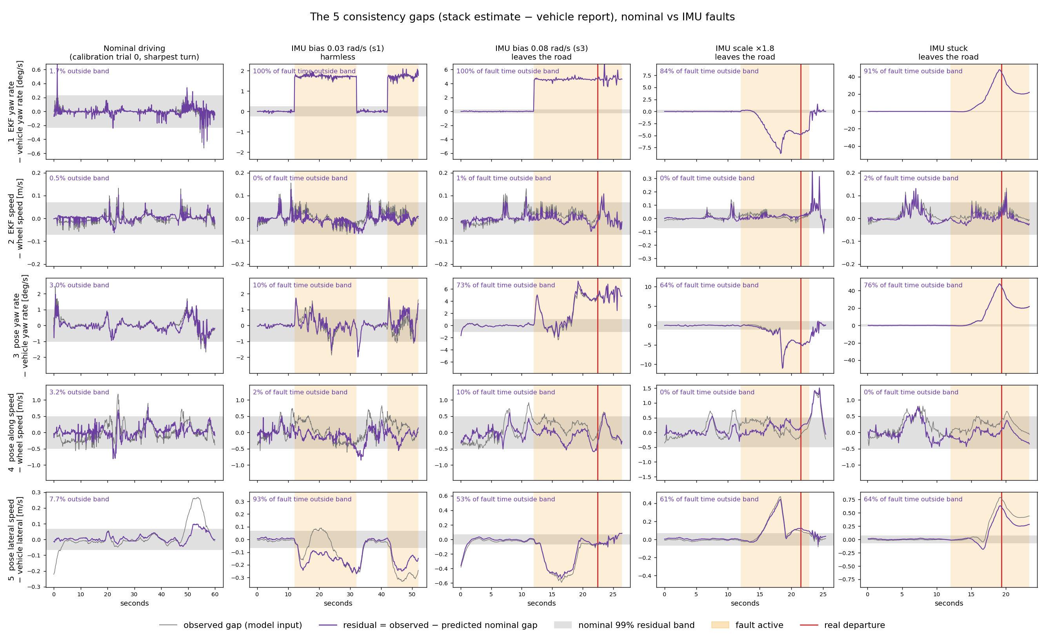
The 5 gaps under nominal and faulty driving
Notes:
These are the five gaps on real data. Rows are the five channels; columns are one nominal trial around its sharpest turn, the harmless IMU fault, and three IMU faults that end with the car leaving the road.
Grey is the observed gap, which is the model input. Purple is the residual: observed minus what the consistency head predicted for normal driving. The grey band is the nominal 99 percent band for the residual. Orange shading is when the fault is active, and the red line is the real departure. The percentage in each panel is how much of the fault time the residual spends outside the band.
First column, nominal: everything stays in the band almost all the time, 0.5 to 8 percent outside, mostly in the sharp turn.
Row 1, the EKF-versus-vehicle yaw rate, catches every IMU fault, including the harmless one: 84 to 100 percent of fault time. That's the WHEN. But it can't tell harmful from harmless: the harmless s1 fault is a perfect 1.7 degree-per-second step.
Row 2 never fires: the EKF's speed is the wheel speed, so this gap carries almost no information. I'd keep it as a sanity check.
Row 3 is the interesting one. On the harmless fault, the pose's own yaw rate stays inside the band: LiDAR keeps correcting the heading, so the pose that Autoware drives on isn't actually turning wrong. On the three departures, it leaves the band, 64 to 76 percent of the time, because the EKF has started rejecting LiDAR. That difference is exactly what separates a harmless fault from a harmful one.
Row 5, lateral: on the harmless fault it's outside the band, but that's LiDAR pulling the pose sideways to correct it, and the filter knows LiDAR is healthy then, so it doesn't count it as error. On the departures it's the lateral drift itself.
Row 4, along-track, is noisy and mostly inside the band: along-track error is small for these faults.

Slide 14
EXPERIMENTAL PLATFORM
Simulation stack:
→ Simulator: AWSIM Labs v1.6.1 (Unity-based, ROS2 native, physics-accurate sensors)
→ AV stack: Autoware Universe (production-grade; same stack used in real-vehicle deployments)
→ Interface: ROS2 Humble; all data logged via rosbag2 at 10 Hz
→ Map: Shinjuku HD map (Lanelet2 OSM format, urban multi-lane environment)
Obstacle:
→ Type: Static parked vehicle (CAR object, 4.5m × 1.8m)
→ Baseline placement: 30m ahead of ego at 150m route distance from spawn
→ Placed in LL 238 (confirmed two-lane: LL 238 with adjacent LL 237)
Route profiles used:
→ Goal 007: 710m route, northward corridor through Shinjuku
→ Goal 011: 633m route, same corridor, different terminal
→ Goal 021: 697m route, extended northern approach
Per-run output:
→ rosbag (all ROS2 topics at full rate)
→ result.json (status, driving_time, MRM events)
→ residuals CSV (one row per 1-step window: NLL, obj_dist, has_adjacent_lane, CUSUM)
Notes:
This is the experimental platform. We run AWSIM Labs, a Unity-based simulator with native ROS 2, against the full Autoware Universe stack, the same software that runs on real vehicles, on the Nishishinjuku HD map. Everything is logged as rosbags and processed at 10 hertz.
One note: the obstacle and route details on this slide are from the earlier obstacle-avoidance framing. The fault campaigns I'm presenting today run on the same platform and the same map, with goals 7 and 12 for the IMU fault runs.
--- Earlier background notes ---
AWSIM + Autoware is the standard simulation platform for AV research in the ROS2 ecosystem and is used by multiple research groups and Toyota's AV division. Its advantage over CARLA or similar is native Autoware integration — the full production stack runs unmodified, so behaviors seen in simulation (avoidance, MRM triggers, AEB events) are representative of what a real vehicle would do with the same software. This is important: we are not studying a toy planner, we are studying the actual decision-making of a production AV system.
The 10Hz data collection rate matters: it matches the ST-GAT model's training frequency, so there is no interpolation or resampling needed between the rosbag and the inference pipeline. The stride=1 means every consecutive window of 30 frames is a training/test sample, giving high temporal resolution for the residual time series.
The single-vehicle obstacle is intentionally simple — we want to isolate the avoidance decision problem from multi-agent interaction. The extension to NPC vehicles in adjacent lanes is stated future work.

Slide 15
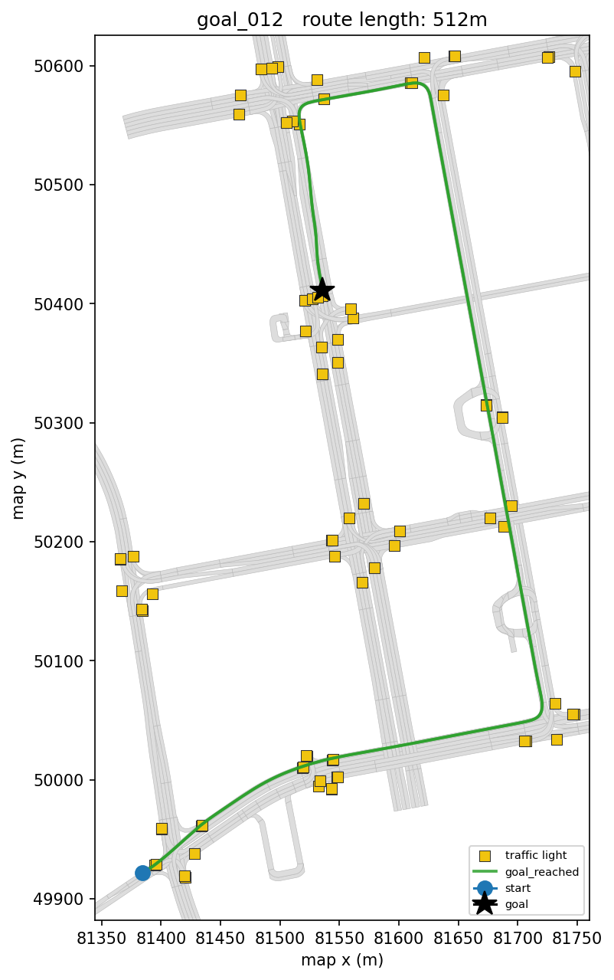
DATA COLLECTED SO FAR
Nominal baseline: 26 goals across the Nishishinjuku map, ~2 trials each, the reference distribution everything else is compared against.
Fault campaigns:
IMU Faults | Traffic-light (Camera) faults
imu_fault_s1 — mild bias(deliberate negative control,designed to be harmless) | tl_fault_s2 — oscillating color
imu_fault_s3 — stronger bias | tl_fault_s3 — UNKNOWN classification (negative-evidence case)
imu_fault_scale — gyro scale error | tl_fault_s4 — signal blackout (negative-evidence case)
imu_fault_stuck — gyro frozen | tl_fault_ramp — confidence decays continuously to zero
Notes:
This is the data. The nominal baseline is 26 goals across the Nishishinjuku map, about two trials each. That's the reference distribution the model is trained and calibrated on.
The fault campaigns are in the table. IMU faults: s1, a mild gyro bias of 0.03 radians per second that's designed to be harmless, our negative control; s3, a stronger bias of 0.08; a gyro scale error of 1.8 times; and a stuck gyro. Traffic-light faults: an oscillating colour, an UNKNOWN classification, a blackout, and a confidence ramp to zero.
The IMU faults are the ones that matter today: s3, scale and stuck each produce real road departures, four in total, and s1 never does.
--- Earlier background notes ---
All fault campaigns gate on a route-derived zone (turn zone, bias lead-in
zone, or traffic-light zone) computed from the map + planned route — not a
live threshold or a wall-clock guess.
imu_fault_s1 is deliberately a negative control, not an oversight — 0.03 rad/s gyro bias is designed to be absorbed by EKF/localization's noise-rejection band even during a turn, so a LOW detection rate on this campaign specifically is a pass, not a miss (see slide 11's results table, color-coded accordingly).
tl_fault_s3 (tl_unknown) and tl_fault_s4 (tl_blackout) are the two campaigns where perception genuinely stops reporting a categorical fact the map asserts should be there — the actual negative-evidence case the mechanism (slide 5) is built around. tl_fault_s2 (oscillate) and tl_fault_ramp (confidence decay) are real faults but NOT negative-evidence cases — perception still reports a present value, just a wrong or degrading one. This distinction turned out to matter a lot in this session's discriminability results (slide 11) — worth setting up here so it lands cleanly later in the deck.

Slide 16
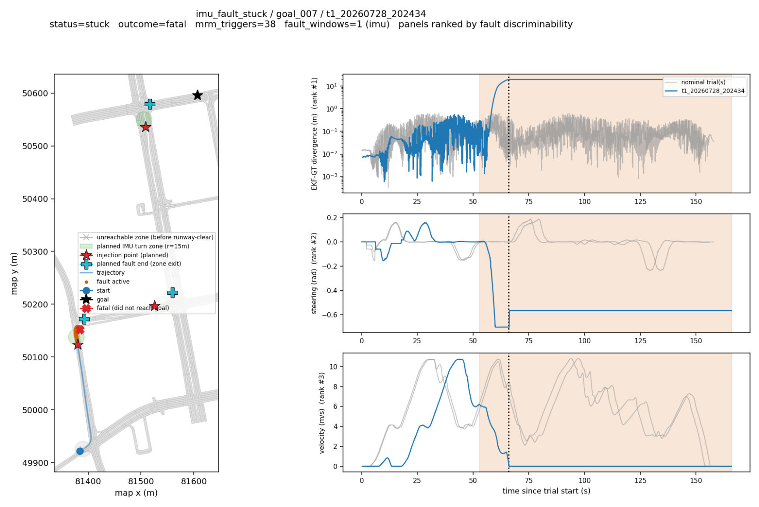
FAULT INJECTION STRATEGY, TYPES, & MAG.
Notes:
This is how faults are injected, on one example trial: the stuck gyro on goal 7.
Every fault is gated on a zone computed from the planned route and the map, not on a timer: turn zones and bias lead-in zones for IMU faults, the governing traffic light for traffic-light faults. That way the fault always lands where it can matter.
On the left is the route with the fault zones; on the right, the signals over time with the fault window shaded. In this trial the gyro freezes at the start of a turn, the heading estimate stops following the real turn, and the vehicle ends up leaving the road. That's one of our four departures.
--- Earlier background notes ---
Design principle: every fault gates on a route-derived ZONE (turn zone,
IMU bias lead-in zone, or traffic-light zone), computed from the actual
Autoware-planned route geometry + Lanelet2 map — not a live threshold or a
wall-clock guess. Zones re-arm for the rest of a trial (periodic, not
one-shot), so one trial can expose a fault at every qualifying intersection
on the route.
IMU faults (gyro channel) — 4 types, calibrated to a real stability cliff:
→ imu_bias, S1: 0.03 rad/s — deliberate NEGATIVE CONTROL, absorbed by
EKF noise-rejection even mid-turn (designed to be harmless)
→ imu_bias, S3: 0.08 rad/s — consequential: integrates against real yaw
rate during a turn, visible EKF-vs-GT divergence
→ imu_scale_factor: gyro × 1.8 — zero effect on straights by
construction (proportional to true yaw rate), turn-triggered only
→ imu_stuck_at: gyro frozen at activation value — zero effect if frozen
on a straight, divergence once curvature changes underneath it
(A 3x jump from S1's 0.03 to an earlier abandoned S2 at 0.15 rad/s
caused a hard-brake + permanent stuck within one cycle — the whole S1-S4
magnitude ladder was redesigned around that discovered cliff, bounding
accumulated heading error ≤1.2 rad rather than picking numbers blind)
Traffic-light faults (perception channel) — 4 types, 2 genuine
negative-evidence cases:
→ tl_oscillate (S2): color flips every 5s, 15s cap — present-but-wrong
value, NOT negative evidence
→ tl_unknown (S3): forces UNKNOWN classification, 15s cap — genuine
negative evidence (perception reports nothing usable)
→ tl_blackout (S4): drops the light from the message entirely, 15s cap —
genuine negative evidence (strongest case)
→ tl_confidence_ramp: confidence decays 0.1/s to 0, holds — tests
threshold-crossing behavior specifically, not a step change
Fault plan (Plot: fault_plan_example_tl_fault_s3.png):
→ Shows a campaign's actual gating zone/radius overlaid on the route map
before any data is collected — confirms the fault is scoped to the
right physical location (the one traffic light the vehicle's own route
is governed by, not every light in the perception message)
Fault impact (Plot: fault_impact_example_imu_fault_s3.png):
→ Overlays the nominal reference signal against the faulted trial's
actual signal (EKF-vs-GT divergence for IMU, TL color/confidence for
TL), fault-active window shaded
→ Confirms the fault mechanism actually changed the signal it targets —
not just that fault_log.jsonl recorded an event
Why this verification step matters:
→ A fault campaign can "run" (events logged, trial completes) without
the injected fault ever reaching the signal it's supposed to affect —
this happened once already (a topic-wiring bug, since fixed) and
every campaign is now checked this way before being trusted downstream

Slide 17
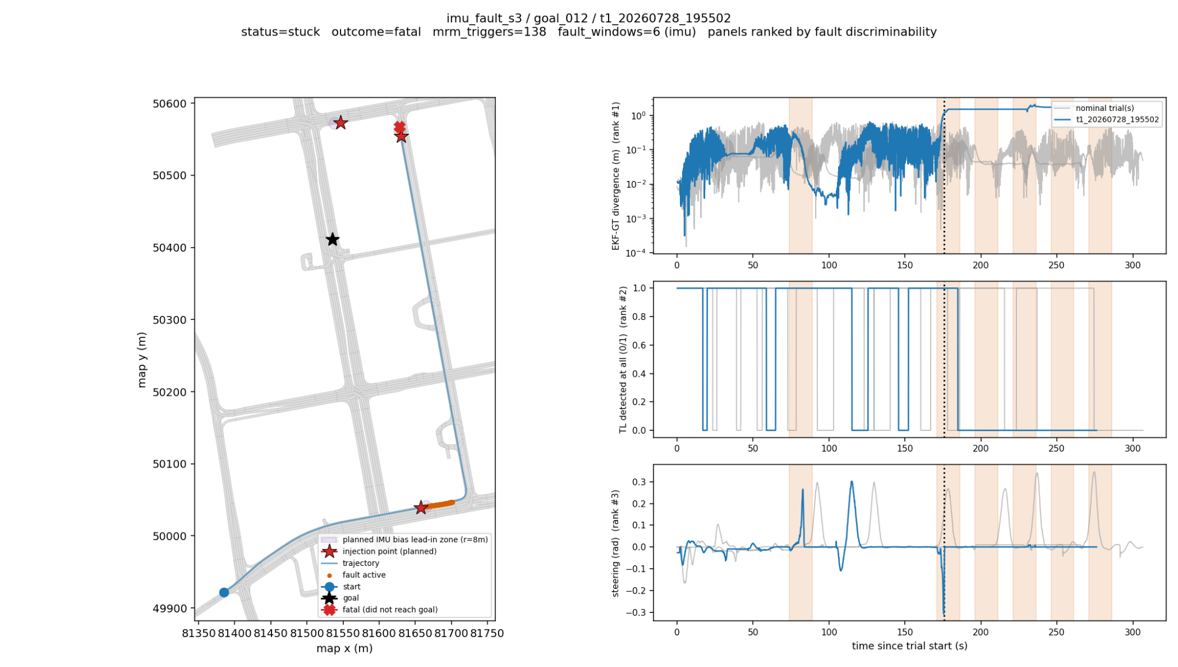
FAULT INJECTION STRATEGY, TYPES, & MAG.
Notes:
A second example, the s3 gyro bias on goal 12. Here the zones re-arm along the route, so one trial exposes the fault at every qualifying turn: you can see the repeated shaded windows.
The magnitudes were chosen around a stability cliff we found: an earlier 0.15 radian-per-second bias caused a hard brake and a permanently stuck vehicle within one cycle, so the ladder was redesigned to bound the accumulated heading error rather than picking numbers blindly.
--- Earlier background notes ---
Design principle: every fault gates on a route-derived ZONE (turn zone,
IMU bias lead-in zone, or traffic-light zone), computed from the actual
Autoware-planned route geometry + Lanelet2 map — not a live threshold or a
wall-clock guess. Zones re-arm for the rest of a trial (periodic, not
one-shot), so one trial can expose a fault at every qualifying intersection
on the route.
IMU faults (gyro channel) — 4 types, calibrated to a real stability cliff:
→ imu_bias, S1: 0.03 rad/s — deliberate NEGATIVE CONTROL, absorbed by
EKF noise-rejection even mid-turn (designed to be harmless)
→ imu_bias, S3: 0.08 rad/s — consequential: integrates against real yaw
rate during a turn, visible EKF-vs-GT divergence
→ imu_scale_factor: gyro × 1.8 — zero effect on straights by
construction (proportional to true yaw rate), turn-triggered only
→ imu_stuck_at: gyro frozen at activation value — zero effect if frozen
on a straight, divergence once curvature changes underneath it
(A 3x jump from S1's 0.03 to an earlier abandoned S2 at 0.15 rad/s
caused a hard-brake + permanent stuck within one cycle — the whole S1-S4
magnitude ladder was redesigned around that discovered cliff, bounding
accumulated heading error ≤1.2 rad rather than picking numbers blind)
Traffic-light faults (perception channel) — 4 types, 2 genuine
negative-evidence cases:
→ tl_oscillate (S2): color flips every 5s, 15s cap — present-but-wrong
value, NOT negative evidence
→ tl_unknown (S3): forces UNKNOWN classification, 15s cap — genuine
negative evidence (perception reports nothing usable)
→ tl_blackout (S4): drops the light from the message entirely, 15s cap —
genuine negative evidence (strongest case)
→ tl_confidence_ramp: confidence decays 0.1/s to 0, holds — tests
threshold-crossing behavior specifically, not a step change
Fault plan (Plot: fault_plan_example_tl_fault_s3.png):
→ Shows a campaign's actual gating zone/radius overlaid on the route map
before any data is collected — confirms the fault is scoped to the
right physical location (the one traffic light the vehicle's own route
is governed by, not every light in the perception message)
Fault impact (Plot: fault_impact_example_imu_fault_s3.png):
→ Overlays the nominal reference signal against the faulted trial's
actual signal (EKF-vs-GT divergence for IMU, TL color/confidence for
TL), fault-active window shaded
→ Confirms the fault mechanism actually changed the signal it targets —
not just that fault_log.jsonl recorded an event
Why this verification step matters:
→ A fault campaign can "run" (events logged, trial completes) without
the injected fault ever reaching the signal it's supposed to affect —
this happened once already (a topic-wiring bug, since fixed) and
every campaign is now checked this way before being trusted downstream

Slide 18
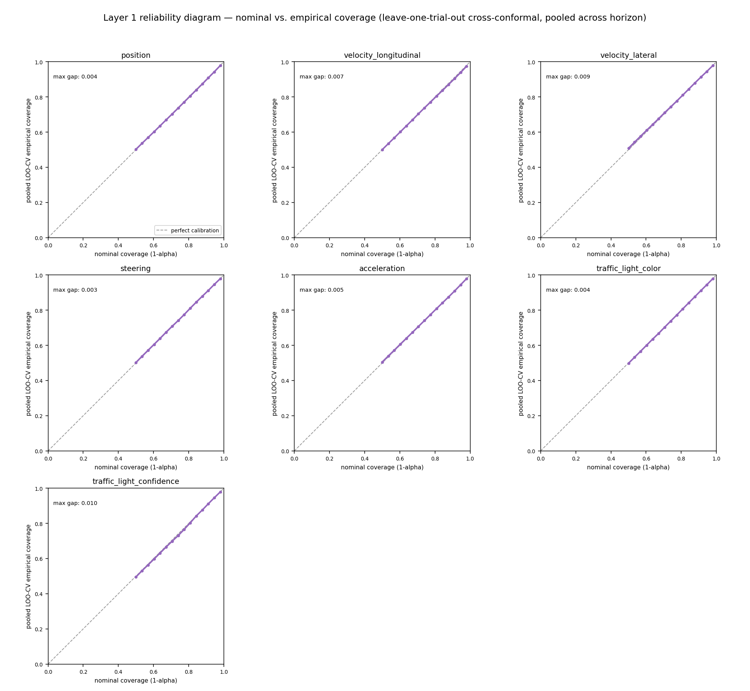
MODEL PREDICTIONS & CALIBRATION
What "calibrated" means in plain terms: if we ask for a band that should contain the truth 90% of the time, it actually does, not 70%, not 99%, 90%. This plot sweeps that check across a whole range of confidence levels, not just one point, and the result tracks the diagonal (perfect
calibration) closely for every feature.
Notes:
This is the calibration check for Layer 1.
What "calibrated" means in plain terms: if we ask for a band that should contain the truth 90 percent of the time, it really does, not 70, not 99. This plot sweeps that check over a whole range of confidence levels for every feature. A perfectly calibrated model traces the diagonal, and after the switch to conformal calibration every feature tracks it closely.
This matters for everything downstream: Layer 2's envelope is built from these errors, so if they claimed the wrong confidence, the risk numbers would be wrong in a way nobody could see.
--- Earlier background notes ---
"Here's the model's raw output on a held-out nominal drive. The dashed
line is what it predicted three seconds out, the solid line is what
actually happened — position on the map, plus velocity, steering, and
the two traffic-light channels underneath. It tracks well. Point
accuracy is good."
THE PIVOT (say this explicitly, don't skip it):
"So — why isn't this the end of the story? Why can't we just ship this
and move to Layer 2?
Because point accuracy is not the claim this framework is making. Look
at the circles around the predicted trajectory — those are the model's
stated UNCERTAINTY, not its prediction. The prediction being close to
the truth tells you the mean is good. It tells you nothing about whether
those circles are the right SIZE. A model can nail the trajectory and
still be completely wrong about how confident it should be — those are
two different, independent things to get right, and this plot only
verifies the first one."
"Every one of those uncertainty circles is a promise: 'the true value
will fall inside this region X% of the time.' That's not a decoration on
the plot — it's the entire product this layer of the dissertation is
selling. Layer 1's whole job is to hand downstream consumers a number
they can trust: 'I'm 90% confident.' If that number is wrong — if 90%
confidence intervals actually only catch the truth 60% of the time, or
99% of the time — the number is a lie wearing the shape of a
probability.
And a monitor that's confidently wrong is worse than one that's honestly
unsure. Nobody downstream can tell the difference between a trustworthy
90% and a fabricated 90% just by looking at it — they have to take it on
faith unless we've separately checked it. That check is calibration, and
it's a completely different question from 'did the model predict the
right trajectory.'"

Slide 19
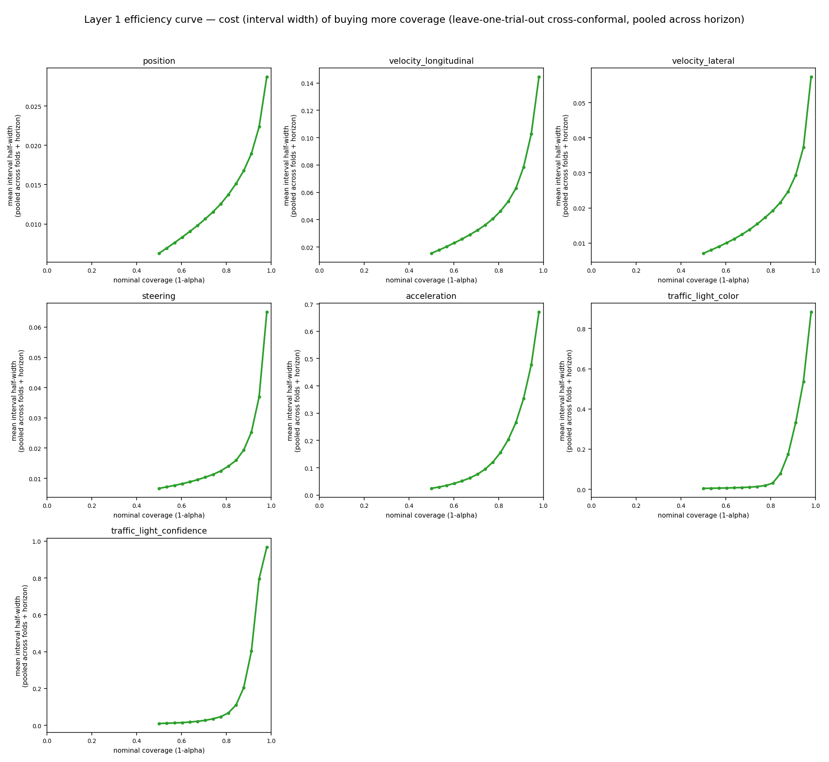
MODEL PREDICTIONS & CALIBRATION
A calibrated interval that's absurdly wide is technically "valid" and useless, this plot is the honest companion check:
How much does the interval have to grow to buy more coverage. Both traffic-light features show a sharp elbow around 80-85% coverage, which is a real, data-driven
reason to operate at a 90% target rather than pushing toward 98%.
BUT, a single pooled number can hide a real problem, and it did…..
Notes:
This is the companion check. A calibrated interval that's absurdly wide is technically valid and useless, so here we ask how much the interval has to grow to buy more coverage.
Both traffic-light features show a sharp elbow around 80 to 85 percent coverage, which is a data-driven reason to operate at a 90 percent target rather than pushing towards 98.
But a single pooled number can hide a real problem, and it did, which is the next slide.
--- Earlier background notes ---
"So here's that check. For every feature, we ask the model for
intervals at every confidence level — 10%, 20%, ... 90% — and measure
how often the true value actually landed inside. Plot that empirical
rate against what was claimed, and a perfectly honest model traces the
diagonal: ask for 70%, get 70%.
This is what we got instead, back when the model's own trained
uncertainty heads were producing these numbers. Every single feature
bows well above the diagonal — ask for a 50% interval, actually get
covered 70-80% of the time. The claimed number and the real number don't
match, by a lot — the gap is 0.16 to 0.28 depending on the feature.
Conceptually, what does that mean? It means the '70%' printed on the
label doesn't mean 70%. In this particular direction the model was
erring wide — safe-looking, not reckless — but that's beside the point:
a probability that doesn't mean what it says isn't usable as a
probability, in either direction. And notice the title: this is checked
ONE STEP AHEAD ONLY. That's about to matter."

Slide 20
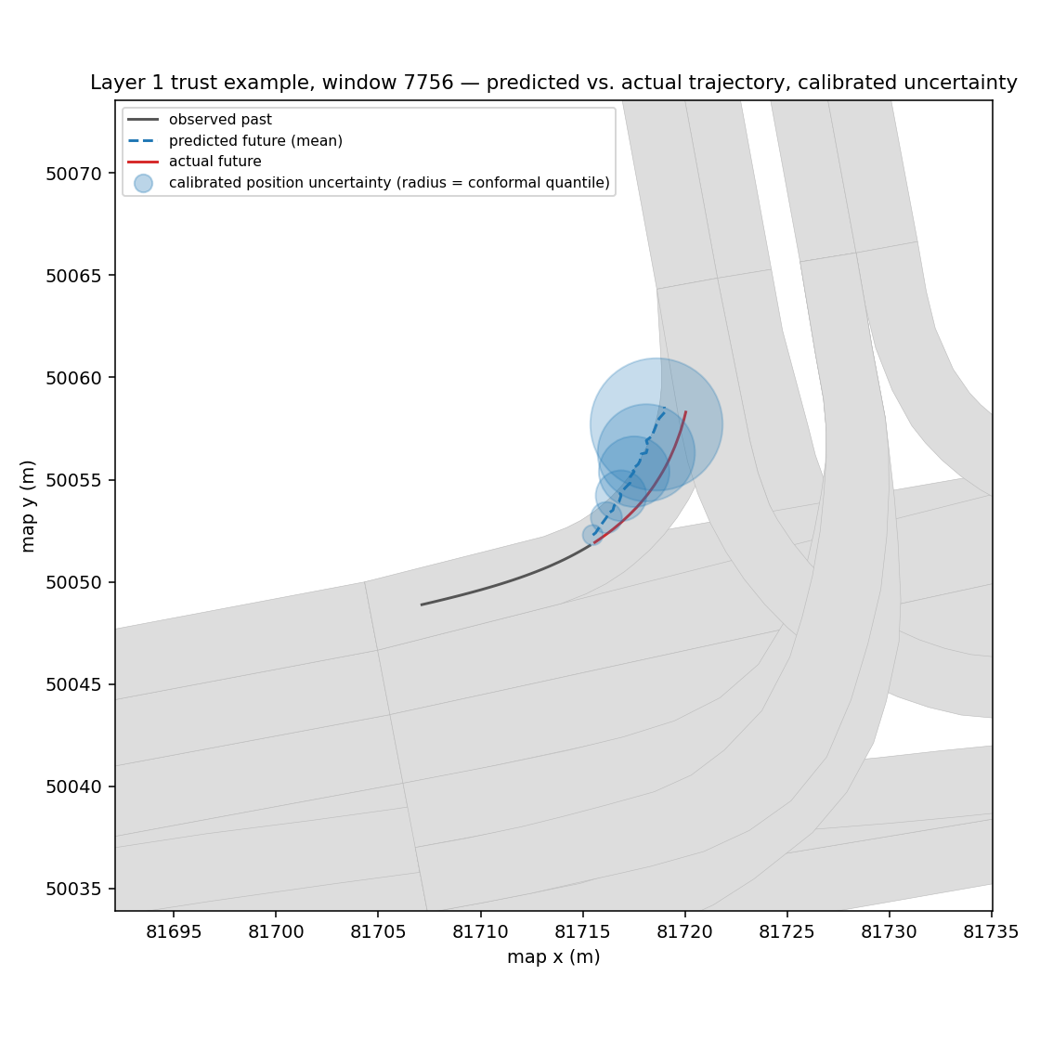
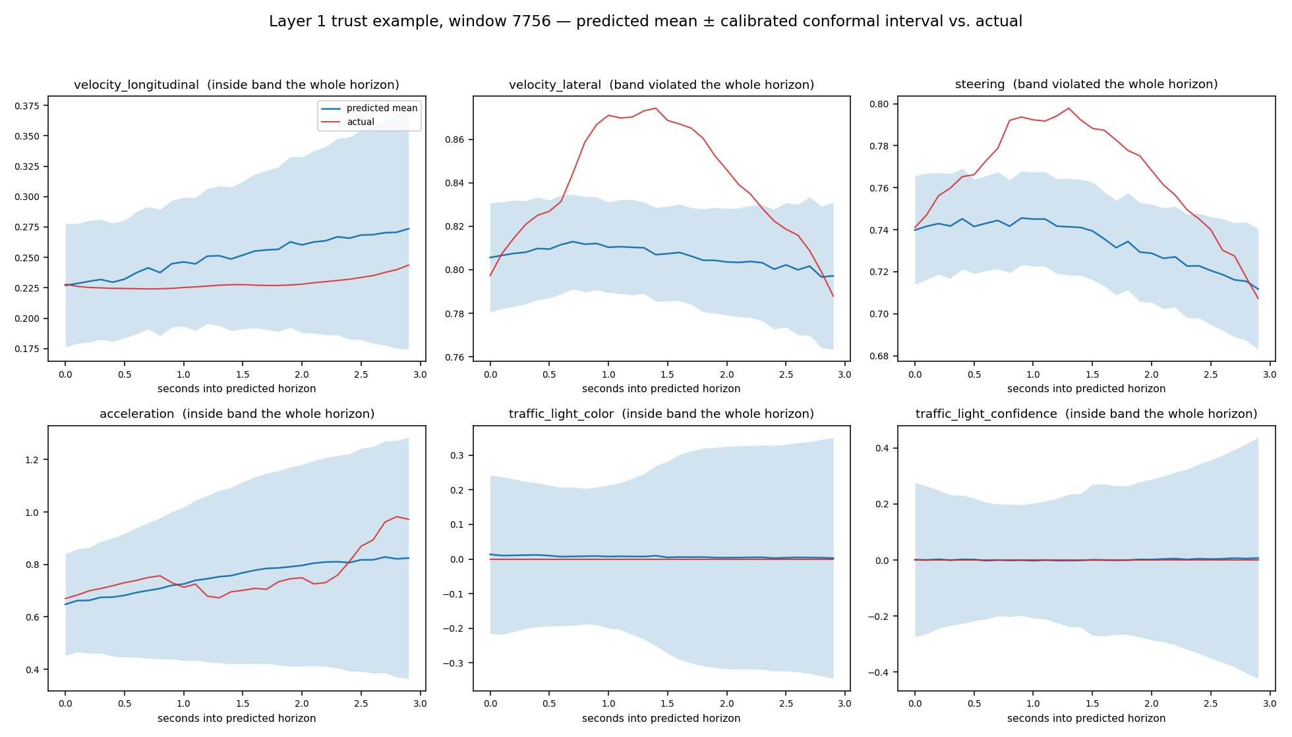
MODEL PREDICTIONS & CALIBRATION
The predicted trajectory visibly undershoots the real turn, steering and lateral-velocity predictions barely rise while the vehicle actually turns sharply. The model wasn't reading the route ahead well enough to anticipate turns it hadn't already started.
Notes:
This is that hidden problem. On turns, the predicted trajectory visibly undershoots the real turn: the steering and lateral-velocity predictions barely rise while the vehicle actually turns sharply.
On turns the vehicle hasn't started yet, the predicted heading change captured only about half of the real one. Most of what looked like turn prediction was the model extrapolating a turn already under way, not anticipating one from the map. And that matters for trust: if turns produce systematically larger errors, a real fault near a turn gets confused with the turn's normal difficulty.
--- Earlier background notes ---
On turns the vehicle hasn't started turning into yet, predicted heading change captures only ~48% of the actual magnitude (vs. ~65% once already mid-turn), most of what looked like "turn prediction" was the model extrapolating a turn already underway, not genuinely anticipating one from the map.
Why this matters for trust, not just accuracy: if ordinary turns produce systematically larger errors than calm driving, the SAME pooled coverage number above either has to stay wide everywhere to remain valid on turns,or — worse — a real fault occurring near a turn gets its effect conflated with the turn's own normal difficulty and partially masked.

Slide 21
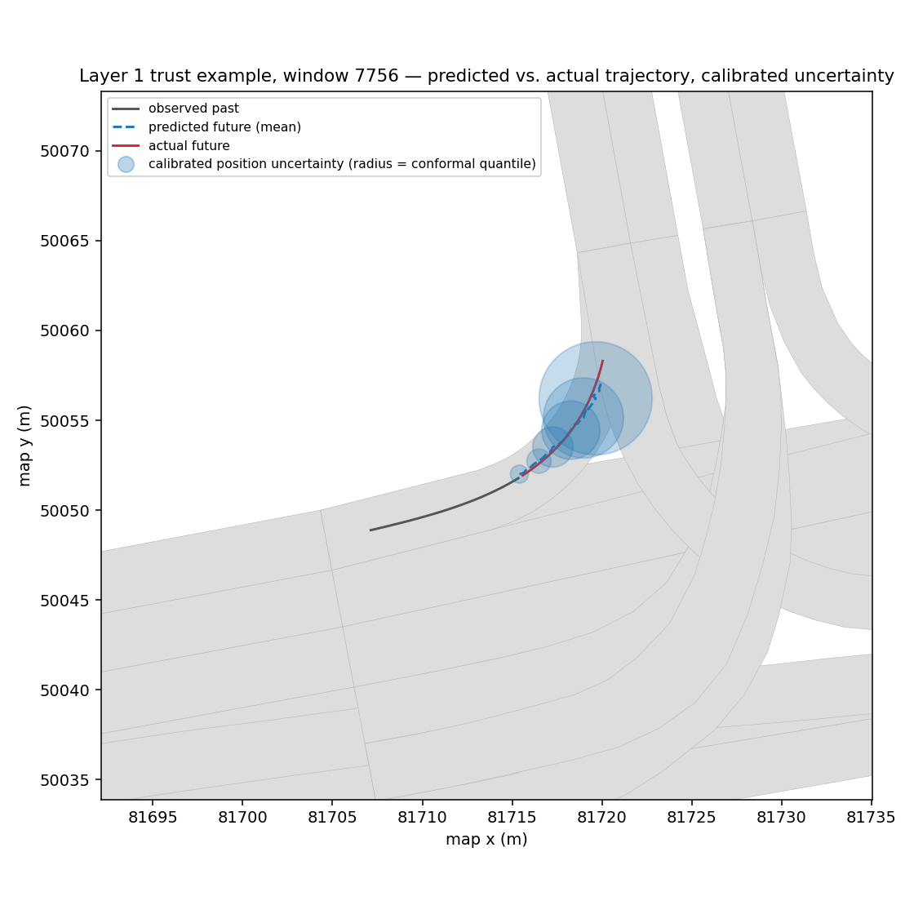
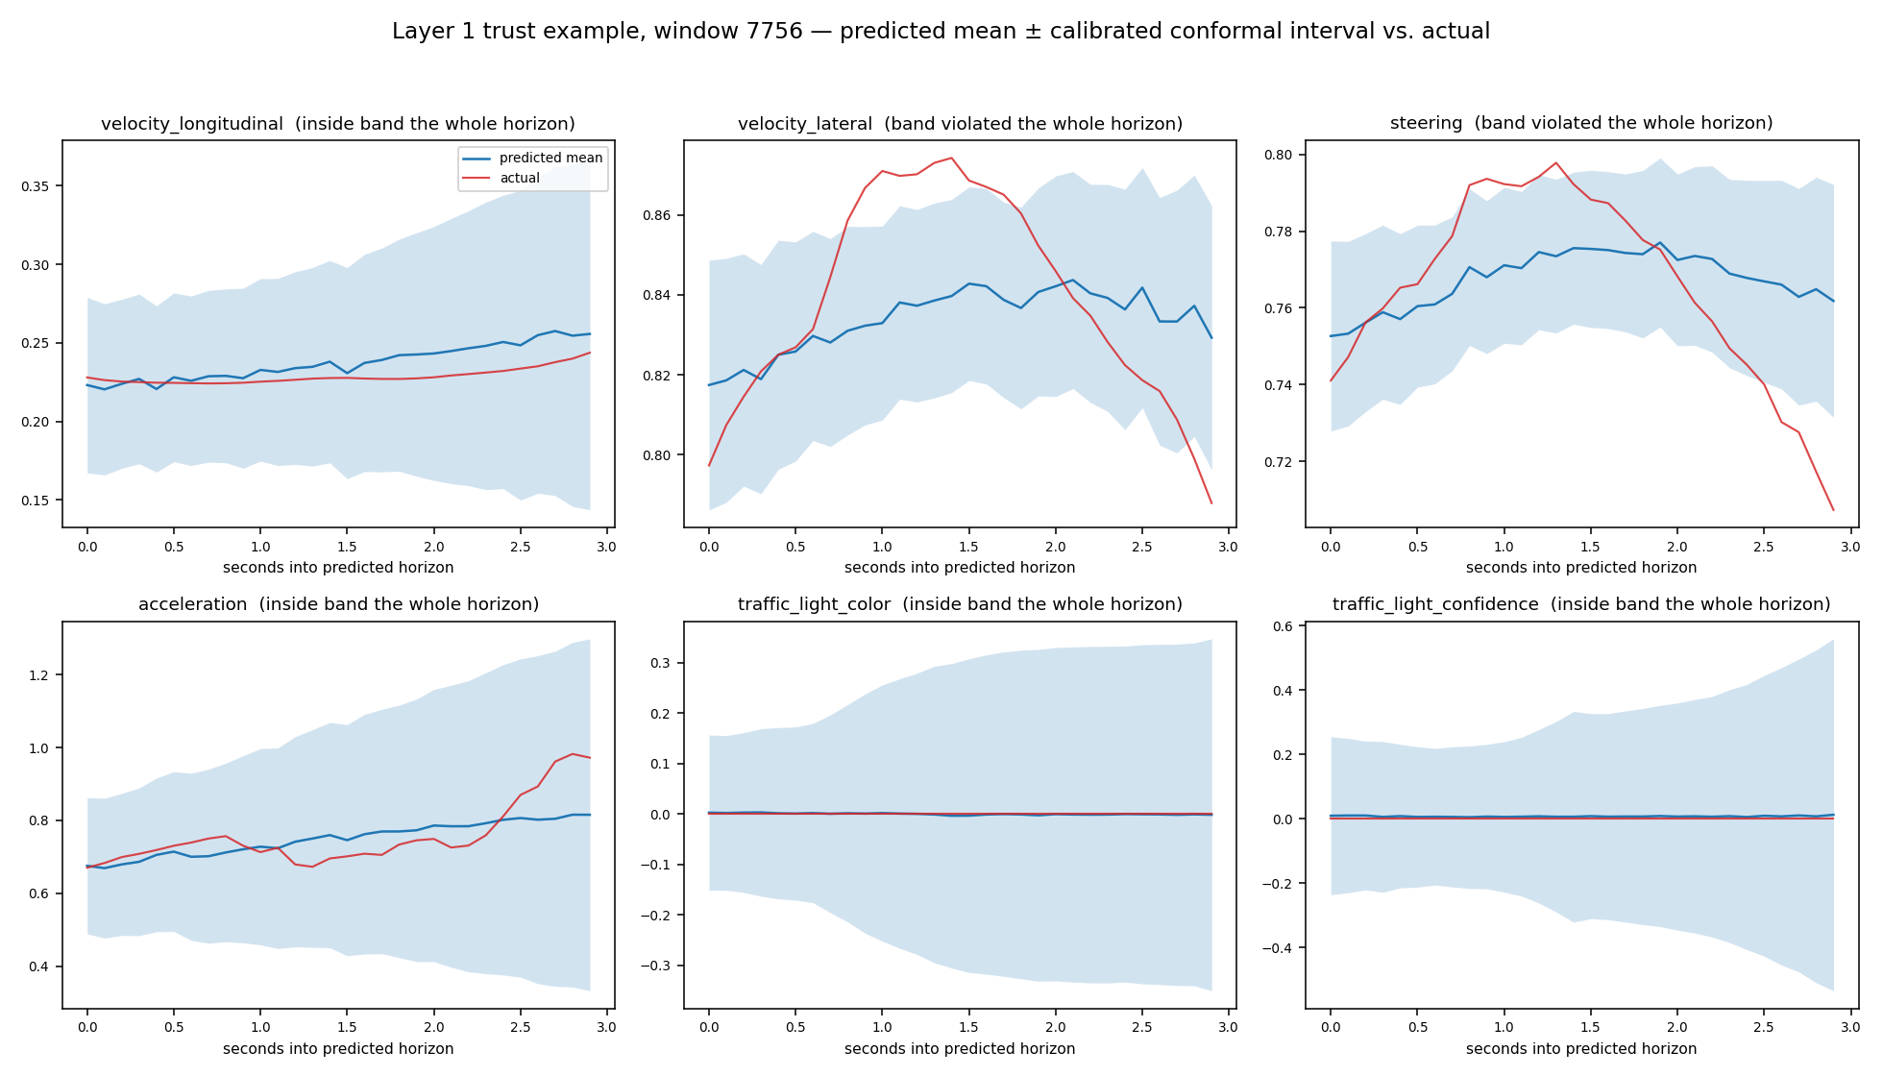
MODEL PREDICTIONS & CALIBRATION
Pooled steering coverage reads ~90% (looks fine), but splits into 94.2% on calm driving and only 75.6% near intersections.
The fix:
→ Oversample turn/intersection-proximate windows during training, weighted by each window's OWN actual difficulty
→ Fully data-driven: weights are inverse-frequency-derived from whatever the CURRENT training set's distribution actually is
Notes:
And this is the fix. Pooled steering coverage read about 90 percent, which looks fine, but it split into 94 percent on calm driving and only 76 percent near intersections.
So we oversampled turn and intersection windows during training, weighted by each window's own difficulty, fully data-driven. After the retrain, the predicted trajectory hugs the real curve, and the steering and lateral-velocity predictions rise with the real manoeuvre. Intersection steering coverage went from 76 to 87 percent, position error on the hardest turns dropped by about half, at a small cost on calm driving.
--- Earlier background notes ---
Why fix the model instead of just widening the calibrated band there: widening the interval near intersections is statistically honest but
costs detection sensitivity exactly where faults are most often relevant (slide 8's zone geometry is literally where faults are gated to occur) —
a wider-but-honest band there is a worse trade than a model that's actually better at turns.
the
predicted trajectory now visibly hugs the actual curve, and steering/
lateral-velocity predictions clearly rise and peak with the real
maneuver instead of staying flat.
Validated, not just visually — intersection steering coverage: 75.6% →
87.3%. Position residual on the hardest turn cases: down 47%. Real,
measured, expected trade-off: calm-driving accuracy costs a few percent
(the model is now mildly biased toward expecting more curvature
everywhere) — an honest, worthwhile trade given what improved.

Slide 22
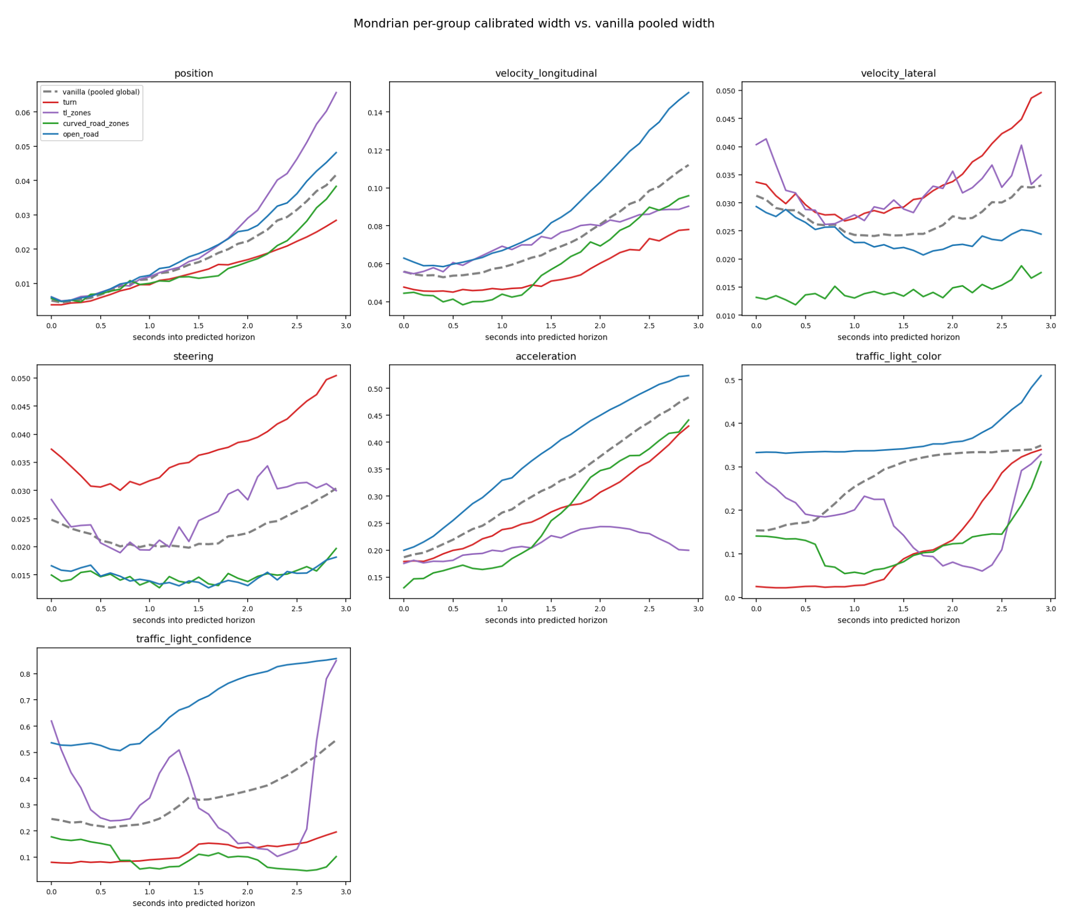
CONDITIONAL CALIBRATION
Once the model itself is better, a sharper calibration question remains:
Should the interval WIDTH itself vary by scenario, not just be validated per scenario? Two approaches, built and compared:
Approach A: Mondrian (discrete group-conditional) conformal calibration:
Partition calibration data into zone categories (turn / intersection / curved-road / open-road), fit a SEPARATE calibrated interval per group instead of one pooled number.
Notes:
Once the model was better, a sharper question: should the interval width itself depend on the scenario?
Approach A is Mondrian, or group-conditional, conformal calibration: split the calibration data by zone type, turn, intersection, curved road, open road, and calibrate each group separately. Every group then lands near the 90 percent target. The cost is that smaller groups need more padding, so some intervals get 11 to 19 percent wider on average.
--- Earlier background notes ---
Every group now lands close to the 90% target — the hidden gap from
slide 11 (before the retrain) is resolved. But: NOT a free win.
Size-weighted across how common each group actually is, steering and
traffic-light-confidence intervals are actually ~11-19% WIDER on average
under this scheme, not tighter — smaller per-group sample sizes need more
statistical padding. Real, honest cost, not hidden.

Slide 23
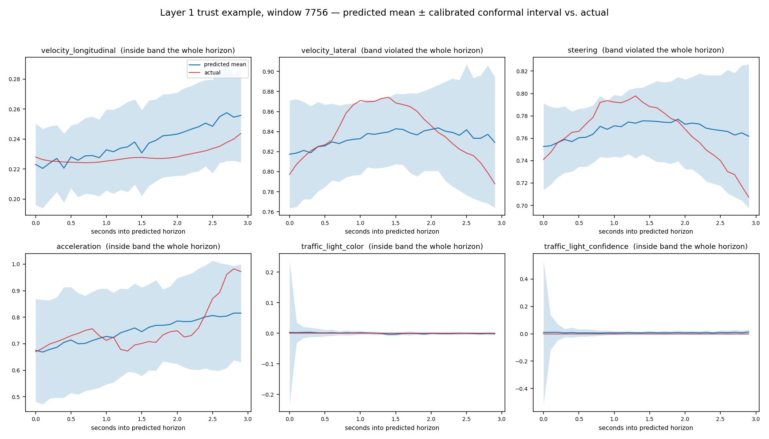
CONDITIONAL CALIBRATION
Approach B: continuous conditioning on the model's own learned scene representation. Find the k most similar past scenes by the model's own internal representation of "what kind of situation is this," calibrate against just that neighborhood
Notes:
Approach B conditions continuously on the model's own scene embedding: for each window, find the most similar past scenes by the model's internal representation and calibrate against just that neighbourhood.
Its advantage is that it improves automatically when the model improves, and it can tighten as well as widen. Its cost is noisier estimates from less data per estimate.
This is now the basis of Layer 2's step 2a: the envelope's futures are built from the real errors of the 150 most similar calibration scenes in this embedding.
--- Earlier background notes ---
Distinguishing property discrete grouping structurally cannot match: this
approach improves AUTOMATICALLY when the underlying model improves — no
manual re-definition of group boundaries needed. Directly confirmed:
after the slide 11 retrain, BOTH the baseline and this approach's result
improved together with zero changes to the calibration scheme itself. It
can also tighten a feature where the pooled calibration was already fine,
not just widen where needed — Mondrian's fixed categories can't do that.
Honest cost: noisier per-step estimates (visible as a real, sudden
widening on an otherwise calm example) from having less data per estimate.
Where this leaves things: neither is a strictly better default — the
right choice likely depends on how much data is available and how
consequential the target scenario is. Both are documented, reproducible,
and available.

Slide 24
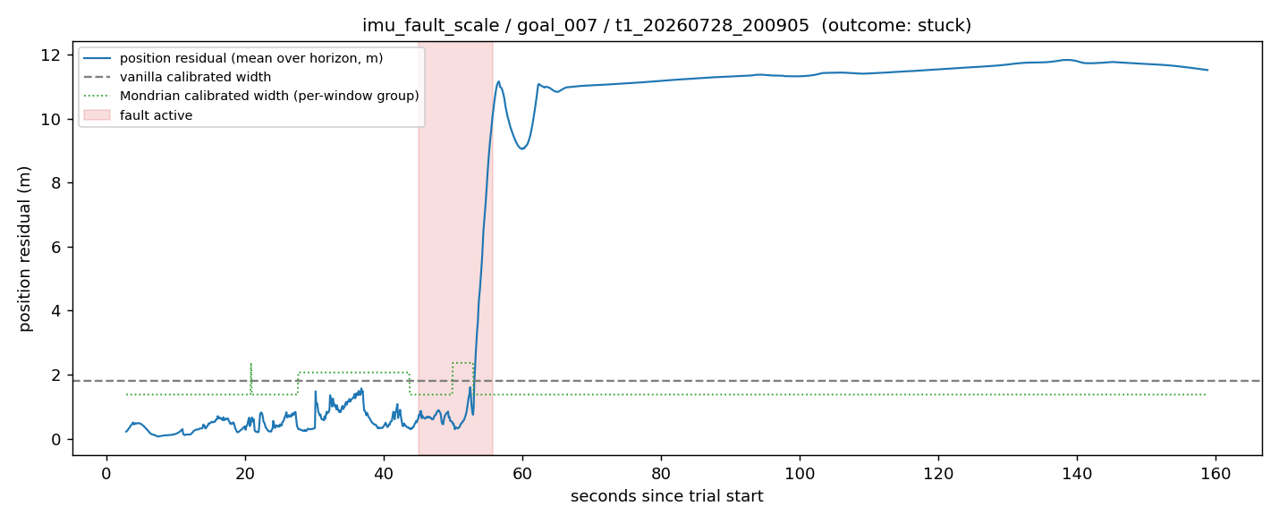
LAYER 1 vs FAULTS
IMU faults corrupt STATE ESTIMATION. Residual triples during the fault window, then KEEPS GROWING afterward instead of recovering, from 44% exceeding the calibrated band right after the fault "ends" to 78% by 60-120 seconds later. A corrupted internal position estimate doesn't self-heal once poisoned.
Notes:
This is Layer 1 against real faults, here the gyro scale fault on goal 7.
IMU faults corrupt state estimation, and the residual shows it: it rises during the fault window and keeps growing afterwards instead of recovering, from 44 percent of points outside the calibrated band right after the fault to 78 percent a minute or two later. A corrupted position estimate doesn't heal on its own.
This is where we were at the last meeting: Layer 1 tells us WHEN, reliably. What it couldn't tell us was how much and which way, which is what the consistency heads and the pose-error filter now add.
--- Earlier background notes ---
"And this is the direct fix for Beat 4's problem. Same plot shape as the
horizon-widening plot — claimed uncertainty vs. actual RMSE across the
3-second horizon — except now the green interval-width line tracks the
blue actual-error line for all seven series, including the non-monotonic
dip-then-rise shape velocity and steering actually have. The interval
isn't just wide, it's shaped correctly — it grows exactly when the real
difficulty grows, because it's built from that empirical shape directly
instead of a network's guess at it."
"Put together: when this model now reports a 90% interval, at any point
in the 3-second window, reality really does fall inside it about 90% of
the time. That statement is now actually true — checked, not assumed.
Why does that matter for Layer 2? Layer 2's entire mechanism is taking
this predicted distribution and rolling it forward through counterfactual
futures to estimate risk — 'given what I don't know right now, what's
the chance this turns into a safety-margin violation in the next few
seconds.' That computation is only as honest as the distribution it
starts from. If the input uncertainty is miscalibrated — too narrow at
exactly the horizon that matters, the way it was in Beat 4 — Layer 2
would inherit that error silently and produce a risk number that's wrong
in a way nobody could catch just by looking at it. It would look like a
working system right up until it wasn't.
Now Layer 2 gets to build on a foundation that's actually been checked,
not just assumed. That's what 'Layer 1 is done' means concretely: not
'the model is perfect,' but 'the uncertainty Layer 2 is about to consume
means what it says.'"

Slide 25
INTERPRETATION AND NEXT STEPS
What the arc actually showed (the meta-result, not just the numbers):
Grounding this framework's own credibility FIRST, before building anything on top of it, was the right call, it surfaced a real problem (measurable miscalibration) that would have silently undermined every downstream result otherwise
The fix that worked was a genuine pivot (conformal on a plain point predictor), not a patch on the original approach.
The question Layer 2 should answer:
A weird residual on an empty straight road is noise; the same residual approaching an occluded intersection is a crash. Map anomaly to actual risk by rolling counterfactual futures forward through the digital twin, same substrate as Layer 1 (per-feature residuals), different question asked of it ("so what," not "how surprising").
What we need next:
Richer, continuous "bad event" logging, current collision/stuck heuristics are too rare/unreliable. Need continuously-loggable margin violations (time-to-collision, minimum following distance, lateral lane-boundary margin)
More nominal trials
Conditioning the conformal quantile on the model's own learned scene embedding (graph context / h_last), plumbing to borrow statistical strength across similar situations; layered on top of, not replacing, the existing per-horizon-step quantiles
Notes:
This was the conclusion at the last meeting, kept so you can see what's changed since.
Grounding the framework's credibility first was the right call: it found a real miscalibration that would have undermined everything downstream, and the fix was a genuine pivot to conformal calibration on a point predictor.
The question for Layer 2 was: a weird residual on an empty straight road is noise; the same residual approaching an intersection is a crash. Since then we've built exactly that, and conditioned the uncertainty on the model's own scene embedding, which is the third item here. The first item, continuous bad-event logging, is now the road-departure and object safe sets. What remains from this list is more nominal data.

Slide 26
The pose-error filter: inputs and symbols
Input | What it is | From
g_ψ | residual: pose yaw rate − vehicle yaw rate [rad/s] | consistency head 3
g_a | residual: pose along-track speed − wheel speed [m/s] | consistency head 4
g_l | residual: pose lateral speed − vehicle lateral speed [m/s] | consistency head 5
v | vehicle speed [m/s] | input: vehicle report
w | LiDAR health, 0 (no trust) to 1 (full trust) | inputs: EKF gate distance, NDT match probability vs nominal
Symbol | Meaning
ψ | heading error = believed − true heading
x, y | along-track / lateral position error (believed − true), in the believed heading frame
δ = (ψ, x, y) | the pose error
δ̂, P | its estimate, and the estimate's covariance (uncertainty)
ψ̇, ẋ, ẏ | rate of change per second
dt | time step, 0.1 s
R0 | precision of a healthy LiDAR match (0.5°, 0.1 m)
Q | how fast δ drifts in nominal driving (from data)
residual = observed gap − predicted nominal gap (forecasts made in the last 0.5 s, at their latest observed step): the model removes what is normal for this scene.
Not used by the filter: heads 1–2 and the behaviour heads → Layer 1 WHEN, which decides whether the envelope moves.
Notes:
Before the equations, here is exactly what goes into the filter, and a legend for every symbol, so the next two slides are easy to read.
The filter uses three of the model's outputs: the residuals of consistency heads 3, 4 and 5. g-psi is the residual of the pose-yaw-rate gap, in radians per second. g-a is the residual of the along-track speed gap, and g-l the residual of the lateral speed gap, both in metres per second. A residual here is the observed gap minus the head's predicted nominal gap, averaged over the forecasts made in the last half second at their latest observed step. So the prediction removes the part of the gap that's normal for this scene.
Two more inputs that aren't model outputs: v, the vehicle's own speed from the velocity report, and w, the LiDAR health weight between 0 and 1, built from the two localization-health inputs compared with their nominal quantiles.
What the filter does not use: heads 1 and 2, and the behaviour heads. Those feed Layer 1's WHEN, which decides whether the envelope moves at all.
On the right is the symbol legend. The pose error delta has three parts: psi, the heading error, believed heading minus true heading; x and y, the along-track and lateral position errors, believed minus true, measured in the believed heading frame. Delta-hat is our estimate of it, P the covariance, meaning how uncertain the estimate is. A dot over a symbol means its rate of change per second. dt is one time step, 0.1 seconds. And R0 is how precise a healthy LiDAR match is: half a degree and 10 centimetres.

Slide 27
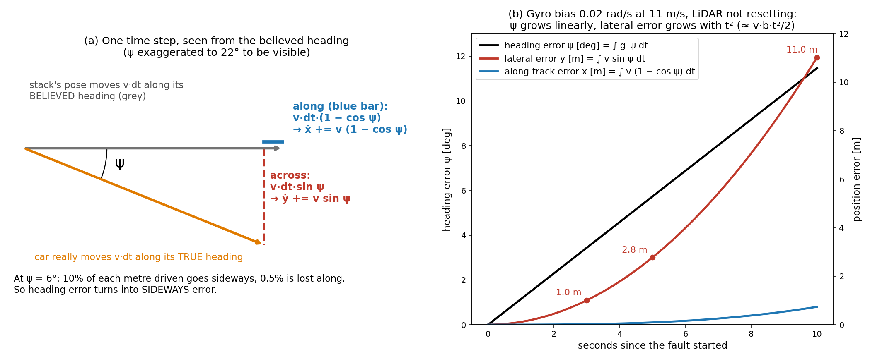
Growth: where the sine and cosine come from
Growth: ψ̇ = g_ψ ẋ = g_a + v(1 − cos ψ) ẏ = g_l + v·sin ψ
The pose moves v·dt along its believed heading; the car moves v·dt along the true heading, ψ away. Split the true step: cos ψ along, sin ψ across. The difference is the error growth; the gaps g_a, g_l add any extra motion of the pose (e.g. a LiDAR correction).
Under the IMU faults the pose moves at wheel speed along its own heading, so g_a ≈ g_l ≈ 0: the lateral error grows only through v·sin ψ.
Notes:
This is the derivation of the growth equations, conceptually.
Look at panel a. Take one time step, dt, and look at it from the believed heading, the grey arrow. Autoware's pose moves forward by v times dt along the heading it believes. But the car really moves the same distance along its true heading, the orange arrow, which is psi away. I've exaggerated psi to 22 degrees so you can see it.
Now split the true step into two parts relative to the believed heading. The part along it is v dt cos psi; the part across it is v dt sin psi. That's just the definition of sine and cosine in a right triangle. The believed pose went v dt straight ahead, so after one step the believed position is ahead of the truth by v dt times one minus cos psi, the blue bar, and off to the side by v dt sin psi, the red dashed line. Divide by dt and you get the rates: x-dot gains v times one minus cos psi, and y-dot gains v sin psi.
The g terms add whatever extra motion the pose made that the vehicle didn't: g-a and g-l. And the heading error just grows at the yaw-rate gap: psi-dot equals g-psi.
Two things make this matter. At small angles, sin psi is about psi and one minus cos psi is about psi squared over 2. At 6 degrees, 10 percent of every metre driven goes sideways but only half a percent is lost along the track. So heading error turns into sideways error, not along-track error.
And under the IMU faults, Autoware's pose moves at wheel speed along its own heading, so g-a and g-l are about zero, and the lateral error grows only through v sin psi. When LiDAR does correct the pose sideways, that shows up in g-l with the opposite sign.
Panel b integrates it for a constant gyro bias of 0.02 radians per second at 11 metres per second, with no LiDAR reset. Psi grows linearly, to 11 degrees after 10 seconds. The lateral error grows with time squared: 1 metre at 3 seconds, 2.8 at 5, 11 metres at 10. Along-track stays under a metre. That quadratic growth is why these faults look harmless for a few seconds and then leave the road quickly.

Slide 28
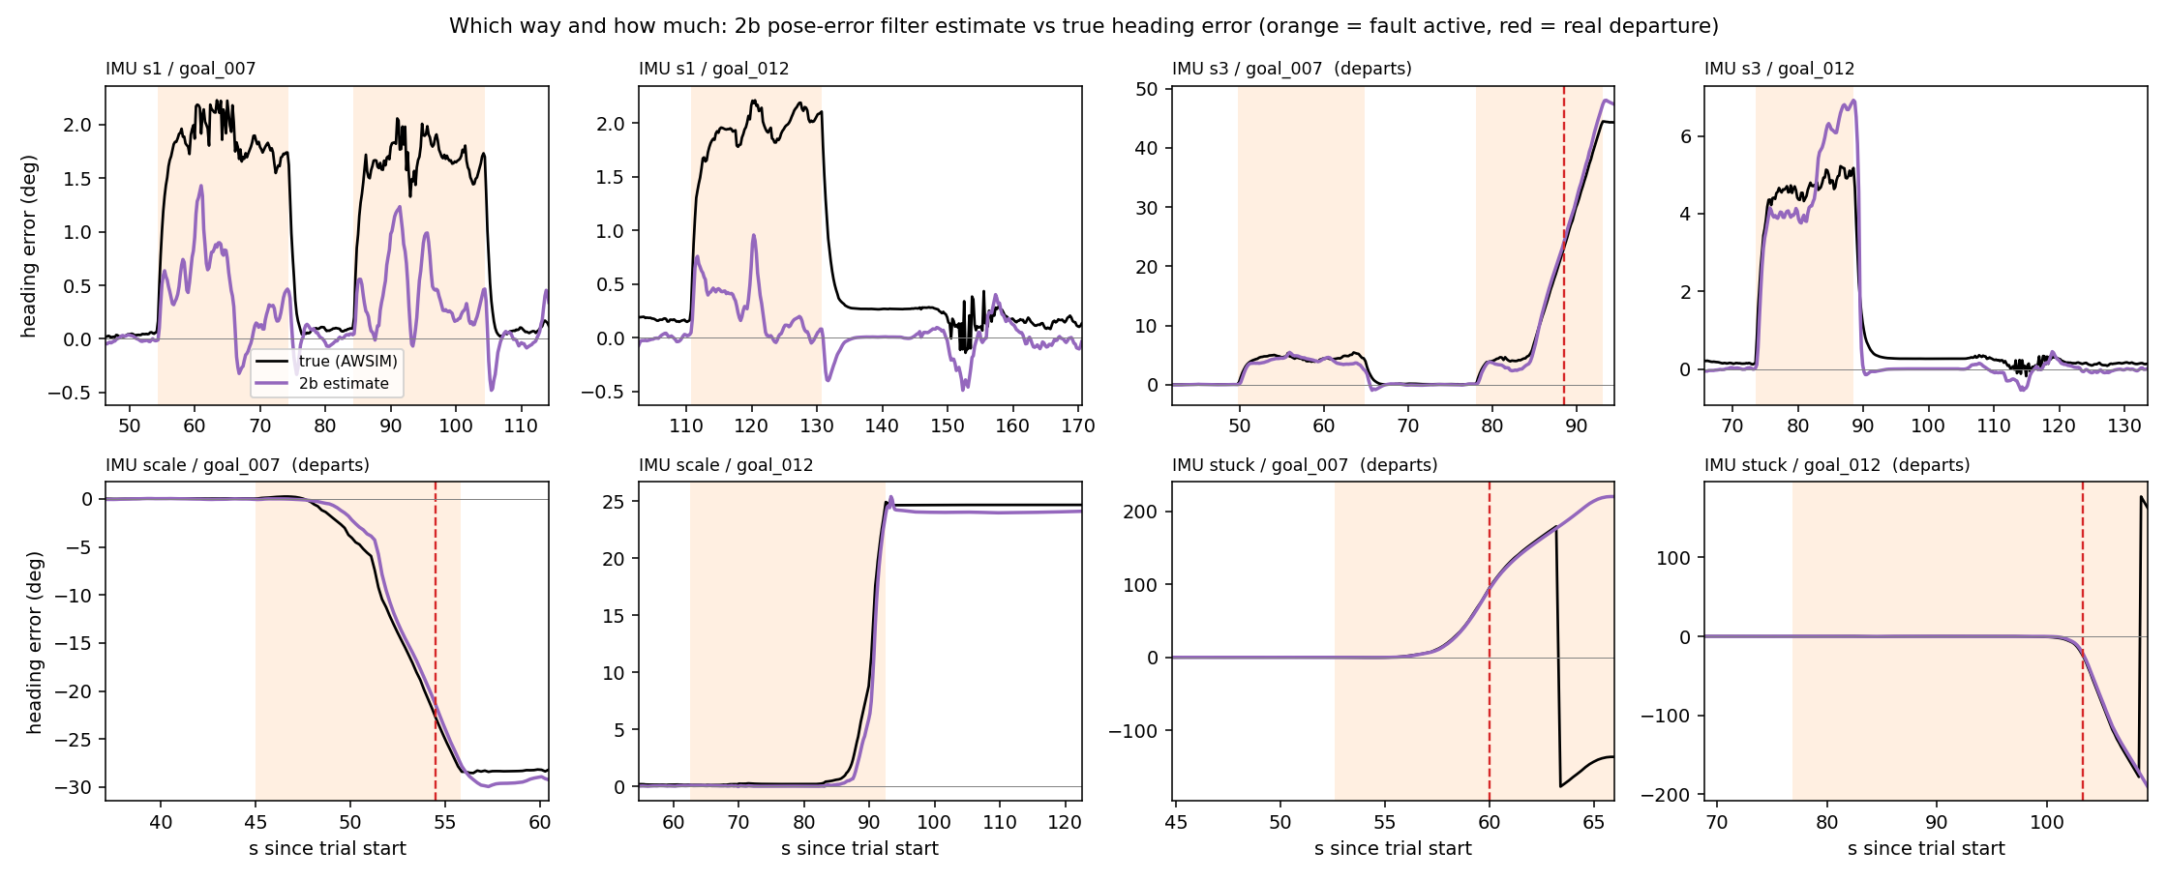
From gap to pose error: one filter
Reset (LiDAR matched to the map):
healthy → "δ ≈ 0", trusted in proportion to w ∈ [0, 1]; the EKF rejecting LiDAR → w = 0, no reset.
Each 0.1 s step:
1 Predict: δ ← δ + growth·dt; P ← F P Fᵀ + Q·dt
2 Update (if w > 0): K = P (P + R0/w)⁻¹; δ ← δ − K δ; P ← (I − K) P
K large (LiDAR trusted, we are unsure) → strong pull to 0
w = 0 → no pull, δ keeps growing
Output: δ̂ and P → Layer 2 (move the envelope), Layer 3 (correct: true pose ≈ believed − δ̂).
Checked: true error > 5° or > 1 m ⇒ LiDAR health never nominal. Nominal driving: estimate inside the nominal band 100% of the time.
Purple: filter estimate ψ̂. Black: true ψ (AWSIM). Orange: fault active; red dashed: real departure.
Notes:
Now the filter itself: growth from the previous slide, plus a reset from LiDAR.
The reset: LiDAR matched to the point-cloud map is the only absolute reference. When it's healthy, it says the pose is right, delta is about zero. We trust that in proportion to the health weight w.
Each time step has two parts. Predict: add the growth times dt to delta, and grow its uncertainty P by Q, which is how fast delta drifts in normal driving, measured from nominal data, not tuned. Update, only when w is above zero: compute the gain K, which compares our own uncertainty P with LiDAR's uncertainty R0 divided by w, and pull delta toward zero by K. If LiDAR is fully healthy and we're uncertain, the pull is strong. If w is zero, because the EKF is rejecting LiDAR, there's no pull at all and delta keeps growing.
That's a standard Kalman filter; the only unusual part is the measurement, which says "the error is zero" and is trusted according to LiDAR health.
We checked the assumption it rests on: wherever the true error was larger than 5 degrees or 1 metre, LiDAR health was never nominal. So the filter never gets reset while the pose is really wrong.
The output, delta-hat and P, goes to two places: Layer 2, which moves the envelope by it, and Layer 3, which corrects the pose: true pose is about believed pose minus delta-hat.
The plots on the right: estimated heading error in purple against the true heading error from AWSIM, in black, for all eight IMU trials. On the four departures it tracks within 1 to 3 degrees at the moment of departure.

Slide 29
Layer 2: what each stage uses
Stage | Question it answers | Built from | Depends on
2a nominal envelope | Where will I go, relative to where I THINK I am? | Forecast + 200 real error trajectories from the 150 most similar calibration scenes (model embedding) | Prediction only
2b move | Where am I REALLY, relative to where I think I am? | Pose-error estimate δ̂ and covariance P (previous slide) | Consistency only
2c safe sets | Is the real future safe? | Drivable area (HD map) and tracked objects | Neither: map and objects
Why a rigid move is the right model
Under a localization fault, Autoware's plan is right IN ITS OWN FRAME: it believes it is centred in the lane and steers to stay there. The frame is wrong.
True future = believed future, rotated and shifted by the pose error.
→ Prediction alone: P stays at its nominal value; the fault is invisible.
→ Pose error alone: you know you are 2 m off, but not whether that matters here, or how soon.
→ Together: the same 25° error is harmless on one road and a departure on another.
Notes:
Before the pictures, here's the logic of Layer 2, because the moving of the envelope only makes sense once you see what each piece contributes.
2a answers: where will I go, relative to where I think I am? That's pure prediction: the forecast, plus 200 real error trajectories taken from the 150 most similar calibration scenes, found by the model's own embedding. So the spread is how wrong the model has actually been in situations like this one.
2b answers: where am I really, relative to where I think I am? That's pure consistency: the pose-error estimate and its uncertainty from the filter.
2c answers: is the real future safe? Neither prediction nor consistency: the map and tracked objects are the judge.
The key insight is the bottom box. Under a localization fault, Autoware's plan is right in its own frame: it believes it is centred in the lane, and it steers to stay there. The frame itself is wrong. So the true future is the believed future, moved by the frame error. That's why 2b is a rigid rotation and shift. And it's why you need both halves: with prediction alone, P stays nominal and the fault is invisible; with the pose error alone, you know you're 2 metres off but not whether that matters here.

Slide 30
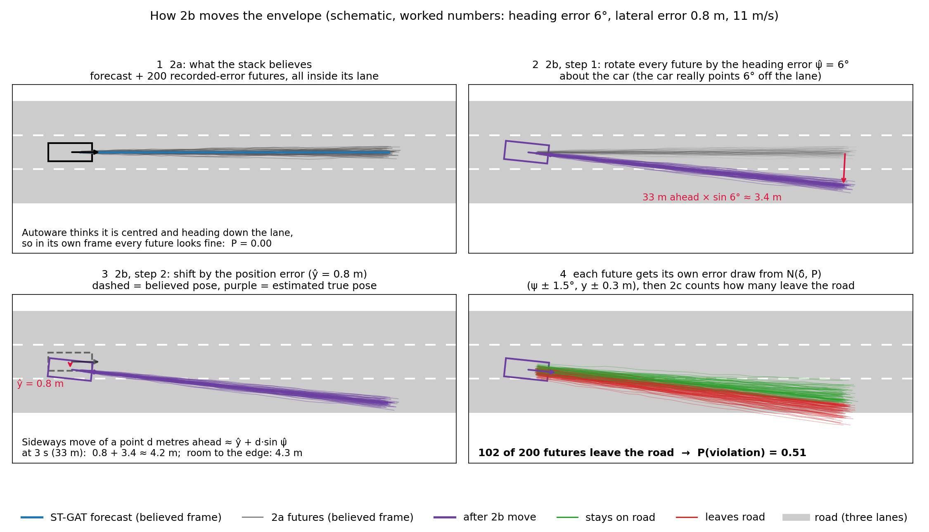
How the envelope moves, step by step
Rule of thumb: a point d metres ahead moves sideways by ≈ ŷ + d·sin ψ̂. Formally: τ_k = R(ψ_k)(μ + ε_k) + (x_k, y_k), δ_k ~ N(δ̂, P).
Notes:
This is a schematic, not data, with numbers chosen to make the arithmetic visible: a heading error of 6 degrees, a lateral error of 0.8 metres, 11 metres per second.
Panel 1: what the stack believes. Forecast plus 200 futures, all in the lane. In its own frame, P is zero.
Panel 2: rotate every future about the car by the heading error. A point 33 metres ahead, which is 3 seconds at 11 metres per second, moves sideways by 33 times sine 6 degrees, about 3.4 metres. That's the whole reason heading error dominates: it's multiplied by distance.
Panel 3: shift by the lateral error, 0.8 metres. So the sideways move at 3 seconds is about 0.8 plus 3.4, 4.2 metres, against 4.3 metres of room to the road edge.
Panel 4: we're not certain of the error, so each of the 200 futures gets its own draw of the error from the filter's estimate and covariance. Some land on the road, some don't. P(violation) is just the share that leave: here 102 of 200, so 0.51.
One rule of thumb to remember: sideways move of a point d metres ahead is about y plus d times sine psi.

Slide 31
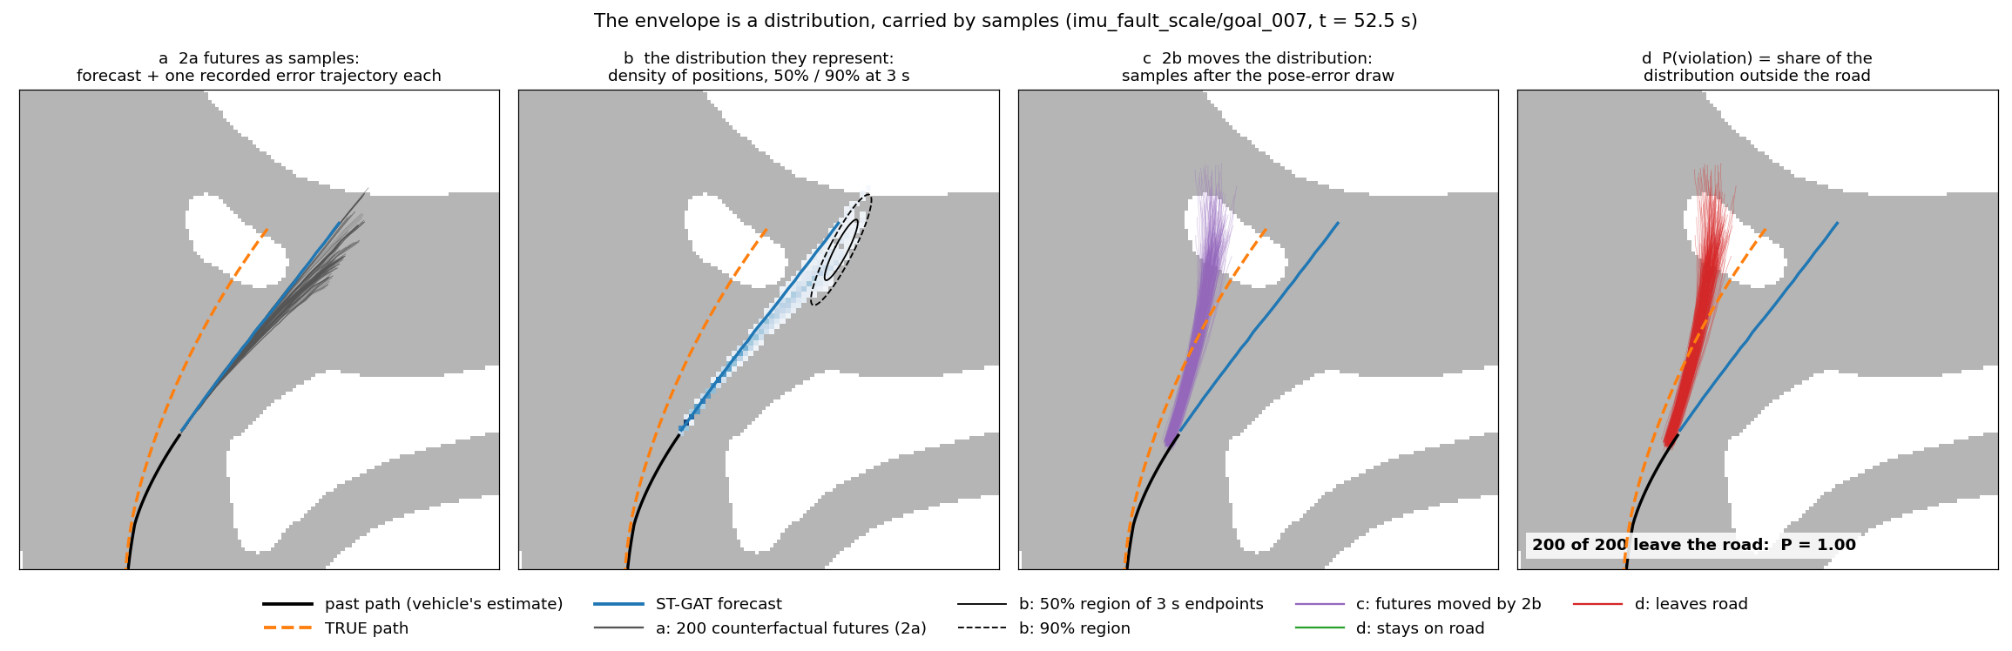
The same steps on a real departure
imu_fault_scale / goal_007, t = 52.5 s, 2 s before the real departure. Heading error: true −13.9°, estimated −12.8°.
The futures are samples of a distribution (b): each line = forecast + one real error trajectory from a similar scene. 2b moves the whole distribution onto the true path (c).
Notes:
Now the same steps on real data: the scale fault on goal 7, at 52.5 seconds, 2 seconds before the vehicle left the road.
Panel a: the 200 futures in grey, around the forecast in blue. The black line is the past path as the vehicle's own estimate saw it; the dashed orange line is the true path from AWSIM. You can see the stack believes it's going straight through, along the blue line, while the truth curves left.
Panel b: why it looks like a bunch of trajectories. Each line is one sample of a distribution. Here is that distribution as a density, with the 50 and 90 percent regions of where the car is after 3 seconds.
Panel c: after the 2b move, every sample is rotated by about 13 degrees and shifted. The purple envelope now lies along the true path, not the believed one. Our estimate at this moment was 12.8 degrees against a true 13.9.
Panel d: 2c counts. All 200 leave the road, so P is 1.0, two seconds before the actual departure.

Slide 32
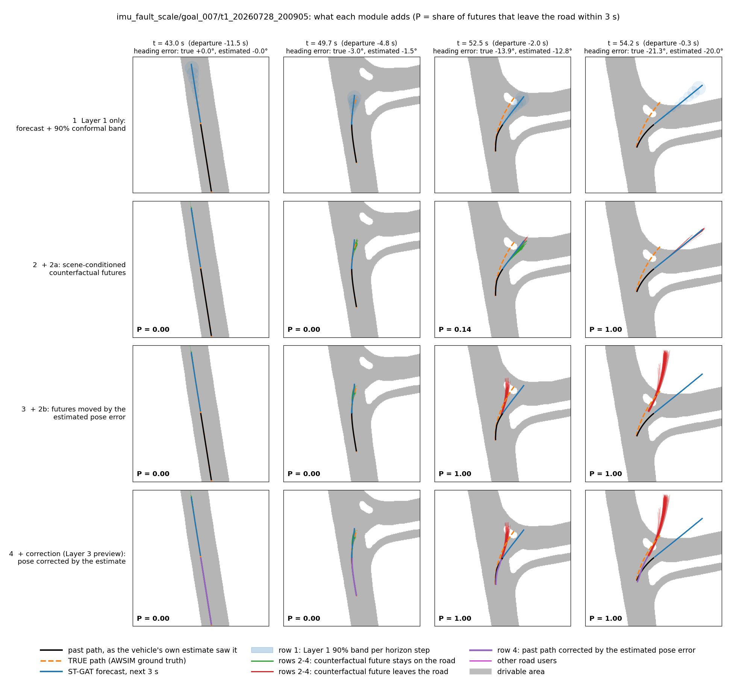
What each module adds
Rows (top to bottom)
1 Layer 1: forecast + 90% band (believed frame)
2 + 2a: scene-conditioned futures (still believed frame)
3 + 2b: futures moved by the estimated pose error
4 + correction: believed path − δ̂ (purple) lies on the TRUE path (orange)
Columns: 11.5, 4.8, 2.0, 0.3 s before the departure.
P at 2 s before departure:
2a only: 0.14 → with 2b: 1.00
Earliest column: nothing moves, P = 0 in every row.
Notes:
This is the filmstrip by module, same trial. Each column is a moment before the departure: 11.5, 4.8, 2 and 0.3 seconds before. Each row adds a module.
Row 1, Layer 1 alone: forecast and calibrated band. It's in the believed frame, so it never leaves the road until it's far too late.
Row 2, adding 2a: the scene-conditioned futures. Still in the believed frame, so P is 0.14 two seconds before departure.
Row 3, adding 2b: the futures move by the estimated pose error onto the true path. P goes to 1.0 at 2 seconds before departure; at 4.8 seconds, the error is still small, about 1.5 degrees, so P is still 0.
Row 4, the correction preview: the purple past path is the believed path minus our estimate, and it lies on the true orange path.
The left column, long before the fault matters, shows that nothing moves on nominal driving: P is zero in every row.

Slide 33
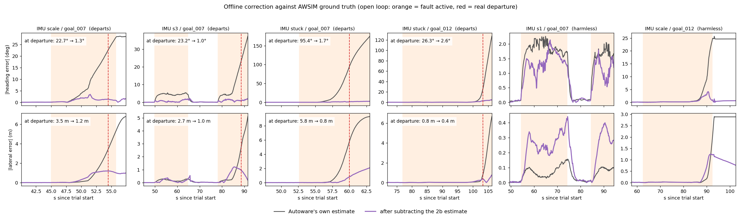
From warning to correction (offline)
At departure | scale / 007 | s3 / 007 | stuck / 007 | stuck / 012
Heading error: Autoware → corrected | 22.7° → 1.3° | 23.2° → 1.0° | 95.4° → 1.7° | 26.3° → 2.6°
Lateral error: Autoware → corrected | 3.5 → 1.2 m | 2.7 → 1.0 m | 5.8 → 0.8 m | 0.8 → 0.4 m
Open loop: the vehicle did not use the correction. Correct only while Layer 1 distrusts the state (harmless s1: 0.1 → 0.4 m if corrected).
Notes:
Once we know how much and which way, we can subtract the error rather than just warn.
The grey lines are the error of Autoware's own pose against ground truth: heading on top, lateral below. Purple is what's left after subtracting our estimate. At the moment each vehicle left the road: scale goal 7, 22.7 degrees down to 1.3; s3 goal 7, 23.2 to 1.0; stuck goal 7, 95.4 to 1.7; stuck goal 12, 26.3 to 2.6. Lateral error at departure goes from 0.8 to 5.8 metres down to 0.4 to 1.2.
Two caveats. This is open loop: the vehicle never used the correction. Whether it would have stayed on the road is what the closed-loop experiment is for. And correct only while Layer 1 says the state is off: on the harmless s1 fault, correcting raised the lateral error from 0.1 to 0.4 metres.
So P(violation)'s role changes: it decides between correcting and stopping, and confirms the mitigation worked.

Slide 34
Next: the closed-loop comparison
Configuration | Under a fault it… | Expected result
Autoware alone | does nothing | departs on s3, scale, stuck (measured)
+ Layer 1 | stops on any anomaly | safe, but stops on every harmless fault
+ Layer 2 | stops when P(violation) rises | safe, stops only when it matters
+ Layer 3 | corrects the pose; stops only if it cannot | safe, and finishes the mission
Measured: departures prevented (safety) · unnecessary stops and distance driven under fault (availability).
Steps: pose-error filter ✓ · offline correction ✓ · online node (Layers 1–2 at 10 Hz) · one Autoware interface · rerun fault scenarios per configuration.
Limits to state: only localization (IMU-type) faults can be corrected, because they have a second source; traffic-light faults can be flagged but not sized → stop. 4 departures so far; 3 s horizon.
Notes:
This is what I'd propose as the final result: a closed-loop comparison, the same fault scenarios in AWSIM, four configurations.
Autoware alone: departs on s3, scale and stuck, that's today's ground truth. Plus Layer 1, stop on any anomaly: safe but stops on every harmless fault. Plus Layer 2, stop only when P(violation) rises: safe and selective. Plus Layer 3, correct the pose with our estimate and stop only if it can't be corrected: the expectation is safe and finishes the mission.
Measured: departures prevented on the safety side; unnecessary stops and distance driven under the fault on the availability side.
Needed: an online node running Layers 1 and 2 at 10 hertz, one interface into Autoware, and rerunning the scenarios. The interface choice is one of my questions for you.

Slide 35
Novelty, paper plan and venues
Novelty: from self-consistency to consequence
→ The nominal agreement between the stack's estimates and the vehicle's reports is LEARNED (scene-dependent) and conformally CALIBRATED: no fault models.
→ It yields the state error itself: when, how much, which way.
→ That error is carried to a consequence on the real map, P(violation), separating harmful from harmless faults.
→ The same estimate drives the response: correct and continue, or stop.
Related, to cite and differentiate: analytical redundancy / FDIR (hand-built residual generators, stop at detection and recovery).
Papers and educated-guess venues
P1 Layer 1 (calibration, audit and fix, faults): IEEE IV, ITSC, or DSN (dependability framing)
P2 Layers 1 + 2 + offline correction: IEEE T-ITS or T-IV
P3 Closed loop (capstone): IEEE RA-L (+ ICRA / IROS) or T-IV; expect "simulation only" pushback
Weakness to address first: AWSIM's vehicle-side velocity is near ground truth. Real wheel odometry is noisier and slips → re-test the filter with realistic odometry noise and bias added offline.
Notes:
On how to sell it. Correction from redundant measurements by itself is old: control theory calls it analytical redundancy, or fault detection, isolation and recovery. We should cite it and say what's different.
What's different is the chain: the nominal relationship between the stack's estimates and the vehicle's reports is learned and scene-dependent, and calibrated with conformal prediction, not hand-modelled per fault. The error it yields is carried through to a consequence, P(violation) on the real map, which separates harmful faults from harmless ones. And the same estimate drives the response.
The paper plan is as before. For venues, my educated guess: Layer 1 to the IEEE Intelligent Vehicles Symposium, ITSC, or DSN if we frame it as dependability. Layers 1 and 2 with the offline correction to T-ITS or T-IV, journals that accept simulation results. The closed loop to RA-L with ICRA or IROS, or T-IV, where we should expect pushback on simulation-only.
One weakness to fix before reviewers find it: in AWSIM the vehicle-side velocity report is close to ground truth. On a real car it comes from wheel odometry, noisier and with slip. A cheap check is to add realistic odometry noise and bias offline and rerun the filter.

Slide 36
Where I need your call
1 Capstone. Is the four-configuration closed loop the right final result, with pose correction as Layer 3?
2 Paper split. Closed loop as Paper 3, or folded into Paper 2?
3 Autoware interface. Inject a corrected pose (direct, invasive), or limit speed / request a stop (easy, tests only slowing)?
4 Scenarios. False-green traffic light, tight vs wide geometry for the same IMU fault, or more nominal driving first?
Notes:
Four questions.
One: is the four-configuration closed loop the right capstone, with pose correction as Layer 3, or should Layer 3 stay with conservative responses like slowing and stopping?
Two: the paper split. Closed loop as its own Paper 3, or folded into Paper 2?
Three: the interface into Autoware. Injecting a corrected pose is the most direct test of correction but the most invasive, because it competes with Autoware's own EKF. Limiting speed or requesting a stop is easier but only tests slowing down.
Four: scenario priorities for the next lab sessions: a false-green traffic-light fault, the only TL fault that can actually cause a consequence; the same IMU fault in tight versus wide geometry; or more nominal driving first, which strengthens every calibration claim.

Slide 37
BACKUP: earlier framing
Slides after this point are hidden: the obstacle-avoidance problem statement, the result-shape plan, and the NLL/CVaR results it superseded.
Notes:
Backup divider. Everything after this slide is hidden by default: the earlier obstacle-avoidance problem statement, literature gap and formal problem, the result-shape plan written before the alarm-rate metrics were moved to internal benchmarks, and the NLL and CVaR results from that framing.
If any of it comes up, for example why we moved away from the avoidance-versus-stop classifier, unhide the relevant slide. The short answer is that the fault-focused direction gave a cleaner problem with ground truth: AWSIM tells us the true pose, so we can measure the estimated error and the correction directly.

Slide 38
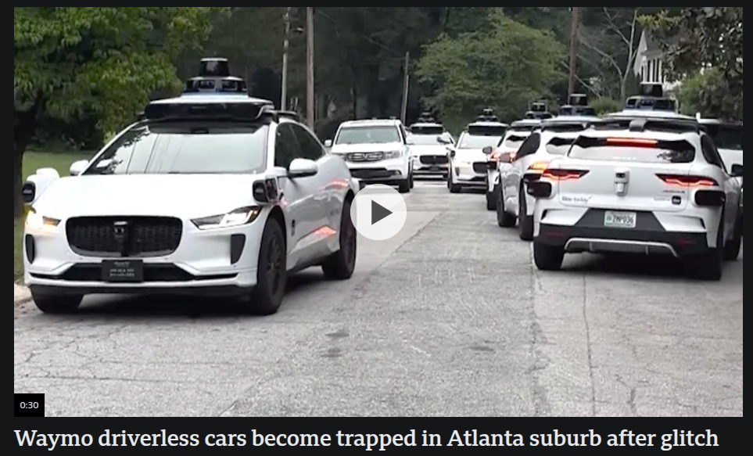
PROB: AV Safety Defaults Are Binary and Static
Scenario: autonomous vehicle encounters an unexpected static obstacle at 30m, traveling at 7 m/s
Current behavior (Autoware default):
→ Minimum Risk Condition (MRC): decelerate to a complete stop in-lane
→ Conservative, always "safe" in the collision-avoidance sense
But MRC creates secondary risks:
→ Stopped vehicle in active traffic lane → rear-end collision hazard
→ Traffic blockage, mission failure, emergency vehicle obstruction
→ In urban environments, MRC may be the MORE dangerous outcome
The right action depends on context:
→ Adjacent lane available + enough lead time → avoidance is safer
→ No adjacent lane OR obstacle too close → MRC is correct
→ Current systems cannot distinguish these cases at runtime
The gap: avoidance policy is a fixed parameter (manual vs. auto), not a runtime decision
→ No system assesses whether the specific situation makes avoidance warranted
Source: BBC, https://www.bbc.com/news/videos/czx20g00ly1o
Notes:
The concrete motivating observation: in our Autoware + AWSIM experiments, we collected 18 runs where the vehicle encountered an obstacle at 30m on a two-lane road with a clear adjacent lane. With avoidance policy=manual (the Autoware default), the vehicle stops every time. With policy=auto, the vehicle successfully avoids in every run. The system has the geometric and kinematic capacity to avoid — it simply doesn't because the policy is fixed. The question we are addressing: can the digital twin give us a runtime signal to switch that policy dynamically, and can we prove it makes the right call?
The secondary hazard point (stopped vehicle in active lane) is well-documented in ISO 26262 SOTIF annexes and in traffic engineering literature. Emphasize that MRC is not always the "safe" choice — it trades collision risk against traffic risk. This framing connects directly to Dr. Pisu's risk assessment background.

Slide 39
LIT. GAP: The Avoidance Decision Has No Owner
1. Avoidance PLANNING (well-studied):
→ MPC, CBF, polynomial trajectory optimization, reachability analysis
→ Assumption: the decision to avoid is already made upstream
→ Representative work: Ziegler et al. (2014), Brito et al. (2019), Pek & Althoff (2020)
2. Risk ASSESSMENT (well-studied):
→ Time-to-Collision (TTC), Post-Encroachment Time (PET), probabilistic risk bounds
→ Quantifies risk of current state but prescribes no action
→ Representative work: Jansson (2005), Lefèvre et al. (2014), our prior T-ITS 2025
3. Emergency Braking / AEB (well-studied):
→ Purely kinematic threshold logic: TTC < τ → brake
→ No lane availability check, no learned model, no distinction between obstacle types
→ ISO 22737, Euro NCAP AEB protocols
The gap — Avoidance DECISION-MAKING (unstudied):
→ No framework asks: "Given this specific situation, is avoidance the correct response?"
→ Systems default to MRC (stop) or avoidance (go) based on a static configuration parameter
→ The decision is made by the system integrator at deployment time, not by the vehicle at runtime
Our problem statement fills this gap:
→ Real-time binary classification: {avoidance warranted, MRC mandatory}
→ Validated across conditions where the correct answer differs
Notes:
The key point for Dr. Pisu: risk assessment tells you HOW risky a situation is, and avoidance planning tells you HOW to avoid — but nothing tells you WHEN avoidance is the appropriate response vs. stopping. This is the decision-theory layer that sits between risk quantification and action execution. It is analogous to the mode-switching logic in hybrid systems control, which is well-studied in controls theory but not in the AV safety context.
Be prepared for the question: "Isn't this just threshold-based TTC with a lane check?"
The answer is no — and this is worth defending carefully because it is the core justification for Signal 3.
Consider the false-positive problem: a vehicle decelerates toward a red light at 25m ahead, at 6 m/s. TTC = 25/6 ≈ 4.2 s. The road is two-lane. Signal 1 (topology) passes. Signal 2 (kinematic) passes if the TTC threshold is τ_min = 3 s. A pure TTC + lane-check system would output "avoidance warranted" — and Autoware would attempt a lane change at an intersection, which is dangerous. This would fire on every red light, crosswalk stop, or slow vehicle on a multi-lane road.
The fundamental problem is that "decelerating toward something 30m ahead on a multi-lane road" is kinematically and topologically identical whether that something is a red light or a blocked lane. The trajectory alone cannot distinguish them. Distinguishing them requires either (a) semantic scene understanding — classify what's ahead — which depends on the quality of the perception pipeline and fails under occlusion; or (b) a model of nominal behavior that flags when the vehicle's response is unexpected. We use (b).
The digital twin was trained on nominal driving, which includes stopping at signals, yielding at crosswalks, and following slow vehicles. When the vehicle performs a planned stop, the model predicts smooth deceleration and NLL stays low — the stop is in the model's distribution. When an unexpected obstacle blocks the lane and the vehicle executes an avoidance maneuver (lateral lane change, off-trajectory swerve), the model has no prior for that behavior at that point in the route. NLL spikes sharply — precisely because the vehicle is doing something it has never done at that location in training.
This is the only real-time evidence that distinguishes "unexpected blockage requiring a decision" from "planned stop." Without Signal 3, Signals 1 and 2 produce an unacceptable false-positive rate on ordinary urban driving. Signal 3 is the gating condition that makes the system safe to activate.
Additional nuance: lowering the TTC threshold does not solve this — it just delays the false positive until the vehicle is dangerously close. And raising it misses real fast-approaching obstacles. The residual signal has no such trade-off: it fires based on the vehicle's behavioral deviation, not on distance or time alone.

Slide 40
PROBLEM STATEMENT & CONTRIBUTION
Formal problem:
Given: Ego vehicle at speed v encountering an unexpected static obstacle at distance d
Classify in real-time: {avoidance warranted, MRC mandatory}
With: formal coverage guarantee on the classification error rate
Scope (this work):
→ Single unexpected static obstacle, obstacle detected by onboard perception
→ Single adjacent lane considered for avoidance (first-order case)
→ No NPC vehicles in adjacent lane (controlled simulation)
→ Static environment (no dynamic obstacles other than the primary one)
Hypothesis: A composite signal combining three independently necessary components correctly classifies avoidance feasibility across all failure modes:
(1) Topological feasibility: ∃ adjacent driveable lanelet in HD map
(2) Temporal feasibility: TTC = d / v_approach > τ_min
(3) Behavioral confirmation: CVaR_α(residual) > θ (digital twin detects non-nominal event)
Each component is necessary for a distinct failure mode; no two-signal subset achieves equivalent classification accuracy (ablation study).
Contribution: First empirically validated, real-time feasibility classifier for the avoidance-vs-MRC decision using a composite signal with conformal prediction coverage guarantee on the behavioral component
Notes:
The conformal prediction coverage guarantee is the formal safety claim for Signal 3. Here is the actual mechanism, explained from first principles:
CONFORMAL PREDICTION IN THREE STEPS:
Step 1 — Calibration set.
Take 9 held-out nominal driving runs (no obstacle, successful mission completion). For each run, compute the run-level behavioral score: CVaR₉₅(NLL), the expected NLL in the worst 5% of windows. This gives 9 scalar scores: s₁, s₂, ..., s₉, one per nominal run.
Step 2 — Threshold construction.
Sort the scores in ascending order. Set the threshold θ at the ⌈(n+1)(1−α)⌉-th order statistic, where n=9 and α=0.05. For n=9, α=0.05: ⌈10 × 0.95⌉ = ⌈9.5⌉ = 10, so θ = the empirical maximum of the calibration scores (most conservative). For α=0.10 with n=9: θ = the 9th largest = the 9th of 9 = the maximum. Practical note: with more calibration runs (say 20), we get θ at the 19th percentile with tighter control. This motivates collecting more nominal data.
Step 3 — Classification and guarantee.
For any new run: compute s_new = CVaR₉₅(NLL_new). If s_new > θ, classify as anomalous (avoidance warranted). The conformal prediction guarantee is:
P(s_new > θ | nominal driving) ≤ α
This holds without any assumption on the distribution of NLL — it does not require Gaussianity, known variance, or any parametric model. The only assumption is exchangeability: the calibration and test runs are from the same data-generating process (same simulation, same Autoware configuration). This is a finite-sample guarantee, not asymptotic.
ANALOGY FOR DR. PISU:
The 3σ rule in statistical process control gives P(false alarm) ≈ 0.0027 — but only if the process output is Gaussian. Conformal prediction gives the same type of guarantee (P(false alarm) ≤ α) without the Gaussianity assumption, using actual data quantiles instead of a distributional formula. If the residuals happen to be Gaussian, conformal prediction recovers the same bound; if they are not, it still holds.
APPLICATION HERE:
The threshold θ controls the false positive rate of Signal 3: at most α of nominal runs will be incorrectly classified as anomalous. The false negative rate (missing a real obstacle condition) is an empirical result from obs_recovery vs. obs_noescape. Together, they give a complete characterization of the classifier's performance in terms a committee can evaluate.
The guarantee applies specifically to the behavioral component. Signals 1 and 2 (topology, kinematics) are deterministic — they have no probabilistic content and need no statistical treatment. The three-signal AND gate inherits the Signal 3 false positive bound: P(all three fire | nominal driving) ≤ P(Signal 3 fires | nominal) ≤ α.
Emphasize the scope carefully. Limiting to single static obstacle / no adjacent-lane traffic is not a weakness — it establishes the foundational case. Extensions to multi-agent and dynamic obstacles are valid future work, and stating them explicitly shows awareness of the full problem space.

Slide 41
RESULT SHAPE
Target result shape:
Reliability diagram for RISK: log predicted P(safety-margin violation within horizon H) at every timestep, check ground truth H seconds later, bin by predicted probability, plot predicted vs. observed.
Lead time vs. false-alarm rate curve: any anomaly signal trades lead time against false alarms, report the curve, compare at matched false-alarm rates. Why decomposition wins here specifically: a monolithic score must clear one global threshold; a structured, persistent per-feature signature(e.g. IMU bias producing coherent one-directional drift) can be flagged more sensitively without eating false alarms elsewhere. Lead time is bought with STRUCTURE, not magnitude.
Table: fault type x margin violated x lead time.
Detection threshold vs. fault magnitude curve: sweep magnitude down, find where the discriminating regime is. Flagged as a stretch goal, needs more experiment infrastructure than the other three.

Slide 42
THE THREE-SIGNAL FEASIBILITY CLASSIFIER
Decision logic: all three conditions must hold for avoidance to be enabled:
What each signal handles:
Signal 1 (Topology):
→ Fails when: obstacle on single-lane road, no driveable neighbor
→ Deterministic: HD map lookup, no uncertainty
→ Cannot distinguish: multi-lane with adequate time vs. multi-lane too close
Signal 2 (Kinematic):
→ Fails when: obstacle detected too late (<5m), no time for path planning
→ Semi-deterministic: depends on perception accuracy of distance/speed
→ Cannot distinguish: adjacent lane exists vs. does not exist
Signal 3 (Behavioral — digital twin):
→ Fails when: situation appears nominally plausible (normal deceleration)
→ Probabilistic: CVaR from learned distribution residual
→ Necessary because: Signals 1+2 alone cannot distinguish real obstacles from routine stops (traffic lights, crosswalks), no trajectory anomaly exists, until the vehicle has already committed to a stop
Integration point: signals are evaluated at 10 Hz; threshold τ_min and θ calibrated on held-out nominal runs using conformal prediction (finite-sample coverage guarantee)
Notes:
The AND-logic structure is important and should be stressed: this is NOT a learned end-to-end classifier. It is a structured decision gate where each component is independently interpretable and has a clear failure mode it addresses. This is intentional — it preserves the interpretability that ISO 26262 functional safety requires, and it allows each component to be independently validated and potentially replaced.
The question "why do you need Signal 3 at all if you have Signals 1 and 2?" is the critical one. The answer: an obstacle at 30m on a multi-lane road at 7 m/s satisfies Signals 1 and 2 — but so does an AV decelerating at a red light at 30m on a multi-lane road at 7 m/s. Signal 3 (the digital twin residual) is what distinguishes a real unexpected obstacle from normal planned deceleration. Without it, the framework would fire avoidance at every traffic light. This is the novel contribution of the digital twin component.
Dr. Pisu will likely ask: "What is the latency of Signal 3?" Answer: the residual is computed per 3-second window at 10Hz (stride=1), so it is effectively available at 10Hz with 3 seconds of history. The total system latency from detection to override signal is under 100ms, which is within Autoware's planning cycle time.

Slide 43
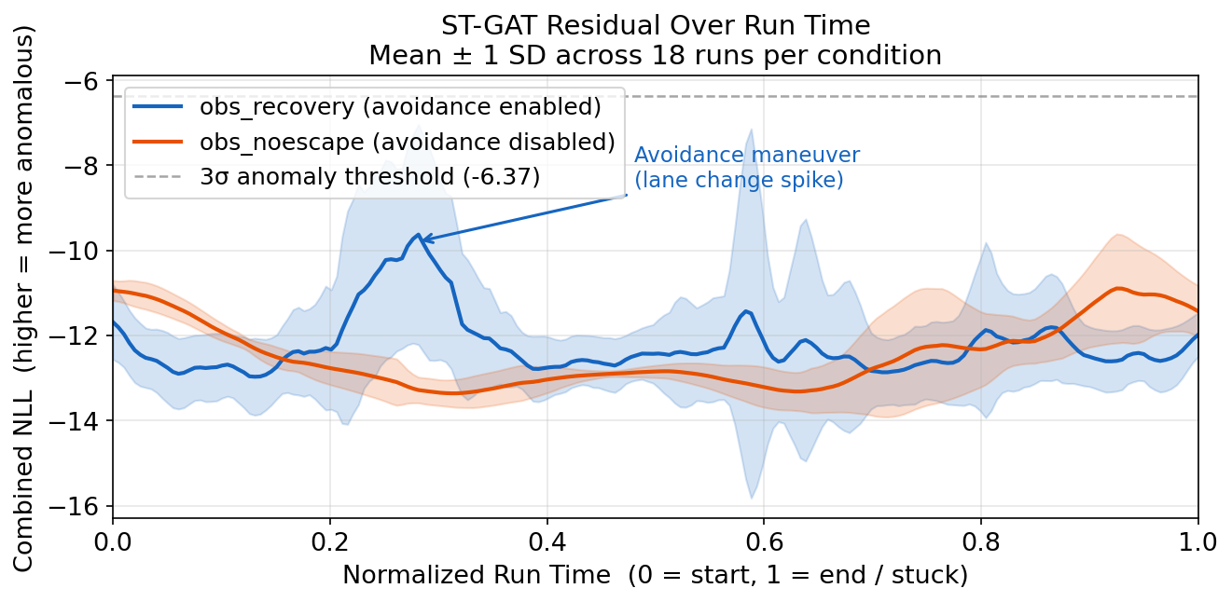
R1: POPULATION-LEVEL NLL TIME-SERIES
Key message:
The spike is brief (~2–3 s out of a 60–160 s run).
Full-run CVaR averages over all the nominal driving time and HIDES the spike.
→ Max NLL (or short-window CVaR) is the right statistic for classification — shown next.
Notes:
The normalized time axis is necessary because recovery runs end when the vehicle reaches its goal (variable length, 42–1622 windows) and noescape runs end when the vehicle is stuck (fixed ~274 windows). Without normalization, averaging is not meaningful — a 1622-window run and a 42-window run are measuring the same event (obstacle encounter + outcome) at wildly different absolute times.
The takeaway from this plot for Dr. Pisu is about signal design, not raw performance. The plot demonstrates empirically why "full-run CVaR" is a poor statistic: it averages the spike over the entire run, reducing its significance. This motivates the choice of max NLL as the discriminating feature. In controls terms, this is analogous to using a peak detector rather than an RMS detector for a transient event — the transient carries all the information, and time-averaging destroys it.
The 3σ threshold line (−6.37) is the empirical threshold computed from nominal runs. The blue mean barely crosses it because the spike is transient and the average across 18 runs smooths the individual spikes to different positions on the normalized time axis. The box plot on the next slide shows that run-level max NLL is clearly separated, even when the time-averaged mean is not.
Be ready for the question: "Why does recovery have higher variance at the start?" The answer is the normalization artifact from the one short run — not a real physical effect. Once the full four-condition dataset is collected, this artifact will be diluted.

Slide 44
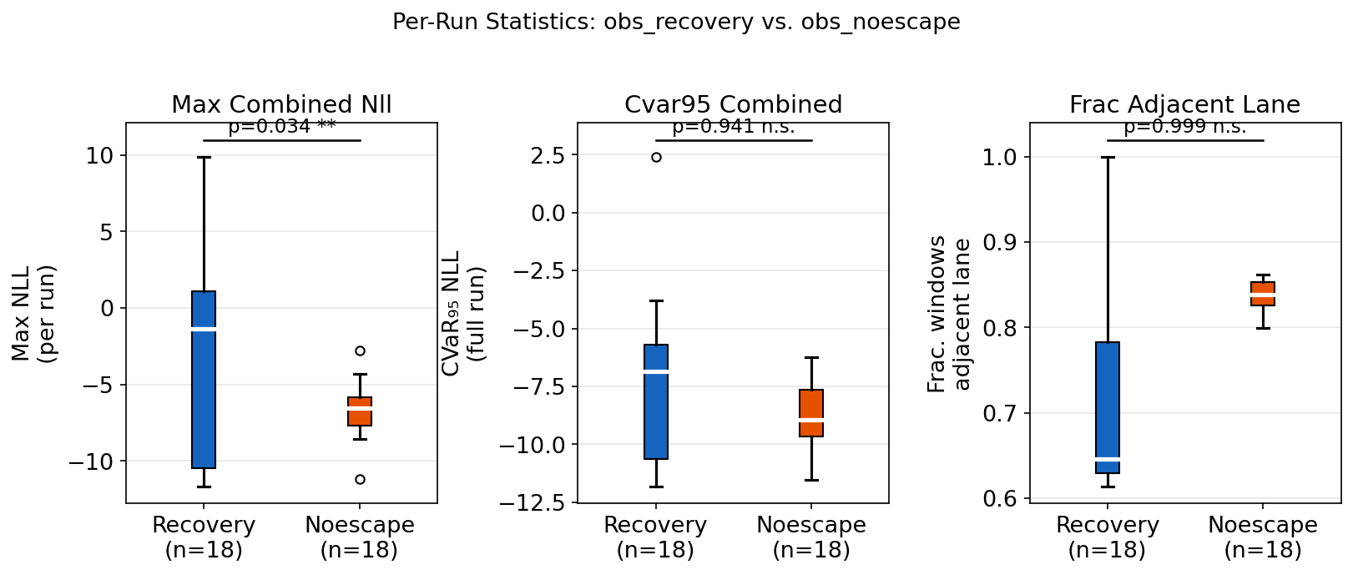
R2:PER-RUN STAT. THREE CANDIDATE SIGNALS
LEFT: Max NLL (per run):
Recovery: max NLL ≈ −3 to +2 (wide range, spikes above 0)
Noescape: max NLL ≈ −6 to −6.3 (narrow range, never crosses threshold)
p = 0.034 (**) → statistically significant separation
→ Validates Signal 3: the behavioral residual spike correctly distinguishes the two conditions
Notes:
The three-panel layout is intentional: it shows one positive result and two null results, and the null results are informative rather than failures.
The middle panel (CVaR full run) is a statistical lesson in signal design. The spike in recovery runs lasts approximately 25 windows (~2.5 seconds) out of a run averaging 800+ windows. CVaR₉₅ averages the worst 5% of windows — at 800 windows, that is 40 windows. The spike windows are included, but so are 15 other high-NLL windows from ordinary acceleration events. The result is that CVaR for recovery is barely different from CVaR for noescape. This is not a failure of the residual signal — it is a failure of the statistic. Max NLL, or a windowed CVaR (rolling 50-window CVaR), would recover the separation.
The right panel (has_adjacent_lane) shows a null result that supports the research design. Both conditions place the obstacle on the same multi-lane roads, so of course the topology signal shows no difference. The panel is in the presentation because it demonstrates that we have implemented the topology feature correctly and tested it, not because we expect it to separate these two conditions. The result is: "this signal is ready, but needs the right dataset." Dr. Pisu should see this as evidence that the research plan is systematic, not as a failed signal.
The Mann-Whitney test is appropriate here because: (a) we cannot assume normality with n=18, (b) the distributions are bounded and skewed, (c) it is consistent with prior AV safety literature that uses non-parametric tests for small simulation samples. If asked why not t-test: the NLL distribution has a heavy tail (driven by the spike windows) and t-test would be invalid.

Slide 45
R2:PER-RUN STAT. THREE CANDIDATE SIGNALS
MIDDLE: CVaR₉₅ over entire run:
Recovery ≈ Noescape (distributions nearly overlap)
p ≈ 0.94 → NO separation
→ Confirms why full-run CVaR is a poor statistic:
the spike is too brief relative to the run length, diluted by 99% nominal windows
Notes:
The three-panel layout is intentional: it shows one positive result and two null results, and the null results are informative rather than failures.
The middle panel (CVaR full run) is a statistical lesson in signal design. The spike in recovery runs lasts approximately 25 windows (~2.5 seconds) out of a run averaging 800+ windows. CVaR₉₅ averages the worst 5% of windows — at 800 windows, that is 40 windows. The spike windows are included, but so are 15 other high-NLL windows from ordinary acceleration events. The result is that CVaR for recovery is barely different from CVaR for noescape. This is not a failure of the residual signal — it is a failure of the statistic. Max NLL, or a windowed CVaR (rolling 50-window CVaR), would recover the separation.
The right panel (has_adjacent_lane) shows a null result that supports the research design. Both conditions place the obstacle on the same multi-lane roads, so of course the topology signal shows no difference. The panel is in the presentation because it demonstrates that we have implemented the topology feature correctly and tested it, not because we expect it to separate these two conditions. The result is: "this signal is ready, but needs the right dataset." Dr. Pisu should see this as evidence that the research plan is systematic, not as a failed signal.
The Mann-Whitney test is appropriate here because: (a) we cannot assume normality with n=18, (b) the distributions are bounded and skewed, (c) it is consistent with prior AV safety literature that uses non-parametric tests for small simulation samples. If asked why not t-test: the NLL distribution has a heavy tail (driven by the spike windows) and t-test would be invalid.

Slide 46
R2:PER-RUN STAT. THREE CANDIDATE SIGNALS
RIGHT: Fraction of windows with adjacent lane (has_adjacent_lane):
Noescape slightly HIGHER than recovery (wrong direction)
p ≈ 0.999 → strongly not significant
→ Both datasets are on the same multi-lane roads — topology cannot separate them
→ This is expected: the topology signal requires obs_singlelane data (not yet collected)
Notes:
The three-panel layout is intentional: it shows one positive result and two null results, and the null results are informative rather than failures.
The middle panel (CVaR full run) is a statistical lesson in signal design. The spike in recovery runs lasts approximately 25 windows (~2.5 seconds) out of a run averaging 800+ windows. CVaR₉₅ averages the worst 5% of windows — at 800 windows, that is 40 windows. The spike windows are included, but so are 15 other high-NLL windows from ordinary acceleration events. The result is that CVaR for recovery is barely different from CVaR for noescape. This is not a failure of the residual signal — it is a failure of the statistic. Max NLL, or a windowed CVaR (rolling 50-window CVaR), would recover the separation.
The right panel (has_adjacent_lane) shows a null result that supports the research design. Both conditions place the obstacle on the same multi-lane roads, so of course the topology signal shows no difference. The panel is in the presentation because it demonstrates that we have implemented the topology feature correctly and tested it, not because we expect it to separate these two conditions. The result is: "this signal is ready, but needs the right dataset." Dr. Pisu should see this as evidence that the research plan is systematic, not as a failed signal.
The Mann-Whitney test is appropriate here because: (a) we cannot assume normality with n=18, (b) the distributions are bounded and skewed, (c) it is consistent with prior AV safety literature that uses non-parametric tests for small simulation samples. If asked why not t-test: the NLL distribution has a heavy tail (driven by the spike windows) and t-test would be invalid.
Implication:
Max NLL = the correct statistic for the behavioral classifier.
The topology and kinematic signals cannot be validated on this dataset alone.
→ New data collection (obs_singlelane, obs_tooclosetoreact) is the clear next step.

Slide 47
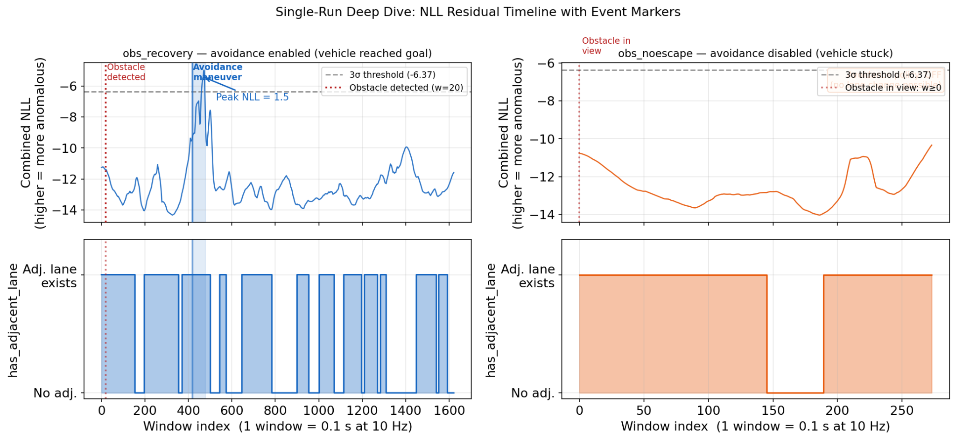
R3:SINGLE-RUN DEEP DIVE — EVENT TIMELINE
What this proves:
• Signal 3 fires IF AND ONLY IF avoidance is executed — confirming the expected mechanism
• The approach phase (obstacle visible, no avoidance) produces NO NLL signal — explains
why full-run CVaR is diluted; and why windowed detection must be active at maneuver time
Notes:
This plot is the most important of the three for conveying the physical intuition. Walk Dr. Pisu through the sequence event by event on the recovery side before showing the noescape side.
The key moment to emphasize is the approach phase (windows 20–442). During this phase, the vehicle sees the obstacle (obj_dist drops to 0.07) and begins decelerating — but NLL is at its lowest, around −11 to −12. This is the identifiability result made visible: the digital twin is NOT surprised by the deceleration, because decelerating toward something ahead is exactly what it expects from the training distribution (traffic lights, crosswalks, slow vehicles all produce the same trajectory). This is why Signals 1 and 2 alone are insufficient — they would have already fired (topology: adjacent lane exists; kinematic: TTC > 3s during approach) — but Signal 3 says "nothing unusual is happening yet."
Then at window 443, the vehicle executes the lane change. NLL goes from −12 to +1.5 in approximately 250 milliseconds (2–3 windows). The digital twin has no model of "swerve left at kilometer-marker X" — it was never in the training data. That is the evidence we need.
For the noescape panel, the message is: the obstacle is there, the vehicle approaches it every run, and the digital twin never fires. This is the correct behavior — from a trajectory perspective, smooth deceleration is smooth deceleration regardless of what's causing it. The framework correctly reports "nothing anomalous" on the noescape runs because the vehicle is behaving nominally right up until it stops.
The vertical markers (obstacle detection line, avoidance shaded region) are the key annotation additions. They show that the spike is not random noise — it is time-locked to the avoidance maneuver, every time. That is the mechanistic validation the committee will ask for.
Anticipated question: "Can you detect the avoidance in time to be useful?" Note that the spike begins building at window ~443 and peaks at ~468. The threshold crossing at window ~418 (where NLL first exceeds −6.37) gives approximately (468-418) × 0.1 = 5 seconds of warning before the peak — enough for a downstream controller to act. This is a quantitative result worth highlighting.
Two runs shown side-by-side. X-axis = absolute window index (1 window = 0.1 s at 10 Hz).
LEFT — obs_recovery (avoidance enabled, vehicle reached goal):
① Obstacle detected at window 20: obj_dist drops from 1.0 → 0.07 in one step
→ Vehicle first sees the blocked lane; NLL remains LOW (this deceleration is normal)
② Approach phase (windows 20–442): NLL stays near −11 to −12
→ Digital twin predicts normal deceleration; vehicle is "behaving as expected"
→ This is the identifiability period: indistinguishable from a red light stop
③ Avoidance maneuver (windows 443–475, ~3.2 s):
→ Autoware executes lane change; NLL spikes from −12 to +1.5
→ The digital twin did NOT predict a swerve at this location → residual explodes
→ NLL crosses 3σ threshold (−6.37) — Signal 3 fires
④ Post-avoidance (window 476+): vehicle past obstacle, NLL returns to −12
→ Normal driving resumes; model is no longer surprised
RIGHT — obs_noescape (avoidance disabled, vehicle stuck):
① Obstacle in view: entire run (obj_dist low from window 0)
② NLL throughout: −12 to −6.3, never decisively crosses 3σ threshold
→ Vehicle brakes normally every time; digital twin predicts braking → no surprise
③ No avoidance marker: avoidance policy disabled → no lane change → no spike
Bottom panels: has_adjacent_lane binary signal
Recovery: toggles True/False as vehicle navigates through route
Noescape: stays True throughout (multi-lane road, adjacent lane always present)
What this proves:
• Signal 3 fires IF AND ONLY IF avoidance is executed — confirming the expected mechanism
• The approach phase (obstacle visible, no avoidance) produces NO NLL signal — explains
why full-run CVaR is diluted; and why windowed detection must be active at maneuver time

Slide 48
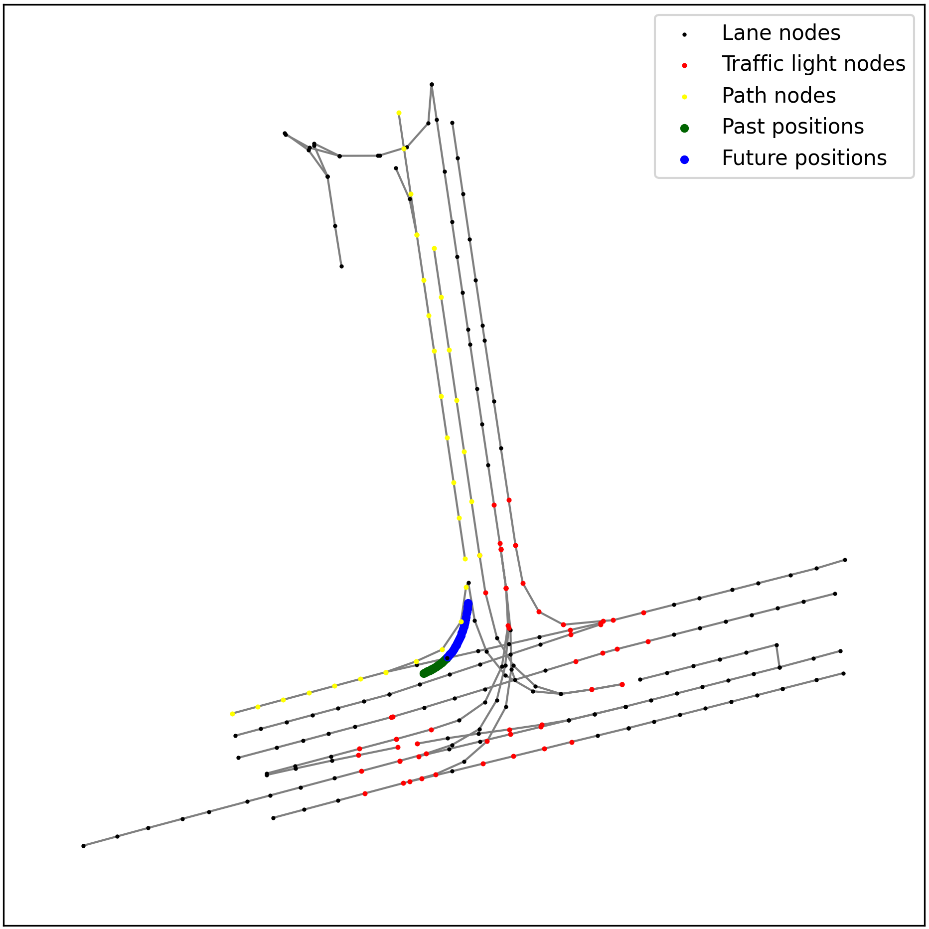
Targeted Control Constraints
Strategy: Target specific Autoware parameters that directly govern safety margins and reaction capability.
1. Max Velocity (Tier 1):
Control: Topic /planning/scenario_planning/max_velocity
Mechanism: Immediate reduction of speed limit.
Default: ~50 km/h
Action: Reduce towards 0 based on risk.
2. Safe Distance Margin (Tier 2):
Control: Parameter obstacle_cruise.safe_distance_margin
Mechanism: Defines the buffer zone maintained behind obstacles.
Default: 5.0 meters
Action: Expand margin (e.g., 5.0m –> 7.5m).
3. Lane Keeping Tolerance (Tier 3)
Control: lane_departure_checker.max_lateral_deviation
Default: 2.0 meters
Action: Tighten (Decrease) to force stricter centering.
Notes:
Graph Embeddings (Spatial Context)
Local road network is represented as a directed graph: 𝐺 = (𝑉, 𝐸), Where:
𝑉 ∈ 𝑅^{𝑛×a} is the node feature matrix, and
𝐸 ⊆ {0,1}^{𝑛×𝑛} is the adjacency matrix.
Agent’s State (Temporal Context)
The ego vehicle’s state at time 𝑡 is:
𝑥^{𝑡}=[u₁, u₂, …, u_{M}],
M = Number of features (pos., vel., steer, detection flags, …)
The state history over a time horizon 𝐻 is: 𝑋^{𝑡}=(𝑥^{𝑡−𝐻}, 𝑥^{𝑡−𝐻+1}, …, 𝑥^{𝑡})
Joint State Representation
The joint state at time 𝑡 is S^{t} = (𝐺, 𝑋^{𝑡}),
where 𝐺 provides the spatial graph context and 𝑋^{𝑡} encapsulates the agent's state history.

Slide 49

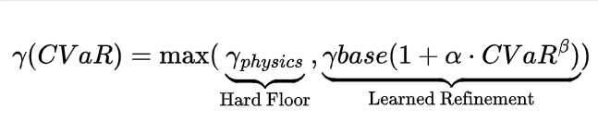
From Risk to Action (The Optimization Problem)
What are we solving? We aim to minimize efficiency loss (time to complete mission) while strictly bounding the probability of failure.
Objective Function:
The Mapping Strategy: We assume pure learning is unsafe and pure physics is too conservative.
Physics Floor: Guarantees absolute safety bounds (e.g., stopping distance never violates physics).
CVaR Sensitivity: As residuals variance or bias increases, gamma scales up non-linearly, reacting aggressively to high-risk outliers (tail events) before the average error becomes critical.
Assumption: High residuals in the Digital Twin consistently correlate with increased real-world uncertainty/risk.
Notes:
Future State Distribution
The future states over prediction horizon 𝐻′ is Y^{t} = (𝑦^{t+1}, 𝑦^{t+2}, …, 𝑦^{t+H′}), each 𝑦^{t} is modeled probabilistically, with a Gaussian distribution:
𝑦^{t} ∼ N(𝜇^{𝑡}, 𝜎^{𝑡}),
where 𝜇^{𝑡} and 𝜎^{𝑡} are the predicted mean and variance (uncertainty), respectively.

