Slide 1

SMART INDIA HACKATHON 2026
TITLE PAGE
Problem Statement ID - SIH26241
Problem Statement Title -
AI-Enabled Career Counselling and Family Decision-Support Platform for Vocational Education
Theme - Smart Education
PS Category - Software
Team ID -
Team Name - SmritiCare

Slide 2



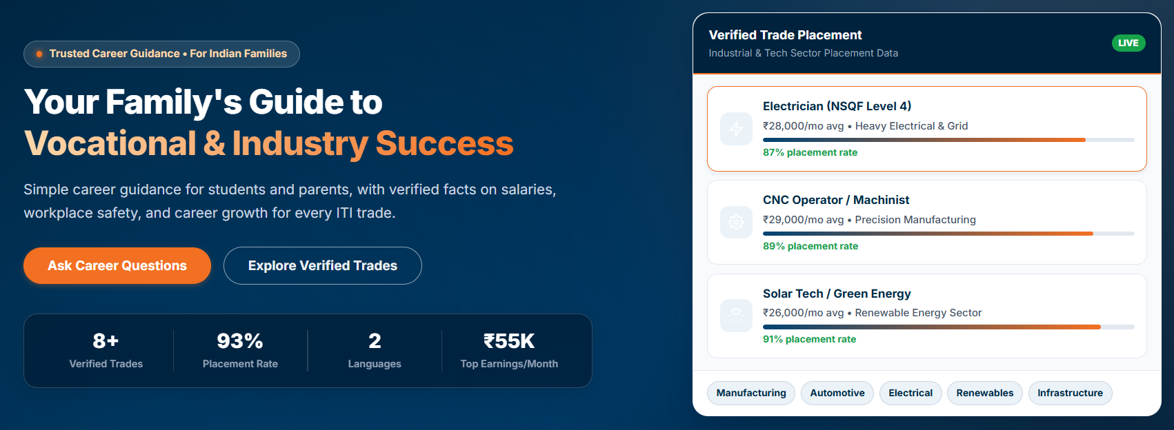
VocGuide
A bilingual, voice-enabled career counselling & family decision-support ecosystem purpose-built for Indian vocational skilling.
SmritiCare
The Problem
Dimension | Conventional Career Tools | Our Innovation
Target Audience | Learner-only (ignores family influence). | Joint Family Unit
Data Integrity | Generic AI answers, static articles, or hallucinated claims. | Zero-Hallucination RAG
Accessibility | Text-heavy, English-first, complex dashboards. | Voice-First & Vernacular
Resolution Pathway | Bot terminates when user is unsatisfied. | Live Human Escalation
Government Utility | Black box with zero policy feedback. | Policy Resistance Telemetry
Parents are the real decision-makers (80%+)
Strong cultural bias towards conventional degrees
Unaddressed anxieties about safety, pay and career progression.
Existing guidance tools are student-centric, ignoring the veto power.
Our Innovation
The Solution
Joint Conversation Guide
Uses empirical benchmarks (NCVT, DGT) for real salary & Placement Figures
Reassucres families about safety ratings and PPE standards
Human Counsellors and real-time dashboard to track resistance.

Slide 3
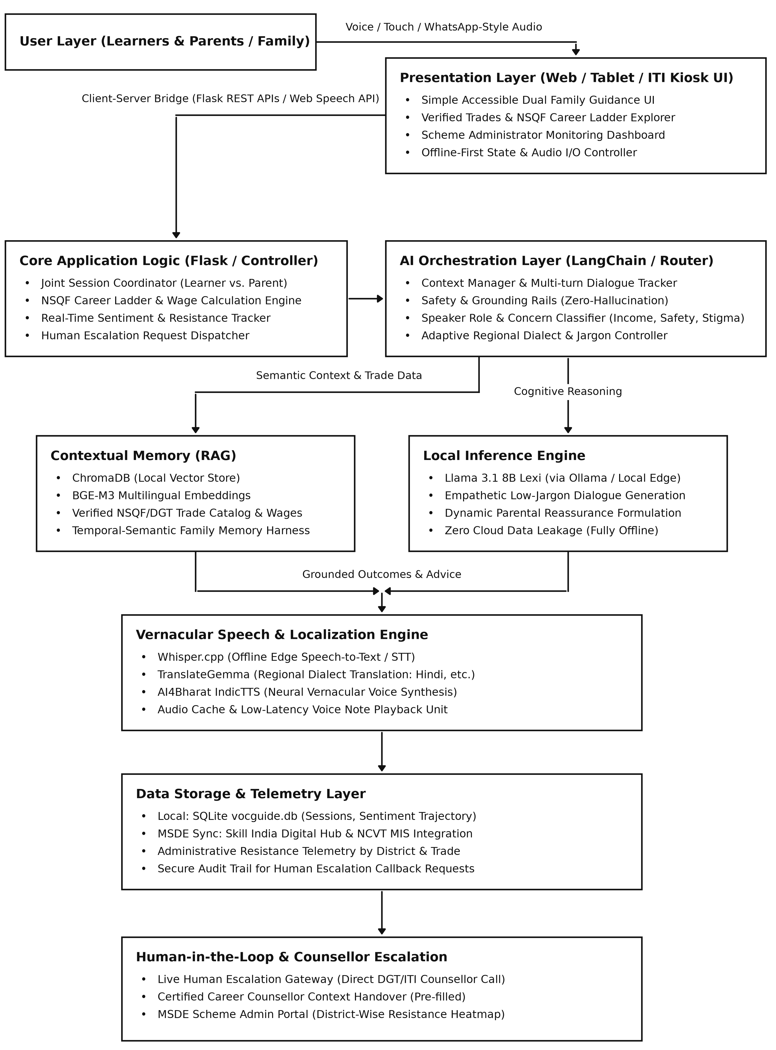
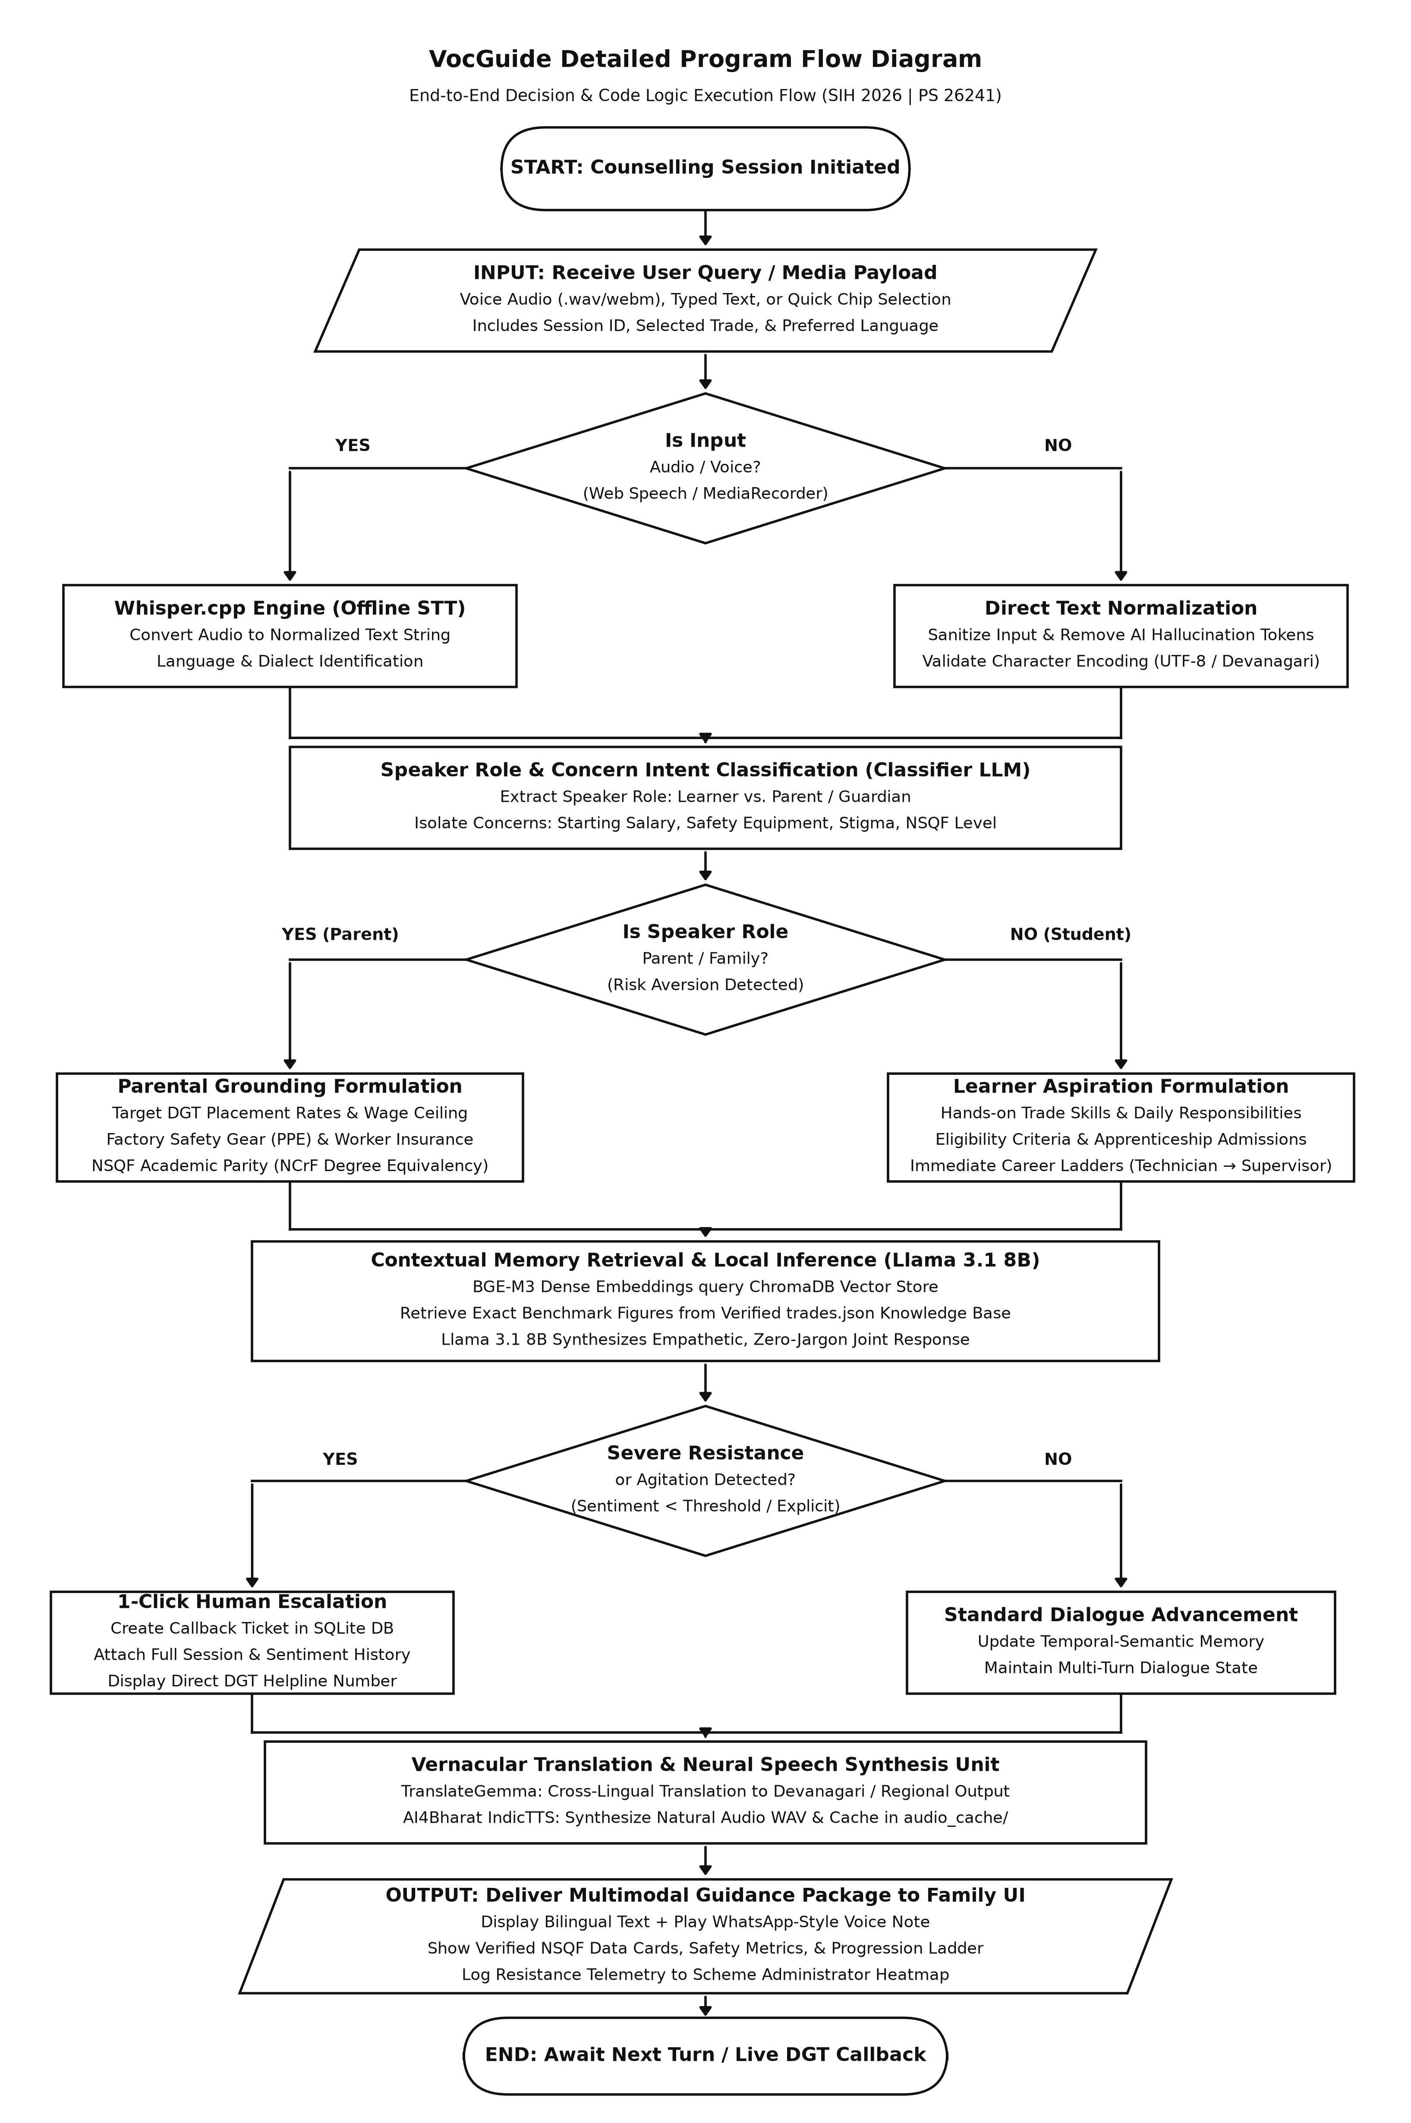
TECHNICAL APPROACH
SmritiCare
System Architecture
Flowchart
Technology Stack
Frontend
Vanilla HTML5, CSS3 & JavaScript
Backend
Python 3.14 + Flask
AI Layer
LangChain
Meta Llama 3.1 8B
TranslateGemma, BGE-M3
Embeddings
Speech & Audio Layer
Whisper.cpp, AI4Bharat IndicTTS
Local Storage & Database
- SQLite3, ChromaDB

Slide 4
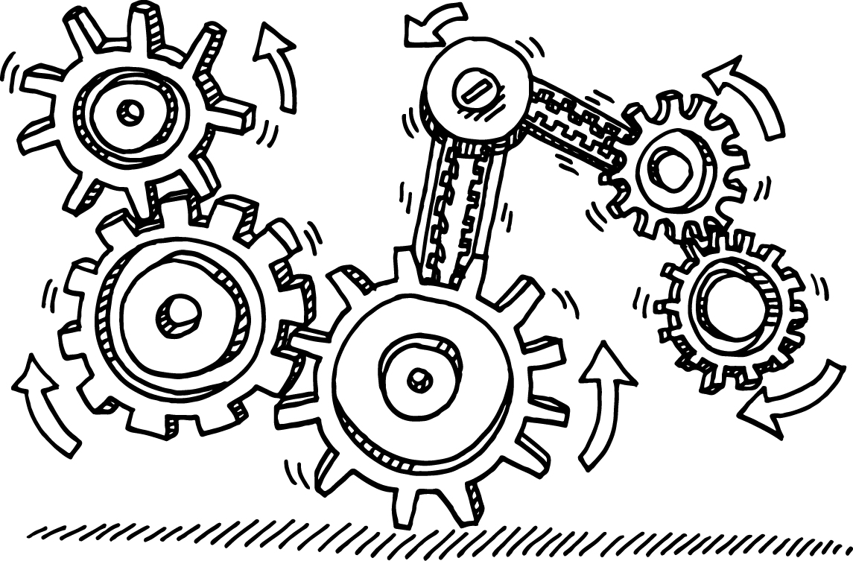
FEASIBILITY AND VIABILITY
SmritiCare
Operational & Ecosystem Feasibility
Economic & Financial Viability
Technical Feasibility
Seamless MSDE / NCVT Integration: Designed with standard RESTful APIs that easily plug into existing government skilling infrastructure.
Plug-and-Play Institutional Rollout: Requires zero complex client installation, accessible via a lightweight web browser on smartphones or through kiosks at 15,000+ Industrial Training Institutes (ITIs) and rural Common Service Centres (CSCs).
Low Maintenance Overhead: Data is decoupled into verified schemas (trades.json / SQLite), allowing non-technical scheme administrators to update wage benchmarks, scheme subsidies, or new trades without touching model code.
Zero Recurring API Licensing Fees: Built entirely on an open-source AI stack eliminating per-token cloud costs.
Ultra-Low Cost per Session: Estimated compute cost is under ₹0.08 per completed counselling session, making population-scale deployment feasible on government budgets.
High Return on Public Investment (ROI): In India, a single mid-course ITI dropout costs the public exchequer over ₹45,000 in wasted subsidies. Preventing just 2, 3 dropouts per ITI recovers the platform's deployment cost for an entire district.
Working End-to-End Prototype.
Edge & Consumer-Hardware Compatible: Powered by 4-bit/8-bit quantized models (Meta Llama 3.1 8B, Whisper.cpp, and BGE-M3), the entire AI stack can run locally on modest consumer hardware.
Offline-Resilient RAG Architecture: Retrieval-Augmented Generation (ChromaDB + SQLite) and local MD5 audio caching allow the platform to serve repeated parent queries with instant <100ms response times, even in areas with intermittent rural internet connectivity.

Slide 5


IMPACT AND BENEFITS
SmritiCare
Impact on Target Audience
For Youth: Eliminates parental veto; provides clear career ladders (e.g. ₹28k starting -> ₹55k supervisor).
For Parents: Replaces fear of "dead-ends" with 82 - 93% verified placement rates and factory PPE safety proofs.
For MSDE / Admins: Real-time Resistance Heatmap pinpoints exact districts and reasons where parents hesitate.
Solution Benefits
Social: Restores Dignity of Labor; boosts female enrollment in safe, certified trades (Healthcare 93% placement).
Economic: 35 - 40% drop in mid-course dropouts, saving the public exchequer ₹45,000+ per student in wasted subsidies.
Environmental: Promotes green-collar pathways (Solar PV, EV Battery) via 100% paperless, remote counselling.

Slide 6
RESEARCH AND REFERENCES
SmritiCare
A. ITI outcomes and perception
[1] Directorate General of Training (DGT), MSDE, "Tracer Study of ITI Graduates: Final Report," Mott MacDonald, New Delhi, Jan. 2018. https://dgt.gov.in/sites/default/files/pdf/Tracer%20Study%20of%20ITI%20Graduates-Final%20report.pdf
[2] DGT, MSDE, "Tracer Study to Assess Employment Outcomes of ITI Pass Outs (STRIVE Project)," Deloitte, New Delhi, May 2024. https://dgt.gov.in/sites/default/files/National%20Tracer%20Study%20-%20STRIVE.pdf
[3] NITI Aayog, "Transforming Industrial Training Institutes," New Delhi, Jan. 2023. https://www.niti.gov.in/sites/default/files/2023-02/ITI_Report_02022023_0.pdf
[4] U. Ajithkumar and M. Pilz, "Attractiveness of Industrial Training Institutes (ITI) in India: A study on ITI students and their parents," Education + Training, vol. 61, no. 2, pp. 153, 168, 2019. https://doi.org/10.1108/ET-04-2018-0102
B. Policy
[5] Ministry of Education, Govt. of India, National Education Policy 2020, New Delhi, 2020. https://static.pib.gov.in/WriteReadData/userfiles/NEP_Final_English_0.pdf
[6] NCVET, MSDE, "Notification of National Credit Framework (NCrF) in respect of Vocational Education," F. No. 26001/01/2019-20/NCVET, 2023. https://ncvet.gov.in/wp-content/uploads/2023/05/National-Credit-Framework-NCVET-notification.pdf. Report of the High-Level Committee: https://ncvet.gov.in/wp-content/uploads/2023/05/Report-on-National_Credit_Framework.pdf
C. Speech, language and retrieval
[7] G. Gerganov and contributors, "whisper.cpp," GitHub. https://github.com/ggml-org/whisper.cpp
[8] AI4Bharat, "IndicTTS: Text-to-Speech Synthesis in Indian Languages with FastPitch and HiFi-GAN Architectures," Indian Institute of Technology (IIT) Madras, 2023. [Online]. Available: https://ai4bharat.org
D. Stakeholders
[9] Ministry of Skill Development and Entrepreneurship (MSDE) (https://www.msde.gov.in) , National Council for Vocational Education and Training (NCVET) (https://ncvet.gov.in), NITI Aayog (https://www.niti.gov.in), Directorate General of Training (DGT) (https://dgt.gov.in), National Council for Vocational Training (NCVT) (https://ncvtmis.gov.in).

