Slide 1
HTML5

Slide 2
Objectives
Learn how markup languages like HTML process documents
Understand HTML syntax and structure
Learn basic tags and how to use them
Know the differences between HTML5 and earlier versions

Slide 3
HTML History and Basic Syntax

Slide 4
HTML History
HTML defined using SGML
Used for general layout of documents that could be displayed by a wide variety of computers
HTML versions:
HTML 4.0 (1997)
HTML 4.01 (1999)
XHTML 1.0 (2000): HTML 4.01 redefined using XML
XHTML 1.1 (2001): Modularized 1.0, no frames
XHTML 2.0: 2009, dropped from development
HTML5: newest version

Slide 5
Basic HTML Syntax
Elements defined by tags:
Opening tag: <name>
Closing tag: </name>
Container := opening tag + closing tag
Container encloses content
Element := container + content
Void element := tag without content
Written as: <name />

Slide 6
HTML Syntax Examples
<p>This is my web page</p>
<br />
Opening tag
Content
Closing tag
Void element
XHTML vs HTML5:
XHTML required <br />
HTML5 recommends <br> but supports either

Slide 7
Tag Attributes
Tags may have attributes that provide additional information to the browser on how the tag should be interpreted
Attributes appear between the tag name and the right bracket of the opening tag
Attributes are specified in keyword form, delimited by double quotes
attrName1=“value1” attrName2=“value2”
Example:
<img src=“picture.jpg” alt=“Picture”>
(src and alt are attributes, “picture.jpg” and “Picture” are the attribute values)

Slide 8
Coding Style

Slide 9
Coding Style
Whitespace := line breaks, spaces, tabs that browsers do not process
Comments := text that describes the code (HTML), but is not processed by the browser
Comment form: <!-- … -->
Example: <!-- This is the first section -->
Make use of both whitespace and comments to make your code easily readable and understandable!
Consistently indent (tab or 2 or 4 spaces) each nested element
Separate sections of code with blank lines
Insert comments with good descriptions around sections of code
Insert comments whenever a line of code may need clarification

Slide 10
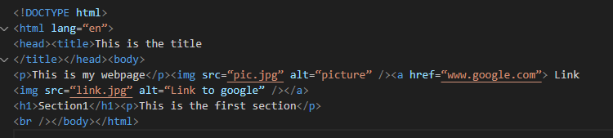
Coding Style Examples
Bad style example:
<!DOCTYPE html>
<html lang=“en”>
<head><title>This is the title
</title></head><body>
<p>This is my webpage</p><img src=“pic.jpg” alt=“picture” /><a href=“www.google.com”> Link
<img src=“link.jpg” alt=“Link to google” /></a>
<h1>Section1</h1><p>This is the first section</p>
<br /></body></html>

Slide 11
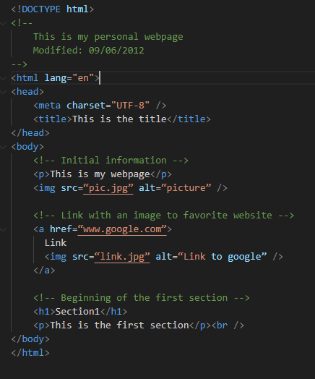
Coding Style Examples
Good style example:
<!DOCTYPE html>
<!--
This is my personal webpage
Modified: 09/06/2012
-->
<html lang=“en”>
<head>
<title>This is the title</title>
</head>
<body>
<-- Initial information -->
<p>This is my webpage</p>
<img src=“pic.jpg” alt=“picture” />
<-- Link with an image to favorite website -->
<a href=“www.google.com”>
Link
<img src=“link.jpg” alt=“Link to google” />
</a>
<-- Beginning of the first section -->
<h1>Section1</h1>
<p>This is the first section</p><br />
</body>
</html>

Slide 12
Coding Style Guidelines
HTML5 Style Guide and Coding Conventions [link]

Slide 13
HTML Document Structure and Basic Tags

Slide 14
HTML5 Document Structure
Every HTML5 document should begin with:
<!DOCTYPE html>
<html>, <head>, <title>, <body> are required elements
<html> is the root of the whole document
Should include lang attribute: <html lang=“en”>
Inside of <html> should be the document head and the body: <head>, <body> tags
Head of the document (inside <head> tag):
Include <title> tag (usually displayed in title bar)
Include <meta charset=“utf-8” /> to provide character set information (UTF=Unicode Transformation Format - 8 bit)
Can also contain scripts and CSS style sheets

Slide 15
HTML Layout Formatting
Text that will be displayed in the browser should normally be placed in paragraph elements: <p> tag
<p> breaks the current line and inserts a blank line, where the beginning of the content of the paragraph is placed
Should be closed by </p> tag
Paragraph example:
…
<body>
<p>
Welcome to my webpage!
</p>
</body
…

Slide 16
HTML Layout Formatting
Line breaks
The effect of the <br> tag is mostly the same as that of <p>, except for the blank line
Example of paragraphs and line breaks
On the plains of hesitation <p> bleach the
bones of countless millions </p> <br />
who, at the dawn of victory <br /> sat down
to wait, and waiting, died.
Typical display of this text:
On the plains of hesitation
bleach the bones of countless millions
who, at the dawn of victory
sat down to wait, and waiting, died.
Preserving whitespace
The text content of a <pre> element is displayed as it is entered

Slide 17
HTML Layout Formatting
Heading tags: <h1>, <h2>, …, <h6>
6 sizes
1, 2, and 3 use font sizes that are larger than the default font size
4 uses the default size
5 and 6 use smaller font sizes

Slide 18
HTML Formatting
Deprecated Tags
Tags that are still supported, but should not be used because they are not guaranteed to be supported in the future
Examples: <i> (for italics), <b> (for bold)
<i>,<b> were used to style the text, but now style sheets are used instead
Content-based style tags
Tags that define the type of text that is to follow
Browsers may render such text in a special way
Examples:
<em> (emphasize, usually italics)
<strong> (usually bold)
<code> (monospaced font; used for program listings)

Slide 19
HTML Formatting
Supscripts and superscripts: <sub>, <sup>
Example: x<sub>2</sub><sup>3</sup> Displays: x₂³
<blockquote> tag
Used for separating pieces of text from the normal flow of text
Browsers usually indent, sometimes italicize
A block element: should not be nested inside of inline elements
Formatting done by content-based style tags can be done by using style sheets, but tags are not yet deprecated

Slide 20
Character Entities
Character entities are used to insert special symbols that cannot be normally typed (“¼”)or have special meaning in HTML (“<“)
Char. | Entity | Meaning
& | &amp; | Ampersand
< | &lt; | Less than
> | &gt; | Greater than
" | &quot; | Double quote
' | &apos; | Single quote
¼ | &frac14; | One quarter
½ | &frac12; | One half
¾ | &frac34; | Three quarters
° | &deg; | Degree
(space) | &nbsp; | Non-breaking space

Slide 21
Horizontal Rules
<hr /> draws a line across the display, after a line break
Same thing can be done with style sheets

Slide 22
Meta Element Usage
Meta elements can be used to specify information for search engines
Provide additional information about a document
e.g.: keywords, description
Use name and content attribute pair
Examples: <meta name="keywords" content=“java, c, programming language, computers">
<meta name=“description” content=“This is the personal website of...”>

Slide 23
Using Images

Slide 24
Image Formats
GIF (Graphic Interchange Format)
8-bit color (256 different colors)
JPEG (Joint Photographic Experts Group)
24-bit color (16 million different colors)
Both use compression, but JPEG compression is better
Portable Network Graphics (PNG)
Newer
Files are bigger than jpeg – no lost data!

Slide 25
Using Images
Images are inserted into a document with the <img/> tag along with the src attribute
The alt attribute is used for
Non-graphical browsers
Browsers with images turned off
Example: <img src = "comets.jpg"
alt = "Picture of comets" />
The <img> tag has 30 different attributes, including width and height (in pixels)
(width and height should always be specified to speed up page loading!)

Slide 26
Using Images
Make sure to specify the relative path with the filename inside of the src attribute:
src=“pictures/dog.jpg”
Relative path: assumes that the current path is the document root (e.g. public_html or www directories) and looks in the specified path for the given file
e.g. /public_html/pictures/dog.jpg
Make sure you have permission to use the picture in your own website!

Slide 27
Hypertext

Slide 28
Hypertext Links
Hypertext is the essence of the Web!
Links are specified with the href (hypertext reference) attribute of the <a> (anchor) tag
Content of <a> is the visual link in the document

Slide 29
Hypertext Links
Style note: a link should blend in with the surrounding text, so reading it without taking the link should not be made less pleasant
Links can have images: <a href = "c210data.html"> <img src = "smallplane.jpg" alt = "Small picture of an airplane" /> Info on C210 </a>

Slide 30
Hypertext Links within a Page
If the target is not at the beginning of the document, the target spot must be marked
Target labels can be defined in many different tags with the id attribute, as in <h1 id = "baskets"> Baskets </h1>
The link to an id must be preceded by a pound sign (#)
If the id is in the same document, this target could be <a href = "#baskets"> What about baskets? </a>
If the target is in a different document, the document reference must be included <a href = "myAd.html#baskets”> Baskets </a>

Slide 31
Lists and Tables

Slide 32
Lists
Three types of lists:
Unordered (starts with <ul> tag)
Ordered (starts with <ol> tag)
Definition list (starts with <dl> tag)
For unordered and ordered lists:
<li> tag defines each list element
Can nest lists, but must start new list with <li> tag
For definition lists:
<dt> specifies the term
<dd> specifies the definition

Slide 33
Examples
Let’s see some examples [link]

Slide 34
Tables
A table is a matrix of cells, each possibly having content
The cells can include almost any element
Some cells have row or column labels and some have data
A table is specified as the content of a <table> tag
Each row of a table is specified as the content of a <tr> tag
The row headings are specified as the content of a <th> tag
The contents of a data cell is specified as the content of a <td> tag

Slide 35
Tables - Borders and Titles
A border attribute in the <table> tag specifies a border between the cells
If border is set to "border", the browser’s default width border is used
The border attribute can be set to a number, which will be the border width
Without the border attribute, the table will have no lines. (unless specified by a style sheet)
In HTML5, table borders should be defined using style sheets
Tables are given titles with the <caption> tag, which can immediately follow <table>

Slide 36
Tables - colspan and rowspan
A table can have two levels of column labels
The colspan attribute must be set in the <th> tag to specify that the label must span some number of columns
The rowspan attribute can be set to specify that the label must span some number of rows

Slide 37
Tables - Sections
Header, body, and footer, which are the elements:
thead (column labels)
tbody (row labels + data)
tfoot (usually used for totals)
If a document has multiple tbody elements, they are separated by thicker horizontal lines

Slide 38
Table Usage
In the past, tables were used to align elements in rows and columns - general layout
This is no longer done and is frowned upon
Use Cascading Style Sheets to place elements in rows and columns - general layout
Use tables only when the information is naturally tabular… this is different that it used to be prior to HTML5

Slide 39
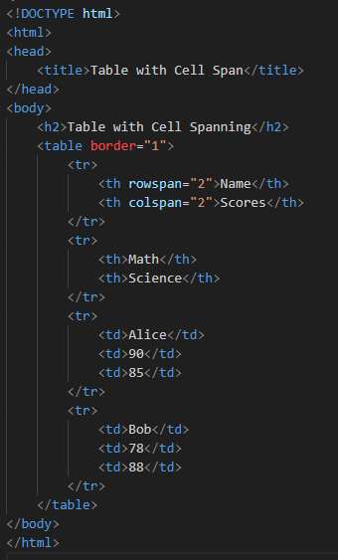
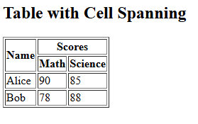
Examples
Let’s see some examples [link]

Slide 40
Forms

Slide 41
Forms
A form is the usual way information is gotten from a browser to a server
HTML has tags to create a collection of objects that implement this information gathering
The objects are called widgets or controls or components (e.g., radio buttons and checkboxes)
All of the controls of a form are defined in the content of a <form> tag

Slide 42
Form Processing
When the Submit button of a form is clicked, the form’s values are sent to the server for processing
The only required attribute of <form> is action, which specifies the URL of the application that is to be called when the Submit button is clicked action = "http://www.cs.ucp.edu/cgi-bin/survey.pl"
If the form has no action, the value of action is the empty string
The method attribute of <form> specifies one of the two possible techniques of transferring the form data to the server, get and post
get appends form data as a query string at the end of the URL
post appends form data to the end of the HTTP request message

Slide 43
Form Widgets
Many are created with the <input> tag
The type attribute of <input> specifies the kind of widget being created:
text
password
checkbox
radio
reset
submit
Other widget tags
<select>
<textarea>

Slide 44
Text box
A Textbox creates a horizontal box for text input
Default size is 20; it can be changed with the size attribute
If more characters are entered than will fit, the box is scrolled (shifted) left
If you don’t want to allow the user to type more characters than will fit, set maxlength, which causes excess input to be ignored
<input type = "text" name = "Phone" size = "12" />

Slide 45
Labels
Widgets can be placed in label elements
<label>Phone: <input type = "text" name="phone"/>
</label>
Label tag makes sure that the label text is “attached” to the given widget

Slide 46
Password Widget
Just like text except asterisks are displayed, rather than the input characters

Slide 47
Checkbox
Checkboxes are used to collect multiple choice input
Every checkbox requires a value attribute, which is the widget’s value in the form data when the checkbox is 'checked'
A checkbox that is not 'checked' contributes no value to the form data
By default, no checkbox is initially 'checked'
To initialize a checkbox to 'checked', the checked attribute must be set to "checked"

Slide 48
Radio Buttons
Radio buttons are collections of checkboxes in which only one button can be 'checked' at a time
Every button in a radio button group MUST have the same name
If no button in a radio button group is 'pressed', the browser often 'presses' the first one

Slide 49
Selection Box
Uses the <select> tag
(The name attribute of <select> is required)
Each item of a menu is specified with an <option> tag, whose pure text content (no tags) is the value of the item
An <option> tag can include the selected attribute, which when assigned "selected“ specifies that the item is preselected

Slide 50
Selection box (continued)
There are two kinds of menus:
those that behave like checkboxes and
those that behave like radio buttons (the default)
Menus that behave like checkboxes are specified by including the multiple attribute, which must be set to "multiple"
The size attribute of <select> can be included to specify the number of menu items to be displayed (the default is 1)
(If size is set to > 1 or if multiple is specified, the menu is displayed as a pop-up menu)

Slide 51
Text Areas
Created with <textarea>
Usually include the rows and cols attributes to specify the size of the text area
Default text can be included as the content of <textarea>
Scrolling is implicit if the area is overfilled

Slide 52
Reset and Submit Buttons
Both are created with <input>
<input type = "reset"
value = "Reset Form" />
<input type = "submit”
value = "Submit Form" />
Submit has two actions:
Encode the data of the form
Request that the server execute the server-resident program specified as the value of the action attribute of <form>
A Submit button is required in every form

Slide 53
Examples
Let’s see some examples [link]

Slide 54
HTML5 Specifics

Slide 55
HTML5
HTML5 is still new
Some browsers may not support it
Some browsers support some features
Code can be included to detect HTML5 features and produce a message to the user

Slide 56
Audio
Prior to HTML5: needed a plug-in for audio
Audio files use encoding algorithms (audio codecs, e.g. MP3, Vorbis)
Coded audio data is stored in containers (Ogg, MP3, Wav)
Vorbis is stored in Ogg container
MP3 in MP3 container
Wav in Wav container

Slide 57
Inserting Audio in HTML5
Use audio element:
<audio attributes>
<source src=“filename1”>
…
<source src=“filename2”>
Your browser does not support the audio element
</audio>
Browser chooses the first audio file it can play and skips the content; if none, it displays the content
Different browsers have different audio capabilities
The controls attribute, which is set to “controls”, creates a start/stop button, a clock, a progress slider, total time of the file, and a volume slider

Slide 58
Video
Prior to HTML5: needed a plug-in
Video codecs are stored in containers (just like audio)
Video codecs:
H.264 (MPEG-4 AVC) - stored in MPEG-4 container
Theora - any container
VP8 - any container
Different browsers support different codecs

Slide 59
Inserting Video in HTML5
Use <video> tag
<video attributes>
<source src=“filename1”>
<source src=“filename2”>
Your browser doesn’t support video element
</video>
The width and height attributes set the screen size
The autoplay attribute, set to “autoplay”, specifies that the video should play as soon as it is ready
The preload attribute, set to “preload”, specifies that the video should be loaded as soon as the document is loaded
The controls attribute, set to “controls”, is like that of the audio element

Slide 60
HTML5 Organizational Elements
Header elements
<hgroup> - container for header information
<hgroup>
<header>
<h1> The Podunk Press </h1>
<h2> ″All the news we can fit″ </h2>
</header>
-- table of contents –
</hgroup>

Slide 61
HTML5 Organizational Elements
Footer elements
<footer> - container for footer information
<footer>
&copy; The Podunk Press, 2012
<br />
Editor in Chief: Squeak Martin
</footer>

Slide 62
HTML5 Organizational Elements
<section> - container for sections
<article> - container for self contained parts of a document (from another source)
<aside> - container for tangential info
<nav> - navigational sections (list of links)

Slide 63
Examples
Let’s see some examples [link]

Slide 64
Syntactic Differences between HTML & XHTML
Case sensitivity
Closing tags
Quoted attribute values
Explicit attribute values
id and name attributes
Element nesting

Slide 65
HTML5 Validation
There are tools that exist to validate whether your HTML code adheres to the HTML5 standard
Here is one by W3Schools:
http://validator.w3.org/
Make sure to select “HTML5 (experimental)” as your document type
NOTE: All of your HTML5 code should pass validation!

Slide 66
Summary
HTML5 is the newest version of a markup language used for specifying the layout of documents
HTML uses tags to markup the content of the document
Tags may have attributes that modify how the tag is interpreted by the browser
It is important to maintain good programming style - comment and use whitespace
Required elements of HTML are <html>, <head>, <title>, and <body>
Some common formatting tags are: <p>, <br>, <h1>, <h2>, <hr>
HTML tags can be used to insert: images, hypertext, lists, tables, and forms

