Slide 1
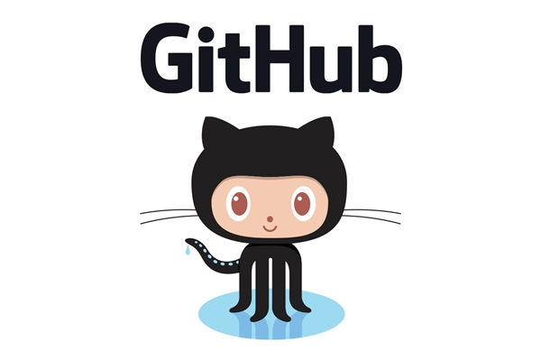
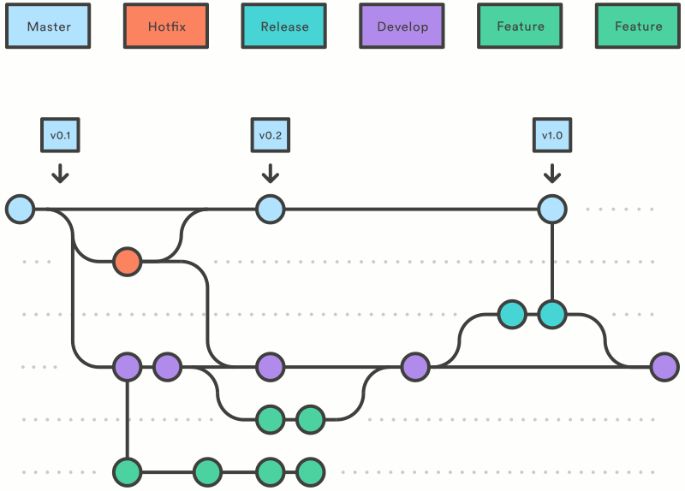

Getting Started with Git and GitHub
Notes:
Welcome to today's lecture! We’ll be diving into one of the most fundamental tools in modern software development—Git—and one of the most widely-used platforms for code hosting and collaboration—GitHub. Whether you're building software alone or as part of a team, these tools are essential. By the end of this session, you’ll understand not just how to use Git and GitHub, but also why they matter.

Slide 2
Introduction to Git, GitHub & Version Control
Git is a free, open-source Distributed Version Control System (DVCS).
GitHub is a popular web-based platform for hosting Git repositories.
Version Control helps:
Track and revert changes.
Collaborate seamlessly across teams.
Example: Like updating a shopping list with friends—everyone contributes without overwriting others’ changes.
Notes:
Welcome to this overview of Git and GitHub. Before diving into Git and GitHub, it’s important to understand the concept of version control systems. A version control system lets you track changes in your source code, making it easier to recover previous versions or undo mistakes.
This is especially helpful when collaborating with others—everyone can contribute without interfering with each other’s work.
Think of it like managing a shared shopping list with your roommates. Without version control, you might end up with a chaotic list. But with version control, you can clearly see who added what, and update the list with ease.
Git and GitHub are popular tools among developers and data scientists because they streamline this entire process.

Slide 3
What is Version Control?
Tracks changes in files over time
Allows reverting to previous versions
Facilitates collaboration
Notes:
Imagine writing an essay without being able to go back to a previous version if something goes wrong. That's what working without version control is like. Version control systems let you keep a complete history of every change made to your code. You can roll back, compare, and understand how your project has evolved. They also allow teams to work on the same codebase at the same time without overwriting each other’s work.

Slide 4
Git
Distributed version control system
Created by Linus Torvalds in 2005
Fast, reliable, and secure
Notes:
Git is a distributed version control system, which means every developer’s machine contains a complete history of the project. This makes it faster, more robust, and lets you work offline. Linus Torvalds created Git in 2005 to help manage the Linux kernel. It's now used by millions of developers around the world for both small and large projects.

Slide 5
Git vs GitHub
Git | GitHub
Local tool | Hosting service
Tracks changes | Shares & stores code
Works offline | Web interface
Notes:
It’s important to distinguish between Git and GitHub. Git is the tool that you run on your computer. It helps you track changes locally. GitHub, on the other hand, is a remote hosting service for Git repositories. It allows developers to share their work online, collaborate with others, and manage software projects publicly or privately.

Slide 6
Core Features of Git
Distributed system: Local copies on each contributor’s machine.
Enables branching strategies (e.g., feature branches).
Common file types supported: code, docs, images, etc.
Other Git hosting services: GitLab, Bitbucket, Beanstalk.
Git can be used via command line or web platforms.
Notes:
Speaker Notes:
Git is a free and open-source distributed version control system, which means every contributor has a full copy of the project history on their local machine.
This allows users to work offline, and when they’re ready, sync their changes with a shared server. This distributed nature is one of the reasons Git is so widely adopted.
Git also supports branching strategies, like feature branches, so developers can work on new features or bug fixes without disrupting the main codebase.
Even though Git was designed for code, it can also track changes in documents, images, or other file types.
While Git is primarily used through the command line, GitHub provides a user-friendly web interface to manage your Git repositories. There are also other platforms like GitLab, Bitbucket, and Beanstalk.

Slide 7
Git Workflow
Modify files
Stage changes
Commit
Push to GitHub
Notes:
The Git workflow follows these steps: you make changes, add them to the staging area, commit them to your repository, and finally push them to GitHub to back up and share with others.

Slide 8
Git Workflow
Local
Remote
Working Directory
Staging Area
Repository
Remote (GitHub)
git add
git commit
git push
git pull
git checkout
Notes:
Let’s take a closer look at how Git actually works behind the scenes.
The Git workflow is typically broken down into three major areas:
Working Directory: This is the place where you’re actively editing your project files. Any time you open your text editor or IDE and start changing code, you’re working in this space. But just making changes here doesn’t mean Git is tracking them yet.
Staging Area (also called the Index): Here’s where things get interesting. Before you commit changes, Git gives you a chance to stage them using git add. This lets you decide exactly which changes to include in the next commit.
Think of it like shopping: when you're in a store, you're picking items off the shelf—these are your changes in the working directory. The staging area is your shopping cart—you're telling Git, “I want to commit these specific items.” You can stage all changes (git add .), just one file (git add filename.py), or even specific lines or hunks (git add -p).
This separation gives you full control. Maybe you fixed two unrelated bugs in one file—you can stage them in separate commits so your project history stays clean and meaningful.
Repository (Local Git Database): Once you've staged changes, you run git commit -m "Message" to permanently save them in your Git history. This creates a snapshot of your project in time. Git commits are like save points. You can go back to them, compare them, or branch off from them later.
Remote Repository (GitHub): After you’ve committed locally, you can share your work with others using git push. This sends your changes to GitHub, which serves as a remote backup and a collaboration hub.

Slide 9
Key Git & GitHub Terms
Repository: Project directory under version control.
Fork: Copy of a repository to modify independently.
Pull Request: Request to merge changes after review.
Working Directory: Local project files.
Commit: Snapshot of code changes.
Branch: Separate line of development.
Merge: Integrate branch changes into another.
Clone: Local copy of a remote repository.
Notes:
Speaker Notes:
Let’s go over a few basic terms that are essential when working with Git and GitHub.
Repository: This is the main project folder that’s tracked by Git.
Fork: A personal copy of someone else’s repository. You can experiment or build upon it independently.
Pull Request: This is how you ask others to review and possibly merge your changes into the main project.
Working Directory: Your local files that belong to a Git project.
Commit: A snapshot of your project’s current state, along with a message describing what changed.
Branch: A separate line of development—great for working on features or fixes.
Merge: Combines changes from one branch into another.
Clone: A local copy of a remote repository, useful when you want to contribute or experiment.

Slide 10
DevOps Integration
Repositories store and track application source code and document changes.
Git supports agile methodologies, CI/CD pipelines, and team collaboration.
GitLab (alternative to GitHub) includes full DevOps tools: code review, branching, merging, CI/CD.
Notes:
Finally, let’s connect GitHub to the broader development workflow. Repositories in GitHub are more than just code containers—they track changes, support collaboration, and integrate directly into continuous integration and delivery pipelines, or CI/CD. GitHub supports agile development and teams can use branching and merging strategies to manage releases. There are also alternatives like GitLab, which offers an all-in-one DevOps platform, including built-in CI/CD tools. In summary, GitHub acts as the online home for Git repositories, allowing teams to collaborate, manage version control, and streamline their software development lifecycle."

Slide 11
Installing Git
Download from git-scm.com
Use git --version to verify installation
Notes:
To get started, download and install Git from git-scm.com. It’s available for Windows, macOS, and Linux. After installation, open your terminal or command prompt and type git --version to make sure it’s properly installed. You should see something like “git version 2.42.0” or higher.

Slide 12
Basic Git Configuration
git config --global user.name "Your Name“
git config --global user.email "your@email.com"
Notes:
Before using Git, you should tell it who you are. Every Git commit records the author’s name and email address. Using the git config commands shown here, you configure your identity once, and Git uses it for all your projects.

Slide 13
Cloning Repositories
git clone https://github.com/user/repo.git
Tracking Files:
git add filename
git add .
Committing Changes:
git commit -m "Descriptive message«
Viewing History:
git log
Notes:
Cloning is the process of copying a GitHub repository to your local machine. The git clone command brings down all the files and the entire history of the project. It’s how you get started when collaborating on an existing project or exploring open-source work.
When you make changes to files, Git doesn’t track them automatically. You need to stage them using git add. You can add files one by one, or use git add . to stage all changes. Staging gives you control over which changes go into a commit.
Once files are staged, you save a snapshot using git commit. The -m flag lets you write a short message describing the changes. Good commit messages are critical. They help you and others understand the evolution of the project over time.
To see the full history of commits, use git log. This command shows each commit with its hash, author, date, and message. It’s useful for tracking changes, debugging, and understanding what has happened in the repository over time.

