Slide 1
Time-Series Analysis of USD to INR Currency Exchange Rate
Project By
Kalyani Pandit, Sonu Kumar , Soham Bhat
Syed Haseem, Aishwarya Shinde

Slide 2
PROJECT GOAL
Time Series Analysis of USD to INR Foreign Exchange Rate
Splitting the data into Training data and Test data
Implementing Mean, Naïve, ARIMA and Holt models and Forecasting
Comparing accuracy values of the models

Slide 3
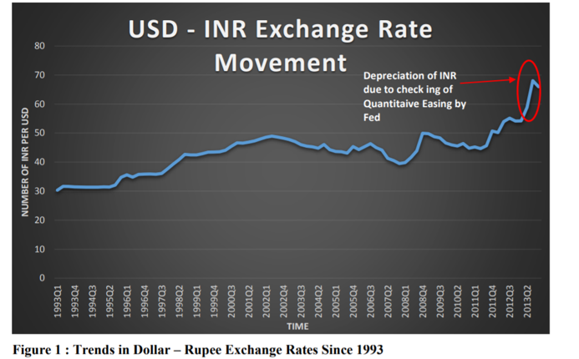
USD TO INR CURRENCY EXCHANGE RATE
Determines relative economic strength among different countries
Currency prices vary on Daily basis
Affects - students, IT people, NRIs, individual, institutional investors, International travel, exports, imports

Slide 4
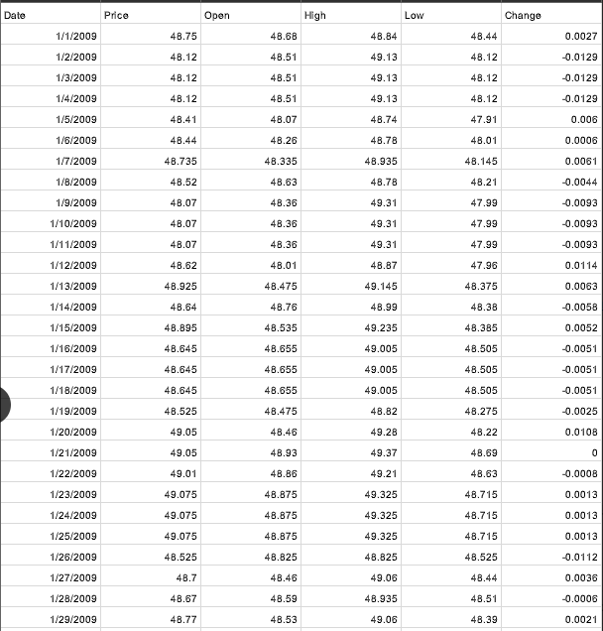

DATASET
Collected original data from Investing.com from the year 2009 to 2019
The dataset consist of 6 columns and 3957 rows
Price column is used for the analysis part
Dataset consist of following six attributes: Date, Price Open Price, High Price, Low Price and Change
Training = 01012009 till 12312018=3652 obs
Testing 01012019 till 11012019 = 305 obs
No Nulls
No data on Holidays and weekends

Slide 5
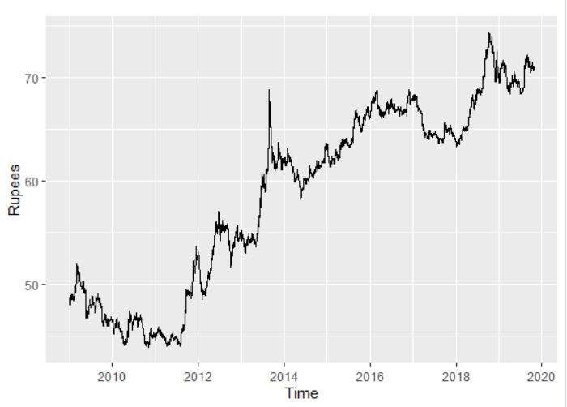
DATA GRAPH
2008 to 2011 →Growth in Indian Economy from 6.9% to 7.5 %
2011 forecasted → 8% but actual decreased to 6.9%
Since 2011 → Rs depreciation started (Economy slow down)
$ increase from 44 to 53
Higher inflation, decline in foreign investments, volatility in domestic equity market , slowdown of growth and employment → Rs. Depreciation continued
2013 spike → $ rise from 54 to 65
2016 Demonetization in India → $ constant
2019 Article370 was removed & Indian constitution was applied to J&K, affected economy → $ 69 to 73.4
Today’s rate = 71

Slide 6
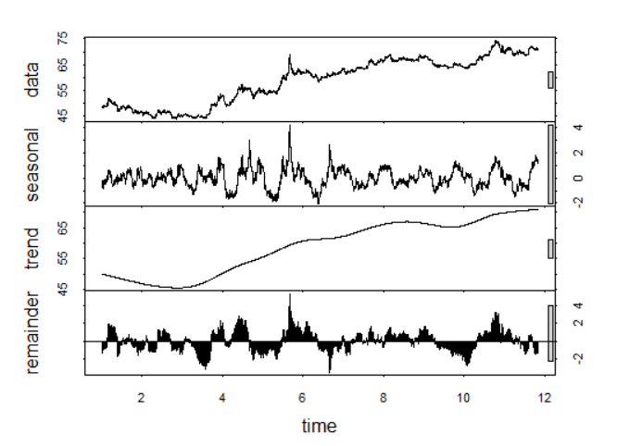
STL DECOMPOSITION

Slide 7
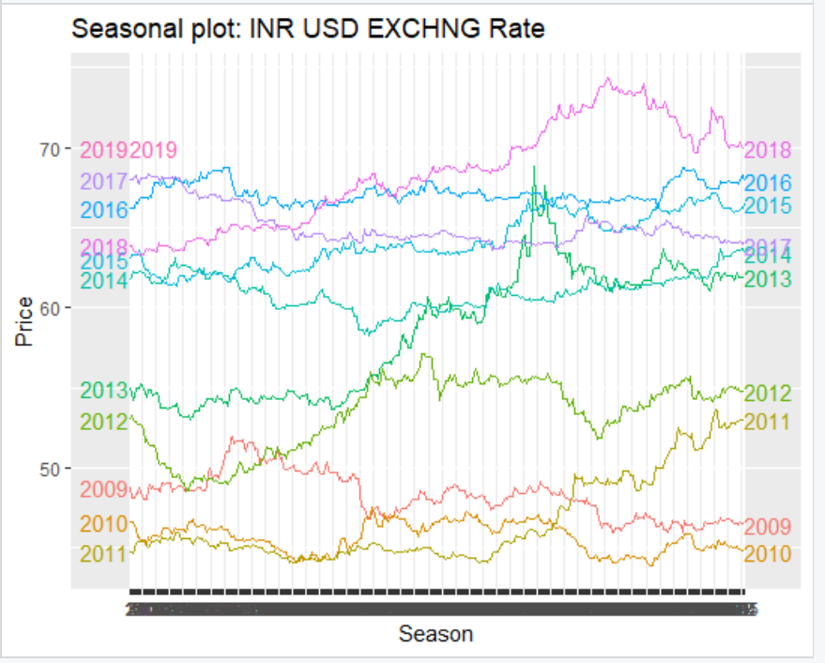

Slide 8
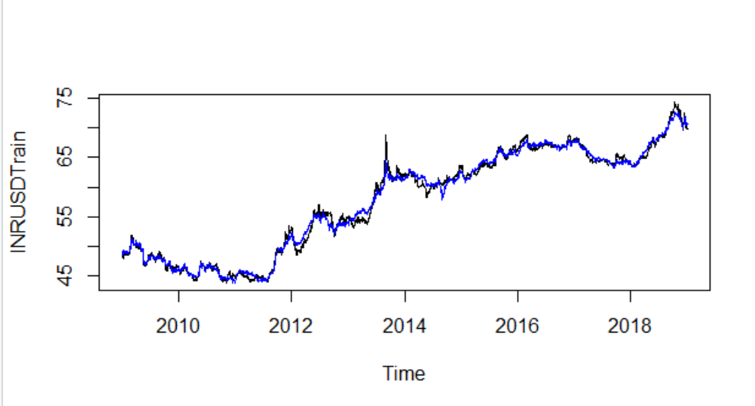
ORIGINAL+SEASONALLY ADJ DATA

Slide 9
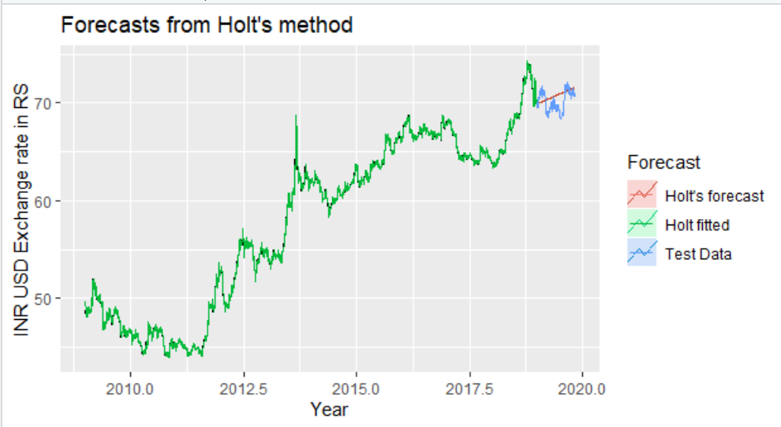
HOLT’S FORECASTING METHOD

Slide 10
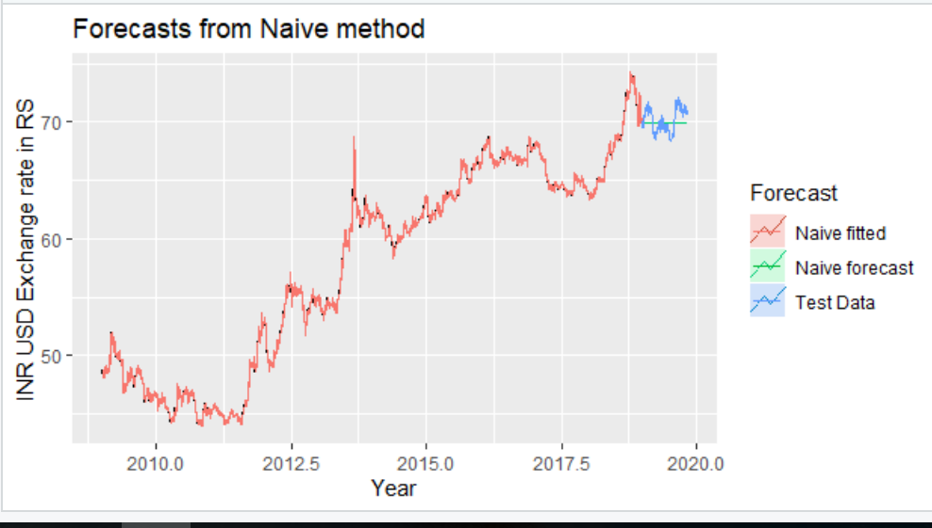
NAÏVE’S FORECASTING METHOD

Slide 11
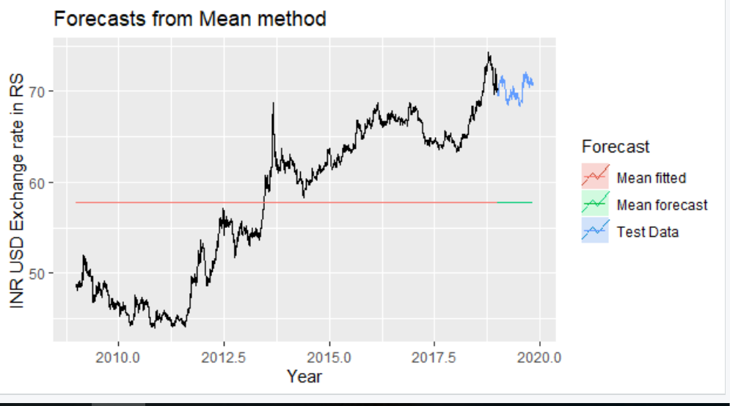
SIMPLE AVERAGE FORECASTING METHOD

Slide 12
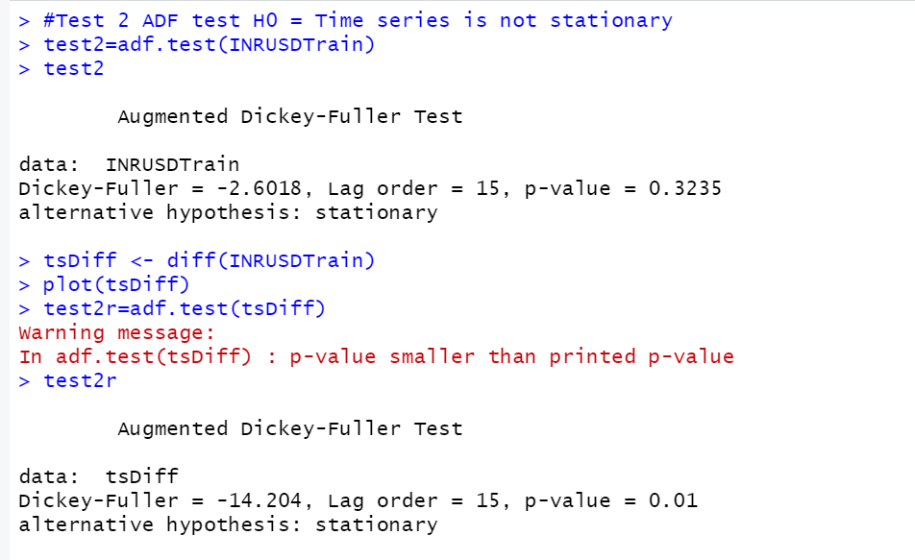

Slide 13
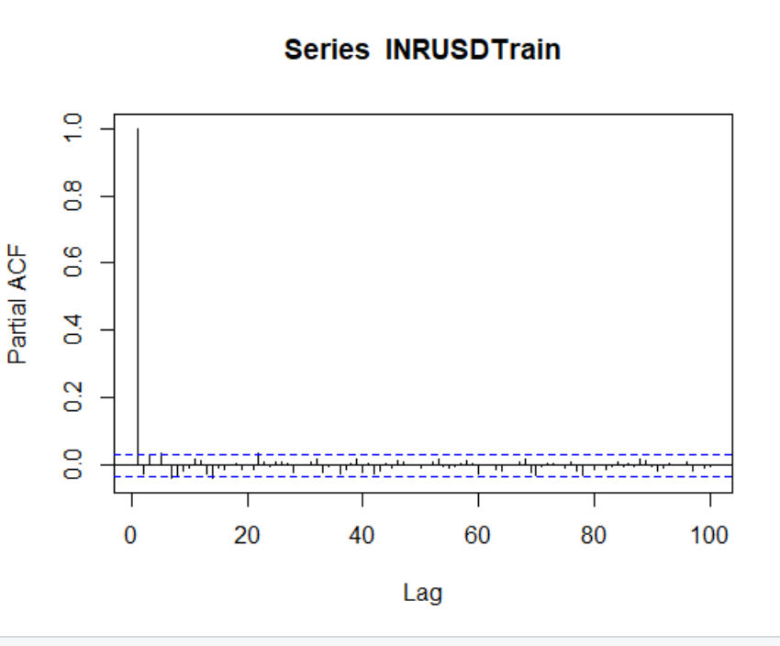
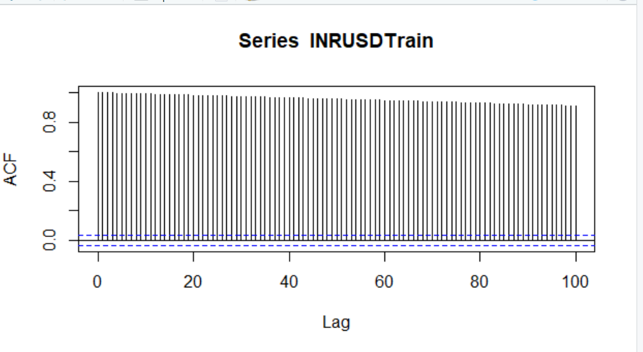
ACF and PACF PLOT OF THE DATA

Slide 14
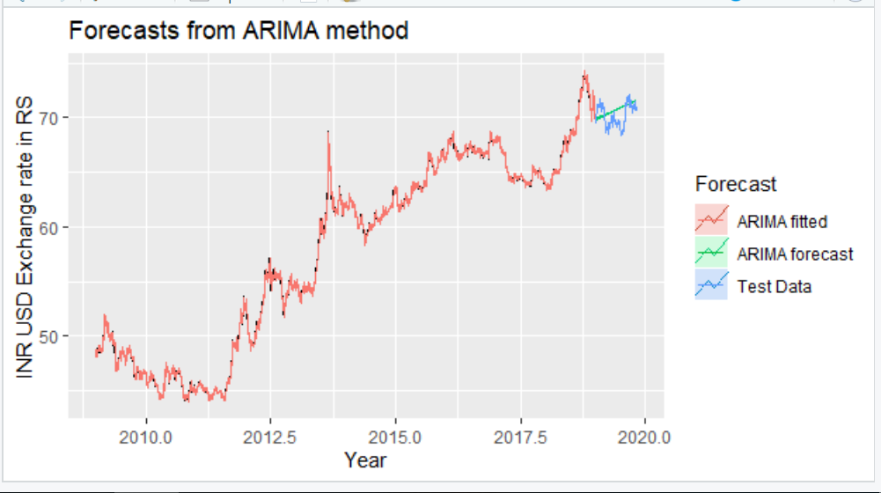
ARIMA MODEL
Auto.arima() => p=3, d=1, q=4

Slide 15
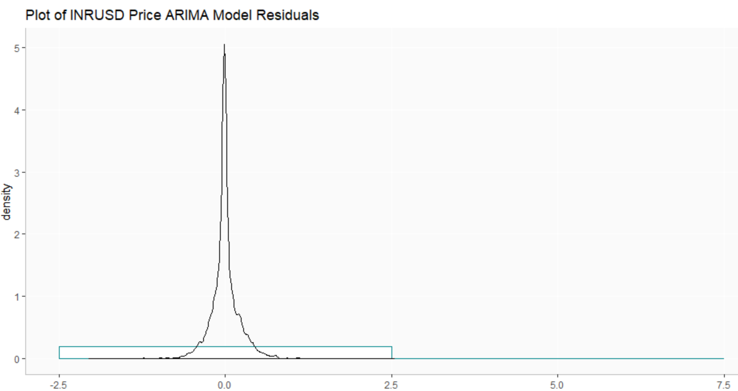
HISTOGRAM OF THE RESIDUALS (ARIMA)

Slide 16
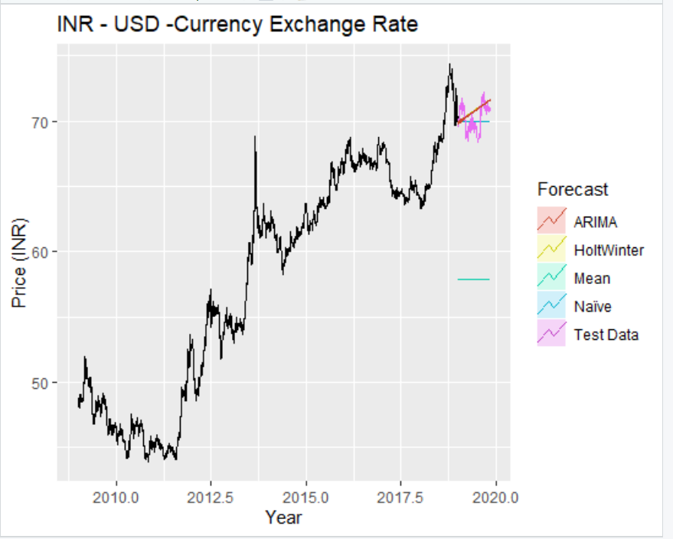

Slide 17
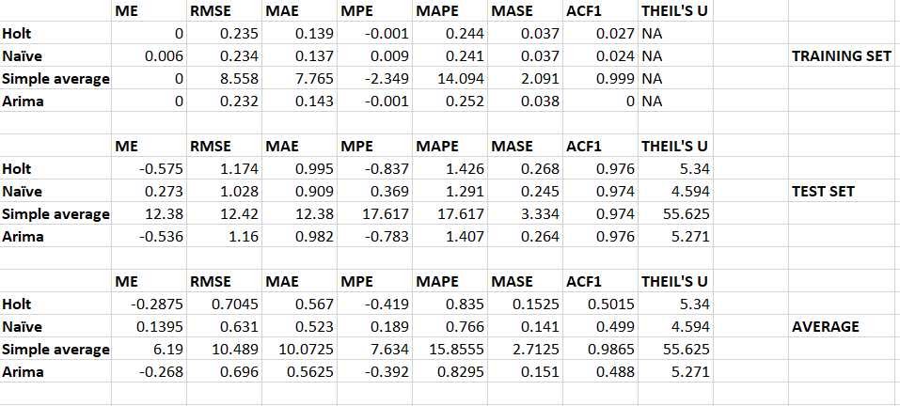
COMPARING ACCURACY

Slide 18
REFERENCES
http://home.iitk.ac.in/~srajal/ECONOMETRICS%20-%20I%20Term%20Paper.pdf
https://en.wikipedia.org/wiki/History_of_the_rupee#2013_Depreciation
https://otexts.com/fpp2/
https://www.capitalmind.in/2018/09/chart-the-history-of-the-rupee-dollar-exchange-rate-since-1966/
https://pdfs.semanticscholar.org/9ad2/617df15aa7cd28bdff2cab35aa2b4b580e5d.pdf
https://www.eastasiaforum.org/2012/01/27/india-s-economic-slowdown-a-stain-on-2011/

Slide 19
THANK YOU! ANY QUESTIONS?

