Slide 1
Forecasting and Time Series
DADM Project By-
Aakash Shetty, Kalyani Pandit,
Pratik Patil, Saiprasad Bahulekar,
Saket Tulsan, Sonu Kumar,
Vaibhavi Mulay, Vatsal Gandhi

Slide 2
Time-Series Analysis and Forecasting of the S&P 500 Stock Index
Stock Market - Standard & Poor's 500 Index
One of the best representations of the U.S. stock market.
Measures performance of 500 large companies in US
Data from Yahoo Finance – Open, close, Low, High and Adjusted Closing value

Slide 3
Dataset
Data Source: Yahoo Finance
Monthly data from Jan 1995 till March 2017
Total rows: 267
Split- Training observations: Jan 1995 till December 2014
Testing observations: Jan2015 till March 2017
Attributes: Open, close, Low, High and Adjusted Closing value

Slide 4
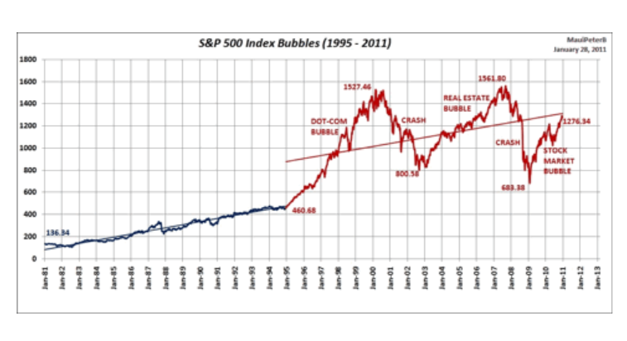
Project Goal:
Time Series Analysis of S&P 500 Stock index
Models: Mean, Naïve, Seasonal Naïve, ARIMA
Which model fits better
Forecasting future Stock index value
Audience: Individual, Institutional investors, government, Market research analysts etc

Slide 5
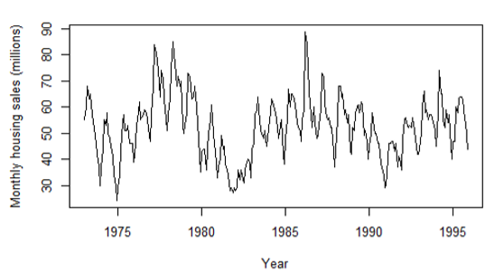
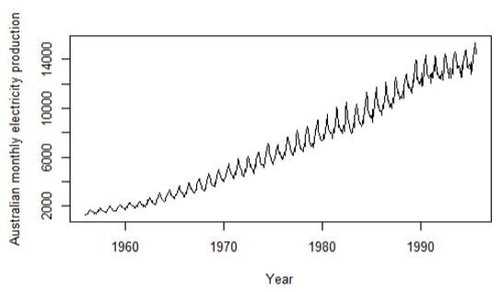
Time Series
Data that exists over a continuous time interval with equal spacing between every two consecutive measurements.
Can be used to understand the past as well as predict the future
Examples: Monthly housing sales, Average Daily temperatures, Daily closing values of indexes, weekly product sales

Slide 6
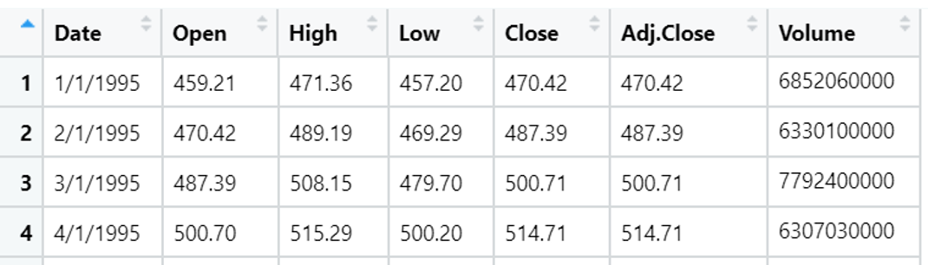
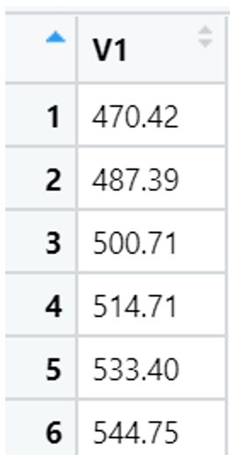
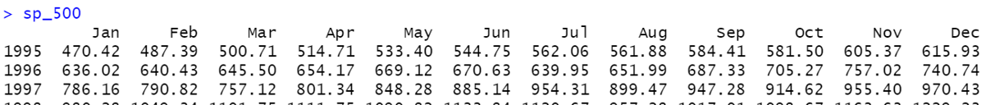
Creating a Time series from S&P 500 index data:
Data95tooct2019.csv
data_master <- read.csv("C:/Semester1/DADM_Project/Data95tooct2019.csv")
sp_500 <- ts(data_master$Adj.Close, start=c(1995, 1), freq=12)
View(sp_500)

Slide 7
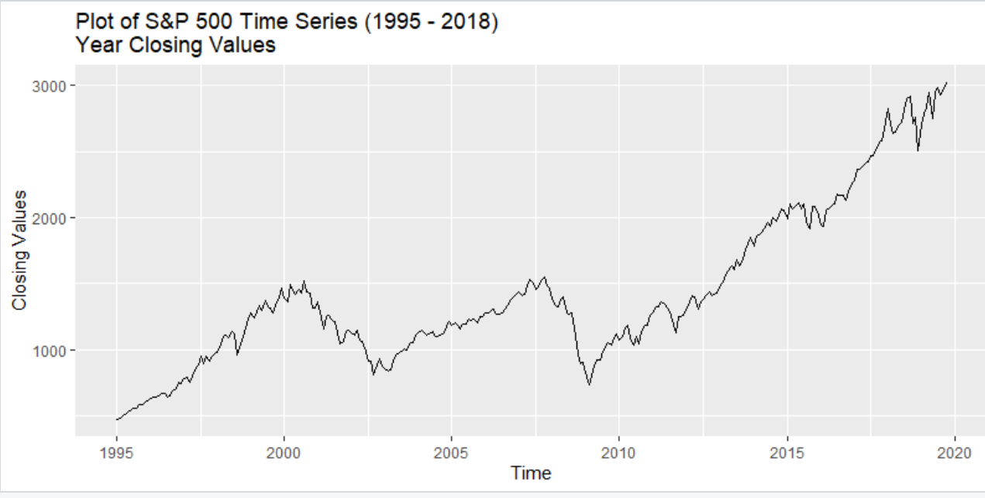
Question: What are the three basic components of a Time series?

Slide 8
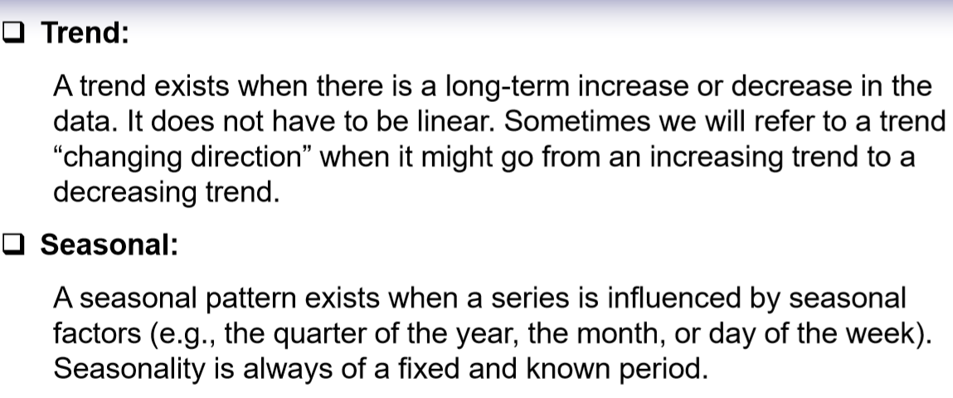
Time Series Components
Cyclic :
A cycle occurs when the data exhibit rises and falls that are not of a fixed frequency. These fluctuations are usually due to economic conditions, and are often related to the “business cycle”. The duration of these fluctuations is usually at least 2 years.

Slide 9
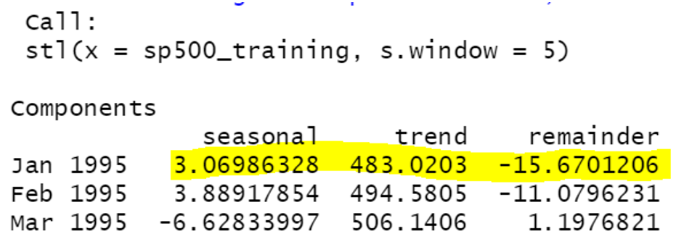
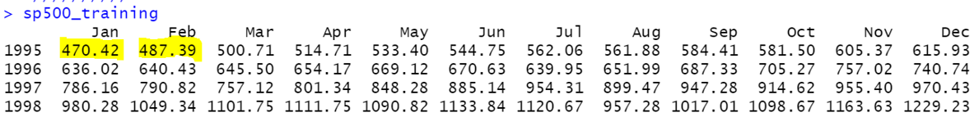
Time Series Decomposition
3 Main Components: Seasonality, Trend and remainder/Error
𝑦𝑡 = 𝑆𝑡 + 𝑇𝑡 + 𝐸𝑡
Separeted by STL Decomposition in R.

Slide 10
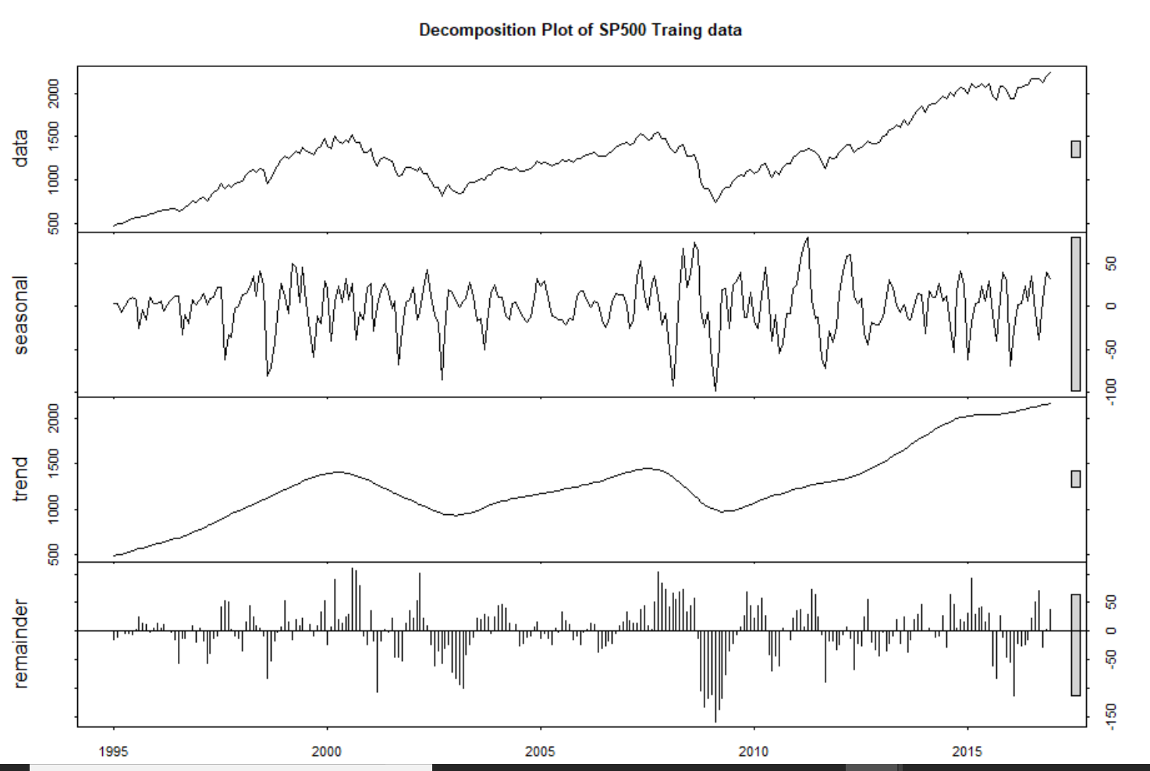
Plotting STL for S&P500 index:

Slide 11
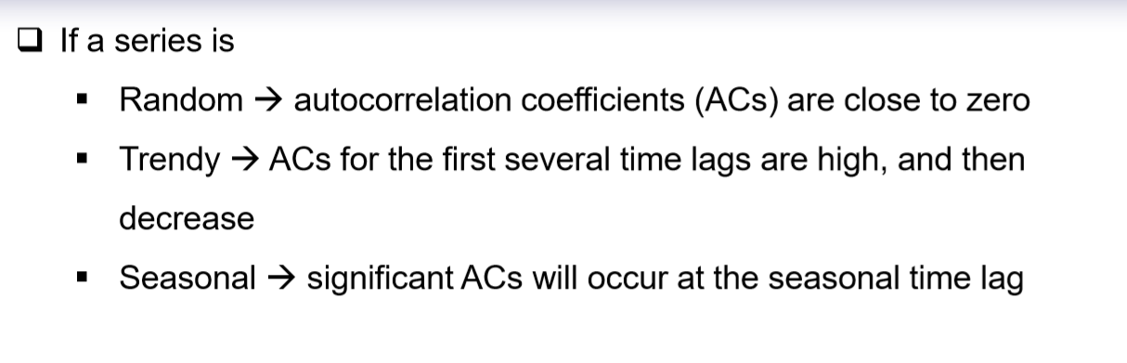
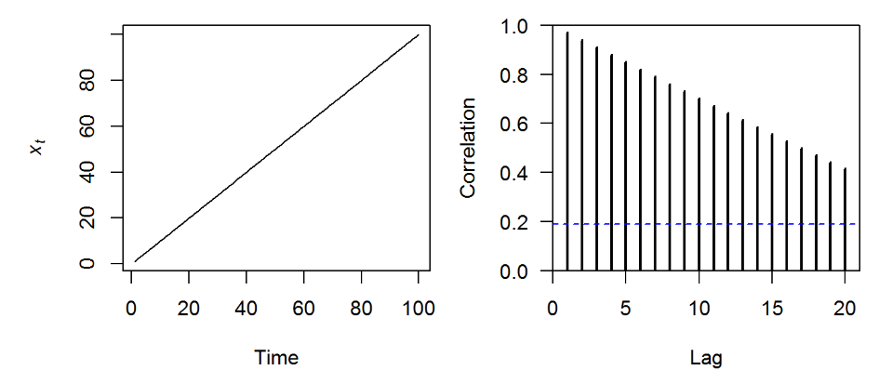
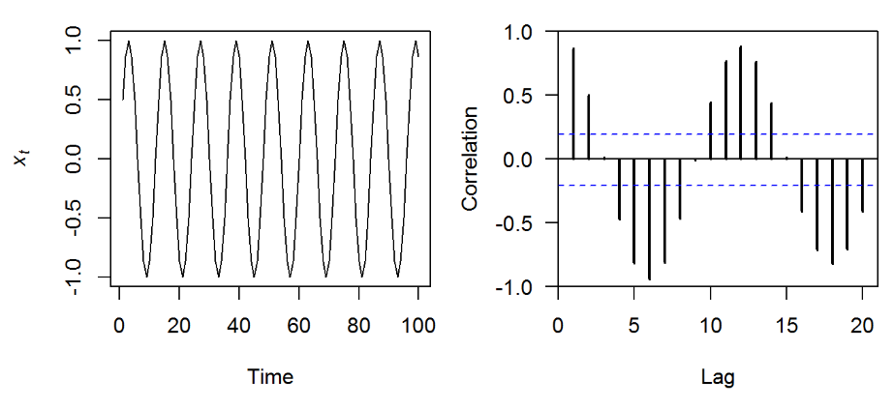
Autocorrelation:
Just as correlation measures the extent of relationship between two variables, autocorrelation measures the linear relationship between lagged values of a time series.

Slide 12
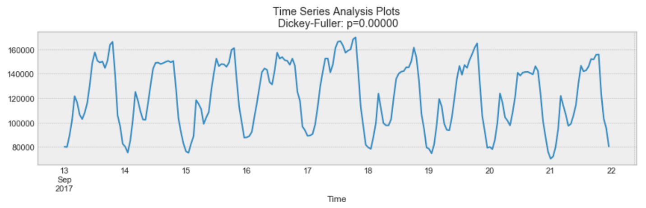
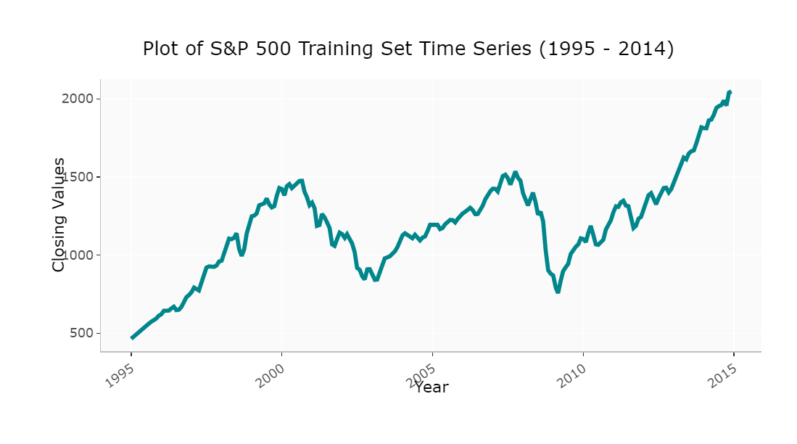
Stationarity:
Time series is stationary if its statistical properties do not change over time i.e. it has constant mean and variance.
Above, process looks Stationary.
→ Growing Trend, Variance increases
→ Volatlity increases over time
→ Mean is not constant over time
So, S&P500 is NON-Stationary
→ Augmented Dickey-Fuller Test

Slide 13

TIME SERIES FORECASTING METHODS
SIMPLE AVERAGE METHOD:
Uses the mean of all the relevant historical observations as the forecast of the next period.
If we let the historical data be denoted by 𝑦1, … , 𝑦𝑇, then we can write the forecasts as

Slide 14
TIME SERIES FORECASTING METHODS
NAÏVE METHOD
This method is only appropriate for time series data.
All forecasts are simply set to be the value of the last observation.
That is, the forecasts of all future values are set to be 𝑦𝑇, where 𝑦𝑇 is the last observed value.
This method works remarkably well for many economic and financial time series.

Slide 15
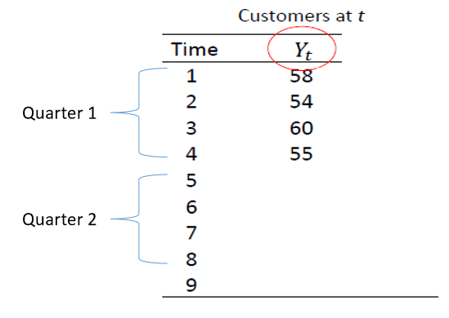
Seasonal Naïve Method
A similar method is useful for highly seasonal data.
We set each forecast to be equal to the last observed value from the same season of the year (e.g., the same month of the previous year).
R Code snaive(y, h) - Where y- training data
h – forecasting count
Example :
Here the forecasting values of Q2 will be:
Time | Yt
5 | 58
6 | 54
7 | 60
8 | 55

Slide 16
ARIMA – Auto Regressive Integrated Moving Average
ARIMA models provide another approach to time series forecasting.
ARIMA models aim to describe the autocorrelations in the data.
Autocorrelation measures the linear relationship between lagged values of a time series.
There are several autocorrelation coefficients, depending on the lag length.
AR or MA or ARIMA requires time series data to be stationary.

Slide 17
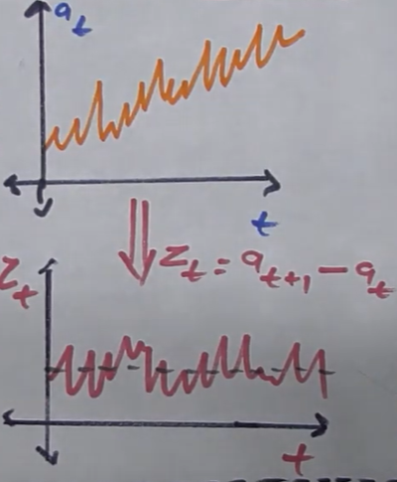
ARIMA
Original data : a at time t . Consider t be January data.
We cannot directly apply AR or MA because the data is not constant variance over time and has seasonality but it does not have constant mean.
To eliminate this trend in the data, ARIMA model is used where difference in the data.
Integrating means instead of predicting values , we predict the difference from one time stamp to another.
Why we use differentiated data? In any linear increasing data(given ), we have some constant value with which it is increasing. To get this constant for all time stamps and get a linear constant mean data, we use differentiated data.
Forecasting value : Z at time t . Consider it to be January of next year.
Constant mean , original constant SD and no seasonality.

Slide 18
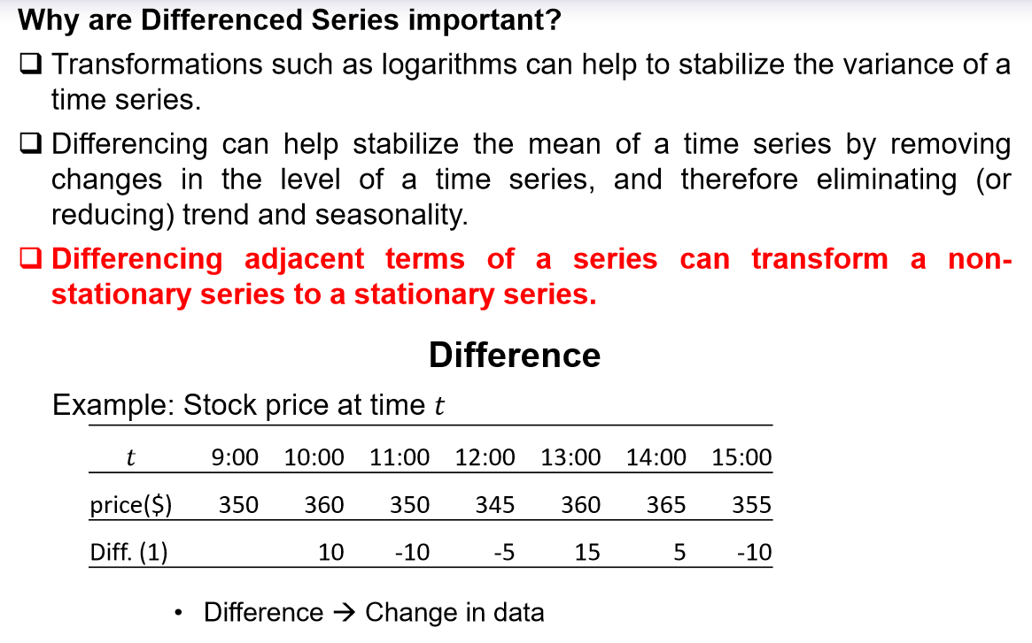
ARIMA
R code : ndiffs()

Slide 19
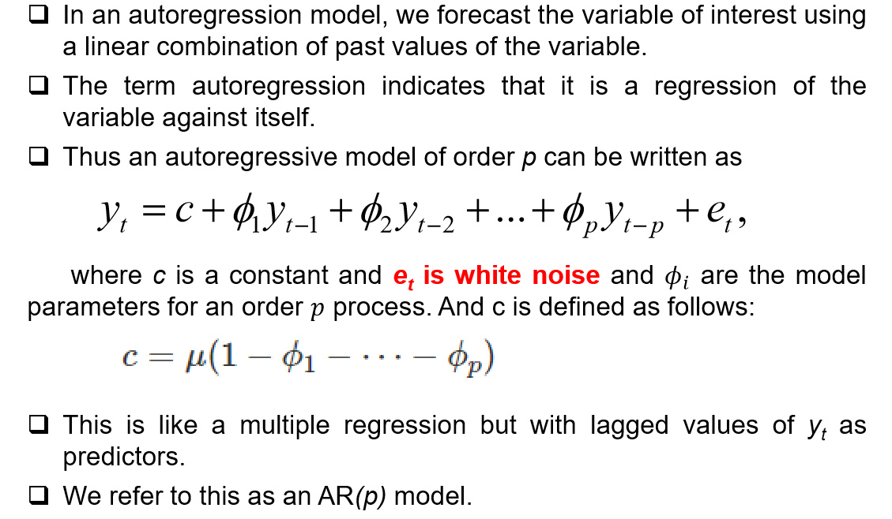
ARIMA Autoregressive Models

Slide 20
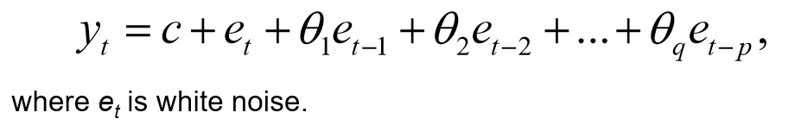
ARIMA Moving Average Models
Rather than use past values of the forecast variable in a regression, a moving average model uses past forecast errors in a regression-like model.
We refer to this as an MA(q) model.

Slide 21
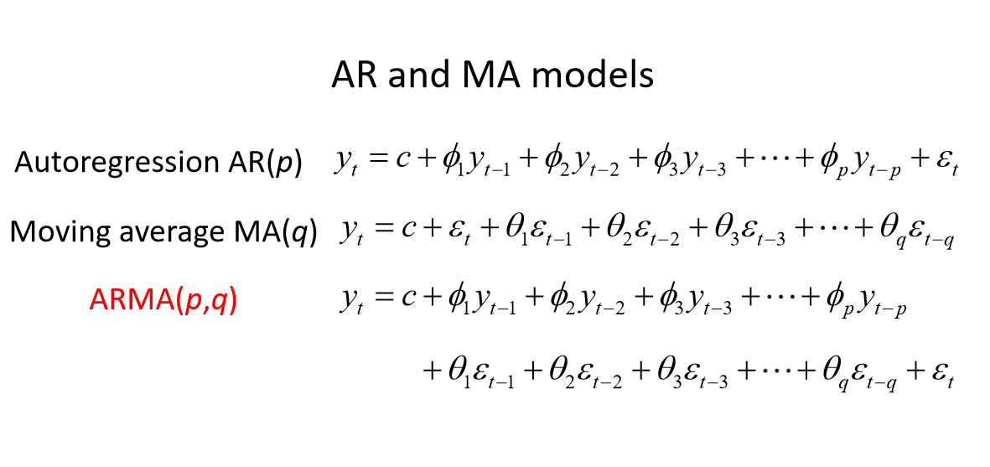
ARIMA

Slide 22
ARIMA
ARIMA (p,d,q )
p = order of the autoregressive part;
d = degree of first differencing involved;
q = order of the moving average part.
White noise ARIMA(0,0,0)
Random walk ARIMA(0,1,0) with no constant
Random walk with drift ARIMA(0,1,0) with a constant
Autoregression ARIMA(p,0,0)
Moving average ARIMA(0,0,q)
Selecting appropriate values for p, d and q can be difficult.
The auto.arima() function in R will do it for you automatically.

Slide 23

How to Calculate Forecasting Accuracy
Error: It is the difference between the actual value and forecast value.
Mean Error: It shows the deviation of a forecast from actual demand. This is the mean of the differences per period between a number of period forecasts and the actual demand for the corresponding periods.
Error = Actual value – Forecast
ME = mean($e_{i}$)

Slide 24
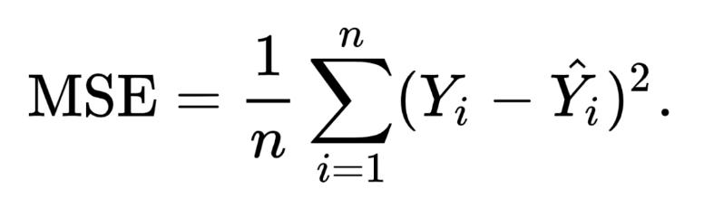
Mean Squared Error: The mean squared error tells you how close a regression line is to a set of points. It does this by taking the distances from the points to the regression line (these distances are the “errors”) and squaring them. The squaring is necessary to remove any negative signs.

Slide 25

Mean absolute error: It is the average of the difference between predicted and actual values in the test.
MAE = mean(|$e_{i}$|)

Slide 26
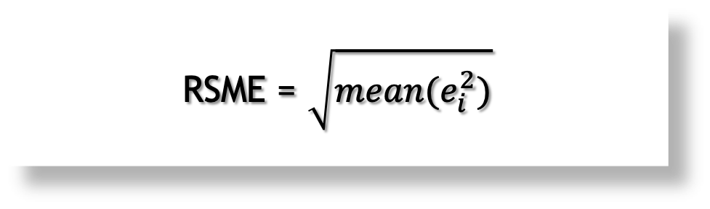
Root mean squared error: It is the square root of mean squared error.
RSME = $\sqrt{{mean(e}_{i}^{2})}$

Slide 27
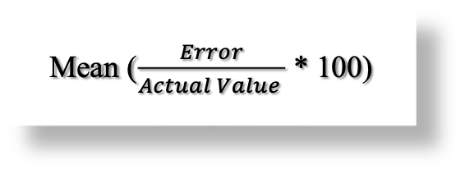
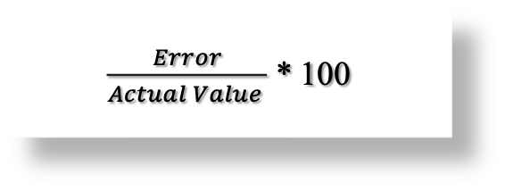
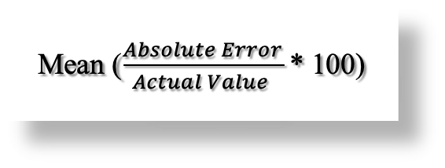
Percentage Error:
Mean Percentage Error:
Mean Absolute Percentage Error:
$\frac{Error}{Actual Value }$ * 100
Mean ($\frac{Error}{Actual Value }$ * 100)
Mean ($\frac{Absolute Error}{Actual Value }$ * 100)

Slide 28
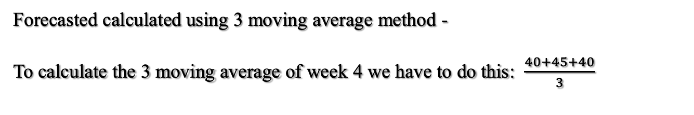
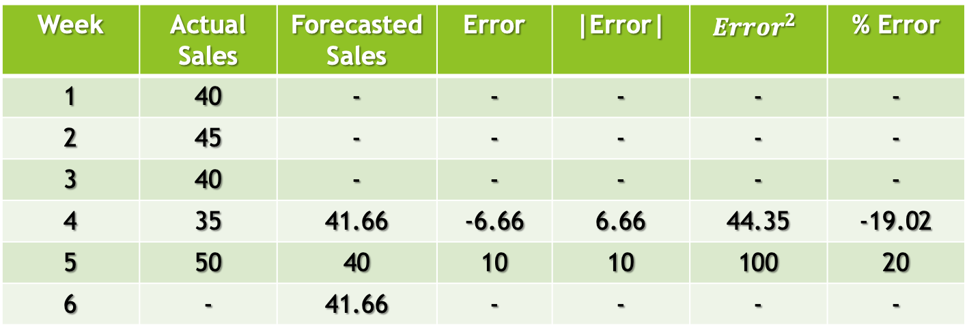
How to Calculate Errors
Week | Actual Sales | Forecasted Sales | Error | |Error| | $${Error}^{2}$$ | % Error
1 | 40 | - | - | - | - | -
2 | 45 | - | - | - | - | -
3 | 40 | - | - | - | - | -
4 | 35 | 41.66 | -6.66 | 6.66 | 44.35 | -19.02
5 | 50 | 40 | 10 | 10 | 100 | 20
6 | - | 41.66 | - | - | - | -
Forecasted calculated using 3 moving average method -
To calculate the 3 moving average of week 4 we have to do this: $\frac{40+45+40}{3}$

Slide 29
Values of the Previous Example
Mean Error = 1.67
Mean Absolute Error = 8.33
Mean Squared Error = 72.175
Root Mean Squared Error = 8.49
Mean Percentage Error = 0.49
Mean Absolute Percentage Error = 19.51

Slide 30
CODE

Slide 31
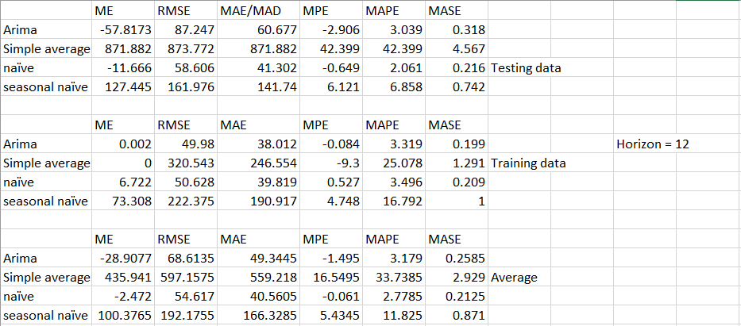
Comparing Models
January 2015 – December 2015

Slide 32
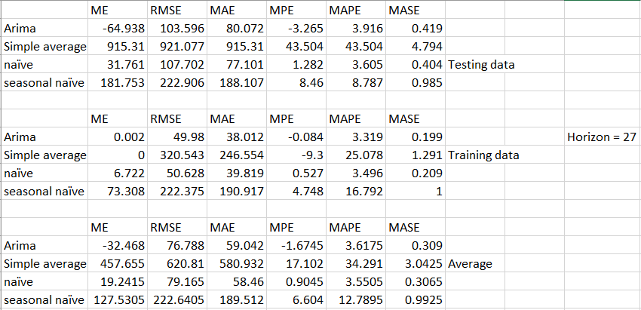
January 2015 – March 2017

Slide 33
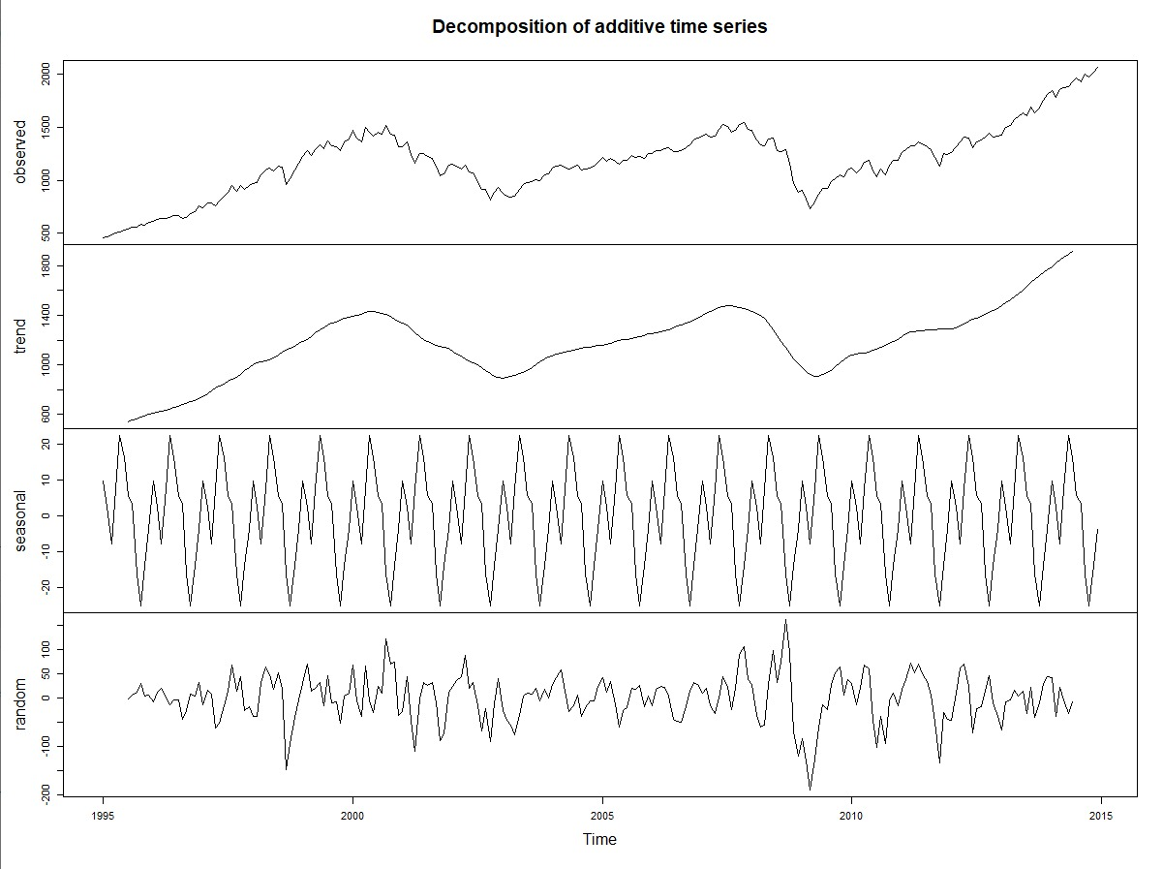

Slide 34
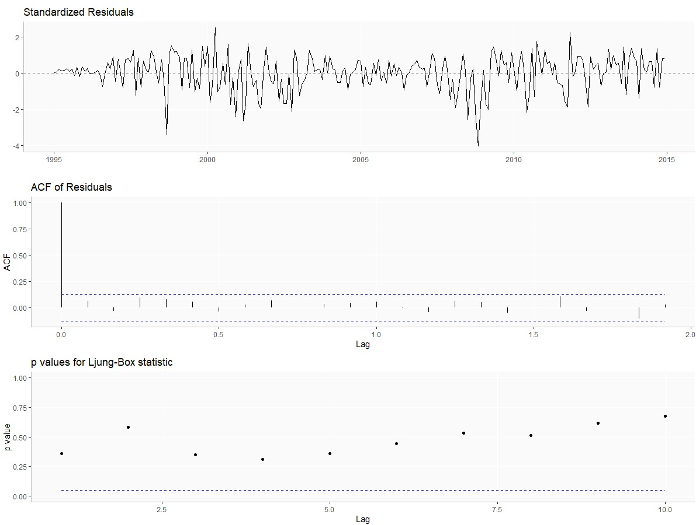

Slide 35
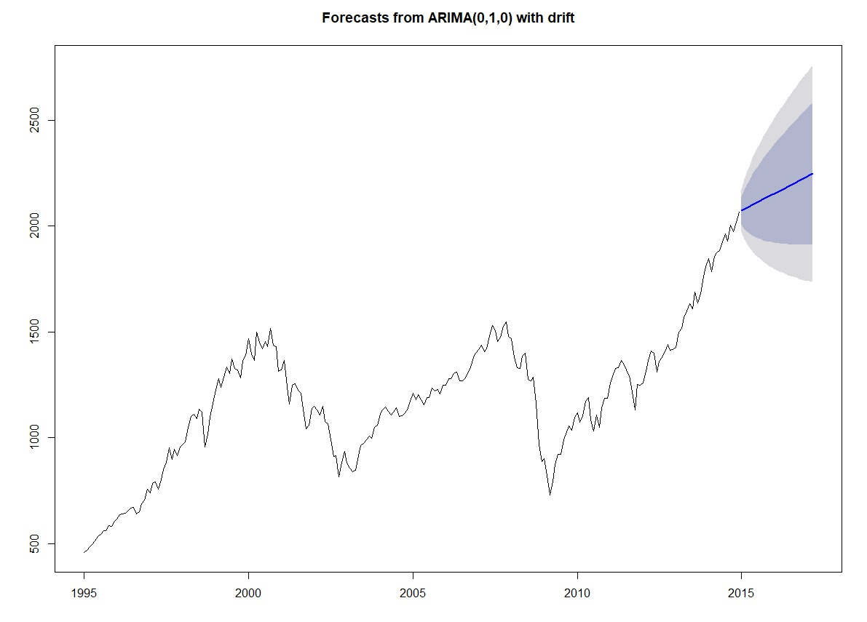

Slide 36
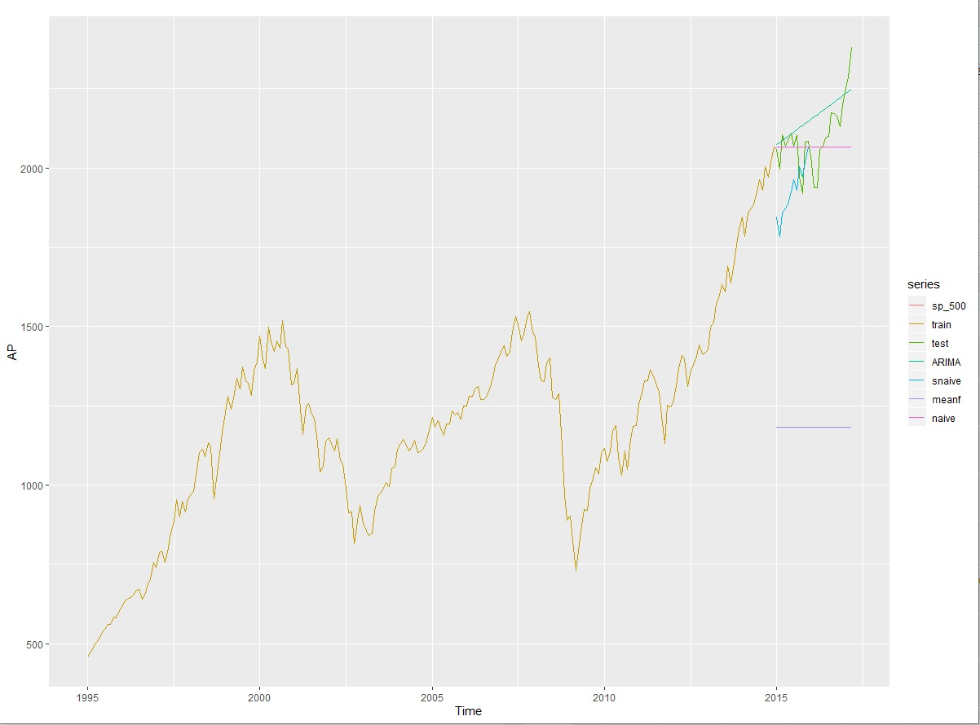
Forecasted values of all the models used

Slide 37
Conclusion
Different Time-Series Analysis methods were used for predicting the future trend of the data (S&P 500 Stock Index)
Data is in non-stationary form, so to make it independent differencing technique was used
These stationary data then passed through different Time-Series Forecasting methods like Simple Averaging, Naïve, Seasonal Naïve & ARIMA.
Among these techniques, ARIMA model gave the best accuracy with minimal errors as compared to other models.
Hence, to make it ARIMA model perform perfectly with high accuracy horizon value should be increased.
In conclusion, ARIMA model gave the best accuracy for predicting the S&P 500 Stock Index.

Slide 38
References
https://www.statisticshowto.datasciencecentral.com/mean-squared-error/
https://github.com/topics/arima-model
https://finance.yahoo.com/quote/%5EGSPC?p=^GSPC&.tsrc=fin-srch
https://docs.infor.com/help_m3kpd_15.1.2/index.jsp?topic=%2Fcom.lawson.help.scplanhs-uwa%2Fczz0569.html
http://r-statistics.co/Time-Series-Analysis-With-R.html
https://www.datacamp.com/community/tutorials/time-series-r

Slide 39
Thank You! Any Questions?

