Slide 1
Windows 11 25H2
Hardening Strategy
Platform
Windows 11 25H2
Environment
Healthcare
Structured, Validated, and Operationally Safe
Secure · Usable · Supportable
Selected Controls
35 Controls Scoped
IT Security · Infrastructure · Confidential
Notes:
Welcome. Thank you for making time. This presentation covers our structured approach to hardening Windows 11 25H2 endpoints in our healthcare environment using DISA STIG guidance. Our goal is straightforward: improve endpoint security without disrupting the tools your teams and our users depend on every day. We will walk through the baseline compliance position, the testing we have completed, our tiered model, and where we need your alignment to move forward.

Slide 2
Objective of This Review
01
Review Windows 11 STIG Findings
02
Identify Safe, High-Value Controls
Analyse the DISA STIG scan output for our Windows 11 25H2 environment and understand what each finding requires.
Select the controls that deliver the greatest security improvement with the lowest operational risk.
03
Avoid Operational Disruption
04
Align Ownership Before Deployment
Ensure that remote access, IT support tools, and user workflows remain fully functional throughout.
Confirm which team owns each category of control so decisions are made by the right people.
Notes:
There are four things we are trying to accomplish with this review. First, understand what the STIG scan is actually telling us. A scan of 160 findings sounds alarming, but not every finding carries equal risk, and not every finding belongs to one team. Second, pick the controls that matter most and can be applied safely. Third, protect operational continuity. Help desk tools, remote access, and user workflows must keep working. Fourth, agree on ownership now, before deployment. Changes to authentication belong to Infrastructure. Changes to network protocols belong to Network. Without that agreement, the rollout cannot succeed.

Slide 3
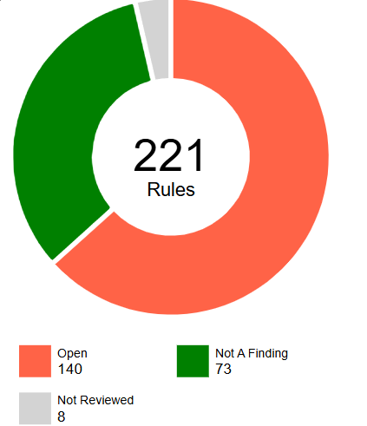
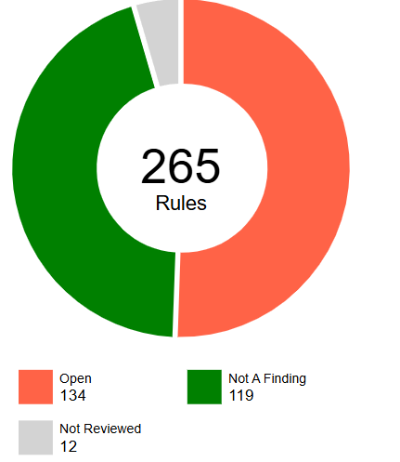
Baseline Scan Overview
SCAP scan results – January 2026
36–45%
~160
Total STIG findings on scan
35
Controls selected for this project
Current STIG
Compliance
~125
Findings owned by other teams or out of scope
36%
~45%
Notes:
Our most recent SCAP scan ran in January 2026. Current baseline compliance is approximately 36 to 42 percent depending on the scan profile used. The scan returned roughly 160 findings in total. Of those, 35 have been selected for this project. The remaining findings either belong to other teams — Network, Infrastructure, or Security — or require cross-team decisions before any action can be taken. The 35 scoped controls come from all three tiers but are the safest, highest-value subset to pilot first. The key message here is that raw scan output alone is not a deployment plan. This project exists to make it structured, safe, and actionable. Replace the placeholder on the right with your actual SCAP summary screenshot before presenting.

Slide 4
Findings Breakdown and Selection Strategy
Full scan breakdown — 35 of 160 findings selected for this project
~160
Total Findings
11
Tier 1 – Safe to Deploy
16
Tier 2 – Under Testing
8
Tier 3 – Deferred
~125
Other Teams / Out of Scope
These 160 findings represent the full SCAP scan — not just the 35 in scope. The 35 selected controls span all three tiers and represent the safest, highest-value subset to pilot first.
Notes:
This chart shows how the 160 total findings break down by category. Tier 1 contains 11 controls — these are low impact, high security value, and ready to deploy. Tier 2 contains 48 controls — these carry moderate operational risk and are being validated in structured batches. Tier 3 contains 12 deferred controls — these have been assessed as too risky for this phase without cross-team agreement. The remaining approximately 89 findings belong to other teams — Network, Infrastructure, or Security — or require broader organisational decisions. The point is simple: applying all 160 at once is not a strategy. This breakdown is.

Slide 5
Tier Classification Model
Controls grouped by operational risk and deployment readiness
Tier 1
Tier 2
Tier 3
VALIDATED · PILOT READY
TESTING IN PROGRESS
DEFERRED · ACCEPTED RISK
Low operational impact on users and IT
High security value
Smoke-tested and validated
Ready for GPO / Intune deployment
11 controls
WDigest, Kerberos AES, PS2, cmdline logging, script block logging, subcategories, Game DVR, Copilot, auto sign-in, IPv4/IPv6 source routing
Moderate operational impact
Requires structured batch testing
Cross-team review in progress
Deployment follows validation
16 controls
passwords, lockout, BitLocker baseline, Credential Guard, VBS/DMA, audit groups, telemetry, consumer UX, RDP/RPC, RDP creds/drive mapping
Higher operational risk if applied
Requires cross-team alignment
Excluded from current scope
Risk formally accepted and documented
8 controls
FIPS, NTLM/SMB, UAC auto-deny, inactivity lock, BitLocker PIN, deny logon, Bluetooth
Tier 3 exclusions: User Rights lockdown · Secondary Logon disable · AppLocker · SMB Packet Signing · Hardened UNC Paths
Notes:
Every STIG control in our scope has been placed into one of three tiers based on its operational risk. Tier 1 — 11 controls. Zero to minimal impact on users or support tools. High security value. Already validated and ready to deploy. Tier 2 — 48 controls. Moderate operational risk. Being tested in controlled batches before any wider deployment. Tier 3 — 12 controls. These carry higher operational risk and require cross-team agreement. They have been formally deferred with documented accepted risk. Five specific items are explicitly excluded from this project entirely: User Rights lockdown, disabling Secondary Logon, AppLocker strict allowlisting, SMB Packet Signing, and Hardened UNC Paths. Each of these has the potential to disrupt IT operations and cannot be applied without broad cross-team coordination.

Slide 6
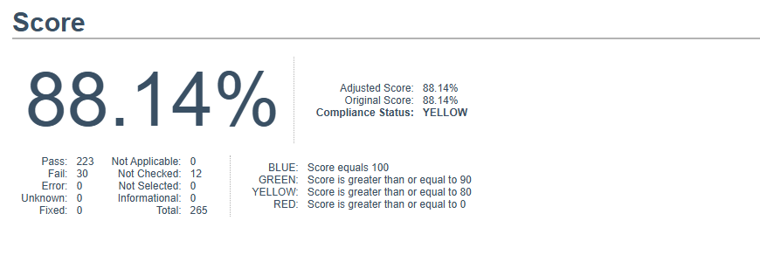
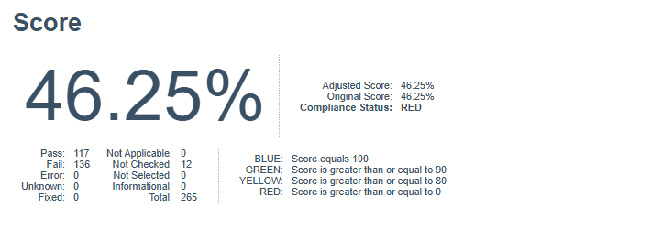
Testing Comparison: Two Device Strategy
Full STIG application vs. tiered selection model
Device A – Full STIG Application
Device B – Tiered Selection Model
All LGPO / STIG recommendations applied
Compliance increased to ~88%
Remote access tools impacted
IT support workflows disrupted
Device became unstable
Not production-ready
35 selected controls applied
Compliance at ~42–45%
Remote access fully functional
IT support tools working normally
Device remained stable throughout
Ready for controlled pilot rollout
High compliance alone does not equal operational success. Stability is not optional.
Notes:
We ran both approaches side by side on test devices. Device A had all STIG recommendations applied. Compliance jumped to 82 percent. But the device became unstable. Remote access tools were impacted. IT support workflows broke. That device is not suitable for production deployment regardless of its compliance score. Device B had only 35 carefully selected controls applied. Compliance sits at 42 to 45 percent — lower, but every operational function remained intact. That device is ready for a controlled pilot. This is the core argument for a tiered approach. A lower compliance number on a stable, usable device is more valuable than a high number on something your IT team cannot support.

Slide 7
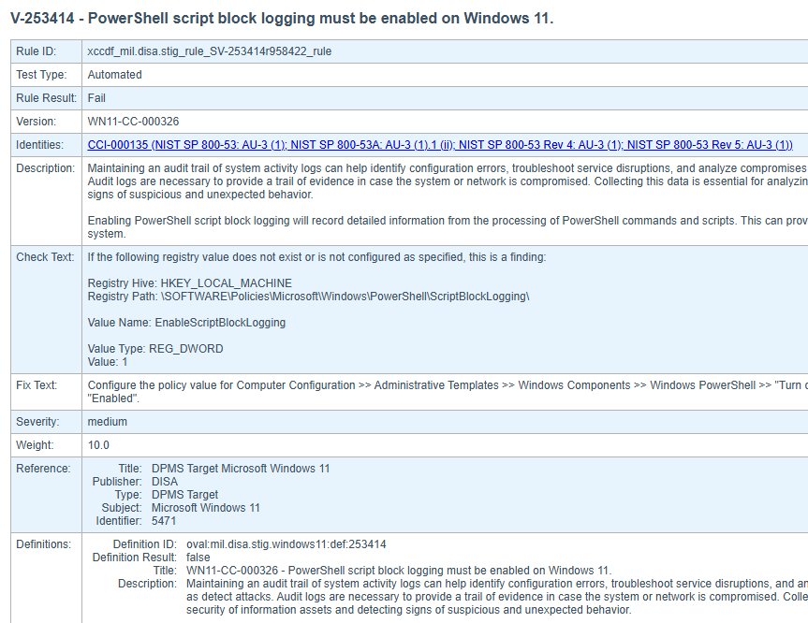
Example Control: PowerShell Script Block Logging
Tier 1 · Low User Impact · High Visibility Value
STIG ID
V-253414
[ INSERT: STIG Viewer – Failed Control Screenshot ]
What it does
Logs every PowerShell command executed on the device to the Windows Event Log
Why it matters
Provides visibility into malicious or suspicious scripts — critical for incident investigation and audit trails
User impact
None. This is a background setting. Users do not interact with it and will not notice it is enabled
How applied
Single registry key via Group Policy (HKLM\SOFTWARE\Policies\Microsoft\Windows\PowerShell\ScriptBlockLogging)
Tier
Tier 1 — Validated and ready to deploy
Notes:
Let me walk through a concrete example to make this tangible. STIG control WN11-CC-000326 requires PowerShell Script Block Logging to be enabled. What does that mean in practice? Every time PowerShell runs any command on a device — whether by a user, an administrator, or an attacker — Windows writes a log entry with the full command text. If something malicious runs on a device, we can see exactly what it was and when. The user impact is zero. This is a background Windows setting. No pop-ups, no prompts, no change to how the device looks or behaves. We apply it with a single registry key, pushed through Group Policy. This is exactly the type of Tier 1 control we want in production as soon as we have approval — high security value, zero disruption.

Slide 8
Remediation Workflow
Every control follows the same structured eight-step process
1
Review STIG Fix Text
2
Validate Against MS Guidance
Understand exactly what the control requires and what it changes
Cross-reference Microsoft documentation to identify known conflicts
3
Assess Operational Impact
4
Apply Controlled Change
Identify effect on users, help desk, remote access, and support tools
Implement via Group Policy or registry in a test environment first
5
Validate Configuration
6
Smoke Test User Workflows
Confirm the setting applied correctly and the control passes
Run structured checklist: login, remote access, IT tools, stability
7
Document Evidence
8
Maintain Rollback Option
Capture before and after state, screenshots, and validation notes
Tested reversal procedure documented before any wider deployment
Note: Domain GPO policies override local changes. Cross-team alignment is required before any production rollout.
Notes:
Every single control in this project goes through the same eight steps before it is considered approved for deployment. We start by reading the fix text. Then we validate against Microsoft's own documentation to avoid conflicts. We assess what the change might affect operationally. We apply the change in a test environment, then validate that it worked correctly. We run a smoke test checklist — login, remote access, support tools, stability. We document everything: before and after screenshots, GPO results, registry states, and notes. And critically, before anything goes to production, we have a tested rollback procedure documented and ready. Important note at the bottom: Domain Group Policy will override any local changes. This is why cross-team coordination is essential before we push to production.

Slide 9

Validation Example: Before & After
Confirming change success without operational disruption
Before – Control Fails
After – Control Passes
→
Setting not configured · STIG fails
Control passes · No disruption · Support tools intact
Registry key confirmed applied via GPO
STIG scan passes on re-test
Remote access and help desk tools verified functional
Smoke test checklist completed — all items pass
Notes:
After applying each control, we capture evidence that it worked and that nothing was disrupted. On the left: the before state. The registry key or policy is missing or unset, the STIG fails. On the right: the after state. The setting is applied, the STIG passes, and the device is operating normally. We also run through a structured checklist: confirm the registry key via GPO, re-run the STIG scan to confirm it passes, verify remote access and help desk tools, and sign off the smoke test. All evidence is stored in our tracking tool. If anyone asks what the device looked like before, or who approved the change, that information is recorded.

Slide 10
Governance & Tracking Tool
Centralised platform for decisions, evidence, and rollback documentation
Tier Classification
Owner Tagging
Decision Workflow
All controls organised by Tier 1, 2, and 3 with category filtering
Each control assigned to EUC, Infrastructure, Network, or Security
Approve / Conditional / Reject status with documented rationale
Pre / Post State Tracking
Smoke Test Notes
Rollback Documentation
Before and after screenshots and registry states stored per control
Structured checklist results recorded for every deployment batch
Reversal steps documented and tested before any production deployment
[ INSERT: Web App Dashboard ]
[ INSERT: STIG Detail View ]
[ INSERT: Evidence / Rollback Section ]
Notes:
To manage all decisions, evidence, and progress across 35 controls, we built a small internal workflow tool. It lets us classify controls by tier, tag owners, record Approve/Conditional/Reject decisions with rationale, store before and after screenshots, log smoke test results, and document rollback procedures. Everything is in one place. If anyone asks who approved a control, what the device looked like before, or how to reverse a change, the answer is in the tool. If you are asked about the tool: it was created internally with Copilot assistance for workflow automation. All security logic, control decisions, and validations were reviewed and confirmed manually by the team. Copilot helped with the development work, not the security judgements. Replace the three placeholder boxes with screenshots from your actual tool before presenting.

Slide 11
Ownership & Cross-Team Alignment
Each control category has a clear responsible team
EUC
Endpoint Configuration
Audit settings, local policies, event log sizes, screen lock, PowerShell settings
Infrastructure
Authentication Policies
Password policies, logon settings, Credential Guard, cached credentials
Network
Network-Related Controls
SMB protocol versions, IPv6 settings, unused network protocol controls
Security
Audit Requirements
Audit policy alignment, compliance reporting, log review and retention
Hardening requires shared ownership. No single team can complete this safely without the others.
Notes:
STIG hardening touches four distinct areas of the environment, and each has a clear owner. End User Computing owns endpoint configuration — audit settings, local policies, screen lock, PowerShell settings. Infrastructure owns authentication policies — password rules, logon settings, Credential Guard. Network owns network protocol controls — SMB versions, IPv6 settings, unused protocols. Security owns audit alignment — audit policies, compliance reporting, log retention. What we need from this meeting is confirmation of these assignments. Without clear ownership, changes cannot be deployed safely, and accountability gaps will create risk rather than reduce it.

Slide 12
Controlled Rollout Plan
A staged, validated path from pilot to production
01
Final Tier 1 Approval
02
Pilot Deployment
03
QA Validation
Leadership and owner sign-off on Tier 1 controls before any deployment begins
Apply controls to a small representative group of 5–10 devices across user roles
Remote access, IT support tools, user workflows, and audit logs all verified stable
04
Ring-Based Rollout
05
Intune / GPO Deployment
06
Monitoring & Rollback
Gradual expansion: IT staff first, then broader user groups, then full environment
Configurations deployed via Group Policy or Intune depending on device management model
Post-deployment monitoring active, with documented rollback plan ready to execute if needed
Notes:
Once we have leadership approval, this is the deployment sequence. Phase 1: Final approvals on Tier 1 controls from the relevant owners. Phase 2: Deploy to a small pilot group — five to ten devices representing a cross-section of roles. Phase 3: Structured QA validation. Remote access tested, help desk tools tested, user workflows confirmed, audit logs reviewed. Phase 4: Ring-based rollout — IT staff first, then broader groups. Phase 5: Full production deployment via Group Policy or Intune. Phase 6: Post-deployment monitoring active, with rollback procedure documented and ready. Nothing advances to the next phase until the previous one is confirmed clean.

Slide 13
Risk vs. Stability: Finding the Balance
The case for a tiered model
Balanced
Tiered Model
Security Only
Stability Only
Structured approach
Apply everything
Apply nothing
High-value controls applied
Stability preserved
Operations unaffected
Rollback options maintained
Leadership aligned
High compliance score
Maximum control coverage
Remote access may break
Support tools may fail
Rollback risk is high
No disruption to operations
No improvement in posture
Audit findings remain open
Regulatory exposure persists
Security gaps unaddressed
Risk of Instability
Secure & Operationally Stable
Risk Exposure
Notes:
This slide captures the core argument of the whole presentation in one visual. If we apply everything — the Security Only approach — we get a high compliance score, but we risk breaking remote access, IT support tools, and user workflows. That instability creates its own operational risk. If we apply nothing — the Stability Only approach — operations run smoothly today, but security gaps remain open, audit findings stay on the books, and regulatory exposure persists. The Balanced Tiered Model is the answer. High-value controls applied. Stability preserved. Operations unaffected. Leadership aligned. This is what we have built. The goal was never to chase a compliance number. The goal was to build a security improvement that actually holds up in a production healthcare environment.

Slide 14
Key Takeaways
Leadership Alignment Needed
Security must not break daily operations
Tier 1 — validated and ready for pilot deployment
Tier 2 — under structured validation, progressing well
Tier 3 — deferred with documented accepted risk
Seeking leadership alignment to move forward
Confirm ownership assignments by team
Approve Tier 1 for pilot deployment
Align on Tier 2 testing timeline
Formally accept or escalate Tier 3 deferrals
Identify pilot group and target date
Goal: Secure and usable endpoints
across the Windows 11 25H2 environment.
Questions and discussion
Notes:
To close. The central message of this presentation is that security must not break daily operations. A compliance number is only meaningful if the device behind it is stable and supportable. Tier 1 controls — 11 controls — are validated and ready for a pilot deployment as soon as we have approval. Tier 2 — 48 controls — are progressing well through structured batch testing. Tier 3 — 12 controls — have been formally deferred with documented accepted risk. That documentation is available for review. What we need from this group today: One — confirm ownership assignments. Two — approve Tier 1 for the pilot. Three — align on the Tier 2 testing timeline. Four — formally accept or escalate Tier 3 deferrals. Five — help us identify the pilot group and a target date. Thank you. Happy to take questions.

