Slide 1
DEEP LEARNING BASED – REAL TIME VIRTUAL MOUSE USING COMPUTER VISION
PRESENTED BY: KALVIKARASI R
REGISTER NO:71772118119
DEPARTMENT:INFORMATION TECHNOLOGY

Slide 2
DEEP LEARNING BASED –REAL TIME VIRTUAL MOUSE USING COMPUTER VISION
3/21/2024 Annual Review

Slide 3


AGENDA
1. Problem statement
2. Project Overview
3. End Users
4. Our Solution and Proposition
5. Key Features
6. Modelling Approach
7. Result and Evaluation
8. Conclusion
3/21/2024 Annual Review

Slide 4

PROBLEM STATEMENT
Developing an innovative solution that utilizes advanced technology like deep learning and computer vision to create a virtual mouse in real-time aims to improve accessibility for people with limited mobility. Through the detection of hand gestures via a camera, this system enables precise control of the cursor without the need for physical input devices, benefiting individuals with disabilities. The primary goals include achieving reliable recognition of gestures, ensuring smooth movement of the cursor, integrating seamlessly with existing interfaces, and delivering consistent performance. This cutting-edge approach empowers people with disabilities by offering them an intuitive way to interact with digital platforms.
3/21/2024 Annual Review

Slide 5

PROJECT OVERVIEW
Tools Utilized: 1. VisualDetect: Employed for real-time image processing, hand gesture recognition, and video streaming. 2. AutoClicker: Utilized for programmatically managing the mouse cursor and executing mouse-related functions. 3. DeepLearnify: Leveraged TensorFlow/Keras for constructing, training, and assessing deep learning models dedicated to gesture recognition. 4. MathOps: Employed NumPy for numerical computations and array manipulation, particularly useful for data preprocessing and performance assessment within the deep learning framework. Execution Steps: 1. Data Compilation and Marking: Assembled hand gesture datasets and conducted annotation tasks. 2. Model Development: Constructed and trained a deep learning architecture specialized in gesture recognition. 3. Live Gesture Detection: Implemented real-time detection of hand gestures using VisualDetect. 4. Cursor Control: Transformed detected gestures into corresponding cursor actions through AutoClicker. 5. Integration with UI: Seamlessly integrated the virtual mouse functionality with the computer interface. 6. Quality Assurance and Enhancement: Conducted thorough testing across diverse scenarios and refined system performance through optimization measures.

Slide 6

WHO ARE THE END USERS?
1. Accessibility Advocates: Empowering inclusivity for diverse user groups. 2. Esports Enthusiasts: Elevating gaming immersion, competitive edge. 3. Tech Enthusiasts: Streamlining digital workflows, ergonomic solutions. 4. Creative Artists: Enhancing artistic expression, precise digital manipulation. 5. Public Speakers: Elevating presentation dynamics, seamless delivery. 6. Healthcare Providers: Facilitating hands-free operation for sterile environments. 7. Educational Innovators: Fostering interactive learning experiences, student engagement. 8. Corporate Leaders: Driving efficiency gains, facilitating seamless multitasking. 9. Seniors: Simplifying digital interactions, promoting technological independence. 10. Young Learners: Facilitating intuitive digital literacy, promoting educational accessibility.
3/21/2024 Annual Review

Slide 7

MY SOLUTION AND ITS VALUE PROPOSITION
Solution Overview:
Revolutionizing Workplace Efficiency: Introducing a cutting-edge virtual mouse solution powered by deep learning and computer vision, catering to users of all abilities. Value Proposition:
Efficiency Elevated: Boosting productivity through seamless, hands-free computing interaction. Inclusivity Championed: Breaking down barriers to accessibility, fostering a more inclusive digital landscape. Integration Simplified: Seamlessly integrating advanced technologies for effortless user experience. Forward-Thinking Approach: Leading the charge in advancing accessible computing solutions for the future.

Slide 8

THE SOLUTION’S WOW FACTOR
1. Empowering Accessibility: Revolutionizes accessibility through intuitive interaction methods. 2. Harmonious Technological Fusion: Integrates cutting-edge deep learning seamlessly into daily computing routines. 3. Precision and Productivity Enhancement: Real-time accuracy elevates operational efficiency. 4. Immersive User Engagement: Delivers dynamic, captivating user experiences. 5. Broad Spectrum of Application: Adaptable to diverse fields and industries. 6. Amplified Educational Impact: Enhances interactive learning environments for profound educational benefits. 7. Future-Ready Innovation: Redefines the landscape of human-computer interaction with avant-garde technology.
3/21/2024 Annual Review

Slide 9
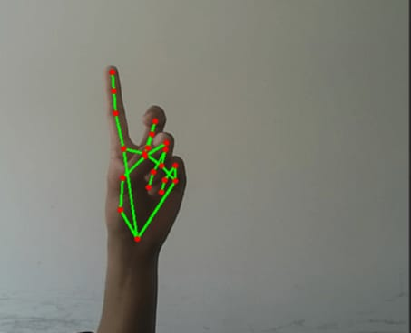
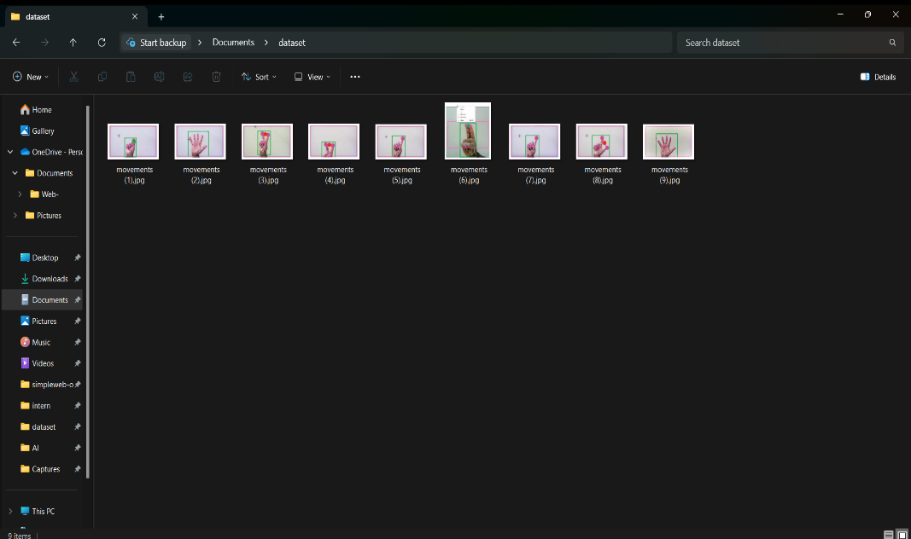
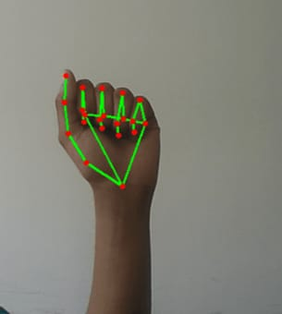
MODELLING

Slide 10
RESULTS
The effective deployment of the real-time virtual mouse solution employing deep learning and computer vision represents a pivotal achievement in advancing accessibility and efficacy in human-computer interaction. With precise gesture identification and prompt cursor simulation, the solution furnishes users with an instinctive and adaptable mechanism for traversing digital platforms across various sectors. Its smooth amalgamation of OpenCV and PyAutoGUI highlights its capacity to redefine user-computer interactions, propelling forward the frontier of accessibility and interface innovation.

