Slide 1
Programming Logic and Design
Ninth Edition
Chapter 7
File Handling and Applications

Slide 2
Objectives
In this chapter, you will learn about:
Computer files
The data hierarchy
Performing file operations
Control break logic
Merging files
Master and transaction file processing
Random access files

Slide 3
Understanding Computer Files
Computer file
  A collection of data stored on permanent storage devices such as your computer’s hard drive, a hard drive on the cloud, DVDs, USB drives, and reels of magnetic tape
  Text files (numbers, names, salaries) that can be read by a text editor
  Binary files (images and music) not encoded as text

Slide 4
Understanding Computer Files (continued -1)
Computer files have:
  A filename - an identifying name given to a computer file that frequently describes the contents
    JanuaryPayroll
    PreviousMonthSales
  A filename extension - a group of characters added to the end of a filename that describes the type of the file
    .txt
    .dat
    .docx

Slide 5
Understanding Computer Files (continued -2)
Computer files have:
  A specific creation time and modification date
  A file size measured in bytes
    byte – one character
    kilobyte – thousands of bytes
    megabyte – millions of bytes
    gigabyte – billions of bytes
    terabyte – trillions of bytes

Slide 6
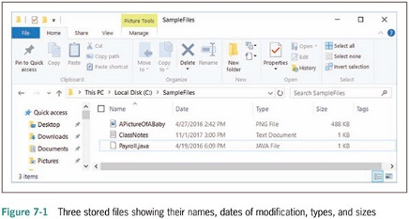
Understanding Computer Files (continued -3)

Slide 7
Understanding Computer Files (continued -4)
Organizing files
  Directories and folders
    Organization units on storage devices
  Path
    Combination of disk drive plus the complete hierarchy of directories
    Example: C:\Logic\SampleFiles\PayrollData.dat

Slide 8
Understanding the Data Hierarchy
Data hierarchy
  Describes the relationships between data components
  Consists of:
    Characters – letters number and special symbols
    Fields – data items representing a single attribute of a record
    Records – groups of fields that go together for some logical reason
    Files – groups of related records
    Database – holds related file data in tables

Slide 9
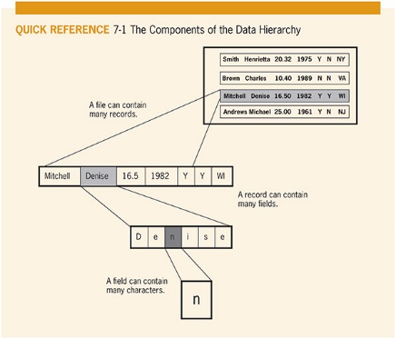
Understanding the Data Hierarchy (continued)

Slide 10
Performing File Operations
File operations to use data files in your programs
  Declare a file identifier
    InputFile employeeData
    OutputFile updatedData
  Open the file
    open employeeData "EmployeeData.dat"
  Reading from a file and processing the data
    input name from employeeData
    input address from employeeData
    input payRate from employeeData

Slide 11
Performing File Operations (continued -1)
Reading from a file and processing the data
  Programming languages have different ways of determining how much data to input
  In many languages, a delimiter such as a comma, semicolon, or tab character is stored between data fields

Slide 12
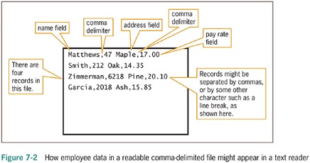
Performing File Operations (continued -2)

Slide 13
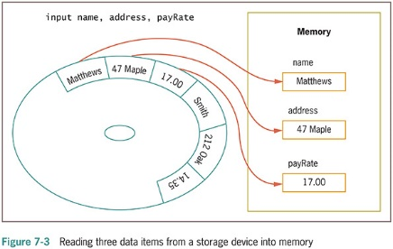
Performing File Operations (continued -3)

Slide 14
Performing File Operations (continued -4)
Sequential file
  Program reads all the records in this file from beginning to end, processing them one t a time
Sorting
  The process of placing records in order by the value in a specific field or fields
    Ascending order – records sorted in order from lowest to highest values
    Descending order – records sorted in order from highest to lowest values

Slide 15
Performing File Operations (continued -5)
Writing data to a file
  When you store data in a computer file on a persistent storage device, you write to the file
    output name, address, payRate to employeeData
Closing a file
  When you finish using a file, the program should close the file
  Always close every file you open
Default input and output devices (keyboard and monitor) do not require opening or closing

Slide 16
A Program that Performs File Operations
Backup file
  a copy kept in case values need to be restored to their original state
  The backup copy is called a parent file
  The newly revised copy is a child file

Slide 17
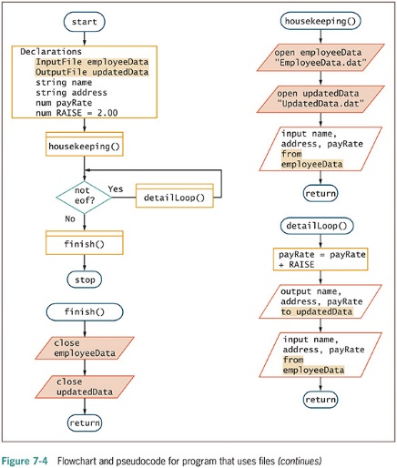
A Program that Performs File Operations (continued -1)

Slide 18
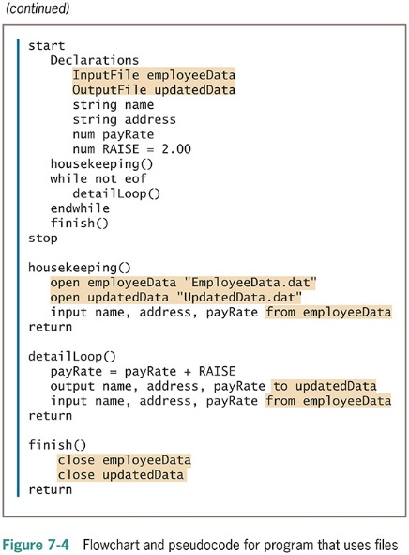
A Program that Performs File Operations (continued -2)

Slide 19
Understanding Control Break Logic
A control break is a temporary detour in the logic of a program
  A control break program uses a change in a value to initiate special actions or processing
  A control break report groups similar data together
    Input records must be in sequential order

Slide 20
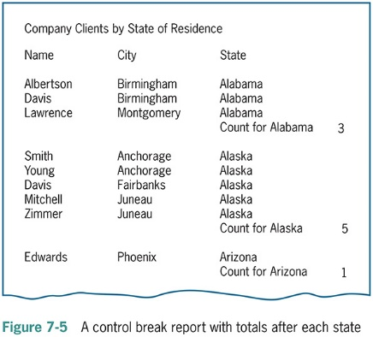
Understanding Control Break Logic (continued -1)

Slide 21
Understanding Control Break Logic (continued -2)
Examples of control break reports
  All employees listed in order by department number, with a new page started for each department
  All books for sale in a bookstore listed in order by category (such as reference or self-help), with a count following each category of book
  All items sold in order by date of sale, with a different ink color for each new month

Slide 22
Understanding Control Break Logic (continued -3)
Single-level control break
  A detour based on the value of a single variable
  Uses a control break field to hold the previous value

Slide 23
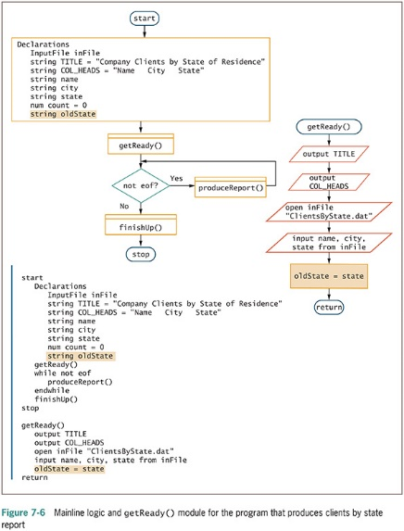
Understanding Control Break Logic (continued -4)

Slide 24
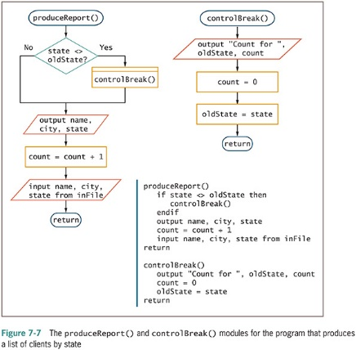
Understanding Control Break Logic (continued -5)

Slide 25
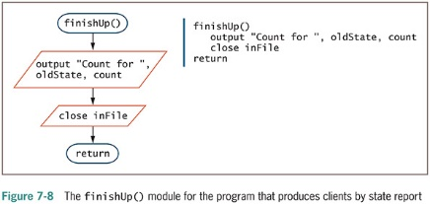
Understanding Control Break Logic (continued -6)

Slide 26
Merging Sequential Files
Merging files
  Combining two or more files while maintaining the sequential order or the records
Examples
  A file of current employees in ID number order, and a file of newly hired employees also in ID number order
  A file of parts manufactured in the Northside factory in part-number order, and a file of parts manufactured in the Southside factory also in part-number order

Slide 27
Merging Sequential Files (continued -1)
Two conditions required for merging files
  Each file has the same record layout
  Sorted in the same order based on the same field

Slide 28
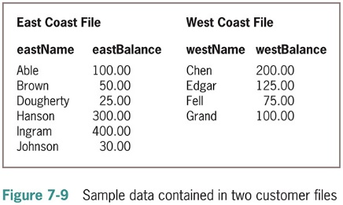
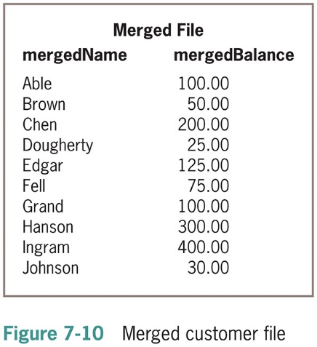
Merging Sequential Files (continued -2)

Slide 29
Merging Sequential Files (continued -3)
Mainline logic similar to other file-processing programs, except for handling two files
With two input files, must determine when both files are at eof
  Define a flag variable to indicate that both files have reached eof
  Must define two input files
  Read one record from each input file

Slide 30
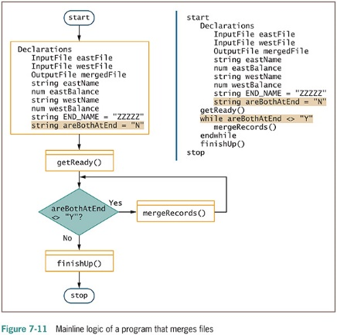
Merging Sequential Files (continued -4)

Slide 31
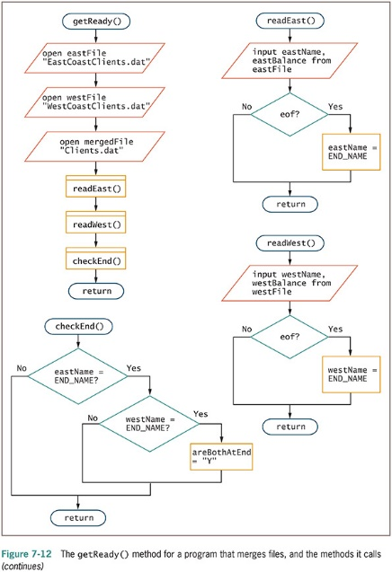
Merging Sequential Files (continued -5)

Slide 32
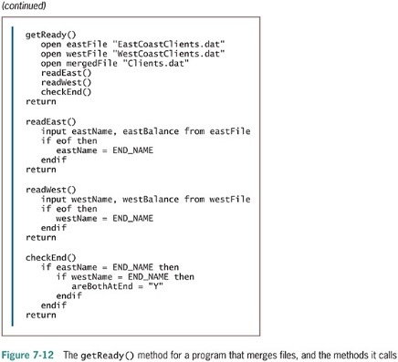
Merging Sequential Files (continued -6)

Slide 33
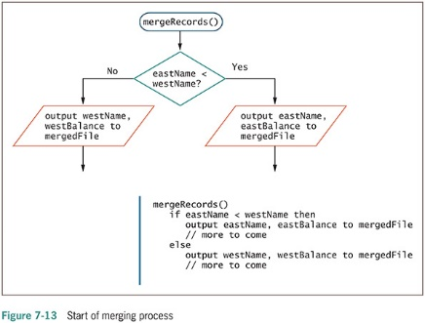
Merging Sequential Files (continued -7)

Slide 34
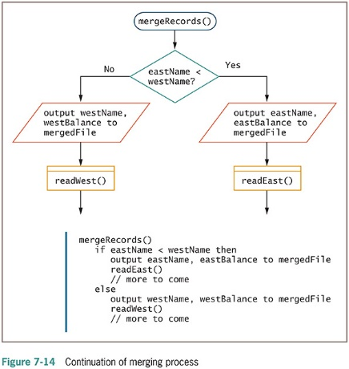
Merging Sequential Files (continued -8)

Slide 35
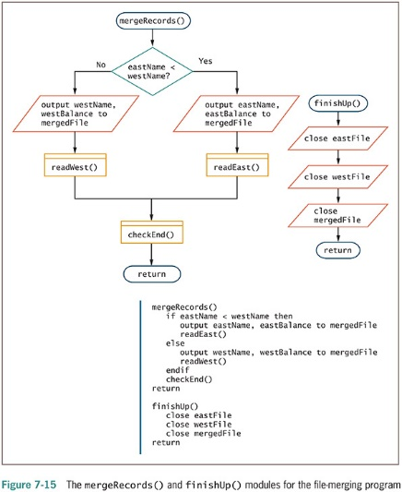
Merging Sequential Files (continued -9)

Slide 36
Master and Transaction File Processing
Some related files have a master-transaction relationship
Master file
  Holds complete and relatively permanent data
Transaction file
  Contains temporary data to be used to update the master file
Update the master file
  Changes to values in its fields based on transactions

Slide 37
Master and Transaction File Processing (continued -1)
Examples
  A library maintains a master file of all patrons and a transaction file with information about each book or other items checked out
  A college maintains a master file of all students and a transaction file for each course registration
  A telephone company maintains a master file of every telephone line (number) and a transaction file with information about every call

Slide 38
Master and Transaction File Processing (continued -2)
Updating approaches
  Change information in master file
  Copy master file and change new version
Begin with both files sorted in the same order on the same field

Slide 39
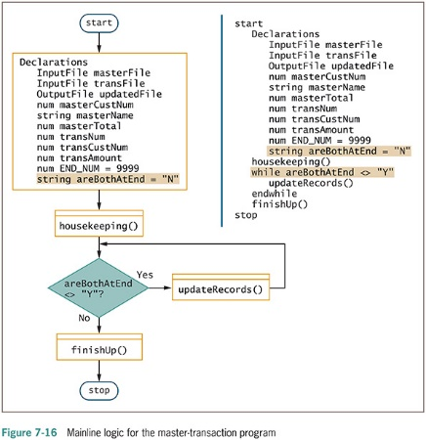
Master and Transaction File Processing (continued -3)

Slide 40
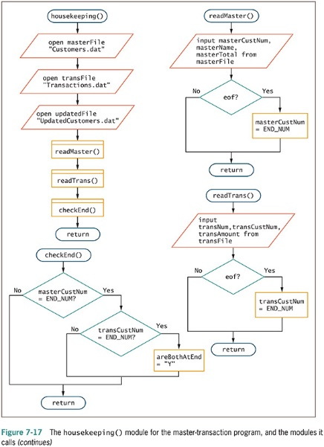
Master and Transaction File Processing (continued -4)

Slide 41
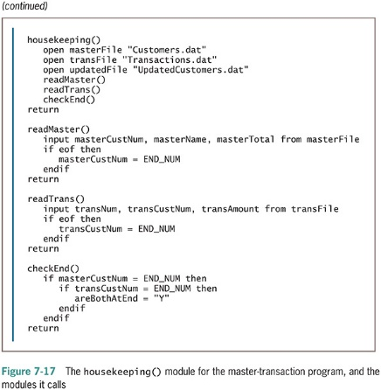
Master and Transaction File Processing (continued -5)

Slide 42
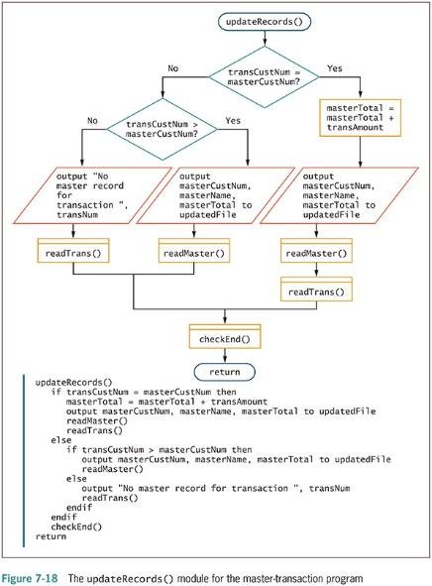
Master and Transaction File Processing (continued -6)

Slide 43
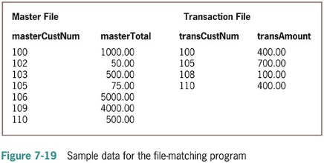
Master and Transaction File Processing (continued -7)

Slide 44
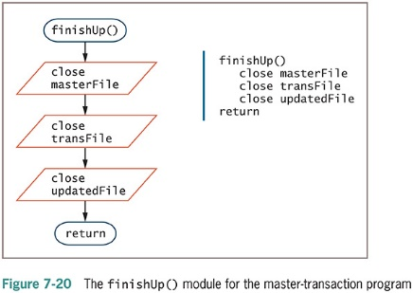
Master and Transaction File Processing (continued -8)

Slide 45
Random Access Files
Batch processing
  Involves performing the same tasks with many records, one after the other
  Uses sequential files
Real-time applications
  Require that a record be accessed immediately while a client is waiting
Interactive program
  A program in which the user makes direct requests

Slide 46
Random Access Files (continued -1)
Random access files
  Records can be physically located in any order
  Instant access files
    Files in which records must be accessed immediately
  Also known as direct access files

Slide 47
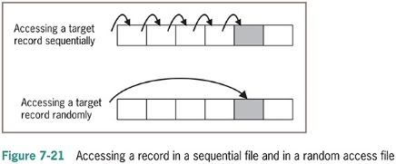
Random Access Files (continued -2)

Slide 48
Summary
Computer file
  A collection of data stored on a nonvolatile device in a computer system
Data items are stored in a hierarchy
To use a data file you must declare, open, read, write, and close the file
Sequential file: records stored one after another in some order

Slide 49
Summary (continued -1)
Control break program reads a sorted sequential file and performs special processing based on a change in one or more fields in each record in the file
Merging files combines two or more files
  Maintains the same sequential order
Master files
  Hold permanent data
  Updated by transaction files

Slide 50
Summary (continued -2)
Master files
  Hold relatively permanent data
  Updated by transaction files
Real-time applications
  Require random access files where records can be located in any order
Instant access files and direct access files are files in which records must be accessed immediately

